Slide 1
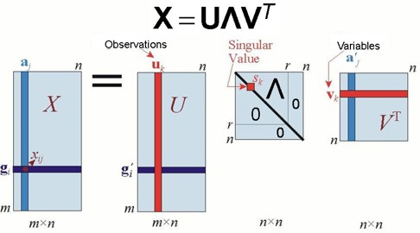
variables
x_{j}
λ_{k}
observations
x_{i}’
x_{i}’
n × p
n × r
r × r
r × p

