Slide 1
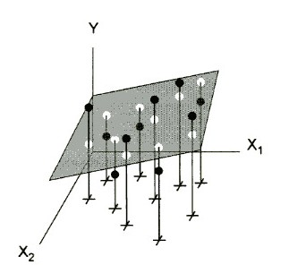
Y value
Fitted value
r(x₁,x₂) ~ 0
data points in x₁,x₂ plane

Slide 2
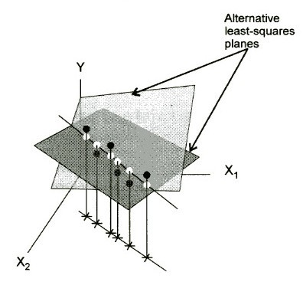
Alternative least squares planes
But: same predicted values!
r(x₁,x₂)=1.0

Slide 3
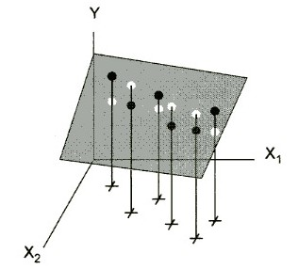
r(x₁,x₂) = 0.9

Slide 4
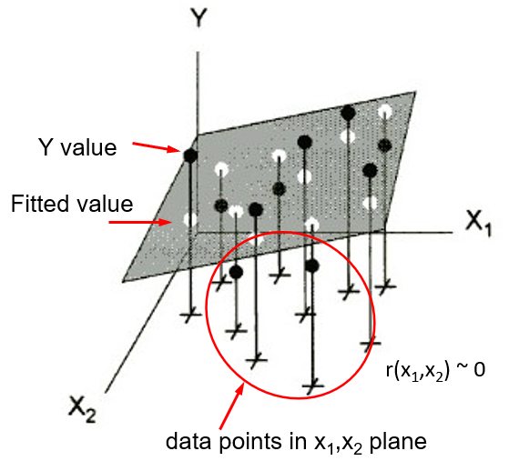
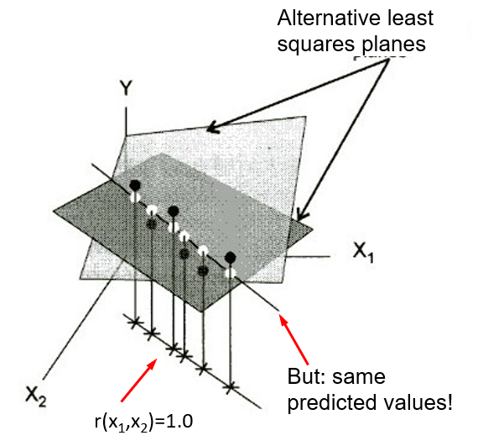
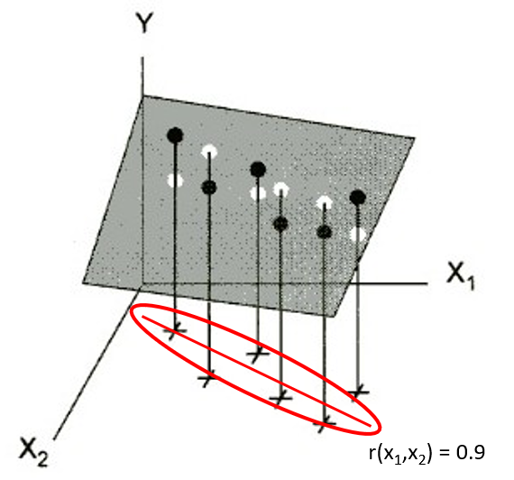
(a)
(b)
(c)

