Slide 1
Visualizing Multivariate Data & Models with R A preview
Michael Friendly
QM Forum, Mar. 2024
https://friendly.github.io/Vis-MLM-book/

Slide 2
Topics
The LM Family & Friends

Slide 3
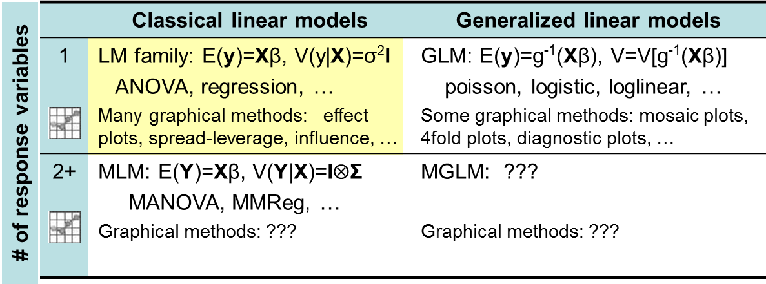
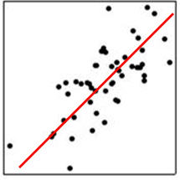
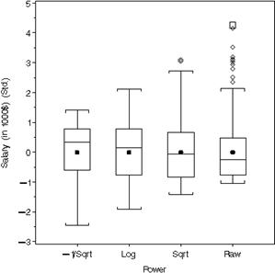
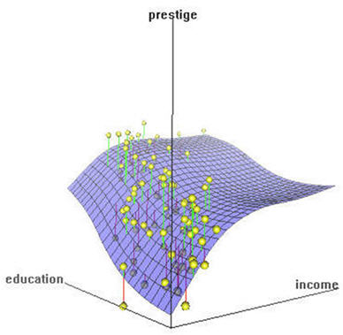
The LM family & friends
Models, graphical methods & opportunities

Slide 4
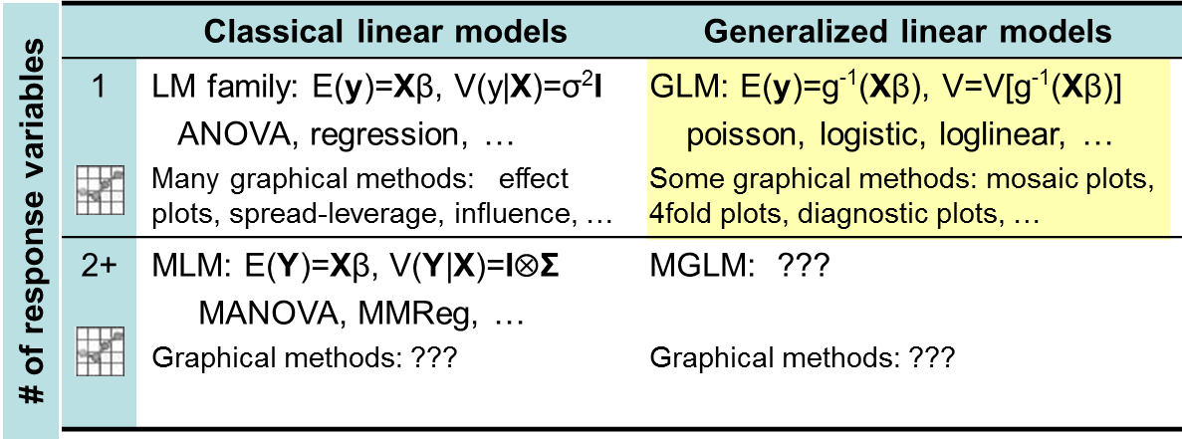
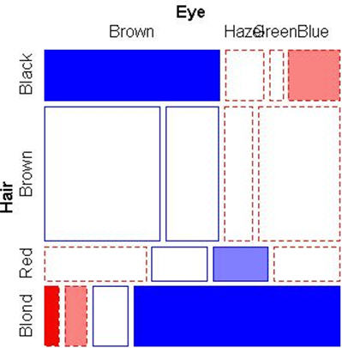
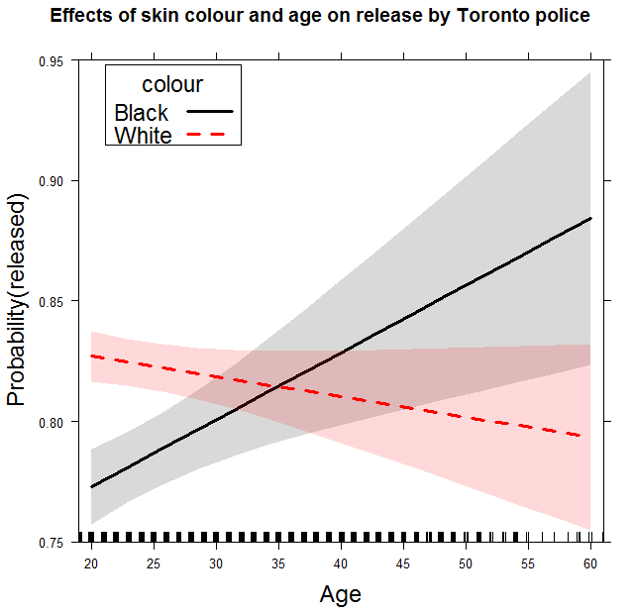
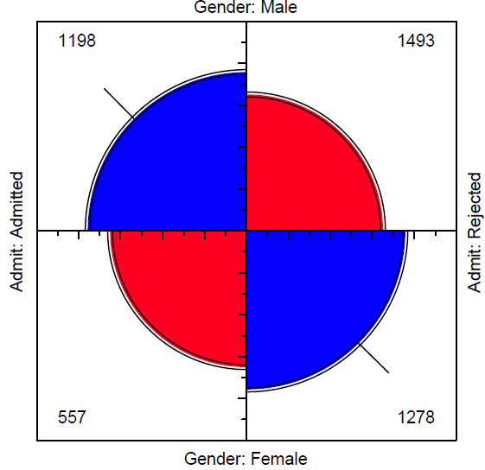
The LM family & friends
Models, graphical methods & opportunities

Slide 5
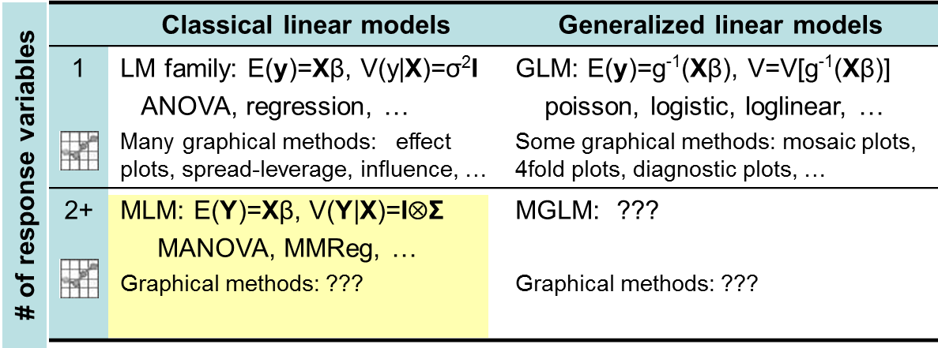

The LM family & friends
Models, graphical methods & opportunities
Today: HE plots & related methods

Slide 6
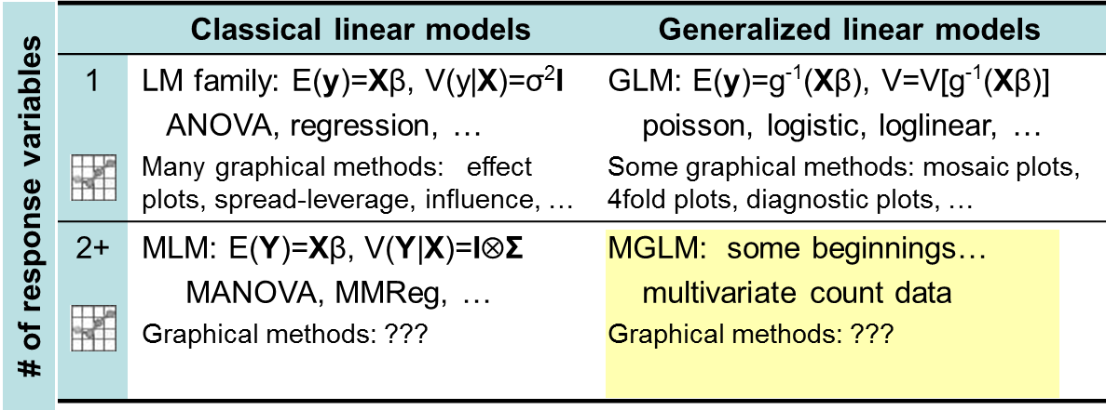
The LM family & friends
Models, graphical methods & opportunities
Tomorrow: Someone’s PhD thesis (better models)
Applications: big data, genomics, … beg for better graphical methods

Slide 7

Goal: Extend the familiar graphical methods for univariate linear models to the MLM (MANOVA, MMRA, CDA, …)
Topics:
Data plots, model plots, diagnostic plots
Data ellipses, confidence ellipses
PCA, biplots (the multivariate juicer)
y ~ X β → Y ~ X B (Anova→MANOVA)
Hypothesis-Error (HE) plots
Canonical discriminant plots
…

Slide 8



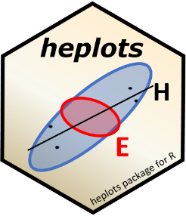
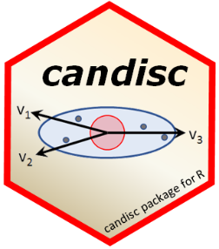


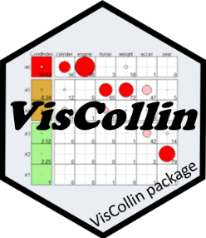
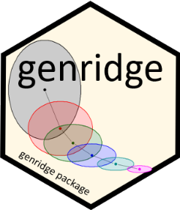

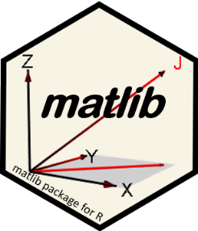
Software: packages
Categorical data
vcd & vcdExtra
nestedLogit: nested dichotomies
Linear & multivariate models
heplots: HE plots & related methods
candisc: Analyze/view MLMs in low-D space
mvinfluence: Multivariate influence
ggbiplot: ggplot2 biplots for PCA & LDA
VisCollin: Visualizing collinearity diagnostics
genridge: Generalized ridge trace plots
gellipsoid: Generalized ellipsoids
matlib: Matrix linear algebra, 2D & 3D
See: https://github.com/friendly/friendly/blob/main/packages.md
Notes:
To this end, I’ve developed a variety of R packages …

Slide 9
Plots for data analysis
data plots: display raw data, with annotations to aid interpretation (regression lines, smooths, data ellipses)
reconnaissance plots: bird’s-eye overview for high-D multivariate data
scatterplot matrices, corrgrams, parallel coord plots
visual thinning: favor summaries over data points
dimension reduction plots: plot in low-D space
PCA, biplots
Canonical correlation, LDA
model plots: plot results of a fitted model
coefficient plots
marginal effect plots, added variable plots, …
diagnostic plots: show deviations from assumptions
residual plots, influence plots
homogeneity of variance plots, …

Slide 10
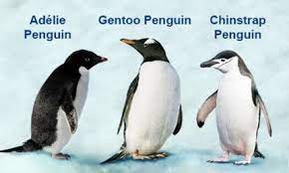
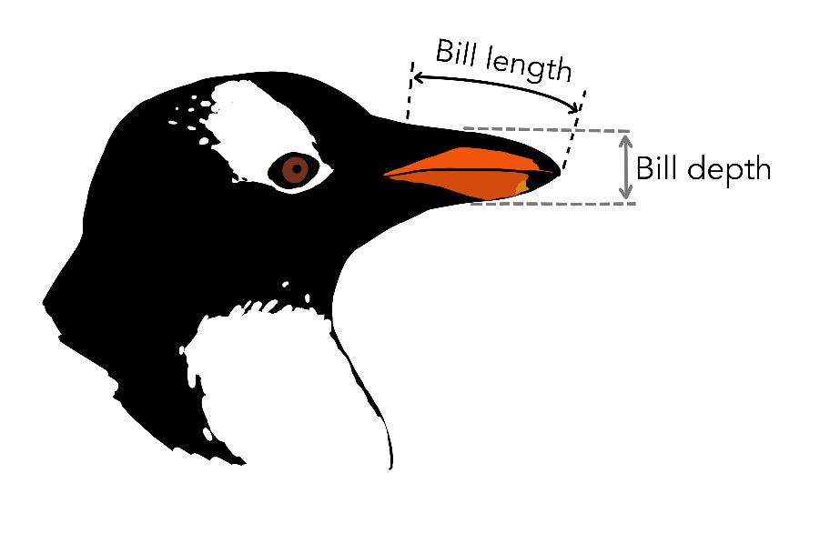
Penguins data
Data on penguin species observed in the Palmer Archipelago
Species: Adélie, Chinstrap & Gentoo
Islands: Biscoe, Dream & Torgersen
Years: 2007, 2008, 2009
Sex: Male, Female
Four measures: Bill length, Bill depth, Flipper length, Body mass
Body mass
Flipper length
Purpose: examine diff^{ces} in size, appearance in relation to foraging & habitat

