Slide 1
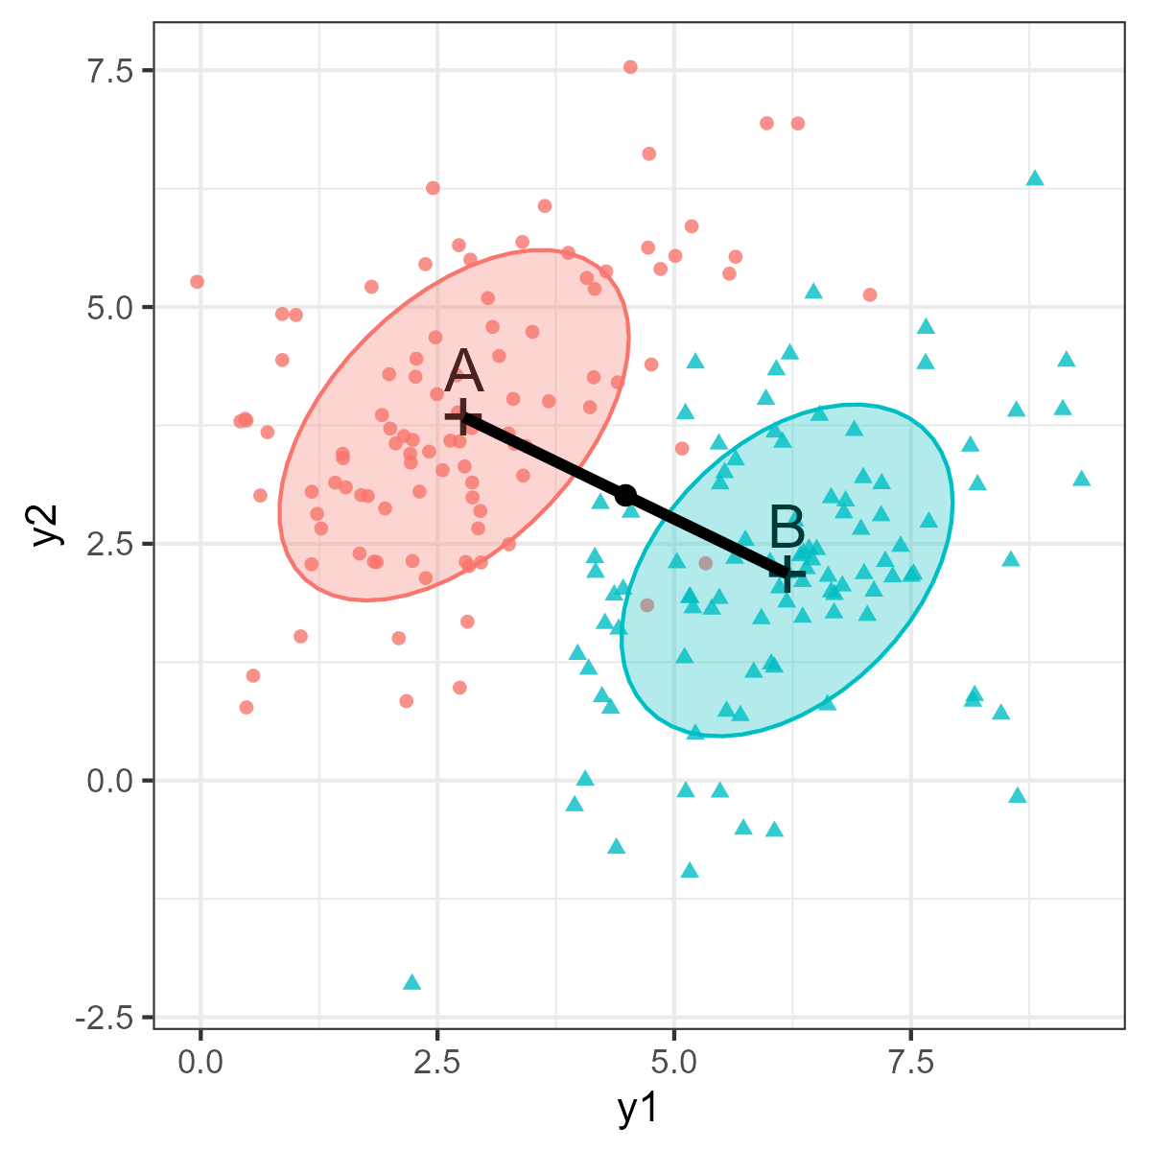

Discriminant boundary

