Slide 1
Visualizing Multivariate Data & Models with R A preview
Michael Friendly
QM Forum, Mar. 2024
https://friendly.github.io/Vis-MLM-book/

Slide 2
Topics
The LM Family & Friends

Slide 3
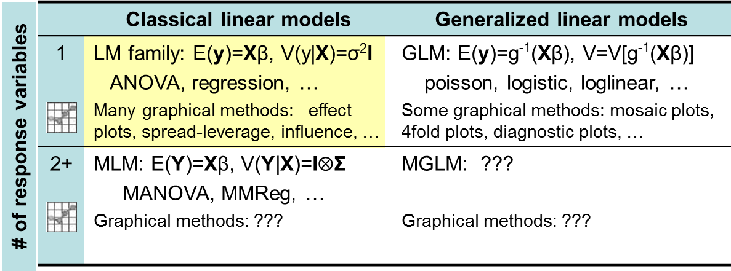
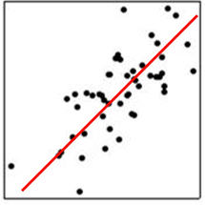
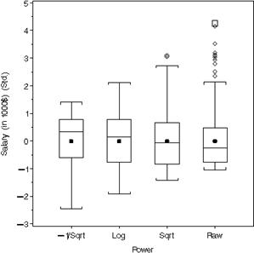
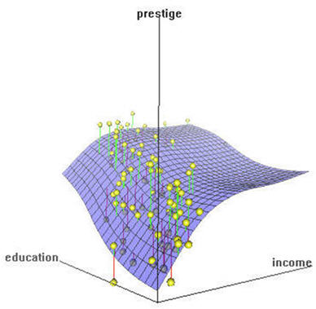
The LM family & friends
Models, graphical methods & opportunities

Slide 4
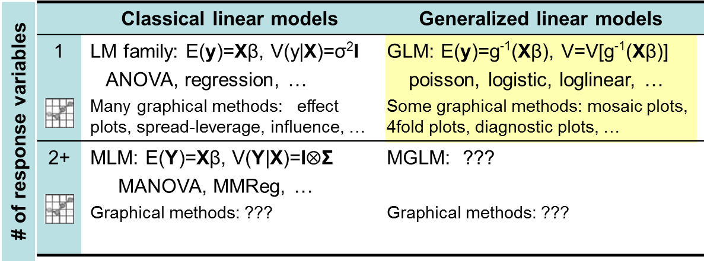
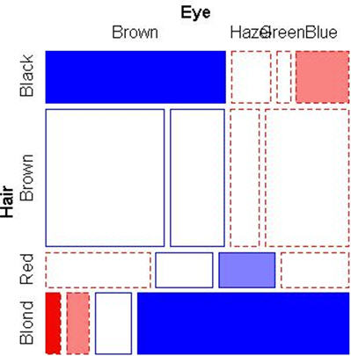
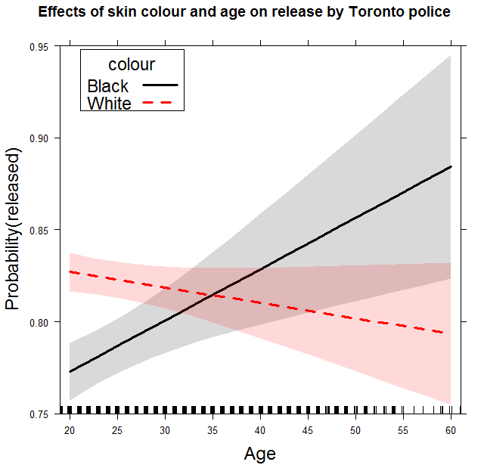
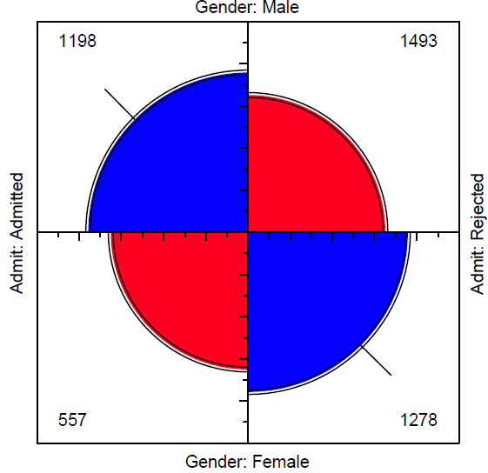
The LM family & friends
Models, graphical methods & opportunities

Slide 5
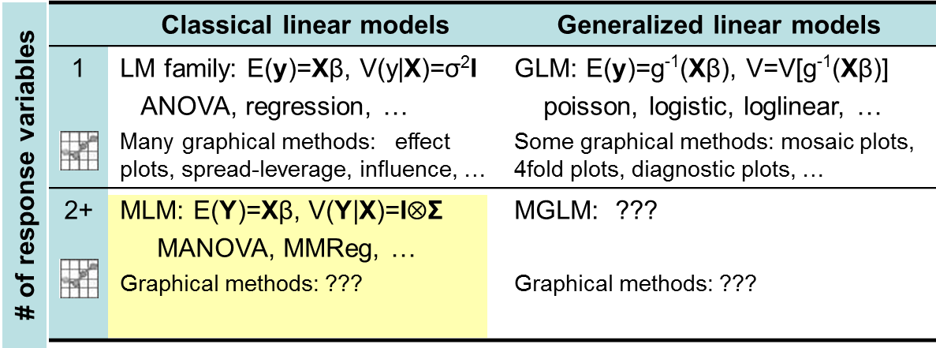

The LM family & friends
Models, graphical methods & opportunities
Today: HE plots & related methods

Slide 6
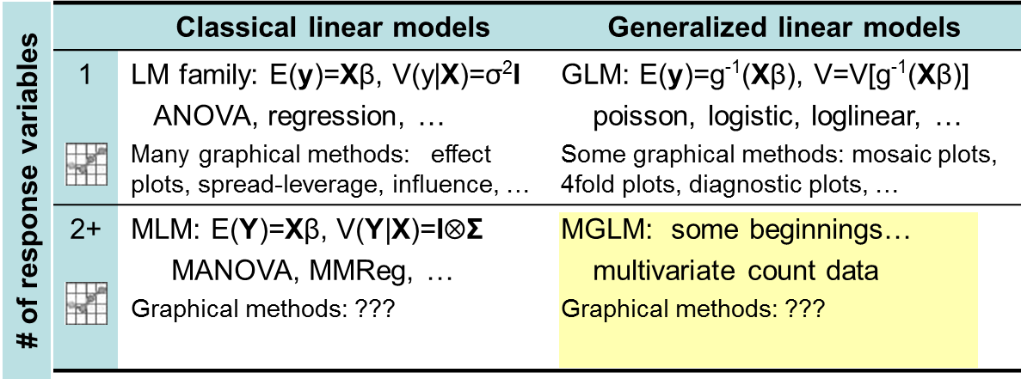
The LM family & friends
Models, graphical methods & opportunities
Tomorrow: Someone’s PhD thesis (better models)
Applications: big data, genomics, … beg for better graphical methods

Slide 7

Goal: Extend the familiar graphical methods for univariate linear models to the MLM (MANOVA, MMRA, CDA, …)
Topics:
Data plots, model plots, diagnostic plots
Data ellipses, confidence ellipses
PCA, biplots (the multivariate juicer)
y ~ X β → Y ~ X B (Anova→MANOVA)
Hypothesis-Error (HE) plots
Canonical discriminant plots
…

Slide 8



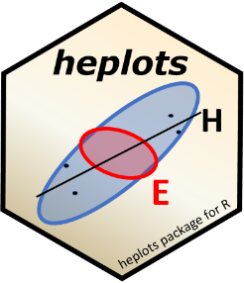
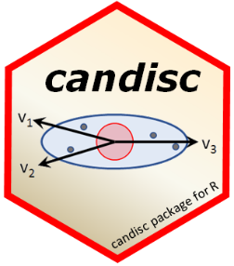



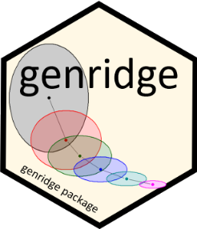

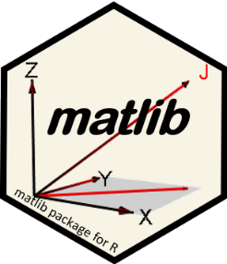
Software: packages
Categorical data
vcd & vcdExtra
nestedLogit: nested dichotomies
Linear & multivariate models
heplots: HE plots & related methods
candisc: Analyze/view MLMs in low-D space
mvinfluence: Multivariate influence
ggbiplot: ggplot2 biplots for PCA & LDA
VisCollin: Visualizing collinearity diagnostics
genridge: Generalized ridge trace plots
gellipsoid: Generalized ellipsoids
matlib: Matrix linear algebra, 2D & 3D
See: https://github.com/friendly/friendly/blob/main/packages.md
Notes:
To this end, I’ve developed a variety of R packages …

Slide 9
Plots for data analysis
data plots: display raw data, with annotations to aid interpretation (regression lines, smooths, data ellipses)
reconnaissance plots: bird’s-eye overview for high-D multivariate data
scatterplot matrices, corrgrams, parallel coord plots
visual thinning: favor summaries over data points
dimension reduction plots: plot in low-D space
PCA, biplots
Canonical correlation, LDA
model plots: plot results of a fitted model
coefficient plots
marginal effect plots, added variable plots, …
diagnostic plots: show deviations from assumptions
residual plots, influence plots
homogeneity of variance plots, …

Slide 10
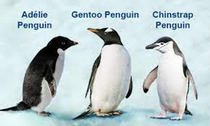
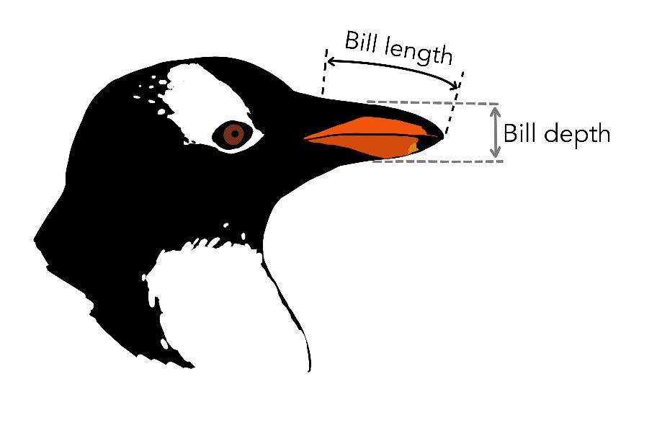
Penguins data
Data on penguin species observed in the Palmer Archipelago
Species: Adélie, Chinstrap & Gentoo
Islands: Biscoe, Dream & Torgersen
Years: 2007, 2008, 2009
Sex: Male, Female
Four measures: Bill length, Bill depth, Flipper length, Body mass
Body mass
Flipper length
Purpose: examine diff^{ces} in size, appearance in relation to foraging & habitat

Slide 11
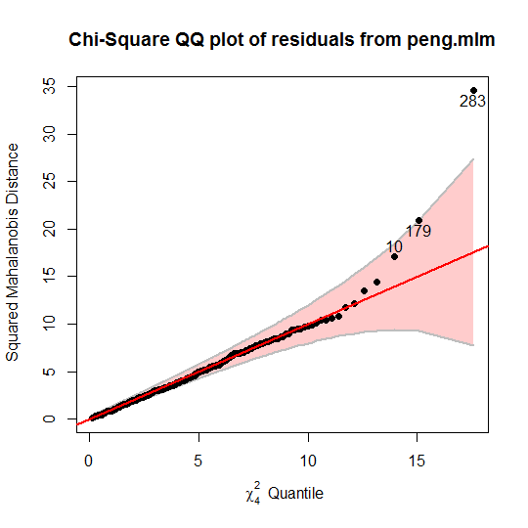
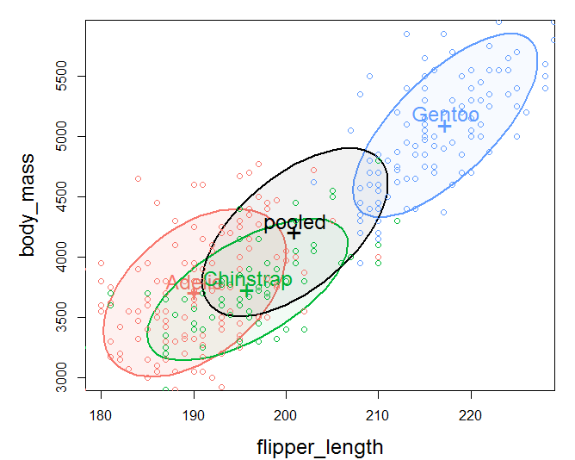
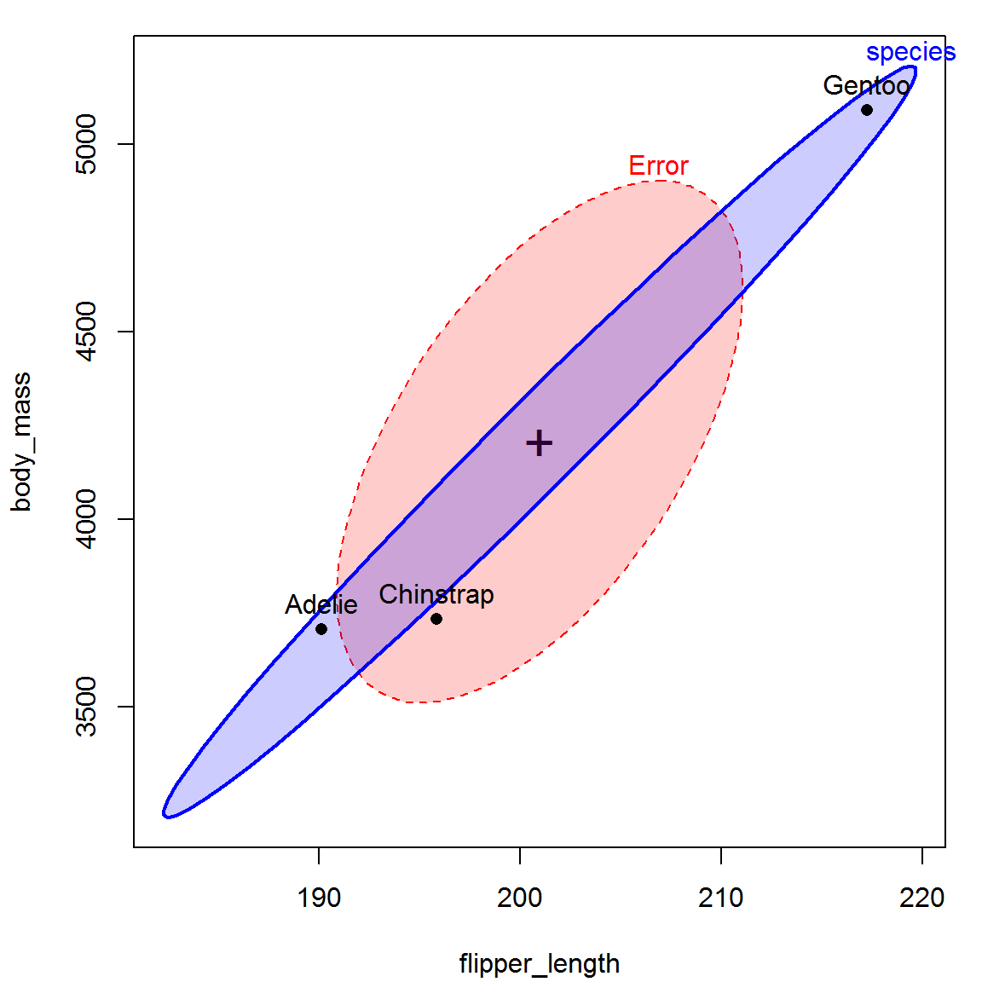
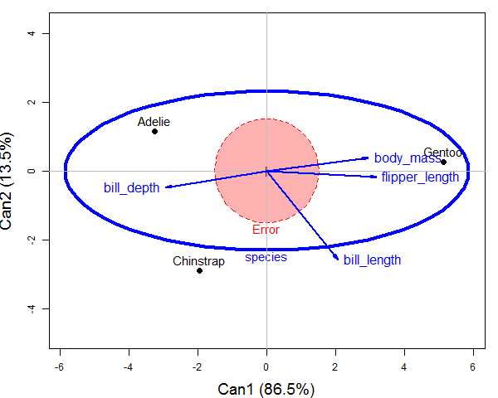
MLM visualization: Overview
Univariate linear models, y = Xβ + ε well developed
data plots, marginal effect plots, diagnostic plots
What about the MLM: Y = XB + E ?
data: data ellipses
multivariate effects: heplots
reduced-rank displays: canonical discriminant plots
diagnostic plots: MVN χ² QQ plot, mvinfluence plot
Notes:
I began this work on multivariate visualization from the thought that graphical methods were well developed for linear models for a single response variable
The extension to multivariate linear models is very direct mathematically:
Sums of squares -> square matrices for fitted values and residuals
Standard F tests -> tests based on eigenvalues

Slide 12
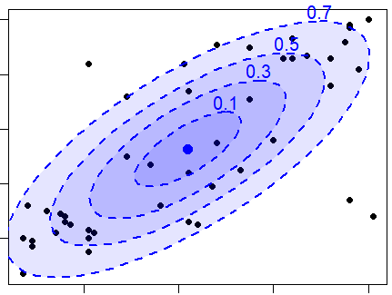
Data ellipsoids
For a p-dimensional multivariate sample, Y_{N×p} , the sample mean vector, , and sample covariance matrix, S, are minimally sufficient statistics under classical (Gaussian) assumptions.
These can be represented visually by the p-dimensional data ellipsoid, of size (“radius”) c,
→ an ellipsoid centered at the means whose size & shape reflects variances & covariances
Contours are Mahalanobis D_{M}² (y_{i}) ~ χ_{p}²
I consider this a minimally sufficient visual summary of multivariate location and scatter.

Slide 13
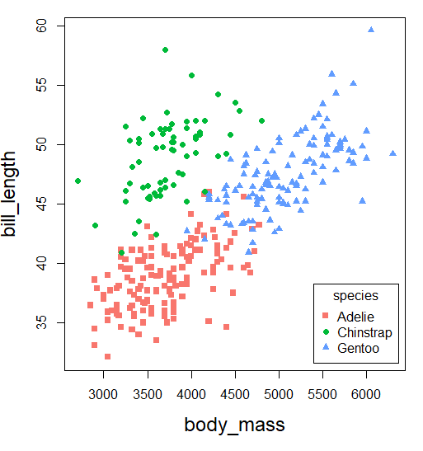
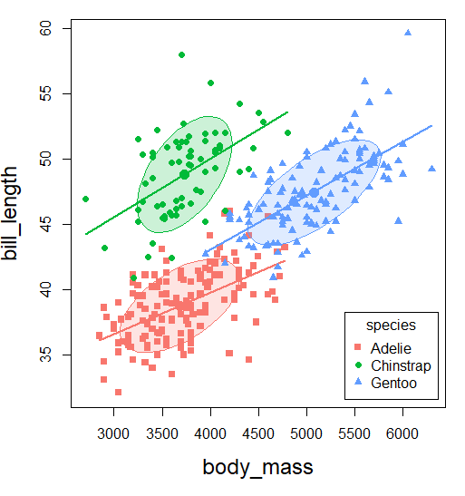
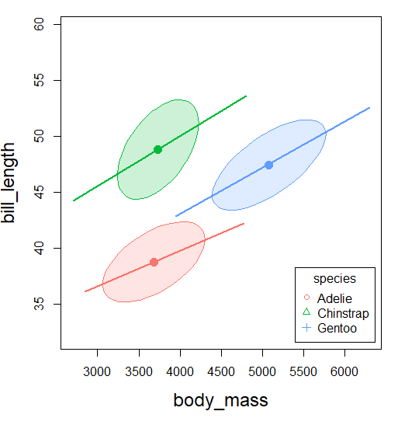
Data ellipses: Sufficient visual summary
Palmer penguins data: Measures of bill length & depth, body mass, flipper length for 3 species
Add data ellipses to show w/in group means & scatter
Remove the points to show the overall patterns: means, shape, corr., precision
What remains is all that linear models care about (ellipses can be made robust!)
Standard scatterplot
Add data ellipses
Remove points
Notes:
As an example, consider the now popular data on body measurements of Antarctic penguins classified by species.
(The classic iris data seems to have been eclipsed b/c of Fisher’s association with the eugenics movement.)

Slide 14
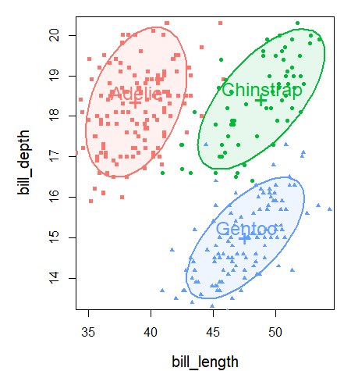
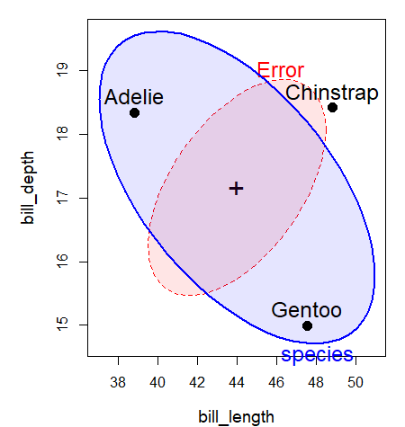
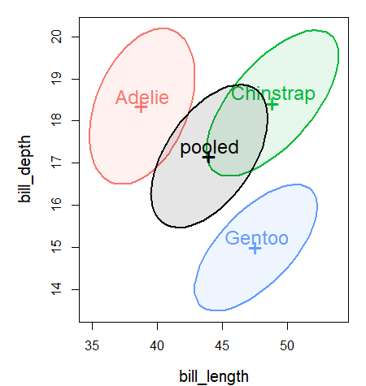
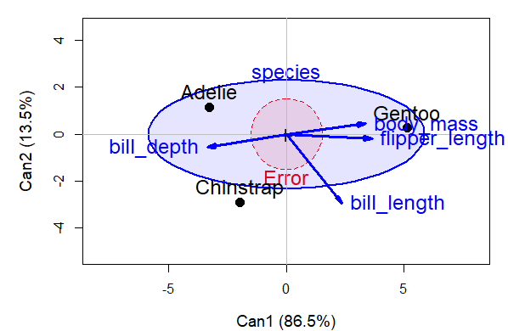
HE plots: Visual overview
Data ellipses
HE plot
Canonical space
Discrim axes
Notes:
The HE plot framework starts with data ellipses for the groups in a multivariate linear model
An “HE plot” summarizes the evidence for differences among groups in a MANOVA design
Equally, this can be cast as a discriminant analysis problem
A simple description can be seen in an HE plot in canonical space

Slide 15
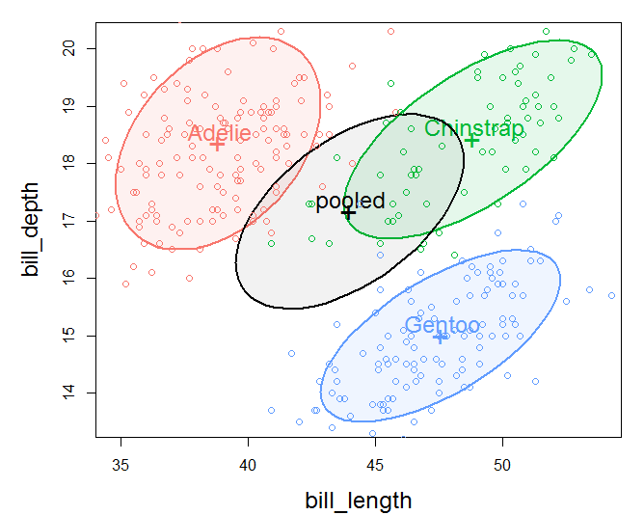
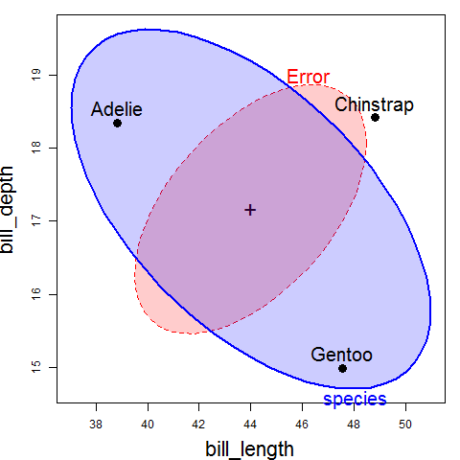
HE plots: Visualizing MLM tests
MLM: lm(cbind(bill_length, bill_depth, flipper_length, body_mass) ~ species)
How big is H (between) variation relative to E (within) variation?
H: data ellipse of the fitted values (means)
E: data ellipse of the residuals (pooled w/in group)
Significance scaling: Effect of species signif. iff H ellipse anywhere outside E ellipse!
Data ellipses
HE plot
Notes:
How can we understand a MANOVA to test for differences among penguin species using various physical measurements?
Data ellipses show the bivariate scatter
The HE plot focuses on what matters in the MANOVA tests

Slide 16
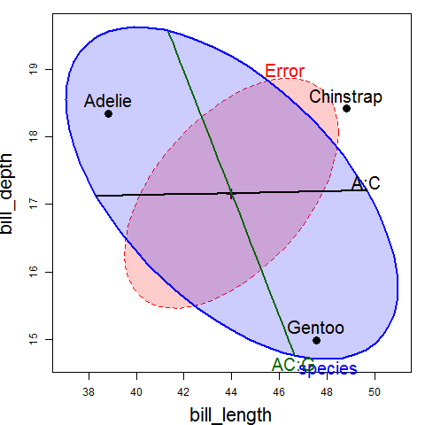
HE plots: Visualizing MLM tests
MLM: lm(cbind(bill_length, bill_depth, flipper_length, body_mass) ~ species)
How big is H (between) variation relative to E (within) variation?
H: data ellipse of the fitted values (means)
E: data ellipse of the residuals (pooled w/in group)
Significance scaling: Effect of species signif. iff H ellipse anywhere outside E ellipse!
Contrasts or 1 df linear hypotheses plot as conjugate 1D ellipses
Notes:
There is beautiful geometry here. Linear hypotheses correspond to conjugate ellipses of dimension = df

Slide 17
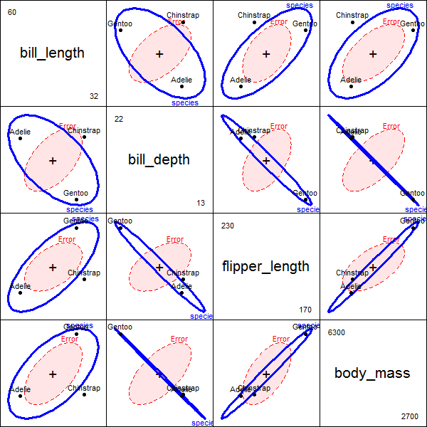
HE pairs() plots
The pairs() method for mlm objects gives all pairwise HE plots in a scatterplot matrix format in data space.
pairs(peng.mod0, size="effect",
fill=c(TRUE, FALSE))
Something new here:
avg. bill depth is negatively correlated with “size” variables – larger penguin species have smaller bill depths (curvature?)
correlation of avg. bill depth with body mass nearly -1

Slide 18



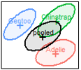
Equality of (co)variance
In the univariate LM, we assume Var(e)= constant, σ². For one-way ANOVA:
The analog for the MLM is equality of within-group covariance matrices
Tests:
Univariate- Levine’s test
Multivariate: Box’s M test
How to visualize???
DATA ELLIPSES

Slide 19
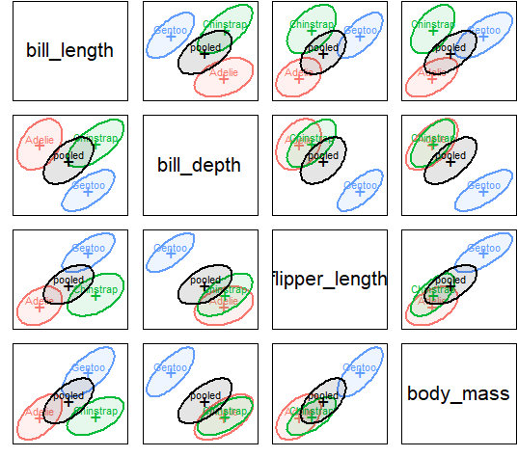
heplots::covEllipses()
Display data ellipses for each of the groups + the pooled within-grp covariance
How similar are they in size & shape?
covEllipses(peng[, 3:6],
group = peng$species,
variables = 1:4,
fill = TRUE, fill.alpha = 0.1)

Slide 20
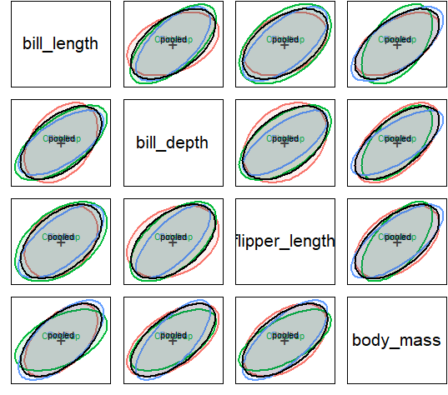
heplots::covEllipses()
Easier to see if we center the data ellipses at the grand means
covEllipses(peng[, 3:6],
group = peng$species,
center = TRUE,
variables = 1:4,
fill = TRUE, fill.alpha = 0.1)

Slide 21
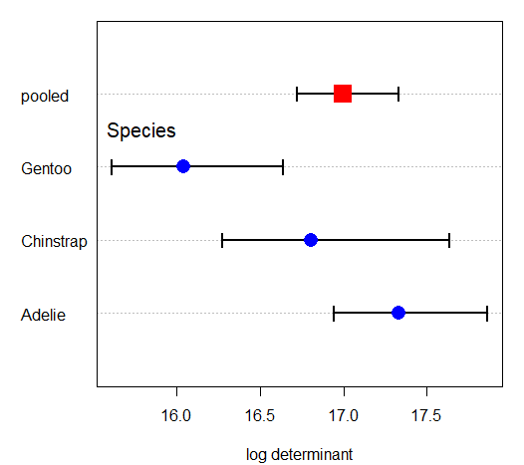
Box’s M test
> (bm <- boxM(peng.mod0))
Box's M-test for Homogeneity of Covariance Matrices
data: Y
Chi-Sq (approx.) = 74.731, df = 20, p-value = 3.02e-08
> plot(bm)
The plot method for boxM shows the contributions to Box’s M test
log |S₁|, … log |S_{g}| and log |S_{p}|
Gentoo is smaller than the others

Slide 22


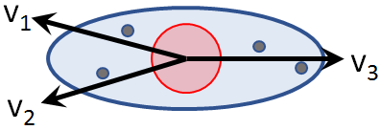

Multivariate Juicers
Squeeze the most flavor from your data in low-D space
data
insight
Biplot: The data juicer
CDA plots: The MANOVA juicer
Notes:
With more than a few variables, you can gain greater understanding with a multivariate juicer.
I know this is SO cheesy! But I find this a nice analogy to explain what we do with low-D methods

Slide 23

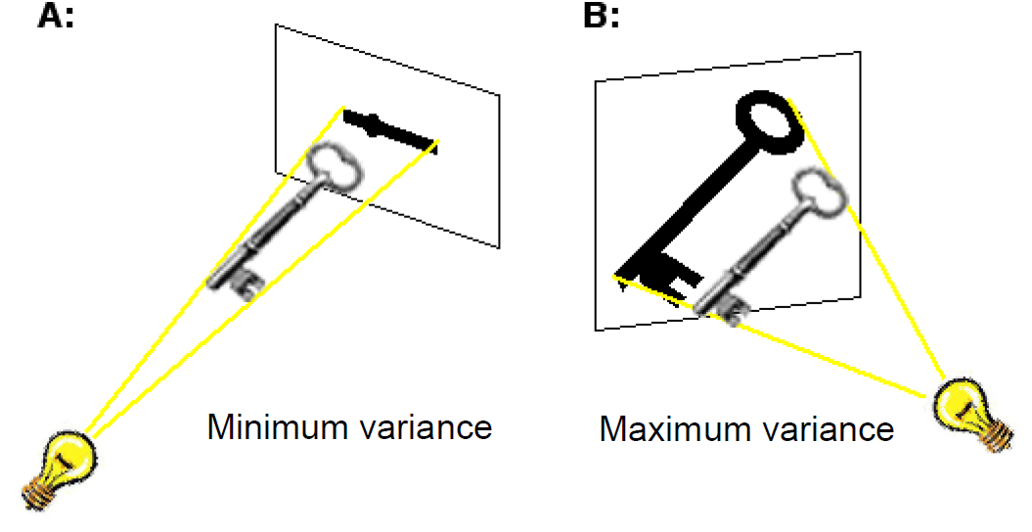
Low-D displays of High-D data
High-D data often shown in 2D views – orthogonal projections in variable space: scatterplots!
Dimension-reduction methods (e.g., PCA) project the data into subspace with optimal properties – account for largest variance
Cover image of Hofstadter, Gödel, Bach & Escher
Notes:
We are used to looking at High-D data in projected 2D views -- scatterplots

Slide 24
PCA, CDA & Biplots
For multivariate data, often want to view the data in a low-D space that extracts the most “juice”
PCA: finds weighted sums of variables which are:
Uncorrelated
Account for maximum variance
CDA: finds weighted sums to account for greatest MANOVA between-group variance (H wrt E)
Biplot: a 2D (or 3D) plot of the largest PCA / CDA dimensions--
Vectors in this plot show the original data variables
Points in this plot show the observations
Data ellipses here show within group relations

Slide 25
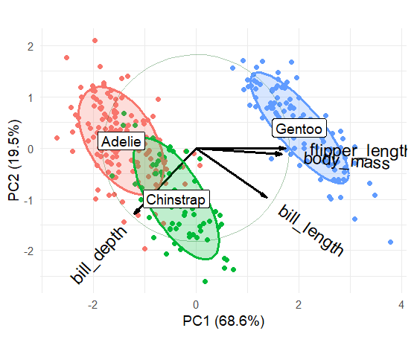

Biplot: The data juicer
peng.pca <- prcomp (~ bill_length + bill_depth + flipper_length + body_mass)
library(ggbiplot)
ggbiplot(peng.pca, obs.scale = 1, var.scale = 1,
groups = peng$species, ellipse = TRUE, circle = TRUE)
PC1, PC2 ~ 88.1% of variance
PC1: largely flipper length & body mass: “penguin size”
PC2: relates to “bill shape”
Easy to characterize the species in terms of these variables
See: https://rpubs.com/friendly/penguin-biplots

Slide 26
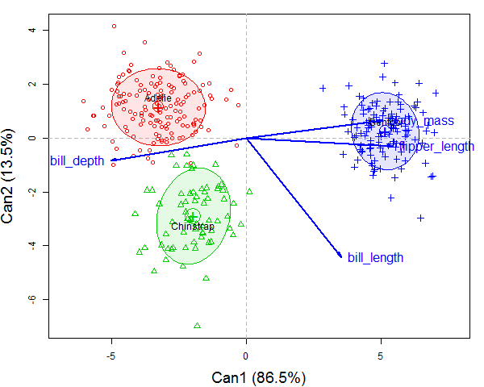
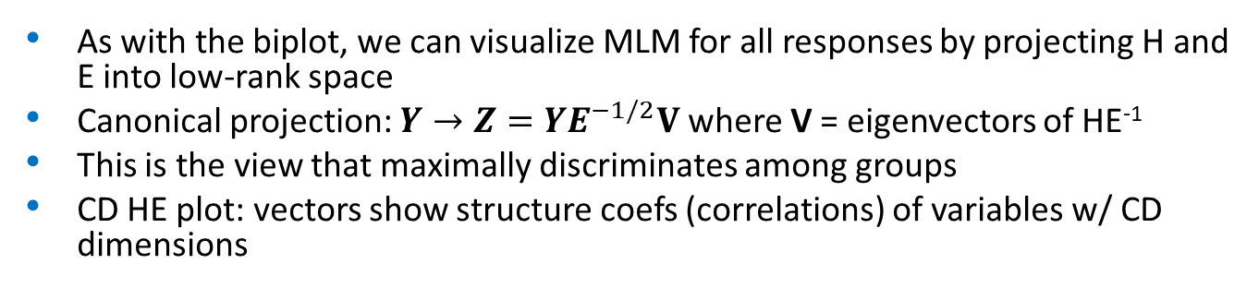
Canonical discriminant plots: The MANOVA juicer
As with the biplot, we can visualize MLM for all responses by projecting H and E into low-rank space
Canonical projection: $Y→Z=YE^{−1/2}V$ where V = eigenvectors of HE⁻¹
This is the view that maximally discriminates among groups
CD HE plot: vectors show structure coefs (correlations) of variables w/ CD dimensions
Biplot of canonical scores
HE plot of canonical scores

Slide 27
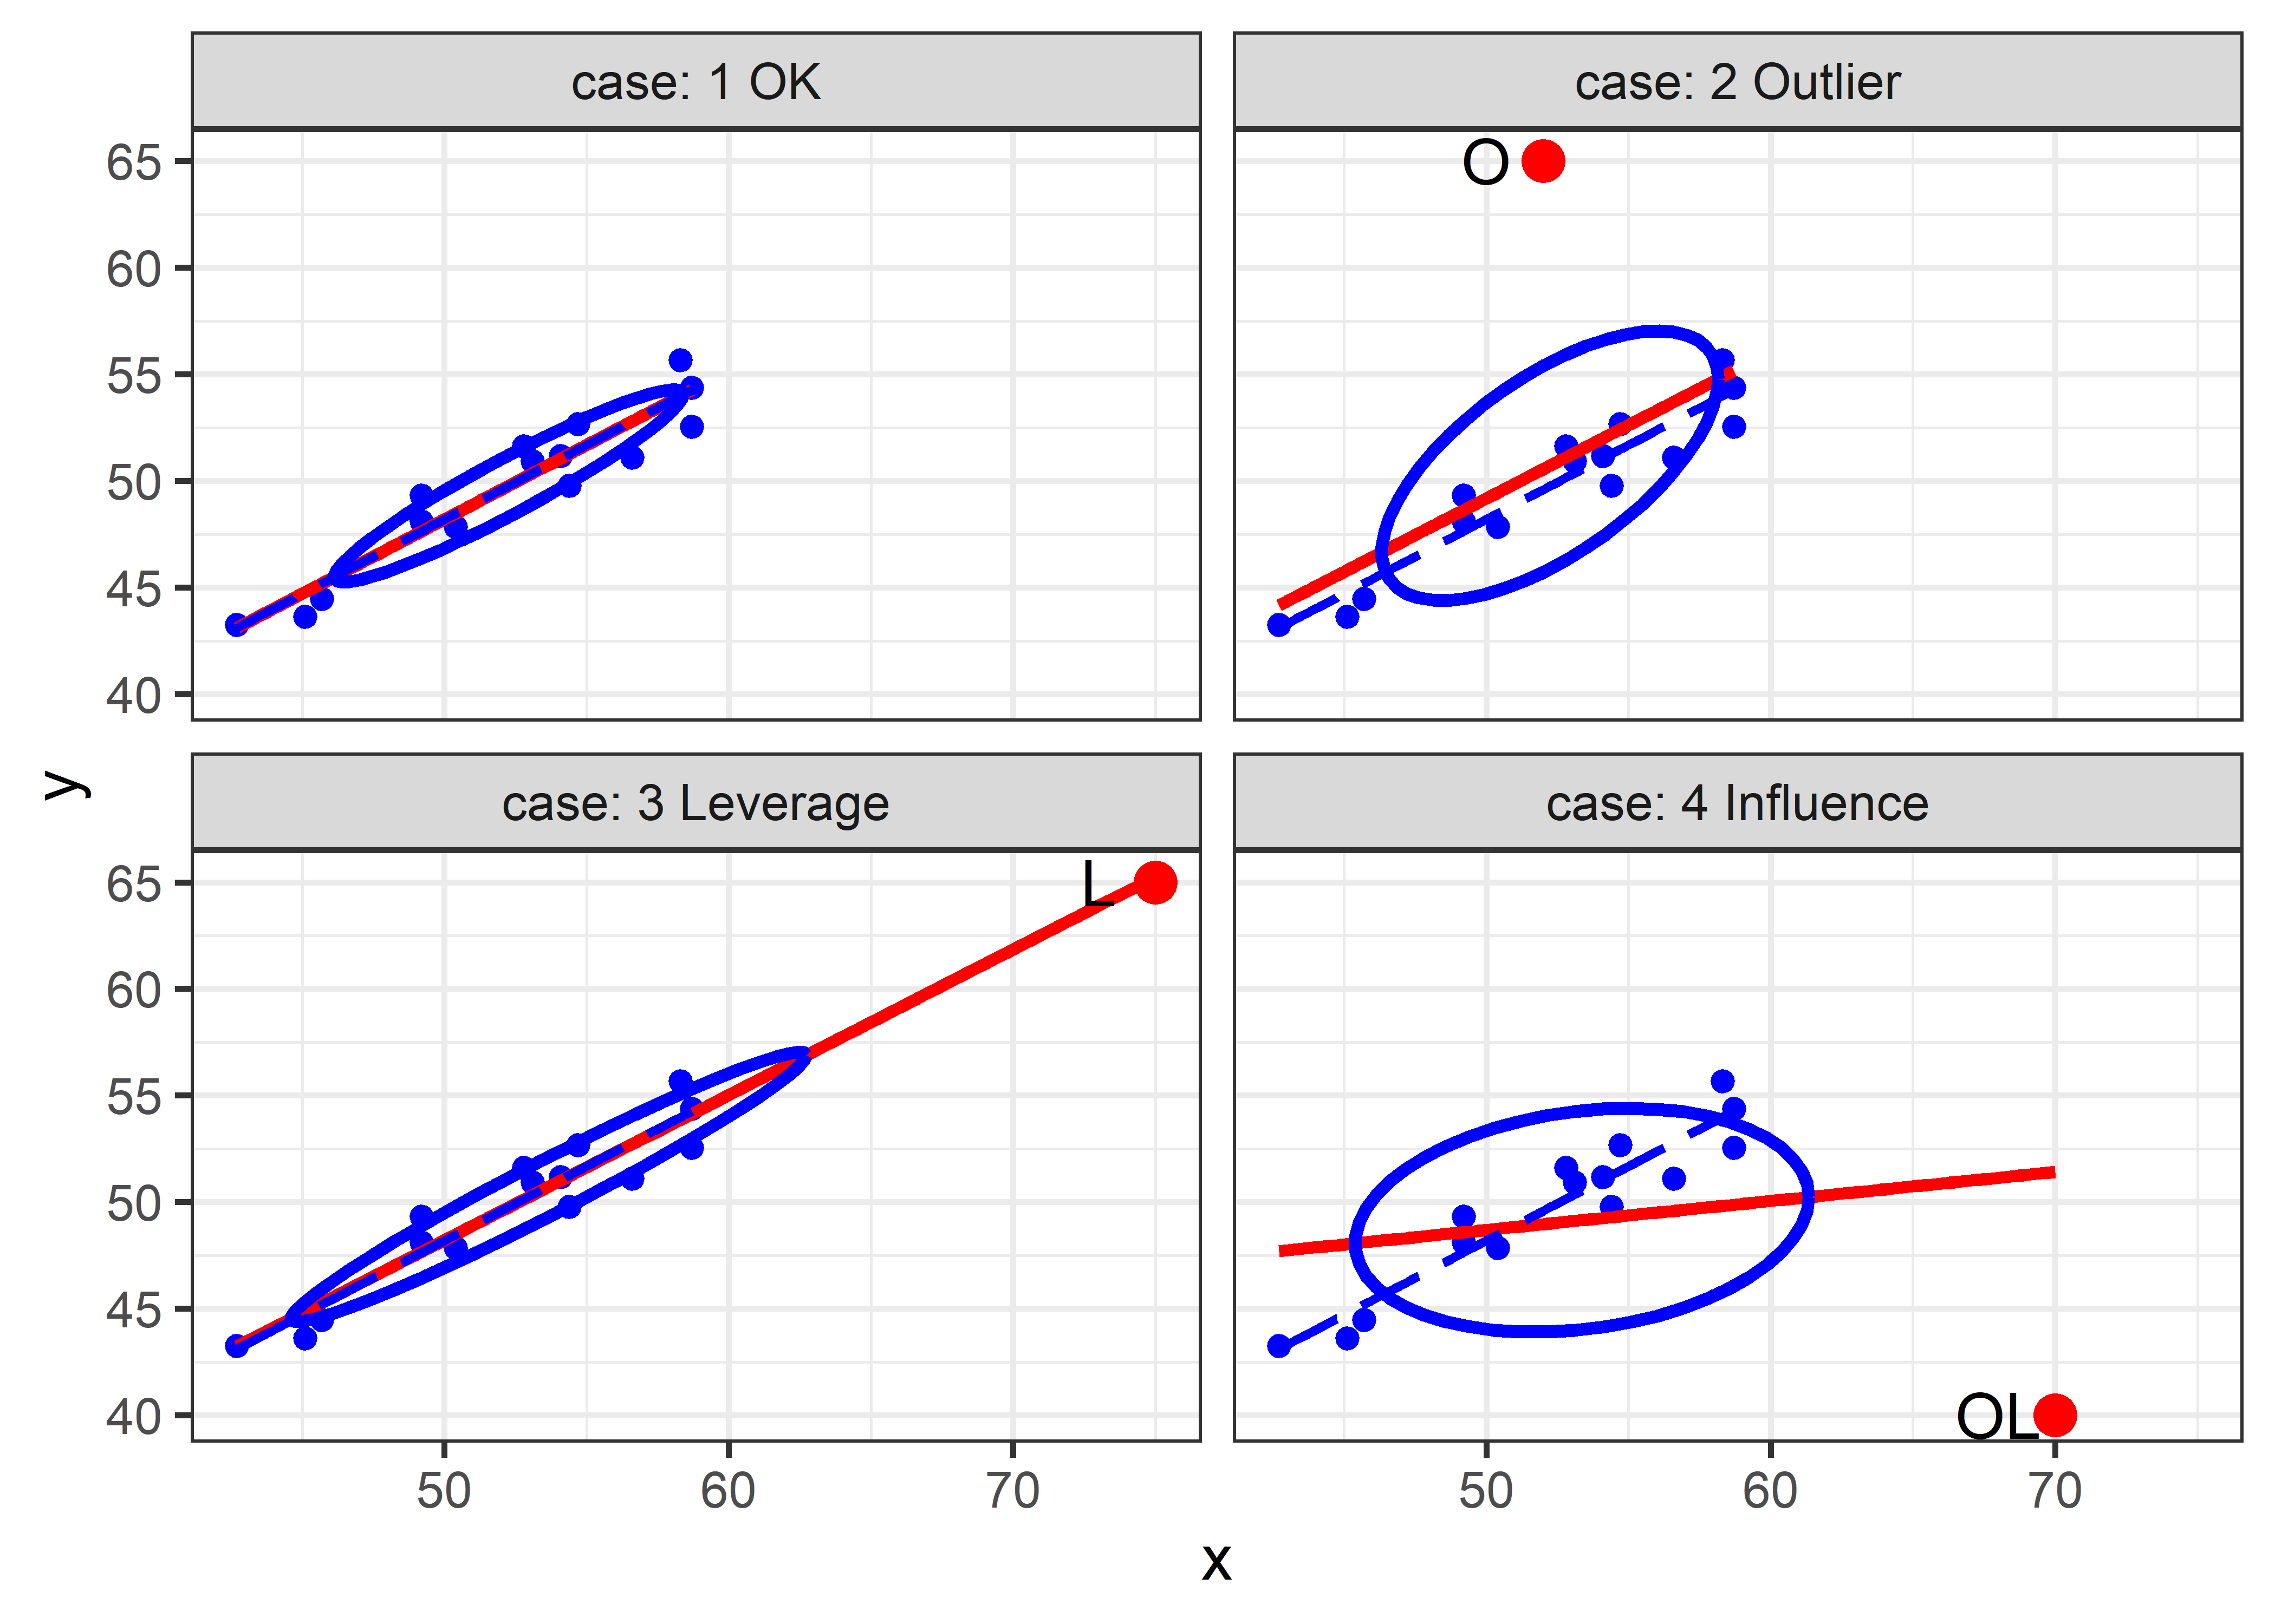
Unusual data: Influence & leverage
“Unusual” observations can have dramatic effects on least-squares estimates in linear models
The leverage-influence quartet illustrates the impact of adding one additional point
What “harms” the fitted model?
1: OK
2: Outlier on y- no harm
3: Outlier on x- no harm
4: Outlier on both- BAD
Heuristic formula:
Influence = X leverage × Y residual

Slide 28
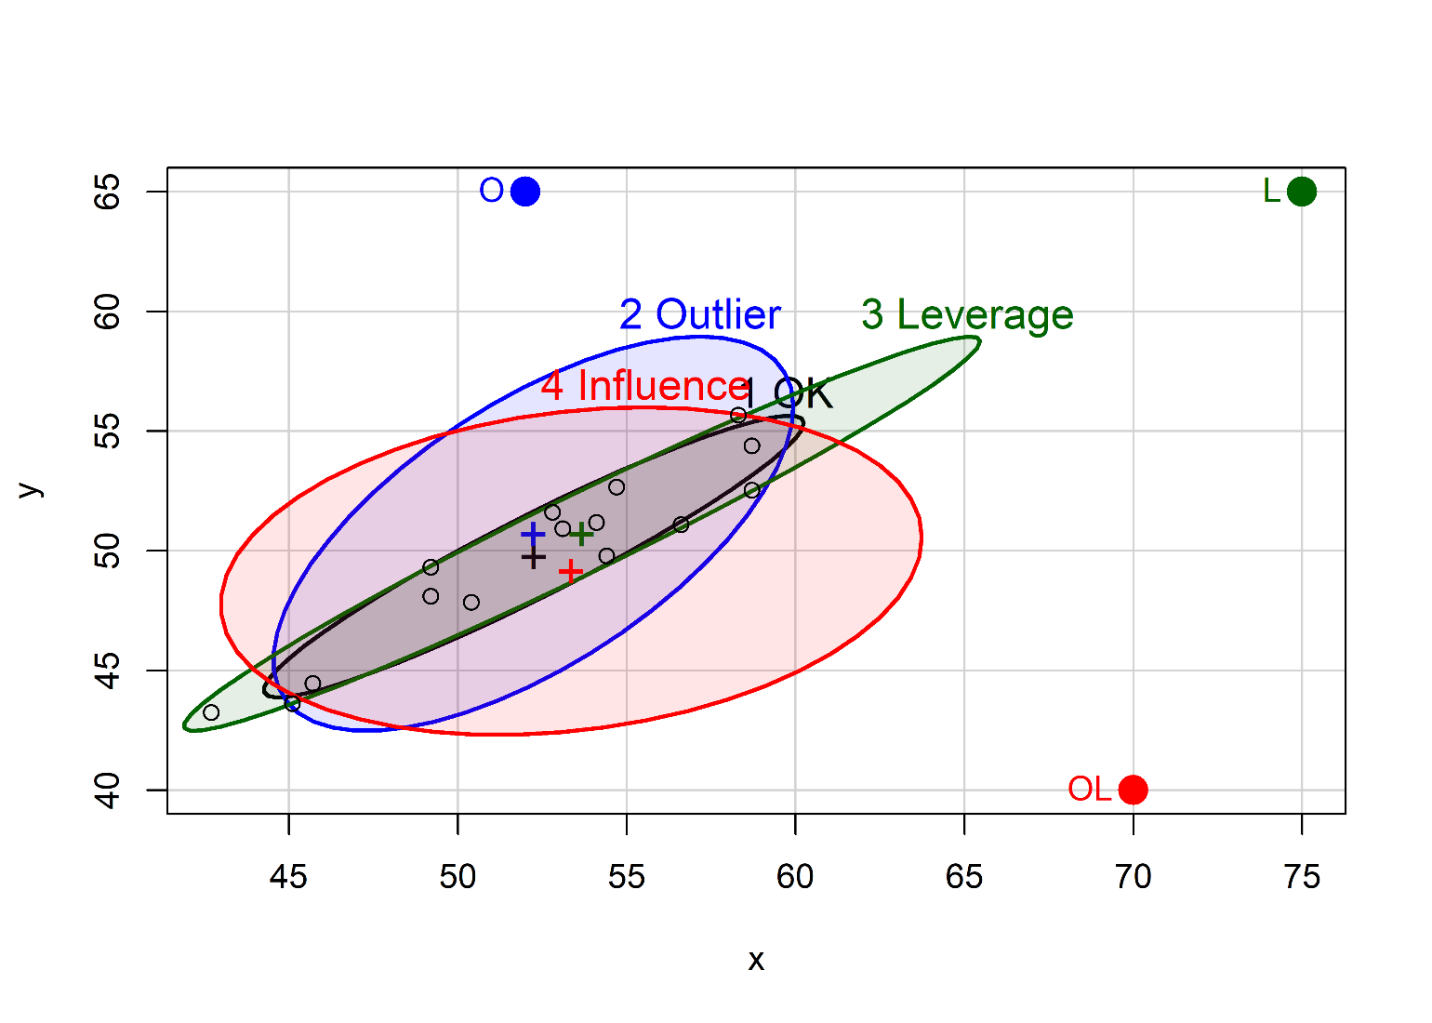
Unusual data: precision
Unusual points also affect precision of estimates, as shown by data ellipses
O: no bias, but increases std. error
L: decreases std. error (“good leverage” point)
OL: biases slope & increases std. error

Slide 29
Multivariate influence
How can we extend this to a MLM with multiple responses?
mymlm <- lm( cbind(y1, y2, y3) ~ x1 + x2 + x3, data=mydata)
and then get useful diagnostics and plots with
influence(mymlm)
hatvalues(mymlm)
influencePlot(mymlm, ...)

Slide 30
Multivariate influence

