Slide 1
Visualizing Multivariate Data & Models with R A preview
Michael Friendly
QM Forum, Mar. 2024
https://friendly.github.io/Vis-MLM-book/

Slide 2
Topics
The LM Family & Friends

Slide 3
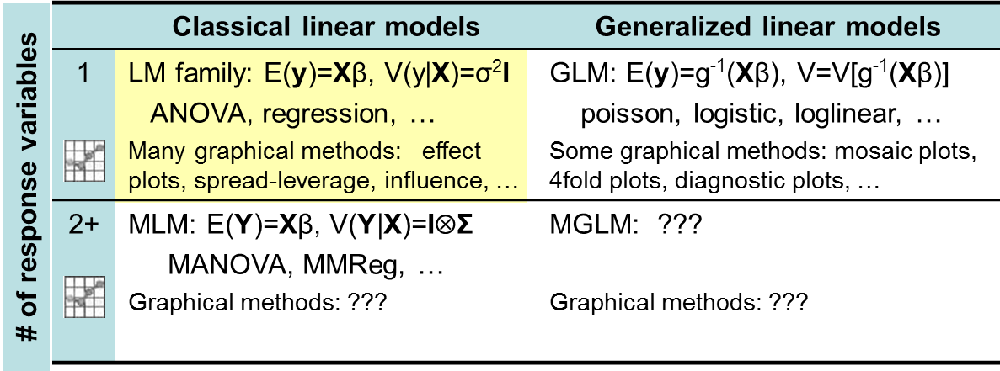
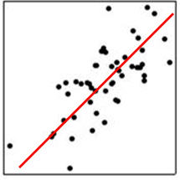
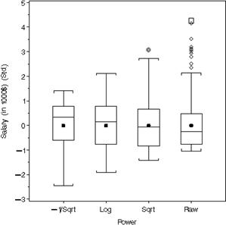
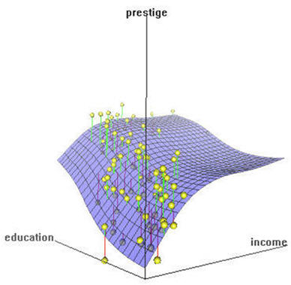
The LM family & friends
Models, graphical methods & opportunities

Slide 4
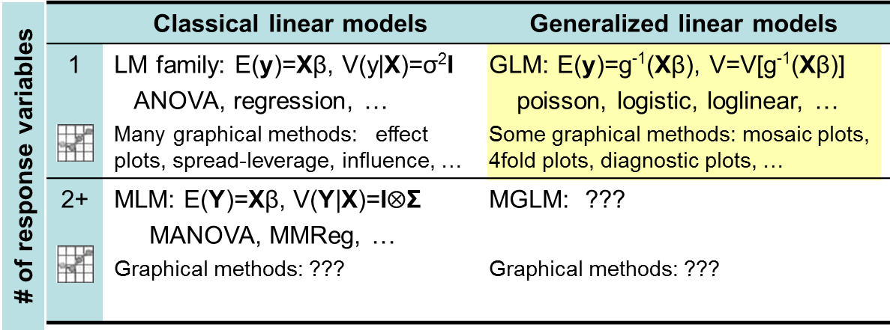
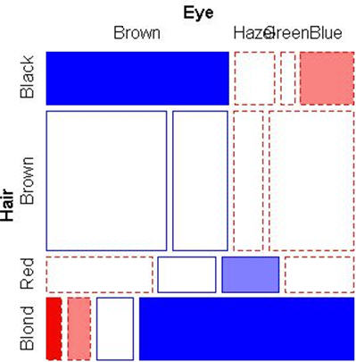
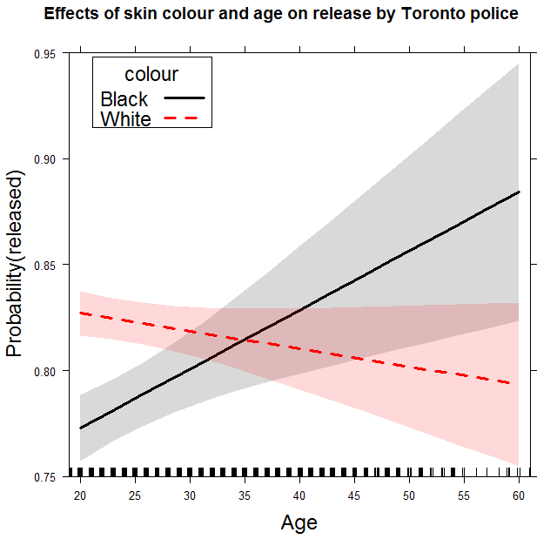
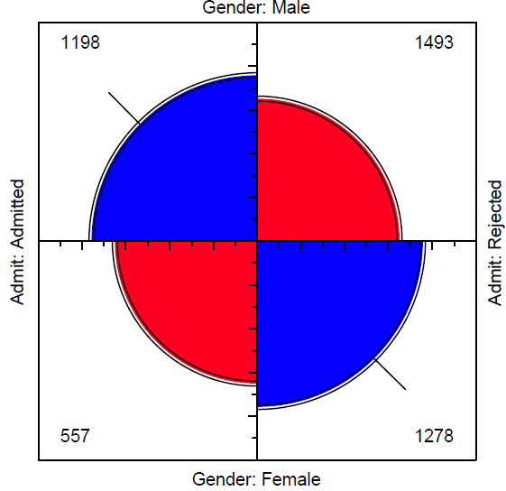
The LM family & friends
Models, graphical methods & opportunities

Slide 5
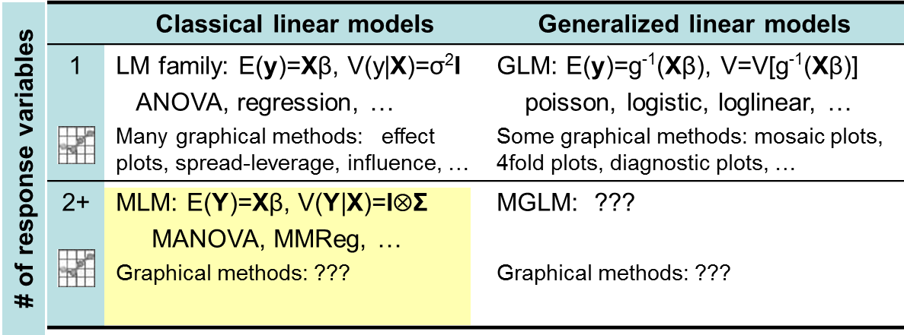

The LM family & friends
Models, graphical methods & opportunities
Today: HE plots & related methods

Slide 6
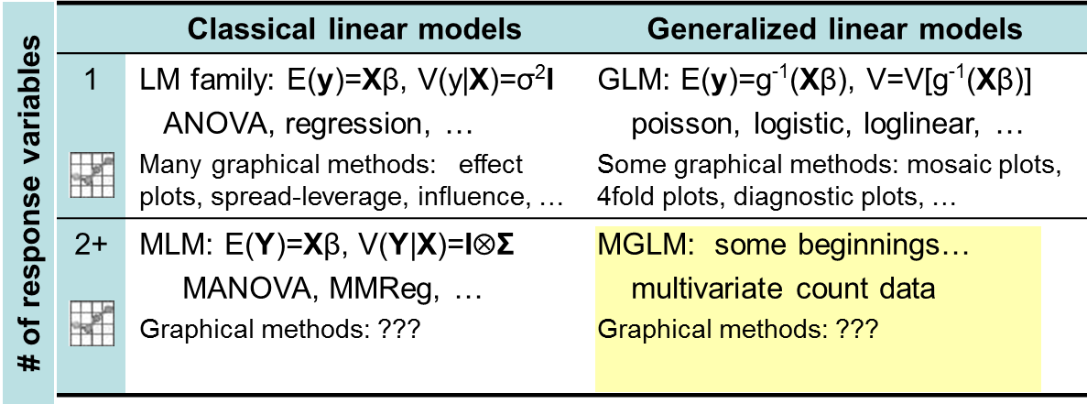
The LM family & friends
Models, graphical methods & opportunities
Tomorrow: Someone’s PhD thesis (better models)
Applications: big data, genomics, … beg for better graphical methods

Slide 7
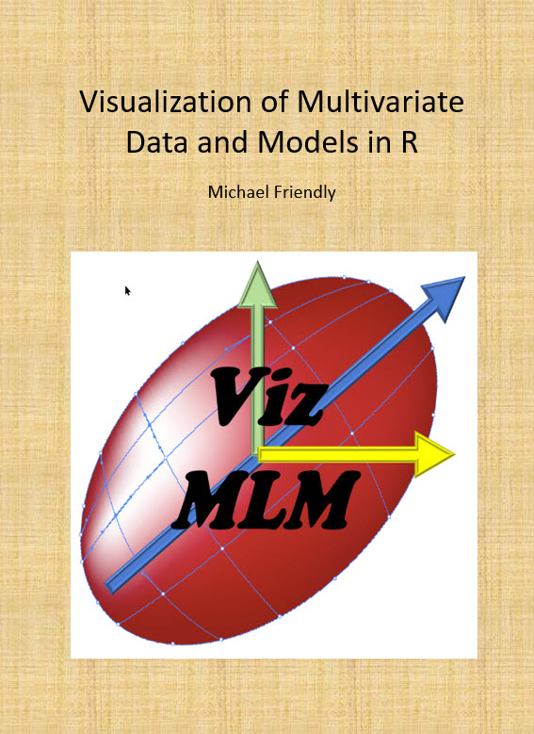
Current, in progress book
Goal: Extend the familiar graphical methods for univariate linear models to the MLM (MANOVA, MMRA, CDA, …)
Topics:
Data plots, model plots, diagnostic plots
Data ellipses, confidence ellipses
PCA, biplots (the multivariate juicer)
y ~ X β → Y ~ X B (Anova→MANOVA)
Hypothesis-Error (HE) plots
Canonical discriminant plots
…

Slide 8



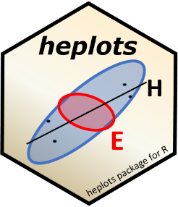
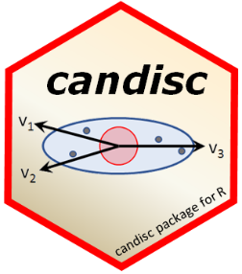


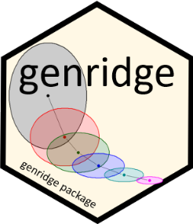

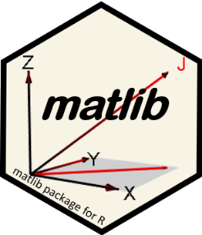
Software: packages
Categorical data
vcd & vcdExtra
nestedLogit: nested dichotomies
Linear & multivariate models
heplots: HE plots & related methods
candisc: Analyze/view MLMs in low-D space
mvinfluence: Multivariate influence
VisCollin: Visualizing collinearity diagnostics
genridge: Generalized ridge trace plots
gellipsoid: Generalized ellipsoids
matlib: Matrix linear algebra, 2D & 3D
See: https://github.com/friendly/friendly/blob/main/packages.md
Notes:
To this end, I’ve developed a variety of R packages …

