Slide 1
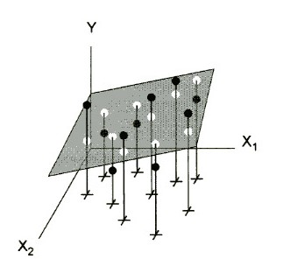
Y value
fitted value
r(x₁,x₂) ~ 0
data points in x₁,x₂ plane

Slide 2
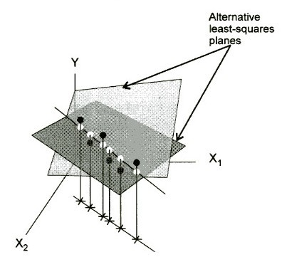
But: same predicted values!
r(x₁,x₂)=1.0

Slide 3
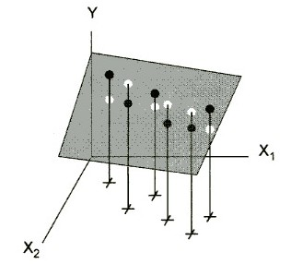
r(x₁,x₂) = 0.9

