Slide 1
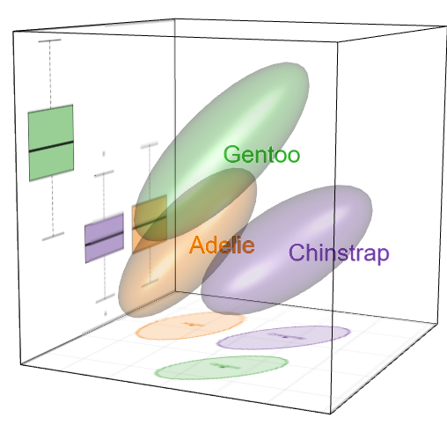

Visualization of Multivariate Data and Models in R
A Romance in Many Dimensions
Michael Friendly

Slide 2

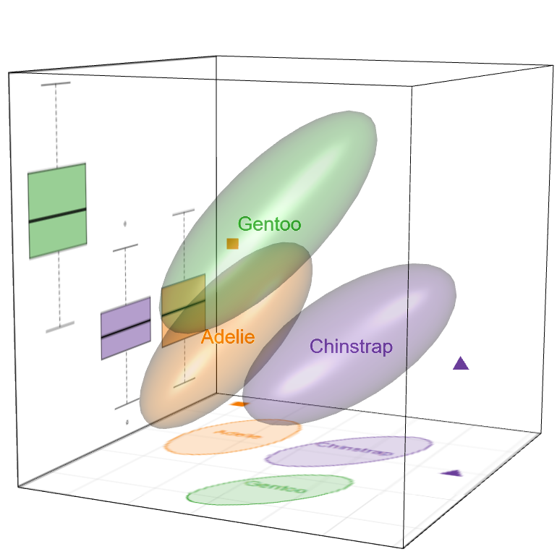
Visualization of Multivariate Data and Models in
A Romance in Many Dimensions
Michael Friendly

Slide 3

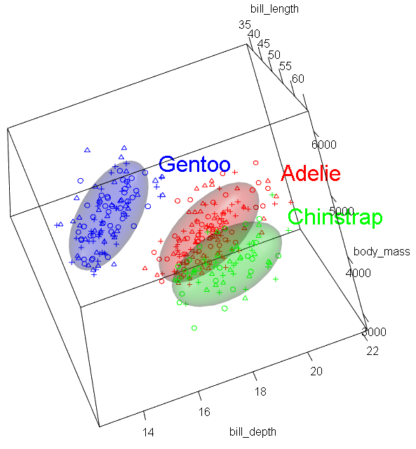
Visualization of Multivariate Data and Models in R
Michael Friendly

Slide 4
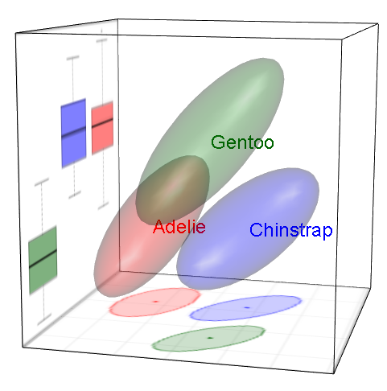
Visualization of Multivariate Data and Models in R
Michael Friendly

Slide 5
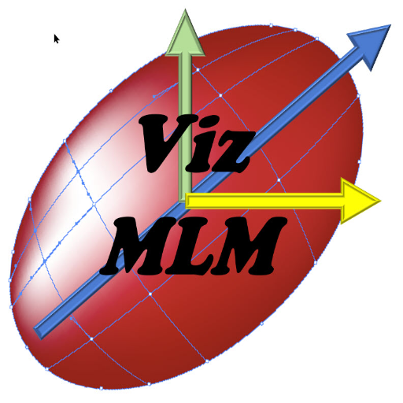
Visualization of Multivariate Data and Models in R
A Romance in Many Dimensions
Michael Friendly

Slide 6
Visualization of Multivariate Data and Models in R
Michael Friendly

