Slide 1
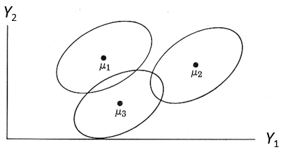
reading
Shakespeare
physics
math

Slide 2
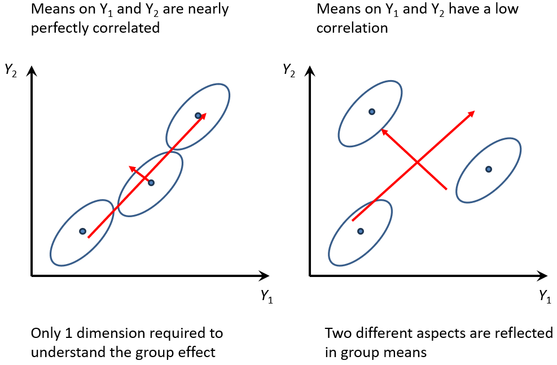
physical
play
attention
normal
mild sch.
mental
no disability
profound sch.
memory
caring

