Slide 1
x₂
x
p
x^{T}p
x₁

Slide 2
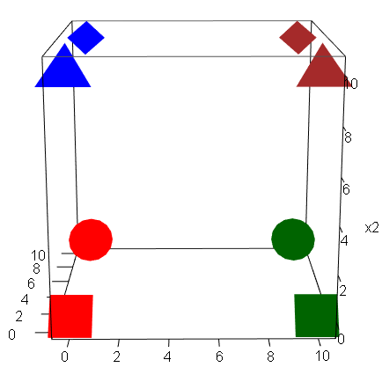
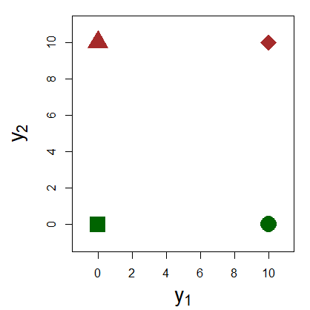
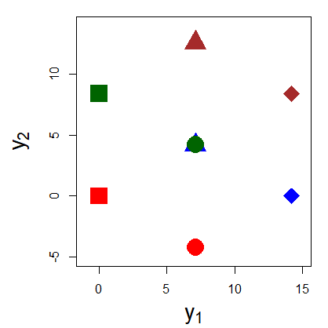
(a)
(b)
(c)

Slide 3
