Slide 1
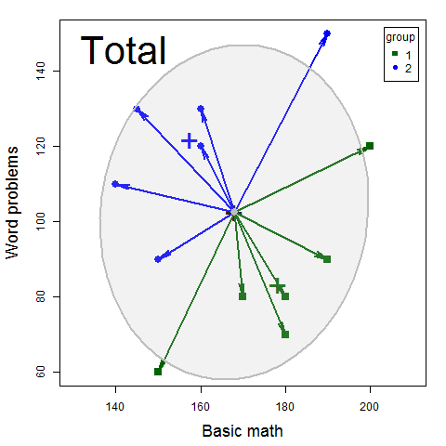
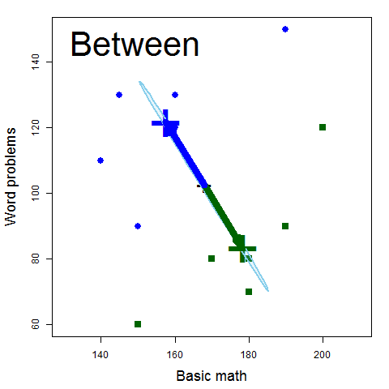
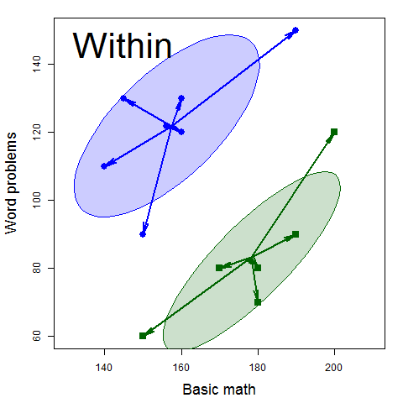
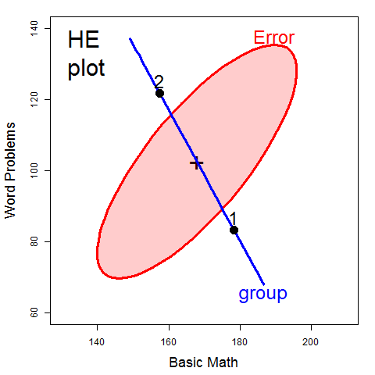
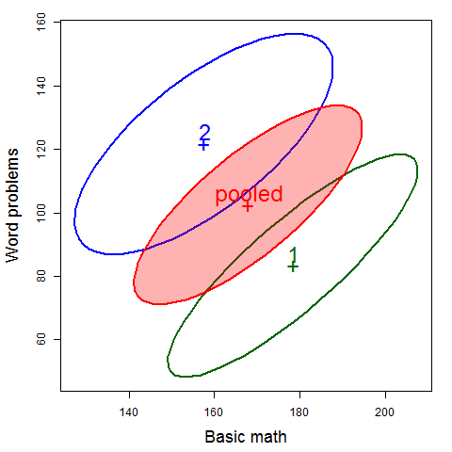
Visualizing SSP_{T} = SSP_{H} + SSP_{E}
=
+
scale & overlay
pool→ SSP_{E}
Within
Total
Between

Slide 2
SSP_{T}
SSP_{H}
SSP_{E}
=
+
Within
Total
Between

Slide 3
Within
Total
Between
Total (T)
Between (H)
Within (E)

