Slide 1
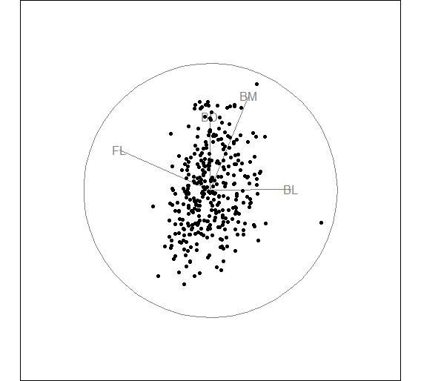
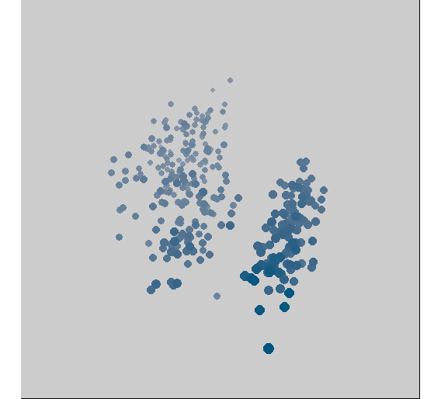
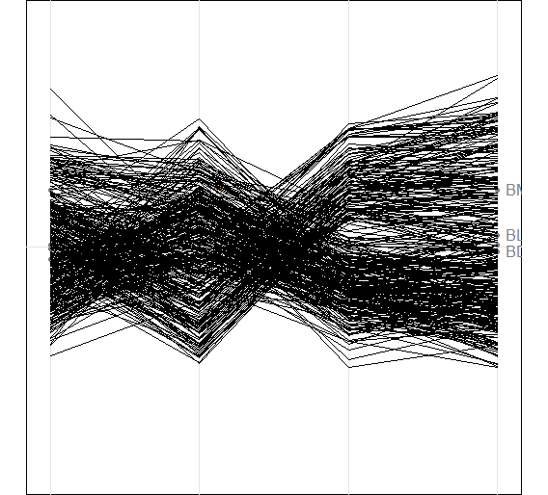
(a) 2D, scatterplot
(b) 3D, simulated depth
(a) 4D, parallel coordinates

