Slide 1
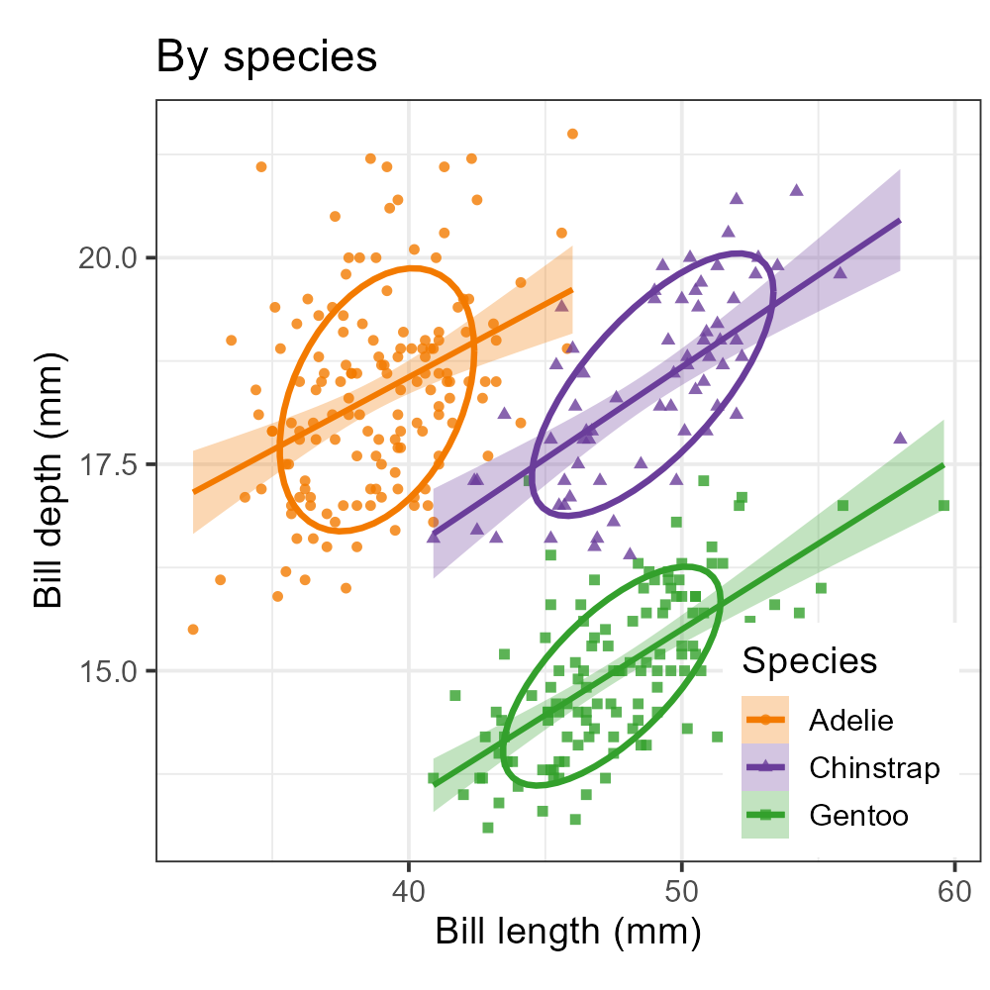
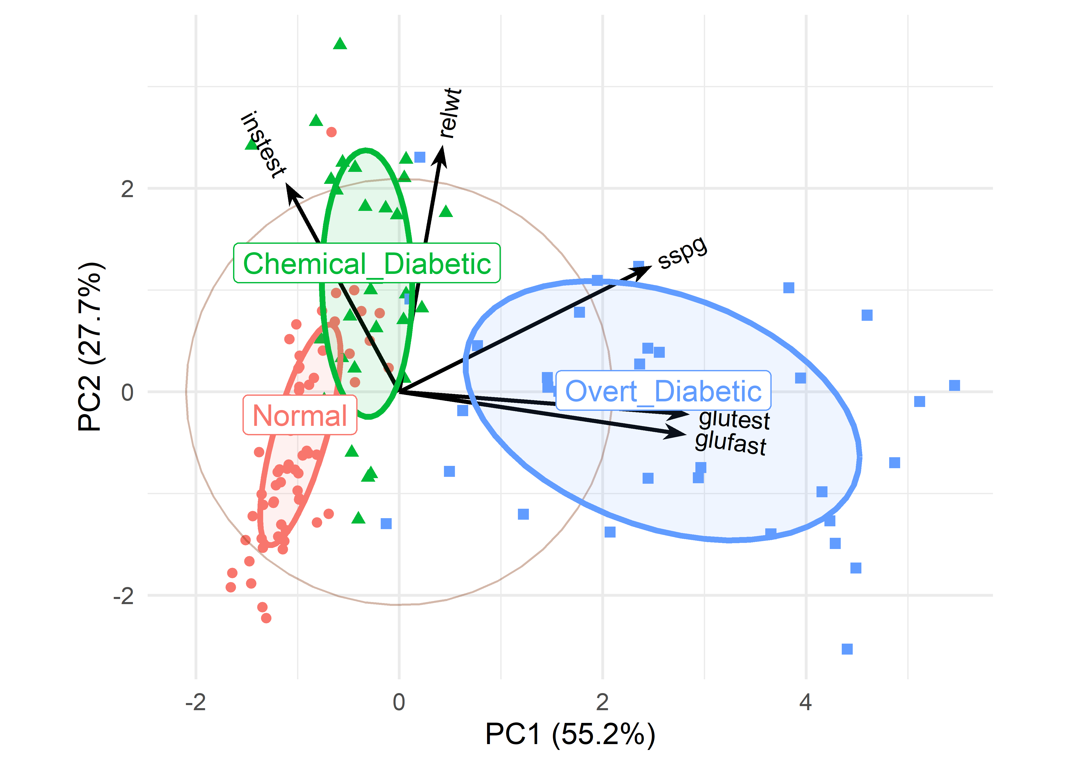
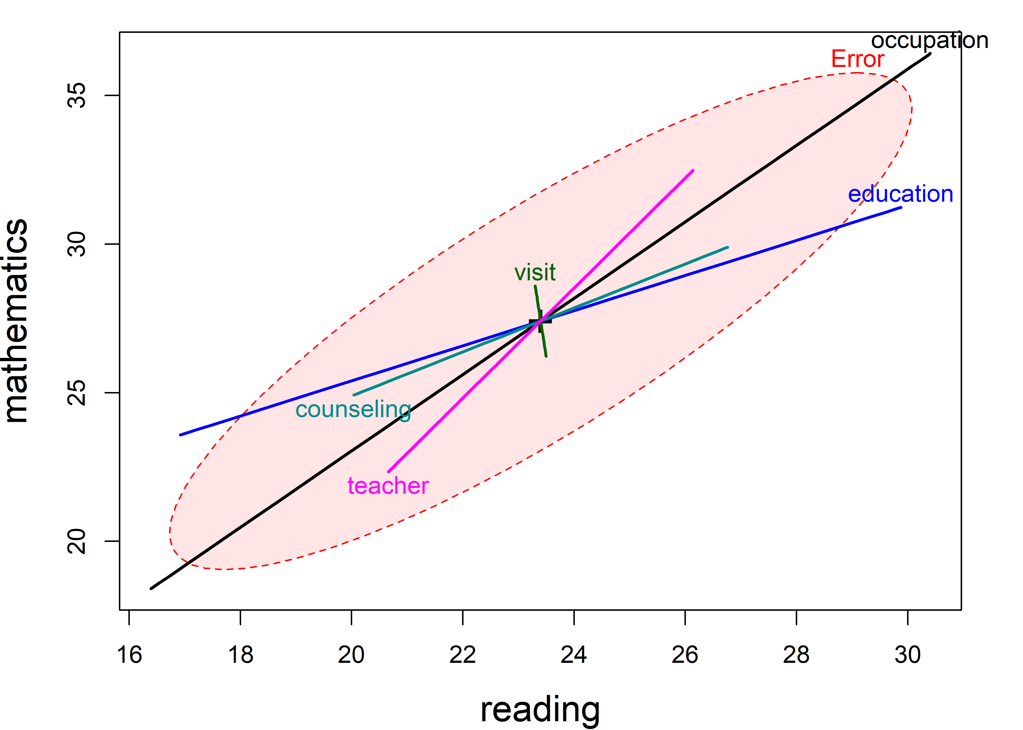
Visualizing Multivariate Data and Models in R
A Romance in Many Dimensions
Methodology & Statistics Group, Utrecht, 5 Nov. 2026
Michael Friendly, York University, friendly.github.io | datavis.ca
Notes:
Title slide. The talk is framed around the book of the same name.

Slide 2
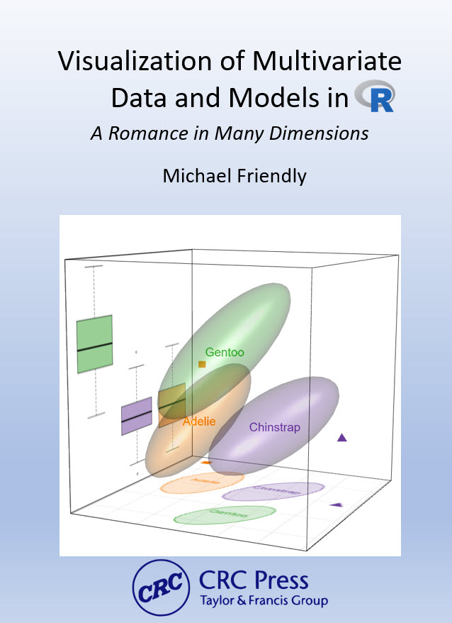
The book
Graphical methods for multivariate data and for multivariate linear models
15 chapters in four parts, from exploratory plots to MANOVA and discriminant analysis
To appear CRC Press / Chapman & Hall, 2027
Online version: friendly.github.io/Vis-MLM-book
Notes:
What the book is and where to find it. The online version has the animations and all the R code.

Slide 3
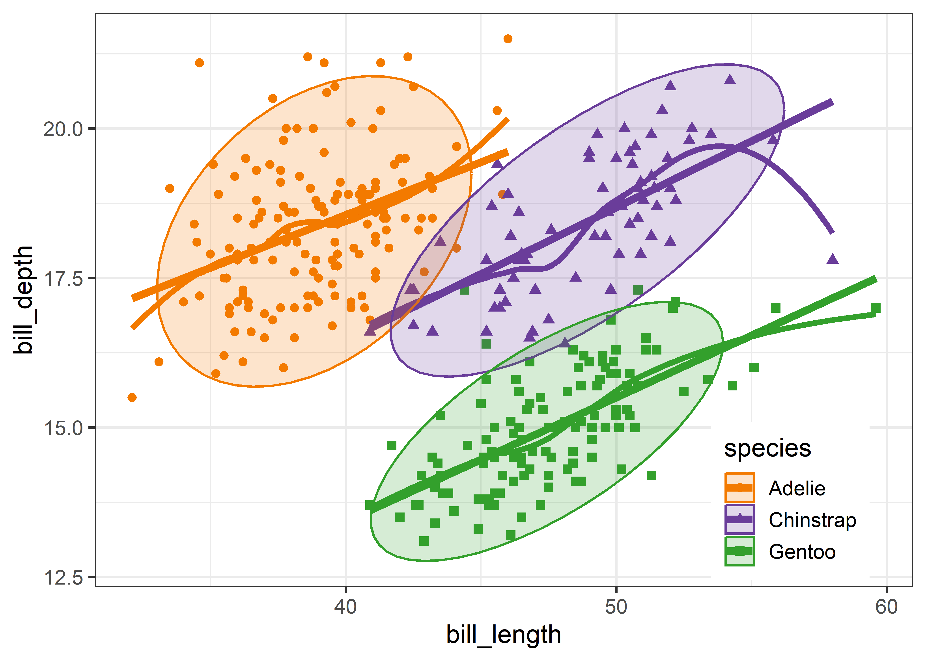
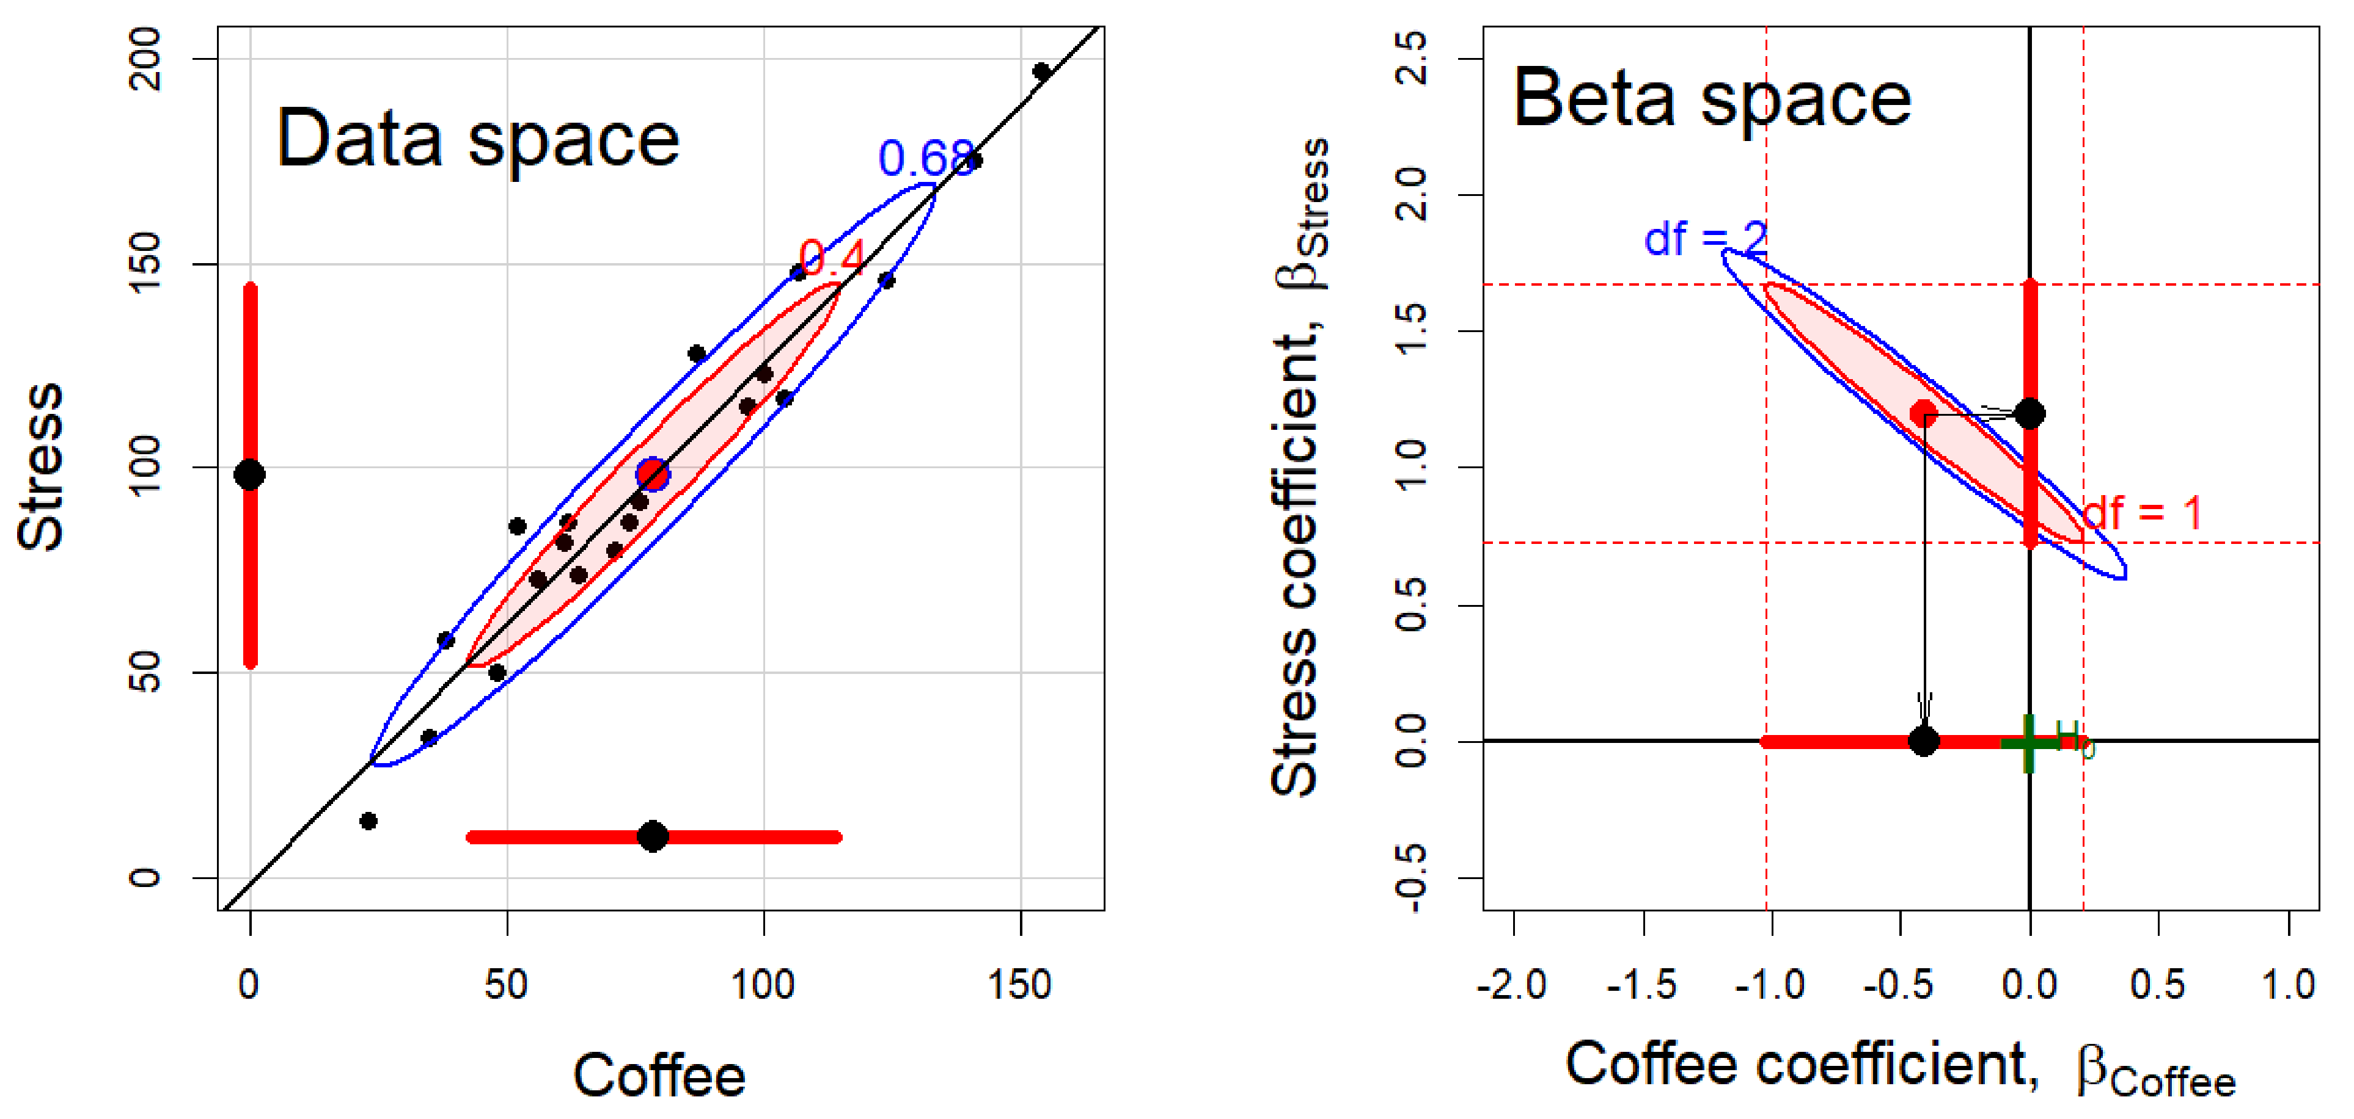
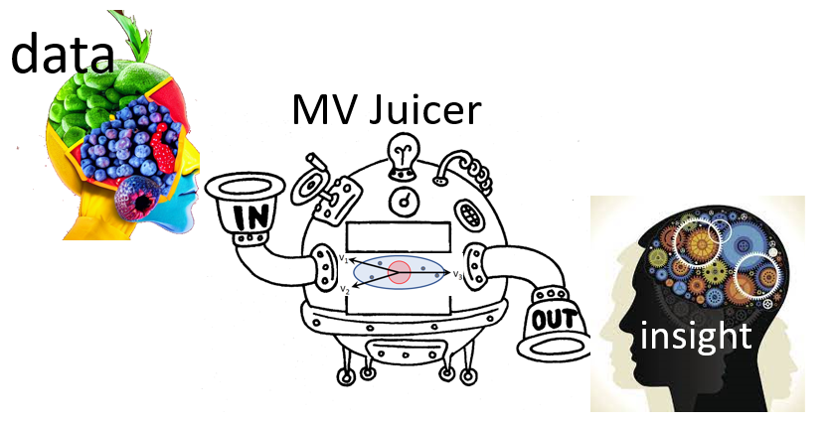
Key features of the book
Exposure and summarization
Plot the raw data, and plot statistical summaries (data ellipses, confidence ellipses) to highlight what should be noticed. Visual thinning balances the two.
Statistics ↔ geometry ↔ data visualization
Statistical ideas are easier to understand as geometry that can be seen in diagrams and data displays. Ideas from one domain amplify the others.
Dimension reduction as “multivariate juicers”
PCA and discriminant analysis squeeze high-dimensional data into informative 2D views. Sometimes the important information is in the smallest dimensions.
Notes:
From the Features section of the Preface. Three of the book's themes: (1) data visualization as a combination of exposure (plotting the raw data) and summarization (plotting statistical summaries), with visual thinning to balance them; (2) the connections among statistics, geometry and data visualization; (3) dimension reduction methods as 'multivariate juicers'.

Slide 4
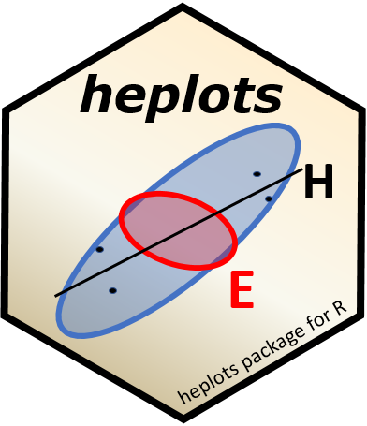
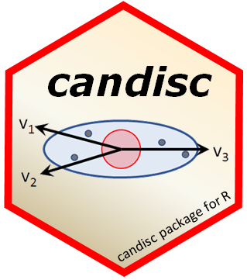

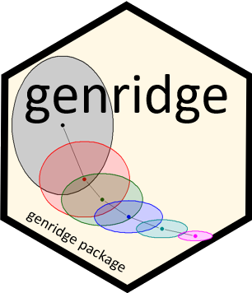
R packages
Theory → Practice: Making tools accessible
heplots
Visualizing hypothesis tests in multivariate linear models: HE plots, covariance ellipses, robust MLMs
candisc
Canonical discriminant and canonical correlation analysis: low-dimensional views of multivariate effects
mvinfluence
Influence measures and diagnostic plots for multivariate linear models
genridge
Generalized ridge trace plots: bias and precision in ridge regression
Notes:
Theory to practice: the methods in the book are only useful if people can apply them. These four packages implement most of what follows: heplots (HE plots and related methods), candisc (canonical views), mvinfluence (multivariate influence), genridge (ridge trace plots).

Slide 5
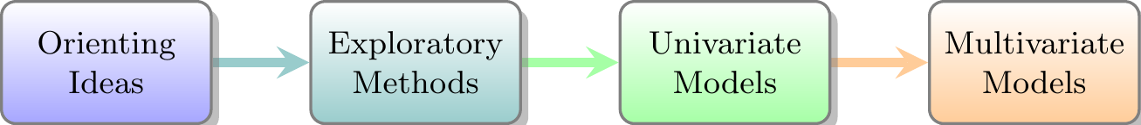
Where we are going
Why many dimensions?
Seeing multivariate data
Dimension reduction
Plots for models with one response
Collinearity and ridge regression
The HE plot framework for multivariate models
Checking multivariate models
Discriminant analysis: Flipped MANOVA
Notes:
Roadmap. The talk follows the book: plots of data, then models with one response, then models with many responses. The ellipse is the recurring device.

Slide 6
Why a romance in many dimensions?
We live in Spaceland, sometimes high-D, but we plot in Flatland

Slide 7
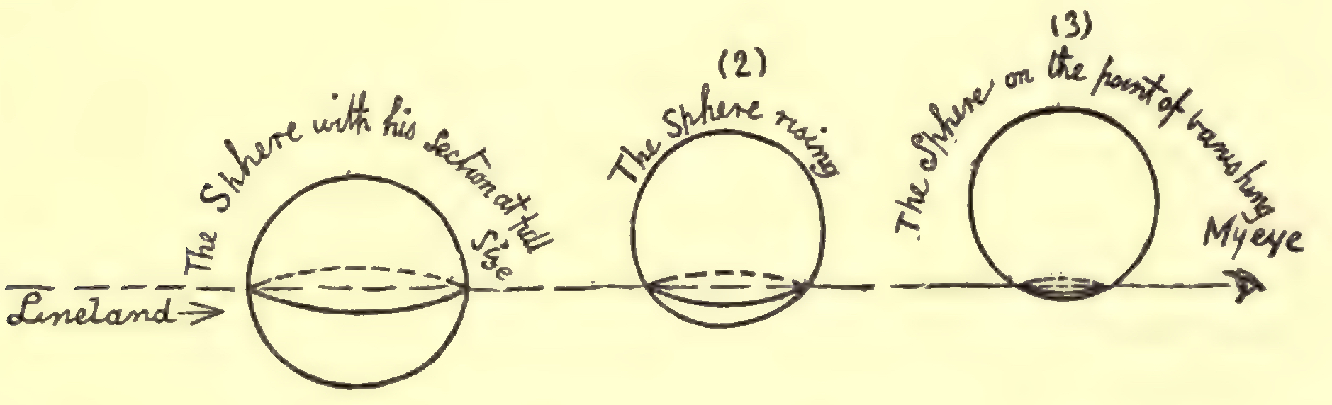
Flatland: we only ever see 2D projections
Abbott's Flatland (1884): a sphere passing through a 2D world is seen as a circle that grows and shrinks
Our 2D plots are Flatland views of data that live in many dimensions
Multivariate visualization is the art of choosing good views
Datavis is the art of making plots informative
That’s the Romance!
Figure 1.1
Notes:
The book's subtitle is a nod to Abbott's 'Flatland: A Romance of Many Dimensions'. The Flatlander sees only a slice of the sphere. We are in the same position with p > 2 variables.

Slide 8
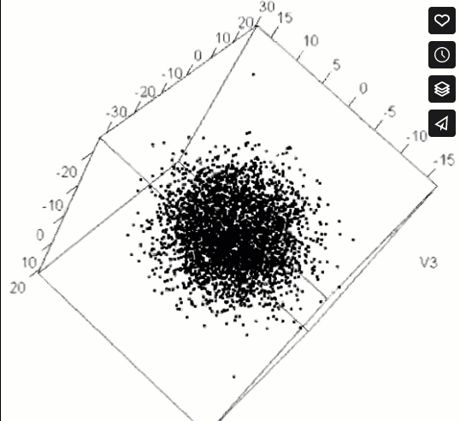
EUREKA! Structure can hide in many dimensions
HistData::pollen, from the 1986 JSM Data Exposition: “Find something interesting here”
Zooming in on the right view reveals what no summary statistic could ever do
Figure 1.5
Notes:
Animation (plays in slide show mode). The pollen data look like a featureless cloud until you zoom in on the dense center, where the points spell out a word.

Slide 9
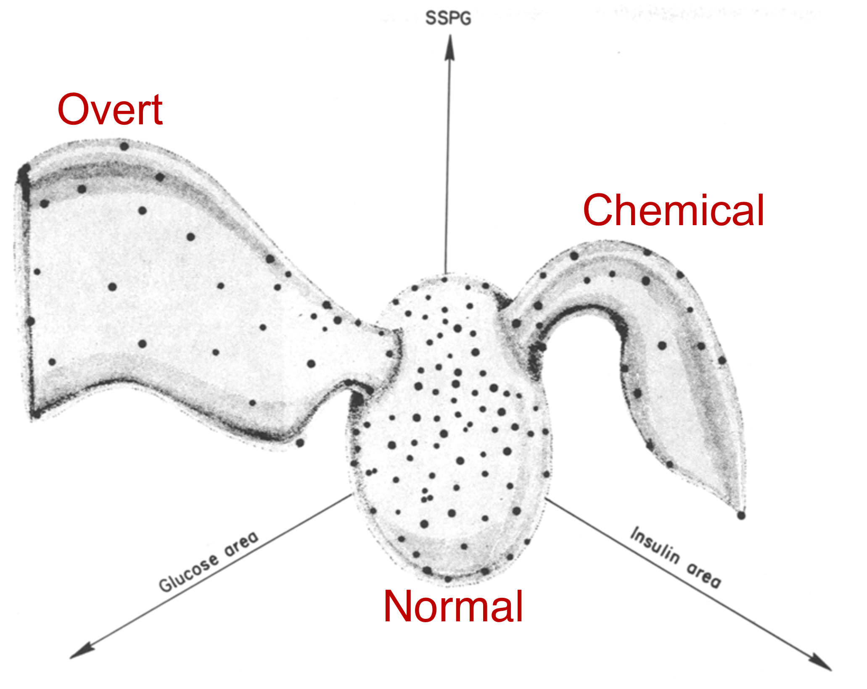
A multivariate discovery: kinds of diabetes
Reaven & Miller (1979) viewed glucose and insulin measures in 3D with PRIM-9
The 3D view showed distinct groups that 2D plots had obscured
The picture changed how the disease was classified
Figure 1.7
Notes:
An example of a scientific discovery that came from looking at data in more than two dimensions. The Diabetes data come back later in the dimension reduction section.

Slide 10
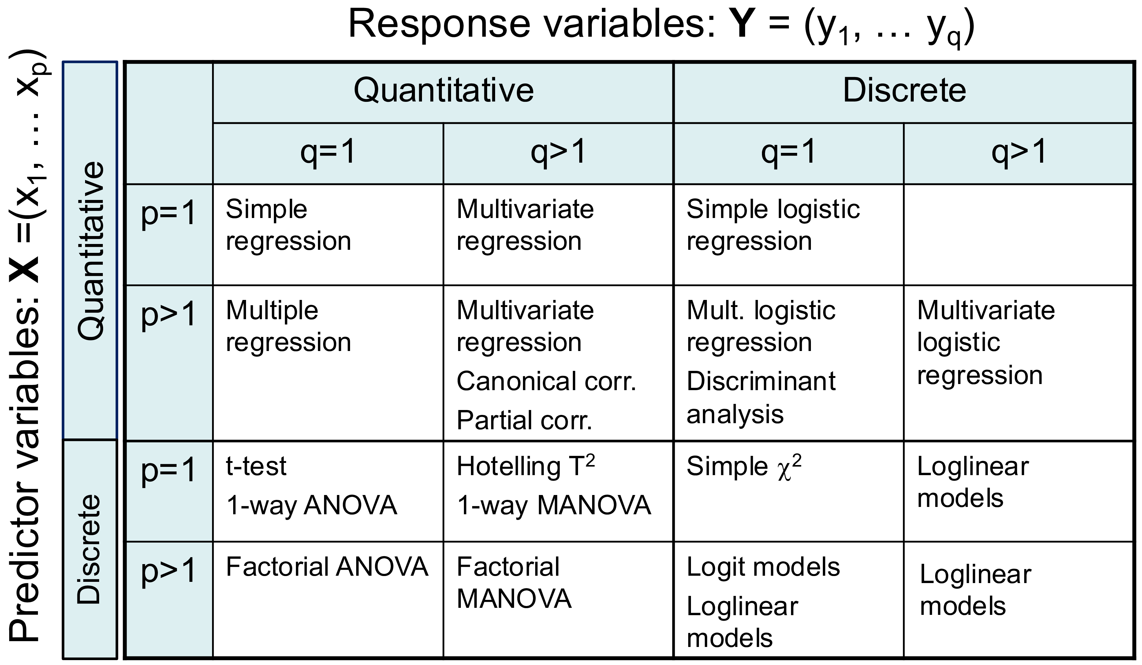
The problem: easy to fit, hard to see
With one response, we have a rich toolkit of plots for linear models
With several responses, lm(cbind(y1, y2, y3) ~ ...) is just as easy to fit
Math is easy too: y ⤳ Y
But the results arrive as tables of multivariate tests
Goal: plots that show what those tests mean, visual inference?
Figure 6.1
Notes:
The table classifies linear model techniques by the number and type of responses and predictors. The right-hand column, multivariate responses, is where graphical methods have been thin.

Slide 11

Seeing multivariate data
Data ellipses, penguins, and looking at many variables at once

Slide 12
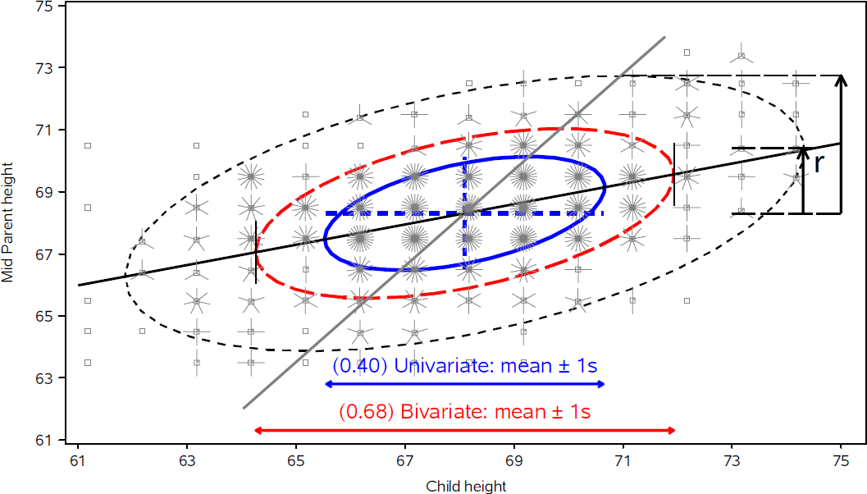
The data ellipse summarizes means, spread & correlation – a sufficient visual summary for N(µ, Σ)
Ellipsoid boundary: Mahalanobis D_{M}² (y_{i}) ~ χ_{p}²
  p=2: shadows generalize univariate confidence intervals
  eccentricity: precision; visual estimate of correlation
r ≈ 0.5 here
Notes:
Galton's data on the heights of parents and children (from the short course, lecture 2). Data ellipses of 50%, 68% and 95% coverage. The ellipse is the workhorse of the book: the same idea returns as confidence ellipses for coefficients and as H and E ellipses for multivariate tests.

Slide 13
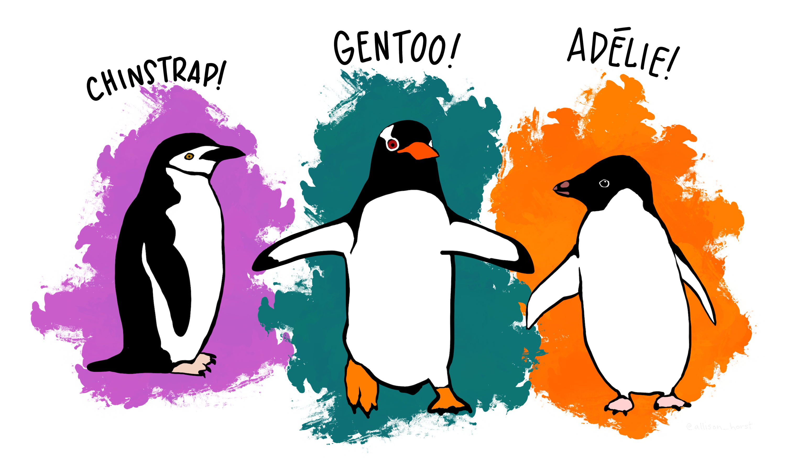
Meet the penguins
Three species, four size measures: bill length, bill depth, flipper length, body mass. Artwork: Allison Horst.
Figure 4.17, 4.19
Notes:
The Palmer penguins are the running example. Here: bill length and bill depth with data ellipses and regression lines for each species.

Slide 14
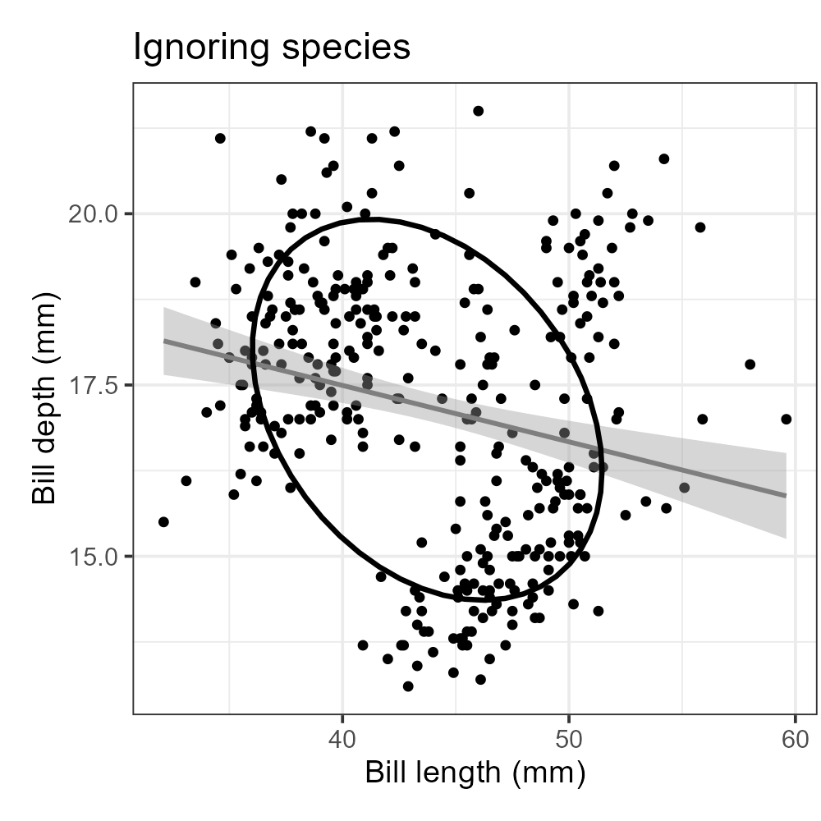
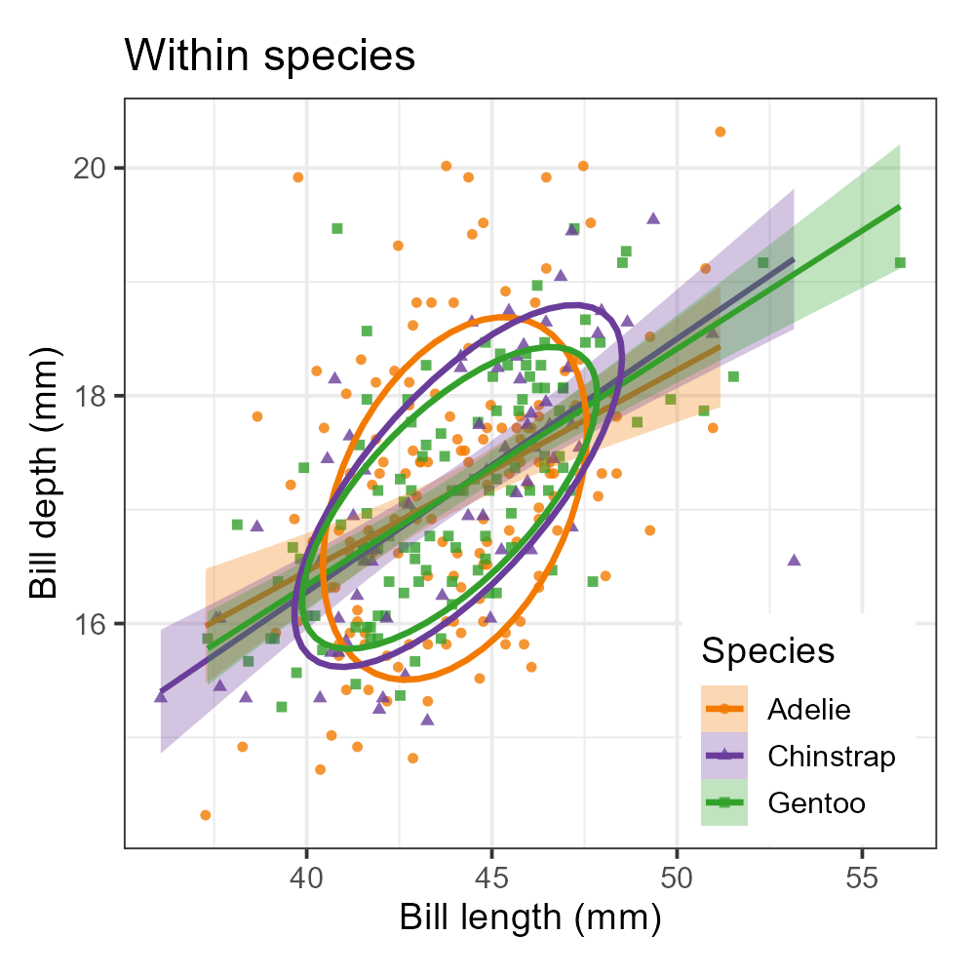
Simpson's paradox: marginal & conditional relations
Ignoring species, longer bills are shallower
By species, relation is positive for each
Within species shows diffs in slopes & covariances
Figure 4.23
Notes:
Panels: (a) ignoring species, (b) by species, (c) pooled within species. The data ellipses make the reversal immediate.

Slide 15
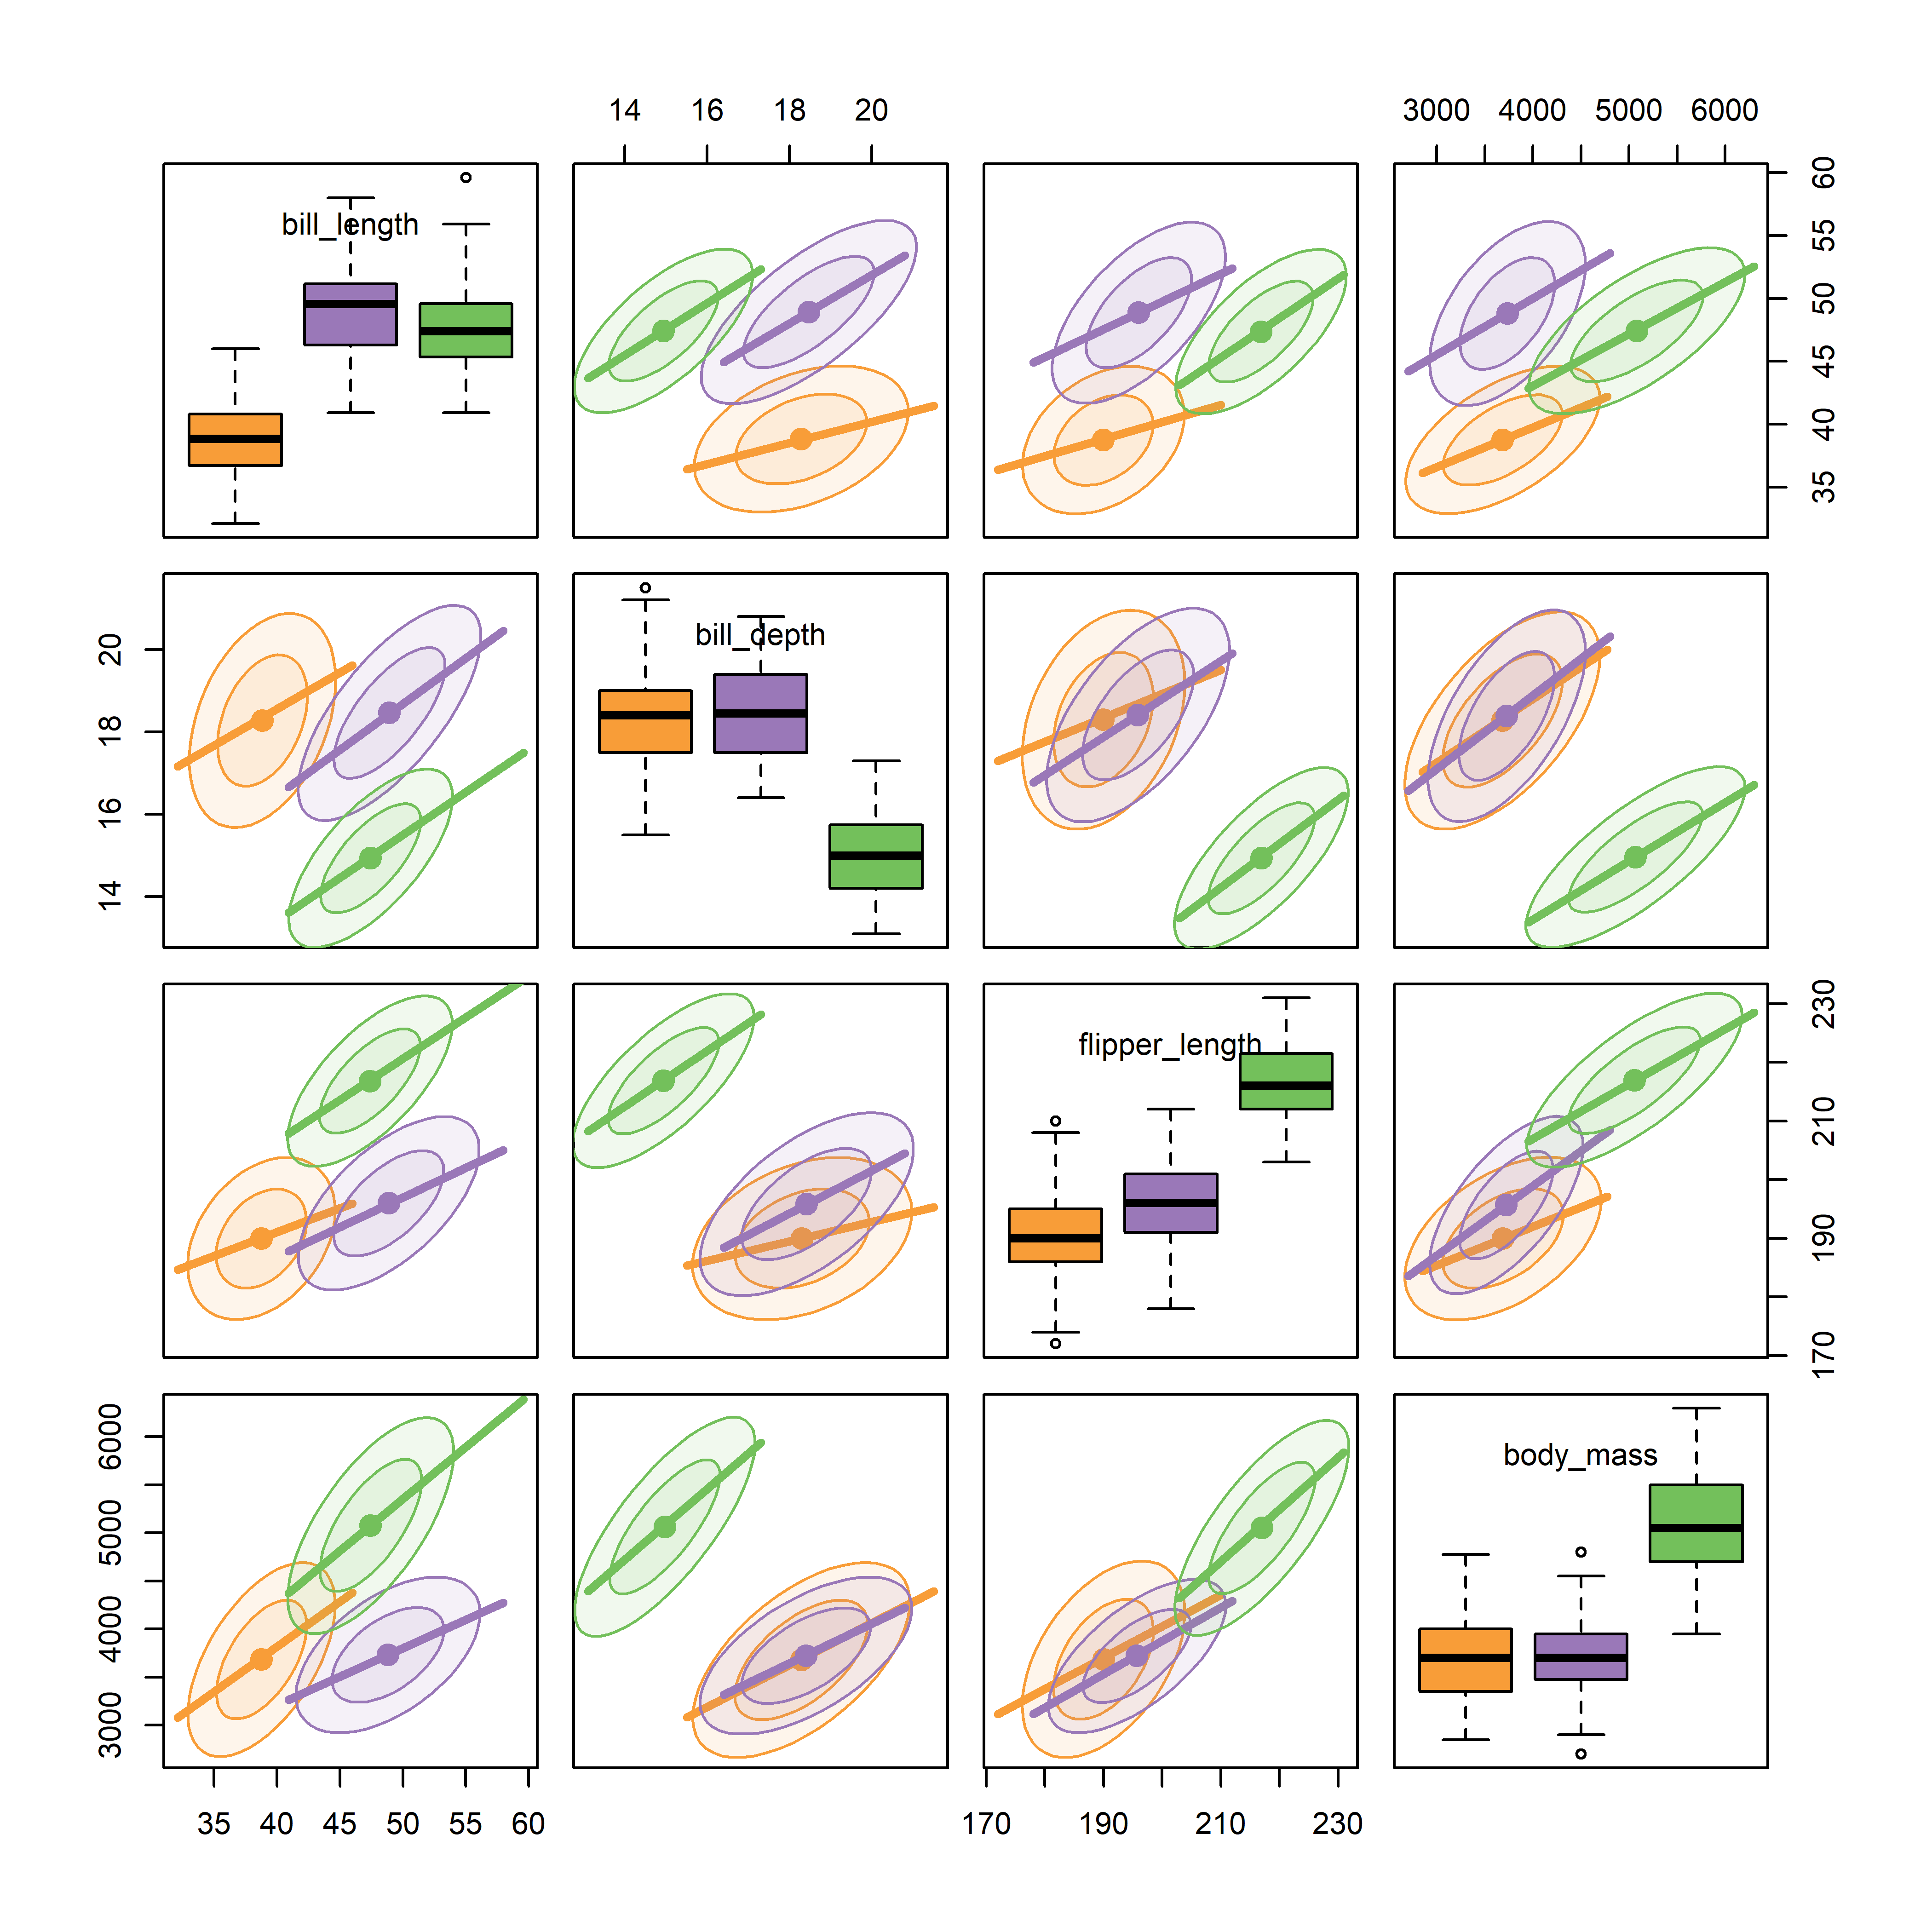
How to visualize p > 2 variables in Flatland?
Scatterplot matrices: all pairs at once
Every pairwise view in one display
Data ellipses & regression lines by species
Works well up to a moderate number of variables
Visual thinning: data → ellipses + regression lines
Figure 4.31
Notes:
Scatterplot matrix of the quantitative penguin variables.

Slide 16
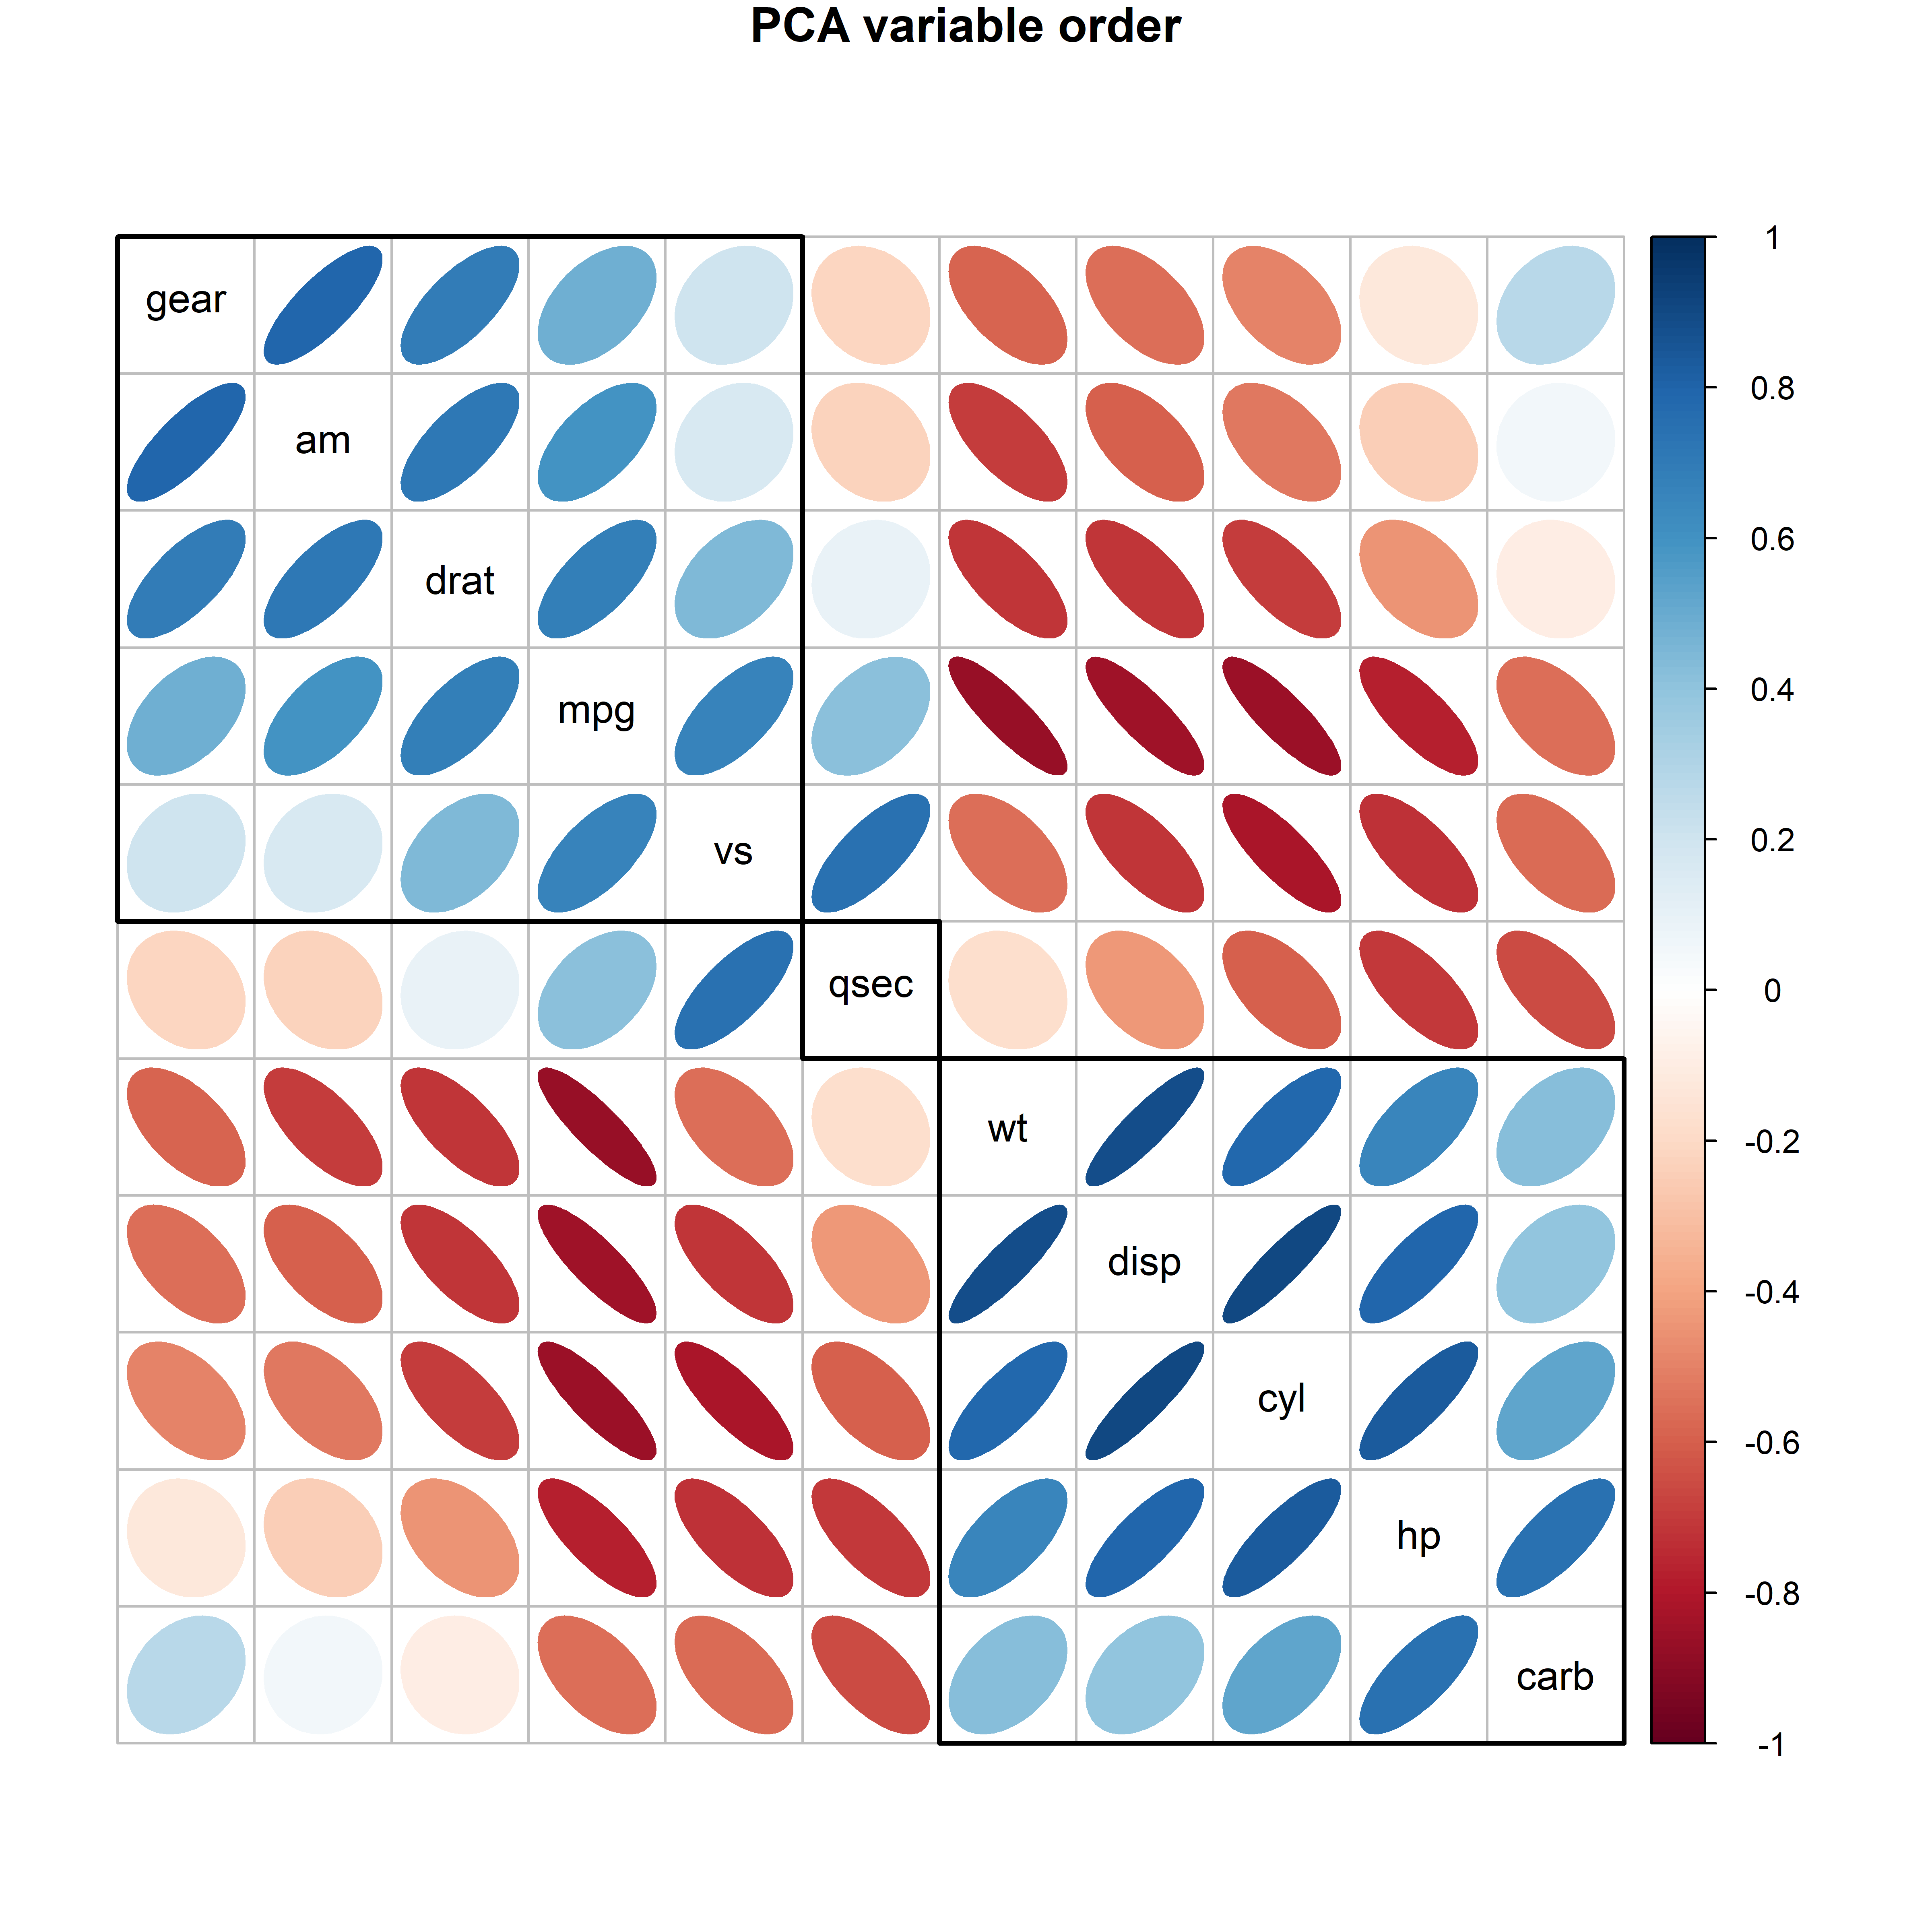
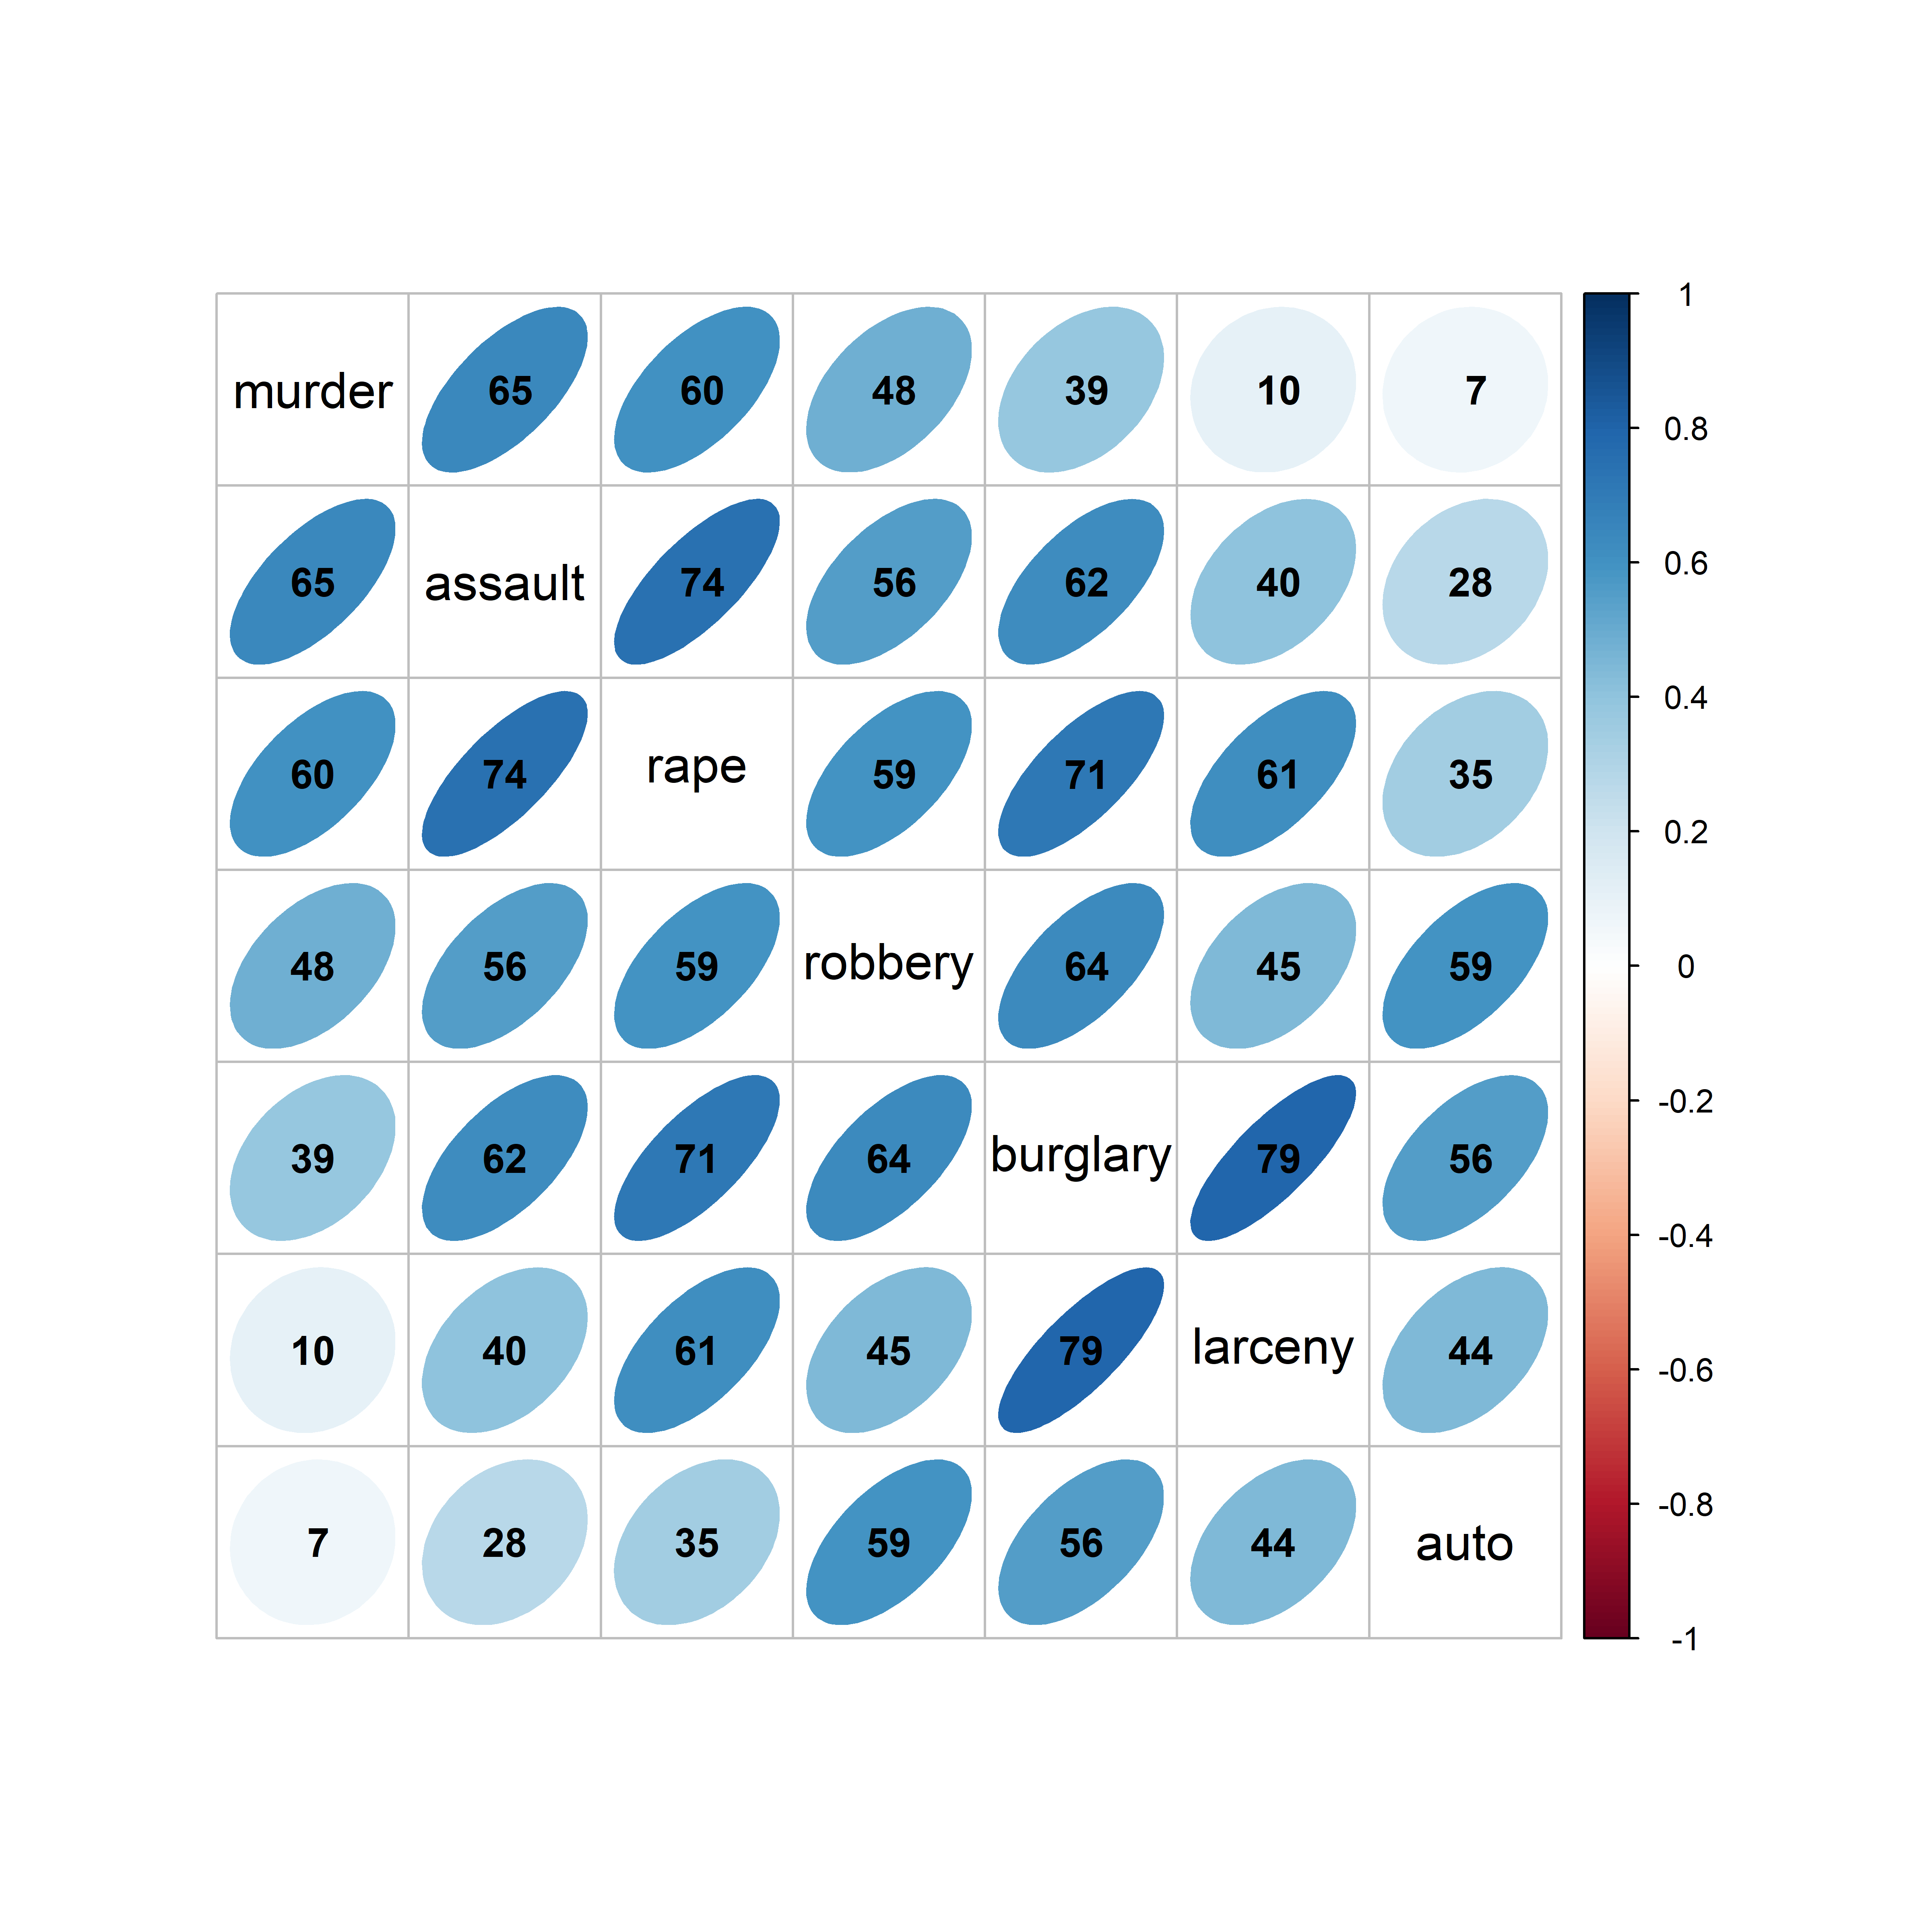
Visual thinning: show less to see more
Effect order: order variables to see what you want to show
With many variables, replace the points by a rendering of each correlation
Order the variables so that similar ones are adjacent
Here: ordered by the angles of the variable vectors from a PCA
Notes:
Corrplot of the crime data, with variables reordered. The ordering idea is taken up again under PCA.

Slide 17
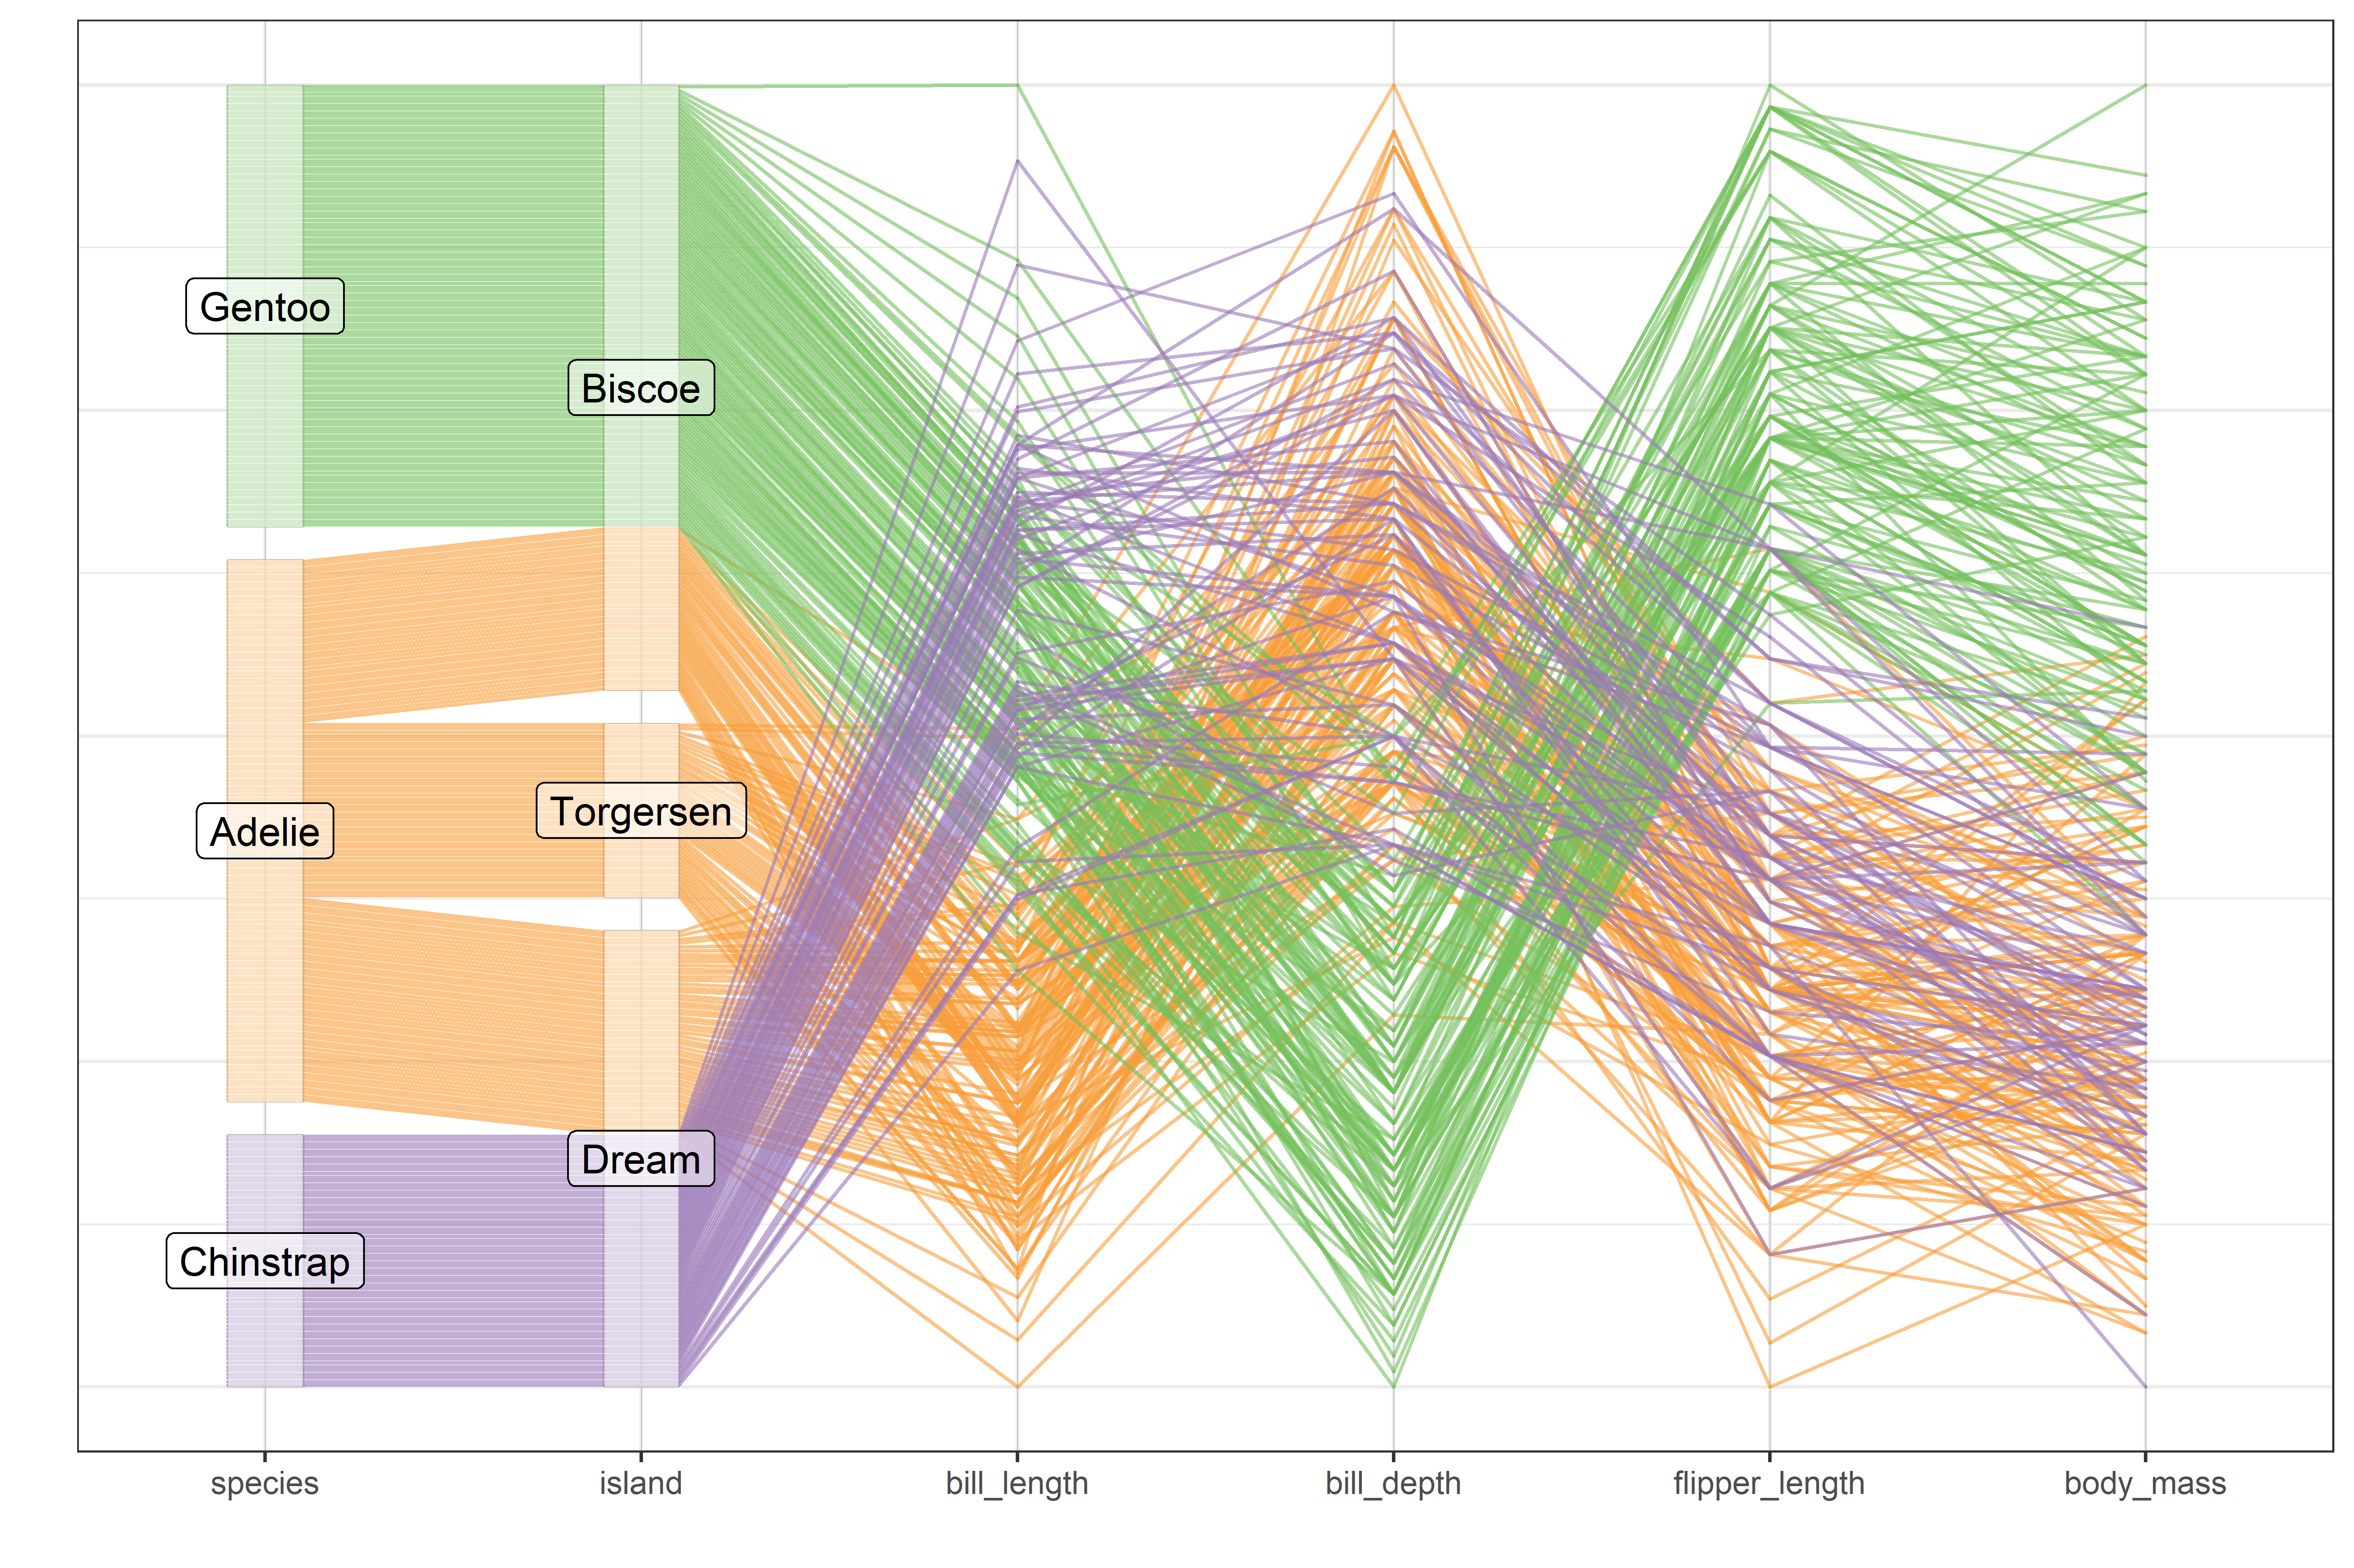
Parallel coordinates: one line per penguin
Each observation is a line across the variable axes
Groups appear as bundles
Easy to extend to more variables
Figure 4.40
Notes:
[OPTIONAL for a 45-minute talk] Parallel coordinates plot of the penguin size variables, colored by species.

Slide 18
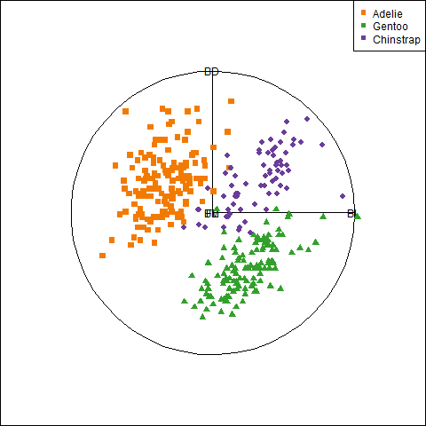
Animated tours: moving through projections
Animation adds one more dimension to what we can see
A grand tour shows a smooth sequence of 2D projections
As in biplot, variable vectors show where you are
A guided tour steers toward interesting ones.
Optimize an index: separation of groups, anomalies
Notes:
Animation (plays in slide show mode): grand tour of the penguin data. Guided tours optimize an index, e.g. separation of groups or the presence of anomalies.

Slide 19
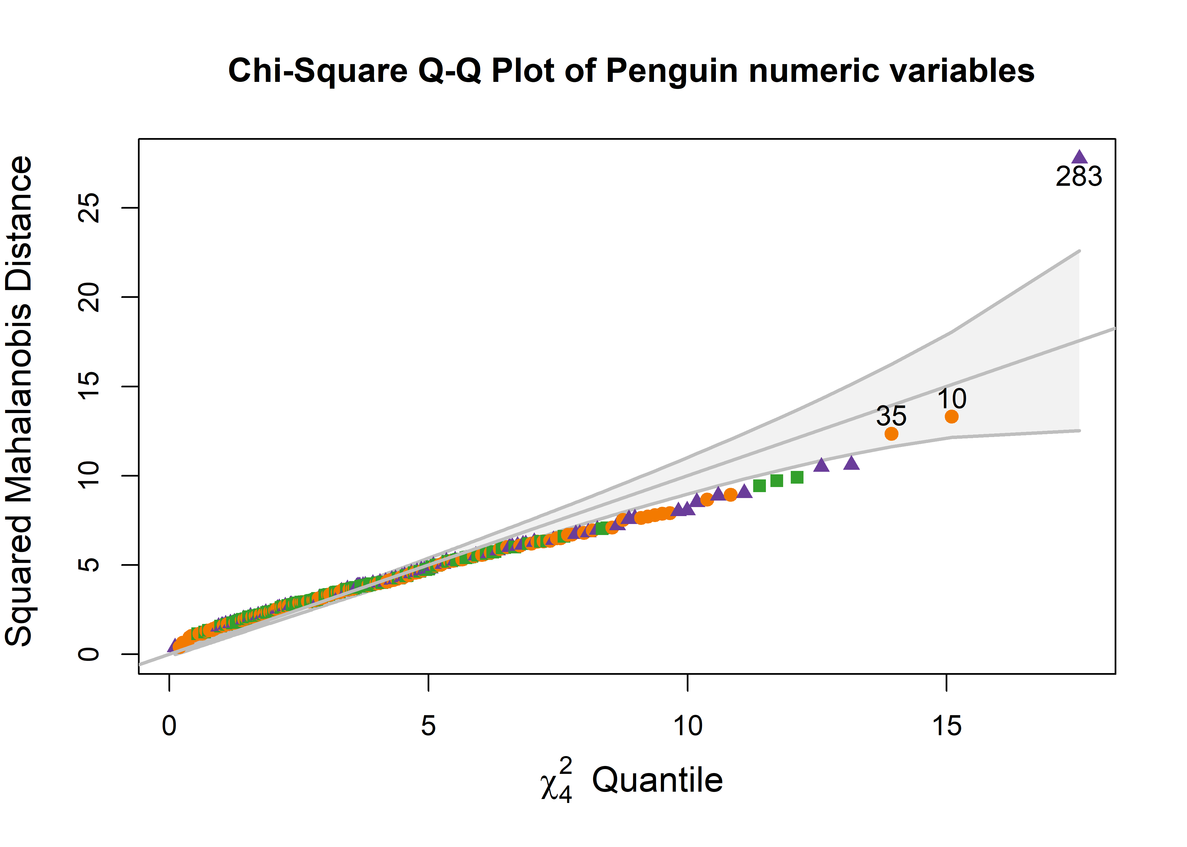
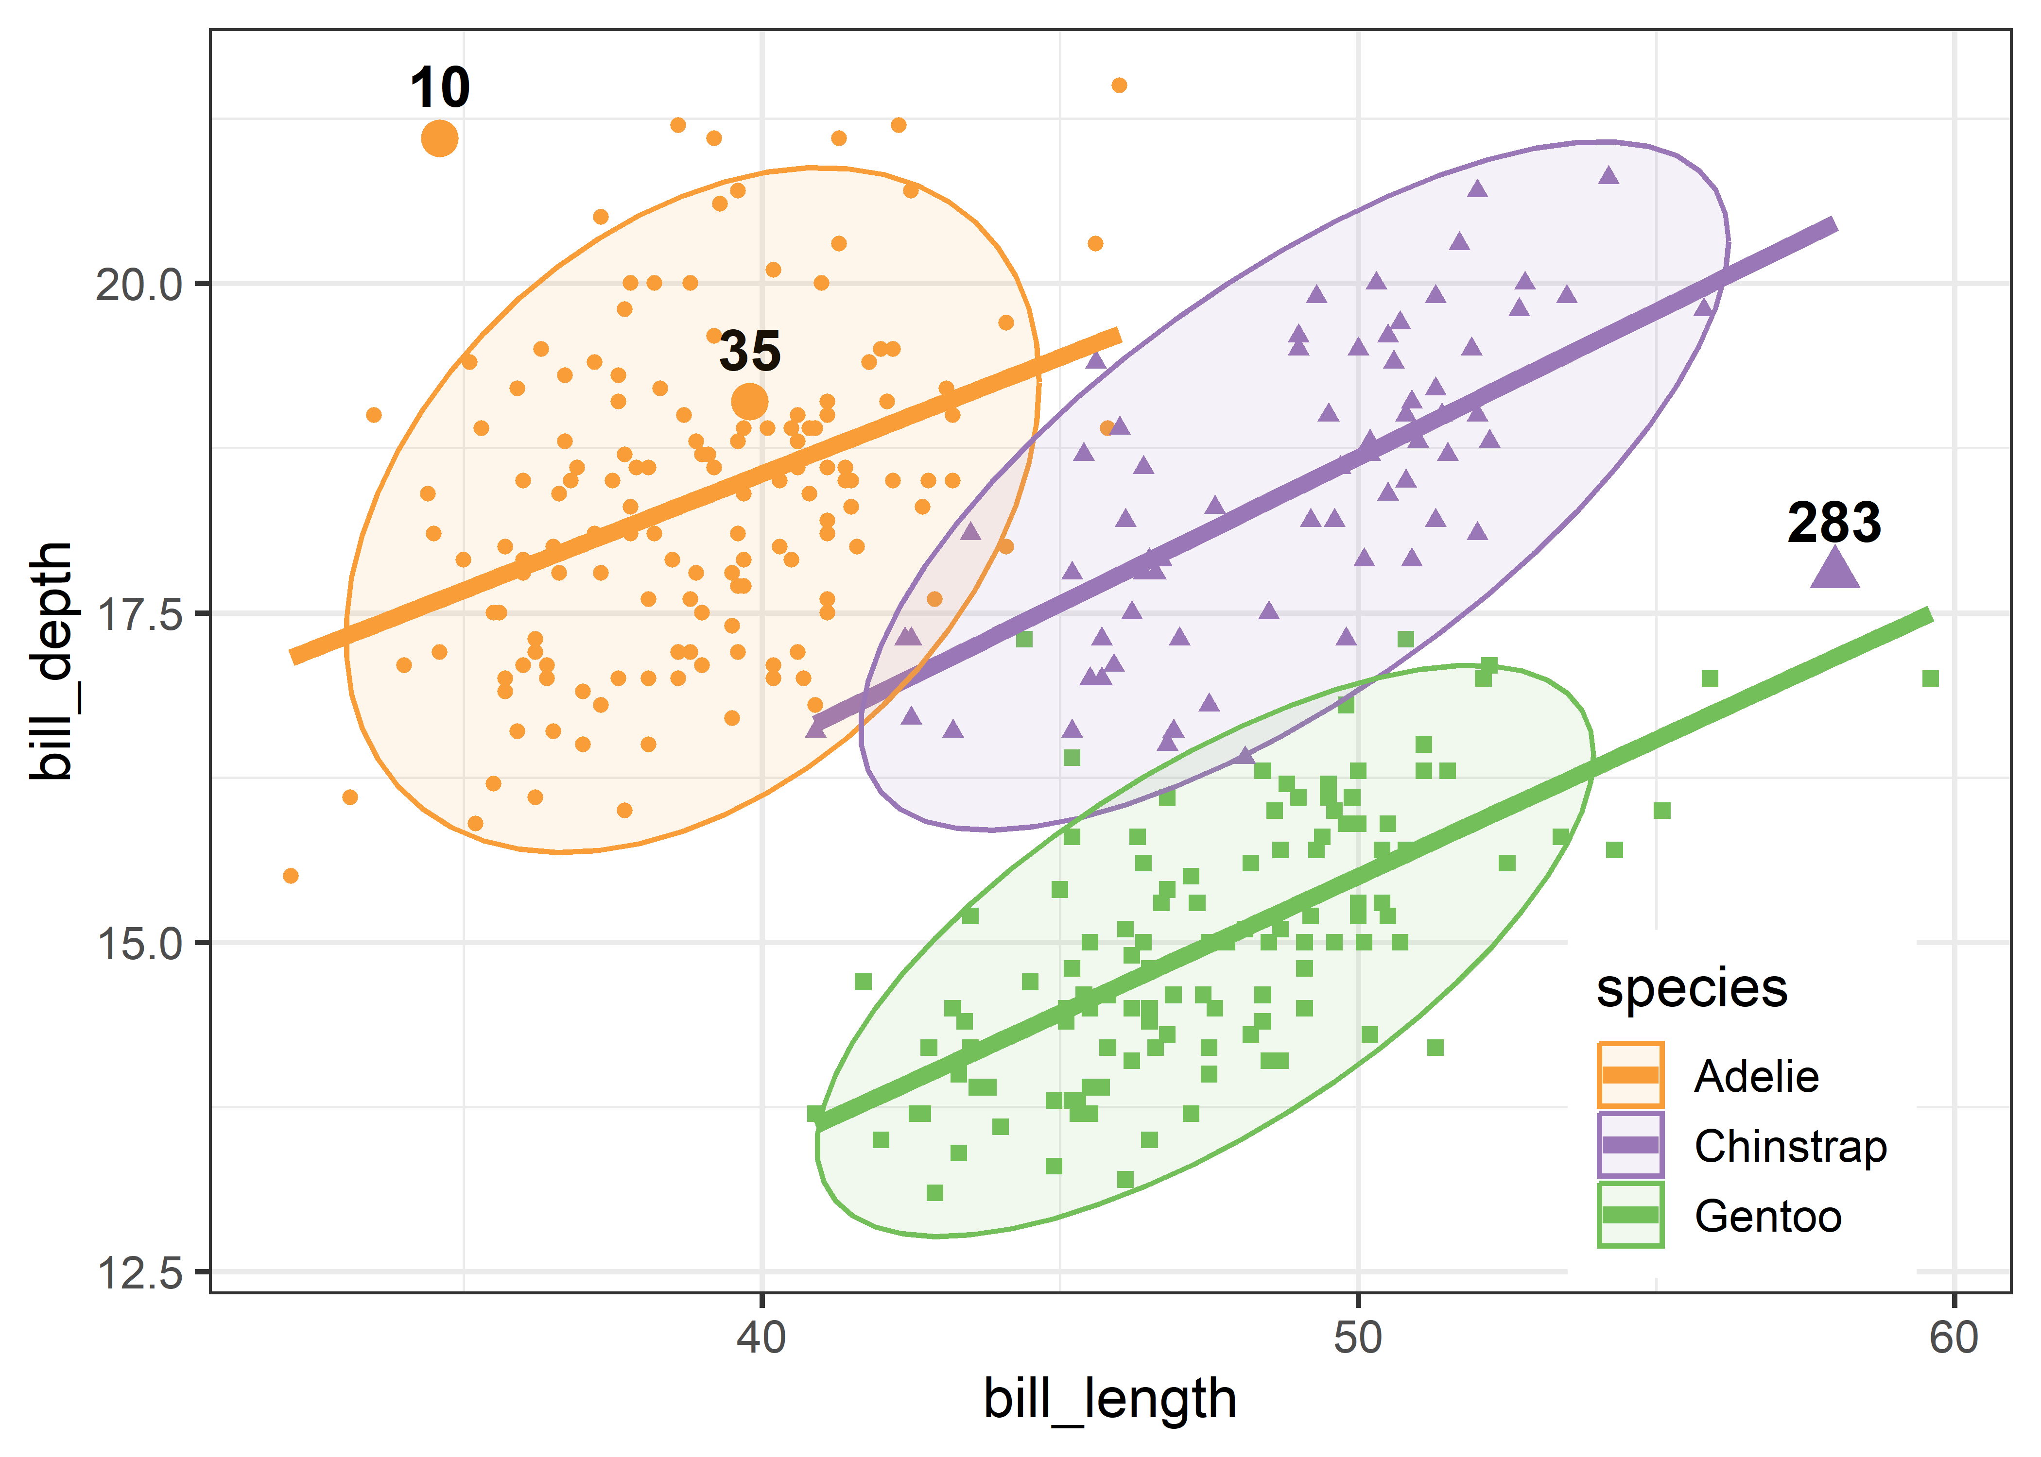
Multivariate outliers: which penguins are unusual?
Hook Nose
Cyrano
Squared Mahalanobis distances against chi-square quantiles. We will meet these birds again.
Figure 4.26, 4.27
Notes:
[OPTIONAL for a 45-minute talk] Chi-square QQ plot for the penguin data, and the unusual birds identified in the bill length-bill depth plot. Two of them, nicknamed Cyrano and Hook Nose, come back in the influence and robust sections.

Slide 20
Flatland and Spaceland: dimension reduction
PCA, biplots, and nonlinear methods

Slide 21
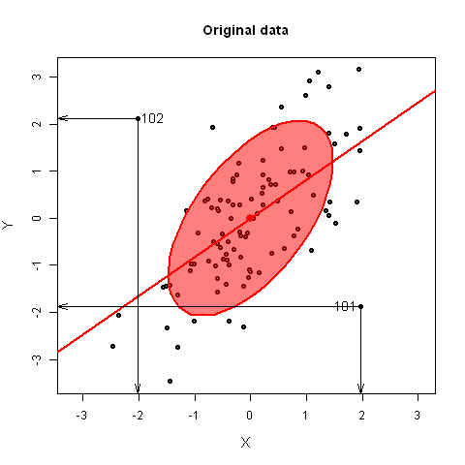
PCA: rotate to the views that show the most variance
PCA is a rotation of the axes: PC1 lies along the direction of greatest variance, PC2 is orthogonal to it.
Outliers typically appear on the smallest dimensions
Figure 5.35
Notes:
Animation (plays in slide show mode): rotation from data space to PCA space, with two added points (101, 102). They are not extreme on either original variable, but stand out on the smallest principal component. Geometry of PCA as a rotation. Tie back to the data ellipse: its major and minor axes are PC1 and PC2.

Slide 22
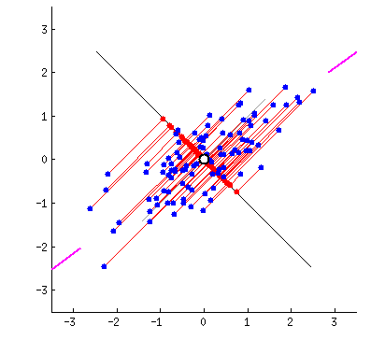
PCA fitted by springs: Physical analog
Least squares ↔ observations connected by springs
For PCA, connect a rigid line to the points by springs
Springs pull the line in proportion to squared distance
It settles on the first principal component
Figure 5.5
Notes:
Animation (plays in slide show mode). The blue points are connected to their projections on the red line by springs perpendicular to that line. A physical intuition for least squares. One of the figures the organizer singled out.

Slide 23

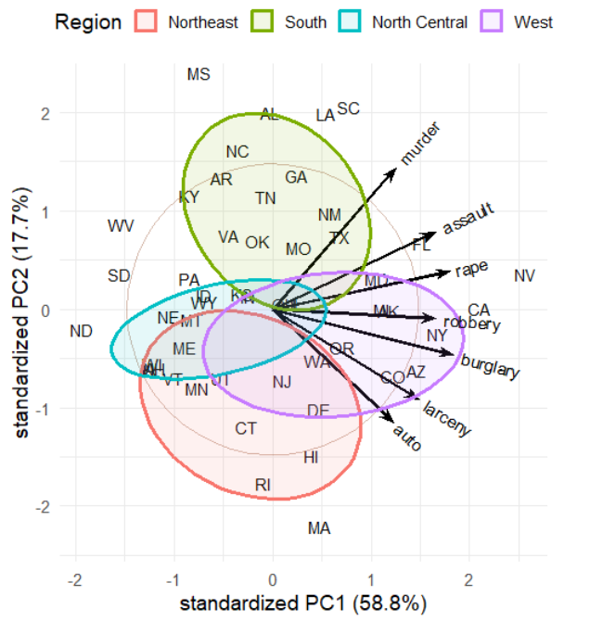
Biplots: observations and variables in one view
Points: observations (US states) in the PC1-PC2 plane
Vectors: variables (crime rates)
  Angles between vectors approximate correlations
  Projecting a point on a vector approximates its value on that variable
Interpretation:
  PC1: Overall crime rate
  PC2: Personal vs. property crime
  Region: summarizes diffs
Figure 5.14
Notes:
Basic biplot of the crime data. The biplot is the low-D view used again and again: for collinearity, for canonical discriminant analysis, and for ridge regression.

Slide 24
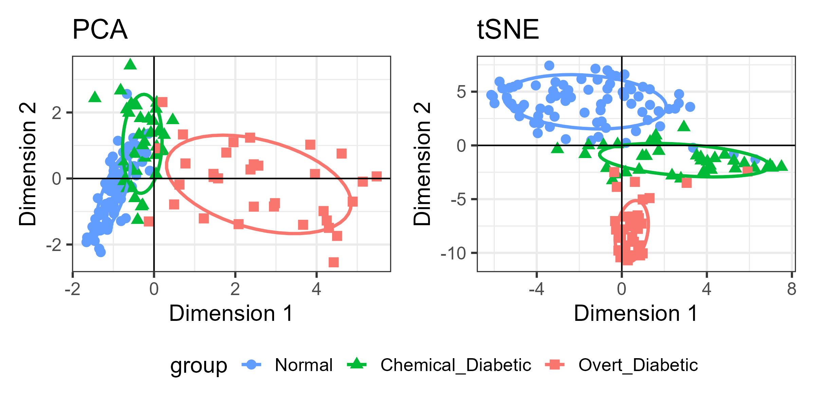
When a linear view is not enough: PCA vs t-SNE
t-SNE separates the Diabetes groups more cleanly, but distances and axes no longer have a direct meaning.
Figure 5.25
Notes:
Comparison of the PCA and t-SNE 2D representations of the Diabetes data. Nonlinear methods preserve local neighborhoods at the cost of global geometry.

Slide 25
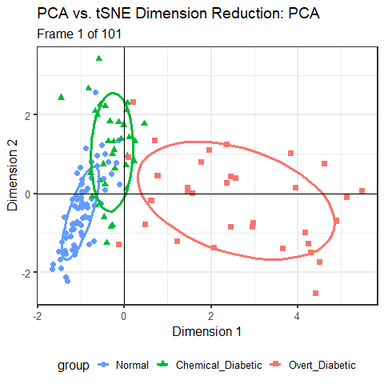
From PCA to t-SNE, animated
We can better understand algorithms visually by animating a smooth interpolation from one to another
Here, the PCA configuration morphs into the t-SNE one largely by a rotation.
But t-SNE achieves wider separation among groups
The data ellipses here carry the visual message.
Figure 5.26
Notes:
Animation (plays in slide show mode): interpolating between the PCA and t-SNE solutions for the Diabetes data. One of the figures the organizer singled out.

Slide 26
Application: effect ordering variables in displays
The same correlations of the mtcars data: in dataset order (left) and in PCA order (right).
Figure 5.27, 5.29
Notes:
[OPTIONAL for a 45-minute talk] Ordering variables by their angles in the biplot puts similar variables together and makes the pattern visible.

Slide 27
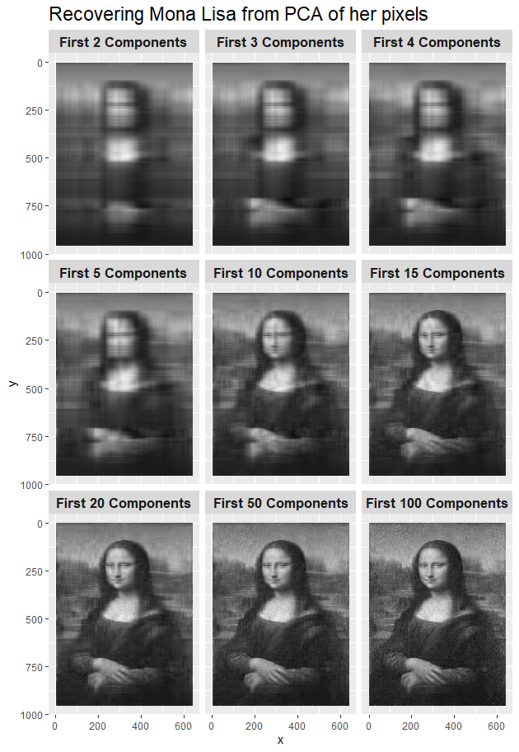
Application: how many dimensions is the Mona Lisa?
Reconstructions from a few principal components: image compression as dimension reduction.
Figure 5.33
Notes:
[OPTIONAL for a 45-minute talk] Re-construction of the Mona Lisa from increasing numbers of components (the eigenfaces idea).

Slide 28
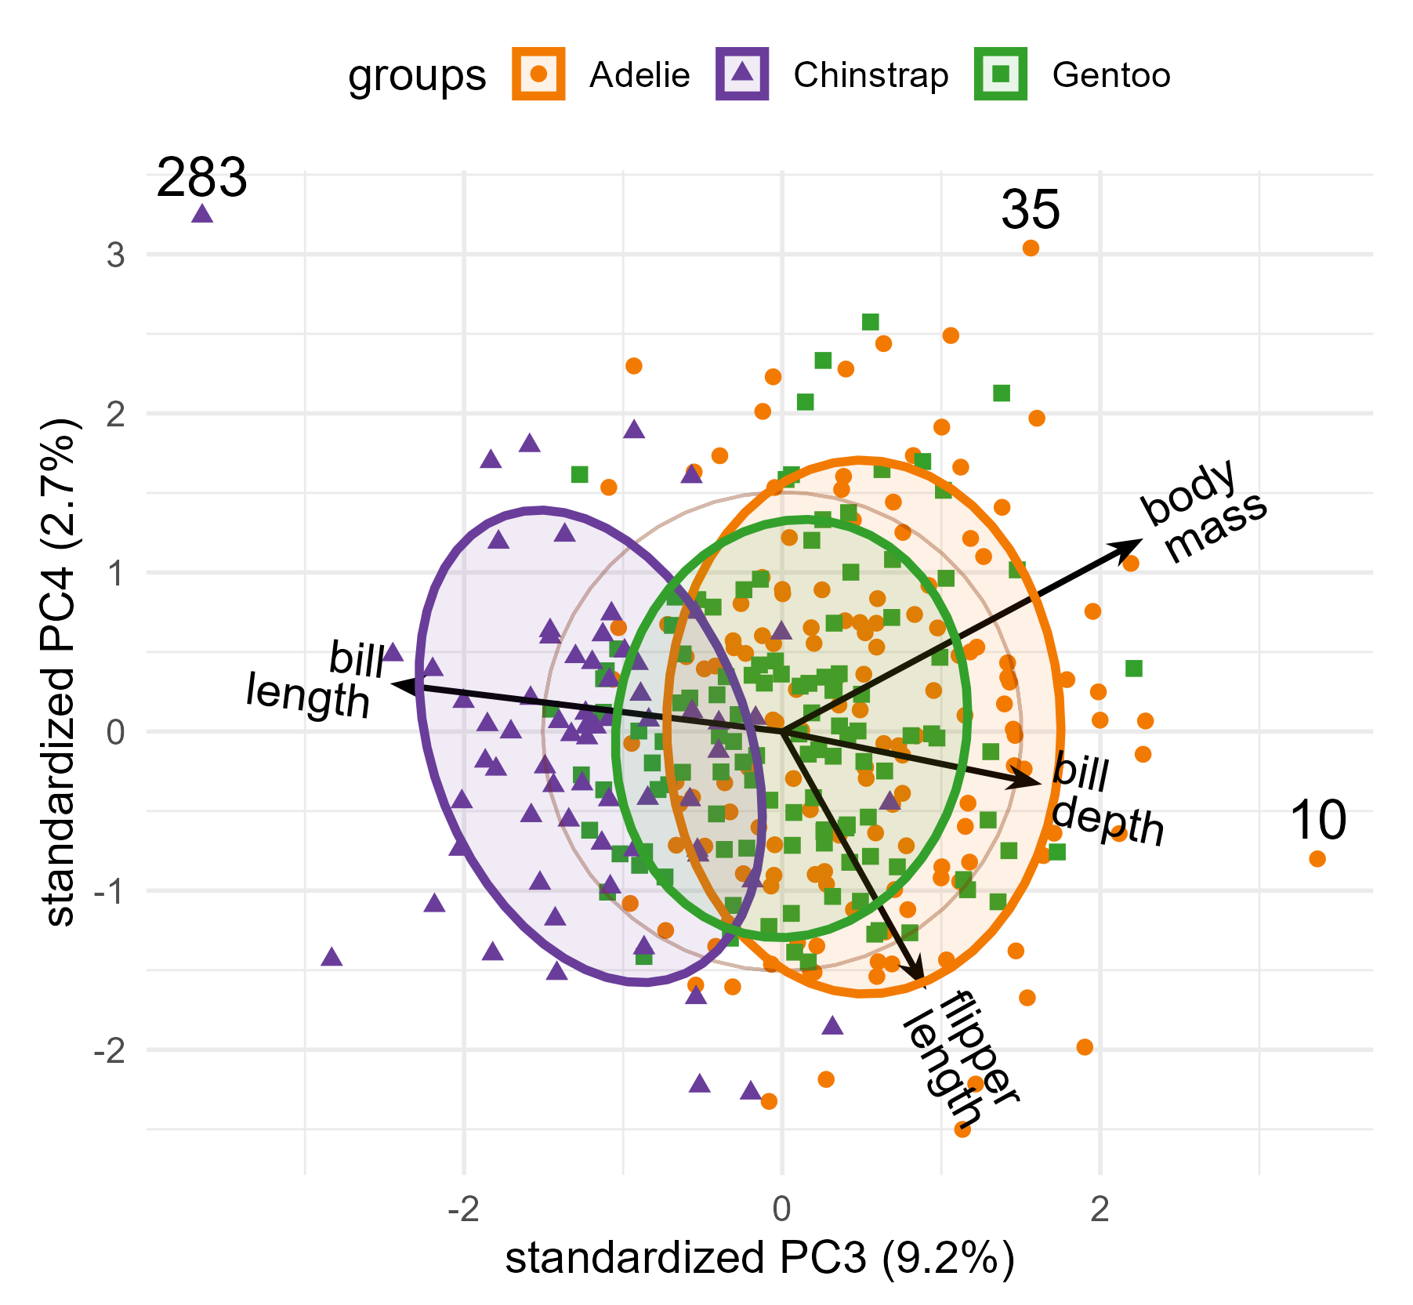
Outliers hide in the smallest dimensions
The first two dimensions show what is typical
The last dimensions show what does not fit the pattern
Biplot of dimensions 3-4 of the penguin data
  Variable vectors show relations to dimensions
  Ellipses show diffs among groups
Cyrano
Hook Nose
Figure 5.37
Notes:
[OPTIONAL for a 45-minute talk] An 'elliptical insight': multivariate outliers often show up in the dimensions with the least variance.

Slide 29
Plots for models with one response
What we already do well, and want to carry over

Slide 30
The regression quartet
Residuals vs. fitted: nonlinearity
Normal QQ: distribution of residuals
Scale-location: non-constant variance
Residuals vs. leverage: influential cases
Figure 7.2
Notes:
The four standard diagnostic plots, here for Duncan's data on the prestige of occupations predicted from income and education.

Slide 31
Coefficient plots: show the estimates, not a table
Estimates with confidence intervals
Standardize, or the scales of the predictors dominate the picture
Easy to compare several models
Figure 7.7
Notes:
Plot of standardized coefficients and their confidence intervals.

Slide 32
Added-variable plots show partial relationships
Coffee, stress and heart damage: the marginal and the partial slope for coffee have opposite signs.
Figure 7.12
Notes:
Marginal + conditional (added-variable) plots for the coffee data, a contrived example constructed by Georges Monette. Each added-variable plot shows the relation of y to one predictor with the others partialled out; the slope is the coefficient in the full model.

Slide 33
Effect displays: what the model predicts
Fitted values for each predictor, averaging over the others.
Figure 7.17
Notes:
[OPTIONAL for a 45-minute talk] Predictor effect plots for all terms in the model for the Prestige data.

Slide 34
Leverage and influence
Leverage: unusual in the predictors
Outlier: a large residual
Influence = leverage x residual
Bubble size: Cook's distance
Figure 7.26
Notes:
Influence plot for the Duncan model. Minister and conductor stand out.

Slide 35
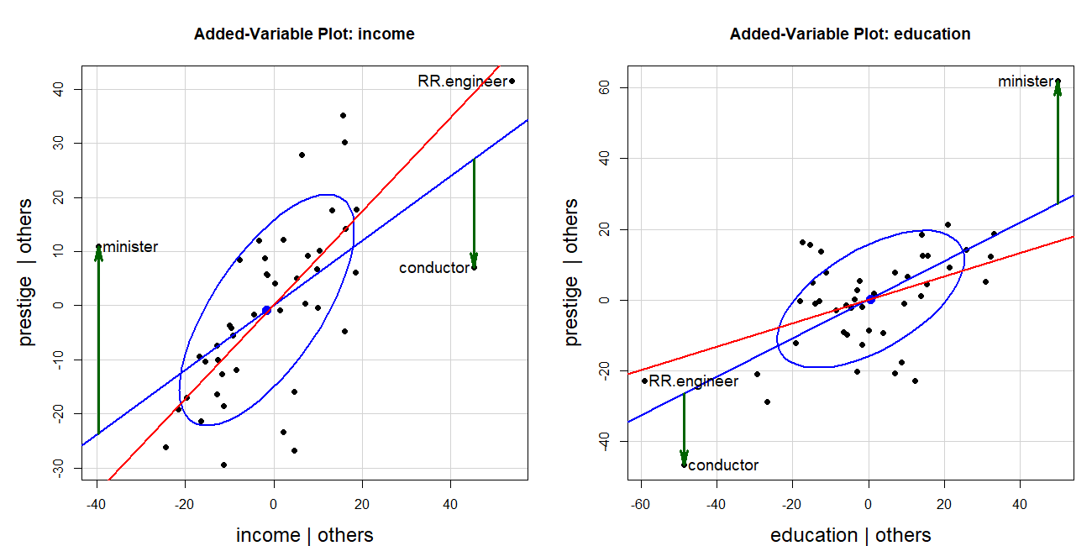
Which observations drive the fit?
Green: the residuals for minister and conductor. Red: the fitted line with those two cases omitted.
Figure 7.27
Notes:
One of the figures the organizer singled out. The two occupations pull the income and education slopes in opposite directions.

Slide 36
Data space and beta space are dual
The confidence ellipse for the coefficients is the inverse of the data ellipse of the predictors.
Figure 8.3
Notes:
[OPTIONAL for a 45-minute talk] Data space and beta space for the coffee data. Where the predictors have a wide spread, the coefficients are estimated precisely, and vice versa. This sets up collinearity.

Slide 37
Measurement error biases more than one coefficient
Error in one predictor attenuates its own coefficient and distorts those of the others.
Figure 8.7
Notes:
[OPTIONAL for a 45-minute talk] Biasing effect of measurement error in one variable on the coefficients, shown in beta space.

Slide 38
Collinearity and ridge regression
Seeing the problem, and seeing the remedy
Notes:
Other problems in fitting & understanding linear models are also made simpler with visual, geometric and dimension reduction ideas

Slide 39
Collinearity: narrow data, inflated uncertainty
As the predictors become more correlated, the data ellipse narrows and the confidence ellipse balloons.
Figure 9.4
Notes:
[OPTIONAL for a 45-minute talk] 95% data ellipses for x1, x2 and the corresponding confidence ellipses for their coefficients, for increasing correlation.

Slide 40
Where's Waldo? Collinearity lives in the smallest dimensions
Tableplot of condition indices and variance proportions; biplot of the two smallest dimensions (Cars data).
Figure 9.6, 9.7
Notes:
[OPTIONAL for a 45-minute talk] The standard collinearity diagnostics table hides the important information. The tableplot makes it stand out; the collinearity biplot shows which variables are involved.

Slide 41
Ridge regression: shrink to gain precision
Constrain the size of the coefficients
The estimate moves from the OLS solution toward the origin
A little bias buys a lot of precision
Figure 9.9
Notes:
[OPTIONAL for a 45-minute talk] Geometric interpretation of ridge regression.

Slide 42
The usual ridge trace shows only the estimates
Longley data: six highly collinear economic predictors
Coefficients plotted against the shrinkage constant
Shows the bias, but nothing about precision
Figure 9.10
Notes:
[OPTIONAL for a 45-minute talk] Univariate ridge trace plot for the Longley data.

Slide 43
Bivariate ridge traces show bias and precision together
Each panel: the confidence ellipse for a pair of coefficients shrinking along the ridge path.
Notes:
[OPTIONAL for a 45-minute talk] One of the figures the organizer singled out. Scatterplot matrix of bivariate ridge trace plots (genridge package). Most of the shrinkage paths are regular; a few are not.

Slide 44
A low-rank view of ridge regression
Transform to the principal component space of the predictors
Shrinkage happens mostly in the smallest dimensions
A biplot shows how the variables relate to them
Figure 9.18
Notes:
[OPTIONAL for a 45-minute talk] Biplot view of the ridge trace plot for the smallest dimensions.

Slide 45
The HE plot framework
Seeing multivariate tests as ellipses

Slide 46
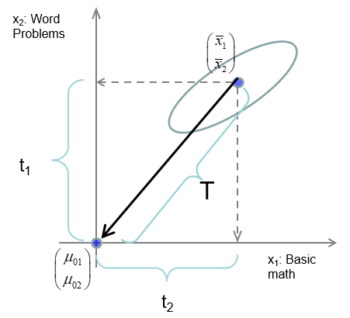
From the t-test to Hotelling's T²
Two groups, several responses
T² is the largest squared t over all linear combinations of the responses
That best combination is the discriminant axis
Figure 10.1
Notes:
Hotelling's T-squared as a generalized t-test.

Slide 47
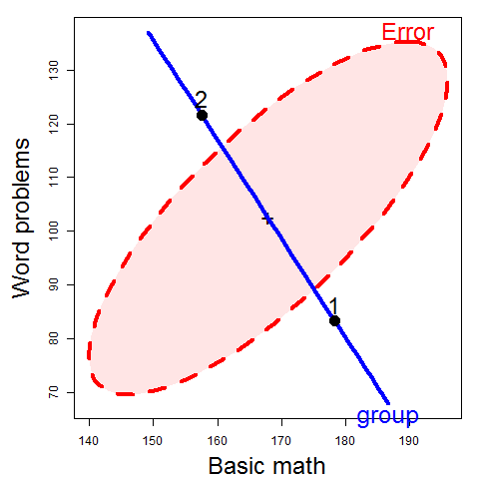
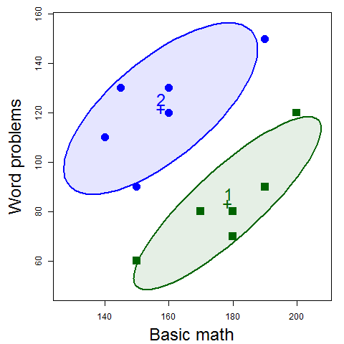
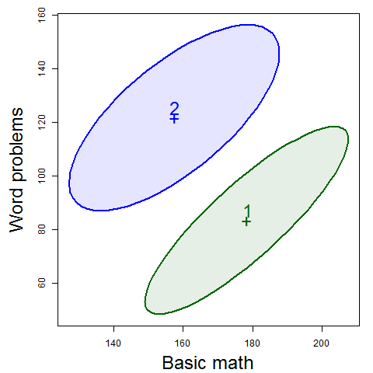
Data → Data ellipses → HE plot
Differences between group means are shown by the H ellipsoid– data ellipsoid of the fitted values (w/ 1 df, degenerates to a line)
  Direction shows relation of groups to response variables
  Size shows “how big is H relative to E”
Variation within groups is reflected in the E ellipsoid-- data ellipsoid of the residuals
  Direction: residual (partial) correlation between BM & WP
  Size/shape: residual variance
Notes:
Mathscore data: two groups, basic math (BM) and word problems (WP). From the data to data ellipses to the HE plot. From the short course, lecture 2.

Slide 48
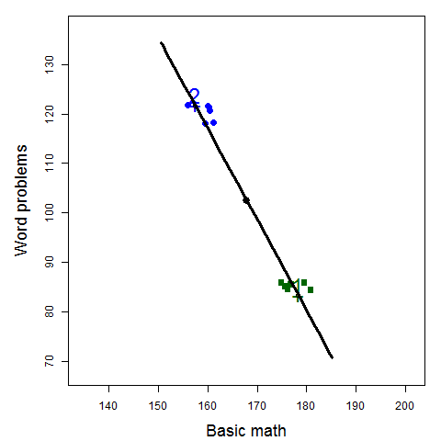

The H ellipse
Jittered fitted values
(gp means)
The H ellipse is the data ellipse of the fitted values (group means, here)
  The H matrix is the sum of squares and crossproducts of the fitted values, corrected for the grand mean
Notes:
The H ellipse is the data ellipse of the fitted values; with 1 df it collapses to a line. From the short course, lecture 2.

Slide 49
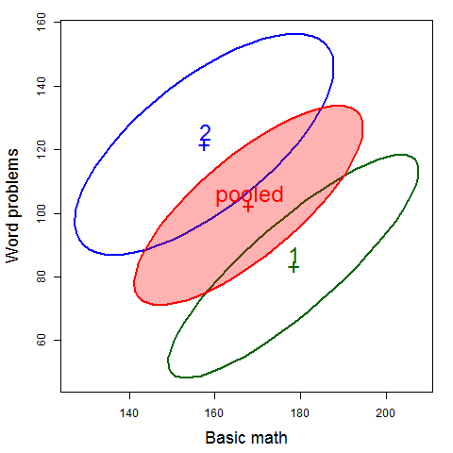
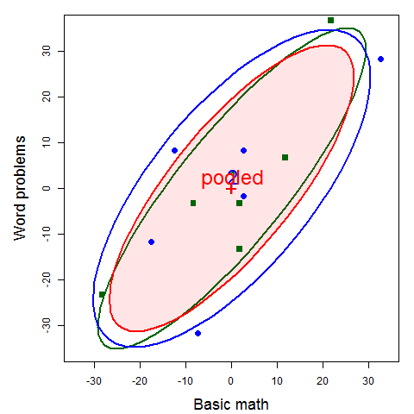

The E ellipse
The E ellipse is the data ellipse of the residuals
  What you get when you subtract the group means from all observations, shifting them to the grand means.
  E matrix called the “within-group pooled covariance matrix”
Notes:
The E ellipse is the data ellipse of the residuals: the pooled within-group covariance. From the short course, lecture 2.

Slide 50
The Hypothesis-Error plot framework
Data ellipses → E ellipse
Group means → H
Projection → discriminant view.
Notes:
One of the figures the organizer singled out. Above: data ellipses summarized in an HE plot showing the pooled within-group error ellipse (E) and the H 'ellipse' for the group means. Below: observations projected on the line joining the means.

Slide 51
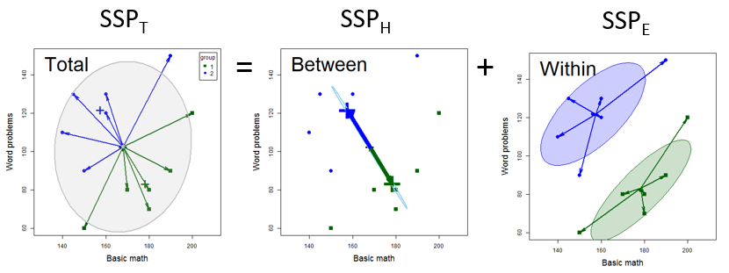
MANOVA: the same sums of squares, now as matrices
Total = Hypothesis + Error. Each is a matrix, so each can be drawn as an ellipse.
Figure 11.2
Notes:
Breakdown of the total SSP matrix into H and E. The Wilks, Pillai, Hotelling-Lawley and Roy tests are all functions of the eigenvalues of H relative to E.

Slide 52
HE plots: is the effect significant, and how?
With significance scaling, an H ellipse that projects outside E signals a significant effect (Roy's test).
Figure 12.5
Notes:
HE plots for the iris data. E: within-group variation. H: variation of the group means. The orientation of H shows how the groups differ.

Slide 53
Contrasts and linear hypotheses
Any linear hypothesis has its own H
A 1 df hypothesis is a line
Contrasts decompose the overall effect
Figure 12.7
Notes:
[OPTIONAL for a 45-minute talk] HE plot for sepal length and width in the iris data, showing contrasts among the species.

Slide 54
HE plot matrices: all pairs of responses
The analog of a scatterplot matrix for a multivariate model
One HE plot for each pair of responses
Figure 12.8
Notes:
All pairwise HE plots for the iris data.

Slide 55
Canonical views: the space where the groups differ most
Canonical discriminant analysis: a PCA of H relative to E
E becomes a circle
Variable vectors show what each dimension means
Figure 12.10
Notes:
Canonical HE plot for the iris data.

Slide 56
Quantitative predictors: each effect is a line
School data: reading and mathematics scores
Length: the strength of the relationship
Direction: how the predictor relates to the two responses
The overall test is the ellipse for all predictors jointly
Figure 12.17
Notes:
One of the figures the organizer singled out. HE plot for the multivariate regression model for the school data. Each predictor has 1 df, so its H 'ellipse' collapses to a line.

Slide 57
Canonical correlation in an HE plot
Canonical correlation: the weighted sums of the Y and X variables that correlate most highly
Shown as an HE plot in the canonical space, with vectors for X & Y variables
Figure 12.22
Notes:
[OPTIONAL for a 45-minute talk] HE plot for the canonical correlation analysis of the school data.

Slide 58
Factorial designs: main effects and interactions
Plastic film data: tear and gloss by rate of extrusion and amount of additive
One H ellipse for each term in the model
Figure 12.11
Notes:
[OPTIONAL for a 45-minute talk] HE plot for the two-way MANOVA of the plastic film data.

Slide 59
MANCOVA: are the regressions the same across groups?
Rohwer data: aptitude and achievement predicted from paired-associate tasks
Overlaid HE plots for the low and high SES groups
Figure 12.25
Notes:
[OPTIONAL for a 45-minute talk] Overlaid HE plots for SAT and PPVT for the two SES groups.

Slide 60
Checking multivariate models
Outliers, influence and robust estimation

Slide 61
The distance plot: outliers and leverage, multivariately
Vertical: Mahalanobis distance of the residuals
Horizontal: Mahalanobis distance of the predictors
The multivariate analog of residuals vs. leverage
Figure 11.18
Notes:
One of the figures the organizer singled out. Distance plot for the school data model.

Slide 62
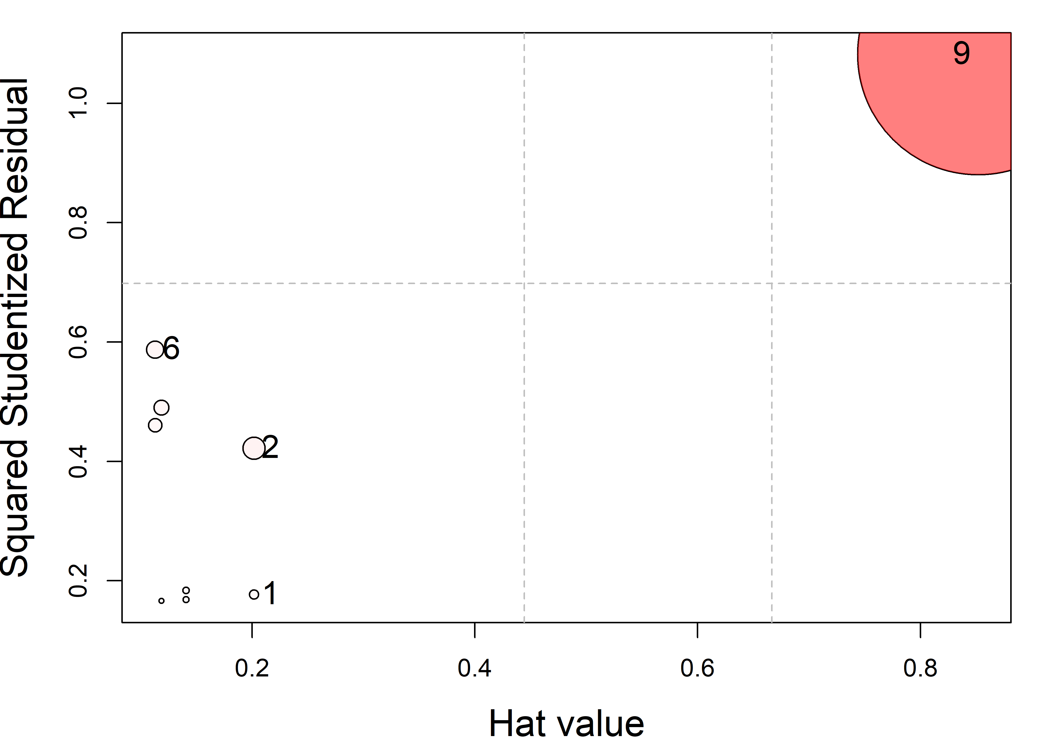
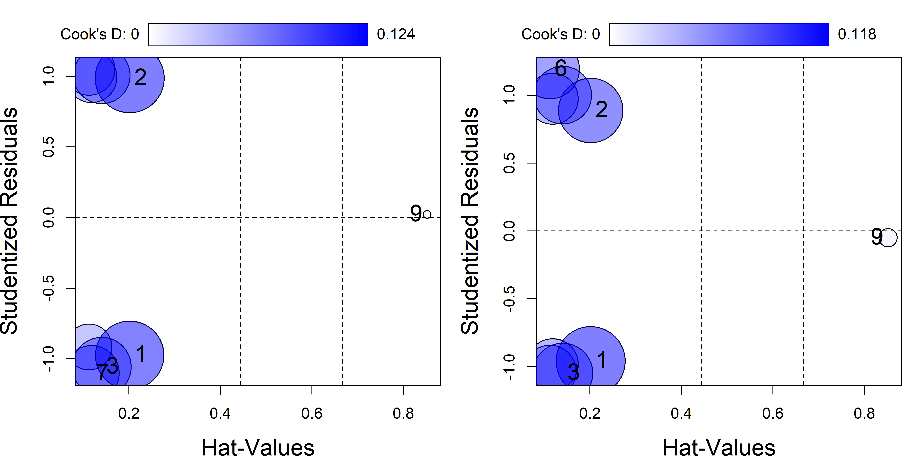
The Mysterious Case 9
Harmless in each univariate model (left), yet wildly influential in the multivariate model (right).
Figure 14.2, 14.3
Notes:
A toy example from Barrett (2003): one predictor, two nearly perfectly correlated responses, nine cases. The univariate Cook's D values for case 9 are very small, but the multivariate Cook's D is 3.22, over 10 times the next largest. Multivariate influence is not the sum of univariate influences.

Slide 63
Influence in the penguin model
Multivariate influence plot (mvinfluence package)
The most influential case is our Chinstrap friend 'Cyrano'
'Hook Nose', an Adélie, is among the others
Figure 14.8
Notes:
Influence plot for the penguin MANOVA model.

Slide 64
Robust MLMs: down-weight what does not fit
robmlm(): iteratively reweighted least squares for a multivariate model
Index plot of the final observation weights
Cyrano gets weight 0; Hook Nose gets 0.13
Figure 14.10
Notes:
heplots::robmlm() applied to the penguin model. Most coefficients change little; the largest changes are for Chinstrap, reflecting the removal of Cyrano.

Slide 65
Are the covariance matrices equal?
MANOVA assumes equal within-group covariance matrices
Compare the data ellipse of each group with the pooled one
Look for differences in size and shape
Figure 13.4
Notes:
[OPTIONAL for a 45-minute talk] All pairwise covariance ellipses for the penguin data.

Slide 66
Visualizing Box's M test
Box's M compares the log determinants of the group covariance matrices with that of the pooled matrix.
Figure 13.6
Notes:
[OPTIONAL for a 45-minute talk] Plots of the contributions to Box's M for the penguin and iris data.

Slide 67
Discriminant analysis
MANOVA turned around: predicting the group

Slide 68
Linear discriminant analysis: the main ideas
Find the directions that best separate the groups, then classify by distance to the group means.
Notes:
[OPTIONAL for a 45-minute talk] Illustration of the main ideas of linear discriminant analysis.

Slide 69
Prediction regions in data space
Classify every point in a grid of values: the LDA boundaries are linear.
Notes:
[OPTIONAL for a 45-minute talk] Linear discriminant prediction regions for the penguin data.

Slide 70
Prediction regions in discriminant space
With three species, two discriminant dimensions show everything
Variable vectors show which measures separate the species
Notes:
[OPTIONAL for a 45-minute talk] The penguin data in discriminant space, with variable vectors.

Slide 71
Quadratic discriminant analysis
With a separate covariance matrix for each group, the boundaries become curved.
Notes:
[OPTIONAL for a 45-minute talk] Quadratic discriminant prediction regions for the penguin data.

Slide 72
A few ideas go a long way
Ellipses: for data, for coefficients, and for hypotheses and error
Projections: every plot is a view; choose the views that answer the question
Low-D views: biplots and canonical plots show many variables in the space that matters
Visual thinning: summarize, so the message can be seen
Multivariate models deserve graphs as good as those for a single response
Notes:
Summary of the themes that recur through the book.

Slide 73
Book, code and packages
Online version: friendly.github.io/Vis-MLM-book
Source and R code: github.com/friendly/vis-MLM-book
R packages: heplots, candisc, mvinfluence, genridge, VisCollin
To appear with CRC Press / Chapman & Hall, 2027
Notes:
Where to find the book and the software.

Slide 74
Questions?
Discussion?

