Slide 1
Visualizing Multivariate Data and Models in R
A Romance in Many Dimensions
Methodology & Statistics Group, Utrecht, 5 Nov. 2026
Michael Friendly, York University, friendly.github.io | datavis.ca
Notes:
Title slide. The talk is framed around the book of the same name.

Slide 2
The book
Graphical methods for multivariate data and for multivariate linear models
15 chapters in four parts, from exploratory plots to MANOVA and discriminant analysis
To appear CRC Press / Chapman & Hall, 2027
Online version: friendly.github.io/Vis-MLM-book
Notes:
What the book is and where to find it. The online version has the animations and all the R code.

Slide 3
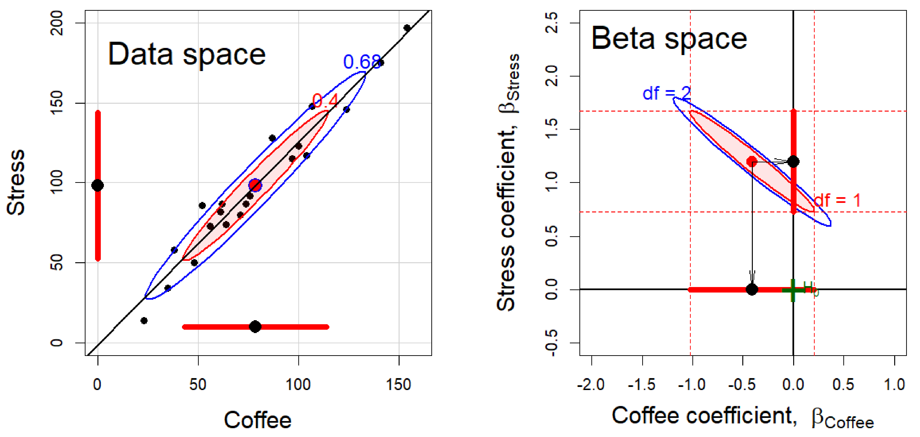
Key features of the book
Exposure and summarization
Plot the raw data, and plot statistical summaries (data ellipses, confidence ellipses) to highlight what should be noticed. Visual thinning balances the two.
Statistics ↔ geometry ↔ data visualization
Statistical ideas are easier to understand as geometry that can be seen in diagrams and data displays. Ideas from one domain amplify the others.
Dimension reduction as “multivariate juicers”
PCA and discriminant analysis squeeze high-dimensional data into informative 2D views. Sometimes the important information is in the smallest dimensions.
Notes:
From the Features section of the Preface. Three of the book's themes: (1) data visualization as a combination of exposure (plotting the raw data) and summarization (plotting statistical summaries), with visual thinning to balance them; (2) the connections among statistics, geometry and data visualization; (3) dimension reduction methods as 'multivariate juicers'.

Slide 4
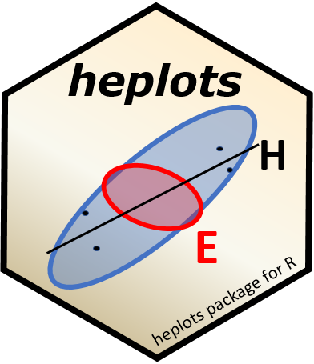
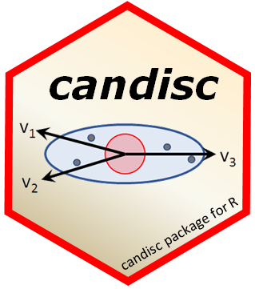

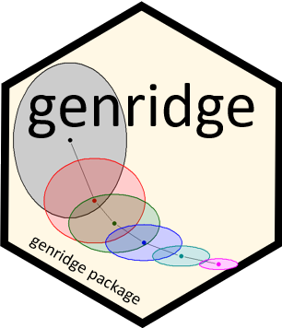
R packages
Theory → Practice: Making tools accessible
heplots
Visualizing hypothesis tests in multivariate linear models: HE plots, covariance ellipses, robust MLMs
candisc
Canonical discriminant and canonical correlation analysis: low-dimensional views of multivariate effects
mvinfluence
Influence measures and diagnostic plots for multivariate linear models
genridge
Generalized ridge trace plots: bias and precision in ridge regression
Notes:
Theory to practice: the methods in the book are only useful if people can apply them. These four packages implement most of what follows: heplots (HE plots and related methods), candisc (canonical views), mvinfluence (multivariate influence), genridge (ridge trace plots).

Slide 5
Where we are going
Why many dimensions?
Ellipses everywhere: seeing multivariate data
Elliptical insights: models with one response
The HE plot framework for multivariate models
Multivariate juicers: low-D views, and Waldo space
Checking multivariate models
Notes:
Roadmap. The talk follows the book: plots of data, then models with one response, then models with many responses. The ellipse is the recurring device.

Slide 6
Why a romance in many dimensions?
We live in Spaceland, sometimes high-D, but we plot in Flatland

Slide 7
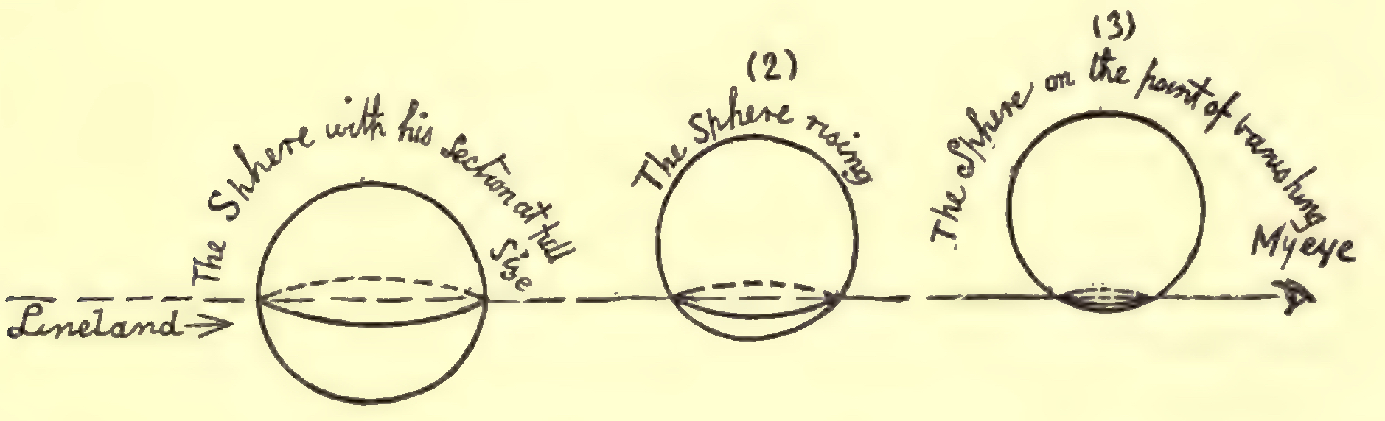
Flatland: we only ever see 2D projections
Abbott's Flatland (1884): a sphere passing through a 2D world is seen as a circle that grows and shrinks
Our 2D plots are Flatland views of data that live in many dimensions
Multivariate visualization is the art of choosing good views
Datavis is the art of making plots informative
That’s the Romance!
Figure 1.1
Notes:
The book's subtitle is a nod to Abbott's 'Flatland: A Romance of Many Dimensions'. The Flatlander sees only a slice of the sphere. We are in the same position with p > 2 variables.

Slide 8
EUREKA! Structure can hide in many dimensions
HistData::pollen, from the 1986 JSM Data Exposition: “Find something interesting here”
Zooming in on the right view reveals what no summary statistic could ever do
Figure 1.5
Notes:
Animation (plays in slide show mode). The pollen data look like a featureless cloud until you zoom in on the dense center, where the points spell out a word.

Slide 9
A multivariate discovery: kinds of diabetes
Reaven & Miller (1979) viewed glucose and insulin measures in 3D with PRIM-9
The 3D view showed distinct groups that 2D plots had obscured
The picture changed how the disease was classified
Figure 1.7
Notes:
An example of a scientific discovery that came from looking at data in more than two dimensions. The Diabetes data come back later in the dimension reduction section.

Slide 10
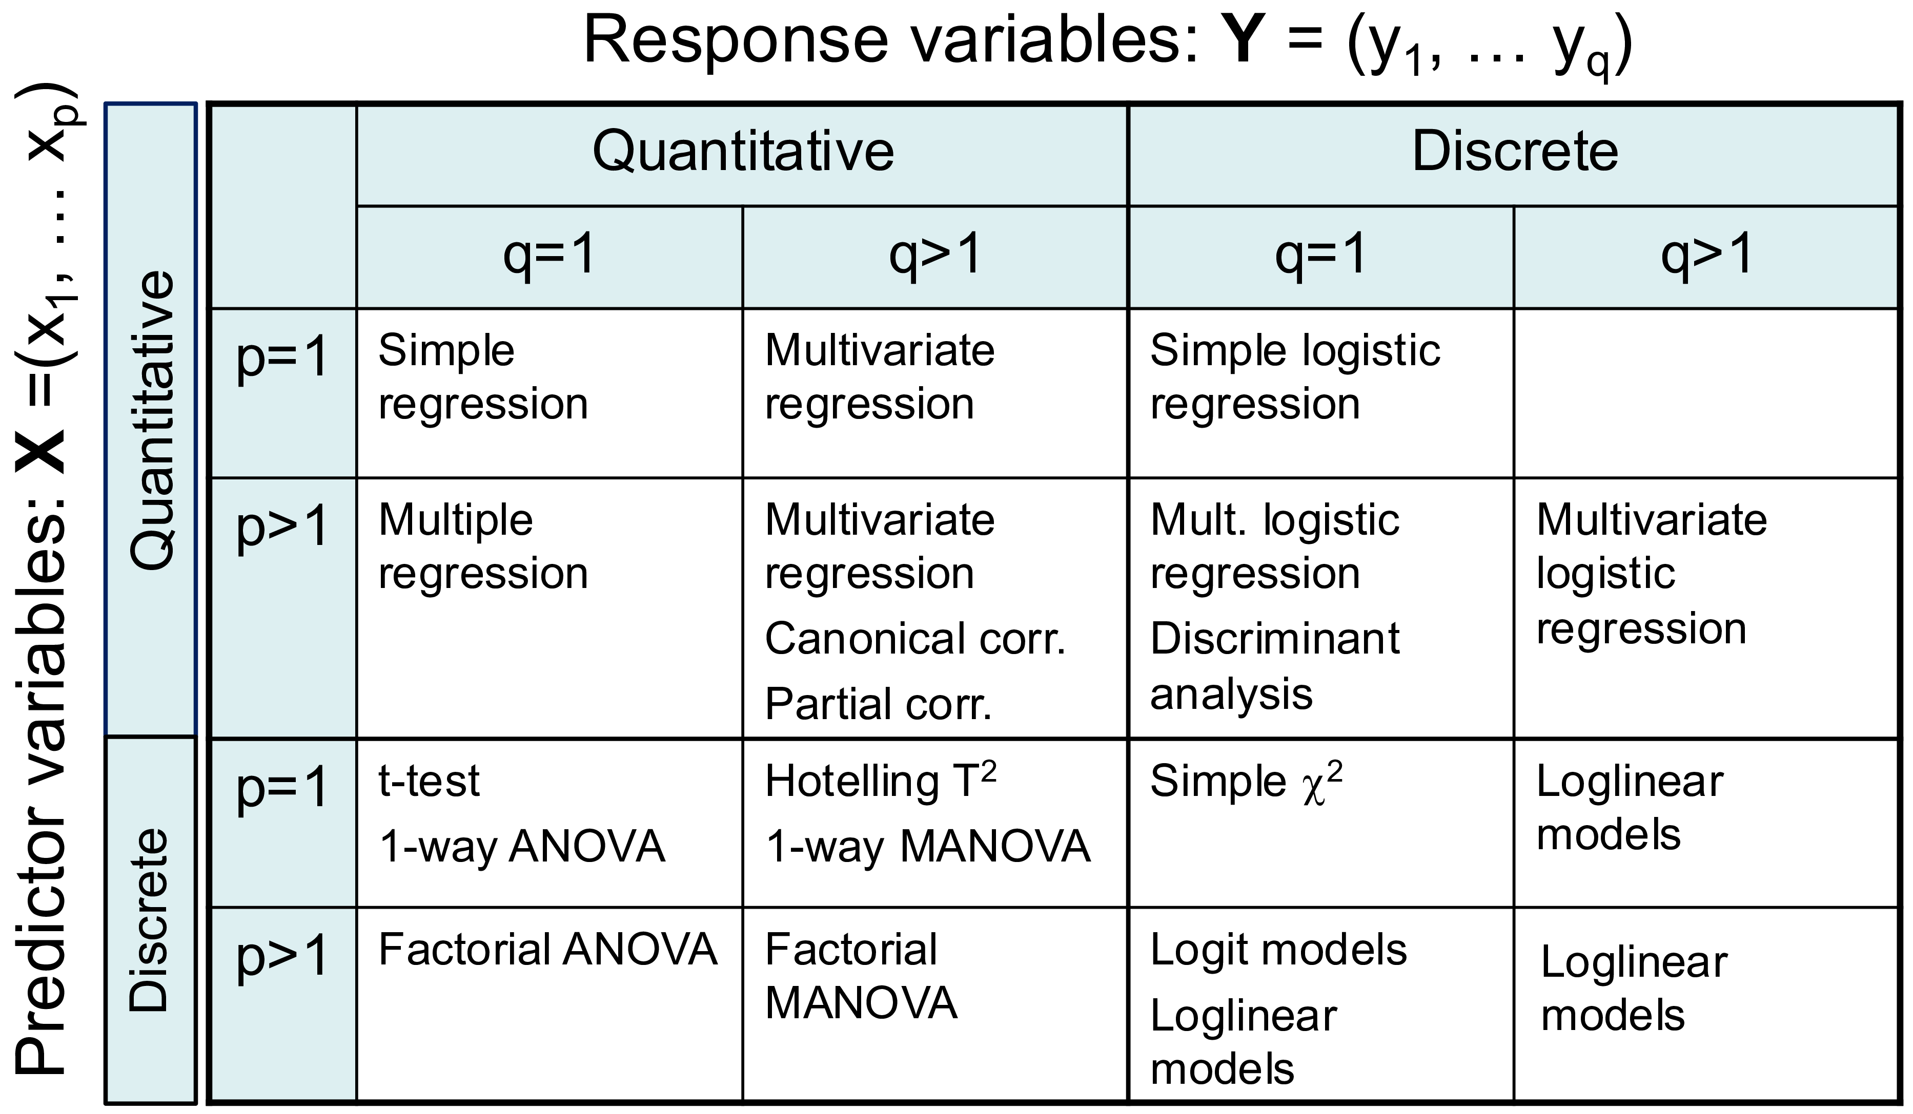
The problem: easy to fit, hard to see
With one response, we have a rich toolkit of plots for linear models
With several responses, lm(cbind(y1, y2, y3) ~ ...) is just as easy to fit
Math is easy too: y ⤳ Y
But the results arrive as tables of multivariate tests
Goal: plots that show what those tests mean, visual inference?
Figure 6.1
Notes:
The table classifies linear model techniques by the number and type of responses and predictors. The right-hand column, multivariate responses, is where graphical methods have been thin.

Slide 11
Seeing multivariate data
Data ellipses, penguins, and looking at many variables at once

Slide 12
Galton’s visual discovery:
Bivariate normal correlation surface (1886)
Notes:
My path to multivariate visualization begins with Galton’s visual insight from a table of heights of parents and their offspring, that later gave rise to the theory of correlation and regression.

Slide 13
Visual smoothing → Insight
Notes:
It is really more a semi-graphic table, recording frequency in this bivariate distribution.
Galton drew smoothed curves- by eye and brain- of equal frequency
He noticed that these formed “concentric and similar ellipses,” and
that the lines of means of x|y and y|x were the loci of conjugate tangents of the ellipses.

Slide 14
Visual insight → Theory (the OMG! moment)
Level curves are ellipses
Regression lines are loci of conjugate tangents
… that Galton should have evolved all this … is to my mind one of the most note-worthy scientific discoveries arising from analysis of pure observation (Pearson 1920, p37)
Galton (1886, Pl X): Smoothed contours of heights of parents and children
Notes:
From this, evolved the famous Galton diagram of correlation and regression shown at the right, where:
level curves of equal frequency are concentric ellipses and
the two regression lines, x|y and y|x are the loci of conjugate tangents.
Equally remarkable, he shows the major and minor axes of the ellipse, which would later be shown to be the principal component directions in a bivariate distribution.

Slide 15
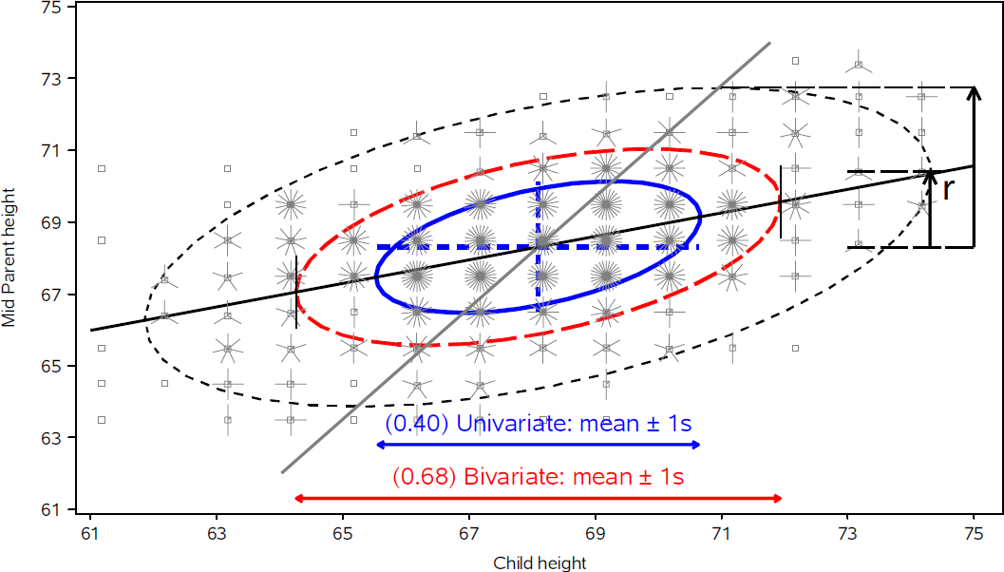
The data ellipse summarizes means, spread & correlation – a sufficient visual summary for N(µ, Σ)
Ellipsoid boundary: Mahalanobis D_{M}² (y_{i}) ~ χ_{p}²
  p=2: shadows generalize univariate confidence intervals
  eccentricity: precision; visual estimate of correlation
r ≈ 0.5 here
Notes:
Galton's data on the heights of parents and children (from the short course, lecture 2). Data ellipses of 50%, 68% and 95% coverage. The ellipse is the workhorse of the book: the same idea returns as confidence ellipses for coefficients and as H and E ellipses for multivariate tests.

Slide 16
Meet the penguins
Three species, four size measures: bill length, bill depth, flipper length, body mass. Artwork: Allison Horst.
Figure 4.17, 4.19
Notes:
The Palmer penguins are the running example. Here: bill length and bill depth with data ellipses and regression lines for each species.

Slide 17
Data ellipses: Sufficient visual summary
Palmer penguins data: Measures of bill length & depth, body mass, flipper length for 3 species
Add data ellipses to show w/in group means & scatter
Remove the points to show the overall patterns: means, shape, corr., precision
What remains is all that linear models care about (ellipses can be made robust!)
Standard scatterplot
Add data ellipses
Remove points
Notes:
As an example, consider the now popular data on body measurements of Antarctic penguins classified by species.
(The classic iris data seems to have been eclipsed b/c of Fisher’s association with the eugenics movement.)

Slide 18
Simpson's paradox: marginal & conditional relations
Ignoring species, longer bills are shallower
By species, relation is positive for each
Within species shows diffs in slopes & covariances
Figure 4.23
Notes:
Panels: (a) ignoring species, (b) by species, (c) pooled within species. The data ellipses make the reversal immediate.

Slide 19
How to visualize p > 2 variables in Flatland?
Scatterplot matrices: all pairs at once
Every pairwise view in one display
Data ellipses & regression lines by species
Works well up to a moderate number of variables
Visual thinning: data → ellipses + regression lines
Figure 4.31
Notes:
Scatterplot matrix of the quantitative penguin variables.

Slide 20
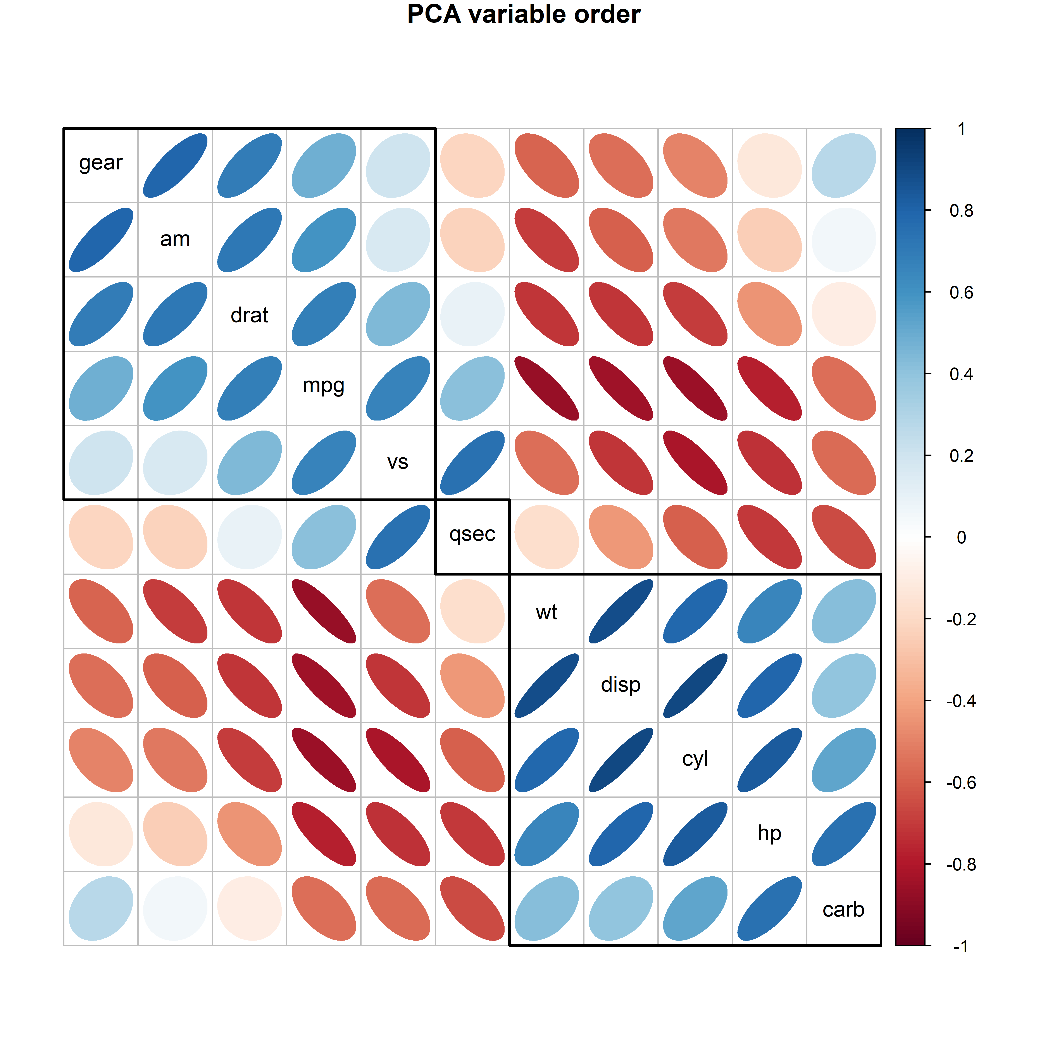
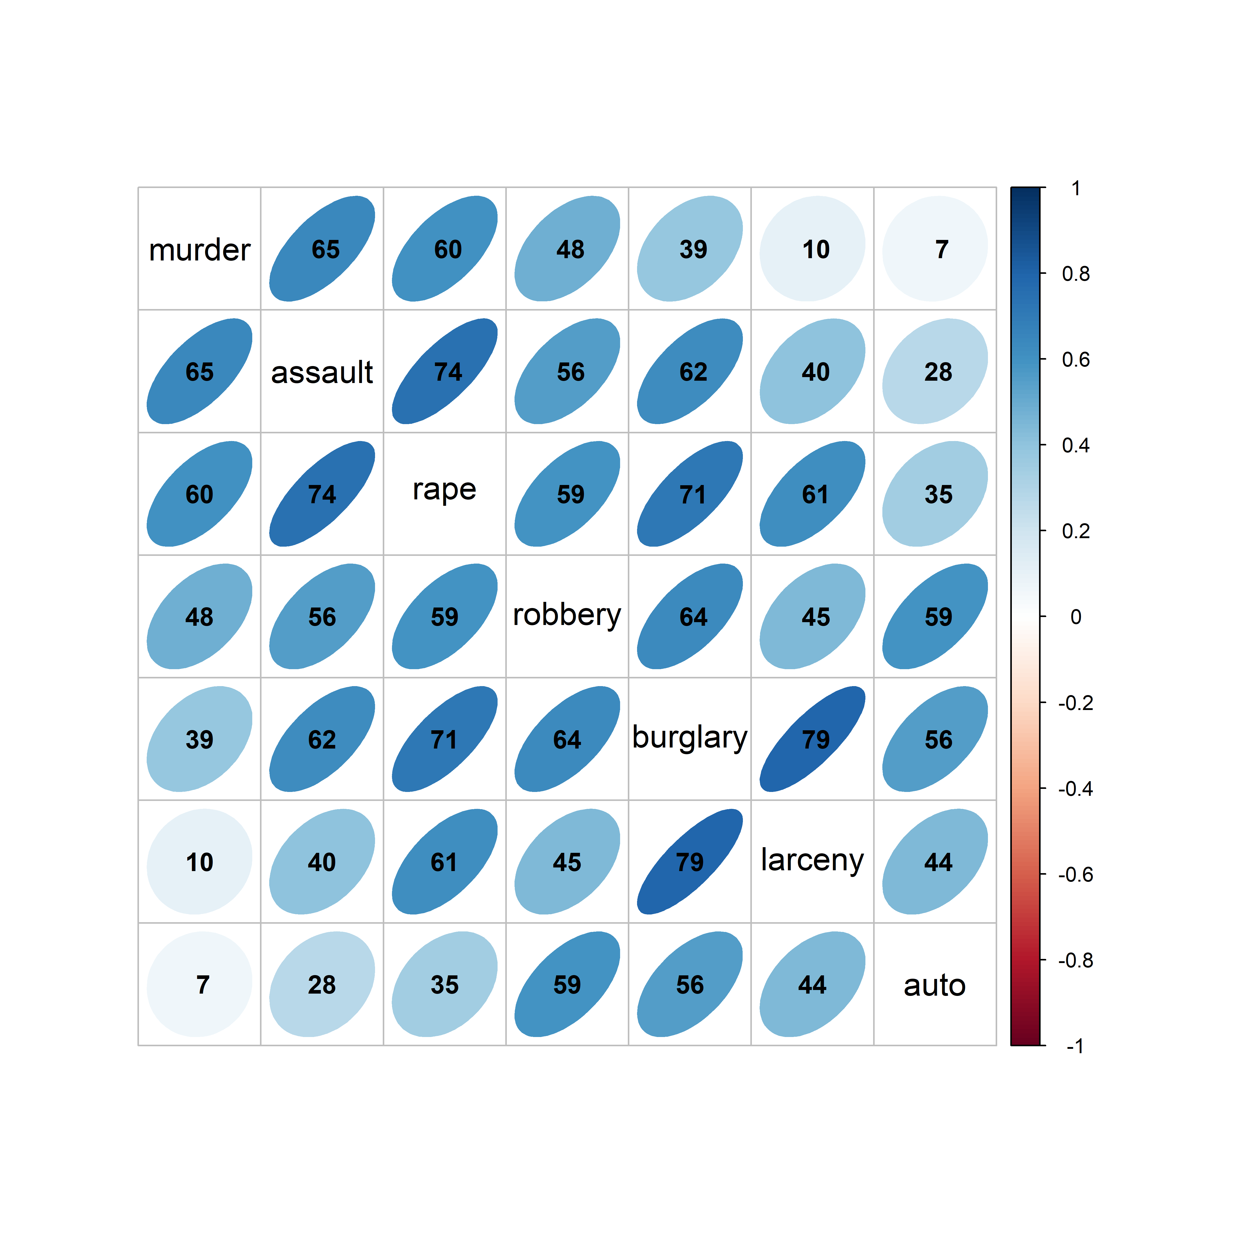
Visual thinning: show less to see more
Effect order: order variables to see what you want to show
corrplot(): With many variables, replace the points by a rendering of each correlation
Order the variables so that similar ones are adjacent
Here: ordered by the angles of the variable vectors from a PCA
Notes:
Corrplot of the crime data, with variables reordered. The ordering idea is taken up again under PCA.

Slide 21
Parallel coordinates: one line per penguin
Each observation is a line across the variable axes
Groups appear as bundles
Easy to extend to more variables
Figure 4.40
Notes:
[OPTIONAL for a 45-minute talk] Parallel coordinates plot of the penguin size variables, colored by species.

Slide 22
Animated tours: moving through projections
Animation adds one more dimension to what we can see
A grand tour shows a smooth sequence of 2D projections
As in biplot, variable vectors show where you are
A guided tour steers toward interesting ones.
Optimize an index: separation of groups, anomalies
Notes:
Animation (plays in slide show mode): grand tour of the penguin data. Guided tours optimize an index, e.g. separation of groups or the presence of anomalies.

Slide 23
Elliptical Insights
Visual understanding of problems in statistics that only confound us in tables & formulas
Outlier detection
Measurement error
Added-variable plots

Slide 24
Multivariate outliers: which penguins are unusual?
Hook Nose
Cyrano
Squared Mahalanobis distances against chi-square quantiles. We will meet these birds again.
Figure 4.26, 4.27
Notes:
[OPTIONAL for a 45-minute talk] Chi-square QQ plot for the penguin data, and the unusual birds identified in the bill length-bill depth plot. Two of them, nicknamed Cyrano and Hook Nose, come back in the influence and robust sections.

Slide 25

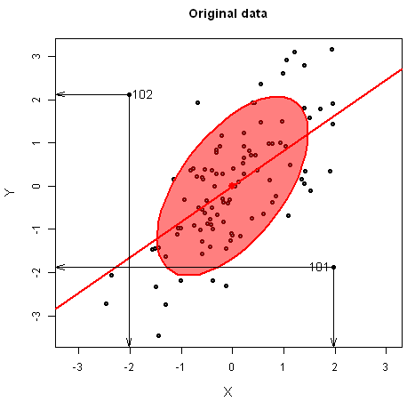
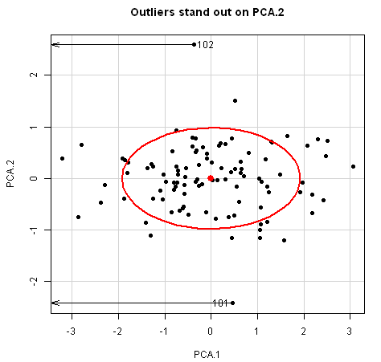
Outlier detection: Waar is Wally?
Multivariate outliers might be invisible in univariate views, but become readily apparent on the smallest principal component
  100 observations on two correlated normal variables with two bivariate outliers near (2,2), (-2, -2)
Data space
Waldo space
Animation: http://www.datavis.ca/gallery/animation/outlier-demo/
Notes:
Like Galton, I’ve been impressed with the insights that can be had from elliptical thinking.
Just a simple demonstration of how outliers become apparent when viewed in the space of small principal components.
I call this Waldo space, by analogy with Martin Hansford’s popular books, Where’s Waldo? (Waar is Wally? in Dutch)

Slide 26
Elliptical insights: Measurement error
In classical linear models, predictors (X) are usually assumed to be fixed (non-random), or measured w/o error
  Rarely true in social science, medicine, …
  (Structural equation models often used to account for this)
  What effects do errors in predictors have on typical regression models?
Main ideas:
  Ellipses in data space show effects on bias and precision
  The same effects can be seen in parameter (β) space
Friendly, Monette & Fox (2013). Elliptical Insights: Understanding Statistical Methods Through Elliptical Geometry. Statistical Science, 28, 1–39. https://www.datavis.ca/papers/ellipses-STS402.pdf
Notes:
Another insight comes from considering the effect of measure error in predictors in linear models.
In data space, we can see these effects on bias and precision of coefficients.
But there is also a dual space of the parameters – beta space.

Slide 27
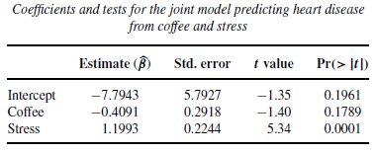
Coffee, stress and heart disease
Imagine a small study investigating the relation between a measure of heart disease (y), and coffee consumption (x₁) and stress (x₂)
Results: lm(Heart ~ Coffee + Stress)
✗
✓
Wow! That means I can drink all the coffee I want as long as I avoid stress.
But what happens if there is measurement error in y or x₁ , x₂ ?

Slide 28
Adding measurement error
Measurement error in Heart (y) decreases precision, but does not add bias
Measurement error in Stress (x₂) biases its effect β_{Stress} → 0 & decreases precision

Slide 29
Measurement error: β₁, β₂
As error in Stress increases, β_{Stress} → 0 .
  OK, understand that now.
But, at the same time, the effect of coffee, β_{Coffee} seems to become larger!
Elliptical insight:
  Increasing error in x₂ drives coefficient for x₁ toward the marginal model, ignoring x₂
  You can also see that in this case the std. errors of β_{Coffee} decrease with error in Stress!

Slide 30
Measurement error biases more than one coefficient
Error in one predictor attenuates its own coefficient and distorts those of the others.
Figure 8.7
Notes:
[OPTIONAL for a 45-minute talk] Biasing effect of measurement error in one variable on the coefficients, shown in beta space.

Slide 31
Data space and beta space are dual
The confidence ellipse for the coefficients is the inverse of the data ellipse of the predictors.
Figure 8.3
Notes:
[OPTIONAL for a 45-minute talk] Data space and beta space for the coffee data. Where the predictors have a wide spread, the coefficients are estimated precisely, and vice versa. This sets up collinearity.

Slide 32
Added-variable plots show partial relationships
Coffee, stress and heart damage: the marginal and the partial slope for coffee have opposite signs.
Figure 7.12
Notes:
Marginal + conditional (added-variable) plots for the coffee data, a contrived example constructed by Georges Monette. Each added-variable plot shows the relation of y to one predictor with the others partialled out; the slope is the coefficient in the full model.

Slide 33
Leverage and influence
Leverage: unusual in the predictors
Outlier: a large residual
Influence = leverage x residual
Bubble size: Cook's distance
Figure 7.26
Notes:
Influence plot for the Duncan model. Minister and conductor stand out.

Slide 34
Which observations drive the fit?
Green: the residuals for minister and conductor. Red: the fitted line with those two cases omitted.
Figure 7.27
Notes:
One of the figures the organizer singled out. The two occupations pull the income and education slopes in opposite directions.

Slide 35
Bias vs. Precision tradeoff
Particularly important when the goal is predictive accuracy
  Complex models, many predictors, e.g., demand for medical care
  In-sample prediction error decreases with model complexity
But, in new samples prediction error suffers from high variance of complex models
How to visualize the tradeoff in data?
+1 if you guessed an ellipse !

Slide 36
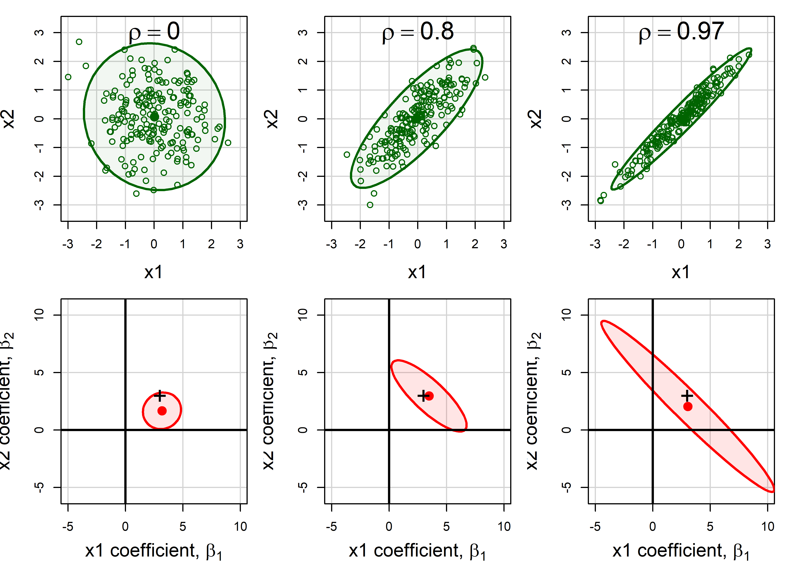
Collinearity: narrow data, inflated uncertainty
As the predictors become more correlated, the data ellipse narrows and the confidence ellipse balloons.
Figure 9.4
Notes:
[OPTIONAL for a 45-minute talk] 95% data ellipses for x1, x2 and the corresponding confidence ellipses for their coefficients, for increasing correlation.

Slide 37
Where's Waldo? Collinearity lives in the smallest dimensions
Tableplot of condition indices and variance proportions; biplot of the two smallest dimensions (Cars data).
Figure 9.6, 9.7
Notes:
[OPTIONAL for a 45-minute talk] The standard collinearity diagnostics table hides the important information. The tableplot makes it stand out; the collinearity biplot shows which variables are involved.

Slide 38
Ridge regression: shrink to gain precision
Constrain the size of the coefficients
The estimate moves from the OLS solution toward the origin
A little bias buys a lot of precision
Figure 9.9
Notes:
[OPTIONAL for a 45-minute talk] Geometric interpretation of ridge regression.

Slide 39
The usual ridge trace shows only the estimates
Longley data: six highly collinear economic predictors
Coefficients plotted against the shrinkage constant
Shows the bias, but nothing about precision
Figure 9.10
Notes:
[OPTIONAL for a 45-minute talk] Univariate ridge trace plot for the Longley data.

Slide 40
Bivariate ridge traces show bias and precision together
Each panel: the confidence ellipse for a pair of coefficients shrinking along the ridge path.
Notes:
[OPTIONAL for a 45-minute talk] One of the figures the organizer singled out. Scatterplot matrix of bivariate ridge trace plots (genridge package). Most of the shrinkage paths are regular; a few are not.

Slide 41
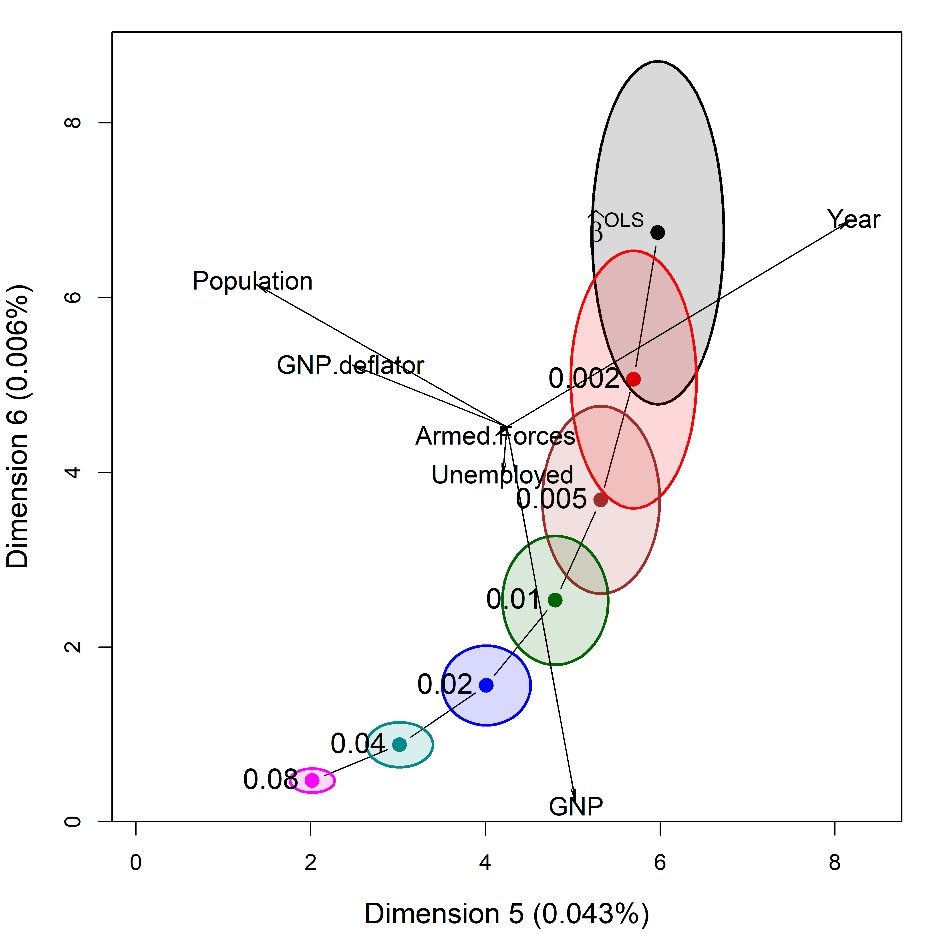
A low-rank view of ridge regression
Transform to the principal component space of the predictors
Shrinkage happens mostly in the smallest dimensions
A biplot shows how the variables relate to them
Figure 9.18
Notes:
[OPTIONAL for a 45-minute talk] Biplot view of the ridge trace plot for the smallest dimensions.

Slide 42
The HE plot framework
Seeing multivariate tests as ellipses

Slide 43
From the t-test to Hotelling's T²
Two groups, several responses
T² is the largest squared t over all linear combinations of the responses
That best combination is the discriminant axis
Figure 10.1
Notes:
Hotelling's T-squared as a generalized t-test.

Slide 44
HE plots: Visual overview
Data ellipses
HE plot
Canonical space
Discrim axes
Notes:
The HE plot framework starts with data ellipses for the groups in a multivariate linear model
An “HE plot” summarizes the evidence for differences among groups in a MANOVA design
Equally, this can be cast as a discriminant analysis problem
A simple description can be seen in an HE plot in canonical space

Slide 45
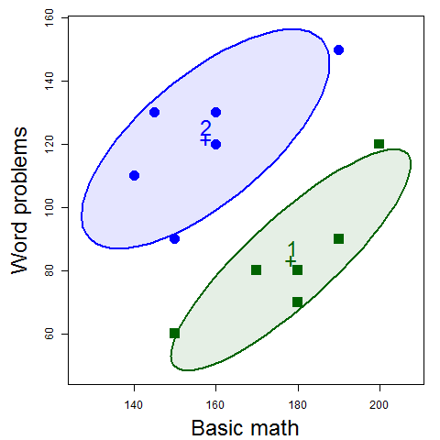
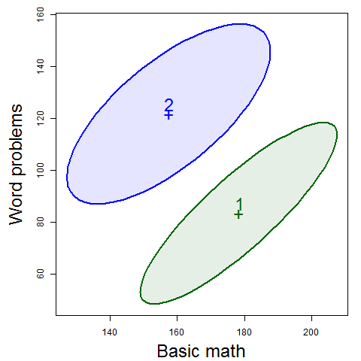
Data → Data ellipses → HE plot
Differences between group means are shown by the H ellipsoid– data ellipsoid of the fitted values (w/ 1 df, degenerates to a line)
  Direction shows relation of groups to response variables
  Size shows “how big is H relative to E”
Variation within groups is reflected in the E ellipsoid-- data ellipsoid of the residuals
  Direction: residual (partial) correlation between BM & WP
  Size/shape: residual variance
Notes:
Mathscore data: two groups, basic math (BM) and word problems (WP). From the data to data ellipses to the HE plot. From the short course, lecture 2.

Slide 46
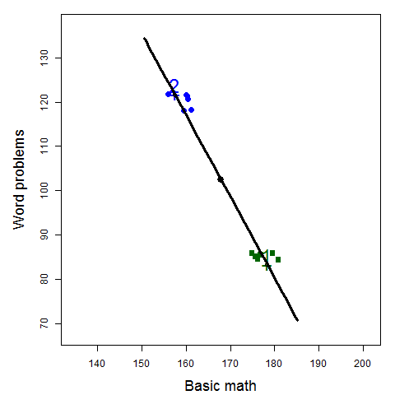

The H ellipse
Jittered fitted values
(gp means)
The H ellipse is the data ellipse of the fitted values (group means, here)
  The H matrix is the sum of squares and crossproducts of the fitted values, corrected for the grand mean
Notes:
The H ellipse is the data ellipse of the fitted values; with 1 df it collapses to a line. From the short course, lecture 2.

Slide 47
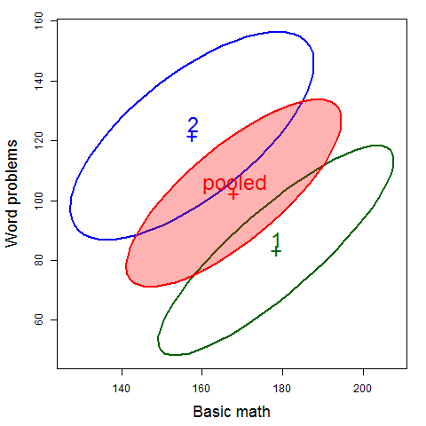
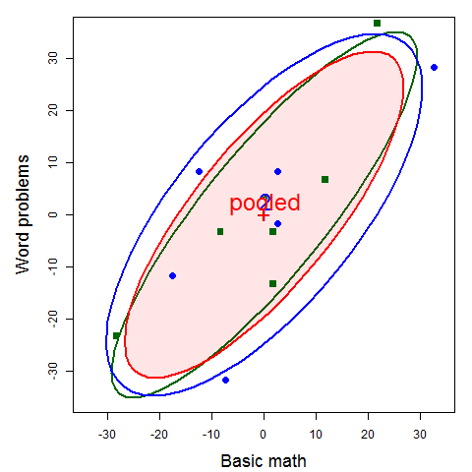

The E ellipse
The E ellipse is the data ellipse of the residuals
  What you get when you subtract the group means from all observations, shifting them to the grand means.
  E matrix called the “within-group pooled covariance matrix”
Notes:
The E ellipse is the data ellipse of the residuals: the pooled within-group covariance. From the short course, lecture 2.

Slide 48
The Hypothesis-Error plot framework
Data ellipses → E ellipse
Group means → H
Projection → discriminant view.
Notes:
One of the figures the organizer singled out. Above: data ellipses summarized in an HE plot showing the pooled within-group error ellipse (E) and the H 'ellipse' for the group means. Below: observations projected on the line joining the means.

Slide 49
MANOVA: the same sums of squares, now as matrices
Total = Hypothesis + Error. Each is a matrix, so each can be drawn as an ellipse.
Figure 11.2
Notes:
Breakdown of the total SSP matrix into H and E. The Wilks, Pillai, Hotelling-Lawley and Roy tests are all functions of the eigenvalues of H relative to E.

Slide 50
HE plots: is the effect significant, and how?
With significance scaling, an H ellipse that projects outside E signals a significant effect (Roy's test).
Figure 12.5
Notes:
HE plots for the iris data. E: within-group variation. H: variation of the group means. The orientation of H shows how the groups differ.

Slide 51
Contrasts and linear hypotheses
Any linear hypothesis has its own H
A 1 df hypothesis is a line
Contrasts decompose the overall effect
Figure 12.7
Notes:
[OPTIONAL for a 45-minute talk] HE plot for sepal length and width in the iris data, showing contrasts among the species.

Slide 52
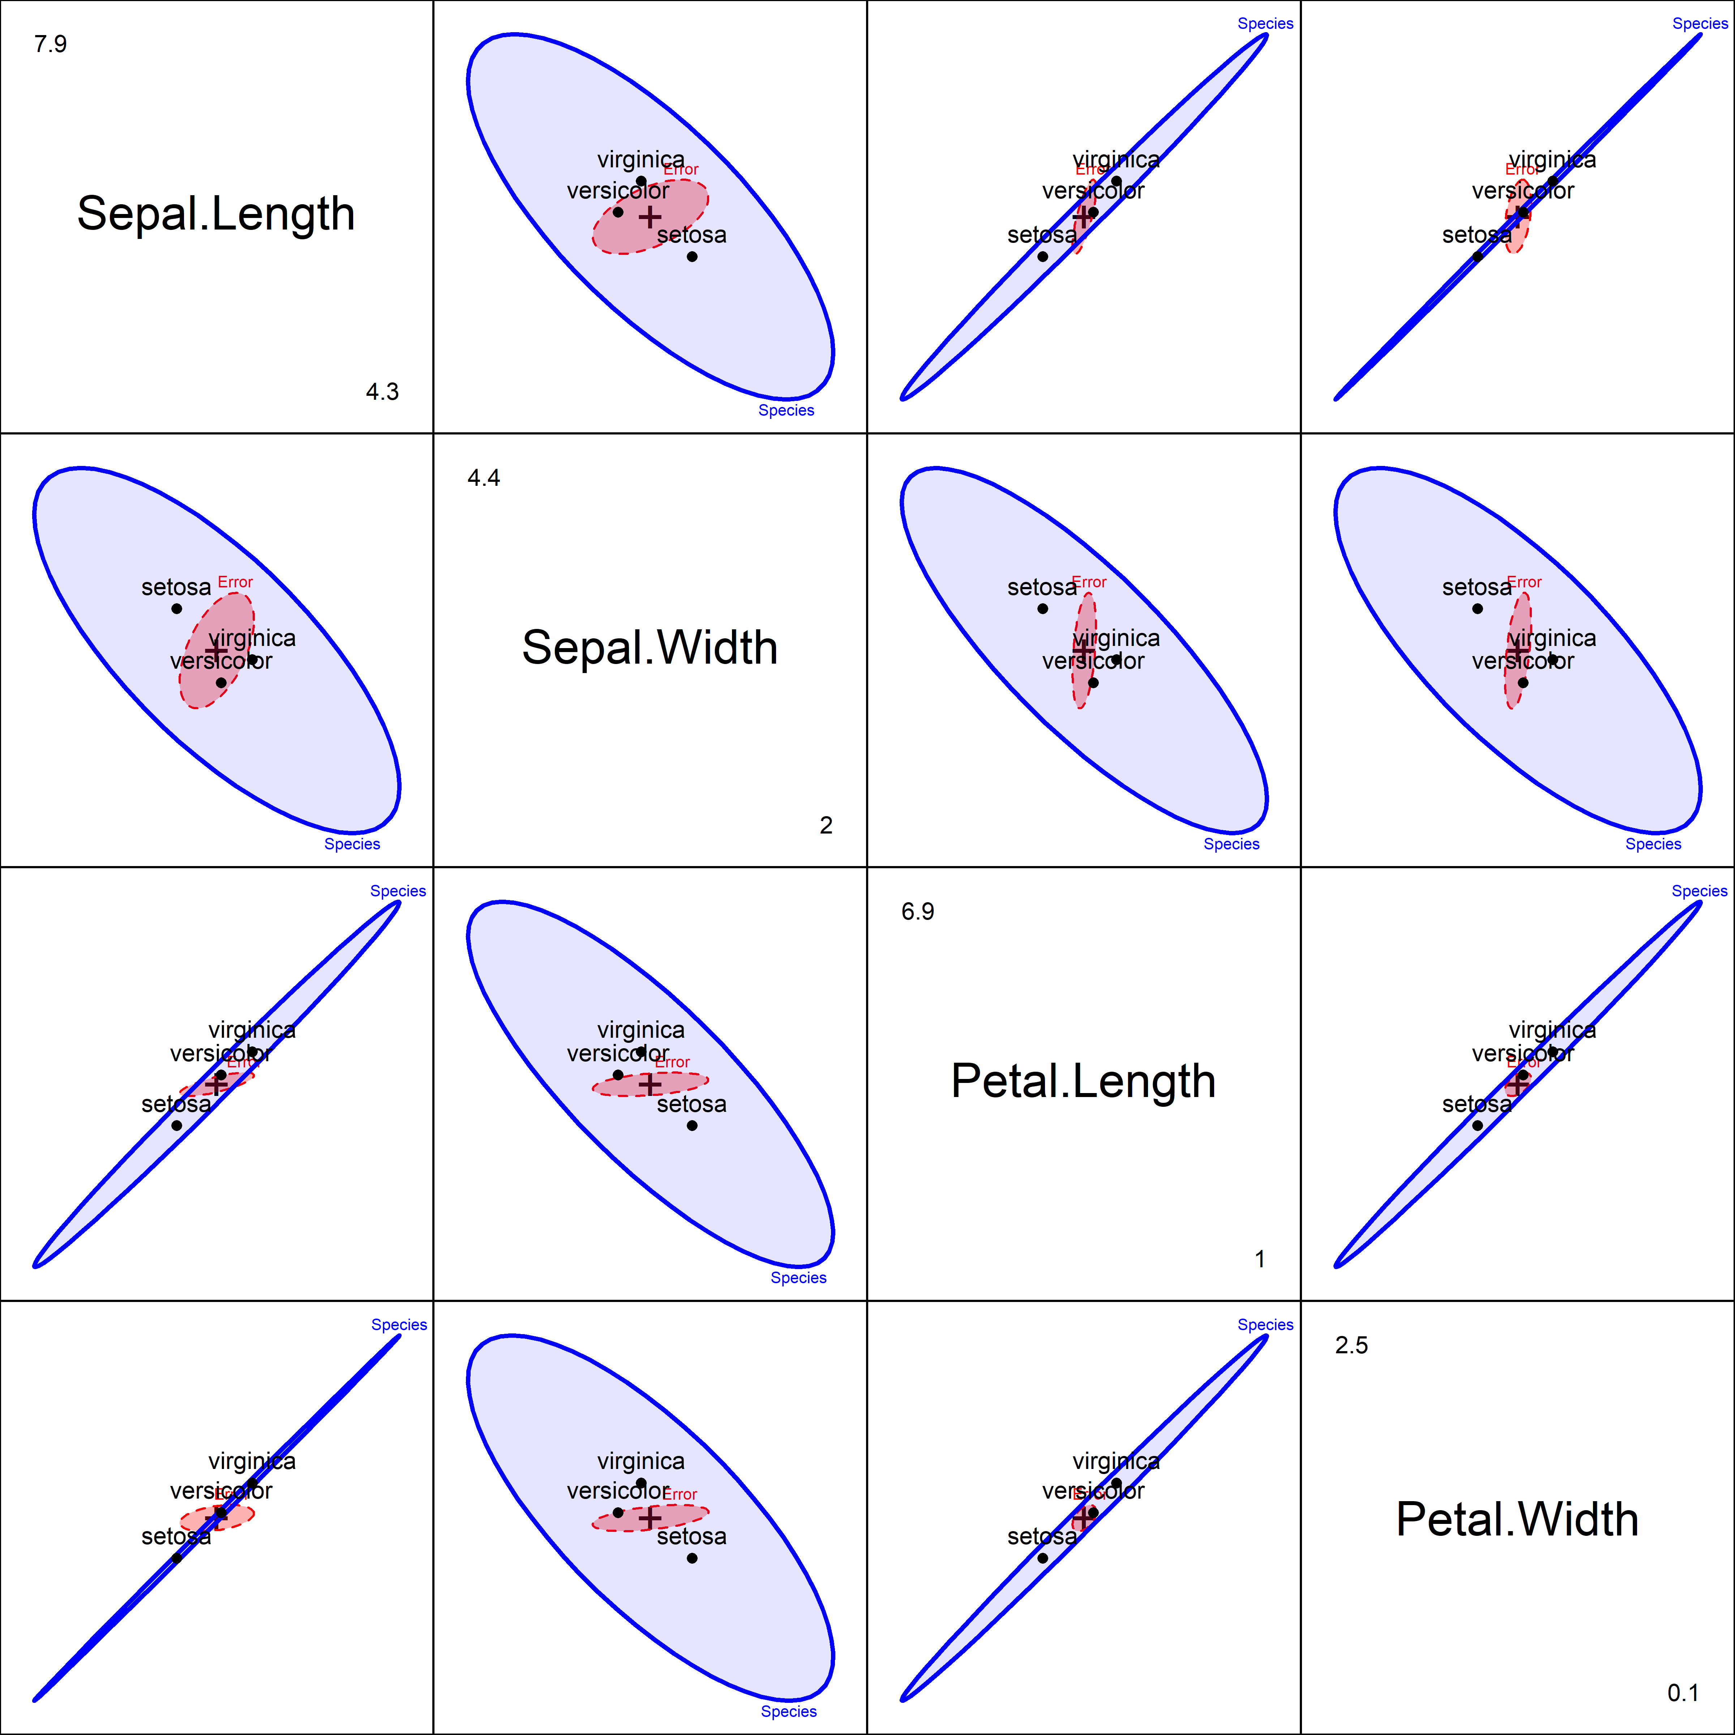
HE plot matrices: all pairs of responses
The analog of a scatterplot matrix for a multivariate model
One HE plot for each pair of responses
Figure 12.8
Notes:
All pairwise HE plots for the iris data.

Slide 53
Quantitative predictors: each effect is a line
School data: reading and mathematics scores
Length: the strength of the relationship
Direction: how the predictor relates to the two responses
The overall test is the ellipse for all predictors jointly
Figure 12.17
Notes:
One of the figures the organizer singled out. HE plot for the multivariate regression model for the school data. Each predictor has 1 df, so its H 'ellipse' collapses to a line.

Slide 54
Flatland and Spaceland: dimension reduction
PCA, biplots, and nonlinear methods

Slide 55
Multivariate Juicers
Squeeze the most flavor from your data in low-D space
data
insight
Biplot: The data juicer
CDA plots: The MANOVA juicer
Notes:
With more than a few variables, you can gain greater understanding with a multivariate juicer.
I know this is SO cheesy! But I find this a nice analogy to explain what we do with low-D methods

Slide 56
PCA: rotate to the views that show the most variance
PCA is a rotation of the axes: PC1 lies along the direction of greatest variance, PC2 is orthogonal to it.
Outliers typically appear on the smallest dimensions
Figure 5.35
Notes:
Animation (plays in slide show mode): rotation from data space to PCA space, with two added points (101, 102). They are not extreme on either original variable, but stand out on the smallest principal component. Geometry of PCA as a rotation. Tie back to the data ellipse: its major and minor axes are PC1 and PC2.

Slide 57
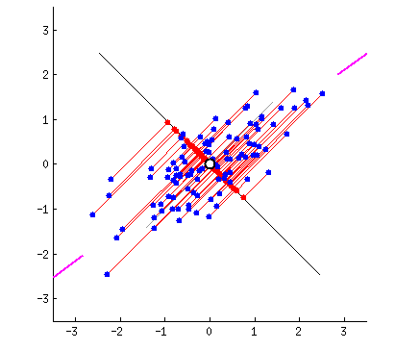
PCA fitted by springs: Physical analog
Least squares ↔ observations connected by springs
For PCA, connect a rigid line to the points by springs
Springs pull the line in proportion to squared distance
It settles on the first principal component
Figure 5.5
Notes:
Animation (plays in slide show mode). The blue points are connected to their projections on the red line by springs perpendicular to that line. A physical intuition for least squares. One of the figures the organizer singled out.

Slide 58
Biplots: observations and variables in one view
Points: observations (US states) in the PC1-PC2 plane
Vectors: variables (crime rates)
  Angles between vectors approximate correlations
  Projecting a point on a vector approximates its value on that variable
Interpretation:
  PC1: Overall crime rate
  PC2: Personal vs. property crime
  Region: summarizes diffs
Figure 5.14
Notes:
Basic biplot of the crime data. The biplot is the low-D view used again and again: for collinearity, for canonical discriminant analysis, and for ridge regression.

Slide 59
Biplot: The data juicer
peng.pca <- prcomp (~ bill_length + bill_depth + flipper_length + body_mass)
library(ggbiplot)
ggbiplot(peng.pca, obs.scale = 1, var.scale = 1,
groups = peng$species, ellipse = TRUE, circle = TRUE)
PC1, PC2 ~ 88.1% of variance
PC1: largely flipper length & body mass: “penguin size”
PC2: relates to “bill shape”
Easy to characterize the species in terms of these variables
See: https://rpubs.com/friendly/penguin-biplots

Slide 60
Canonical views: the space where the groups differ most
Canonical discriminant analysis: a PCA of H relative to E
E becomes a circle
Variable vectors show what each dimension means
Figure 12.10
Notes:
Canonical HE plot for the iris data.

Slide 61
Canonical discriminant plots: The MANOVA juicer
As with the biplot, we can visualize MLM for all responses by projecting H and E into low-rank space
Canonical projection: $Y→Z=YE^{−1/2}V$ where V = eigenvectors of HE⁻¹
This is the view that maximally discriminates among groups
CD HE plot: vectors show structure coefs (correlations) of variables w/ CD dimensions
Biplot of canonical scores
HE plot of canonical scores

Slide 62
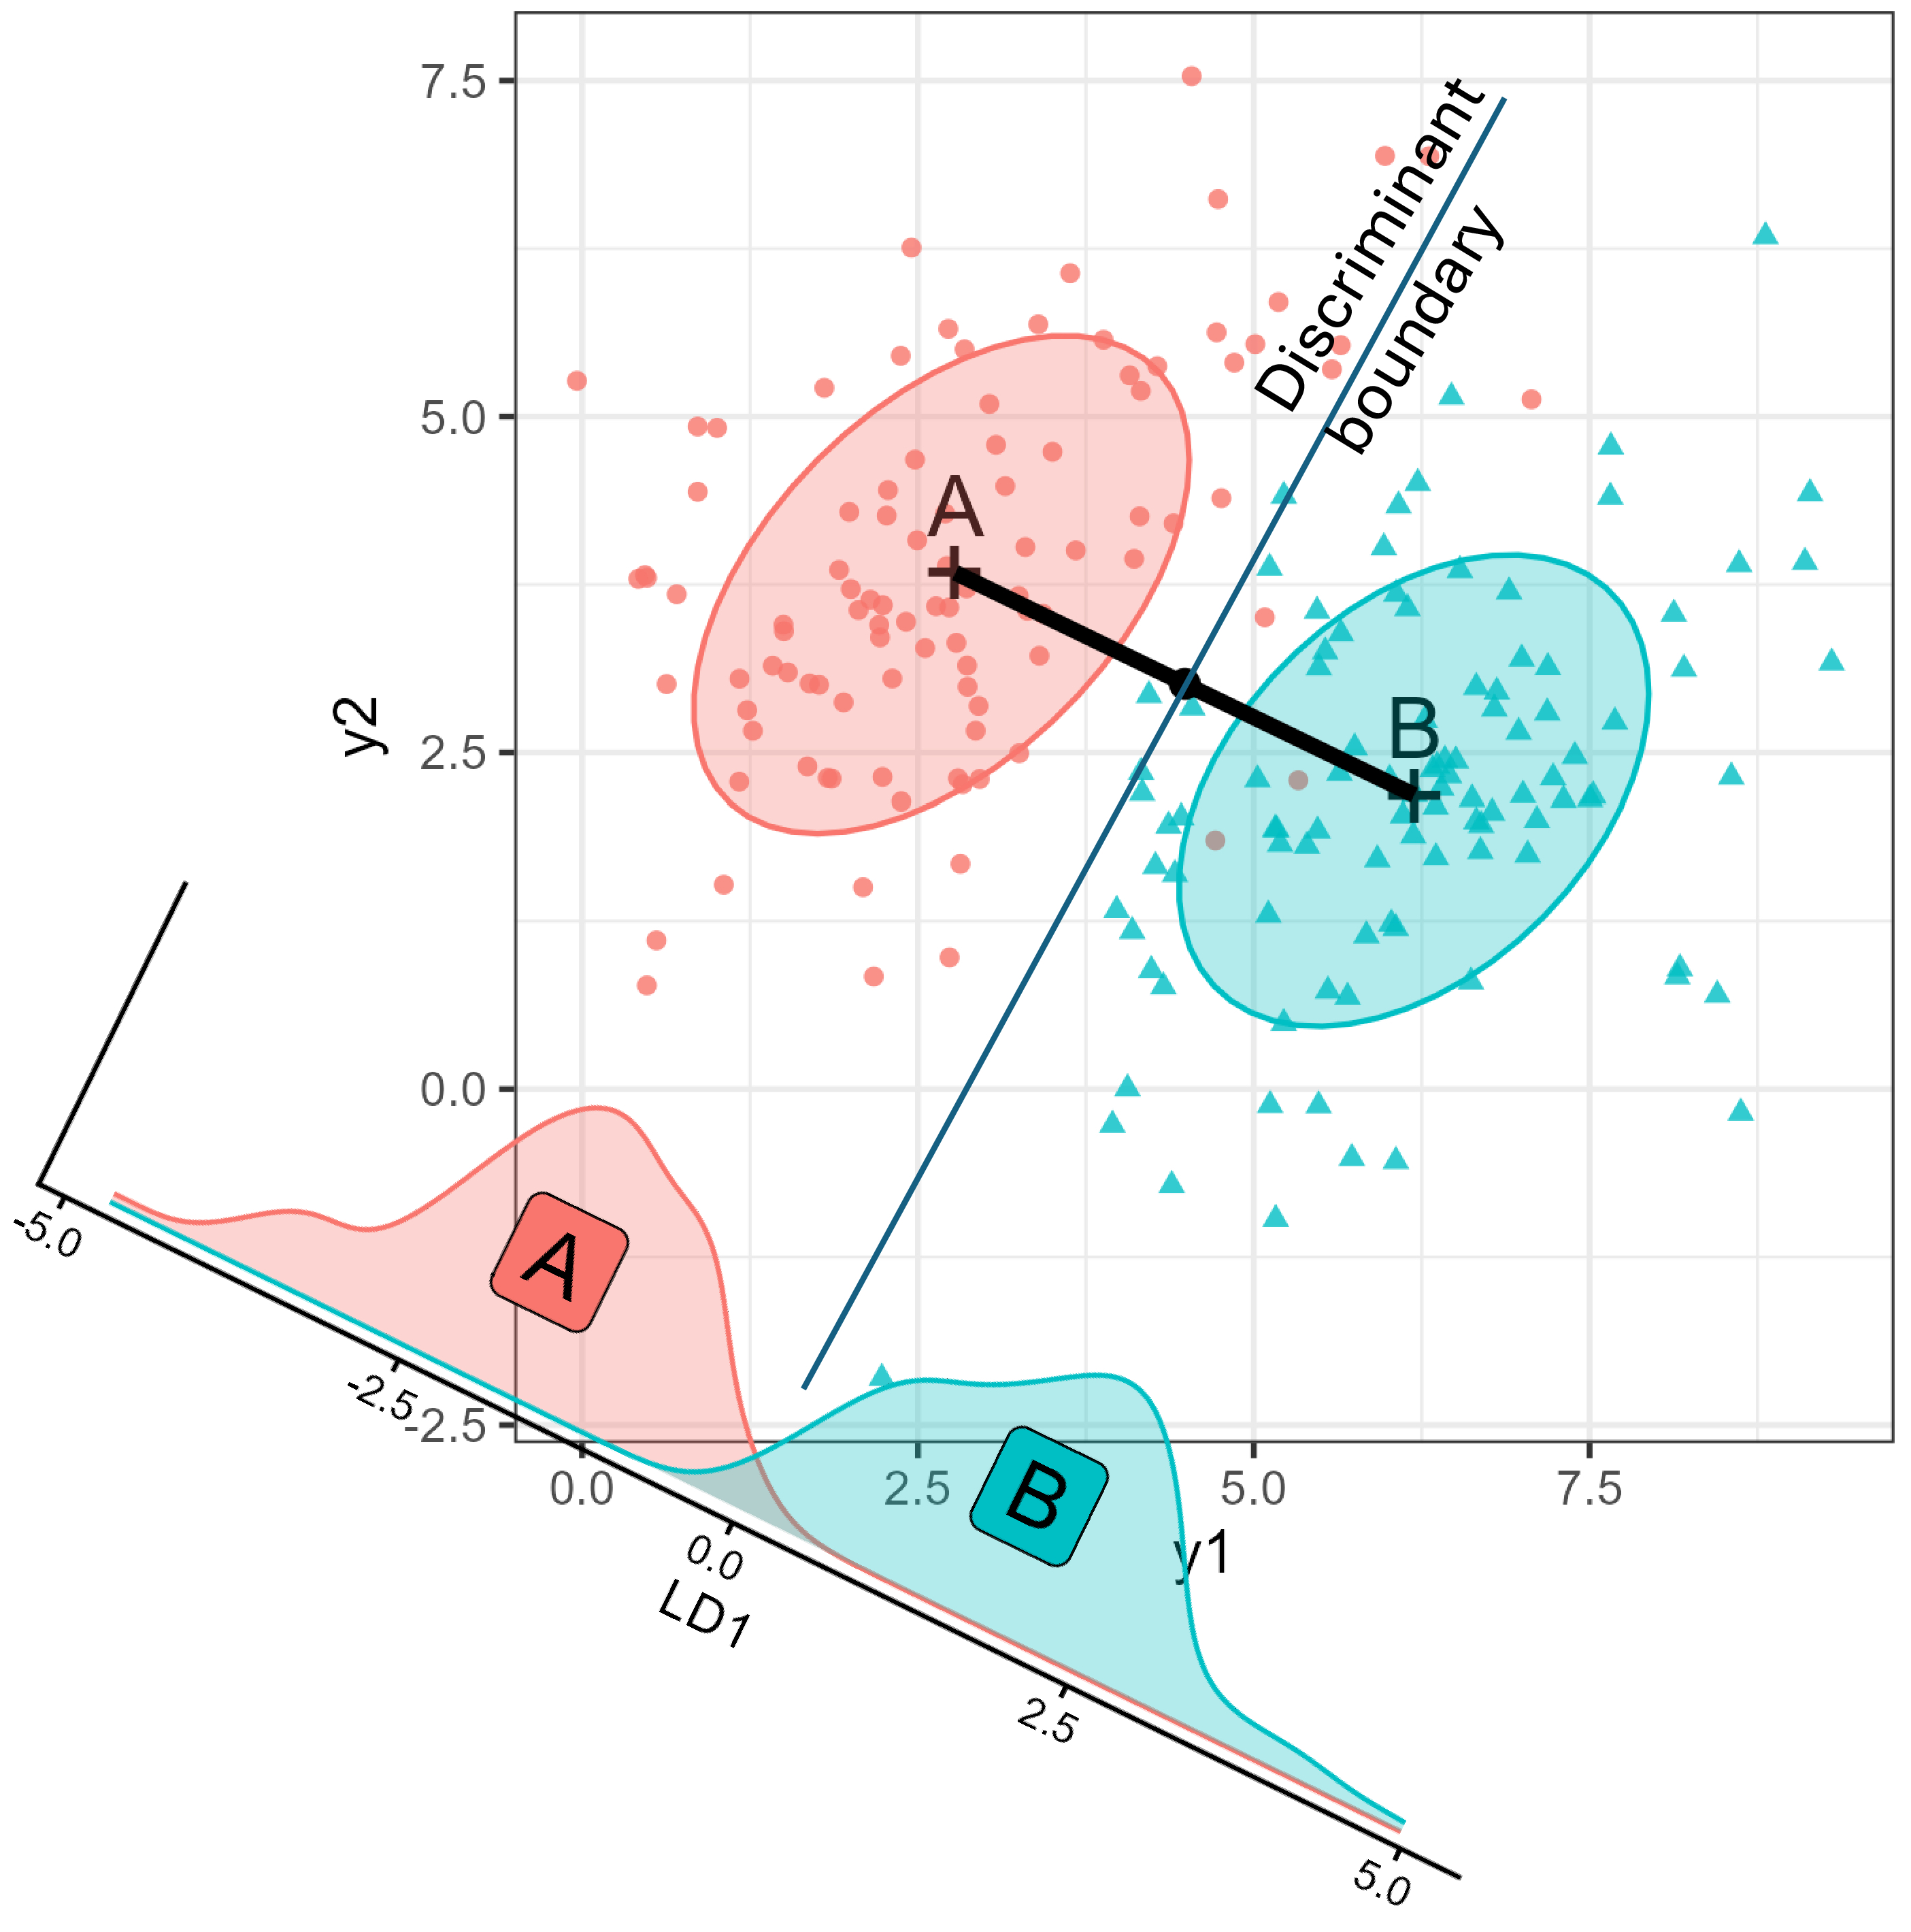
Linear discriminant analysis: the main ideas
Find the directions that best separate the groups, then classify by distance to the group means.
Notes:
[OPTIONAL for a 45-minute talk] Illustration of the main ideas of linear discriminant analysis.

Slide 63
Prediction regions in data space
Classify every point in a grid of values: the LDA boundaries are linear.
Notes:
[OPTIONAL for a 45-minute talk] Linear discriminant prediction regions for the penguin data.

Slide 64
Prediction regions in discriminant space
With three species, two discriminant dimensions show everything
Variable vectors show which measures separate the species
Notes:
[OPTIONAL for a 45-minute talk] The penguin data in discriminant space, with variable vectors.

Slide 65
When a linear view is not enough: PCA vs t-SNE
t-SNE separates the Diabetes groups more cleanly, but distances and axes no longer have a direct meaning.
Figure 5.25
Notes:
Comparison of the PCA and t-SNE 2D representations of the Diabetes data. Nonlinear methods preserve local neighborhoods at the cost of global geometry.

Slide 66
From PCA to t-SNE, animated
We can better understand algorithms visually by animating a smooth interpolation from one to another
Here, the PCA configuration morphs into the t-SNE one largely by a rotation.
But t-SNE achieves wider separation among groups
The data ellipses here carry the visual message.
Figure 5.26
Notes:
Animation (plays in slide show mode): interpolating between the PCA and t-SNE solutions for the Diabetes data. One of the figures the organizer singled out.

Slide 67
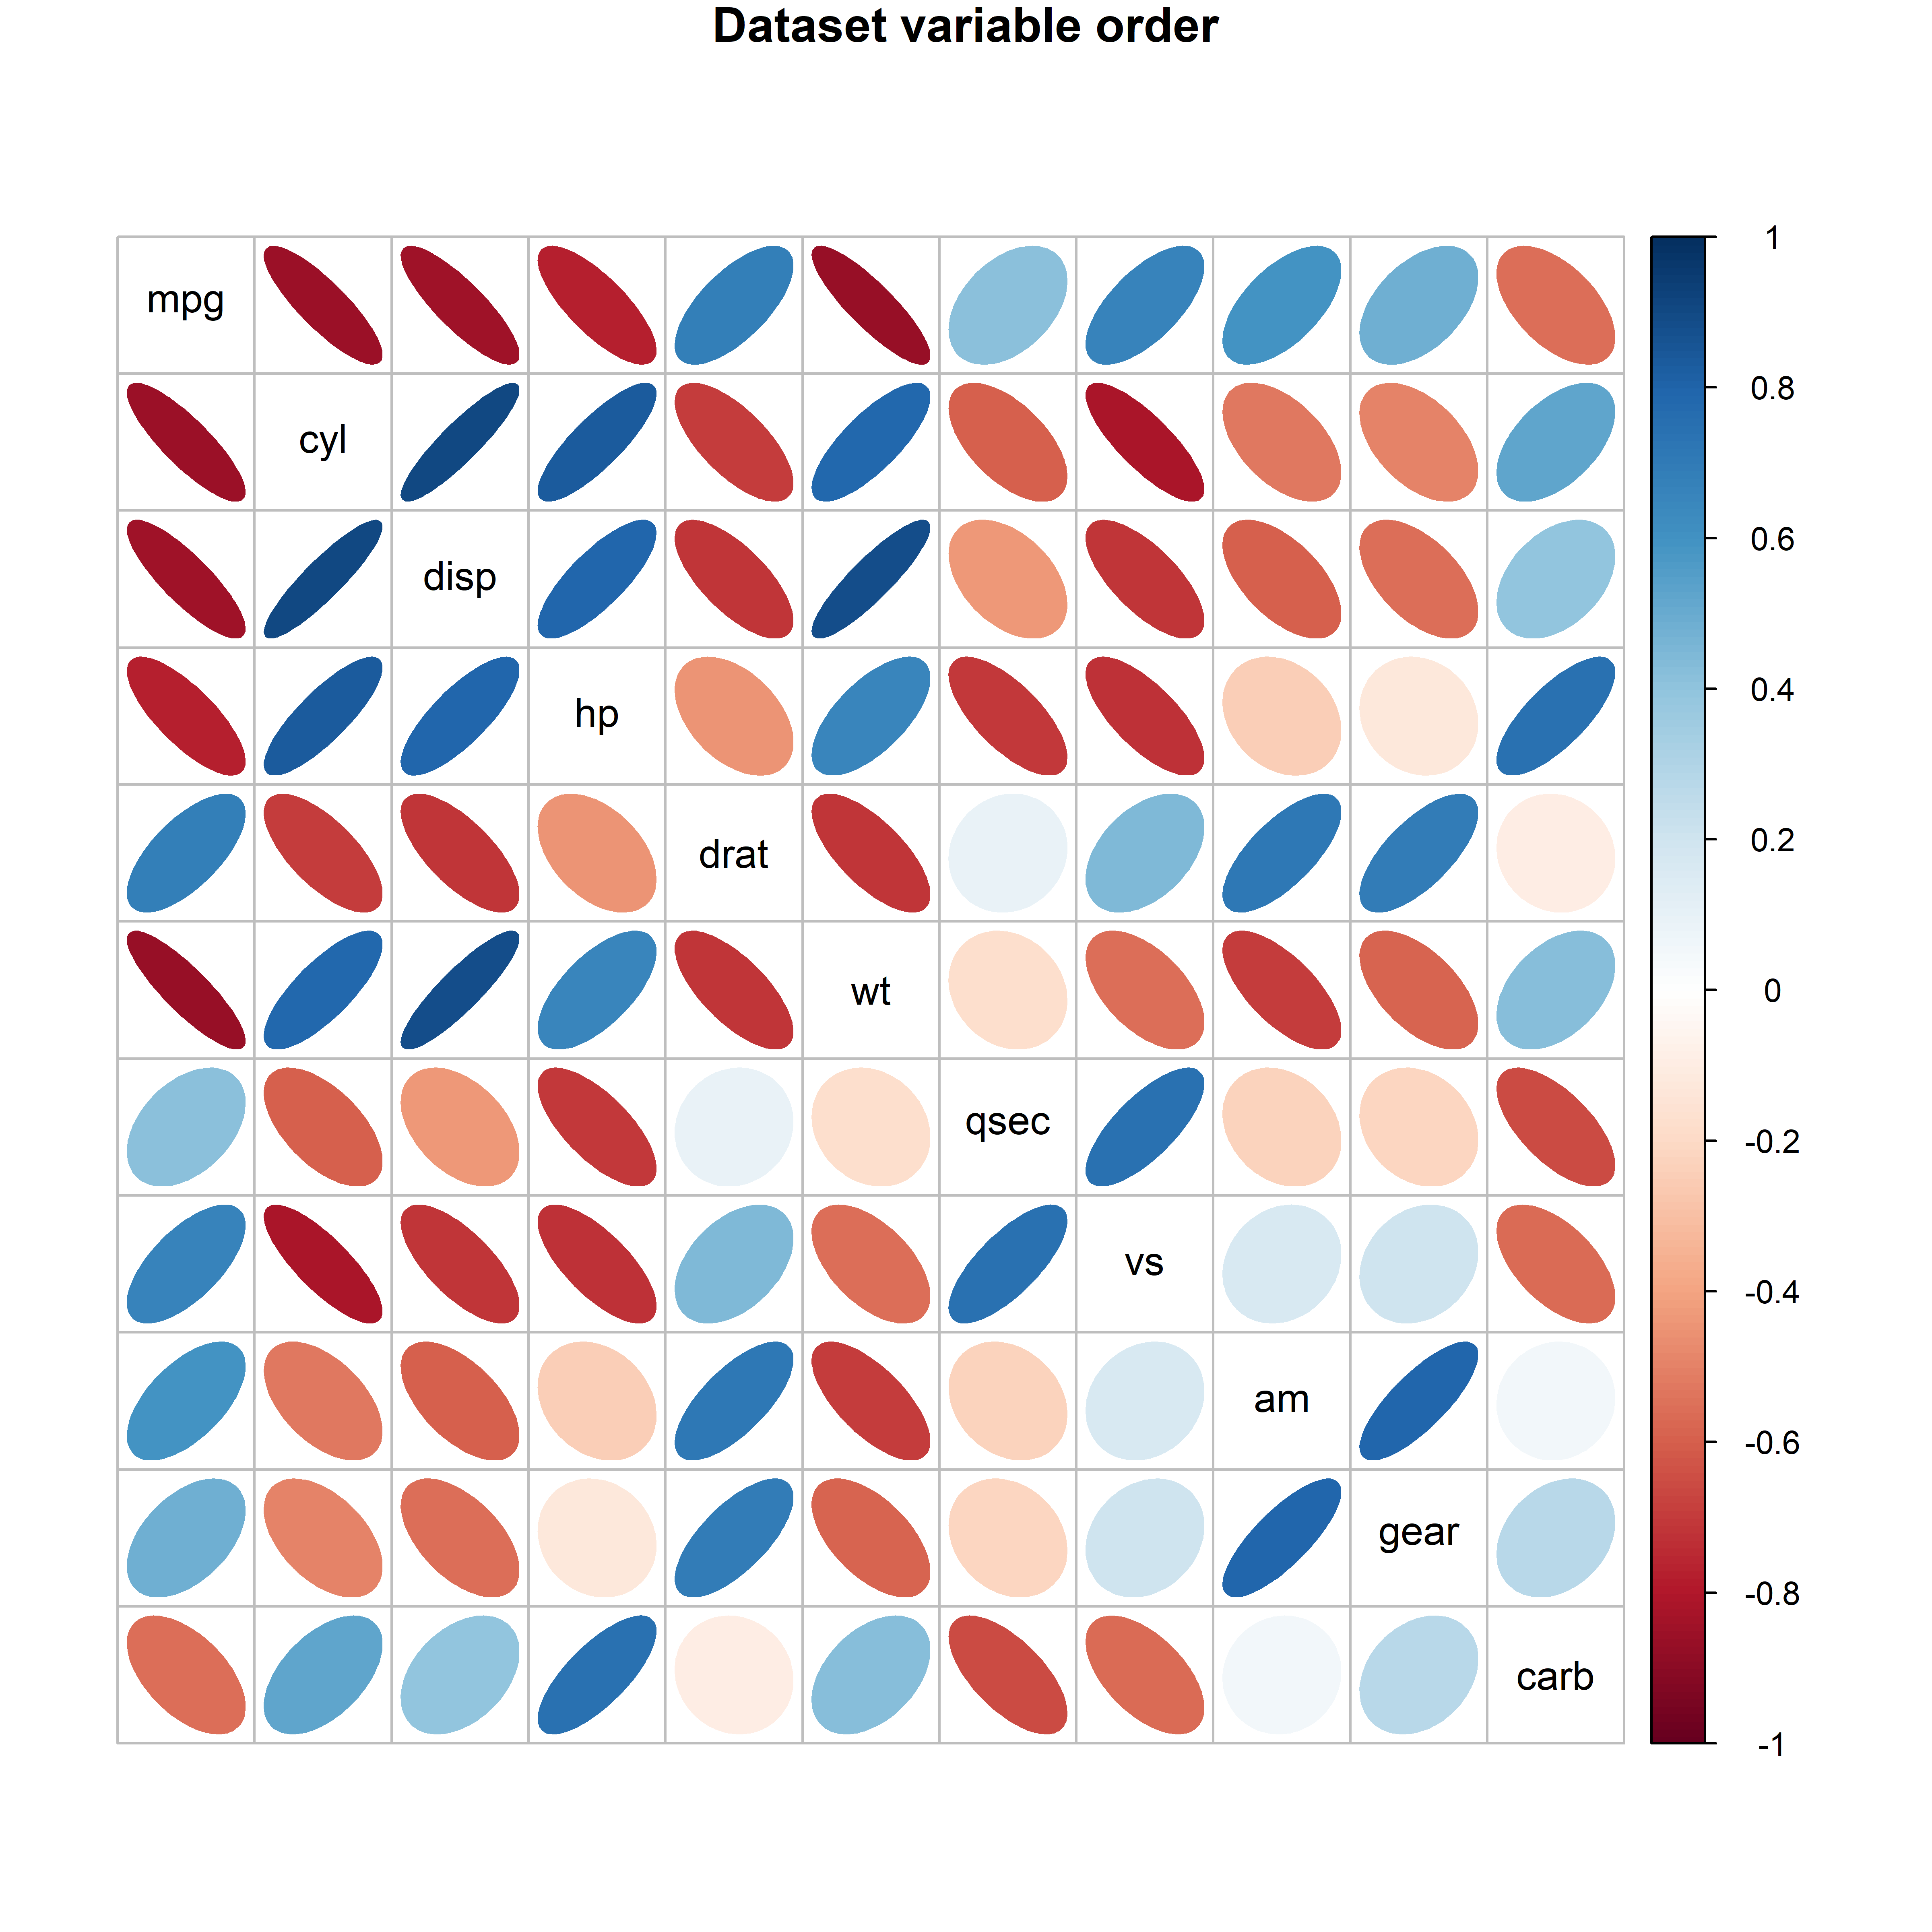
Application: effect ordering variables in displays
The same correlations of the mtcars data: in dataset order (left) and in PCA order (right).
Figure 5.27, 5.29
Notes:
[OPTIONAL for a 45-minute talk] Ordering variables by their angles in the biplot puts similar variables together and makes the pattern visible.

Slide 68
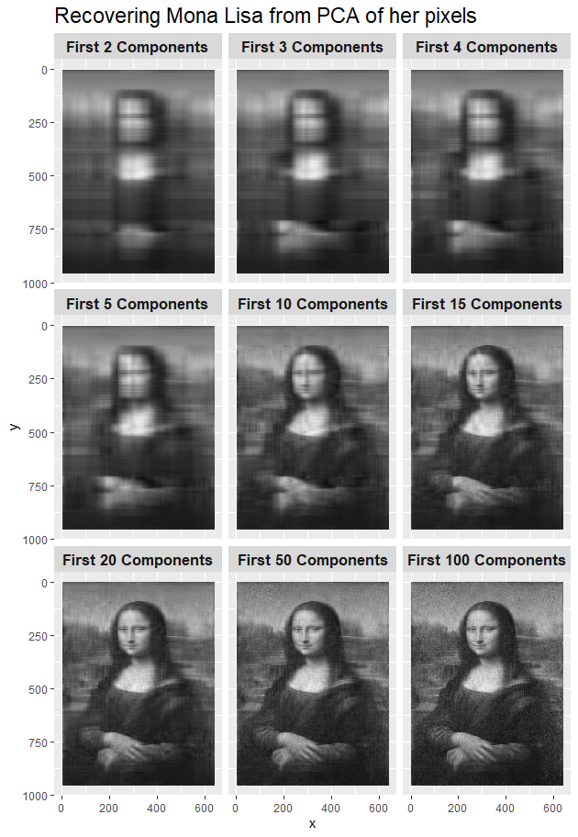
Application: how many dimensions is the Mona Lisa?
Reconstructions from a few principal components: image compression as dimension reduction.
Figure 5.33
Notes:
[OPTIONAL for a 45-minute talk] Re-construction of the Mona Lisa from increasing numbers of components (the eigenfaces idea).

Slide 69
Outliers hide in the smallest dimensions
The first two dimensions show what is typical
The last dimensions show what does not fit the pattern
Biplot of dimensions 3-4 of the penguin data
  Variable vectors show relations to dimensions
  Ellipses show diffs among groups
Cyrano
Hook Nose
Figure 5.37
Notes:
[OPTIONAL for a 45-minute talk] An 'elliptical insight': multivariate outliers often show up in the dimensions with the least variance.

Slide 70
Checking multivariate models
Outliers, influence and robust estimation

Slide 71
The distance plot: outliers and leverage, multivariately
Vertical: Mahalanobis distance of the residuals
Horizontal: Mahalanobis distance of the predictors
The multivariate analog of residuals vs. leverage
Figure 11.18
Notes:
One of the figures the organizer singled out. Distance plot for the school data model.

Slide 72
The Mysterious Case 9
Harmless in each univariate model (left), yet wildly influential in the multivariate model (right).
Figure 14.2, 14.3
Notes:
A toy example from Barrett (2003): one predictor, two nearly perfectly correlated responses, nine cases. The univariate Cook's D values for case 9 are very small, but the multivariate Cook's D is 3.22, over 10 times the next largest. Multivariate influence is not the sum of univariate influences.

Slide 73
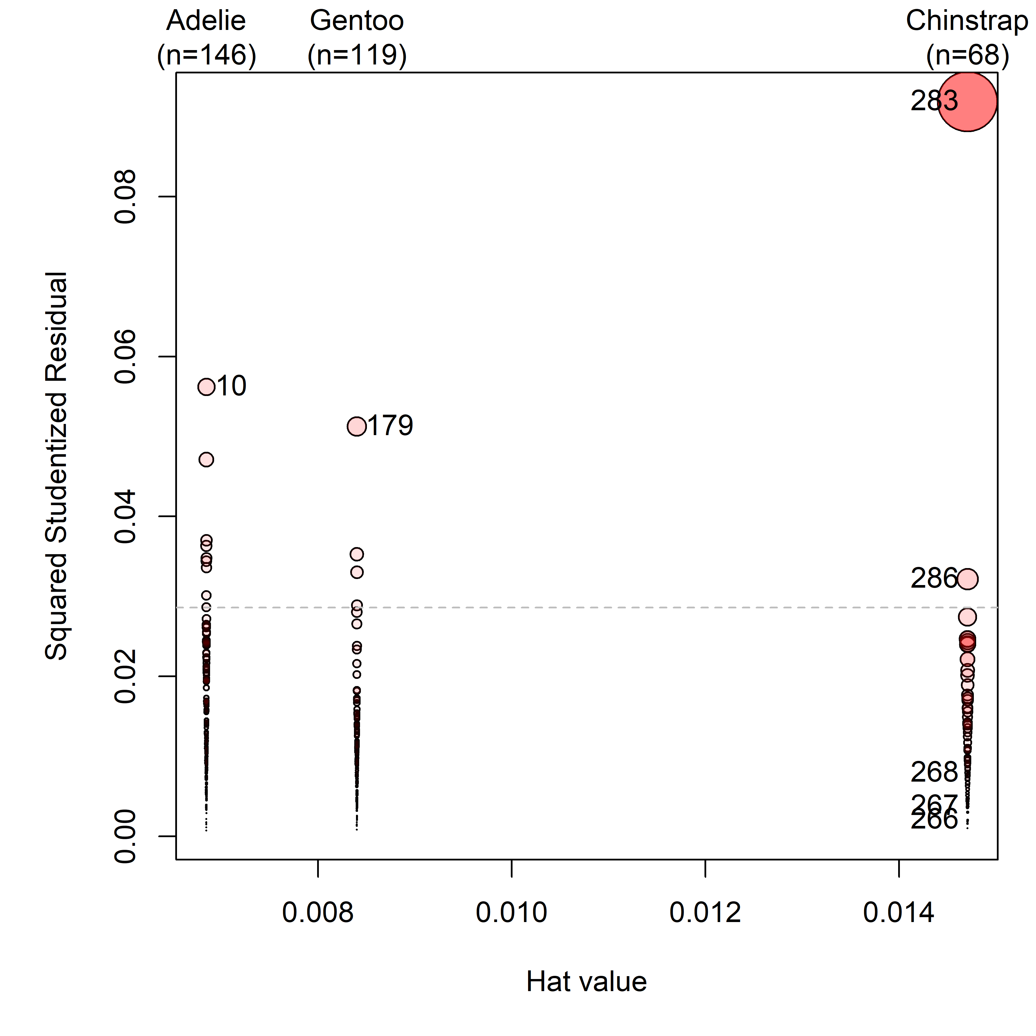
Influence in the penguin model
Multivariate influence plot (mvinfluence package)
The most influential case is our Chinstrap friend 'Cyrano'
'Hook Nose', an Adélie, is among the others
Figure 14.8
Notes:
Influence plot for the penguin MANOVA model.

Slide 74
Robust MLMs: down-weight what does not fit
robmlm(): iteratively reweighted least squares for a multivariate model
Index plot of the final observation weights
Cyrano gets weight 0; Hook Nose gets 0.13
Figure 14.10
Notes:
heplots::robmlm() applied to the penguin model. Most coefficients change little; the largest changes are for Chinstrap, reflecting the removal of Cyrano.

Slide 75
A few ideas go a long way
Ellipses: for data, for coefficients, and for hypotheses and error
Projections: every plot is a view; choose the views that answer the question
Low-D views: biplots and canonical plots show many variables in the space that matters
Visual thinning: summarize, so the message can be seen
Multivariate models deserve graphs as good as those for a single response
Notes:
Summary of the themes that recur through the book.

Slide 76
Book, code and packages
Online version: friendly.github.io/Vis-MLM-book
Source and R code: github.com/friendly/vis-MLM-book
R packages: heplots, candisc, mvinfluence, genridge, VisCollin
To appear with CRC Press / Chapman & Hall, 2027
Notes:
Where to find the book and the software.

Slide 77
Questions?
Discussion?

Slide 78
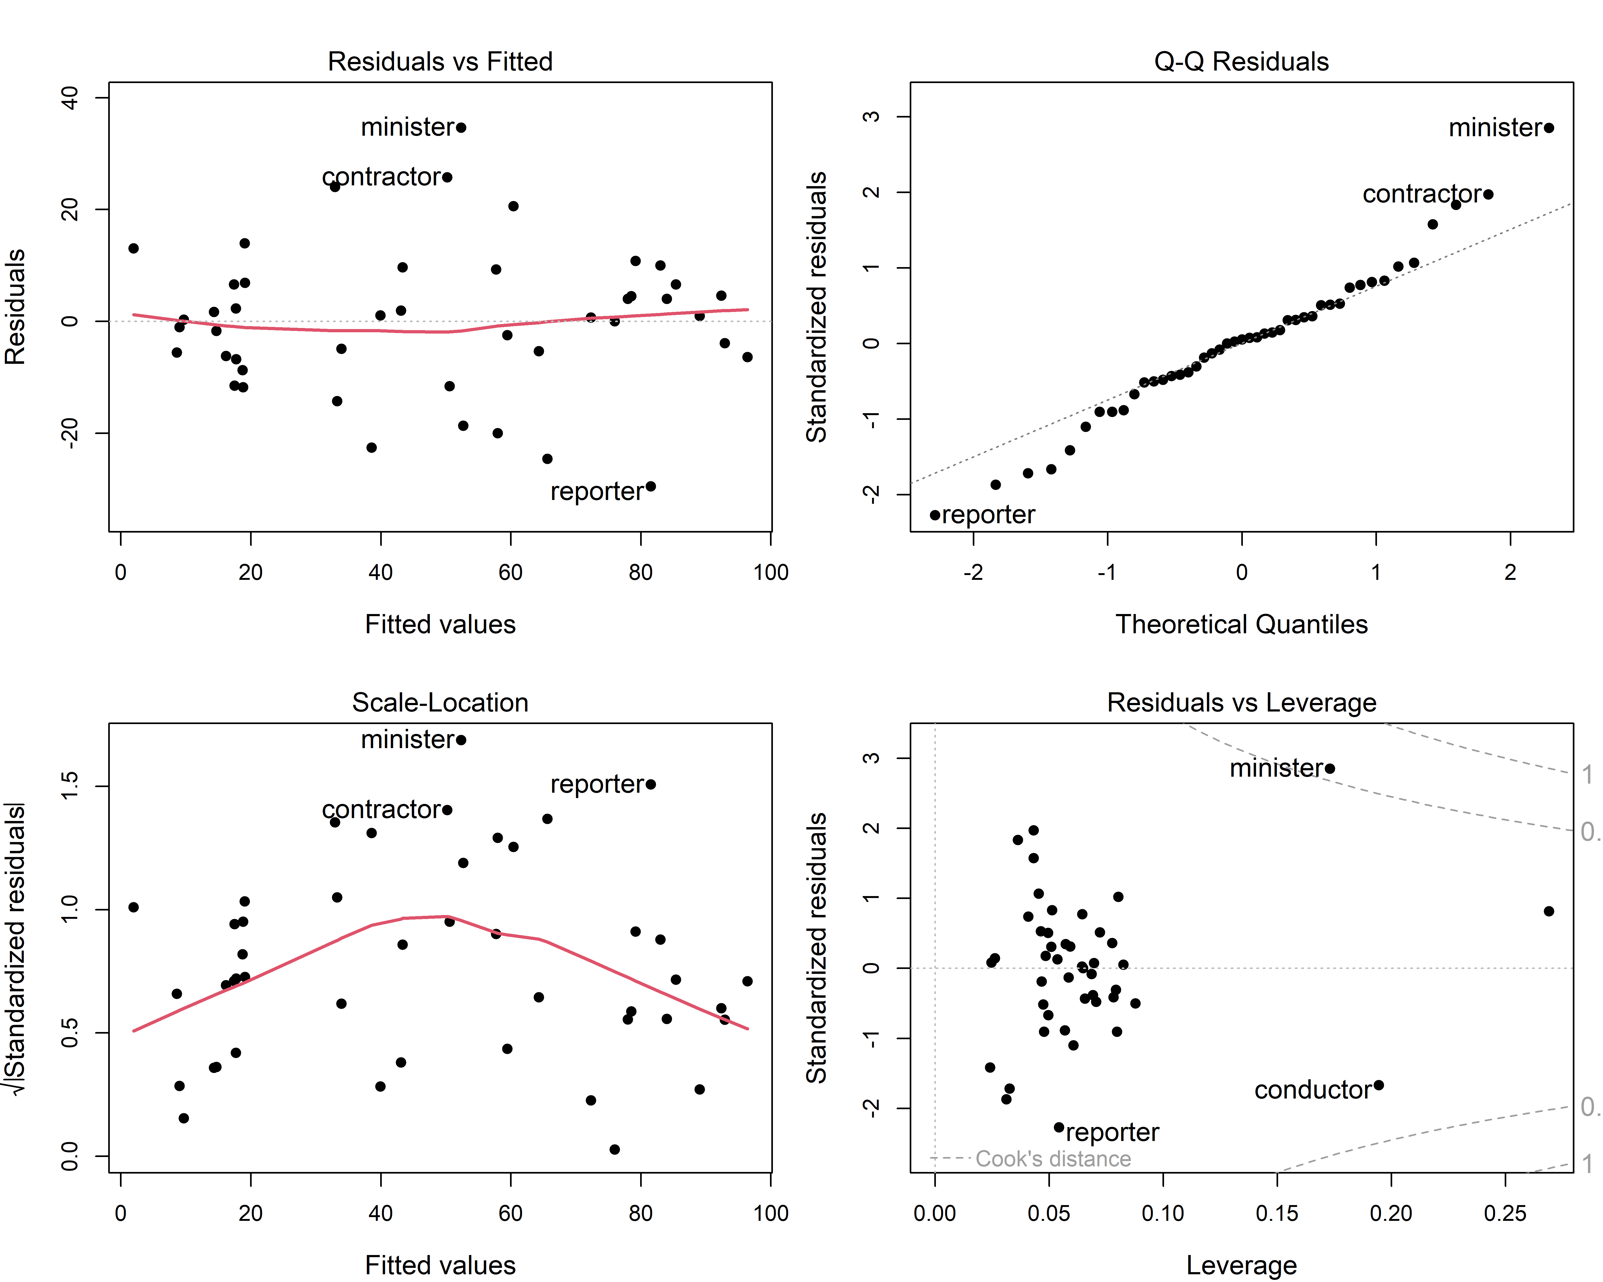
The regression quartet
Residuals vs. fitted: nonlinearity
Normal QQ: distribution of residuals
Scale-location: non-constant variance
Residuals vs. leverage: influential cases
Figure 7.2
Notes:
The four standard diagnostic plots, here for Duncan's data on the prestige of occupations predicted from income and education.

Slide 79
Coefficient plots: show the estimates, not a table
Estimates with confidence intervals
Standardize, or the scales of the predictors dominate the picture
Easy to compare several models
Figure 7.7
Notes:
Plot of standardized coefficients and their confidence intervals.

Slide 80
Effect displays: what the model predicts
Fitted values for each predictor, averaging over the others.
Figure 7.17
Notes:
[OPTIONAL for a 45-minute talk] Predictor effect plots for all terms in the model for the Prestige data.

Slide 81
Collinearity and ridge regression
Seeing the problem, and seeing the remedy
Notes:
Other problems in fitting & understanding linear models are also made simpler with visual, geometric and dimension reduction ideas

Slide 82
Canonical correlation in an HE plot
Canonical correlation: the weighted sums of the Y and X variables that correlate most highly
Shown as an HE plot in the canonical space, with vectors for X & Y variables
Figure 12.22
Notes:
[OPTIONAL for a 45-minute talk] HE plot for the canonical correlation analysis of the school data.

Slide 83
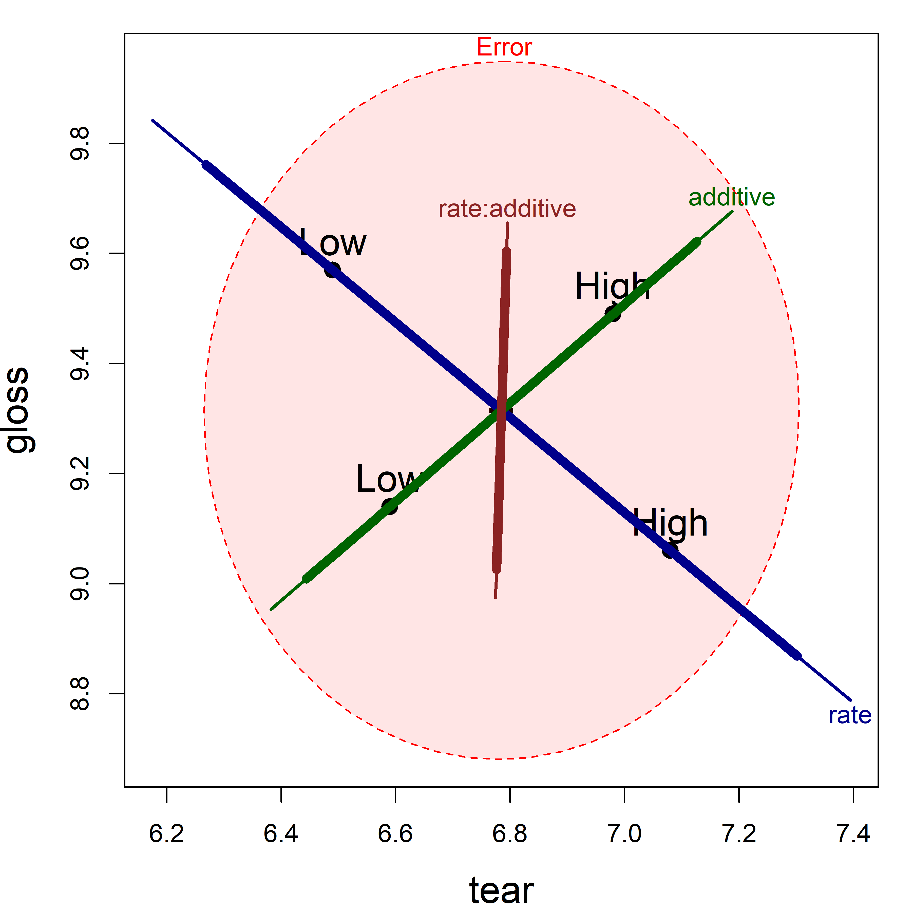
Factorial designs: main effects and interactions
Plastic film data: tear and gloss by rate of extrusion and amount of additive
One H ellipse for each term in the model
Figure 12.11
Notes:
[OPTIONAL for a 45-minute talk] HE plot for the two-way MANOVA of the plastic film data.

Slide 84
MANCOVA: are the regressions the same across groups?
Rohwer data: aptitude and achievement predicted from paired-associate tasks
Overlaid HE plots for the low and high SES groups
Figure 12.25
Notes:
[OPTIONAL for a 45-minute talk] Overlaid HE plots for SAT and PPVT for the two SES groups.

Slide 85
Are the covariance matrices equal?
MANOVA assumes equal within-group covariance matrices
Compare the data ellipse of each group with the pooled one
Look for differences in size and shape
Figure 13.4
Notes:
[OPTIONAL for a 45-minute talk] All pairwise covariance ellipses for the penguin data.

Slide 86
Visualizing Box's M test
Box's M compares the log determinants of the group covariance matrices with that of the pooled matrix.
Figure 13.6
Notes:
[OPTIONAL for a 45-minute talk] Plots of the contributions to Box's M for the penguin and iris data.

Slide 87
Discriminant analysis
MANOVA turned around: predicting the group

Slide 88
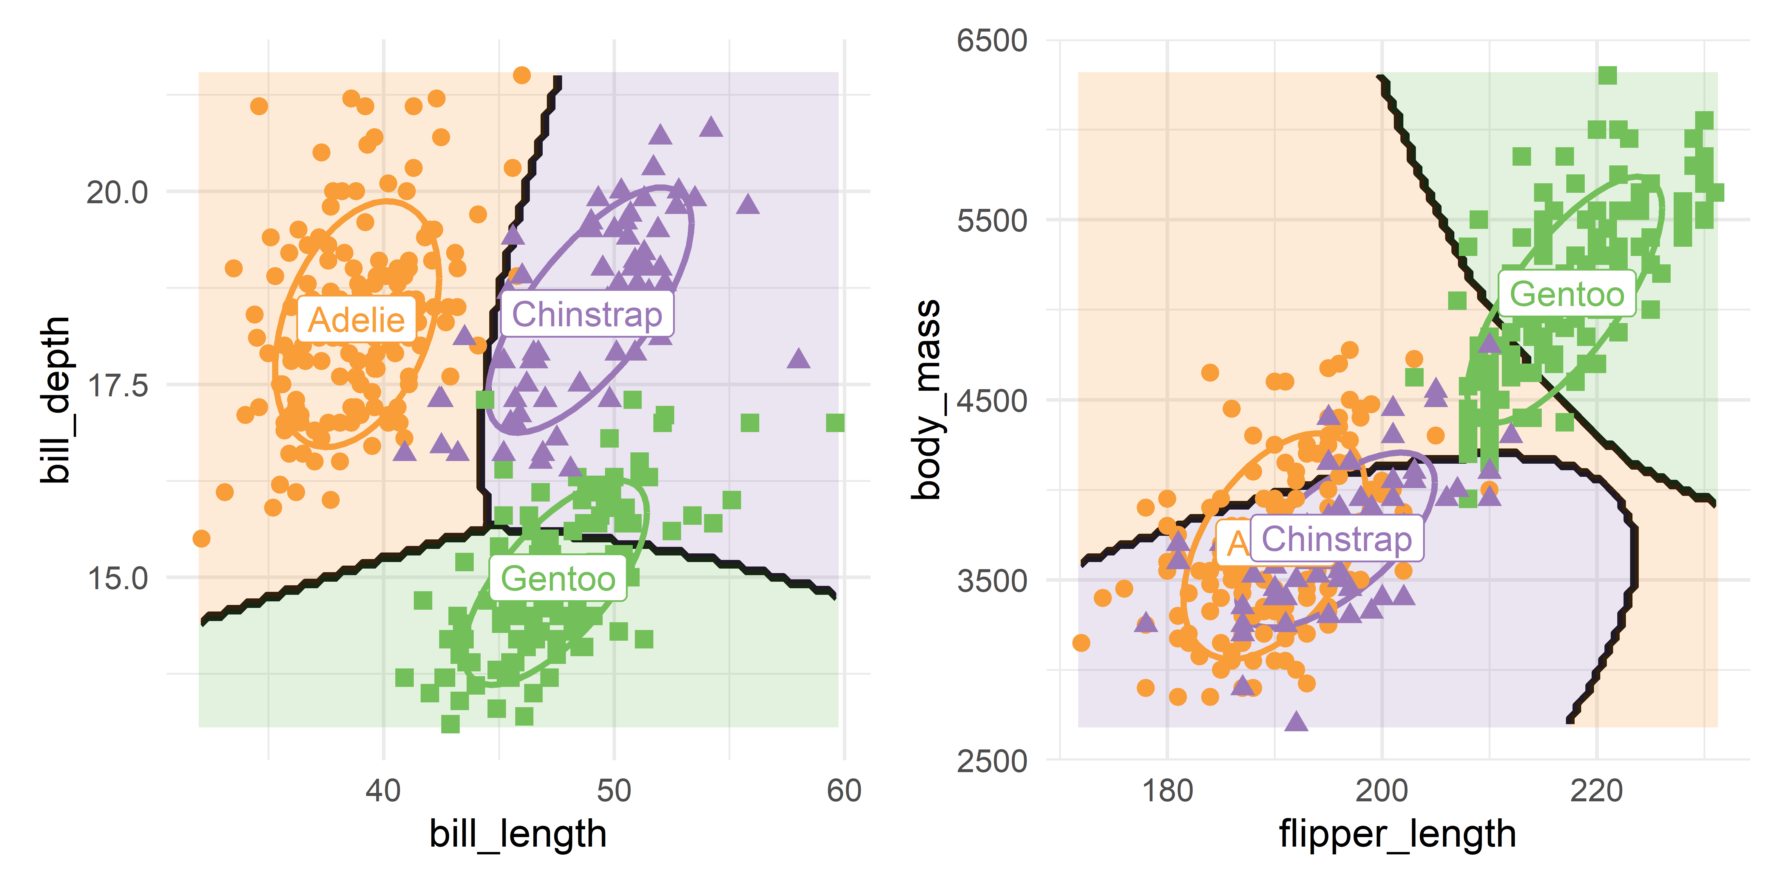
Quadratic discriminant analysis
With a separate covariance matrix for each group, the boundaries become curved.
Notes:
[OPTIONAL for a 45-minute talk] Quadratic discriminant prediction regions for the penguin data.

