Slide 1

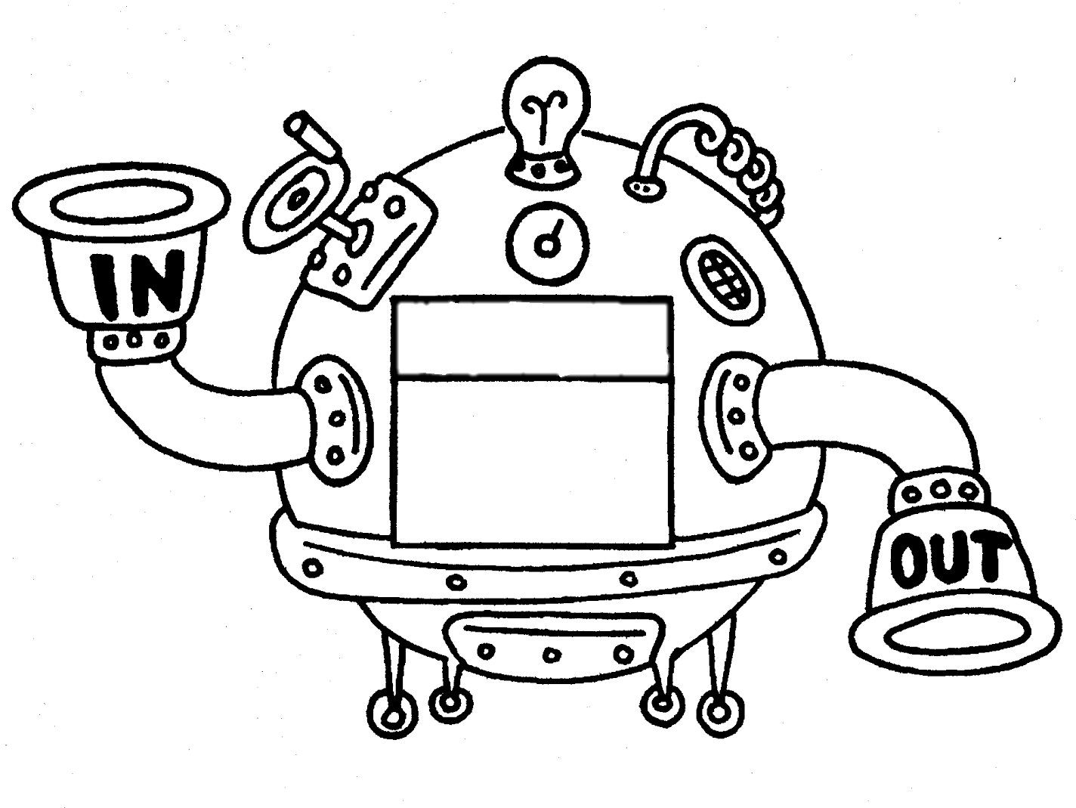

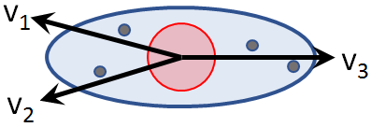
data
MV Juicer
insight
Notes:
With more than a few variables, you can gain greater understanding with a multivariate juicer.
I know this is SO cheesy! But I find this a nice analogy to explain what we do with low-D methods

