Slide 1
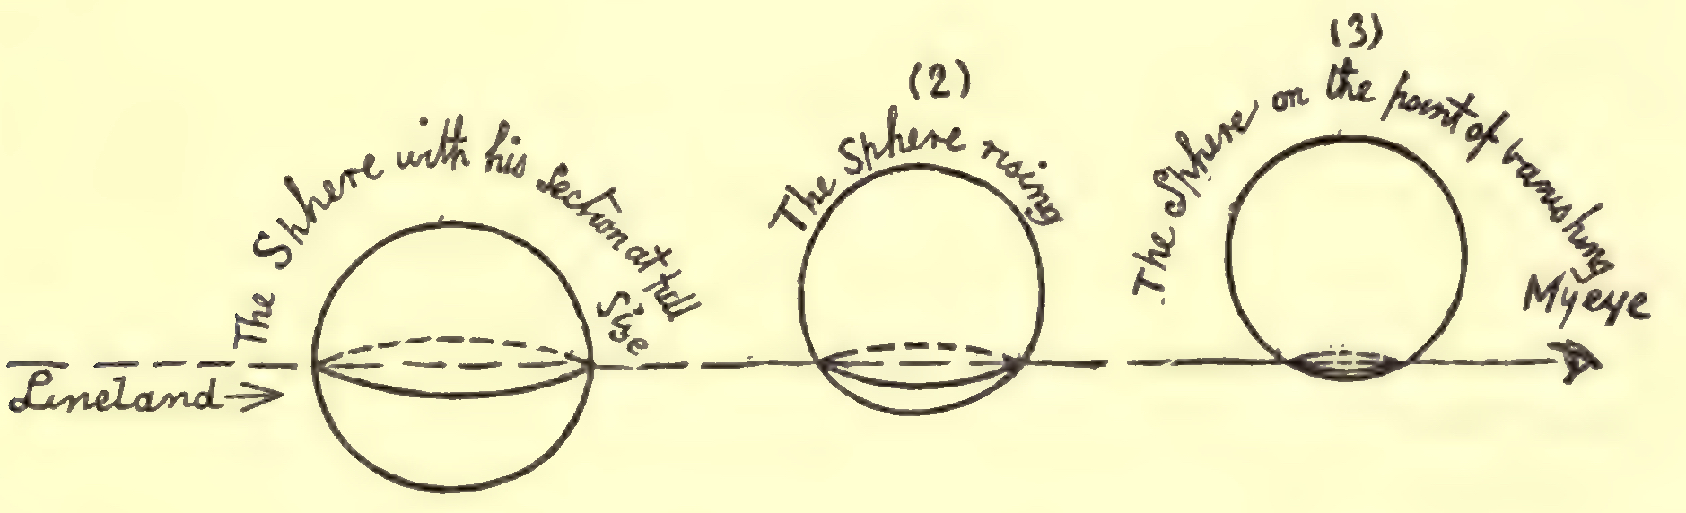
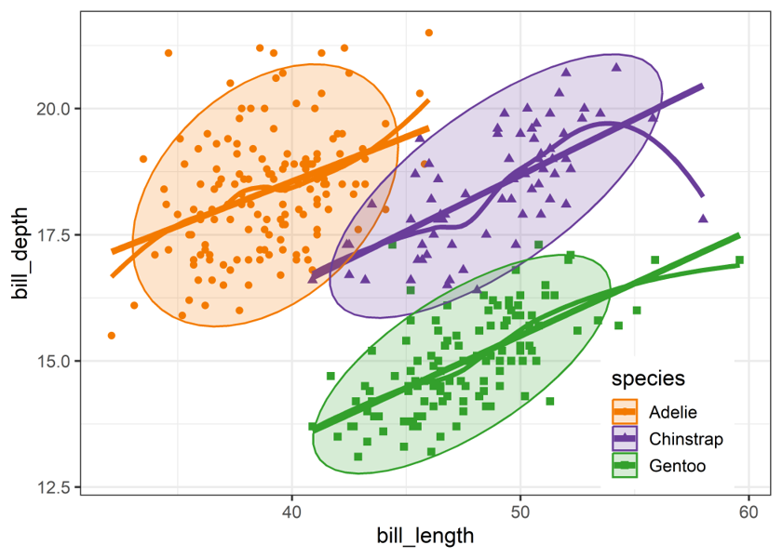
Planeland: we only ever see 2D projections
Abbott's Flatland (1884): a sphere passing through a 2D world is seen as a circle that grows and shrinks
Our 2D plots are Flatland views of data that live in many dimensions
Multivariate visualization is the art of choosing good views
#dataviz is the art of making plots informative (& pretty!)
Truth & Beauty: That’s the Romance!
Figure 1.1
Notes:
The book's subtitle is a nod to Abbott's 'Flatland: A Romance of Many Dimensions'. The Flatlander sees only a slice of the sphere. We are in the same position with p > 2 variables.

Slide 2
Planeland: we only ever see 2D projections
Abbott's Flatland (1884): a sphere passing through a 2D world is seen as a circle that grows and shrinks
Our 2D plots are Flatland views of data that live in many dimensions
Multivariate visualization is the art of choosing good views
#dataviz is the art of making plots informative (& pretty!)
Truth & Beauty: That’s the Romance!
Figure 1.1

Slide 3
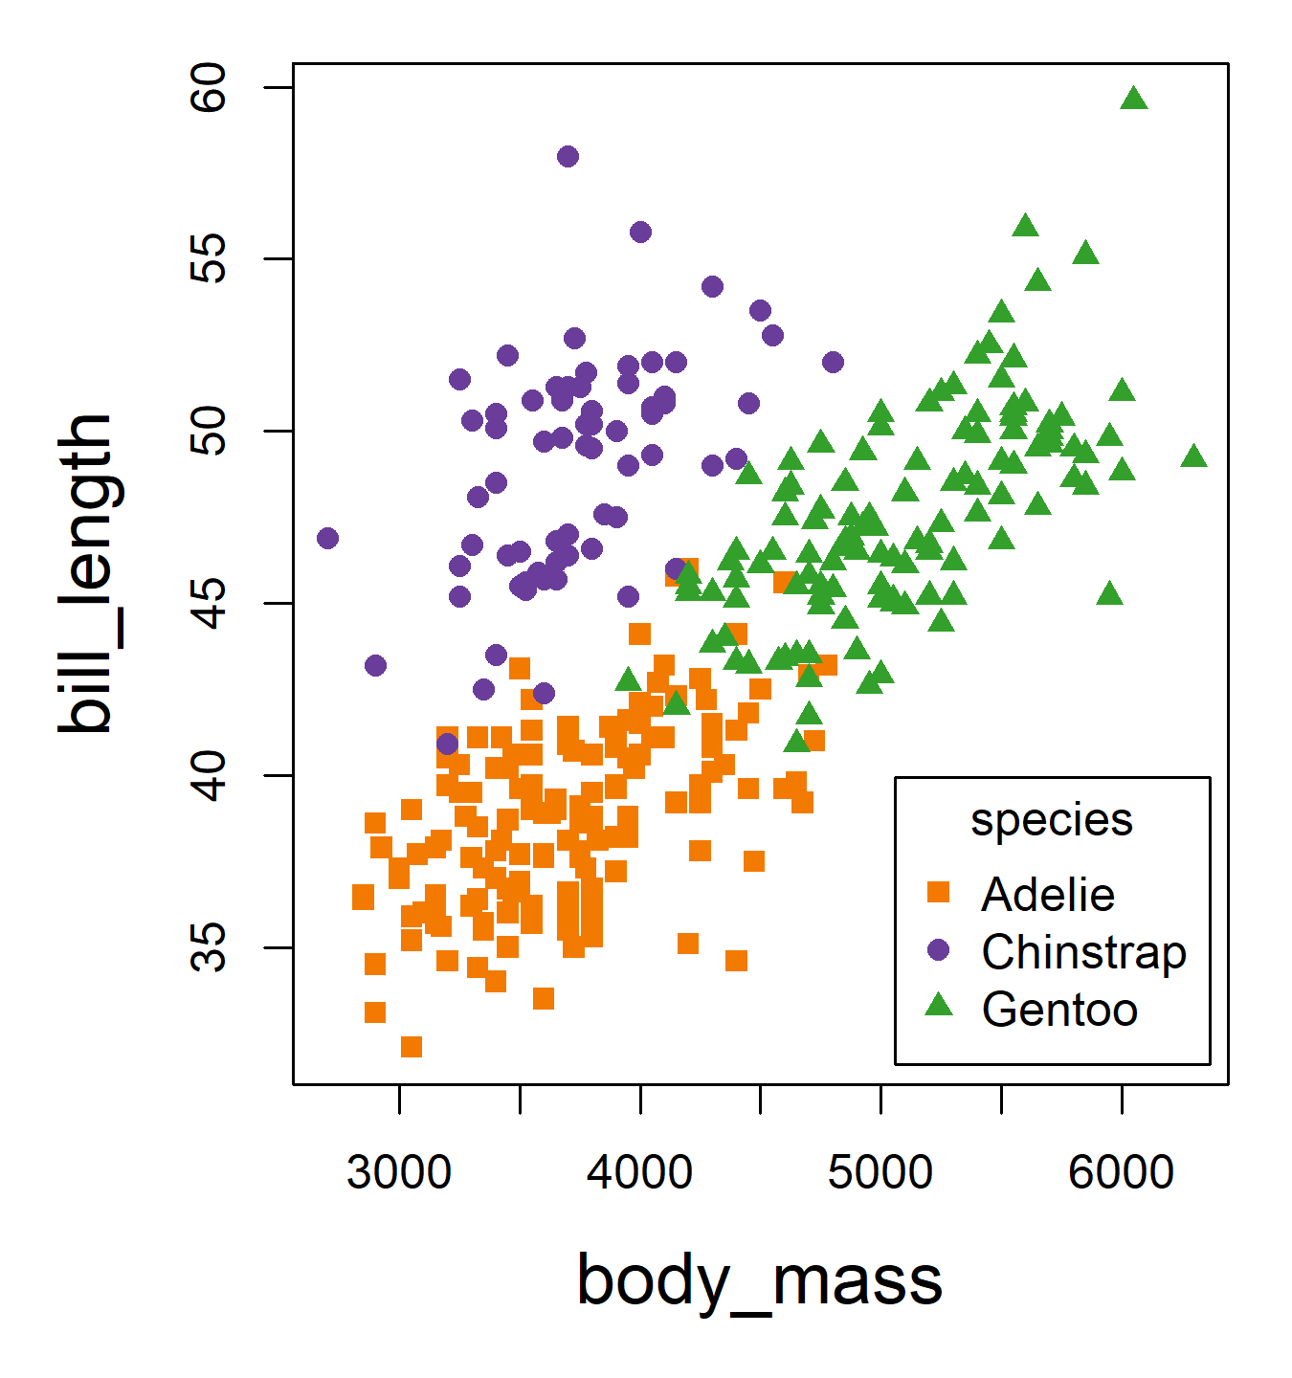
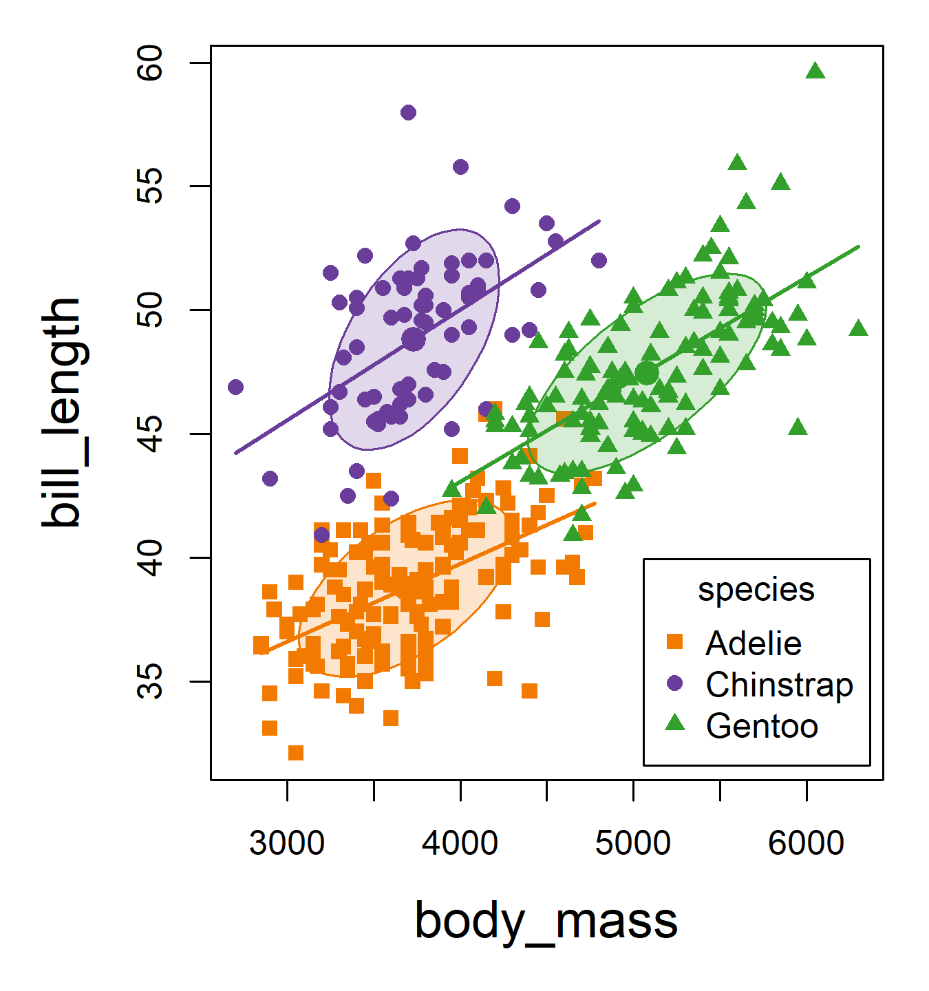
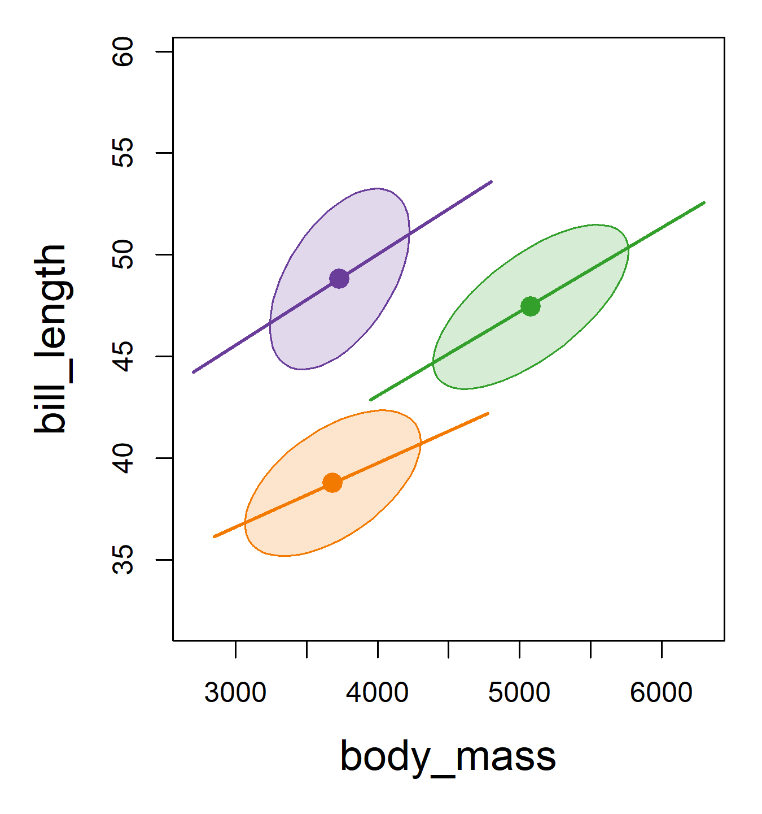
Data ellipses: Sufficient visual summary
Add data ellipses to show w/in group means & scatter (sufficient for N(µ, Σ))
Remove the points to show the overall patterns: means, shape, corr., precision
What remains is all that linear models care about (ellipses can be made robust!)
Standard scatterplot
Add data ellipses
Remove points
Notes:
To illustrate what I mean when I say “sufficient visual summary”– let’s start with an ordinary scatterplot…

Slide 4
Data ellipses: Sufficient visual summary
Add data ellipses to show w/in group means & scatter (sufficient for N(µ, Σ))
Remove the points to show the overall patterns: means, shape, corr., precision
What remains is all that linear models care about (ellipses can be made robust!)
Standard scatterplot
Add data ellipses
Remove points

Slide 5

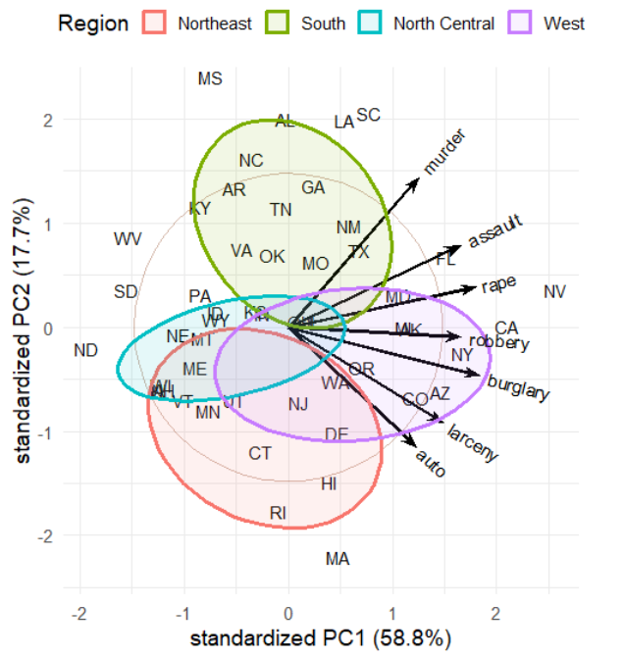
Biplots: observations and variables in one view
Points: observations (US states) in the PC1-PC2 plane
Vectors: variables (crime rates)
  Angles between vectors approximate correlations
  Projecting a point on a vector approximates its value on that variable
Interpretation:
  PC1: Overall crime rate
  PC2: Personal vs. property crime
  Region: summarizes diffs
Figure 5.14
Notes:
Basic biplot of the crime data. The biplot is the low-D view used again and again: for collinearity, for canonical discriminant analysis, and for ridge regression.

Slide 6
Biplots: observations and variables in one view
Points: observations (US states) in the PC1-PC2 plane
Vectors: variables (crime rates)
  Angles between vectors approximate correlations
  Projecting a point on a vector approximates its value on that variable
Interpretation:
  PC1: Overall crime rate
  PC2: Personal vs. property crime
  Region: summarizes diffs
Figure 5.14

Slide 7

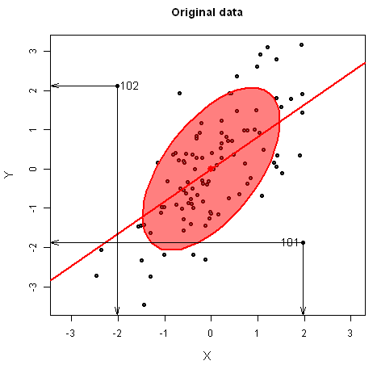
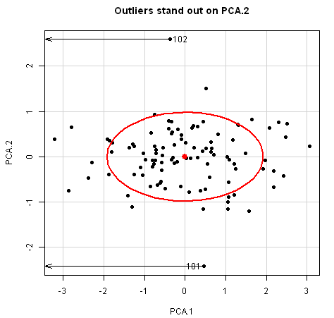
Outlier detection: Waar is Wally?
Multivariate outliers might be invisible in univariate views, but become readily apparent on the smallest principal component
  100 observations on two correlated normal variables with two bivariate outliers near (2,2), (-2, -2)
Data space
Waldo space
Animation: http://www.datavis.ca/gallery/animation/outlier-demo/
Notes:
Like Galton, I’ve been impressed with the insights that can be had from elliptical thinking.
Just a simple demonstration of how outliers become apparent when viewed in the space of small principal components.
I call this Waldo space, by analogy with Martin Hansford’s popular books, Where’s Waldo? (Waar is Wally? in Dutch)

Slide 8
Outlier detection: Waar is Wally?
Multivariate outliers might be invisible in univariate views, but become readily apparent on the smallest principal component
  100 observations on two correlated normal variables with two bivariate outliers near (2,2), (-2, -2)
Data space
Waldo space
Animation: http://www.datavis.ca/gallery/animation/outlier-demo/

Slide 9
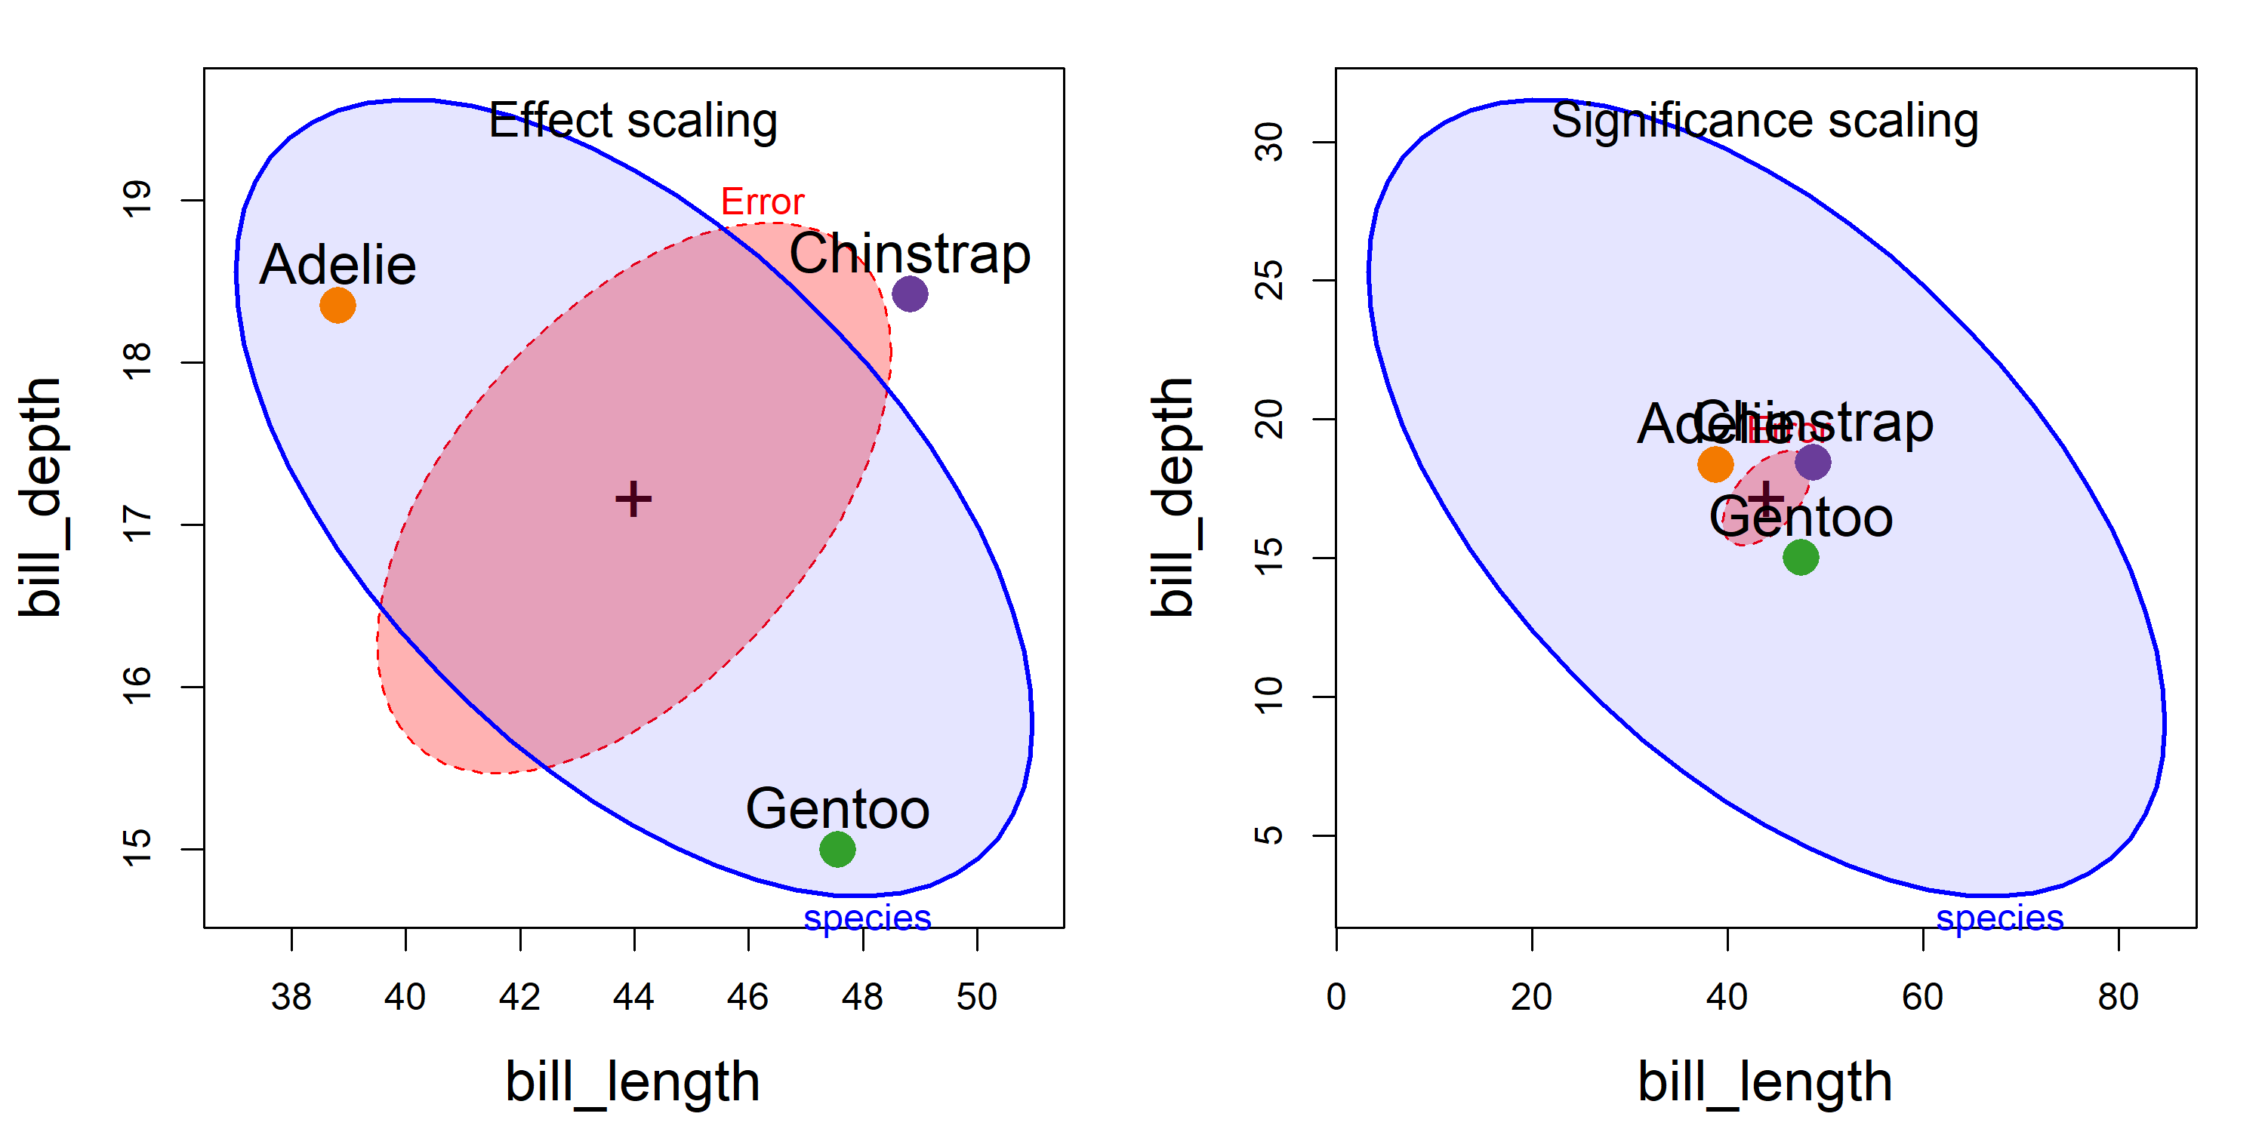
HE plots: Effect scaling vs. Significance scaling
Effect scaling: Plot ellipses for H & E directly
Significance scaling: Scale H so an H ellipse that projects outside E signals a significant effect (Roy's test).
Direction of H vs. E shows how groups differ in a data-space view
cf. Figure 12.5
Notes:
HE plots for bill depth vs bill length in the penguin data, with effect scaling (left) and significance scaling (right).
E: within-group variation. H: variation of the group means.
The orientation of H shows how the groups differ. The species effect is so strong that, with significance scaling, H dwarfs E.

Slide 10
HE plots: Effect scaling vs. Significance scaling
Effect scaling: Plot ellipses for H & E directly
Significance scaling: Scale H so an H ellipse that projects outside E signals a significant effect (Roy's test).
Direction of H vs. E shows how groups differ in a data-space view
cf. Figure 12.5

Slide 11
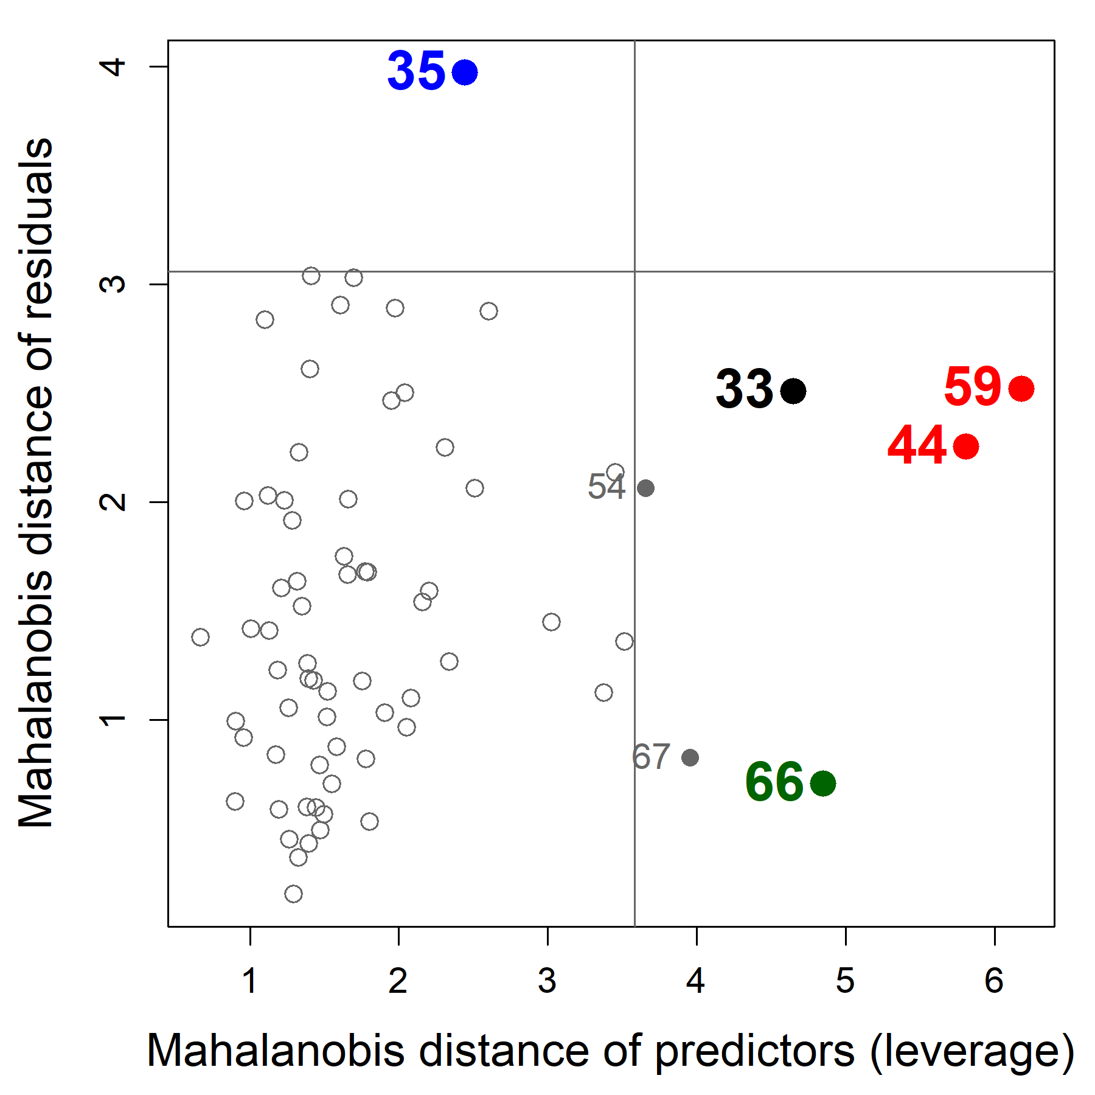
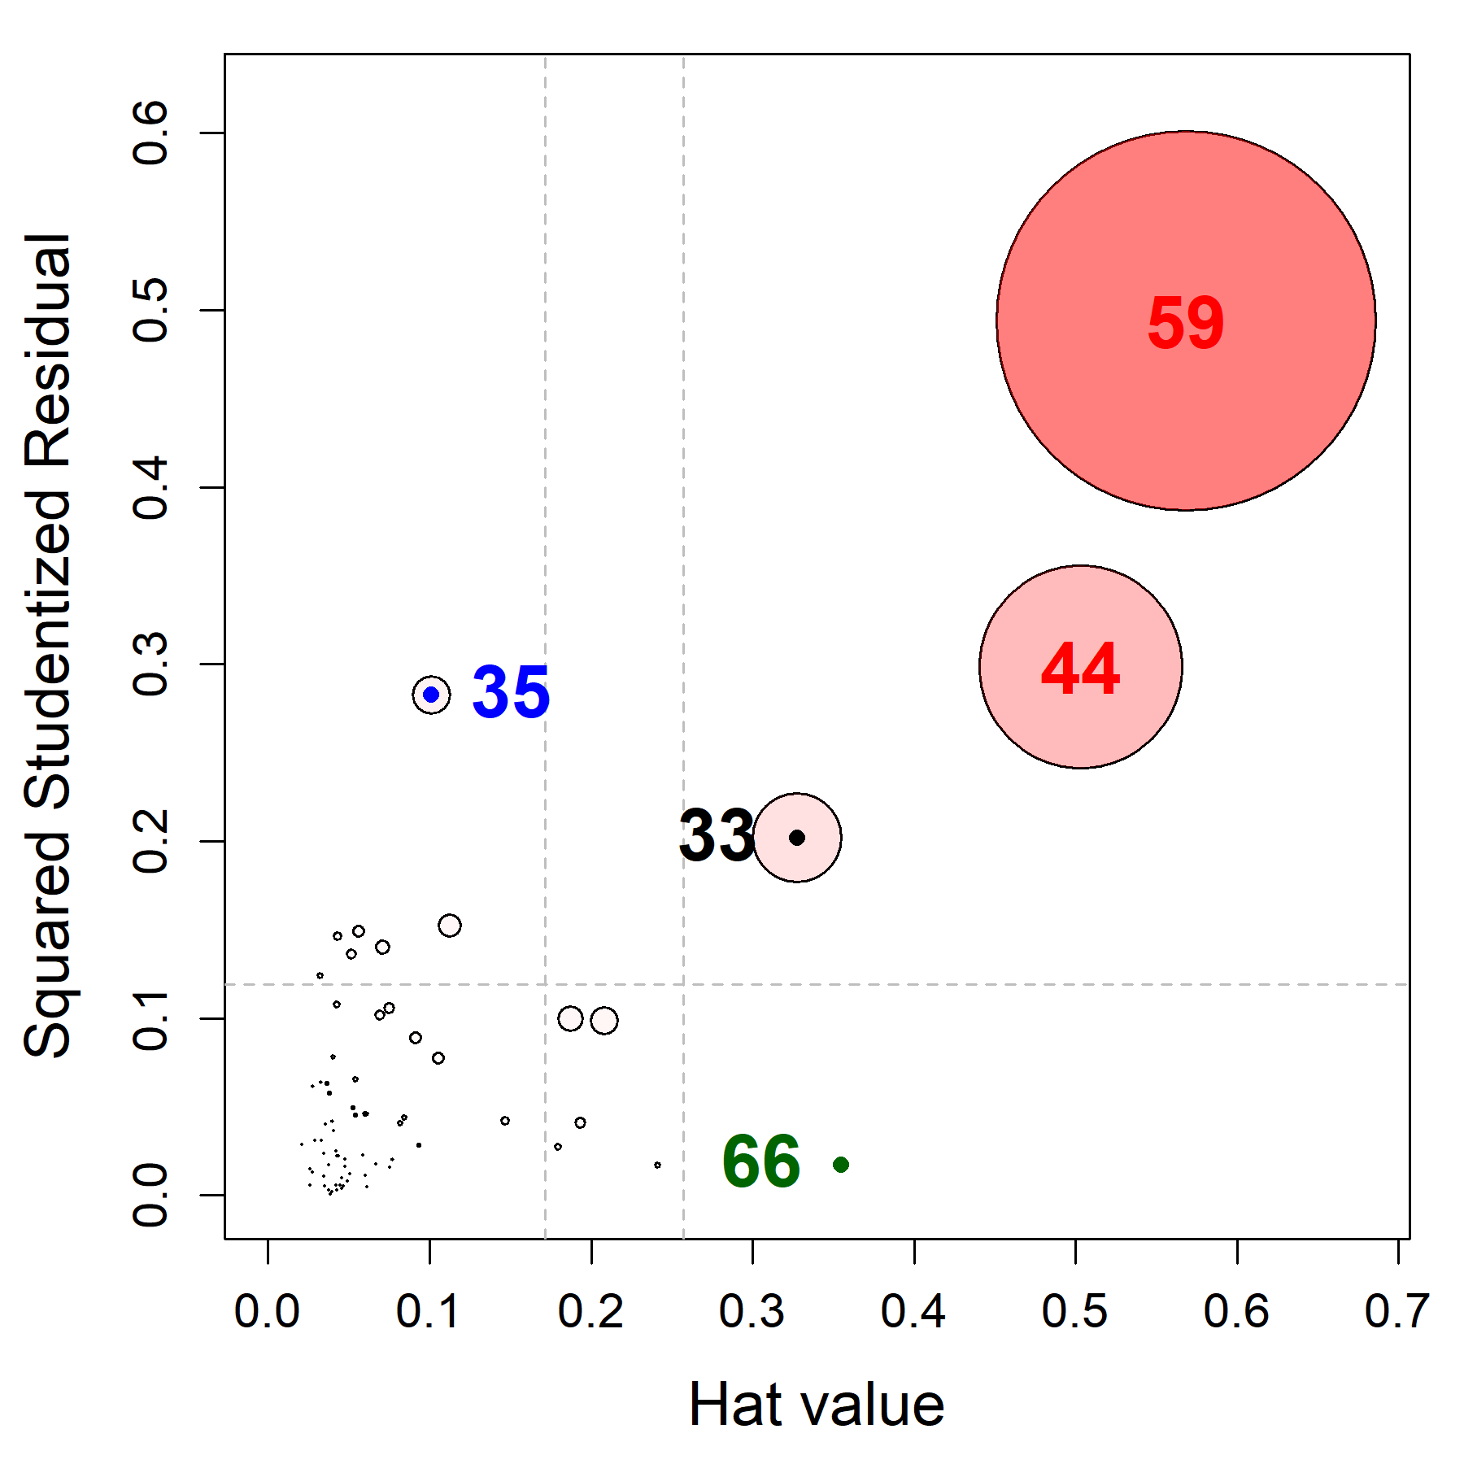
Unusual is not the same as influential
Distance plot: where is it unusual?
Influence plot: does it matter?
School data: 70 schools, 3 outcomes, 5 predictors
Distance plot: predictor distance (leverage) vs. residual distance (outliers)
Lines: cutoffs for “large”
Influence plot: bubble size ~ multivariate Cook’s D
44, 59: high leverage and influential
35: an outlier, but little influence
66: high leverage, but harmless
Refit without 44 and 59: the same three predictors stay significant, but the reading and mathematics coefficients change by 77–104% for visit and over 300% for counseling.
Figure 11.18, 11.19
Notes:
The distance plot is one of the figures the organizer singled out. School data model: reading, mathematics and self-esteem on five predictors, 70 schools. Distance plot (heplots::distancePlot) and influence plot (mvinfluence::influencePlot), re-drawn as a matched pair with the same cases in the same colors (talks/R/school-diagnostics.R).
Click 1: influence plot. Click 2: sensitivity analysis. Cook's D: 59 = 2.99, 44 = 1.60, 33 = 0.71, 35 = 0.30, 66 = 0.07. Without 44 and 59, education, occupation and visit remain significant; relative change in coefficients: visit 104% (reading), 77% (math); counseling 332%, 305%.

Slide 12
Unusual is not the same as influential
Distance plot: where is it unusual?
Influence plot: does it matter?
School data: 70 schools, 3 outcomes, 5 predictors
Distance plot: predictor distance (leverage) vs. residual distance (outliers)
Lines: cutoffs for “large”
Influence plot: bubble size ~ multivariate Cook’s D
44, 59: high leverage and influential
35: an outlier, but little influence
66: high leverage, but harmless
Refit without 44 and 59: the same three predictors stay significant, but the reading and mathematics coefficients change by 77–104% for visit and over 300% for counseling.
Figure 11.18, 11.19

