Slide 1
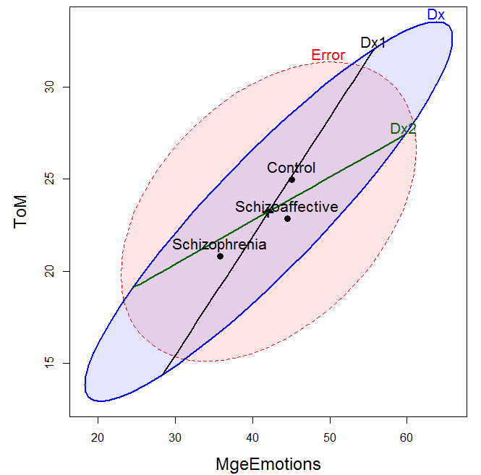
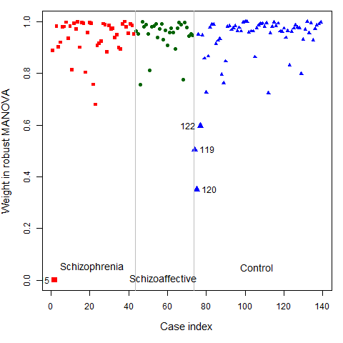
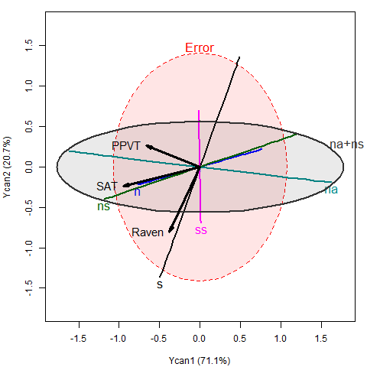
Visualizing Linear Models: An R Bag of Tricks Session 3: Examples & Extensions
Michael Friendly
SCS Short Course
Oct-Nov, 2022
https://friendly.github.io/VisMLM-course/

Slide 2
Today’s topics
Manipulating & visualizing models
MANOVA examples
Distinguishing among psychiatric groups
Robust MLMs: down-weighting outliers
Multivariate regression
PA tests & ability
Canonical correlation
MANCOVA & homogeneity of regression
Homogeneity of (co)variance
Visualizing Box’s M test

Slide 3
Manipulating & visualizing models
R modeling functions [lm(), glm(), …] return model objects, but these are “messy”
extracting coefficients takes several steps: data.frame(coef(mymod))
some info (R², F, p.value) is computed in print() method, not stored
can’t easily combine models
Some have associated plotting functions
plot(model): diagnostic plots
car package: many model plot methods
effects package: plot effects for model terms
But what if you want to:
make a table of model summary statistics
fit a collection of models, compare, summarize or visualize them?

Slide 4

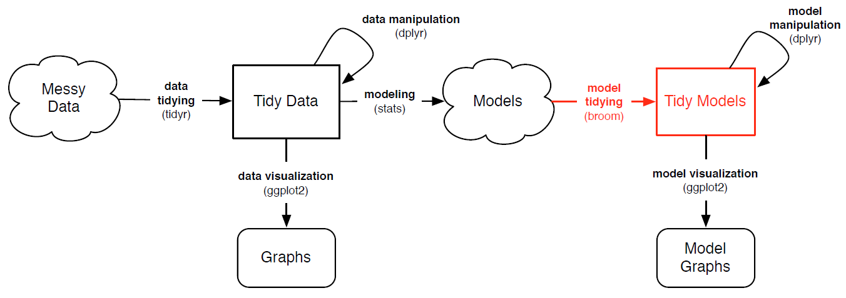
broom: manipulating models
The broom package turns model objects into tidy data frames
glance(models) extracts model-level summary statistics (R², df, AIC, BIC)
tidy(models) extracts coefficients, SE, p-values
augment(models) extracts observation-level info (residuals, …)
Image from: https://opr.princeton.edu/workshops/Downloads/2016Jan_BroomRobinson.pdf

Slide 5

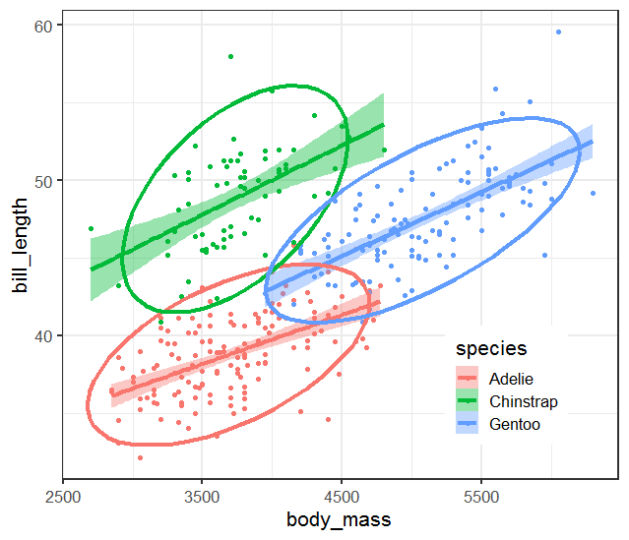
Example: Penguin data
Say we want to model the length of penguin bills
Potential predictors: body_mass, species, sex, island, …
ggplot(data=peng, aes(x=body_mass, y=bill_length, color=species, fill=species)) +
geom_point() +
geom_smooth(method = "lm", size=1.5) +
stat_ellipse(size=1.5)
How to extract & plot model statistics?
How to fit multiple models for subsets (by: sex, island)?

Slide 6
Predict bill_length from body_mass, species, sex, island
peng.mod0 <- lm(bill_length ~ body_mass + species + sex + island, data=peng)
summary(peng.mod0)
Call:
lm(formula = bill_length ~ body_mass + sex + species + island, data = peng)
Residuals:
Min 1Q Median 3Q Max
-6.938 -1.473 0.002 1.257 10.490
Coefficients:
Estimate Std. Error t value Pr(>|t|)
(Intercept) 31.237676 1.378201 22.67 < 2e-16 ***
body_mass 0.001744 0.000394 4.43 1.3e-05 ***
sexm 2.532799 0.361396 7.01 1.4e-11 ***
speciesChinstrap 10.281510 0.410391 25.05 < 2e-16 ***
speciesGentoo 6.149100 0.672481 9.14 < 2e-16 ***
islandDream -0.463555 0.457443 -1.01 0.31
islandTorgersen 0.092246 0.474401 0.19 0.85
---
Signif. codes: 0 ‘***’ 0.001 ‘**’ 0.01 ‘*’ 0.05 ‘.’ 0.1 ‘ ’ 1
Residual standard error: 2.26 on 326 degrees of freedom
Multiple R-squared: 0.832, Adjusted R-squared: 0.829
F-statistic: 269 on 6 and 326 DF, p-value: <2e-16
observation level
component level (coefficients)
model level

Slide 7
glance() gives the model level summary statistics
> glance(peng.mod0)
r.squared adj.r.squared sigma statistic p.value df logLik AIC BIC deviance df.residual
1 0.832 0.829 2.26 269. 4.60e-123 6 -741. 1497. 1528. 1667. 326
tidy() gives the model component (term) statistics
> tidy(peng.mod0)
term estimate std.error statistic p.value
1 (Intercept) 31.2 1.38 22.7 5.90e-69
2 body_mass 0.00174 0.000394 4.43 1.29e- 5
3 sexm 2.53 0.361 7.01 1.39e-11
4 speciesChinstrap 10.3 0.410 25.1 5.61e-78
5 speciesGentoo 6.15 0.672 9.14 6.65e-18
6 islandDream -0.464 0.457 -1.01 3.12e- 1
7 islandTorgersen 0.0922 0.474 0.194 8.46e- 1
augment() gives the observation level statistics
> augment(peng.mod0) %>% sample_n(5)
bill_length body_mass sex species island .fitted .resid .hat .sigma .cooksd .std.resid
<dbl> <int> <fct> <fct> <fct> <dbl> <dbl> <dbl> <dbl> <dbl> <dbl>
1 35.7 3150 f Adelie Biscoe 36.7 -1.03 0.0273 2.26 0.000858 -0.463
2 39.7 3550 m Adelie Biscoe 40.0 -0.263 0.0331 2.26 0.0000684 -0.118
3 41.1 4050 m Adelie Biscoe 40.8 0.265 0.0257 2.26 0.0000532 0.119
4 49.3 4050 m Chinstrap Dream 50.7 -1.35 0.0177 2.26 0.000939 -0.604
5 48.4 5850 m Gentoo Biscoe 50.1 -1.72 0.0169 2.26 0.00145 -0.769

Slide 8
Fitting multiple models
With dplyr::nest_by(), you can fit one model for each subset of the data
Feed this to broom::glance() to get model-level statistics
models <- peng |>
nest_by(species, sex) |>
mutate(model = list(lm(bill_length ~ body_mass, data = data)))
models |>
summarise(broom::glance(model), .groups = "keep") |>
select(species, sex, r.squared, sigma, statistic, p.value, nobs)
# A tibble: 6 x 7
# Groups: species, sex [6]
species sex r.squared sigma statistic p.value nobs
<fct> <fct> <dbl> <dbl> <dbl> <dbl> <int>
1 Adelie f 0.0289 2.01 2.12 0.150 73
2 Adelie m 0.0486 2.24 3.62 0.0610 73
3 Chinstrap f 0.0760 3.03 2.63 0.115 34
4 Chinstrap m 0.0568 1.54 1.93 0.175 34
5 Gentoo f 0.0739 1.99 4.47 0.0389 58
6 Gentoo m 0.153 2.52 10.7 0.00182 61

Slide 9
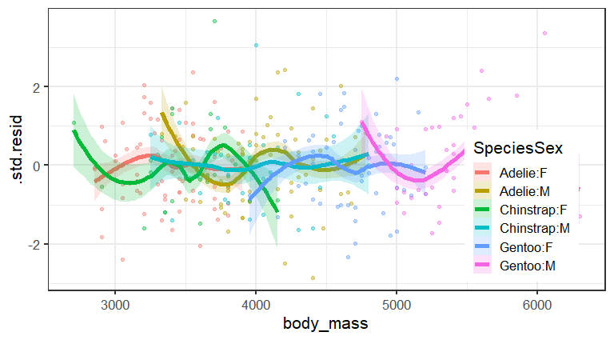
Plotting via broom::augment
models |>
summarise(broom::augment(model), .groups = "keep") |>
mutate(
sex = stringr::str_to_upper(sex),
SpeciesSex = forcats::fct_cross(species, sex)) |> # Combine species and sex
ggplot(aes(x=body_mass, y=.std.res, color=SpeciesSex, fill=SpeciesSex)) +
geom_point(alpha=0.4) +
geom_smooth(method = "lm", size = 2, alpha=0.3)

Slide 10
Ex: Neuro- & Social-Cognitive measures in psychiatric groups
A study by Leah Hartman @York examined whether patients classified as ‘schizophrenic’ or ‘schizoaffective’ (on DSM-IV) could be distinguished from a normal, control sample on standardized tests in the following domains:
Neuro-Cognitive: processing speed, attention, verbal learning, visual learning, problem solving
Social-cognitive: managing emotions, theory of mind, externalizing bias, personalizing bias
Research questions → MANOVA contrasts
Analyze neuro-cog (NC) and social-cog (SC) separately
Do the two psychiatric groups differ from the controls?
Do the psychiatric groups differ from each other?
See: Friendly & Sigal (2017), Graphical Methods for Multivariate Linear Models in Psychological Research: An R Tutorial The Quantitative Methods for Psychology, 13, 20-45, http://dx.doi.org/10.20982/tqmp.13.1.p020

Slide 11

Schizophrenia symptoms: Hallucinations, disorganized thinking, delusions, …
Schizoaffective disorder combines symptoms of schizophrenia with mood disorder (bipolar or depression)

Slide 12
Neuro-cognitive measures
Data
> data(NeuroCog, package=“heplots”)
> car::some(NeuroCog)
Dx Speed Attention Memory Verbal Visual ProbSolv SocialCog Age Sex
14 Schizophrenia 19 9 19 33 24 39 28 44 Female
88 Schizoaffective 27 44 24 33 26 31 36 53 Female
105 Schizoaffective 23 41 42 48 46 29 50 52 Female
114 Schizoaffective 41 53 47 39 30 50 63 32 Female
130 Control 44 25 21 37 32 43 29 43 Female
165 Control 35 35 43 53 57 37 40 30 Male
194 Control 47 40 53 53 40 45 49 55 Female
diagnostic group --------------- neuro-cognitive measures ----------- ---------- ignored ------
Questions:
Do the diagnostic groups differ collectively on the neuro-cognitive measures?
How do group differences relate to research hypotheses?
How many dimensions (aspects) are reflected in the differences among means?

Slide 13
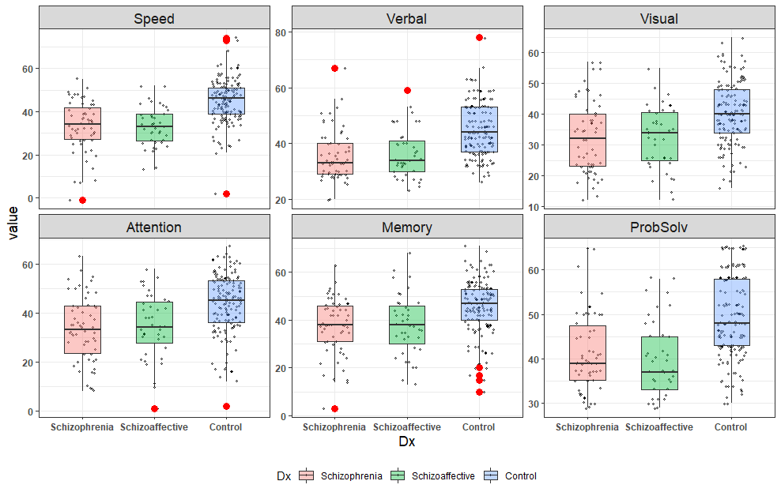
NeuroCog: EDA
Always plot the data first!
With boxplots, often useful to show more: jittered points show the data
What can we see here?

Slide 14
How did I make this plot?
Reshape the data wide → long
ggplot() + geom_jitter() + geom_boxplot() + facet_wrap(~response)
NC_long <- NeuroCog |>
select(-SocialCog, -Age, -Sex) |>
tidyr::gather(key = response, value = "value", Speed:ProbSolv)
# show a few observations
library(dplyr)
NC_long |>
group_by(Dx) |>
sample_n(4) |>
ungroup()
Dx response value
1 Schizophrenia Verbal 37
2 Schizophrenia Speed 49
3 Schizophrenia ProbSolv 61
4 Schizophrenia Visual 23
5 Schizoaffective Attention 11
6 Schizoaffective Speed 39
7 Schizoaffective Visual 41
8 Schizoaffective Memory 54
9 Control Speed 57
10 Control Memory 45
11 Control Speed 41
12 Control ProbSolv 61

Slide 15
How did I make this plot?
Reshape the data wide → long
ggplot() + geom_jitter() + geom_boxplot() + facet_wrap(~response)
ggplot(NC_long, aes(x=Dx, y=value, fill=Dx)) +
geom_jitter() +
geom_boxplot() +
facet_wrap(~response, scales = "free_y") +
theme_bw()

Slide 16
Neuro-cognitive measures: Analyses
Could do a series of univariate ANOVAs
car::Anova(NC.mlm1 <- lm (Speed ~ DX, data=NeuroCog))
car::Anova(NC.mlm2 <- lm (Attention ~ DX, data=NeuroCog))
car::Anova(NC.mlm3 <- lm (Memory ~ DX, data=NeuroCog))
…
Better: MANOVA test for all 6 responses together
Research hypotheses: test contrasts
Dx1: Control – (Schiz + SchizAff)/2 = 0 → linearHypotheses(NC.mlm, “Dx1”)
Dx2: Schiz – SchAff = 0 → linearHypotheses(NC.mlm, “Dx2”)
Dimensions:
Canonical analysis → NC.can <- candisc(NC.mlm); plot(NC.can)
Canonical HE plot → heplot(NC.can)
Tech note: anova() in base R vs. car::Anova
anova() uses only Type 1 (sequential) tests, rarely useful; doesn’t handle MLM well
car::Anova() provides Type 2, 3 (partial) tests; give sensible results for MLMs
car::linearHypotheses() gives univariate and multivariate tests of contrasts
Anova(NC.mlm = lm(cbind(Speed, Attention, Memory, …) ~ Dx, data=NeuroCog )
✗
✓
✓

Slide 17
Tidy univariate analyses: F-tests
Using broom::tidy() we can fit a separate univariate ANOVA model for each response
I’ve used some tidyverse magic to make a nicely formatted table of F values
NC_long |>
mutate(response = factor(response, levels=unique(response))) |> # keep variable order
group_by(response) |>
do(tidy(anova(lm(value ~ Dx, .)))) |> # run anova on each submodel
filter(term != "Residuals") |>
select(-term) |>
rename(F = statistic, df1 = df, # use more specific names
SS = sumsq, MS =meansq) |>
mutate(df2 = 239) |> # kludge: extract dfe from object?
relocate(df2, .after = df1) |>
mutate(signif = noquote(gtools::stars.pval(p.value))) |> # add significance stars
mutate(p.value = noquote(scales::pvalue(p.value))) # format p.values nicely
response df1 df2 SS MS F p.value signif
<fct> <int> <dbl> <dbl> <dbl> <dbl> <noquote> <noquote>
1 Speed 2 239 8360. 4180. 37.1 <0.001 ***
2 Attention 2 239 5579. 2790. 17.4 <0.001 ***
3 Memory 2 239 3764. 1882. 13.9 <0.001 ***
4 Verbal 2 239 4672. 2336. 27.3 <0.001 ***
5 Visual 2 239 3692. 1846. 16.6 <0.001 ***
6 ProbSolv 2 239 4165. 2083. 25.1 <0.001 ***
All variables are signif.

Slide 18
Tidy univariate analyses: t-tests
Can do the same to extract the t-tests for coefficients or contrasts in the univariate models for each response
NC_long |>
mutate(response = factor(response, levels=unique(response))) |>
group_by(response) |>
do(tidy(lm(value ~ Dx, .))) |>
filter(term != "(Intercept)") |>
mutate(signif = noquote(gtools::stars.pval(p.value))) |>
mutate(p.value = noquote(scales::pvalue(p.value)))
response term estimate std.error statistic p.value signif
<fct> <chr> <dbl> <dbl> <dbl> <noquote> <noquote>
1 Speed Dx1 7.99 0.940 8.51 <0.001 ***
2 Speed Dx2 -0.0252 1.10 -0.0229 0.982
3 Attention Dx1 6.44 1.12 5.75 <0.001 ***
4 Attention Dx2 -0.558 1.31 -0.426 0.671
5 Memory Dx1 5.31 1.03 5.16 <0.001 ***
6 Memory Dx2 -0.375 1.20 -0.311 0.756
7 Verbal Dx1 5.91 0.818 7.22 <0.001 ***
8 Verbal Dx2 -0.442 0.957 -0.461 0.645
9 Visual Dx1 5.31 0.933 5.69 <0.001 ***
10 Visual Dx2 -0.0371 1.09 -0.0340 0.973
11 ProbSolv Dx1 5.70 0.807 7.07 <0.001 ***
12 ProbSolv Dx2 0.719 0.944 0.762 0.447

Slide 19
Neuro-cognitive measures: MANOVA
Multivariate tests are more straight-forward & comprehensive
# fit the MANOVA model
NC.mlm <- lm(cbind(Speed, Attention, Memory, Verbal, Visual, ProbSolv) ~ Dx,
data=NeuroCog)
Anova(NC.mlm)
Type II MANOVA Tests: Pillai test statistic
Df test stat approx F num Df den Df Pr(>F)
Dx 2 0.2992 6.8902 12 470 1.562e-11 ***
---
Signif. codes: 0 ‘***’ 0.001 ‘**’ 0.01 ‘*’ 0.05 ‘.’ 0.1 ‘ ’ 1
✓
So, the groups differ. But how?
What about the research hypotheses?
> contrasts(NeuroCog$Dx)
[,1] [,2]
Schizophrenia -0.5 1
Schizoaffective -0.5 -1
Control 1.0 0
Dx1: Control – (Schiz + SchizAff)/2 = 0

Slide 20
Neuro-cognitive measures: Contrasts
A simple result: Control ≠ (Schizophrenia ≈ Schizoaffective)
> print(car::linearHypothesis(NC.mlm, "Dx1"), SSP=FALSE)
Multivariate Tests:
Df test stat approx F num Df den Df Pr(>F)
Pillai 1 0.289 15.9 6 234 2.8e-15 ***
Wilks 1 0.711 15.9 6 234 2.8e-15 ***
Hotelling-Lawley 1 0.407 15.9 6 234 2.8e-15 ***
Roy 1 0.407 15.9 6 234 2.8e-15 ***
---
Signif. codes: 0 ‘***’ 0.001 ‘**’ 0.01 ‘*’ 0.05 ‘.’ 0.1 ‘ ’ 1
> print(car::linearHypothesis(NC.mlm, "Dx2"), SSP=FALSE)
Multivariate Tests:
Df test stat approx F num Df den Df Pr(>F)
Pillai 1 0.006 0.249 6 234 0.96
Wilks 1 0.994 0.249 6 234 0.96
Hotelling-Lawley 1 0.006 0.249 6 234 0.96
Roy 1 0.006 0.249 6 234 0.96
✓
✗

Slide 21
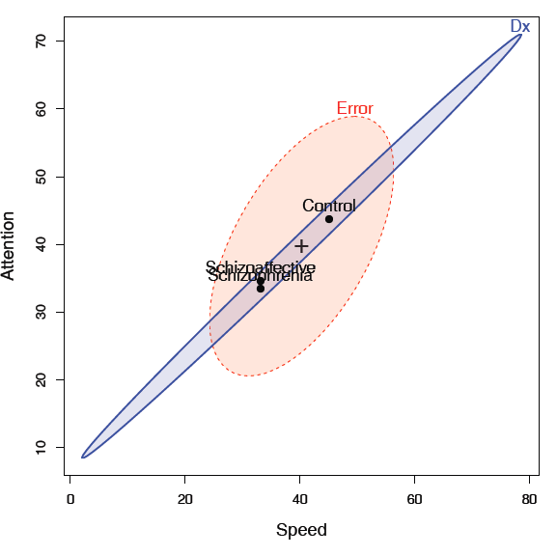
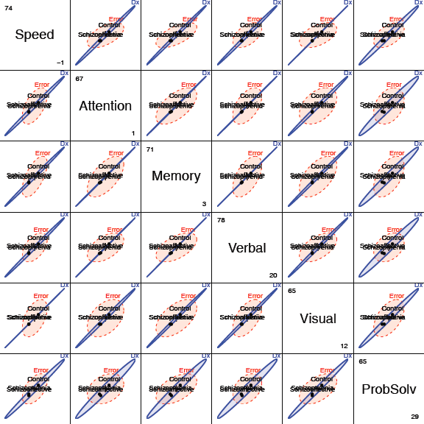
Visualize me: in data space
# Bivariate view for any 2 responses:
heplot(NC.mlm, var=1:2, ...)
# HE plot matrix: for all responses
pairs(NC.mlm, ...)
Wow! All neuro-cog measures highly correlated in group means!
Only 1 dim. of H variation

Slide 22
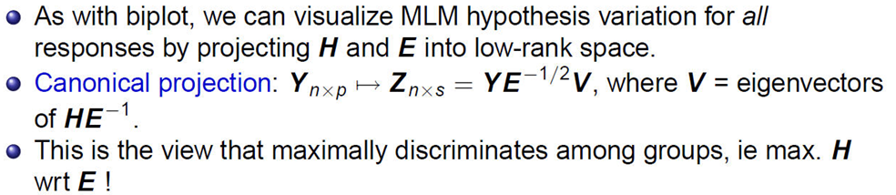
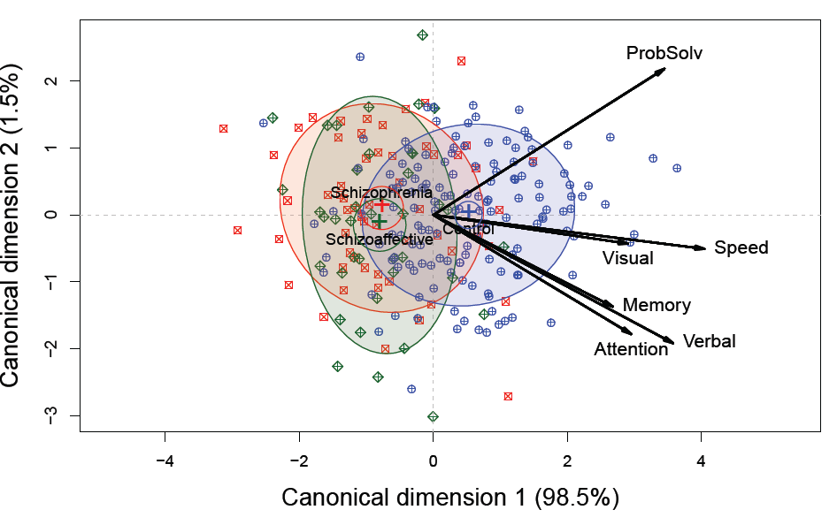
Visualize me: in canonical space
Very simple interpretation
Can1: normal vs. others
All vars highly + correlated;
Can2: only 1.5%, NS; but perhaps suggestive (ProbSolv vs. Attention)

Slide 23
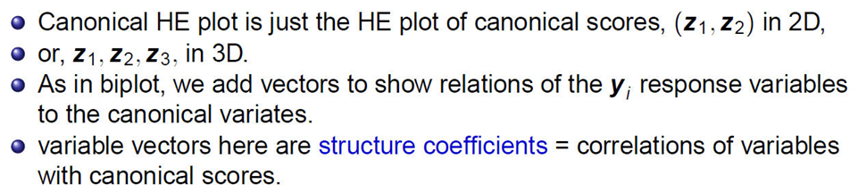
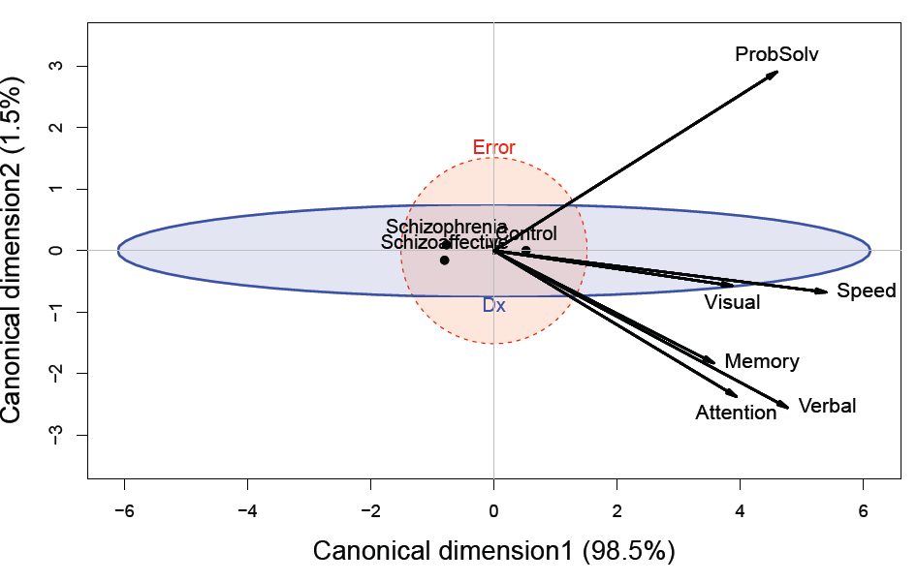
Visualize me: canonical HE plots
The multivariate “juicer”
Shows just group means, H ellipse & E ellipse
Variable vectors offer interpretation of Can dimensions.

Slide 24
Social cognitive measures
These measures deal with the person’s perception and cognitive processing of emotions of others
Scales: managing emotions, theory of mind, externalizing bias, personalizing bias
Questions:
Do these differentiate normal from patient groups?
Can they distinguish between schizophrenic & schizoaffective
If so, this could be a major finding.

Slide 25
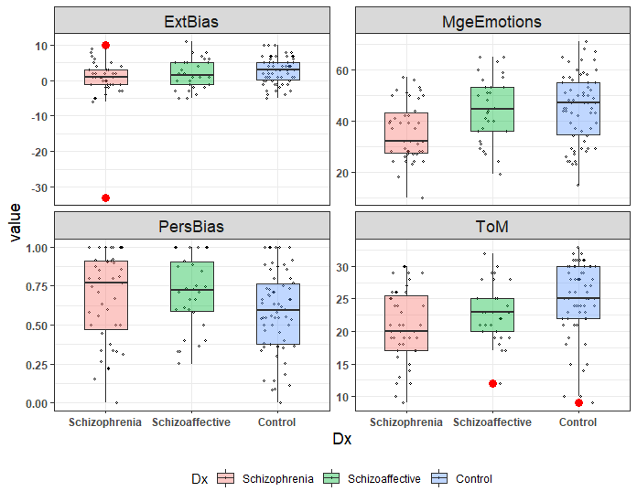
SocialCog: EDA
Again, it is helpful to plot the data!
Same steps: (a) Reshape to long; (b) ggplot() + … + facet_wrap(~response)
What can we see here?
How do groups differ?
Unusual features?

Slide 26
Social cognitive measures
Data
> car::some(SocialCog)
Dx MgeEmotions ToM ExtBias PersBias
24 Schizophrenia 32 18 -2 1.00
58 Schizophrenia 32 17 4 0.92
69 Schizophrenia 52 23 2 0.80
85 Schizoaffective 28 12 -5 1.00
99 Schizoaffective 40 22 1 0.36
111 Schizoaffective 51 23 6 0.91
124 Control 51 24 -5 1.00
155 Control 57 28 1 0.30
168 Control 47 32 0 0.77
216 Control 64 31 3 0.69
diagnostic group ------- social-cognitive measures ------
Analyses
Standard MANOVA test:
Anova(SC.mlm = lm(cbind(…) ~ DX, data=SocialCog)
Test contrasts:
linearHypotheses(SC.mlm, “Dx1”)
linearHypotheses(SC.mlm, “Dx2”)
> contrasts(SocialCog$Dx)
[,1] [,2]
Schizophrenia -0.5 1
Schizoaffective -0.5 -1
Control 1.0 0

Slide 27
Social cognitive measures
> data(SocialCog, package="heplots")
> SC.mlm <- lm(cbind(MgeEmotions,ToM, ExtBias, PersBias) ~ Dx,
data=SocialCog)
> Anova(SC.mlm)
Type II MANOVA Tests: Pillai test statistic
Df test stat approx F num Df den Df Pr(>F)
Dx 2 0.212 3.97 8 268 0.00018 ***
---
Signif. codes: 0 ‘***’ 0.001 ‘**’ 0.01 ‘*’ 0.05 ‘.’ 0.1 ‘ ’ 1
✓
Test contrasts: Dx1 = Normal vs. Patient; Dx2 = Schizo vs. Schizoaffective
> print(linearHypothesis(SC.mlm, "Dx1"), SSP=FALSE)
Multivariate Tests:
Df test stat approx F num Df den Df Pr(>F)
Pillai 1 0.1355 5.212 4 133 0.000624 ***
> print(linearHypothesis(SC.mlm, "Dx2"), SSP=FALSE)
Multivariate Tests:
Df test stat approx F num Df den Df Pr(>F)
Pillai 1 0.0697 2.493 4 133 0.0461 *
✓
✓

Slide 28
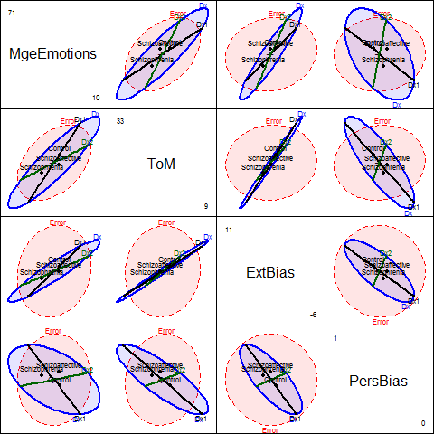
Visualize me: data space
heplot(SC.mlm, hypotheses=list("Dx1", "Dx2"),...)
pairs(SC.mlm, hypotheses=list("Dx1", "Dx2"),...)
The groups are ordered Schizo < ScAffective < Control on these measures
One of these vars is not like the others!

Slide 29
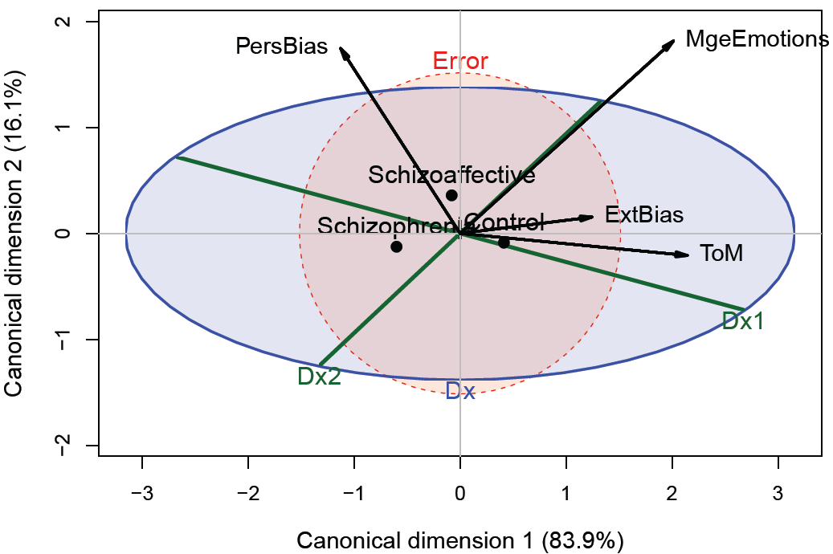
Visualize me: canonical space
Contrasts:
Dx1 : Control vs. patients. Controls > patients on MgeEmotions, ExtBias, ToM
Dx2 : Schizo vs. schizoaffective.
Can1: group order
Can2: Schizoaffective vs. others
Dx1 suggests ≈ spacing
Schizo < ScAff < Control

Slide 30
Model checking & remedies
The MLM assumes residuals are multivariate normal
→ Squared Mahalanobis distances
D²_{M} (y_{i}) = (y_{i}-y̅)^{T} S⁻¹ (y_{i} -y̅) ∼ χ²_{p} with p d.f.
→ a quantile – quantile plot of ordered D²_{M} (y_{i}) vs. quantiles of χ²_{p} should plot as straight line
Outliers are readily apparent
plots: heplots::cqplot()
Influence plots
mvinfluence::influence() calculates multivariate analogs of influence measures

Slide 31
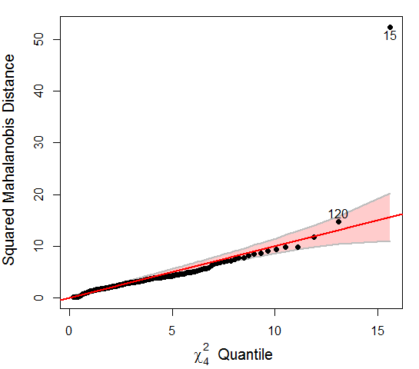
Social cog: cqplot
heplots::cqplot() creates a chi-square QQ plot from a MLM
cqplot(SC.mlm, id.n=2)
One observation appears as an extreme outlier.
This was a case w/ ExtBias = -33,
but valid range = (-10, +10)
Refitting w/o case 15:
Overall & DX1 tests still OK ☺
Dx2 test: p=0.074, now NS ☹

Slide 32
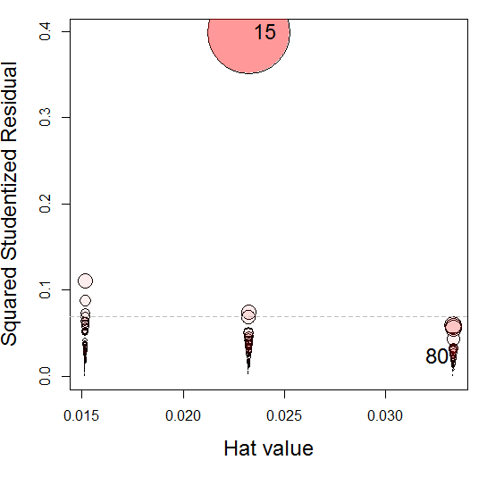
Social cog: Influence
mvinfluence::influencePlot() creates a multivariate analog of an influence plot
>library(mvinfluence)
>influencePlot(SC.mlm, …)
H Q CookD L R
15 0.0233 0.3985 0.4202 0.0238 0.4080
80 0.0333 0.0233 0.0352 0.0345 0.0241
Case 15 stands out as hugely influential (a data error)
The 3 columns of circles correspond to the 3 groups

Slide 33
Robust MLMs
Robust methods for univariate LMs are now well-developed and implemented
→ proper SEs, CIs and hypothesis tests
Analogous methods for multivariate LMs are a current hot research topic
The heplots package now provides robmlm() for the fully general MLM (MANOVA, MMReg)
Uses simple M-estimator via IRLS
Weights: calculated from Mahalanobis D^{2,} a robust covariance estimator and weight function, ψ(D²)
Downside: SEs, p-values only approximate

Slide 34
Robust MLMs
SC.rlm <- robmlm(cbind( MgeEmotions, ToM, ExtBias, PersBias) ~ Dx,
data=SocialCog)
Observation weights
Approx test of Dx2 in robust model
> print(linearHypothesis(SC.rlm, "Dx2"), SSP=FALSE)
Multivariate Tests:
Df test stat approx F num Df den Df Pr(>F)
Pillai 1 0.069 2.44 4 132 0.05 *
Wilks 1 0.931 2.44 4 132 0.05 *
…

Slide 35
Robust MLMs: Pottery data
"
Chemical composition of ancient pottery found at four sites in Great Britain
Sites: AshleyRails, Caldicot, IsleThorns, Llanedyrn
Measures: Al Fe Mg Ca Na
Analyses:
standard MANOVA lm(cbind(Al, Fe, Mg, …) ~ Site, data=Pottery)
robust MANOVA robmlm(cbind(Al, Fe, Mg, …) ~ Site, data=Pottery)
Data:
> car::some(Pottery)
Site Al Fe Mg Ca Na
2 Llanedyrn 13.8 7.08 3.43 0.12 0.17
14 Llanedyrn 12.5 6.44 3.94 0.22 0.23
17 IsleThorns 18.3 1.28 0.67 0.03 0.03
18 IsleThorns 15.8 2.39 0.63 0.01 0.04
21 IsleThorns 20.8 1.51 0.72 0.07 0.10
22 AshleyRails 17.7 1.12 0.56 0.06 0.06
23 AshleyRails 18.3 1.14 0.67 0.06 0.05

Slide 36
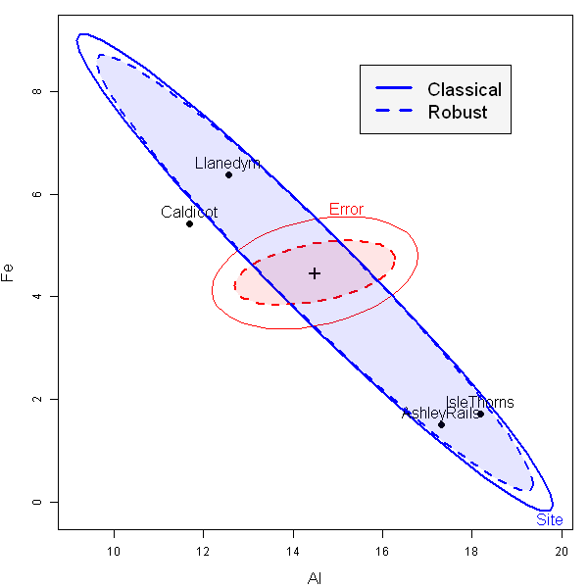
Robust MLMs: Pottery data
> pottery.mod <- lm(cbind(Al,Fe,Mg,Ca,Na)~Site, data=Pottery)
> pottery.rmod <- robmlm(cbind(Al,Fe,Mg,Ca,Na)~Site, data=Pottery)
residual E ellipse shrinks a lot
Observation weights
overlaid HE plots

Slide 37
MMRA example: PA tasks & ability
Rohwer data from Timm (1975)
How well do paired associate (PA) tasks predict performance on measures of aptitude & achievement in kindergarten children?
Samples: 69 children in two groups (schools): ‘Lo’ | ‘Hi’ SES
Outcomes (Y):
Scholastic aptitude test (SAT)
Peabody picture vocabulary test (PPVT)
Raven progressive matrices (Raven)
Predictors (X): Scores (0—40) on PA tasks where the stimuli were:
named (n), still (s), named-still (ns), named-action (na), sentence-still (ss)
> data("Rohwer", package="heplots")
> car::some(Rohwer, n=5)
group SES SAT PPVT Raven n s ns na ss
8 1 Lo 8 68 8 0 0 10 19 14
9 1 Lo 49 74 11 0 0 7 16 13
17 1 Lo 19 66 13 7 12 21 35 27
52 2 Hi 38 66 14 0 0 3 16 11
66 2 Hi 8 55 16 4 7 19 20 13
Having a group factor makes the analysis more complicated (MANCOVA)
Start with analysis of the Hi SES group
> Rohwer2 <- subset(Rohwer, subset=SES==“HI”)

Slide 38
Why not univariate models?
rohwer.mod1 <- lm(SAT ~ n + s + ns + na + ss, data = Rohwer2)
rohwer.mod2 <- lm(PPVT ~ n + s + ns + na + ss, data = Rohwer2)
rohwer.mod3 <- lm(Raven ~ n + s + ns + na + ss, data = Rohwer2)
library(stargazer)
stargazer(rohwer.mod1, rohwer.mod2, rohwer.mod3, type=“text”, …)
Univariate regression models for Rohwer data
========================================================
Dependent variable:
-------------------------------
SAT PPVT Raven
--------------------------------------------------------
n 3.26* 0.07 0.06
s 3.00 0.37 0.49**
ns -5.86*** -0.37 -0.16
na 5.67*** 1.52* 0.12
ss -0.62 0.41 -0.12
--------------------------------------------------------
R2 0.56 0.35 0.31
F Statistic (df = 5; 26) 6.54*** 2.85* 2.32
========================================================
Note: *p<0.05; **p<0.01; ***p<0.001
Results are disappointing
Only model for SAT highly signif.
Only a few coefs. signif. ≠0

Slide 39
MANOVA tests
> rohwer.mlm <- lm(cbind(SAT, PPVT, Raven) ~ n + s + ns + na + ss, data=Rohwer2)
> Anova(rohwer.mlm)
Type II MANOVA Tests: Pillai test statistic
Df test stat approx F num Df den Df Pr(>F)
n 1 0.202 2.02 3 24 0.1376
s 1 0.310 3.59 3 24 0.0284 *
ns 1 0.358 4.46 3 24 0.0126 *
na 1 0.465 6.96 3 24 0.0016 **
ss 1 0.089 0.78 3 24 0.5173
---
Signif. codes: 0 ‘***’ 0.001 ‘**’ 0.01 ‘*’ 0.05 ‘.’ 0.1 ‘ ’ 1
Much better!
Multivariate tests:
pool evidence for all Ys
take correlations of Ys into account
Can also test overall hypothesis, H₀: B = 0 (all coefs = 0)
> print(linearHypothesis(rohwer.mlm,
+ c("n", "s", "ns", "na", "ss")), SSP=FALSE)
Multivariate Tests:
Df test stat approx F num Df den Df Pr(>F)
Pillai 5 1.0386 2.753 15 78.00 0.001912 **
Wilks 5 0.2431 2.974 15 66.65 0.001154 **
Hotelling-Lawley 5 2.0615 3.115 15 68.00 0.000697 ***
Roy 5 1.4654 7.620 5 26.00 0.000160 ***
Strongly reject H₀ by all criteria

Slide 40
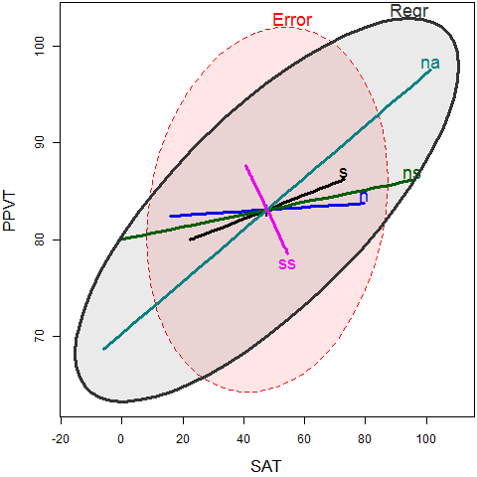
Visualize me!
cols <- c("red", "blue", "black", "darkgreen", "darkcyan", "magenta", "gray20")
hyp <- list("Regr" = c("n", "s", "ns", "na", "ss")) # Test of B = 0
heplot(rohwer.mlm,
hypotheses = hyp,
fill=TRUE, fill.alpha=0.1, col=cols,lwd=c(1,3))
Each predictor gives a 1 df test -> H_{i} ellipse is a line
E here is a 3D ellipsoid (rank(E) = min(p,q))
Interpretation:
Any H ellipse that protrudes outside E ellipse is significant by Roy’s test
Length of each H_{i} line ≈ strength of association
Orientation of each H_{i} line shows relation of X_{i} to the two Y_{j} responses shown.

Slide 41
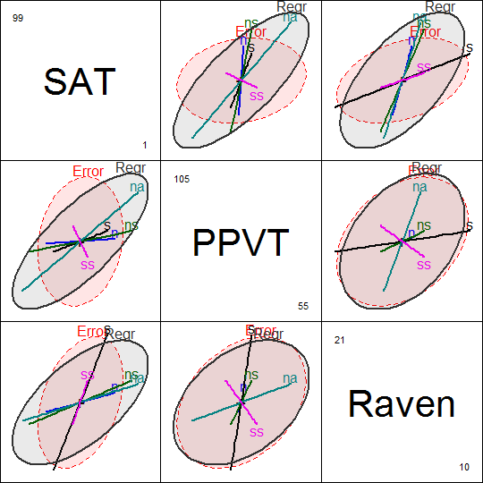
pairs.mlm() plot
View all pairwise HE plots
pairs(rohwer.mlm, hypotheses=hyp,
col=cols, fill=TRUE, fill.alpha=0.1, …)
Can now understand more subtle aspects
SAT is best predicted overall, but relation with PA tests varies
The na & ns tasks are strongest for SAT
Raven is weakly predicted

Slide 42
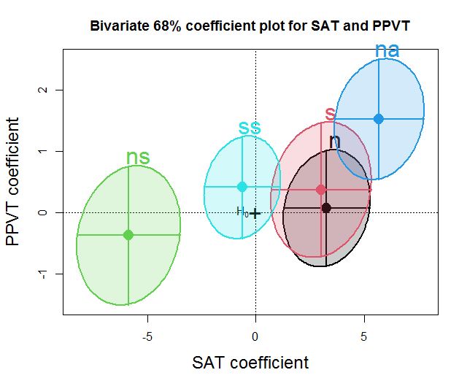
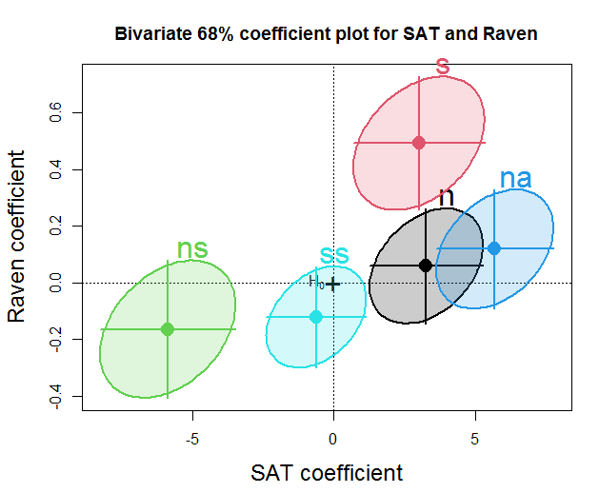
Coefficient plots for MLMs
In multivariate models, confidence intervals for coefficients become ellipsoids
Two coefficients are jointly significant if their conf. ellipse E(b₁, b₂) excludes (0,0)
These plots are provided by heplots::coefplot(mlm)
coefplot(rohwer.mlm, var=c(1,2))
coefplot(rohwer.mlm, var=c(1,3))

Slide 43
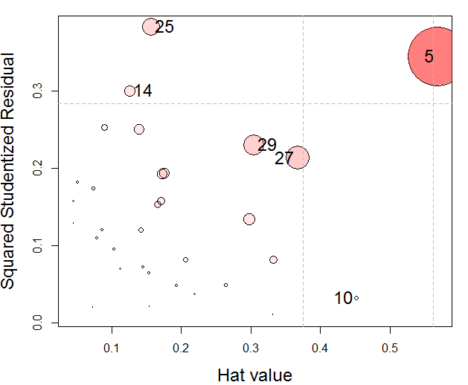
Influence plots
As always, we should check for influential observations and multivariate outliers
mvinfluence::influencePlot(Rohwer.mlm, id.n=4, …)
One point (5) deserves further attention

Slide 44
Canonical correlations
For quantitative (X, Y) data, canonical correlation analysis is an alternative to MMRA
It finds the weighted sums of the Y variables most highly correlated with the Xs
> X <- Rohwer2[, 6:10] # X variables for High SES students
> Y <- Rohwer2[, 3:5] # Y variables for High SES students
> (cc <- cancor(X, Y, set.names=c("PA", "Ability")))
Canonical correlation analysis of:
5 PA variables: n, s, ns, na, ss
with 3 Ability variables: SAT, PPVT, Raven
CanR CanRSQ Eigen percent cum scree
1 0.7710 0.5944 1.4654 71.080 71.08 ******************************
2 0.5465 0.2987 0.4259 20.659 91.74 *********
3 0.3815 0.1455 0.1703 8.261 100.00 ***
Test of H0: The canonical correlations in the
current row and all that follow are zero
CanR LR test stat approx F numDF denDF Pr(> F)
1 0.77096 0.24307 2.9738 15 66.655 0.001154 **
2 0.54652 0.59926 1.8237 8 50.000 0.094538 .
3 0.38147 0.85448 1.4759 3 26.000 0.244178
Two dimensions acct for 91.7% of (X,Y) association
✓
Only Can1 is significant
✗

Slide 45
Visualize CCA in HE plot
cols <- c("red", "blue", "black", "darkgreen", "darkcyan",
"magenta", "gray20")
heplot(cc, hypotheses=list("na+ns"=c("na", "ns")),
fill = TRUE, fill.alpha=0.1, col=cols,
label.pos = c(3, rep(1,5), .1),
cex=1.4, var.cex=1.25, var.lwd=3, var.col="black")
Residuals are uncorrelated in canonical space
H ellipses for X terms same as in ordinary HE plots – outside E ellipse iff signif. by Roy’s test
Variable vectors for Ys: correlations with canonical variables Ycan1, Ycan2
SAT & PPVT: mainly Ycan1
Raven: more aligned with Ycan2

Slide 46
MANCOVA & homogeneity of regression
With a group variable (SES) can test differences in means (intercepts)
rohwer.mod <- lm(cbind(SAT, PPVT, Raven) ~ SES + n + s + ns + na + ss, data=Rohwer)
This assumes that slopes (B) are the same for both groups (homogeneity of regression)
Can test for equal slopes by adding interactions of SES with Xs
rohwer.mod1 <- lm(cbind(SAT, PPVT, Raven) ~ SES * (n + s + ns + na + ss))
Or, fit separate models for each group
rohwer.ses1 <- lm(cbind(SAT, PPVT, Raven) ~ n + s + ns + na + ss,
data = Rohwer, subset = SES == "Hi")
rohwer.ses2 <- lm(cbind(SAT, PPVT, Raven) ~ n + s + ns + na + ss,
data = Rohwer, subset = SES == "Lo")

Slide 47
MANCOVA
Fit the MANCOVA model & test hypotheses
> rohwer.mod <- lm(cbind(SAT, PPVT, Raven) ~ SES + n + s + ns + na + ss,
+ data=Rohwer)
> Anova(rohwer.mod)
Type II MANOVA Tests: Pillai test statistic
Df test stat approx F num Df den Df Pr(>F)
SES 1 0.379 12.18 3 60 2.5e-06 ***
n 1 0.040 0.84 3 60 0.4773
s 1 0.093 2.04 3 60 0.1173
ns 1 0.193 4.78 3 60 0.0047 **
na 1 0.231 6.02 3 60 0.0012 **
ss 1 0.050 1.05 3 60 0.3770
---
Signif. codes: 0 ‘***’ 0.001 ‘**’ 0.01 ‘*’ 0.05 ‘.’ 0.1 ‘ ’ 1
SES: diff in means

Slide 48
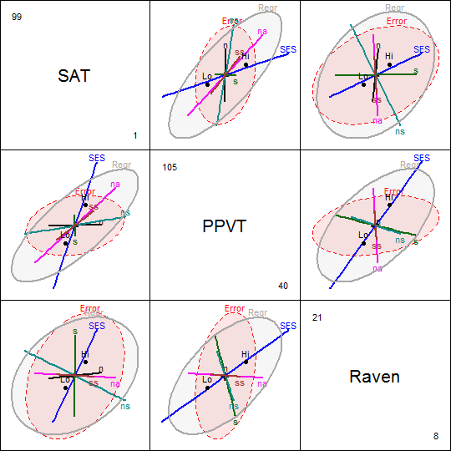
Visualize effects
pairs(rohwer.mod,
hypotheses=list("Regr" = c("n", "s", "ns", "na", "ss")),
fill=TRUE, fill.alpha=0.1)
The SES effect is positive for all Y variables
Hi SES group > Lo SES group

Slide 49
Fit model with interactions
Fit heterogeneous regression model with SES interactions
> rohwer.mod1 <- lm(cbind(SAT, PPVT, Raven) ~ SES * (n + s + ns + na + ss),
+ data=Rohwer)
> Anova(rohwer.mod1)
Type II MANOVA Tests: Pillai test statistic
Df test stat approx F num Df den Df Pr(>F)
SES 1 0.391 11.78 3 55 4.5e-06 ***
n 1 0.079 1.57 3 55 0.20638
s 1 0.125 2.62 3 55 0.05952 .
ns 1 0.254 6.25 3 55 0.00100 ***
na 1 0.307 8.11 3 55 0.00015 ***
ss 1 0.060 1.17 3 55 0.32813
SES:n 1 0.072 1.43 3 55 0.24417
SES:s 1 0.099 2.02 3 55 0.12117
SES:ns 1 0.118 2.44 3 55 0.07383 .
SES:na 1 0.148 3.18 3 55 0.03081 *
SES:ss 1 0.057 1.12 3 55 0.35094
---
Signif. codes: 0 ‘***’ 0.001 ‘**’ 0.01 ‘*’ 0.05 ‘.’ 0.1 ‘ ’ 1
OK, as expected
Hmm ???

Slide 50
Test interactions
Can test all interactions simultaneously with linearHypothesis()
Do I need any interaction terms?
I use a ‘grep’ trick here to find the names of coefficients like ‘SES:’ containing a ‘:’
> coefs <- rownames(coef(rohwer.mod1)) # store coefficient names in a vector
> print(linearHypothesis(rohwer.mod1, # only test for interaction effects
+ coefs[grep(":", coefs)]), SSP=FALSE)
Multivariate Tests:
Df test stat approx F num Df den Df Pr(>F)
Pillai 5 0.4179 1.845 15 171.0 0.03209 *
Wilks 5 0.6236 1.894 15 152.2 0.02769 *
Hotelling-Lawley 5 0.5387 1.927 15 161.0 0.02396 *
Roy 5 0.3846 4.385 5 57.0 0.00191 **
---
Signif. codes: 0 ‘***’ 0.001 ‘**’ 0.01 ‘*’ 0.05 ‘.’ 0.1 ‘ ’ 1
Evidence shows that some slopes differ for Hi/Lo SES

Slide 51
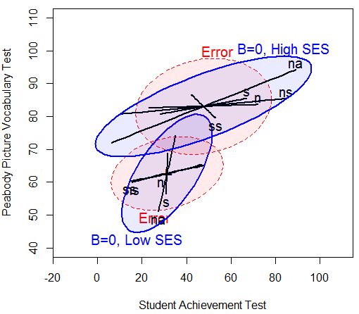
Fit separate models
Fitting a model for each group allows all slopes to differ
Also allows within-group covariances to differ
rohwer.ses1 <- lm(cbind(SAT, PPVT, Raven) ~ n + s + ns + na + ss,
data = Rohwer, subset = SES == "Hi")
rohwer.ses2 <- lm(cbind(SAT, PPVT, Raven) ~ n + s + ns + na + ss,
data = Rohwer, subset = SES == "Lo")
For SAT & PPVT:
means higher for Hi SES
within-group covariance larger for Hi SES
slopes of predictors smaller for Hi SES → SAT more important for this group.

Slide 52
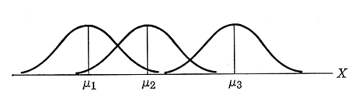
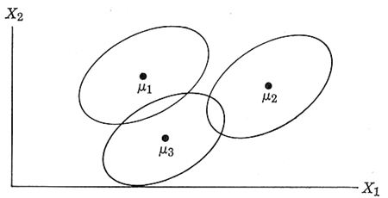




Homogeneity of (co)variances
ANOVA assumes equality of residual variances
MANOVA: assumes equality of covariance matrices
$σ_{1}^{2}=σ_{2}^{2}$= … = $σ_{g}^{2}$
Levine’s test: ANOVA of z_{ij} = | y_{ij} - $\overline{\text{y}\text{i}}|$
$Σ_{1}$= $Σ_{2}$= … = $Σ_{g}$
Box’s M test:
-2 ln(M)~ χ²_{df}
See: http://www.datavis.ca/papers/EqCov-TAS.pdf

Slide 53
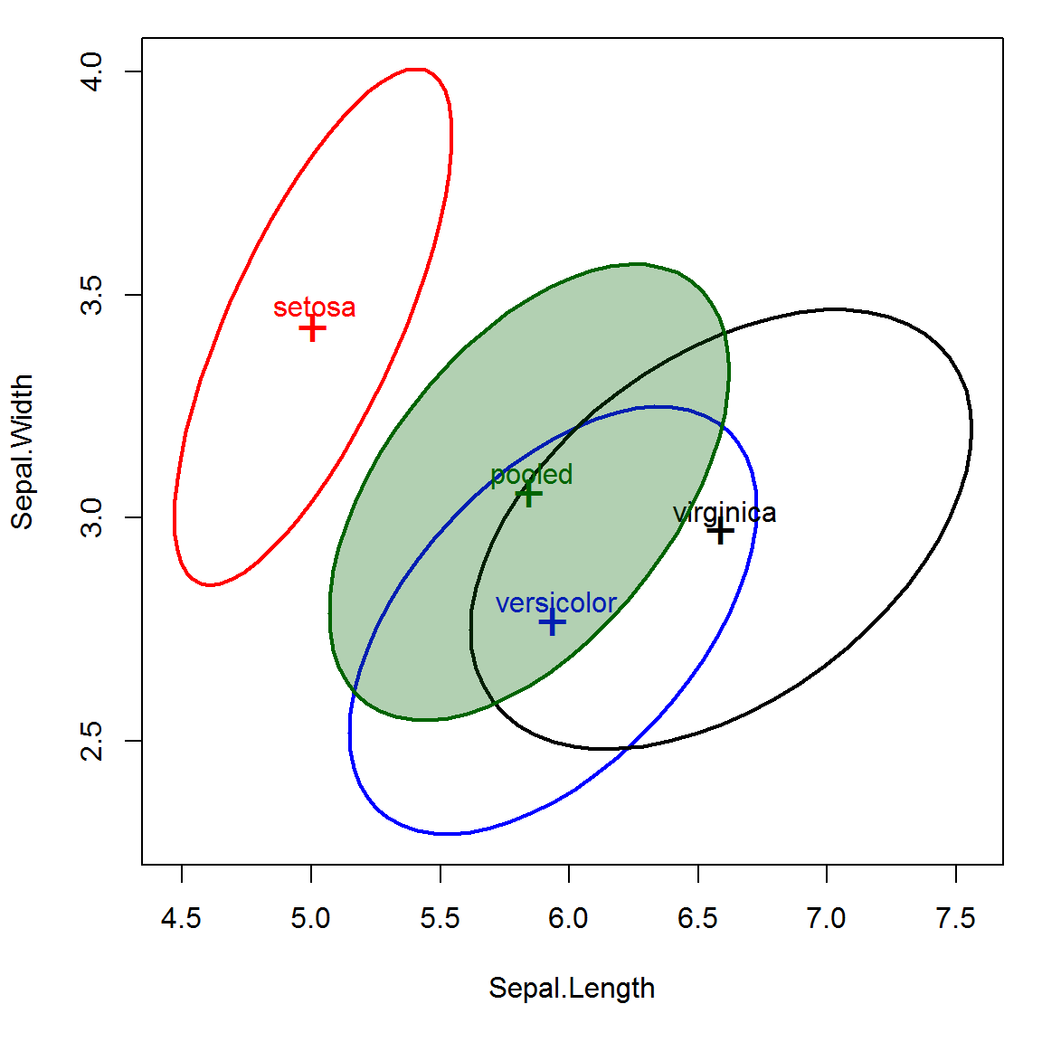
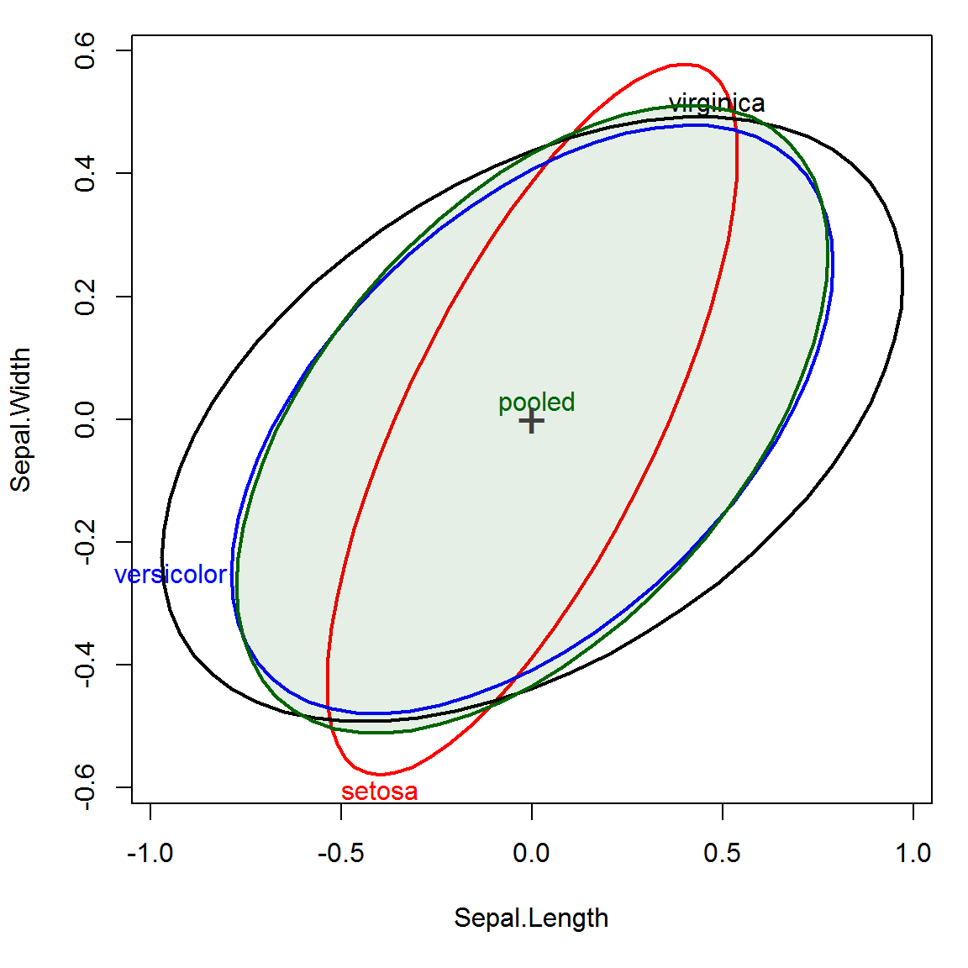
Visualizing covariance matrices
Visualize covariance ellipses in data space
Center to see pure differences in size & shape

Slide 54
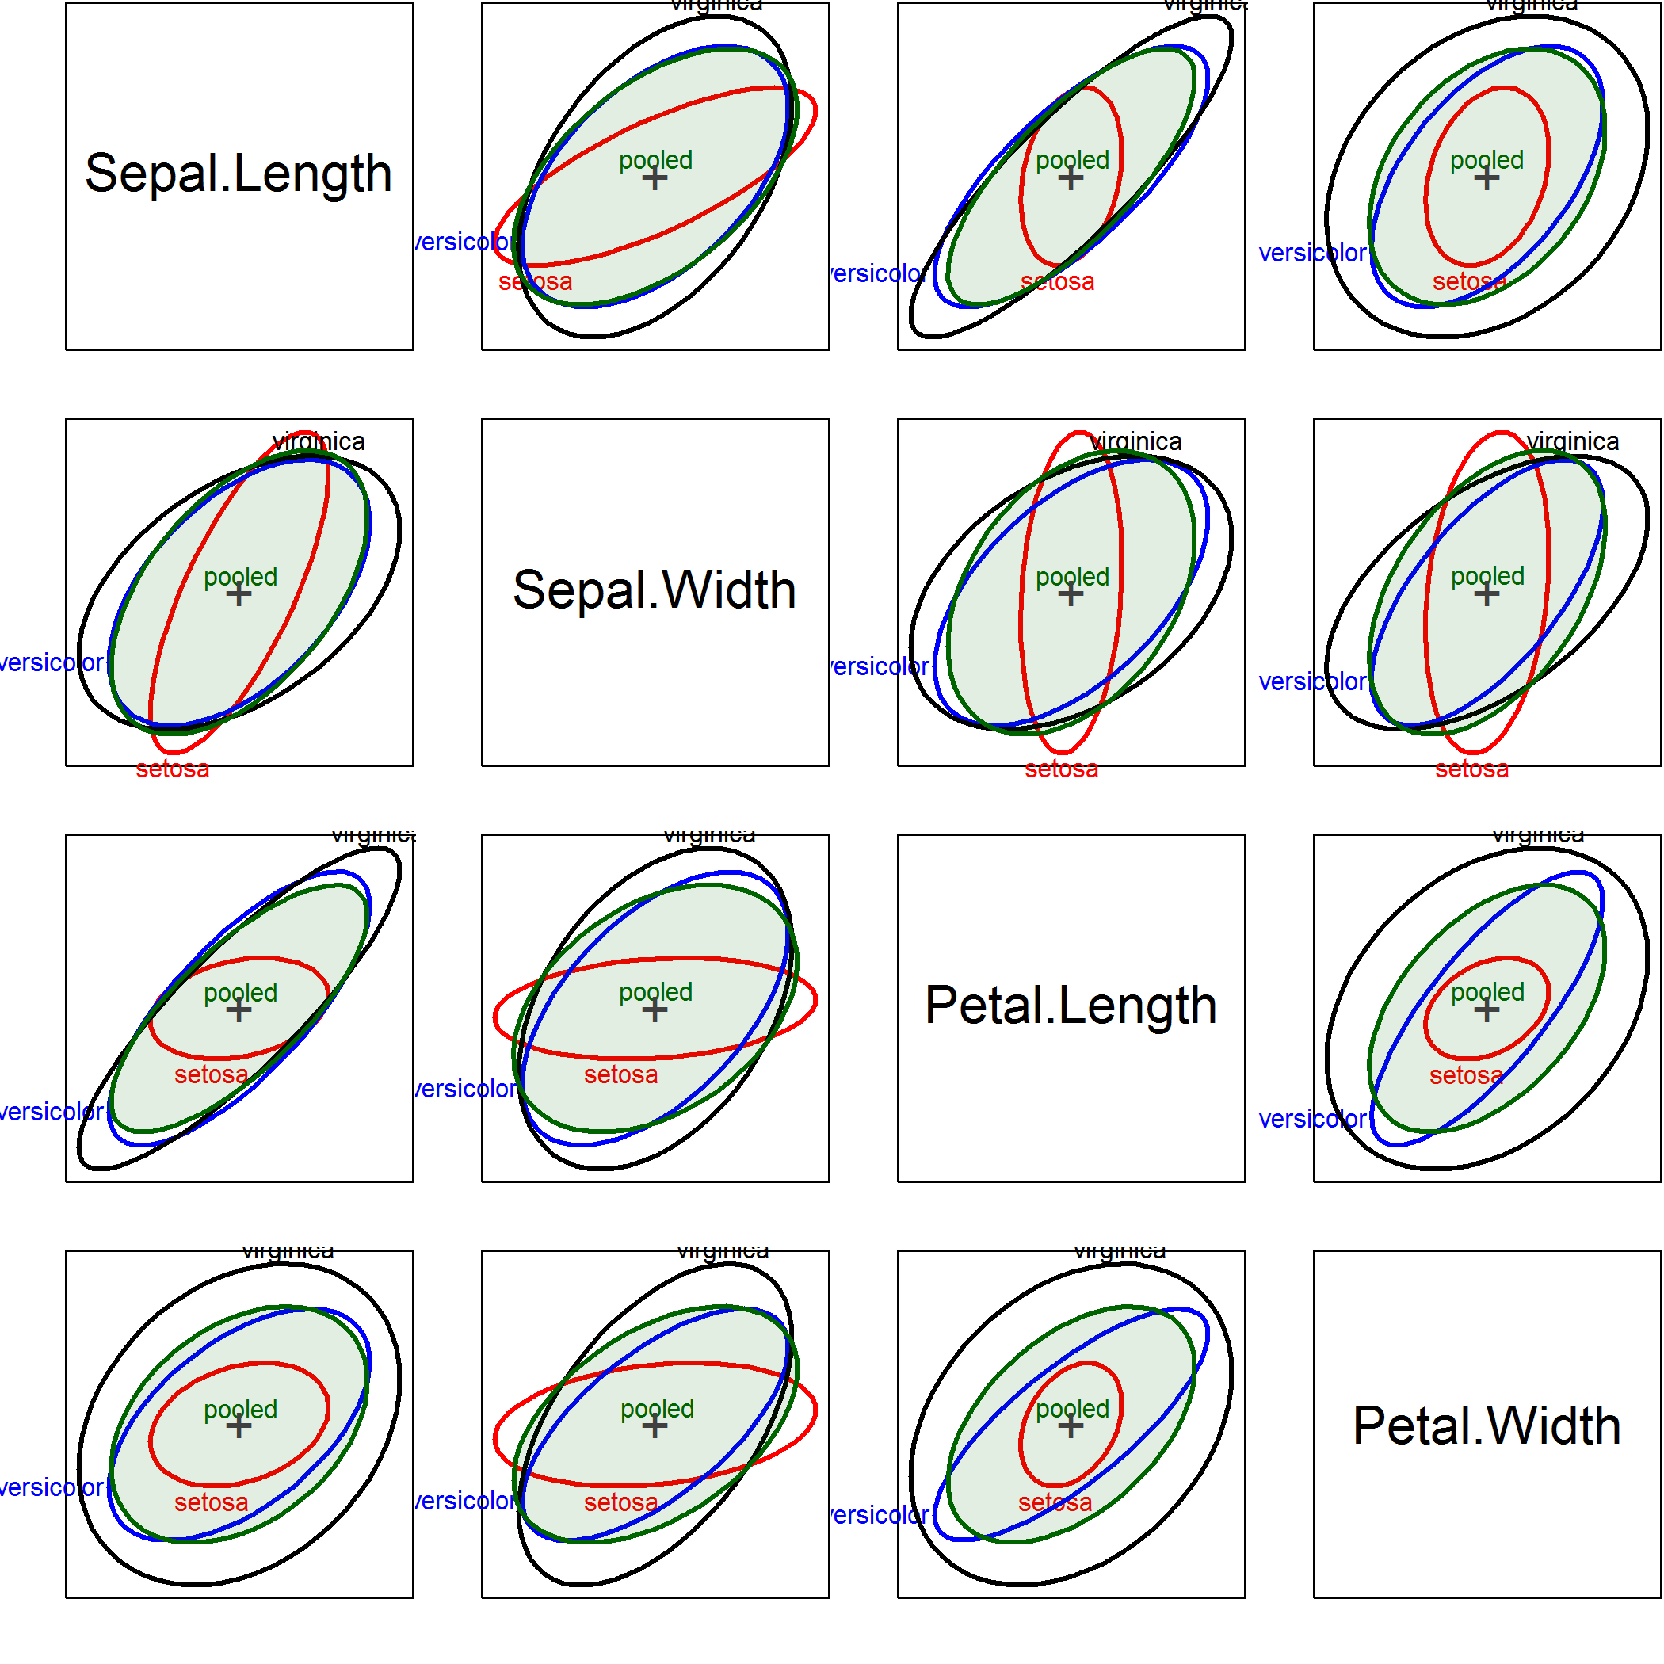
View all pairs
covEllipses(iris[,1:4], iris$Species,
center=TRUE, variables=1:4, …)
In all cases, setosa stands out as different from the others
sometimes correlation differs
sometimes smaller variance(s)

Slide 55
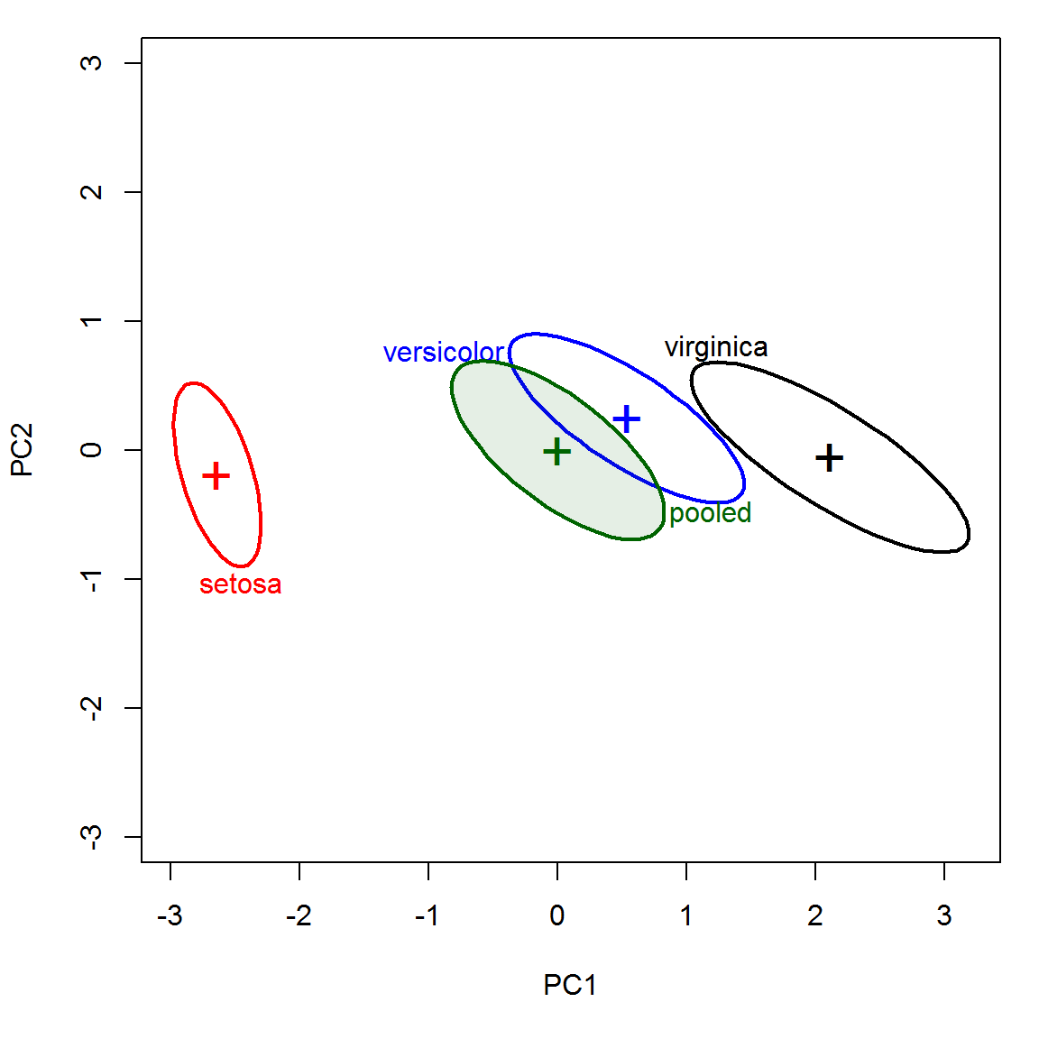
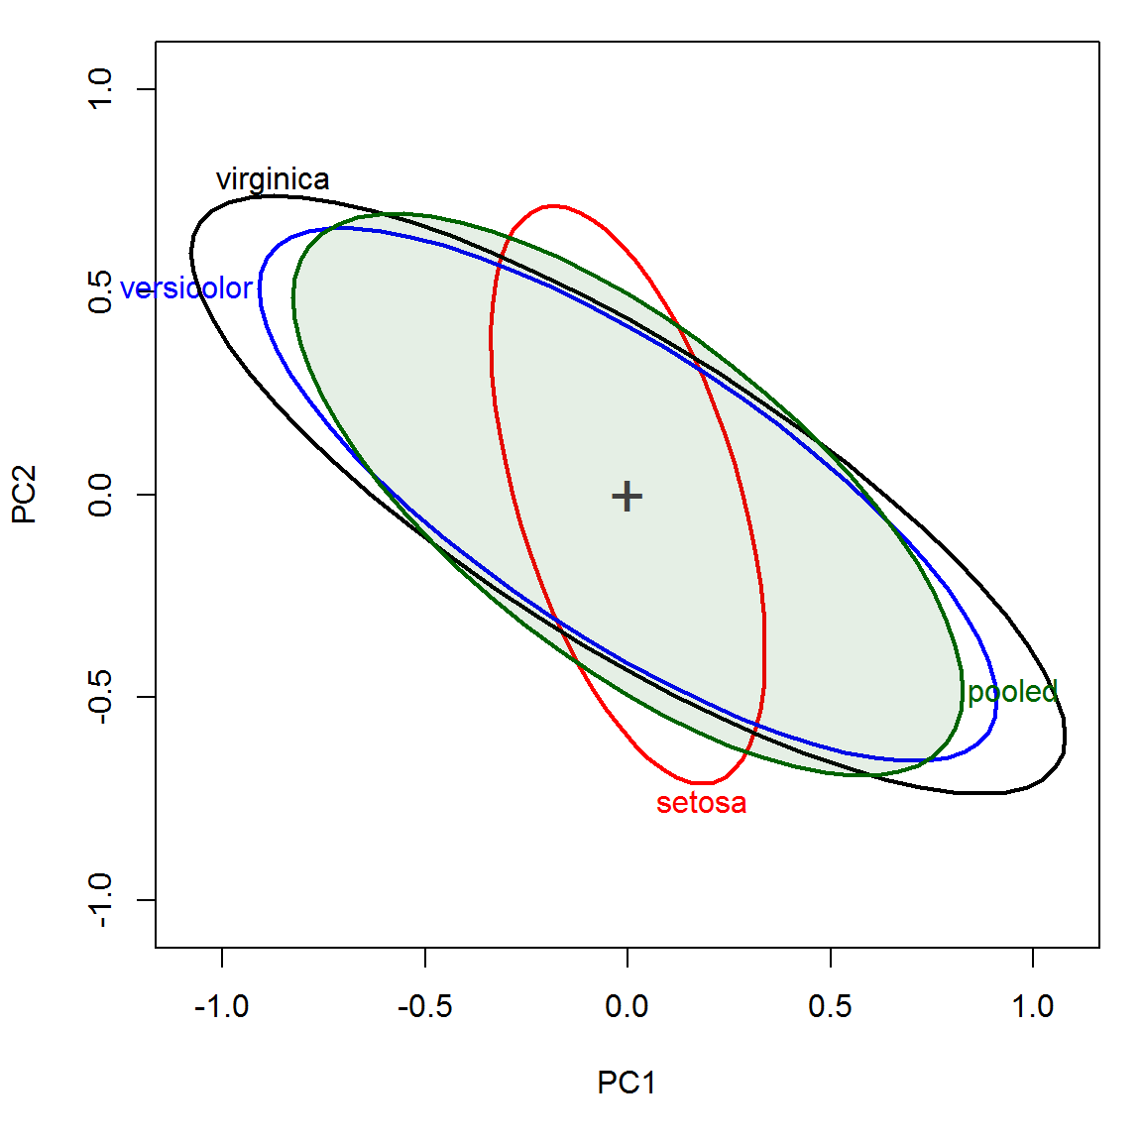
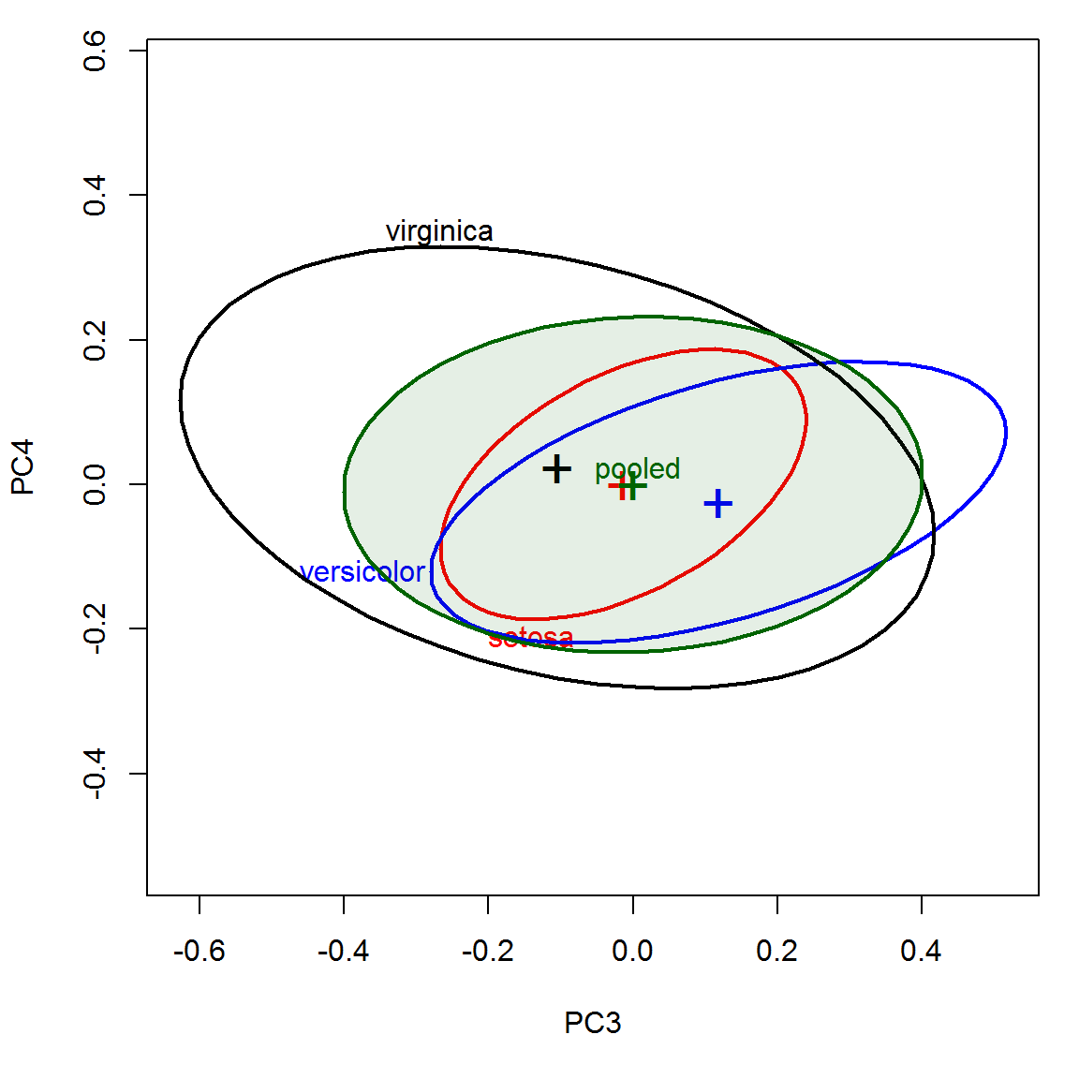
Visualize in PCA space
PCA projects the data into an orthogonal space accounting for maximum variance
Covariance ellipses show the differences among groups in this space
Surprisingly, the small dimensions contribute largely to Box’s M test.
PC1 & PC2
PC3 & PC4
iris.pca <- prcomp(iris[,1:4])
covEllipses(iris.pca$x, iris$Species, …)
covEllipses(iris.pca$x, iris$Species, center=TRUE, …)
covEllipses(iris.pca$x, iris$Species, center=TRUE,
variables=3:4, …)

Slide 56
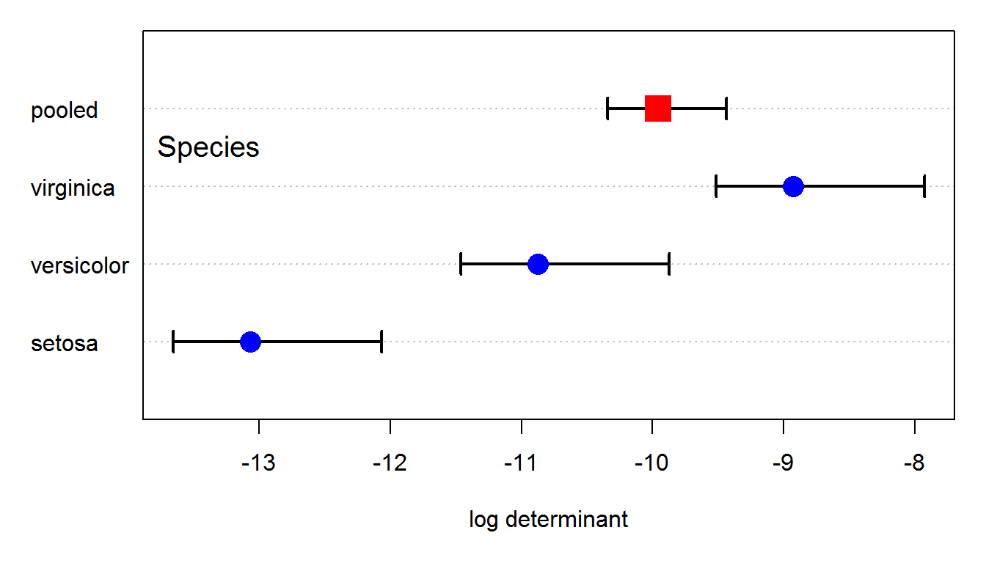
Visualizing Box’s M test
Box's test is based on a comparison of the log |S_{i}| relative to log |S_{p}|: plot them!
CIs based on an asymptotic CLT ≈ distribution of ln|S| (Cai, Liang, and Zhou 2016) (Thx: Augustine Wong)
Unsolved: Bootstrap CI

Slide 57
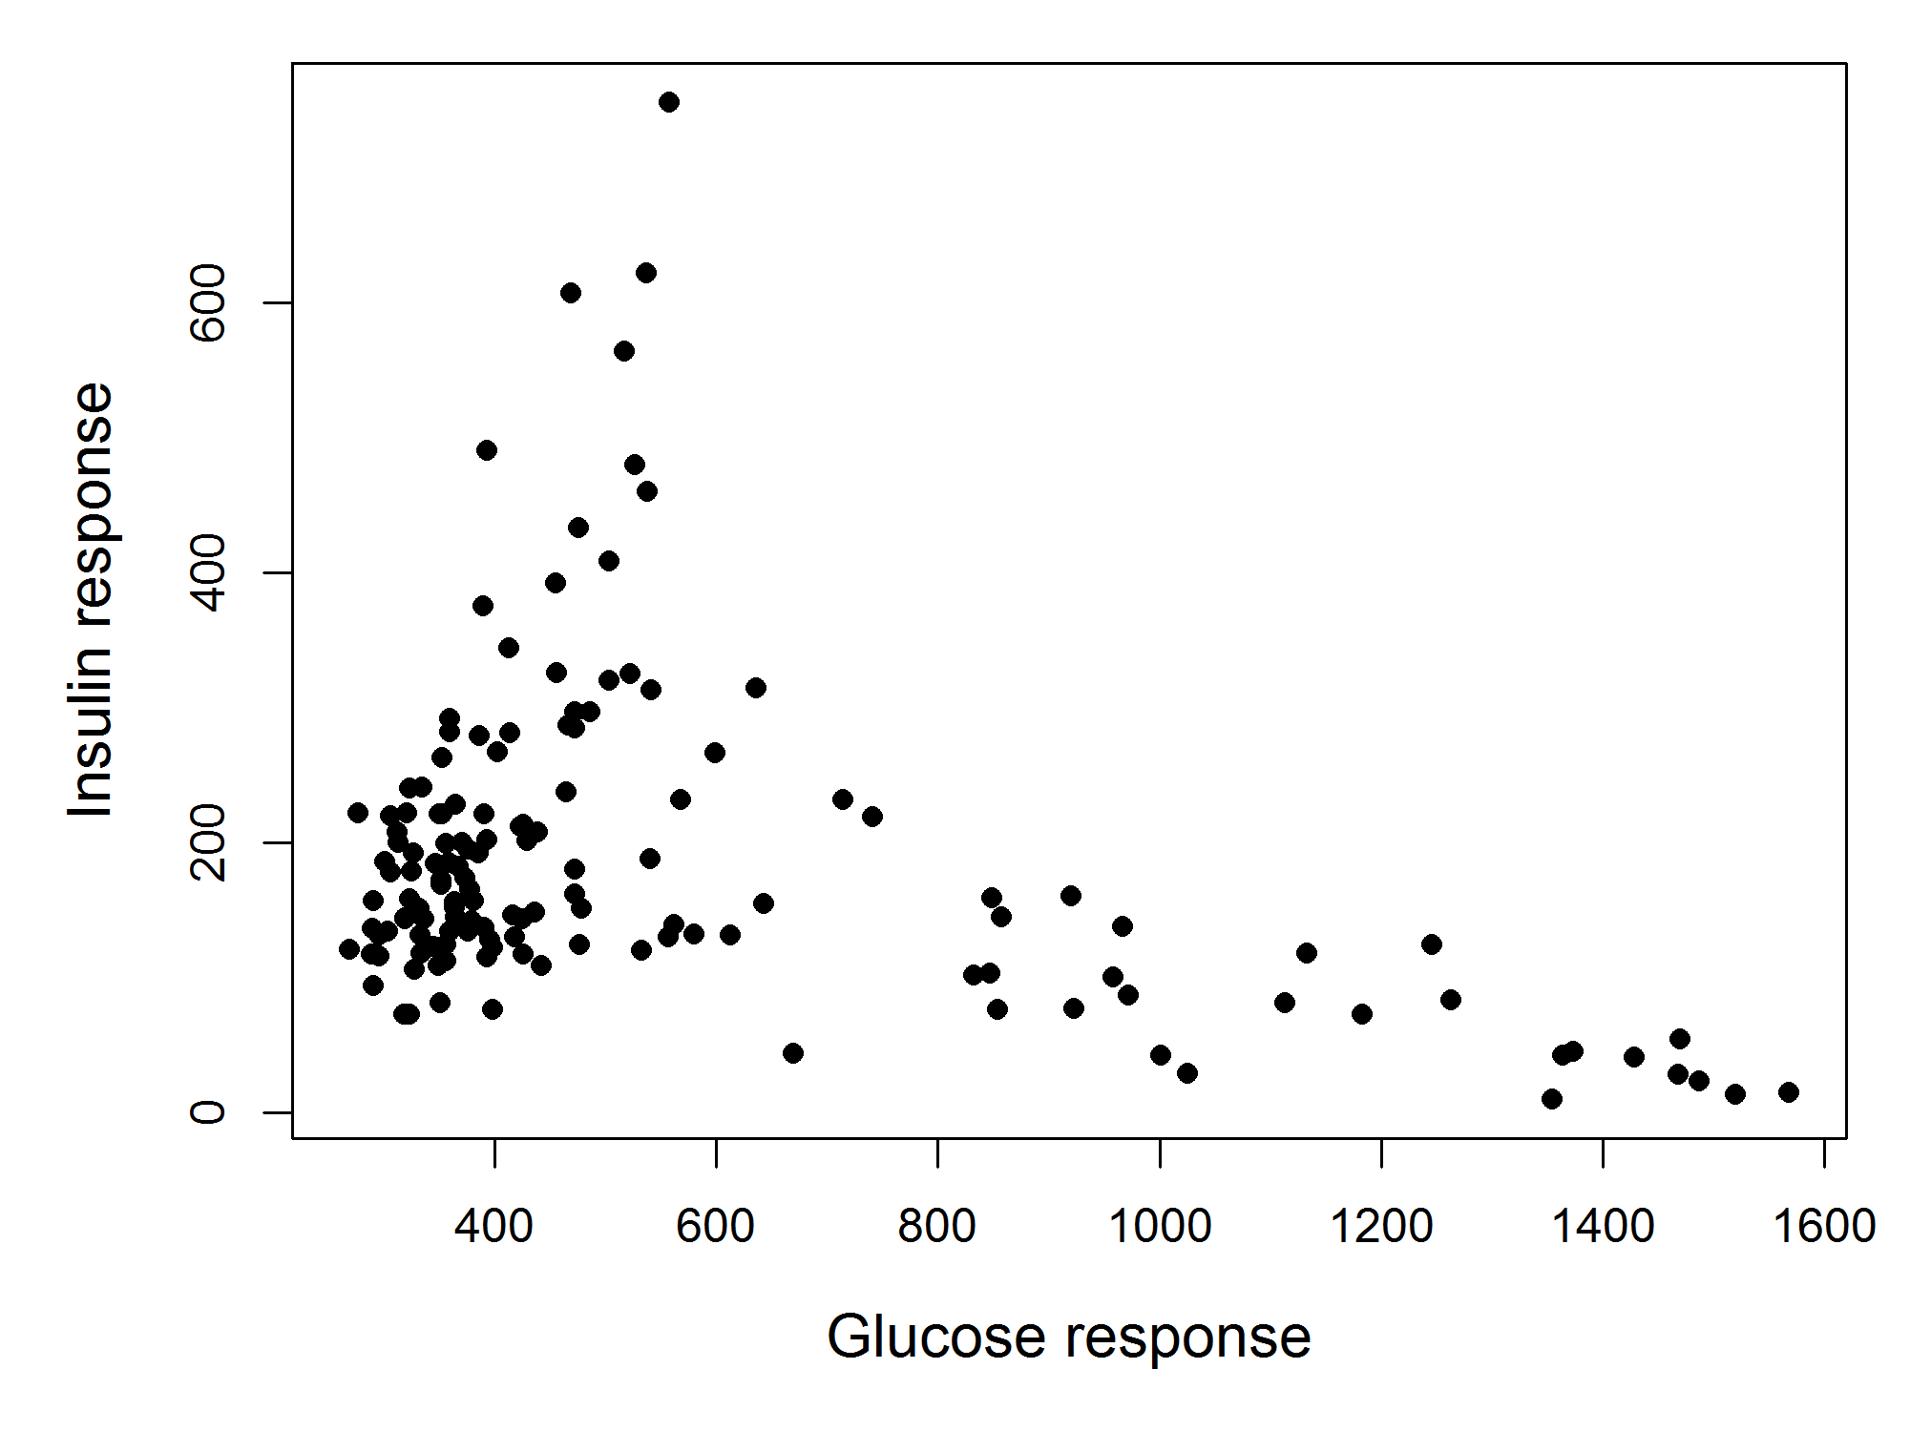
Diabetes data: 2D mystery
Reaven & Miller (1968) found a peculiar “horse shoe” result in analysis of data on the relationship of blood glucose levels and production of insulin in patients with varying degrees of hyperglycemia
In a 2D plot this was a medical mystery.
What could be the explanation?

Slide 58
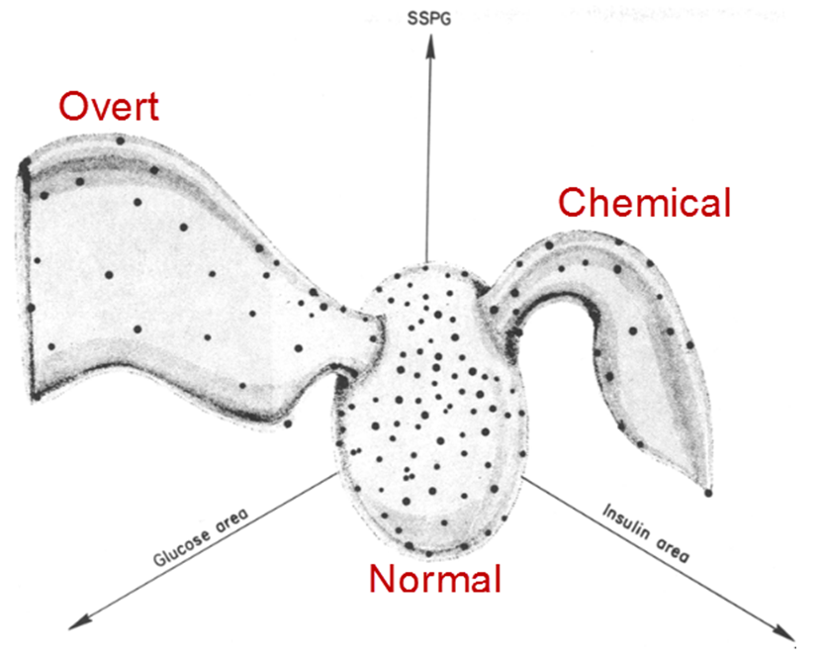
Diabetes data: 3D clarity
Using the first 3D computer graphics system (PRIM-9) they rotated the data in 3-space until a hypothesis was suggested.
Artist’s view of the data suggests there were actually three groups in the data.
Two categories of Type 2 diabetes:
Overt (advanced)
Chemical (latent)
But, these were NOT stages in a progression!

Slide 59
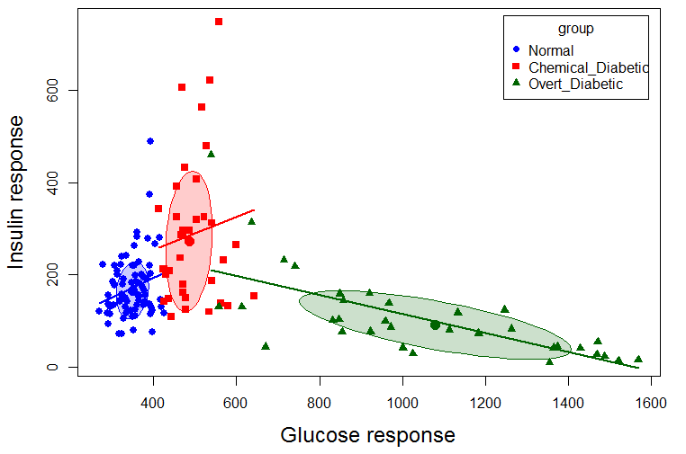
Diabetes data: scatterplots
A grouped scatterplot reveals the truer story
scatterplot( instest ~ glutest | group, data=Diabetes, ellipse=TRUE, … )

Slide 60
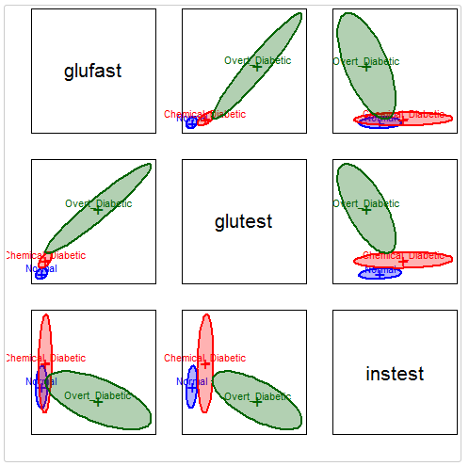
Diabetes data: Ellipses
covEllipses(Diabetes[,2:5], Diabetes$group, fill=TRUE, pooled=FALSE,
col=c("blue", "red", "darkgreen"), variables=1:3)
The pairwise data ellipses show visual summaries of the data
The differences in correlation and variances are dramatic here

Slide 61
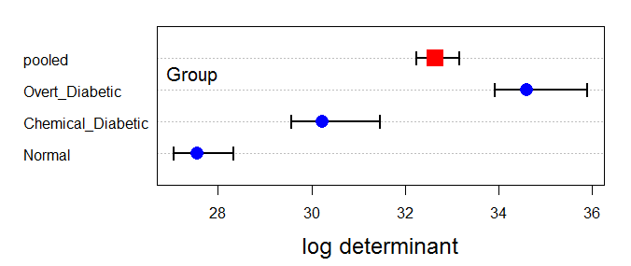
Box’s M test
diab.boxm <- boxM(Diabetes[,2:5], Diabetes$group)
diab.boxm
##
## Box's M-test for Homogeneity of Covariance Matrices
##
## data: Diabetes[, 2:5]
## Chi-Sq (approx.) = 383, df = 20, p-value <2e-16
plot(diab.boxm)
All pairs differ!

Slide 62
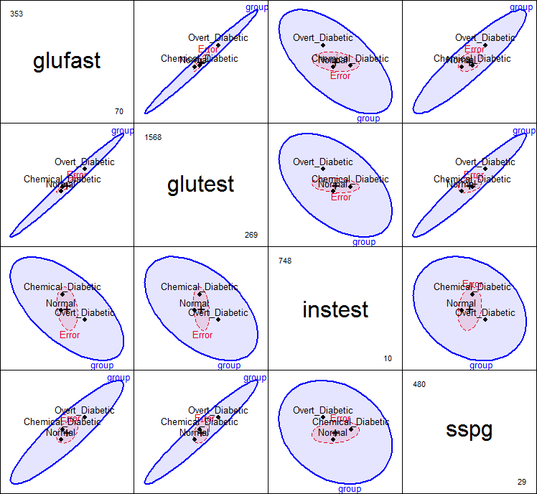
MANOVA & HE plots
diab.mlm <- lm(cbind(glufast, glutest, instest, sspg) ~ group, data=Diabetes)
# HE pairs plot
pairs(diab.mlm, fill=TRUE, fill.alpha=0.1, var.cex=3, cex=1.25)
The groups are well-separated in all views
Mostly positive correlation among group means
But: one of these plots is not like the others!

Slide 63
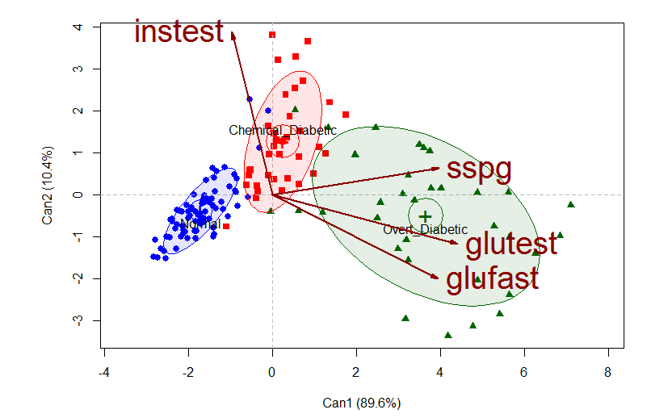
Run the juicer
diab.can <- candisc(diab.mlm)
plot(diab.can, ellipse=TRUE, var.lwd=2, …)

Slide 64
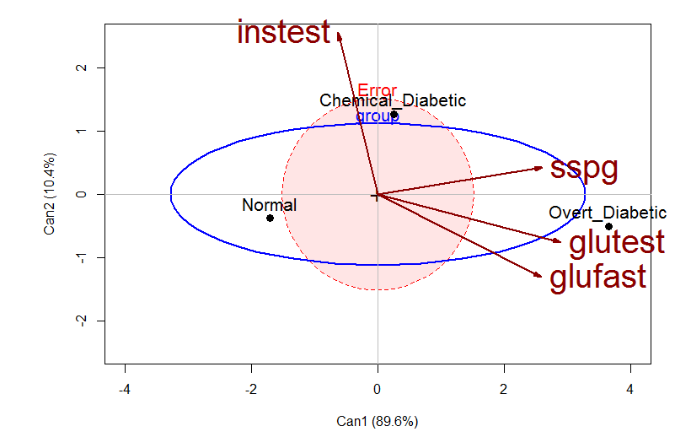
Filter the juice
heplot(diab.can, fill=c(TRUE, FALSE), fill.alpha=0.1, var.lwd=2, size=“effect”)

Slide 65
Summary
MANOVA tests of MLMs are easily visualized in HE plots
Contrasts among groups can be easily shown
Canonical plots show data in 2D/3D space of max. group differences
Robust methods can help guard against outliers
MMRA models
Visualize effects of quant. predictors as lines in data space
Test & visualize any linear hypothesis
Canonical correlations: visualize in 2D/3D of max. (X, Y) correlations
Homogeneity of covariances
Visualize within-group S_{i} and pooled S_{p} by data ellipses
Visualize Box’s M test by simple dot plot of |S_{p}|and |S_{i}|

