Slide 1
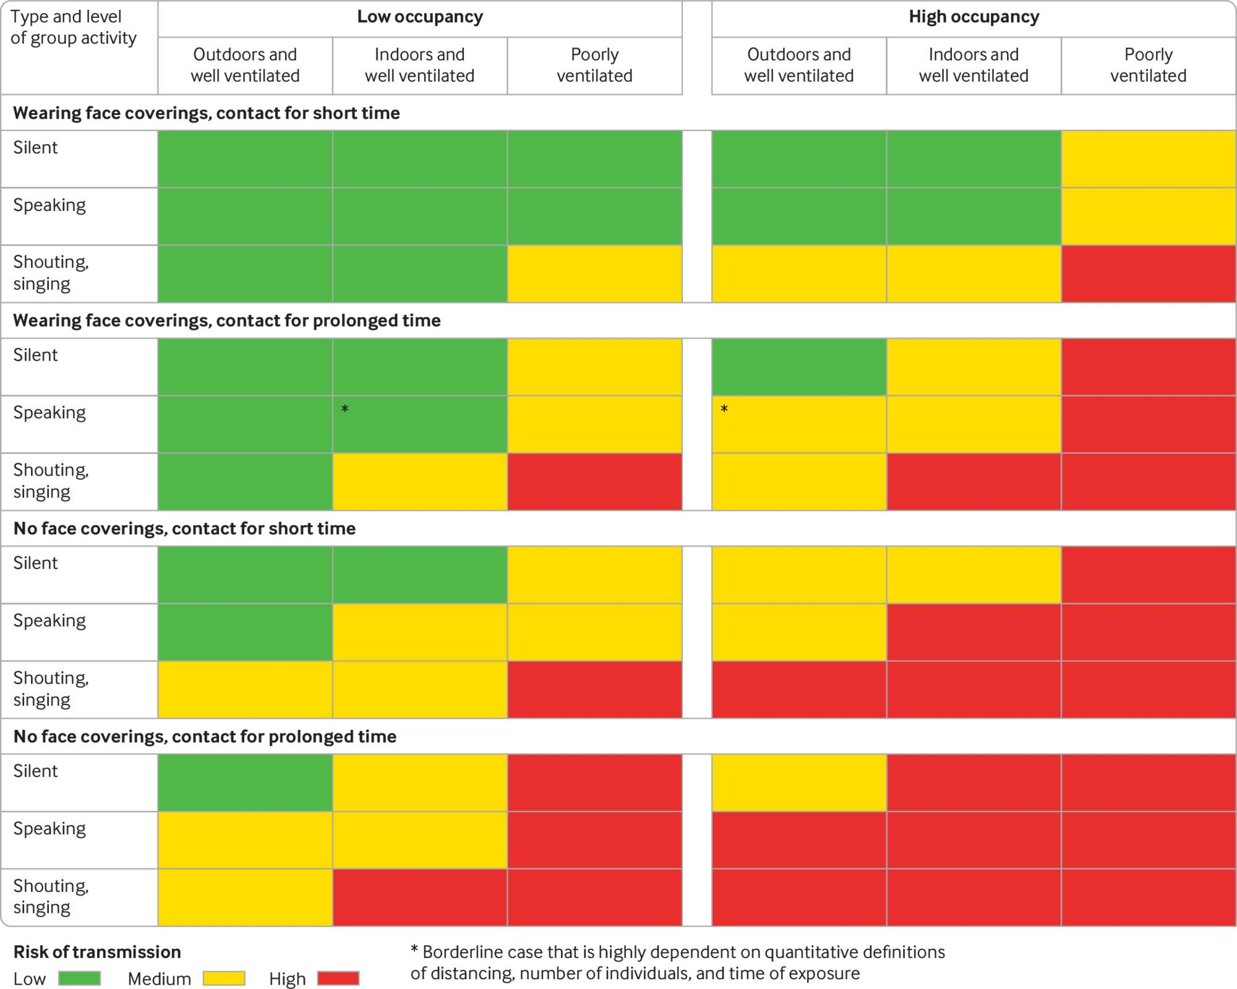

Risk of SARS-CoV-2 transmission from asymptomatic people in different settings and for different occupation times, venting, and crowding levels (ignoring variation in susceptibility and viral shedding rates).
Nicholas R Jones et al. BMJ 2020;370:bmj.m3223
©2020 by British Medical Journal Publishing Group
Notes:
Risk of SARS-CoV-2 transmission from asymptomatic people in different settings and for different occupation times, venting, and crowding levels (ignoring variation in susceptibility and viral shedding rates). Face covering refers to those for the general population and not high grade respirators. The grades are indicative of qualitative relative risk and do not represent a quantitative measure. Other factors not presented in these tables may also need to be taken into account when considering transmission risk, including viral load of an infected person and people’s susceptibility to infection. Coughing or sneezing, even if these are due to irritation or allergies while asymptomatic, would exacerbate risk of exposure across an indoor space, regardless of ventilation

