Slide 1
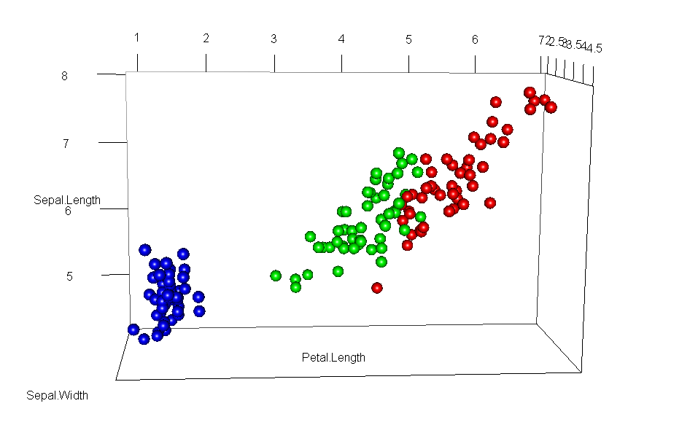
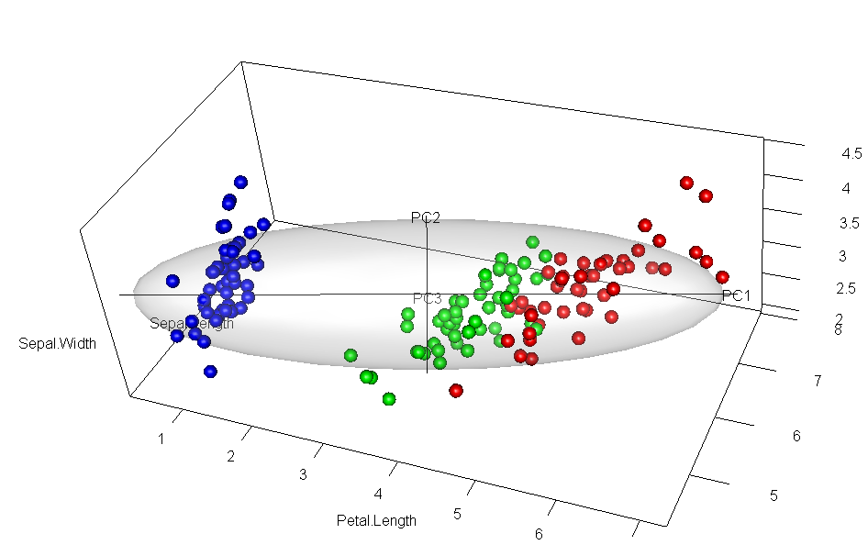


Travels in 3D space Data ellipsoids, biplots, and rgl movies
Michael Friendly
datavis.ca @datavisFriendly

Slide 2
Prelude
Multivariate data often needs > 2D
Usually reduced to multiple 2D views (scatplot matrix)
Static 3D visualization often
Badly rendered
Lacks control of perspective
Lacks direct manipulation of viewpoint
Dynamic 3D visualization
ggobi / rggobi – powerful dynamic graphics, but crummy rendering
rgl – beautiful rendering, good interactive control of perspective, viewpoint, etc., weak 3D “tours”
Goal: Explore 3D vis & animation with rgl

Slide 3
PCA animation: 2D + time
PCA:
PC1 is the direction along which points have max. variance
Equivalently, the perp. deviations from the line have min. residual SS
PCA by springs
Imagine each pt connected to a possible PC1 line by springs
Force ~ deviation²
Forces balance, naturally seek the min. residual SS position.
Voila, QED!
A visual proof

Slide 4
Iris data: rgl:::plot3d()
data(iris); library(rgl)
col <-c("blue", "green", "red")[iris$Species]
plot3d(iris, type="s", size=0.4, col=col, cex=2, box=FALSE, aspect="iso")

Slide 5
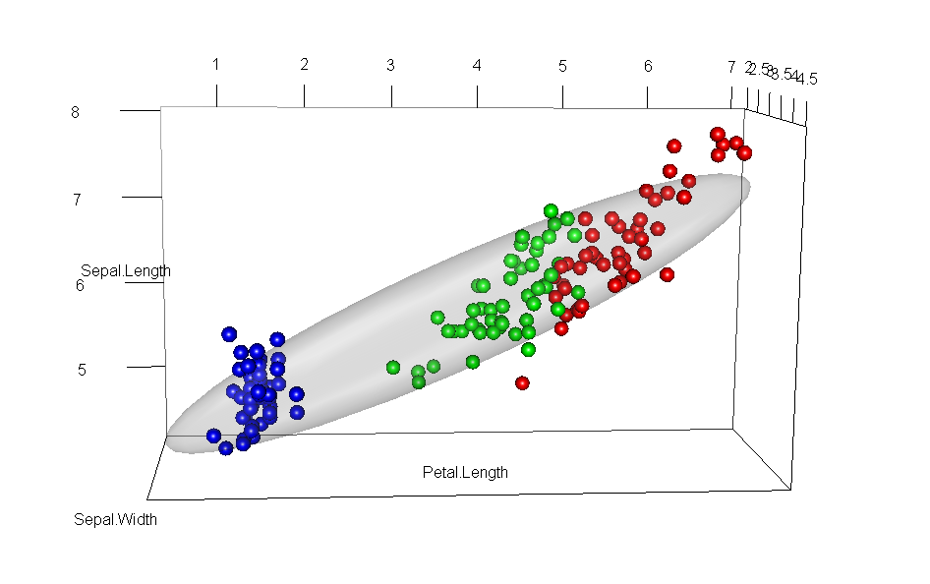
Add data ellipse
cov <- cov(iris); mu <- mean(iris)
plot3d( ellipse3d(cov, centre=mu, level=0.68), col="gray", alpha=0.2, add = TRUE)

Slide 6
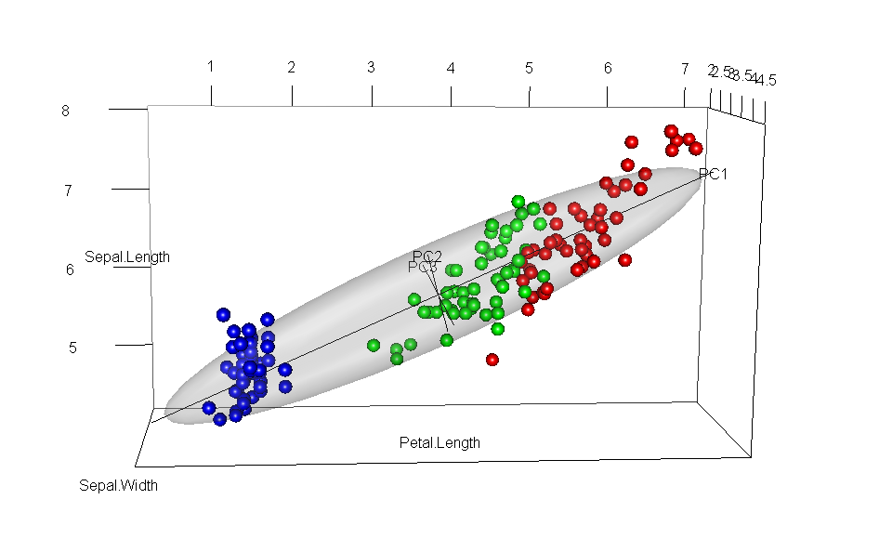
Add PC axes
source("c:/R/functions/ellipse3d.axes.R")
axes <- ellipse3d.axes(cov, centre=mu, level=0.72, labels=TRUE)
M1 <- par3d("userMatrix")

Slide 7
Rotate to show PC1 & PC2: Biplot view
NB: In PCA space, scores are uncorrelated!
# hand rotate / zoom, then save current position
M2 <- par3d("userMatrix")

Slide 8
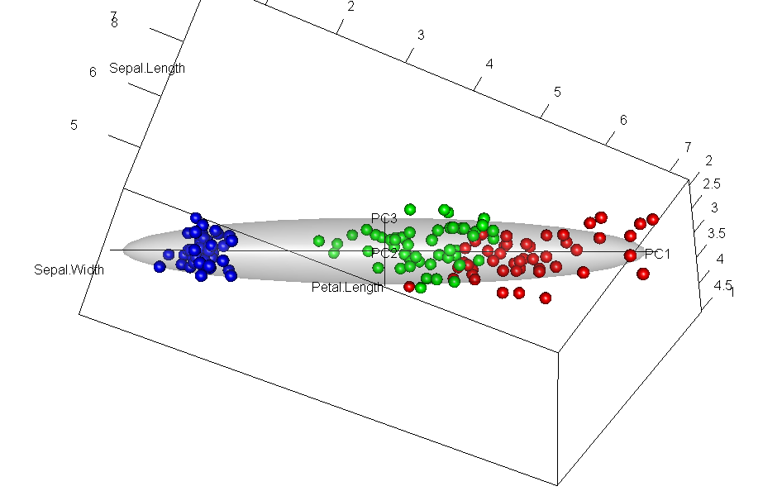
Rotate to show PC1 & PC3
M3 <- par3d("userMatrix")

Slide 9
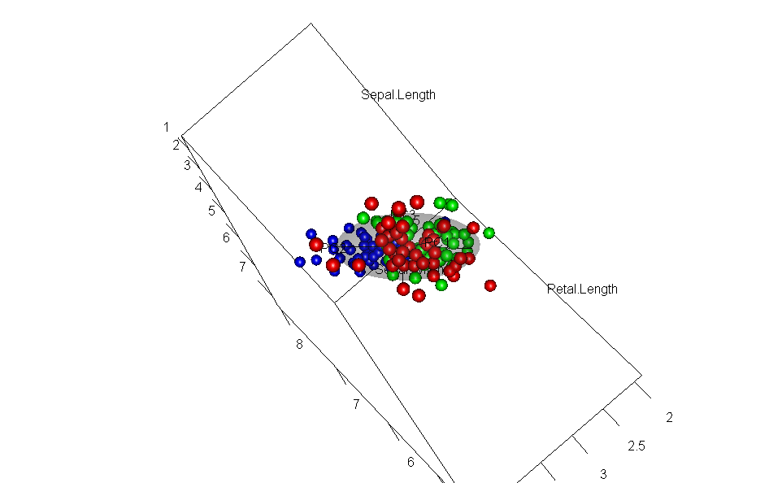
Rotate to show PC2 & PC3
M4 <- par3d("userMatrix")

Slide 10
Biplot movie: rotation to PC coordinates
interp <-par3dinterp( userMatrix=list(M1, M2),
extrapolate="constant", method="linear")
movie3d(interp, duration=4, fps=8, movie="biplot3d-iris")

Slide 11
Grand tour: Interpolation thru multiple views
interp3 <-par3dinterp(userMatrix=list(M1, M2, M3, M4, M3, M2, M1),
extrapolate="constant", method="linear" )
movie3d(interp3, duration=6, fps=8, movie="biplot3d-iris3", dir="../anim")

Slide 12
View in PCA space: bpca package

