Slide 1
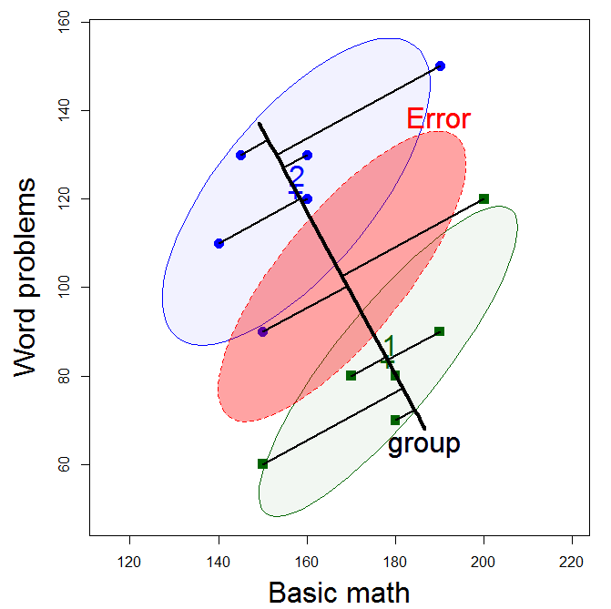
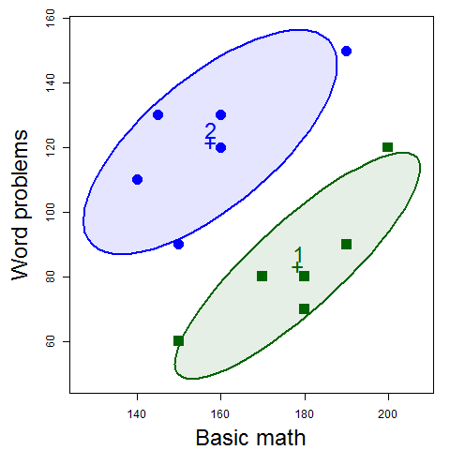
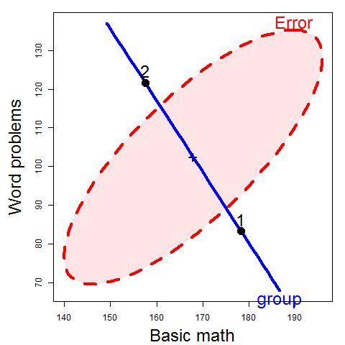
Visualizing Linear Models: An R Bag of Tricks Session 2: Multivariate Models
Data ellipses
HE plot
Michael Friendly
SCS Short Course
Oct-Nov 2021
https://friendly.github.io/VisMLM-course/

Slide 2
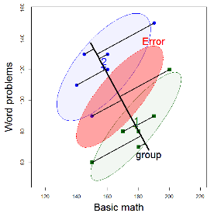
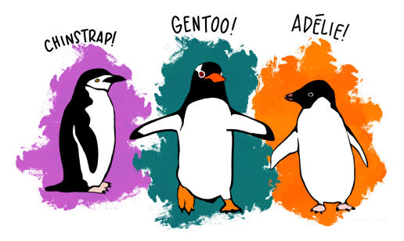
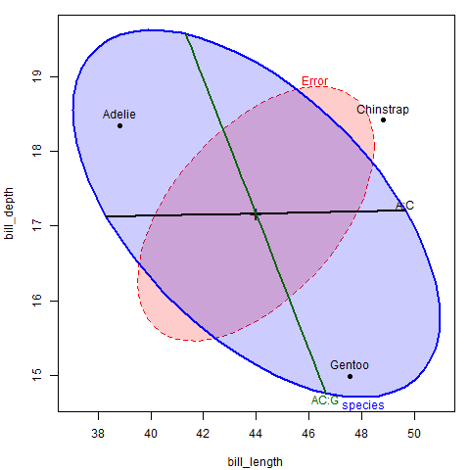
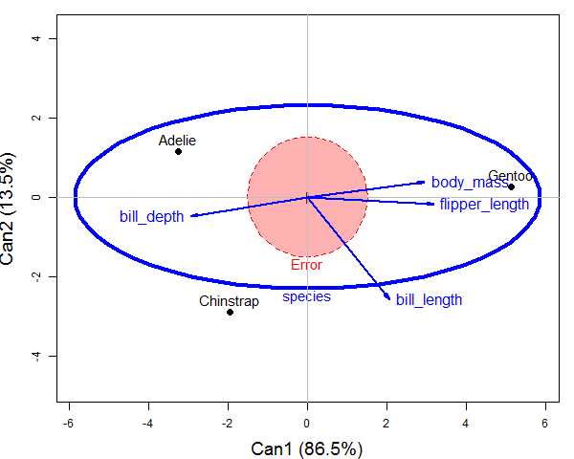
Today’s topics
Brief review of the GLM & MLM
Data ellipses
sufficient visual summaries
HE plot framework
H & E matrices/ellipses
Discriminant/canonical views
Example: Penguins data

Slide 3
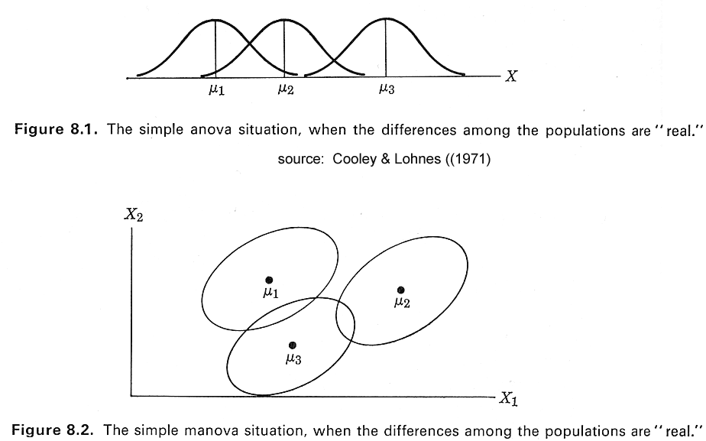
One-way ANOVA vs. MANOVA
ANOVA
Do means differ?
(Assume equal within-group variances)
MANOVA
How do centroids differ?
How many dimensions?
(Assume equal within-group variance-covariance matrices)

Slide 4
GLM: the design matrix (X)
In the full GLM, the design matrix (X) may consist of:
A constant, 1, for the intercept (usually implicit)
Quantitative regressors: age, income, education
Transformed regressors: √age, log(income)
Polynomial terms: age², age³, …
Categorical predictors (“factors”, class variables): treatment (control, drug A, drug B), sex
Interactions: treatment * sex, age * sex
Model formulae in R define y ~ X:
prestige ~ income + education # 2 main effects
prestige ~ income * education # + interaction
prestige ~ income + education + women + type # 4 main effects
prestige ~ education + poly(women, 2) + log(income)*type

Slide 5
Univariate linear model
Model
Sums of squares
Hypothesis tests
matrix of predictors, factors, …
data
fit
residuals
How big is hypothesis variation relative to error variation?

Slide 6
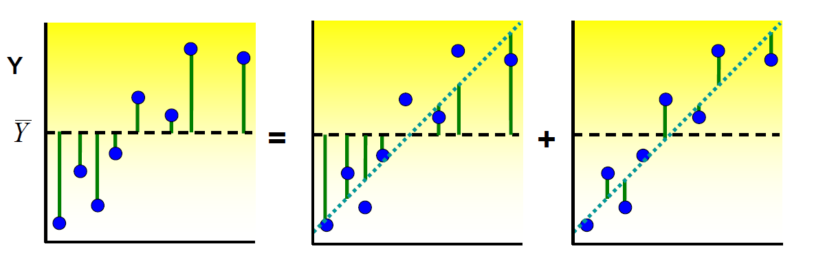
Regression: Visualizing SS_{T} = SS_{H} + SS_{E}
Total variance = Regression variance + Residual variance
F test: How much better is the fitted regression line (β = b̂) than the flat line (β = 0) ?

Slide 7
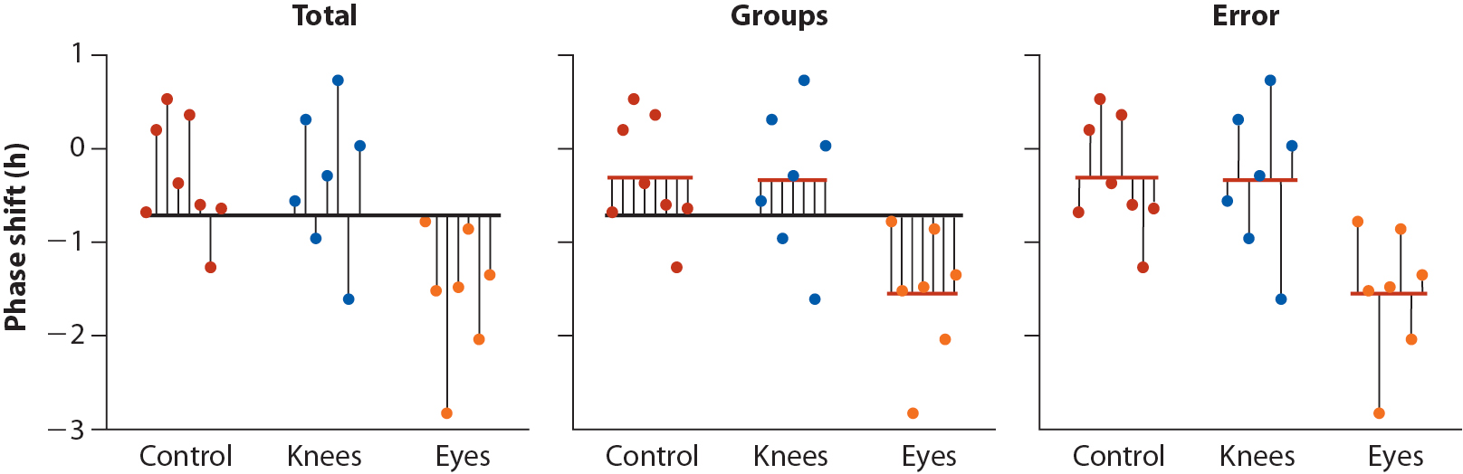
Visualizing SS_{T} = SS_{H} + SS_{E}
Total variance = Between group variance + Within group variance
Response
Control Group A Group B Control Group A Group B Control Group A Group B

Slide 8
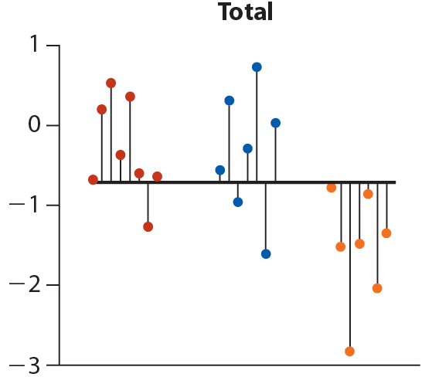
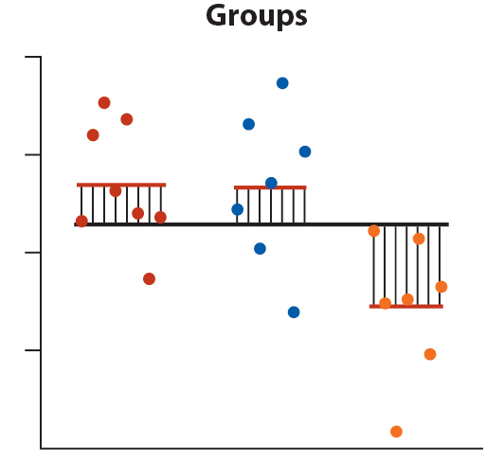
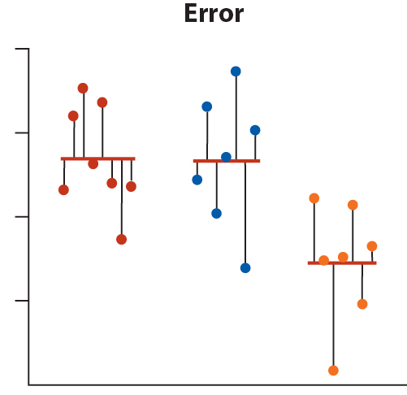
ANOVA: Visualizing SS_{T} = SS_{H} + SS_{E}
Total variance = Between group variance + Within group variance
Response
Control Group A Group B Control Group A Group B Control Group A Group B
F test: How much better is the groups model than the model ignoring groups?

Slide 9
Multivariate linear model
Model
Sums of squares & cross-products
Hypothesis tests
Eigenvalues λ_{i}, i=1:p of H E⁻¹
Wilks’ Λ, Pillai & Hotelling trace, Roy’s test
how many dimensions (aspects of responses)?
matrix of p responses
How big is hypothesis variation relative to error variation?
Ah, but there are up to s = min(p, df_{h}) dimensions of size

Slide 10
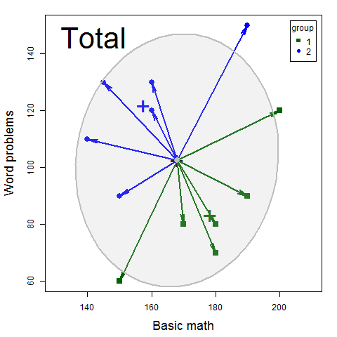
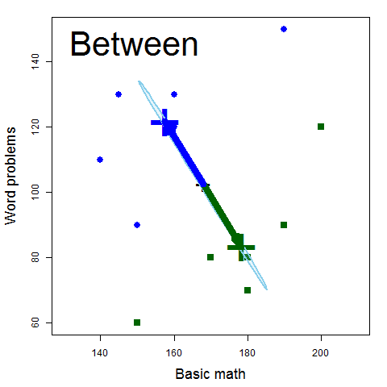
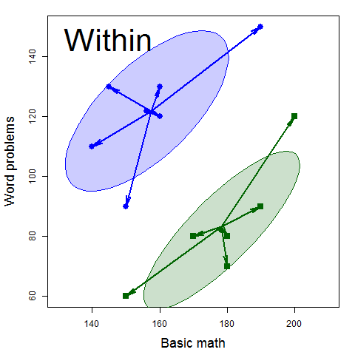
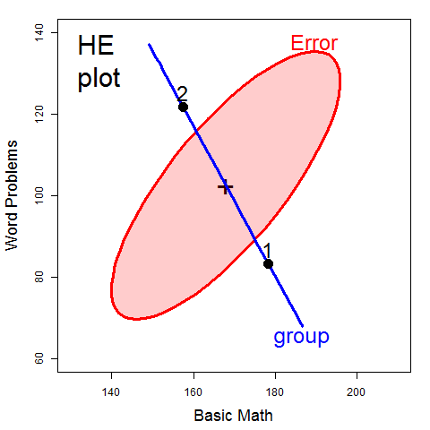
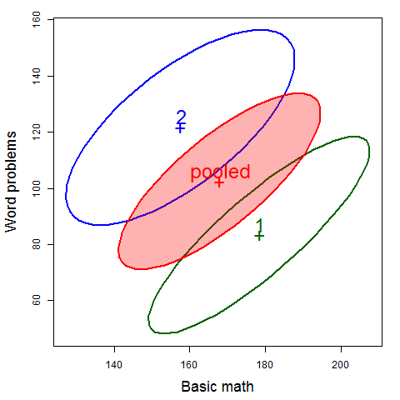
Visualizing SSP_{T} = SSP_{H} + SSP_{E}
=
+
scale & overlay
pool→ SSP_{E}
Within
Total
Between

Slide 11
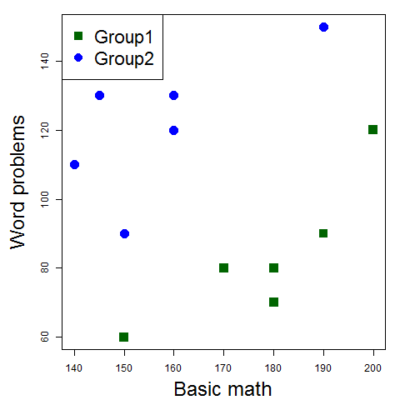
Data ellipsoids
The data ellipsoid is a sufficient visual summary for multivariate location & scatter, just as are sufficient for
Data
Data ellipses

Slide 12
Data ellipsoids: definitions
For a p-dimensional multivariate sample, Y_{N×p} , the sample mean vector, , and sample covariance matrix, S, are minimally sufficient statistics under classical (gaussian) assumptions.
These can be represented visually by the p-dimensional data ellipsoid, of size (“radius”) c centered at ,
→ an ellipsoid centered at the means whose size & shape reflects variances & covariances
We consider this a minimally sufficient visual summary of multivariate location and scatter.
or, D_{M}² (y) ≤ c²

Slide 13
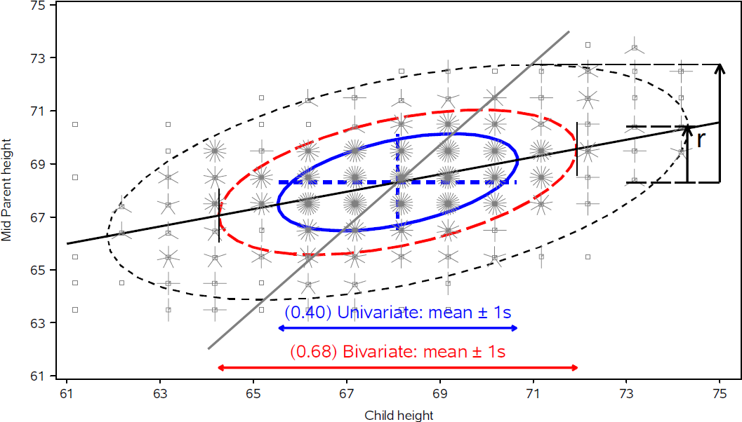
Data ellipsoids: properties
Ellipsoid boundary: Mahalanobis D_{M}² (y_{i}) ~ χ_{p}²
p=2: shadows generalize univariate confidence intervals
eccentricity: precision; visual estimate of correlation
r ≈ 0.5 here

Slide 14
The HE plot framework
Hypothesis-Error (HE) plots
Visualize multivariate tests in the MLM
Linear hypotheses--- lower-dimensional ellipsoids
Extension: HE plot matrices
Canonical displays
low-dimensional multivariate juicers
shows data in the space of maximal effects
Covariance ellipsoids
visualize tests of homogeneity of covariance matrices
For all: robust methods are available or good research projects!

Slide 15
HE plot framework: Trivial example
Two groups of middle-school students are taught algebra by instructors using different methods, and then tested on:
BM: basic math problems (7 * 23 – 2 * 9 = ?)
WP: word problems (“a train travels at 23 mph for 7 hours, but for 2 hours …”)
Do the groups differ on (BM, WP) by a multivariate test?
If so, how ???
> data(mathscore, package="heplots")
> mod <- lm(cbind(BM, WP) ~ group, data=mathscore)
> Anova(mod)
Type II MANOVA Tests: Pillai test statistic
Df test stat approx F num Df den Df Pr(>F)
group 1 0.86518 28.878 2 9 0.0001213 ***
---
Signif. codes: 0 ‘***’ 0.001 ‘**’ 0.01 ‘*’ 0.05 ‘.’ 0.1 ‘ ’ 1
✓

Slide 16
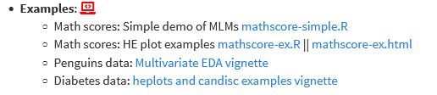

Follow along
The R script (mathscore-ex.R) for this example is linked on the course page. Download and open in R Studio to follow along.
HW: explore other examples
The script was run with `knitr` (ctrl+shift+K) in R Studio to create the HTML output (mathscore-ex.html)
The Code button there allows you do download the R code and comments
(R notebooks are a simple way to turn R scripts into finished documents)

Slide 17
Why do multivariate tests?
Could do univariate ANOVAs (or t-tests) on each response variable (BM, WP)
> Anova(lm(BM ~ group, data=mathscore))
Anova Table (Type II tests)
Response: BM
Sum Sq Df F value Pr(>F)
group 1302 1 4.24 0.066 .
Residuals 3071 10
> Anova(lm(WP ~ group, data=mathscore))
Anova Table (Type II tests)
Response: WP
Sum Sq Df F value Pr(>F)
group 4408 1 10.4 0.009 **
Residuals 4217 10
✗
✓
From this, might conclude that:
Groups don’t differ on Basic Math score ✗
Groups are significantly different on Word problems ✓
Multivariate tests:
Do not require correcting for multiple tests (e.g., Bonferroni)
Combine evidence from multiple response variables (“pooling strength”)
Show how the multivariate responses are jointly related to the predictors
How many aspects (dimensions?)

Slide 18
Why do multivariate tests?
Overall test is highly significant:
Combines the evidence for all predictors
Takes response correlations into account
✓
✓
> mod <- lm(cbind(BM, WP) ~ group, data=mathscore)
> Anova(mod)
Type II MANOVA Tests: Pillai test statistic
Df test stat approx F num Df den Df Pr(>F)
group 1 0.86518 28.878 2 9 0.0001213 ***
Visual test of significance (Roy’s test)
The H ellipse projects outside the E ellipse iff the effect is significant.
HE plot provides an interpretation:
Group 1 > Group 2 on Basic Math, but worse on Word Problems
Group 2 > Group 1 on Word Problems, but worse on Basic Math
BM & WP are + correlated w/in groups

Slide 19
HE plot framework: Visual overview
The data ellipsoid is a sufficient visual summary for multivariate location & scatter, just as are sufficient for
Data
Data ellipses

Slide 20
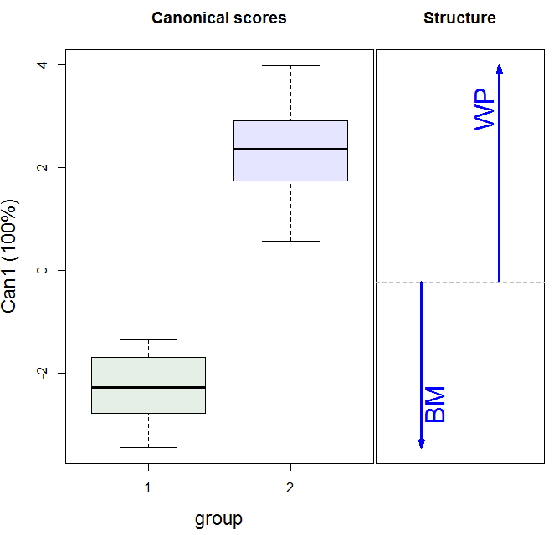
Data ellipses
HE plot
Visual overview
Canonical space
Discriminant scores

Slide 21
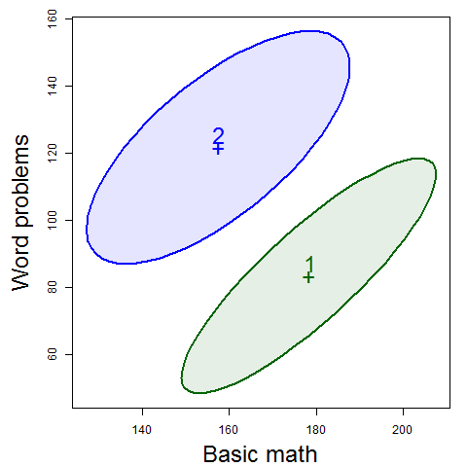
Data → Data ellipses → HE plot
Differences between group means are shown by the H ellipsoid– data ellipsoid of the fitted values (w/ 1 df, degenerates to a line)
Direction shows relation of groups to response variables
Size shows “how big is H relative to E”
Variation within groups is reflected in the E ellipsoid-- data ellipsoid of the residuals
Direction: residual (partial) correlation between BM & WP
Size/shape: residual variance

Slide 22
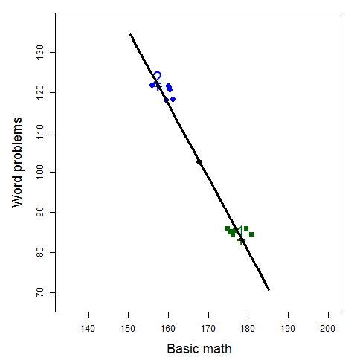
The H ellipse
Jittered fitted values
(gp means)
The H ellipse is the data ellipse of the fitted values (group means, here)
The H matrix is the sum of squares and crossproducts of the fitted values, corrected for the grand mean

Slide 23
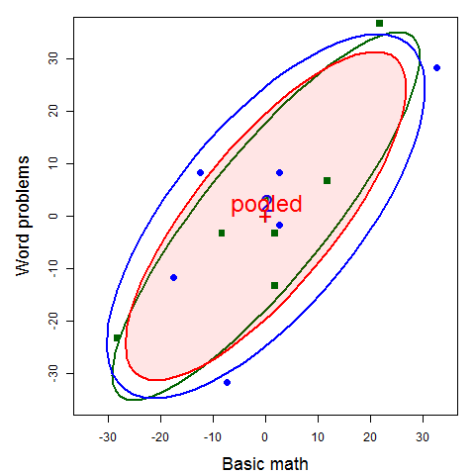
The E ellipse
The E ellipse is the data ellipse of the residuals
What you get when you subtract the group means from all observations, shifting them to the grand means.
E matrix called the “within-group pooled covariance matrix”

Slide 24
H & E in numbers
The H and E matrices are calculated in the car::Anova() function and saved as the SSP and SSPE components, used in the statistical tests.
> math.aov <- Anova(math.mod)
> (H <- math.aov$SSP)
$group
BM WP
BM 1302.1 -2395.8
WP -2395.8 4408.3
> fit
BM WP
1 178.33 83.333
2 178.33 83.333
3 178.33 83.333
4 178.33 83.333
5 178.33 83.333
6 178.33 83.333
7 157.50 121.667
8 157.50 121.667
9 157.50 121.667
10 157.50 121.667
11 157.50 121.667
12 157.50 121.667
Direct calculation:
> fit <- fitted(math.mod)
> ybar <- colMeans(mathscore[,2:3])
> n <- nrow(mathscore)
> crossprod(fit) - n*outer(ybar, ybar)
BM WP
BM 1302.1 -2395.8
WP -2395.8 4408.3

Slide 25
H & E in numbers
> (E <- math.aov$SSPE)
BM WP
BM 3070.8 2808.3
WP 2808.3 4216.7
Direct calculation:
> resids
BM WP
1 11.667 6.667
2 -8.333 -3.333
3 1.667 -3.333
4 21.667 36.667
5 -28.333 -23.333
6 1.667 -13.333
7 2.500 -1.667
8 32.500 28.333
9 -7.500 -31.667
10 2.500 8.333
11 -17.500 -11.667
12 -12.500 8.333
> resids <- residuals(math.mod)
> crossprod(resids)
BM WP
BM 3070.8 2808.3
WP 2808.3 4216.7
> cor(resids)
BM WP
BM 1.00 0.78
WP 0.78 1.00

Slide 26
Discriminant analysis
MANOVA and linear discriminant analysis (LDA) are intimately related and differ mainly in perspective:
MANOVA: Do means of groups on 2+ responses differ?
LDA: Find weighted sums of responses that best discriminate groups
In both cases,
Group differences are represented by the H matrix; residuals: E matrix
Test statistics based on eigenvalues of HE⁻¹
Discriminant weights are eigenvectors of HE⁻¹

Slide 27
Discriminant analysis
For 2 groups,
the discriminant axis is the line joining the two group centroids,
discriminant scores are the projections of observations on this line.
MASS:lda() does this analysis
> (mod.lda <- MASS::lda(group ~ ., mathscore))
Group means:
BM WP
1 178.3 83.33
2 157.5 121.67
Coefficients of linear discriminants:
LD1
BM -0.08350
WP 0.07527
The canonical dimension is Can1 = 0.075 WP - 0.083 BM, a contrast between the two tests

Slide 28
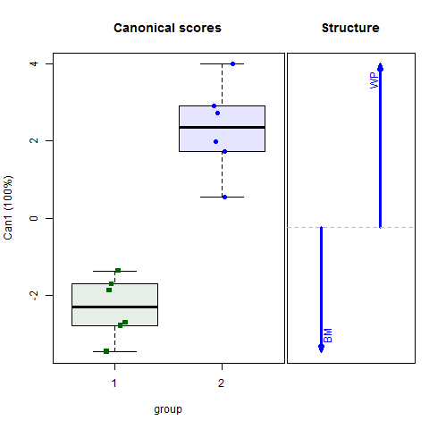
Canonical space
The HE plot view shows the data in data space
Easier to see effects by projecting scores to canonical space – the best-discriminating axes.
For a 1 df effect, there is only one canonical dimension
Arrows show the relative size & direction of discriminant weights
library(candisc)
mod.can <- candisc(math.mod)
plot(mod.can)

Slide 29

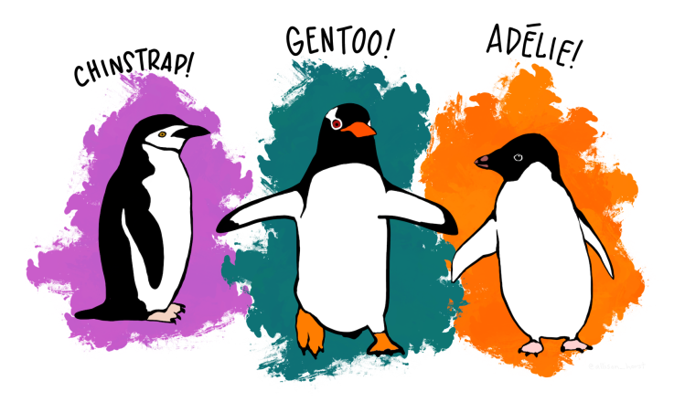
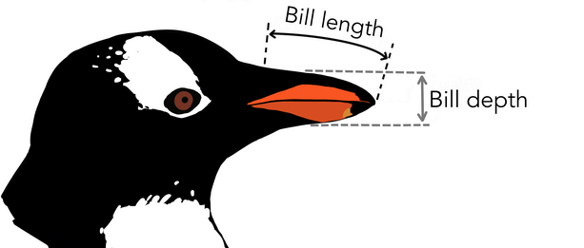
Penguin data
Data on 3 species of penguins, measured on 3 Antarctic islands
How does penguin “size” differ by species, island, … ?
> library(palmerpengiuns)
> peng <- penguins %>% rename(...) %>% ... # clean up names, etc.
> peng[sample(1:333, 5), ]
# A tibble: 5 x 8
species island bill_length bill_depth flipper_length body_mass sex year
<fct> <fct> <dbl> <dbl> <int> <int> <fct> <int>
1 Chinstrap Dream 58 17.8 181 3700 f 2007
2 Adelie Torgersen 39.6 17.2 196 3550 f 2008
3 Gentoo Biscoe 46.2 14.1 217 4375 f 2009
4 Chinstrap Dream 49 19.5 210 3950 m 2008
5 Gentoo Biscoe 50.4 15.7 222 5750 m 2009

Slide 30
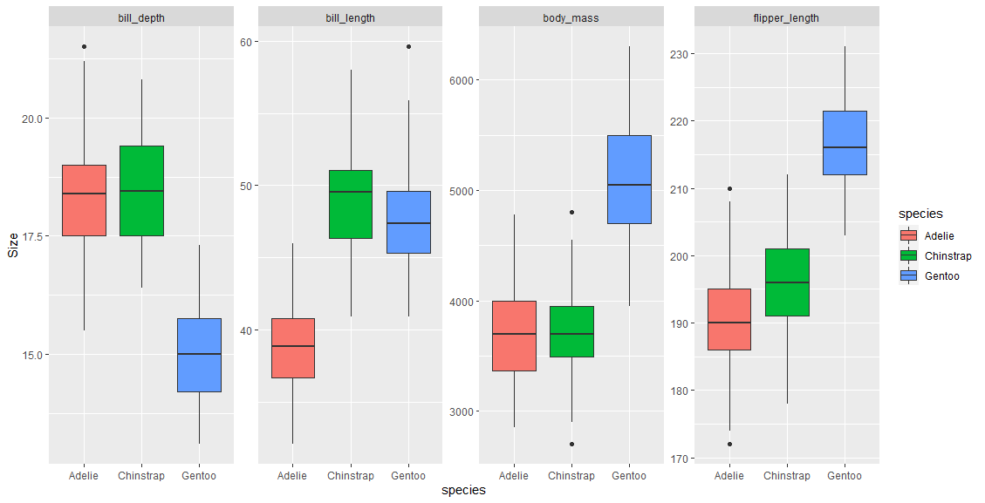
Penguins: Multivariate EDA
Boxplots by grouping variables (factors) are often useful for an initial overview
Can show multiple variables, but hard for >1 factor.
What is the pattern here?

Slide 31
Penguins: Multivariate EDA
Boxplots by grouping variables (factors) are often useful for an initial overview
Need to reshape data from wide to long format
peng_long <- peng %>%
tidyr::gather(Measure, Size, bill_length:body_mass)
ggplot(peng_long, aes(x=species, y=Size, fill=species)) +
geom_boxplot() +
facet_wrap(. ~ Measure, scales="free_y", nrow=1)

Slide 32
PCA & Biplots
For multivariate data, often want to view the data in a low-D space that shows the most total variance
PCA: finds weighted sums of variables which are:
Uncorrelated
Account for maximum variance
How many dimensions are necessary?
A biplot is a 2D (or 3D) plot of the largest PCA dimensions
Vectors in this plot show the original data variables
Points in this plot show the observations
Data ellipses here show within group relations

Slide 33
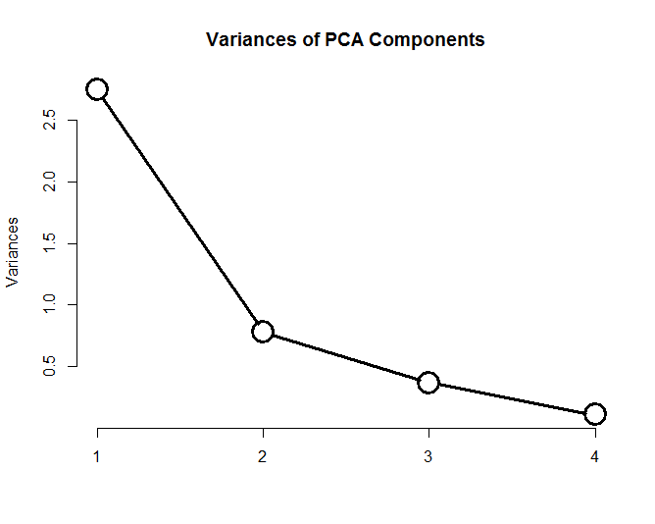
PCA
peng.pca <- prcomp (~ bill_length + bill_depth + flipper_length + body_mass,
data=peng,
na.action=na.omit,
scale. = TRUE)
screeplot(peng.pca, type = "line", lwd=3, cex=3,
main="Variances of PCA Components")
> summary(peng.pca)
Importance of components:
PC1 PC2 PC3 PC4
Standard deviation 1.657 0.882 0.6072 0.328
Proportion of Variance 0.686 0.195 0.0922 0.027
Cumulative Proportion 0.686 0.881 0.9730 1.000
2D: 88.1 %
3D: 97.3 %
See: https://rpubs.com/friendly/penguin-biplots for details

Slide 34
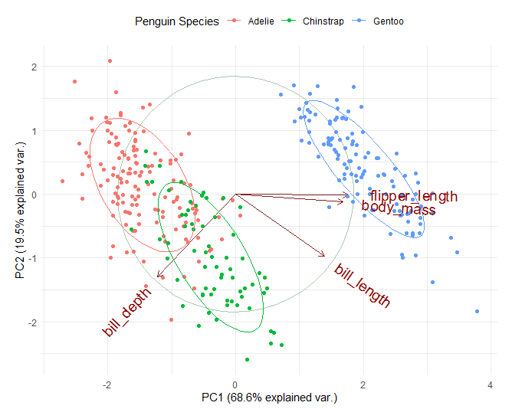
Biplot
library(ggbiplot)
ggbiplot(peng.pca, obs.scale = 1, var.scale = 1,
groups = peng$species,
ellipse = TRUE, circle = TRUE) +
scale_color_discrete(name = 'Penguin Species')
PC1, PC2 ~ 88.1% of variance
PC1: largely flipper length & body mass: “penguin size”
PC2 (& PC1): relates to “bill shape”
Easy to characterize the species in terms of these variables
Adelie
Gentoo
Chinstrap
See: https://rpubs.com/friendly/penguin-biplots

Slide 35
Penguins: MANOVA
Assume the goal is to determine whether/how the penguins differ in size by species
A MLM tests all 4 size variables together: ~ species
Could also use other factors: ~ species + island + sex
> peng.mod0 <-lm(cbind(bill_length, bill_depth, flipper_length, body_mass) ~ species,
data=peng)
> Anova(peng.mod0)
Type II MANOVA Tests: Pillai test statistic
Df test stat approx F num Df den Df Pr(>F)
species 2 1.64 371 8 656 <2e-16 ***
---
Signif. codes: 0 ‘***’ 0.001 ‘**’ 0.01 ‘*’ 0.05 ‘.’ 0.1 ‘ ’ 1
Yet, we are left to understand the nature of this effect wrt. the size variables.
See: https://rpubs.com/friendly/penguin-manova for details

Slide 36
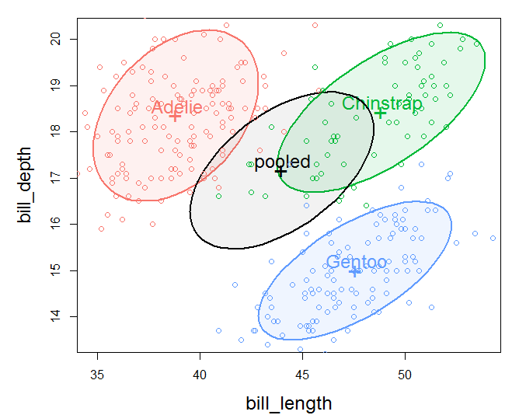
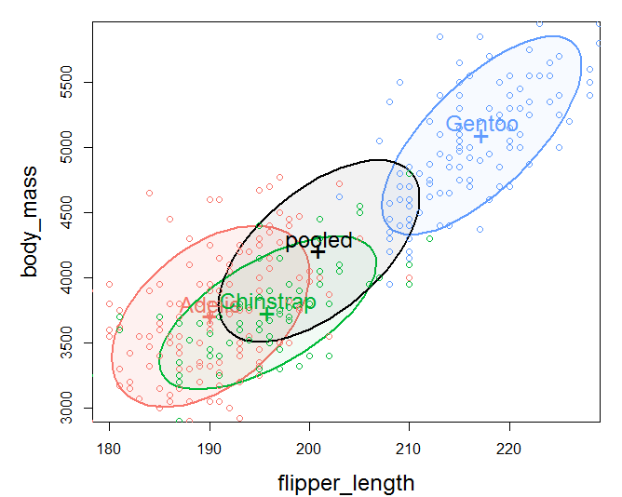
Penguins: view data ellipses
Data ellipses in 2D provide a good start for pairwise relations
bill depth & length
body mass & flipper length
group means negatively correlated
within group correlation > 0
group means positively correlated
within group correlation > 0

Slide 37
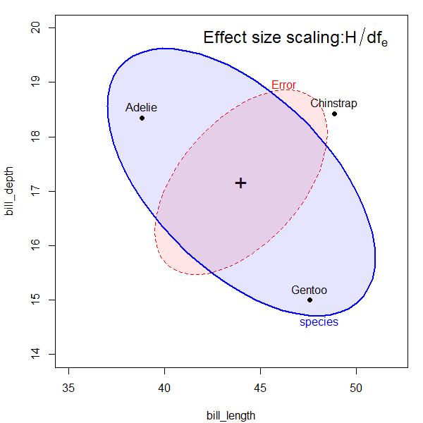
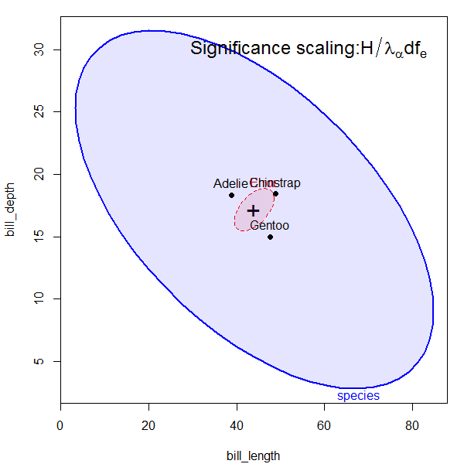
HE plot details
E ellipse reflects within-group error (co)variation
Size: E / df_{e} set to cover 68%, an analog of y̅ ± 1 std
Shift to grand mean for direct comparison with H
H ellipse reflects (co)variation of group means
effect size scaling, uses H/df_{e} to put this on the same scale as the E ellipse. Analog of effect size in univariate designs.
significance (“evidence”) scaling: uses H/λ_{α} df_{e} .
The H ellipse protrudes outside the E ellipse somewhere, iff an effect is significant (Roy’s largest root test) at p < α

Slide 38
Penguins: HE plots
Orientation of the H ellipse reflects negative correlation of the species means: species with larger bill depth have smaller bill length (bill “shape”?)
E ellipse: within species, larger bill length → larger bill depth
heplot(peng.mod0, size=“effect")
heplot(peng.mod0, size="evidence")

Slide 39
Contrasts
In linear models, any effect of df_{h} > 1 can be partitioned into df_{h} separate 1 df tests of contrasts
If orthogonal, H = H₁ + H₂ + … H _{dfh} -- accounts for total effect
Tested as a linear hypothesis, e.g., x₁ – (x₂ + x₃)/2 = 0
Each H_{i} has rank=1, so appears as a line in HE plots
Assume we want to compare the species as two contrasts:
Do Adelie differ from Chinstrap?
Do Gentoo penguins differ from the other two?
> contrasts(peng$species)<-matrix(c(1,-1,0, -1, -1, -2), 3,2)
> contrasts(peng$species)
[,1] [,2]
Adelie 1 -1
Chinstrap -1 -1
Gentoo 0 -2

Slide 40
Contrasts
hyp <- list("A:C"="species1","AC:G"="species2") # give names to contrasts
heplot(peng.mod0, fill=TRUE, fill.alpha=0.2,
hypotheses=hyp, size="effect")
Result is very clear:
Adelie & Chinstrap differ only in bill length
Gentoo differ from other two – longer, but less deep bills (bill shape)
Both of these are large effects!
Together, they are the entire species effect!

Slide 41
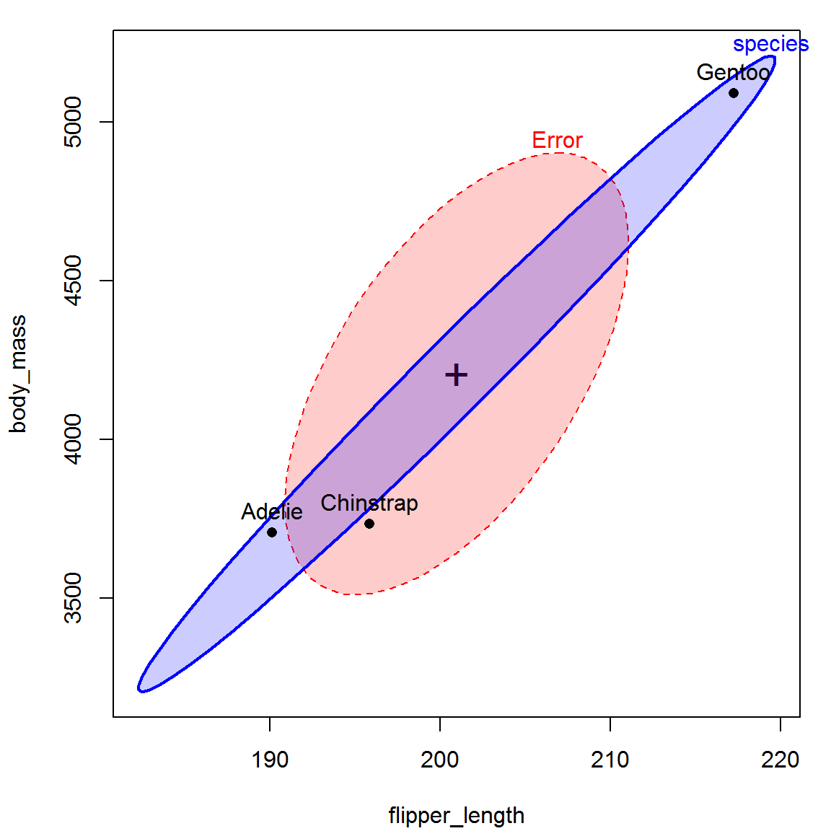
Other HE plots
2D: can plot any pair of responses in data space
pairs.mlm(): all pairwise 2D views
heplot3d(): plots in 3D, can rotate, spin, zoom, …
heplot(peng.mod0, variables=3:4,
fill=TRUE, fill.alpha=0.2, size="effect")
Interpretation:
major axis of the H ellipse measures “penguin size”
Gentoo are the Big Birds in this story!

Slide 42
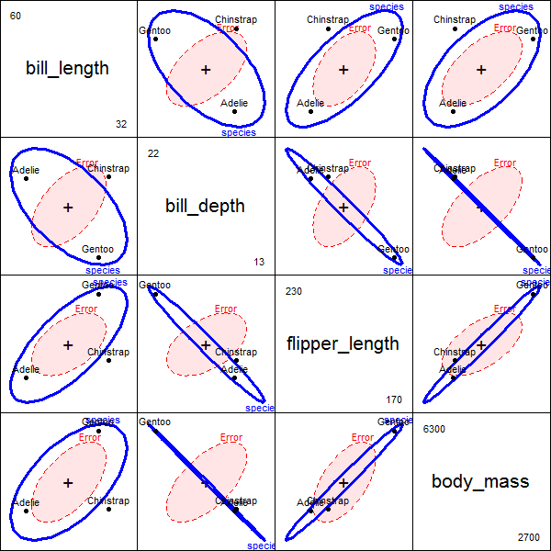
HE Pairs plots
The pairs() method for mlm objects gives a all pairwise HE plots in a scatterplot matrix format.
pairs(peng.mod0, size="effect",
fill=c(TRUE, FALSE))
Something new here:
avg. bill depth is negatively correlated with “size” variables – larger penguin species have smaller bill depths (curvature?)
correlation of avg. bill depth with body mass nearly -1

Slide 43
heplot3d()
3D HE plots can show other features
heplot3d(peng.mod0, size="effect")
The H ellipsoid here is flat (2D), because the species effect has 2 df
In this 3D view, the 3 species form a triangle, suggesting some further interpretation, not seen in 2D views

Slide 44
Canonical view
4 response variables, but only s=min(q, dfh)=2 dimensions.
Here, both dimensions are significant
Can1 accounts for 86.5% of between-species variance
Can 2 accounts for the rest: 13.5%
> library(candisc)
> (peng.can <- candisc(peng.mod0))
Canonical Discriminant Analysis for species:
CanRsq Eigenvalue Difference Percent Cumulative
1 0.938 15.03 12.7 86.5 86.5
2 0.700 2.34 12.7 13.5 100.0
Test of H0: The canonical correlations in the
current row and all that follow are zero
LR test stat approx F numDF denDF Pr(> F)
1 0.0187 516 8 654 <2e-16 ***
2 0.2997 255 3 328 <2e-16 ***
---
Signif. codes: 0 ‘***’ 0.001 ‘**’ 0.01 ‘*’ 0.05 ‘.’ 0.1 ‘ ’ 1
✓
✓

Slide 45
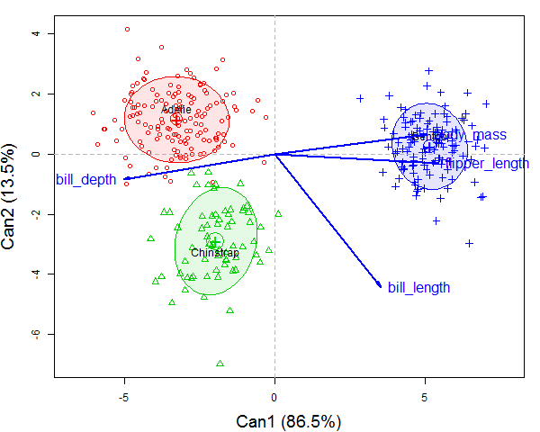
Canonical view
The plot() method for candisc objects shows points for observations and vector for variables
plot(peng.can, ellipse = TRUE … ) #plot CAN scores with ellipses
Can1: largely body mass & flipper length, that separate Gentoo from (Adelie, Chinstrap)
Can2: bill length distinguishes Chinstrap from others.

Slide 46
Canonical HE plot
heplot(peng.can, size="effect", fill=c(TRUE, FALSE))
Here is the entire effect of species shown in one HE plot
In CAN space, residuals are uncorrelated: E = circle
Size of H shows the total effect of species
Variable vectors show how the groups are discriminated.

Slide 47
Summary
MLM just like univariate LM, but for multiple responses
Simultaneous tests – no need for p-value adjustment
Take correlations among responses into account
Indicates # of dimensions of responses
Data ellipses
Summarize bivariate data to show means, variances, correlation
MANOVA: shows how groups differ in these
HE framework
Visualize multivariate tests in the MLM
Canonical displays show these results in the 2D (or 3D) space that accounts for largest between-group variance.

Slide 48
Visualizing MANOVA tests
Data
Data ellipses
SSP_{E} = pooled w/in group
SSP_{H} = var of group means

Slide 49
Within
Total
Between
Within
Total
Between

