Slide 1
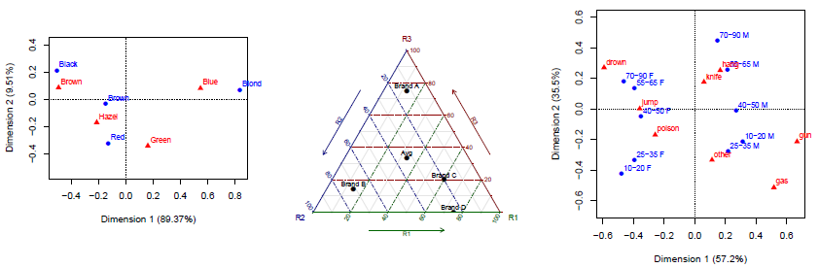
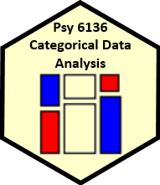
Correspondence analysis
Michael Friendly
Psych 6136
http://friendly.github.io/psy6136

Slide 2


Correspondence analysis: Basic ideas
Analog of PCA for frequency data
Account for maximum % of χ² in few (2-3) dimensions
Finds scores for row (x_{im}) and col (y_{jm}) categories on these dimensions
Uses Singular Value Decomposition of residuals from independence,
Optimal scaling: each pair of scores for rows (x_{im}) and col (y_{jm}) have highest possible correlation (= λ_{m})
Plots of the row and column scores show associations
Row point (x_{im}) near col point (y_{jm}) → positive association d_{ij} > 0

Slide 3


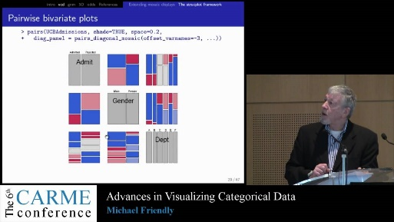
Correspondence analysis: History
Mathematical foundations: “Geometric data analysis”, J. P. Benzecri, ~ 1960s
The French school: L’ Analyse des Donnes
Popularized in European social science
Multidimensional EDA
More descriptive than inferential
“models should follow the data, not vice versa”
High-D phenomena → Low-D approximations
CARME conferences: every 4 years

Slide 4
CA software for R
ca package
ca() – two-way tables; plot(ca() ) for graphs
mjca() – multiple & joint CA; vcdExtra::mcaplot() for plots
FactoMineR & factoextra packages
CA() – many options for graphical displays
fviz_ca() – uses ggplot2; can ggrepel point labels
ade4 package
dudi.coa() – very nice graphics, but somewhat quirky

Slide 5
Example: Hair color, eye color
> library(ca)
> haireye <- margin.table(HairEyeColor, 1:2)
> (haireye.ca <- ca(haireye))
Principal inertias (eigenvalues):
1 2 3
Value 0.208773 0.022227 0.002598
Percentage 89.37% 9.52% 1.11%
Rows:
Black Brown Red Blond
Mass 0.1824 0.4831 0.1199 0.215
ChiDist 0.5512 0.1595 0.3548 0.838
Inertia 0.0554 0.0123 0.0151 0.151
Dim. 1 -1.1043 -0.3245 -0.2835 1.828
Dim. 2 1.4409 -0.2191 -2.1440 0.467
Columns:
Brown Blue Hazel Green
Mass 0.3716 0.363 0.1571 0.1081
ChiDist 0.5005 0.554 0.2887 0.3857
Inertia 0.0931 0.111 0.0131 0.0161
Dim. 1 -1.0771 1.198 -0.4653 0.3540
Dim. 2 0.5924 0.556 -1.1228 -2.2741
χ² % for dimensions
Hair category scores, Dim1-2
Eye category scores, Dim1-2

Slide 6
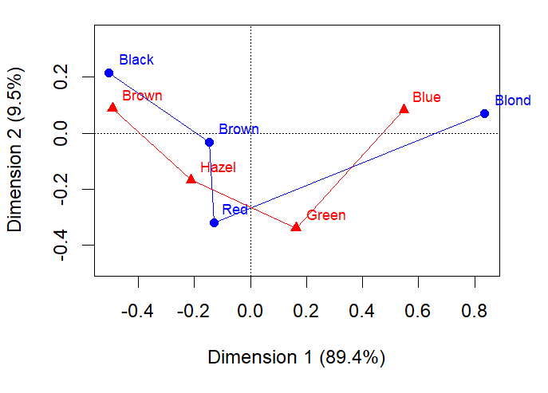
plot(haireye.ca, lines=TRUE)
Rough interpretation: row/col points “near” each other are positively associated (independence residuals d_{ij} >> 0)
Dim 1: 89.4% of χ² (dark → light)
Dim 2: 9.5% of χ² (Red/Green vs. others)

Slide 7
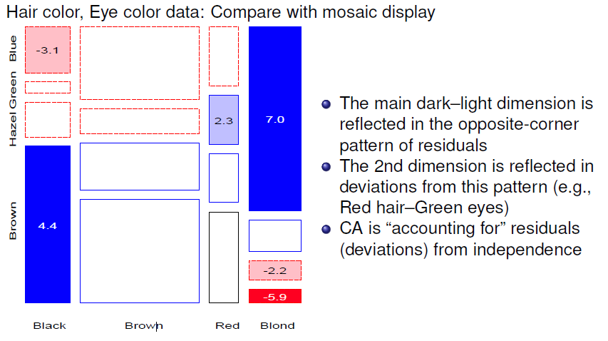

Slide 8
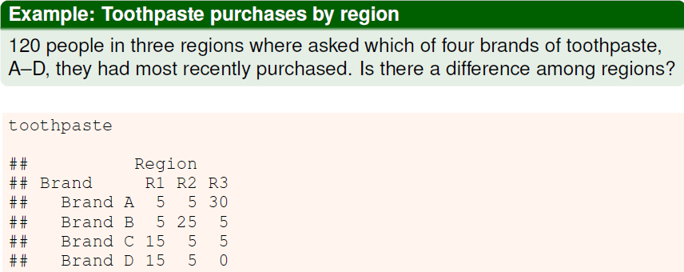
Row & column profiles
For a two-way table, row profiles & column profiles give relative proportions of the categories
An association is present to the extent that the row/col profiles differ
Profiles add to 1.0 (100%), and can be visualized in profile space

Slide 9
Row profiles pertain to the differences among brand preference
Column profiles pertain to the differences among regions
Region
Brand R1 R2 R3 Sum
Brand A 12.5 12.5 75.0 100
Brand B 14.3 71.4 14.3 100
Brand C 60.0 20.0 20.0 100
Brand D 75.0 25.0 0.0 100
Region
Brand R1 R2 R3
Brand A 12.5 12.5 75.0
Brand B 12.5 62.5 12.5
Brand C 37.5 12.5 12.5
Brand D 37.5 12.5 0.0
Sum 100.0 100.0 100.0
There is clearly an association: → the row (& column) profiles differ
> chisq.test(toothpaste)
Pearson's Chi-squared test
data: toothpaste
X-squared = 79.6, df = 6, p-value = 4.3e-15

Slide 10
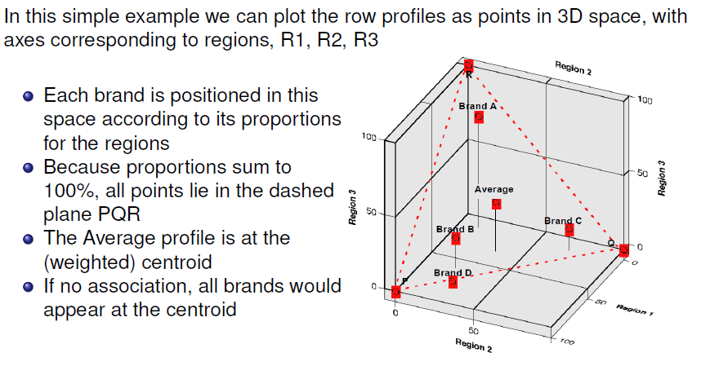
Plotting profiles

Slide 11
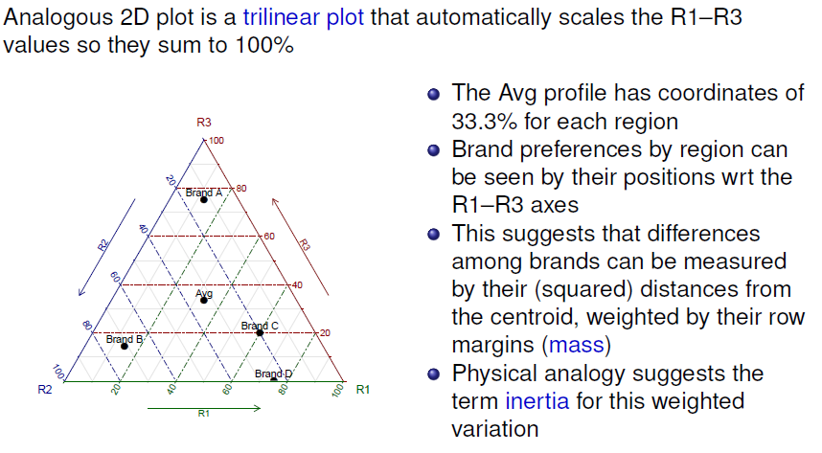
Plotting profiles

Slide 12
CA solution
The CA solution has at most min(r – 1, c – 1) dimensions
The 2D solution here is exact, i.e., accounts for 100% of Pearson χ²
> tp.ca <- ca(toothpaste)
> summary(tp.ca, rows=FALSE, columns=FALSE)
Principal inertias (eigenvalues):
dim value % cum% scree plot
1 0.410259 61.8 61.8 ***************
2 0.253134 38.2 100.0 **********
-------- -----
Total: 0.663393 100.0
Pearson χ² = N ∑ λ²
> # reproduce chi-square
> sum(tp.ca$sv^2) * sum(toothpaste)
[1] 79.607

Slide 13
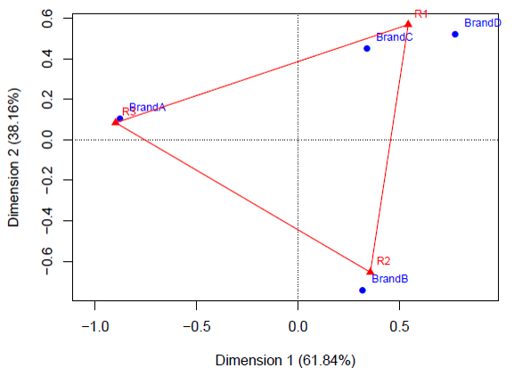
CA solution
Brand A: most in R3
Brand B: most in R2
Brands C, D: most in R1

Slide 14
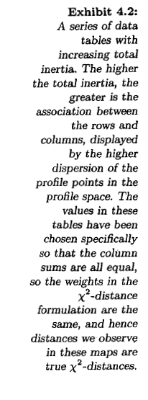
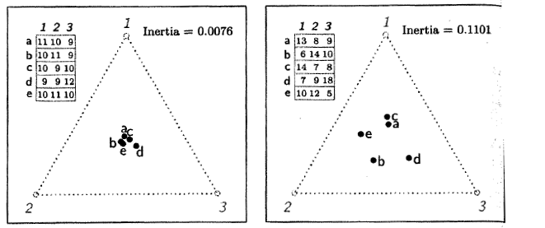
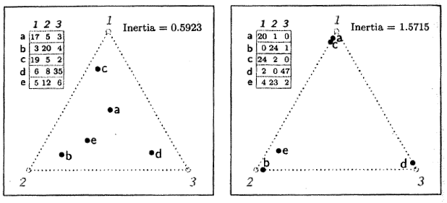
Profiles & inertia

Slide 15
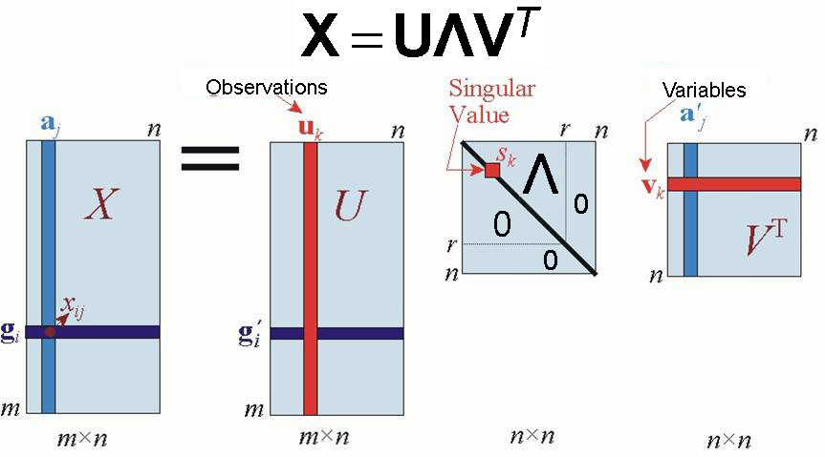
Singular value decomposition
The singular value decomposition (SVD) is a basic technique for factoring a matrix and for matrix approximation
For an m x n matrix X of rank r ≤ min(m, n) the SVD of X is:
data
Row scores
Singular values
Col scores

Slide 16
Properties of the SVD
U: columns are eigenvectors of XX^{T} and form an orthonormal basis for observation profiles such that U^{T}U = I
Λ: diagonal, r singular values = sqrt eigenvalues of both XX^{T} and X^{T}X
V: columns are eigenvectors of X^{T}X, orthonormal: V^{T}V = I

Slide 17
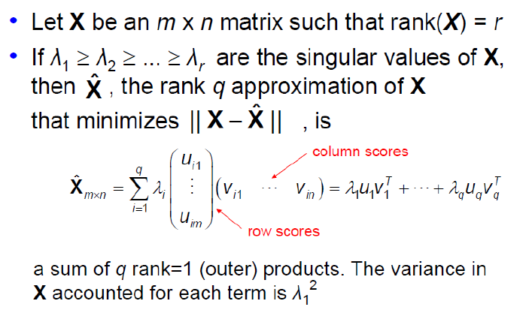
SVD: Matrix approximation

Slide 18
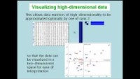
SVD song: It had to be U …
Michael Greenacre, It had to be U - the SVD song, https://www.youtube.com/watch?v=JEYLfIVvR9I

Slide 19
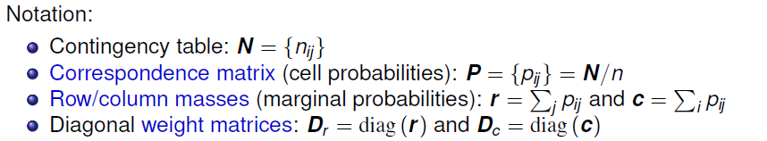
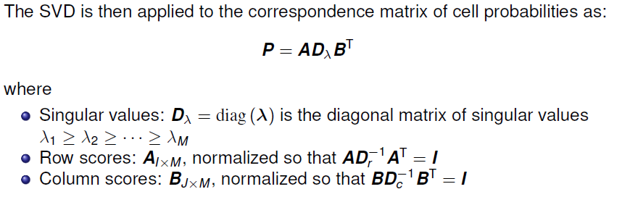
CA notation & terminology

Slide 20
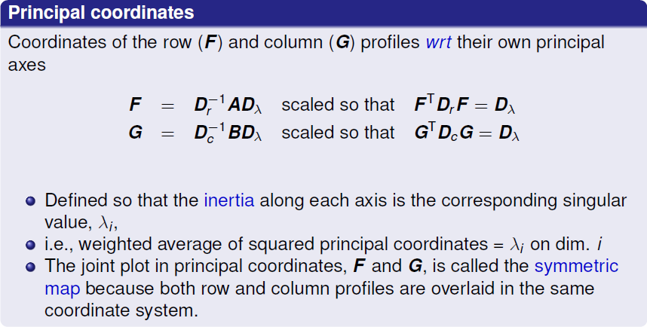
Principal & standard coordinates
Two types of coordinates are used in CA, based on re-scalings of A and B.
Principal coordinates are most commonly used in plotting CA solutions.

Slide 21
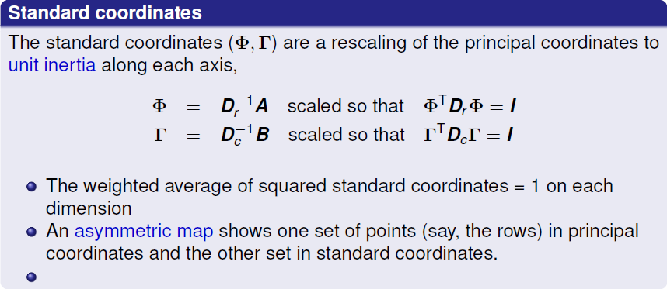
Standard coordinates

Slide 22
Geometric & statistical properties
Nested solutions: CA solutions are nested, meaning that the first two dimensions of a 3D solution will be identical to the 2D solution (similar to PCA)
Centroids at origin: In both principal coordinates and standard coordinates the points representing the row and column profiles have their centroids (weighted averages) at the origin.
The origin represents the (weighted) average row profile and column profile.
Chi-square distances: In principal coordinates, distances between two row profiles, r_{i} and r_{i’} are χ² distances
The squared difference (r_{ij} – r_{i’j} )² between two row profiles is inversely weighted by the column frequency, to account for the different relative frequency of the column categories.
Plotting: For distances to be interpretable, it’s crucial to scale the axes equally, so 1^{cm} is the same on both axes (aspect ratio = 1). This is standard in most packages.

Slide 23
The ca package in R
ca() calculates CA solutions, returning a “ca” object with all the details
> names(haireye.ca)
[1] "sv" "nd" "rownames" "rowmass" "rowdist"
[6] "rowinertia" "rowcoord" "rowsup" "colnames" "colmass"
[11] "coldist" "colinertia" "colcoord" "colsup" "N"
[16] "call"
The result contains the standard row coordinates (rowcoord: Φ ) and column coordinates (colcoord: Γ) used in plotting
> haireye.ca$rowcoord
Dim1 Dim2 Dim3
Black -1.104 1.441 -1.089
Brown -0.324 -0.219 0.957
Red -0.283 -2.144 -1.631
Blond 1.828 0.467 -0.318
> haireye.ca$colcoord
Dim1 Dim2 Dim3
Brown -1.077 0.592 -0.4240
Blue 1.198 0.556 0.0924
Hazel -0.465 -1.123 1.9719
Green 0.354 -2.274 -1.7184

Slide 24
ca plots
The plot() method provides a wide variety of scalings (map= ), with different interpretative properties. Some of these:
“symmetric” – both rows & cols in principal coordinates (default)
“rowprincipal” or “colprincipal” – asymmetric maps with rows in principal coordinates and cols in std coordinates, or vice versa
“symbiplot” – scales both rows and cols to have variances equal to the singular value
The mjca() function is used for multiple correspondence analysis (MCA) for 3+ way tables. Has analogous print(), summary() and plot() methods
vcdExtra::mcaplot() does a nicer job of plotting MCA solutions

Slide 25
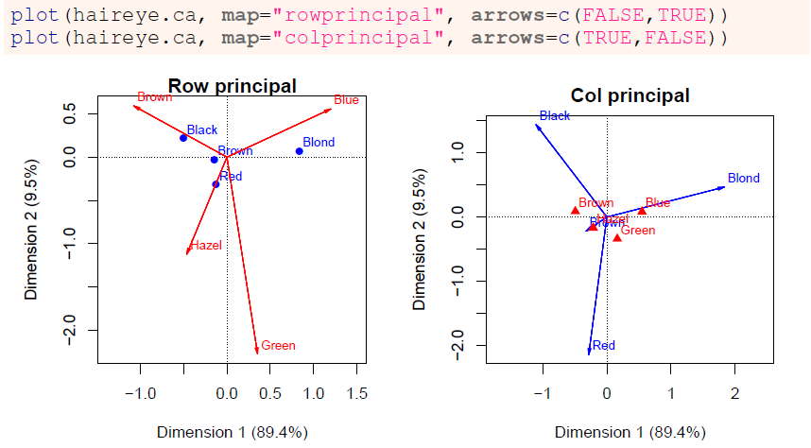
Asymmetric row/col principal plots are biplots – can interpret the projection of points on vectors for the other variable

Slide 26
Optimal category scores
CA has a close relation to canonical correlation analysis, applied to dummy variables representing the categories
The singular values, λ_{i} , are the correlations between the category scores
Assign Dim 1 scores, X1 and Y1 to the row/column categories: → Max. possible correlation, λ₁
Assign Dim 2 scores, X2 and Y2 to the row/column categories: → Max. possible correlation, λ₂, but uncorrelated with X1, Y1
All association between row/col categories is captured by the scores
This optimal scaling interpretation can be used to quantify categorical variables, particularly if Dim 1 is large
Mosaics: Permute rows / cols by Dim 1 scores

Slide 27
Optimal category scores
> haireye.ca <- ca(haireye)
> round(haireye.ca$sv, 3)
[1] 0.457 0.149 0.051
The singular values λ_{i} = canonical correlations
To demonstrate category scores, extract row/col coordinates to a data frame
HE.df <- as.data.frame(haireye)
RC <- haireye.ca$rowcoord # row coordinates
CC <- haireye.ca$colcoord # col coordinates
Y1 <- RC[match(HE.df$Hair, haireye.ca$rownames), 1] # Dim 1
X1 <- CC[match(HE.df$Eye, haireye.ca$colnames), 1]
Y2 <- RC[match(HE.df$Hair, haireye.ca$rownames), 2] # Dim 2
X2 <- CC[match(HE.df$Eye, haireye.ca$colnames), 2]
HE.df <- cbind(HE.df, X1, Y1, X2, Y2)

Slide 28
Optimal category scores
> HE.df <- cbind(HE.df, X1, Y1, X2, Y2)
> print(HE.df, digits=3)
Hair Eye Freq X1 Y1 X2 Y2
1 Black Brown 68 -1.077 -1.104 0.592 1.441
2 Brown Brown 119 -1.077 -0.324 0.592 -0.219
3 Red Brown 26 -1.077 -0.283 0.592 -2.144
Blond Brown 7 -1.077 1.828 0.592 0.467
. . .
13 Black Green 5 0.354 -1.104 -2.274 1.441
14 Brown Green 29 0.354 -0.324 -2.274 -0.219
15 Red Green 14 0.354 -0.283 -2.274 -2.144
16 Blond Green 16 0.354 1.828 -2.274 0.467
Calculate Freq-weighted correlations. All are zero except r(X1, Y1) = λ₁ & r(X2, Y2) = λ₂
> corr <- cov.wt(HE.df[,4:7], wt=HE.df$Freq, cor=TRUE)$cor
> round(zapsmall(corr), 3)
X1 Y1 X2 Y2
X1 1.000 0.457 0.000 0.000
Y1 0.457 1.000 0.000 0.000
X2 0.000 0.000 1.000 0.149
Y2 0.000 0.000 0.149 1.000

Slide 29
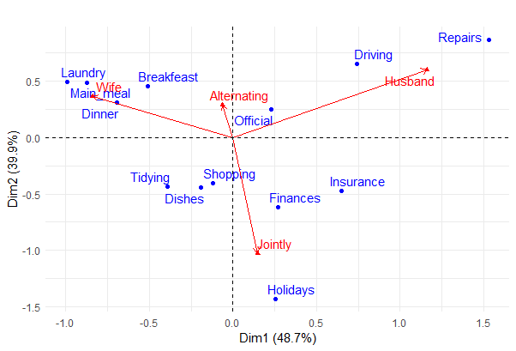
Permuting for a mosaic
data(housetasks, package="factoextra")
res.ca <- FactoMiner::CA(housetasks, graph=FALSE)
fviz_ca(res.ca, repel = TRUE,
geom.col = c("point", "text", "arrow")) +
theme_minimal()
Dim1: H vs Wife
Dim2: single vs jointly

Slide 30
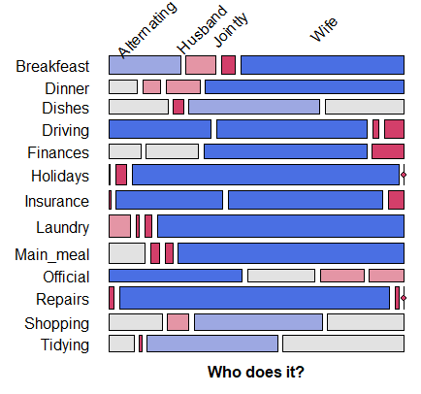
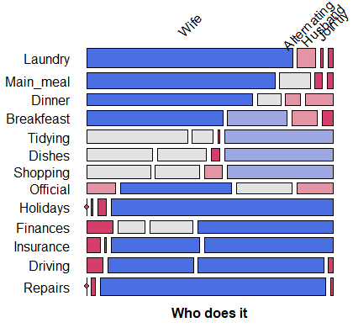
Permuting for a mosaic
library(seriation)
order <- seriate(housetasks, method = "CA")
ht <- permute(housetasks, order, margin=1)
mosaic(ht, shade = TRUE, ...)
The seriate package has a CA method to permute rows/cols of a df or matrix
Alpha ordered
CA ordered

Slide 31
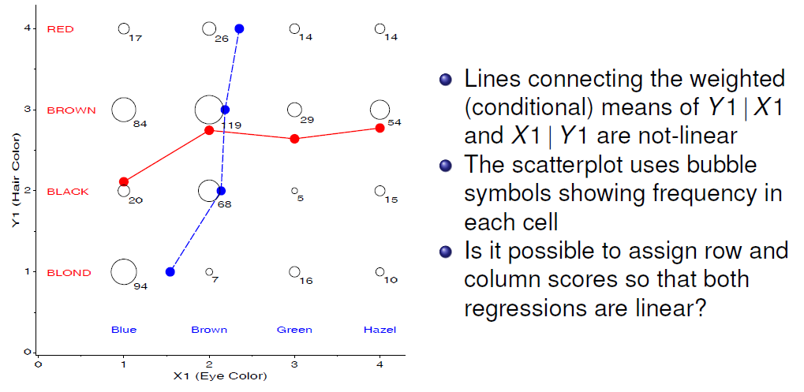
Simultaneous linear regression
Assign linear scores (1-4) X1 to eye color and Y1 to hair color

Slide 32
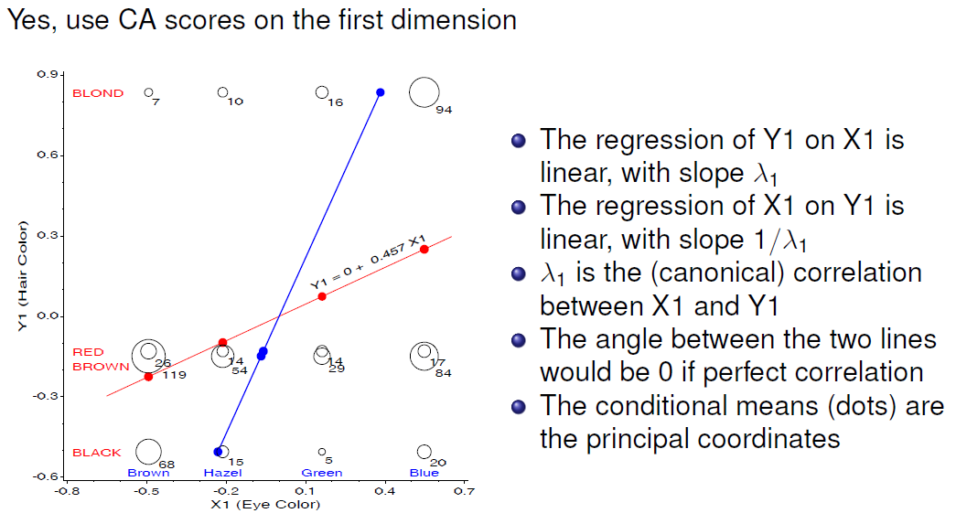
Simultaneous linear regressions

Slide 33
Example: Mental impairment & parent’ SES
Data on mental health status of 1660 young NYC residents, by parents’ SES, a 6 x 4 table. Is higher SES associated with better kids’ mental health?
> data("Mental", package="vcdExtra")
> str(Mental)
'data.frame': 24 obs. of 3 variables:
$ ses : Ord.factor w/ 6 levels "1"<"2"<"3"<"4"<..: 1 1 1 1 2 2 2 2 3 3 ...
$ mental: Ord.factor w/ 4 levels "Well"<"Mild"<..: 1 2 3 4 1 2 3 4 1 2 ...
$ Freq : int 64 94 58 46 57 94 54 40 57 105 ...
Both ses and mental are ordered factors in a frequency data frame
For ca(), convert this to a table using xtabs()
> (mental.tab <- xtabs(Freq ~ ses + mental, data=Mental))
mental
ses Well Mild Moderate Impaired
1 64 94 58 46
2 57 94 54 40
3 57 105 65 60
4 72 141 77 94
5 36 97 54 78
6 21 71 54 71

Slide 34
Mental data: CA solution
> mental.ca <- ca(mental.tab)
> summary(mental.ca, rows=FALSE, columns=FALSE)
Principal inertias (eigenvalues):
dim value % cum% scree plot
1 0.026025 93.9 93.9 ***********************
2 0.001379 5.0 98.9 *
3 0.000298 1.1 100.0
-------- -----
Total: 0.027702 100.0
The exact CA solution requires min(r-1, c-1) = 3 dimensions
Total Pearson χ² is nΣ λ_{i}² = 1660 x 0.0277 = 45.98 with 15 df
Of this, 93.9% is accounted for by the 1st dimension

Slide 35
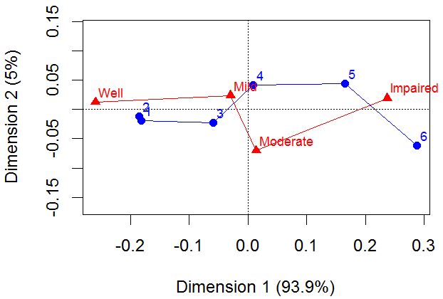
Mental data: CA plot
plot(mental.ca, lines = TRUE)
Category spacing:
SES: perhaps collapse categories (1,2) ??
Mental: Smaller diff betw. Mild, Moderate ??

Slide 36
Looking ahead
CA is largely an exploratory method — row/column scores are not parameters of a statistical model; no confidence intervals
Only rough tests for the number of CA dimensions
Can’t test a hypothesis that the row/column scores are have some particular spacing (e.g., are mental and ses equally spaced?)
These questions can be answered with specialized loglinear models
Nevertheless, plot(ca(table)) gives an excellent quick view of associations

Slide 37
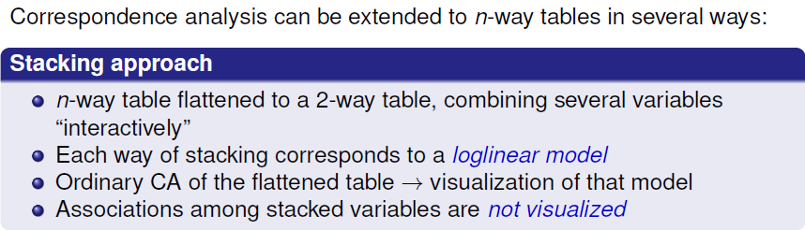
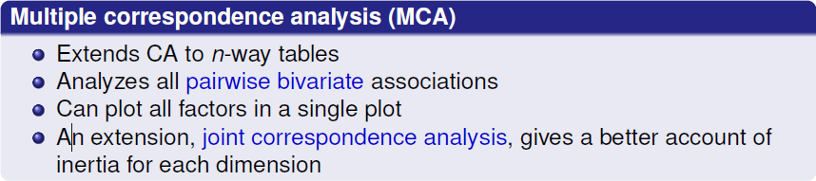
Multi-way tables

Slide 38
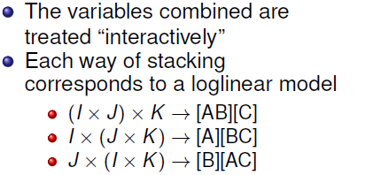
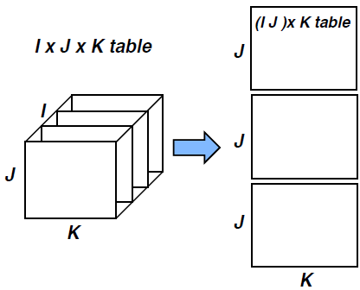
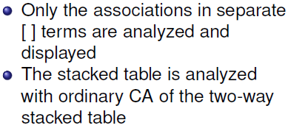
Multi-way tables: Stacking
A 3-way table of size I × J × K can be sliced and stacked as a two-way table in several ways

Slide 39
Interactive coding in R
Data in table or array form: use as.matrix(structable(rows ~ cols))
Data as frequency data frame: use interaction() or paste() followed by xtabs()
mat1 <- as.matrix(structable(A + B ~ C, data=mytable)) # [A B][C]
mat2 <- as.matrix(structable(A + C ~ B + D, data=mytable)) # [A C][B D]
ca(mat2)
mydf$AB <- interaction(mydf$A, mydf$B, sep='.’) # levels: A.B
mydf$AB <- paste(mydf$A, mydf$B, sep=':') # levels: A:B
...
mytab <- xtabs(Freq ~ AB + C, data=mydf) # [A B] [C]

Slide 40
Example: suicide rates in Germany
vcd::Suicide gives a 2 x 5 x 8 table of sex by age.group by method for 53,158 suicides in Germany, in a frequency data frame
Use paste() to join age.group and sex → age_sex in the form ’10-20 M’
> Suicide <- within(Suicide, {
age_sex <- paste(age.group, toupper(substr(sex,1,1)))
})
> head(Suicide)
Freq sex method age age.group method2 age_sex
1 4 male poison 10 10-20 poison 10-20 M
2 0 male cookgas 10 10-20 gas 10-20 M
3 0 male toxicgas 10 10-20 gas 10-20 M
247 male hang 10 10-20 hang 10-20 M
5 1 male drown 10 10-20 drown 10-20 M
6 17 male gun 10 10-20 gun 10-20 M

Slide 41
Suicide rates in Germany
> suicide.tab <- xtabs(Freq ~ age_sex + method2, data=Suicide)
> suicide.tab
method2
age_sex poison gas hang drown gun knife jump other
10-20 F 921 40 212 30 25 11 131 100
10-20 M 1160 335 1524 67 512 47 189 464
25-35 F 1672 113 575 139 64 41 276 263
25-35 M 2823 883 2751 213 852 139 366 775
40-50 F 2224 91 1481 354 52 80 327 305
40-50 M 2465 625 3936 247 875 183 244 534
55-65 F 2283 45 2014 679 29 103 388 296
55-65 M 1531 201 3581 207 477 154 273 294
70-90 F 1548 29 1355 501 3 74 383 106
70-90 M 938 45 2948 212 229 105 268 147
The CA analysis will be that of the loglinear model [Age Sex] [Method]
It will show associations between the age–sex combinations and method of suicide
Associations between age and sex will not be shown in this analysis

Slide 42
Suicide rates in Germany
> suicide.ca <- ca(suicide.tab)
> summary(suicide.ca, rows=FALSE, columns = FALSE)
Principal inertias (eigenvalues):
dim value % cum% scree plot
1 0.096151 57.2 57.2 **************
2 0.059692 35.5 92.6 *********
3 0.008183 4.9 97.5 *
4 0.002158 1.3 98.8
5 0.001399 0.8 99.6
6 0.000557 0.3 100.0
7 6.7e-050 0.0 100.0
-------- -----
Total: 0.168207 100.0
For this table χ2 (63) = 8946. Of this, 92.6% is accounted for in the first two dimensions

Slide 43
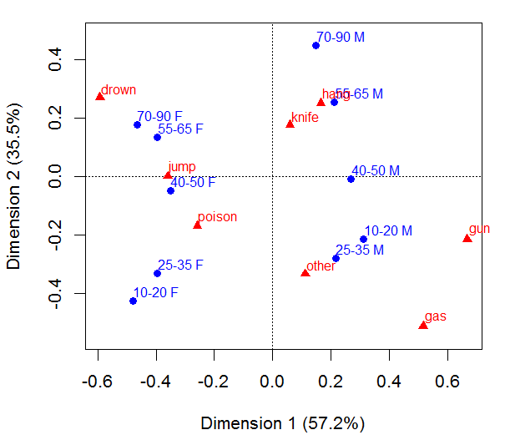
> plot(suicide.ca)
Age
Dim 1: Sex
Dim 2: Age
Can interpret method use by age-sex combination
young M: gas, gun,
young F: poison
Sex

Slide 44
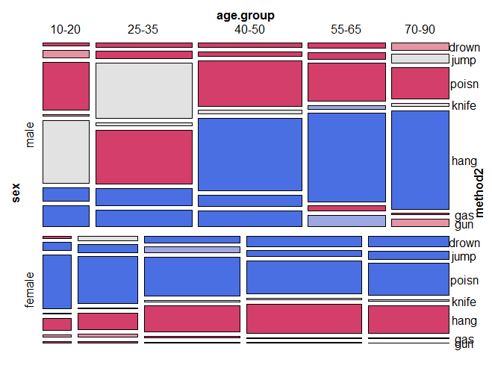
Compare with a mosaic plot, also fitting the model [Age Sex][Method]
suicide.tab3 <- xtabs(Freq ~ sex + age.group + method2, data=Suicide)
mosaic(suicide.tab3, shade=TRUE, legend=FALSE,
expected=~age.group*sex + method2, ... )
DDAR Fig 6.7, p 238
(I permuted methods by CA Dim1 & deleted “Other”)

Slide 45
Marginal tables & supplementary variables
Supplementary variables provide a way to include more info in CA
An n-way table is collapsed to a marginal table by ignoring factors
Omitted variables can be included by treating them as supplementary
These are projected into the space of the marginal CA
E.g., age by method, ignoring sex as the main analysis
> suicide.tab2 <- xtabs(Freq ~ age.group + method2, data=Suicide)
> suicide.tab2
method2
age.group poison gas hang drown gun knife jump other
10-20 2081 375 1736 97 537 58 320 564
25-35 4495 996 3326 352 916 180 642 1038
40-50 4689 716 5417 601 927 263 571 839
55-65 3814 246 5595 886 506 257 661 590
70-90 2486 74 4303 713 232 179 651 253

Slide 46
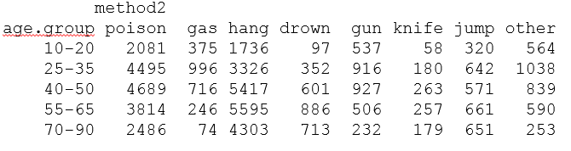
Also have data on relation of sex and method
> (suicide.sup <- xtabs(Freq ~ sex + method2, data=Suicide))
method2
sex poison gas hang drown gun knife jump other
male 8917 2089 14740 946 2945 628 1340 2214
female 8648 318 5637 1703 173 309 1505 1070
> suicide.tab2s <- rbind(suicide.tab2, suicide.sup)
Main analysis table
Supplementary rows

Slide 47
Supplementary variables
Call ca(table, suprow = ) to treat some rows as supplementary variables
> suicide.ca2s <- ca(suicide.tab2s, suprow=6:7)
> summary(suicide.ca2s, rows=FALSE, columns = FALSE)
Principal inertias (eigenvalues):
dim value % cum% scree plot
1 0.060429 93.9 93.9 ***********************
2 0.002090 3.2 97.1 *
3 0.001479 2.3 99.4 *
4 0.000356 0.6 100.0
-------- -----
Total: 0.064354 100.0
The relation of age and method is now essentially 1 dimensional
The inertia of Dim 1 here (0.604) is nearly the same as that of Dim 2 (0.596) for age in the stacked table

Slide 48
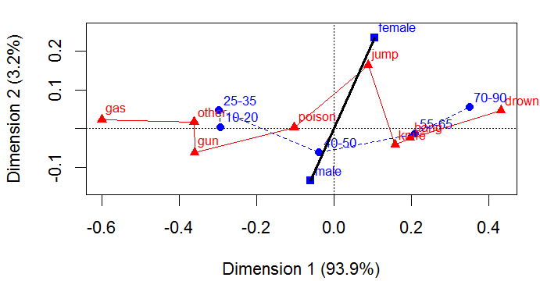
res <- plot(suicide.ca2s,
pch=c(16, 15, 17, 24),
lines = c(FALSE, TRUE))
lines(res$rows[1:5,], col = "blue", lty=2)
lines(res$rows[6:7,], col = "black", lwd=3)
Plotting the solution shows points for row, col & supplementary rows
Ignoring Sex has collapsed Sim 1 (Sex) of the [Age Sex][Method] analysis
Supp. points for Sex show the association of Method with Sex in this space

Slide 49
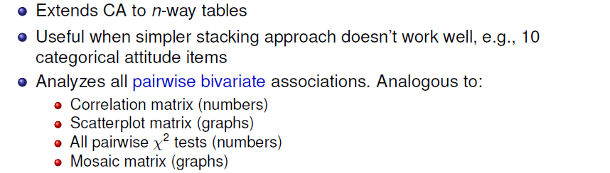
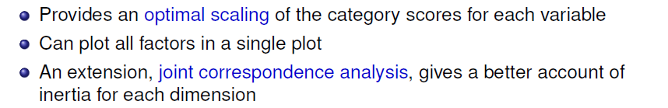
Multiple correspondence analysis

Slide 50
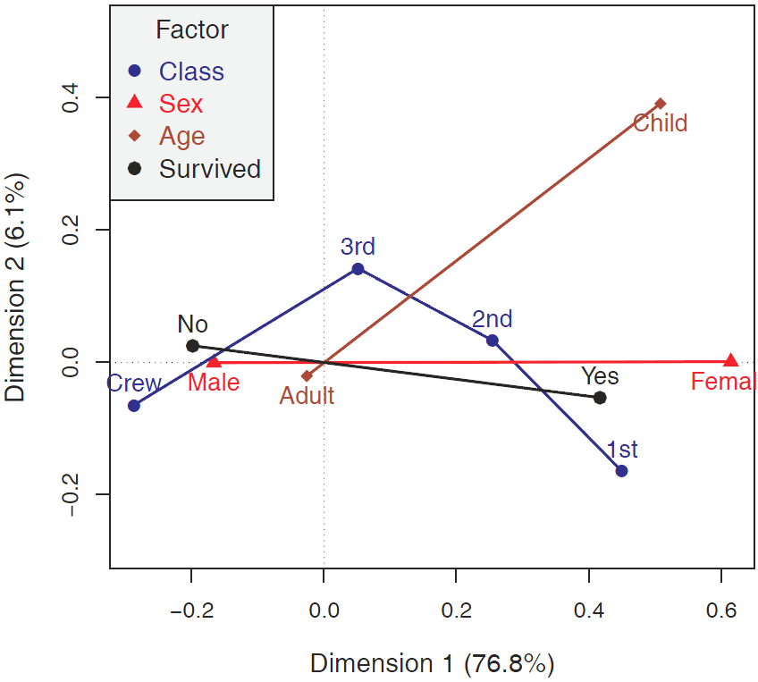
Example: Titanic data
Plot of MCA for the Titanic data
All 4 variables represented in a single plot
Dim 1: Sex
Dim 2: Class & Age
Distance from origin = inertia ~ 1/category freq

Slide 51
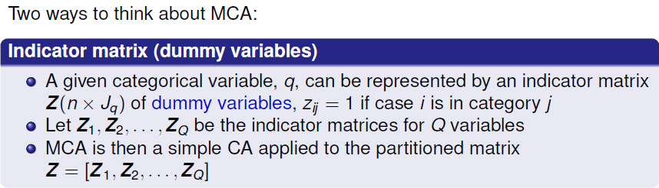
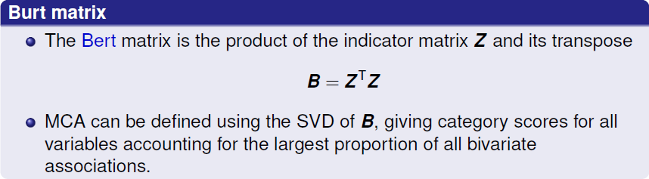
CA → MCA: Indicator & Burt

Slide 52
Indicator matrix: Hair Eye color
For the hair-eye data, the indicator matrix Z has n=592 rows (observations) and 4 + 4 = 8 columns (categories).
Shown below in frequency form: h1 — h4 indicators for hair color, e1—e4 for eye color
E.g., 1st row represents 68 observations with black hair and brown eyes
Hair Eye Freq h1 h2 h3 h4 e1 e2 e3 e4
1 Black Brown 68 1 0 0 0 1 0 0 0
2 Brown Brown 119 0 1 0 0 1 0 0 0
3 Red Brown 26 0 0 1 0 1 0 0 0
4 Blond Brown 7 0 0 0 1 1 0 0 0
5 Black Blue 20 1 0 0 0 0 1 0 0
6 Brown Blue 84 0 1 0 0 0 1 0 0
7 Red Blue 17 0 0 1 0 0 1 0 0
Blond Blue 94 0 0 0 1 0 1 0 0
. . .

Slide 53
Expand this to case form to get Z (592 x 8)
> Z <- expand.dft(haireye.df)[,-(1:2)]
> vnames <- c(levels(haireye.df$Hair), levels(haireye.df$Eye))
> colnames(Z) <- vnames
> dim(Z)
[1] 592 8
If the indicator matrix is partitioned as Z = [Z₁; Z₂], corresponding to the hair, eye categories, then the contingency table is given by N = Z^{T}₁ Z₂.
> Z1 <- as.matrix(Z[,1:4])
> Z2 <- as.matrix(Z[,5:8])
> (N <- t(Z1) %*% Z2)
Brown Blue Hazel Green
Black 68 20 15 5
Brown 119 84 54 29
Red 26 17 14 14
Blond 7 94 10 16

Slide 54

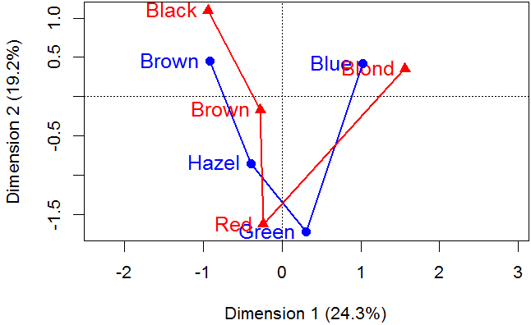
Z.ca <- ca(Z)
res <- plot(Z.ca, what=c("none", "all")) # plus customization

Slide 55
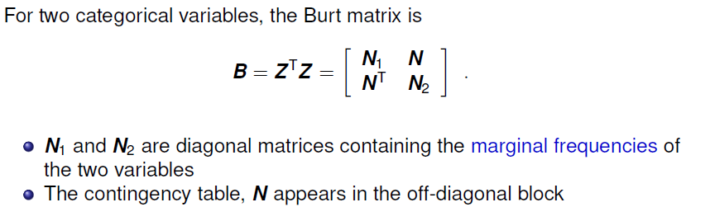
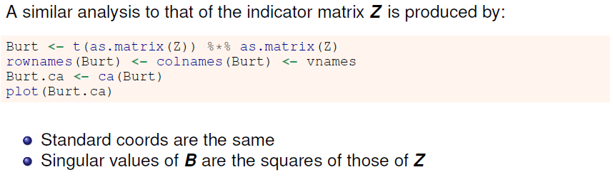
The Burt matrix

Slide 56
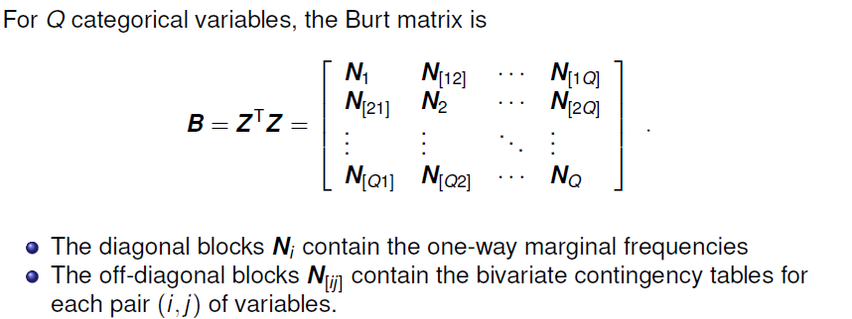
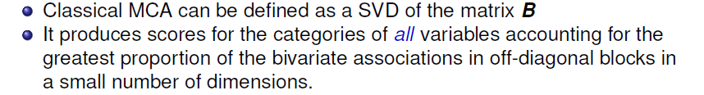
Multivariate MCA

Slide 57
MCA properties
The inertia contributed by a given variable increases with the number of response categories:
inertia (Z_{q}) = J_{q} – 1
The centroid of the categories for each variable is at the origin of the display.
For a given variable, the inertia contributed by a given category increases as the marginal frequency in that category decreases.
Low frequency points therefore appear further from the origin.
The category points for a binary variable lie on a line through the origin.

Slide 58
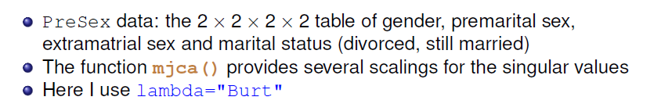
MCA example: pre- and extramarital sex
data("PreSex", package="vcd")
PreSex <- aperm(PreSex, 4:1) # order variables G, P, E, M
presex.mca <- mjca(PreSex, lambda="Burt")
summary(presex.mca, rows=FALSE, columns = FALSE)
Principal inertias (eigenvalues):
dim value % cum% scree plot
1 0.149930 53.6 53.6 *************
2 0.067201 24.0 77.6 ******
3 0.035396 12.6 90.2 ***
4 0.027365 9.8 100.0 **
-------- -----
Total: 0.279892 100.0

Slide 59
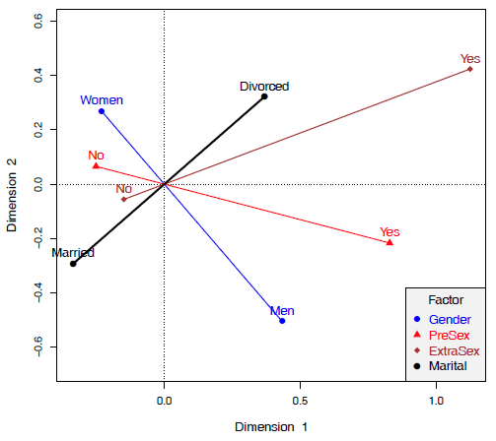
MCA example: pre- and extramarital sex
vcdExtra::mcaplot(presex.mca,
legend=TRUE, legend.pos = "bottomright")
Accounts for 76% of total inertia
Women less likely to report pre- and/or extra-marital sex
Divorced associated with pre- and extra- sex
Gender ⊥ Marital
NB: This only analyzes bivariate associations, i.e., no 3-way associations

Slide 60
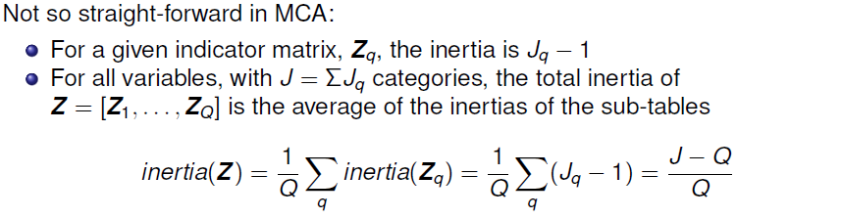
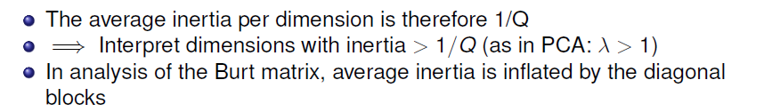
Inertia in MCA

Slide 61
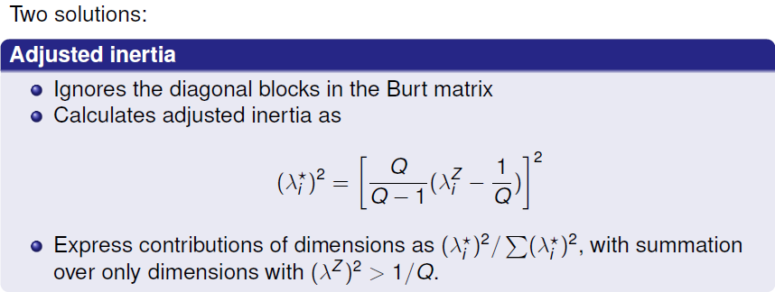

Inertia in MCA: Details
NB: JCA solutions aren’t nested. I generally use adjusted inertia

Slide 62
MCA example: Survival on the Titanic
Analyse the Titanic data using ca::mcja()
The default inertia method is lambda = “adjusted”
Other methods: “indicator”, “Burt”, “JCA”
data(Titanic)
titanic.mca <- mjca(Titanic)
summary(titanic.mca, columns = FALSE)
Principal inertias (eigenvalues):
dim value % cum% scree plot
1 0.067655 76.8 76.8 ***********************
2 0.005386 6.1 82.9 **
3 00000000 0.0 82.9
-------- -----
Total: 0.088118
Using adjusted inertia, the 2D solution accounts for ~ 83% of total, bivariate association.

Slide 63

Plot the solution with vcdExtra::mcaplot()
mcaplot(titanic.mca, legend=TRUE, legend.pos = "topleft")
Dim 1 perfectly aligned with Sex
Also strongly aligned w/ survival & class
Dim 2: reflects class & age
→ Survival associated with Female, 1st vs 3rd class, child

Slide 64


Biplots for contingency tables
The biplot is a related visualization that also uses the SVD to give a low-rank (2D) approximation.
In CA, the weighted χ² distances between row (column) points reflect the differences among row (column) profiles
In the biplot, rows (columns) are represented by vectors from the origin, with an inner-product (projection) interpretation – row point a_{i} is fit by projection on col point b_{j}

Slide 65

Example: Suicide rates
There are different scalings for CA biplots. Here I use the ‘contribution’ biplot
I find the plot less messy to plot arrows for only rows or cols and imagine the projection
plot(suicide.ca, map="colgreen", arrows=c(FALSE, TRUE), lwd=2)
Associations between age-sex categories and suicide methods can be read as projections of the points on the vectors
Lengths of vectors for suicide reflect their contributions to this 2D plot

Slide 66



Summary
Given a new 2-way table, my first thought is nearly always: plot(ca(mytable))

