Slide 1
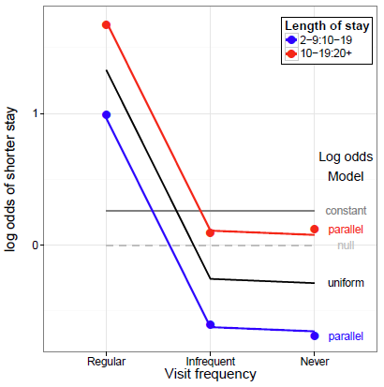
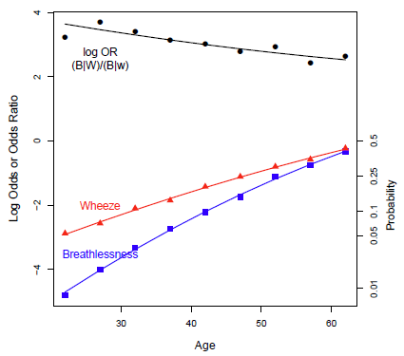
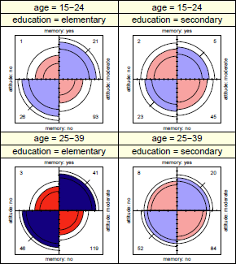
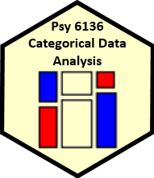
Models & graphs for log odds and log odds ratios
Michael Friendly
Psych 6136
http://friendly.github.io/6136

Slide 2
Today’s topics
We’ve come a long way, but there is more…
Logit models → general models for log odds
Two-way tables
Three-way + tables
Log odds plots
Models for generalized odds ratios
Log odds ratios
Bivariate response models

Slide 3
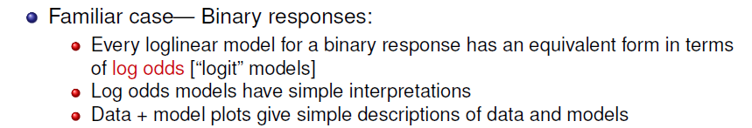
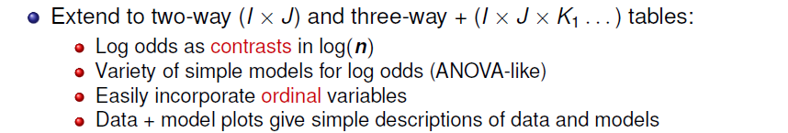
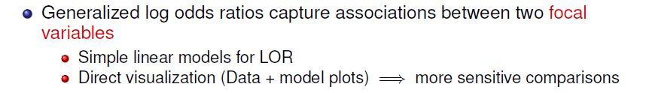
Main ideas
Based on my CARME (2015) presentation, https://www.datavis.ca/papers/CARME2015-2x2.pdf

Slide 4
Logit models → Log odds models
In an I × 2 table for variables[A B], where B is a binary response, the logit model expresses the log odds that B=1 vs. B=2
Models pertain to the one-way log odds
This generalizes to I × J tables, where we consider (J-1) log odds for each level of A, e.g.,
Adjacent categories
In general, I × J → (J-1) log odds contrasts of the B categories for each level of A
Similar to how polytomous responses treated in logistic regression
Can also use comparisons with a baseline category

Slide 5
J responses → J-1 contrasts/logits
Adjacent-category logits
b1 | b2 | b3 | b4
1 | -1
 | 1 | -1
 |  | 1 | -1
Reference-level logits
b1 | b2 | b3 | b4
1 |  |  | -1
 | 1 |  | -1
 |  | 1 | -1
Generalized logit models extend the advantages of the standard one to a polytomous response

Slide 6
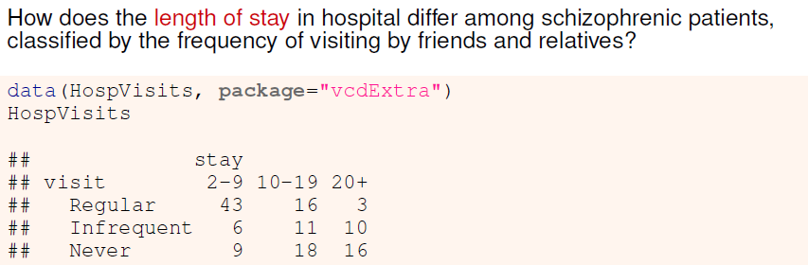
2-way example: Hospital visits
Length of stay is the response, and it is ordered
Can model the adjacent odds or log odds that stay is category j vs (j+1)
E.g., stay= 2-9 vs. 10-19; stay= 10-19 vs. 20+
In general, I x J → I x (J-1) adjacent comparisons
visit is also ordered. Can consider simpler (e.g., linear) models for the log odds

Slide 7
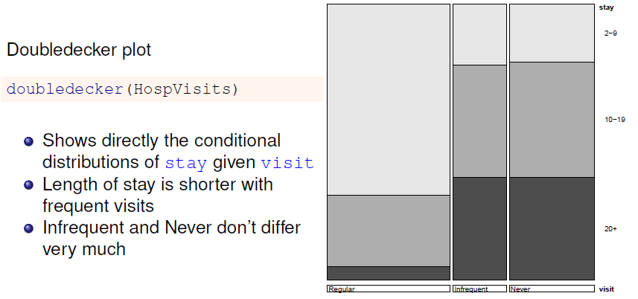
Exploratory plots: Doubledecker

Slide 8
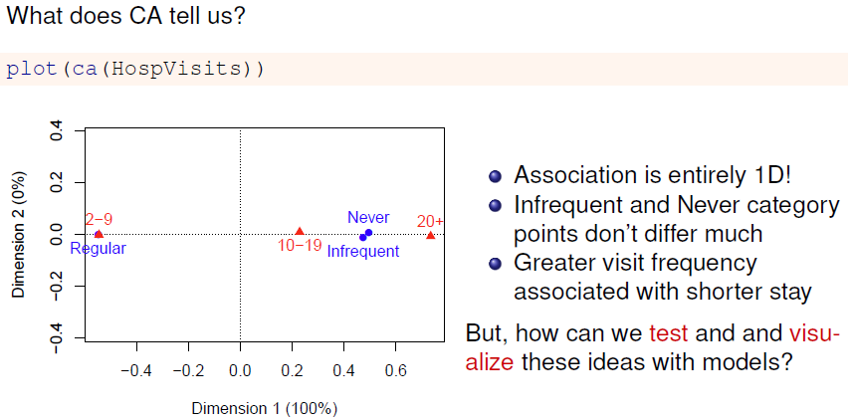
Exploratory plots: ca

Slide 9
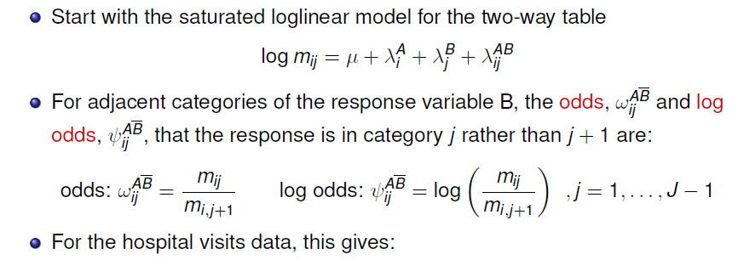
Models for log odds
> t(lodds(HospVisits, response = "stay"))
log odds for stay by visit
stay
visit 2-9:10-19 10-19:20+
Regular 0.989 1.6740
Infrequent -0.606 0.0953
Never -0.693 0.1178

Slide 10
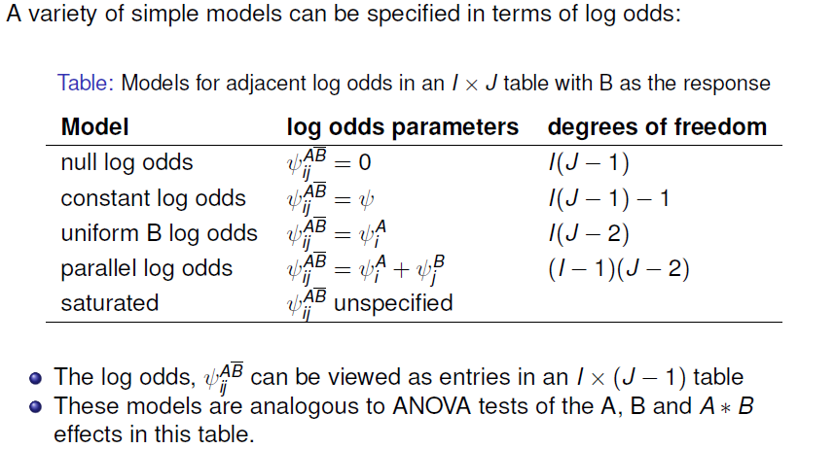
Models for log odds

Slide 11
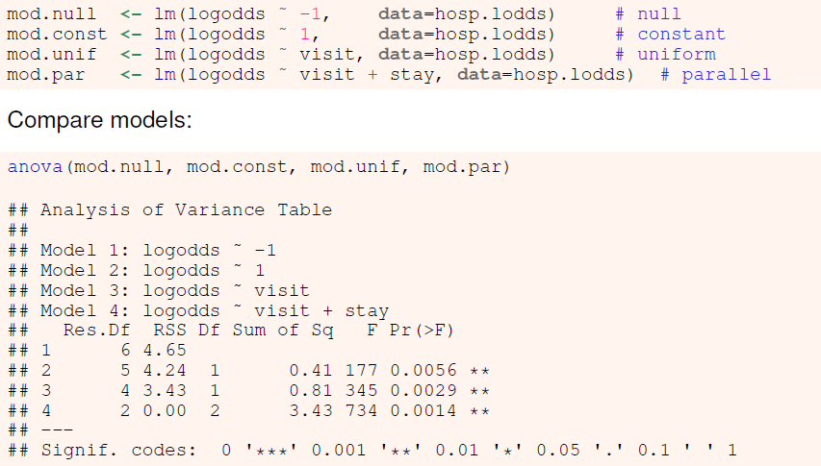
Fit some models
I’m simply using lm() here. Should use WLS: weights = 1/ASE²

Slide 12
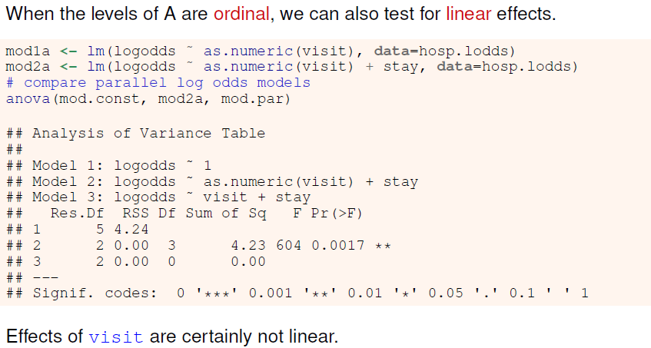
Ordinal variables

Slide 13
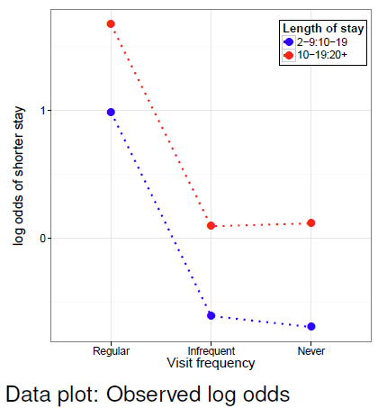
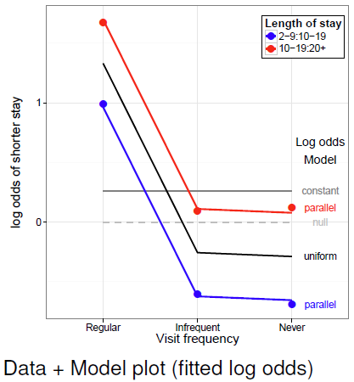
Visualizing log odds and models
Plots of observed and fitted log odds: easy interpretation of data and models

Slide 14
Visualizing log odds and models
Basic plot:
gg <- ggplot(hosp.lodds, aes(x=visit, y=logodds,
group=stay, color=stay)) +
geom_point(size=5) +
geom_line(size=1.2, linetype="dotted")
ylab("log odds of shorter stay\n") +
xlab("Visit frequency") + theme_bw() + …
Add lines for predicted values from the models
grid <- hosp.lodds[,1:2]
gg_lines <- function(grid, mod, size=1.2, color=NULL, ...) {
grid$logodds <- stats::predict(mod, grid)
if(is.null(color)) geom_line(data=grid, size=size, ...)
else geom_line(data=grid, size=size, color=color, ...)
}
gg + gg_lines(grid, mod.null, color="gray", size=1, linetype="dashed") +
gg_lines(grid, mod.const, color=gray(.5), size=1) +
gg_lines(grid, mod.unif, color="black", size=1) +
gg_lines(grid, mod.par)

Slide 15
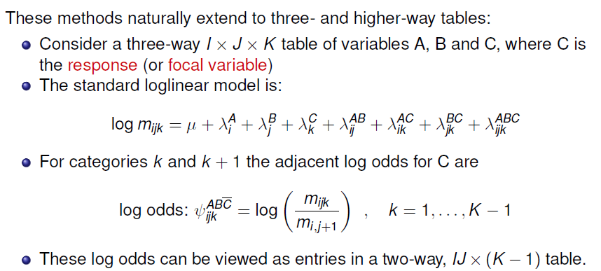
Three-way+ tables: Log odds

Slide 16
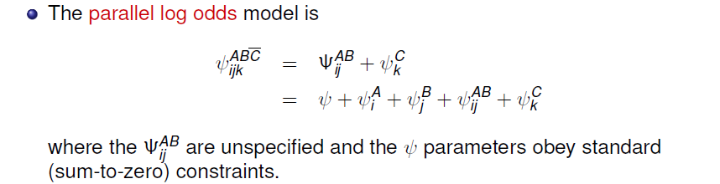
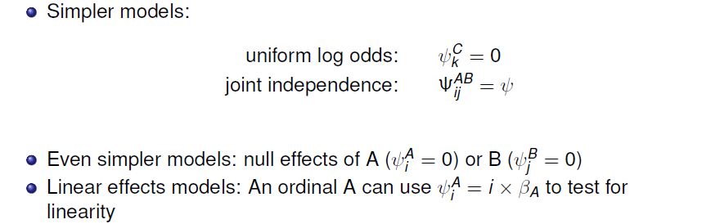
Three-way+ tables: Log odds

Slide 17
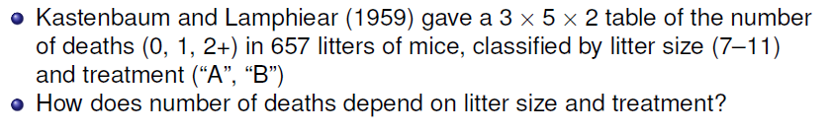
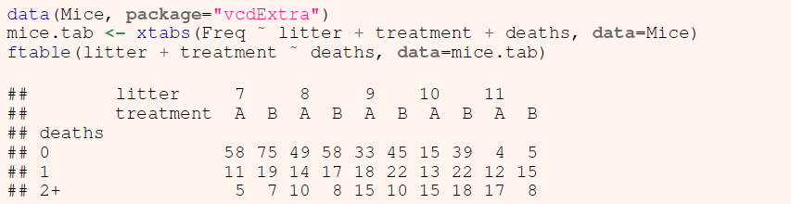
3-way example: Mice depletion data
→ Adjacent categories:
Odds or log odds of 0 vs. 1 deaths
Odds or log odds of 1 vs. 2+ deaths
How do these differ with litter size & treatment?

Slide 18
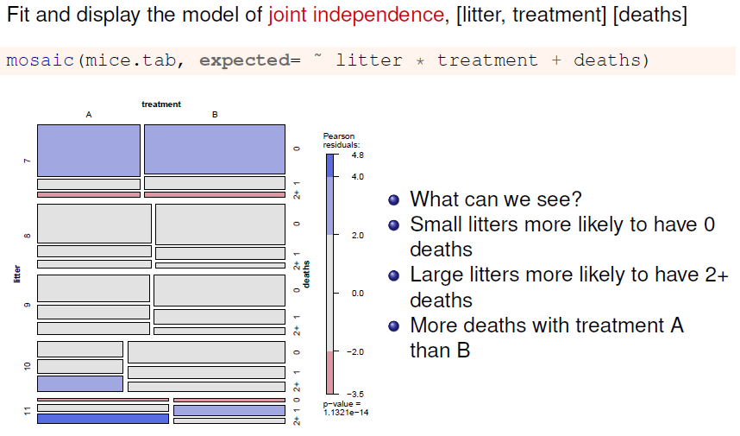
Mice data: mosaic plot

Slide 19
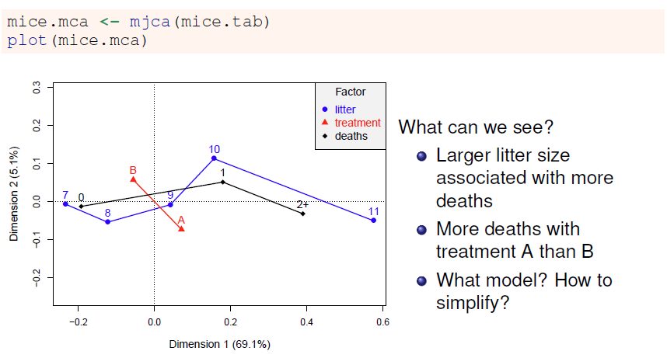
Mice data: MCA

Slide 20
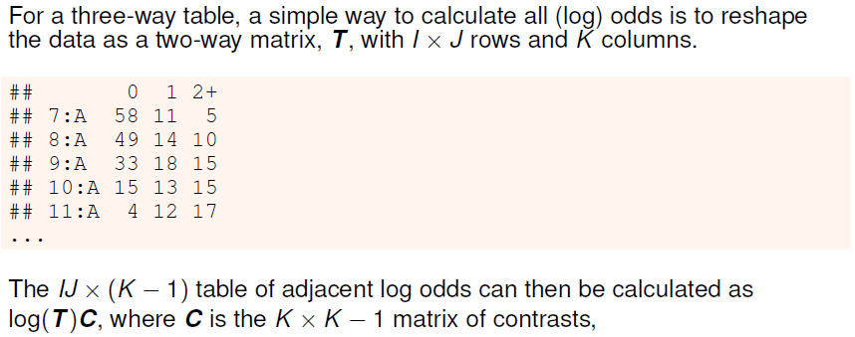
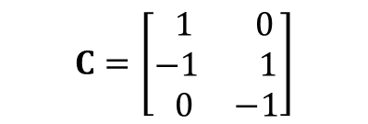
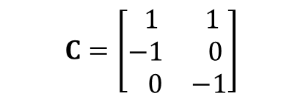
Calculating log odds
$$C=\left[\begin{matrix} 1 & 0 \\ −1 & 1 \\ 0 & −1\end{matrix}\right]$$
$$C=\left[\begin{matrix} 1 & 1 \\ −1 & 0 \\ 0 & −1\end{matrix}\right]$$
In general, any set of K-1 {1, 0, -1} contrasts can be used
Adjacent categories
Reference level = 0

Slide 21
Calculating log odds
mice.tab <- xtabs(Freq ~ litter + treatment + deaths, data=Mice)
# reshape table to matrix
T <- matrix(mice.tab,
nrow=prod(dim(mice.tab)[1:2]),
ncol=dim(mice.tab)[3])
colnames(T) <- dimnames(mice.tab)[[3]]
rn <- expand.grid(dimnames(mice.tab)[1:2])
rownames(T) <- apply(rn, 1, paste, collapse=":")
C <- matrix(c(1, -1, 0,
0, 1, -1), nrow=3)
lodds <- log(T) %*% C
colnames(lodds) <- c("0:1", "1:2+")
> lodds
0:1 1:2+
7:A 1.663 0.788
8:A 1.253 0.336
9:A 0.606 0.182
10:A 0.143 -0.143
11:A -1.099 -0.348
7:B 1.373 0.999
8:B 1.227 0.754
9:B 0.716 0.788
10:B 0.573 0.201
11:B -1.099 0.629

Slide 22
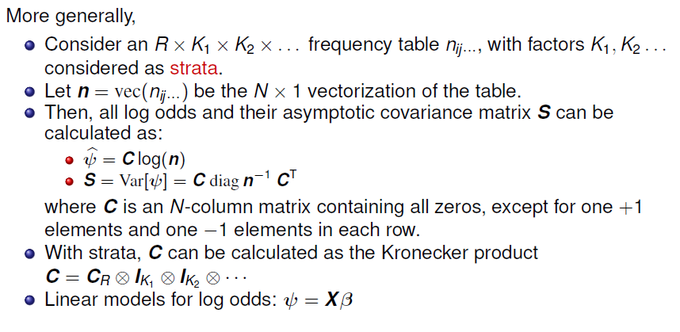
Calculating log odds

Slide 23
Mice data: Log odds
The vcd package contains a general implementation of these ideas:
odds() and lodds(): calculate odds or log odds for 1 variable in an n-way table
Provides methods (coef(), vcov(), confint(), …) for “lodds” objects
> (mice.lodds <- as.data.frame(lodds(mice.tab, response="deaths")))
deaths litter treatment logodds ASE
1 0:1 7 A 1.663 0.329
2 1:2+ 7 A 0.788 0.539
3 0:1 8 A 1.253 0.303
4 1:2+ 8 A 0.336 0.414
5 0:1 9 A 0.606 0.293
6 1:2+ 9 A 0.182 0.350
7 0:1 10 A 0.143 0.379
8 1:2+ 10 A -0.143 0.379
9 0:1 11 A -1.099 0.577
10 1:2+ 11 A -0.348 0.377

Slide 24
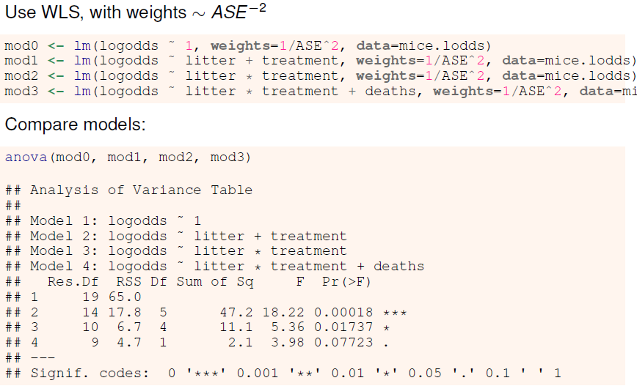
Mice data: Fit models

Slide 25
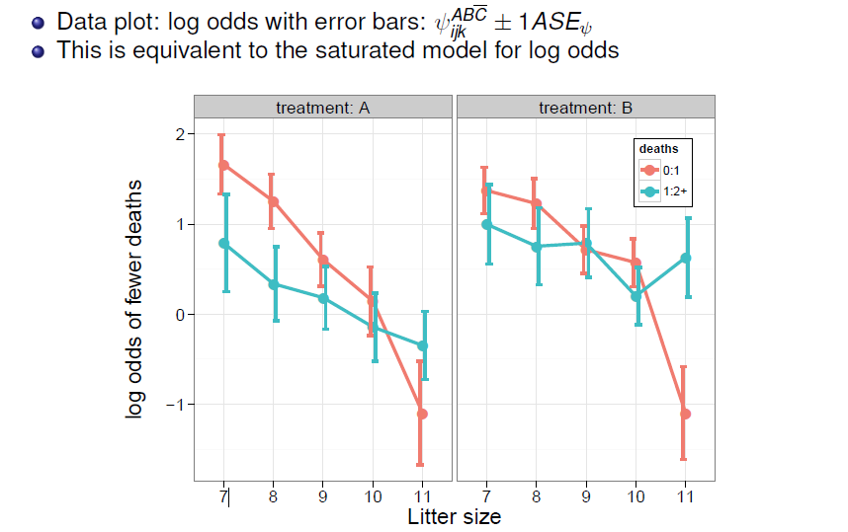
Visualize log odds & models: Data plot

Slide 26
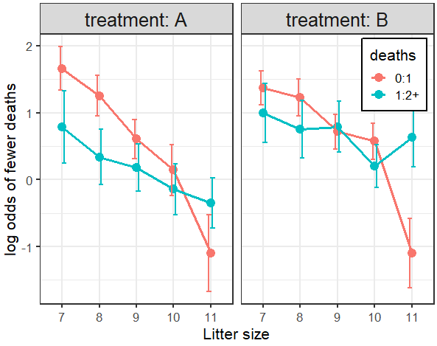
Basic plot:
gg <- ggplot(mice.lodds, aes(x=litter, y=logodds,
color=deaths, group=deaths)) +
geom_point(size=4) +
ylab("log odds of fewer deaths") +
xlab("Litter size") +
theme_bw(base_size = 16) +
theme(legend.position = c(.9, .85),
legend.background = element_rect(colour = "black")) +
facet_grid(. ~ treatment, labeller=label_both) +
theme(strip.text = element_text(size = rel(1.2)))
Add error bars, dodged
bars <- aes(ymin=logodds-ASE,
ymax=logodds+ASE)
gg + geom_line(size=1.2) +
geom_errorbar(bars,
width=0.25, size=1,
position=position_dodge(width=.2))
ggplot thinking:
gg is my basic plot of points
I can add other layers to it

Slide 27
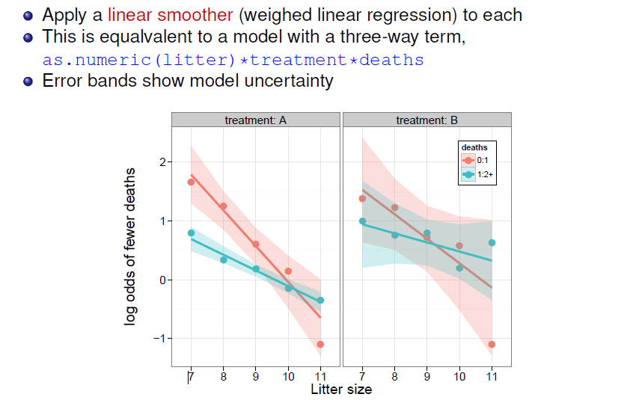
Visualize log odds & models: Smoothing

Slide 28
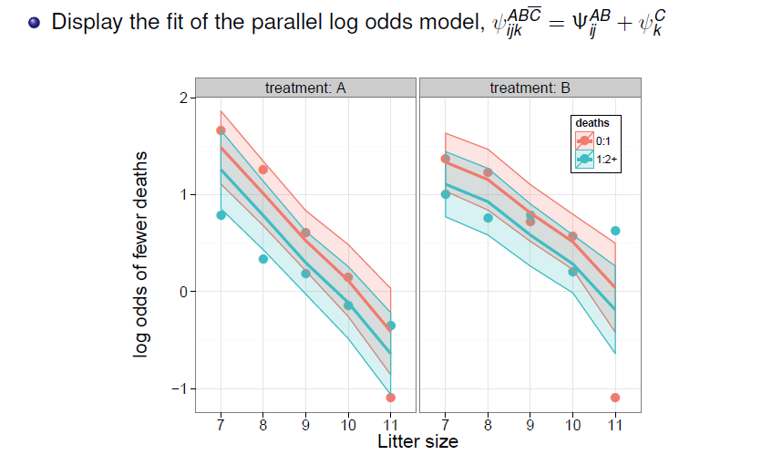
Visualize log odds & models: Data + Model

Slide 29
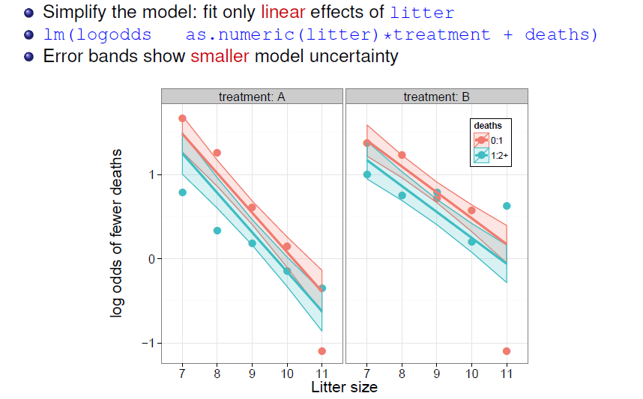
Visualize log odds & models: Data + Model
~

Slide 30
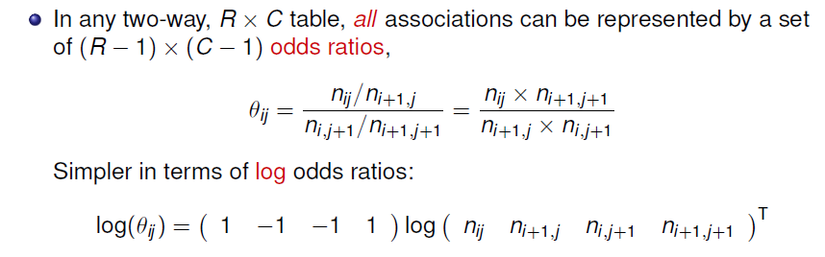
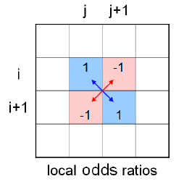
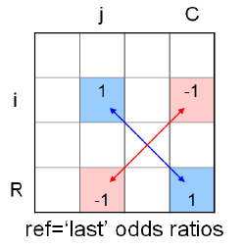
Generalized log odds ratios

Slide 31
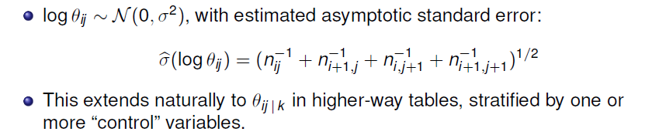
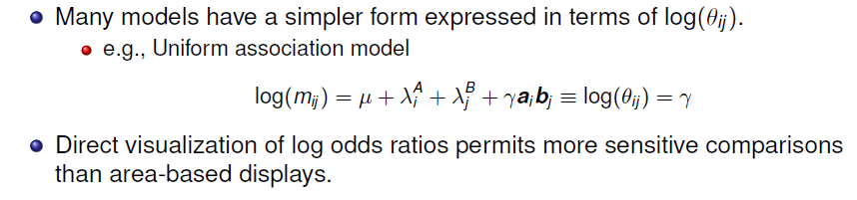
Generalized log odds ratios

Slide 32
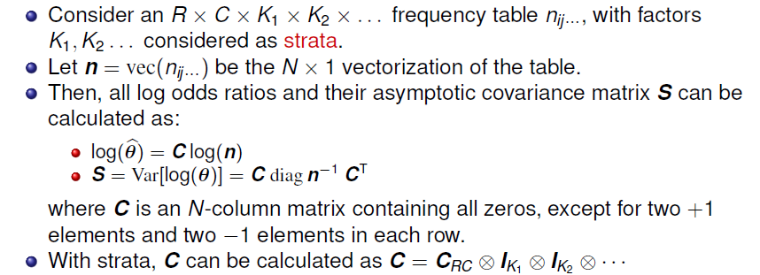

Models for log odds ratios: Computation

Slide 33
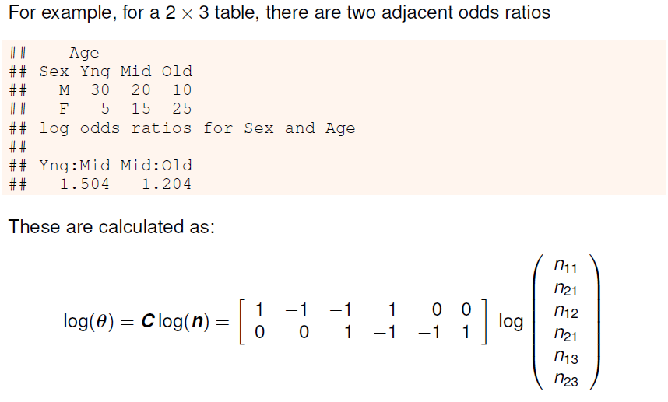
Models for log odds ratios: Computation

Slide 34
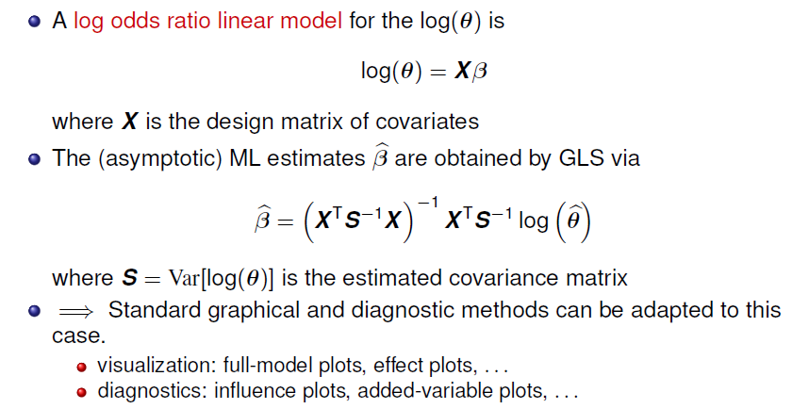
Models for log odds ratios: Estimation
Technical note: for simplicity, I use lm() for WLS, with S⁻¹ = diag(1/ASE²)
Should probably use nlme::gls() instead

Slide 35
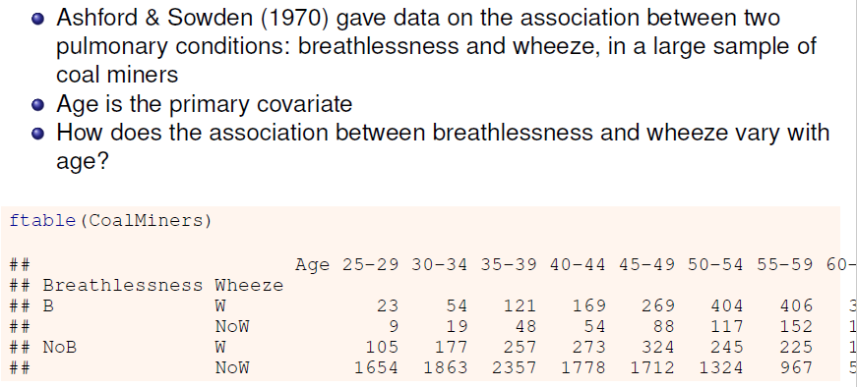
Example: Breathlessness & wheeze in coal miners

Slide 36
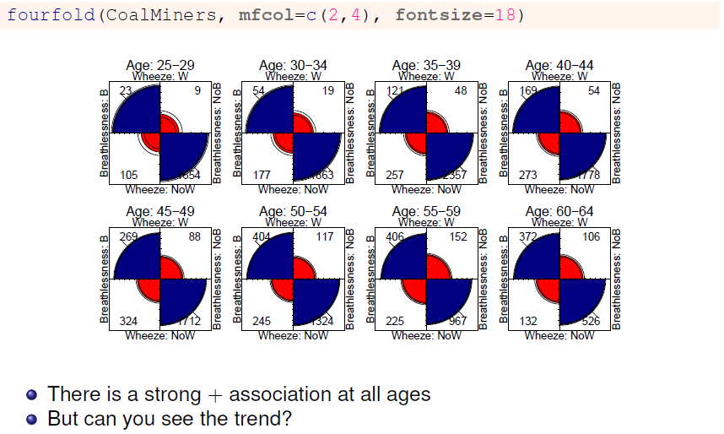
Example: Breathlessness & wheeze in coal miners

Slide 37
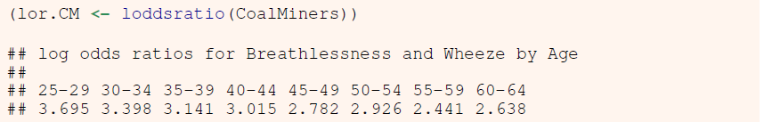
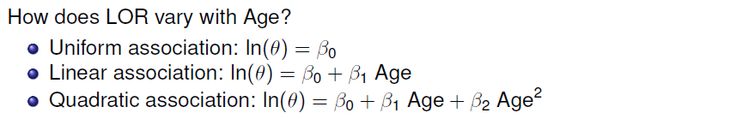
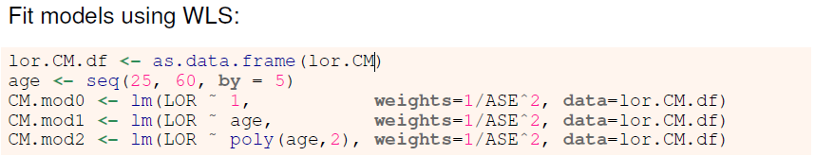
Coal miners: Log odds & models

Slide 38
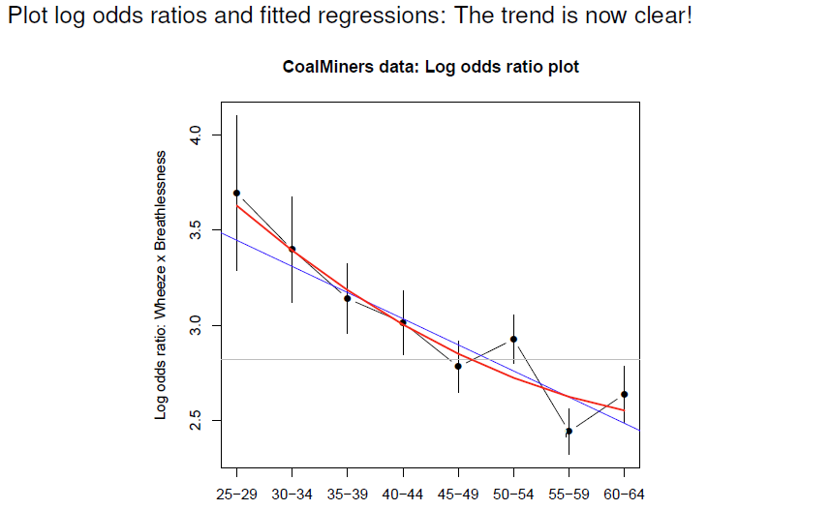
Coal miners: LOR plot

Slide 39
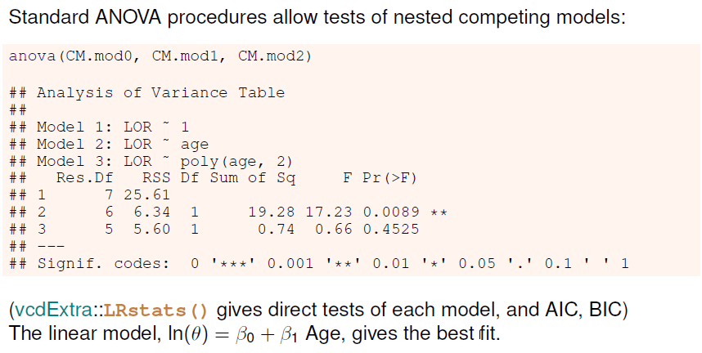
Coal miners: Model comparisons

Slide 40
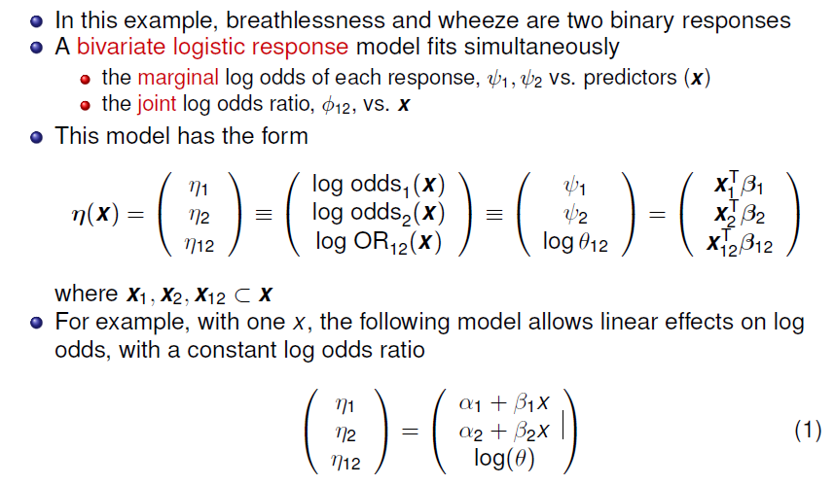
Going further: Bivariate response models

Slide 41
Calculating…
Logits and log odds for a bivariate response can be calculated with vcdExtra::blogits()
data(coalminers, package = "VGAM")
coalminers <- transform(coalminers, Age = (age - 42) / 5)
logitsCM <- vcdExtra::blogits(coalminers[, 1:4], add = 0.5)
colnames(logitsCM)[1:2] <- c("logitB", "logitW")
logitsCM <- cbind(logitsCM,
coalminers[, c("age", "Age")])
logitsCM
logitB logitW logOR age Age
1 -4.736 -2.868 3.20 22 -4
2 -3.977 -2.557 3.66 27 -3
3 -3.317 -2.094 3.38 32 -2
4 -2.733 -1.848 3.13 37 -1
5 -2.215 -1.420 3.01 42 0
6 -1.739 -1.109 2.78 47 1
7 -1.101 -0.797 2.92 52 2
8 -0.758 -0.572 2.44 57 3
9 -0.319 -0.226 2.63 62 4

Slide 42
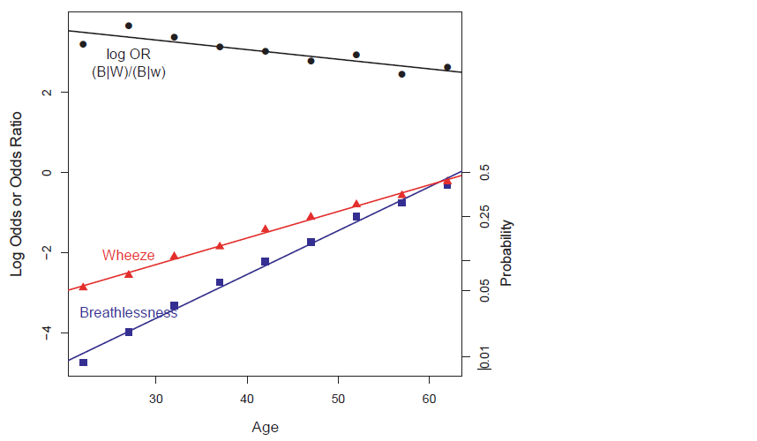
Linear model for log odds and log odds ratios
Log odds & LORs have similar scales, so it is not terrible to plot them together

Slide 43

Linear model for log odds and log odds ratios

Slide 44

Quadratic model for log odds and log odds ratios

Slide 45

Plotting …
With the data in this form, we can use matplot() to plot each column against age
matplot(age, logitsCM[, 1:3], type = "p",
col = col, pch = pch, cex = 1.2, cex.lab = 1.25,
xlab = "Age", ylab = "Log Odds or Odds Ratio")
abline(lm(logitsCM[,1] ~ age), col = col[1], lwd = 2)
abline(lm(logitsCM[,2] ~ age), col = col[2], lwd = 2)
abline(lm(logitsCM[,3] ~ age), col = col[3], lwd = 2)
To plot the quadratic fit, simply use
lm(logitsCM[,1] ~ poly(age,2)
But: this is NOT a model. It simply fits each set of odds separately

Slide 46
Fitting: VGAM::vglm()
VGAM::vglm() can fit a wide class of models for a vector of multivariate responses
The family binom2() is used for bivariate logistic models
An argument zero= allows the logit or odds ratio submodels to be constrained to intercept-only
cm.vglm <- vglm(cbind(nBnW, nBW, BnW, BW) ~ Age,
binom2.or(zero = NULL), data = coalminers)
exp(coef(cm.vglm, matrix = TRUE))
logitlink(mu1) logitlink(mu2) loglink(oratio)
(Intercept) 0.104 0.226 20.530
Age 1.673 1.385 0.877
Each 5 years of age:
Multiplies odds of breathlessness by 1.67, a 67% increase
Multiplies odds of wheeze by 1.38, a 38% increase
Multiplies the OR for association by 0.88, a 12 % decrease

Slide 47

Plotting the model fit
VGAM::fitted() returns the fitted values on the probability scale
VGAM::depvar() returns the observed values on the probability scale
> P <- fitted(cm.vglm)
> colnames(P) <- c("bw", "bW",
"Bw", "BW")
> P
bw bW Bw BW
1 0.94 0.049 0.0046 0.0085
2 0.91 0.064 0.0070 0.0148
3 0.88 0.080 0.0105 0.0254
4 0.84 0.097 0.0158 0.0428
5 0.79 0.114 0.0239 0.0704
…
The plot is made using matplot()
You can get these on the logit scale using the inverse logit function, qlogis()
LP <- qlogis(P)
LY <- qlogis(Y)

Slide 48
Other possibilities
We can also model the relations with age as a quadratic, cubic, …
cm.vglm2 <- vglm(cbind(nBnW, nBW, BnW, BW) ~ poly(Age,2),
binom2.or(zero = NULL), data = coalminers)
VGAM also implements vector generalized additive models, fit using vgam()
cm.vgam <- vgam(cbind(nBnW, nBW, BnW, BW) ~ s(Age, df = 2),
binom2.or(zero = NULL), data = coalminers)

Slide 49

Example: Attitudes toward corporal punishment

Slide 50


Attitudes: Questions
~

Slide 51

Log odds model for attitude

Slide 52

Attitude: Effect plots

Slide 53

Association of attitude with memory: Fourfold plots
How does the association of attitude and memory vary with education and age?
Each fourfold plot visualizes the log odds ratio between them
What’s going on here?

Slide 54

Log odds ratio plot

Slide 55
Summary
Logit models for a binary response generalize readily to a polytomous response
→Models for log odds, familiar interpretation
Handles 3+ way table, ordinal variables
Simple plots for interpretation
Generalized odds ratios handle bivariate responses
Simple linear models for LOR
Easy to model log odds for each response and the LOR simultaneously
Easy to visualize results

