Slide 1
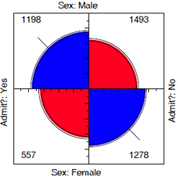
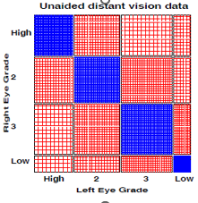
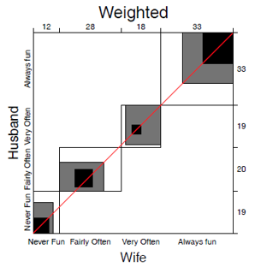
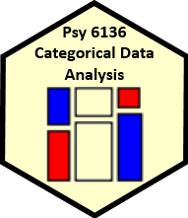
Two-way tables Independence & association
Michael Friendly
Psych 6136
http://friendly.github.io/psy6136

Slide 2
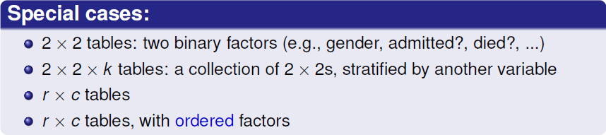
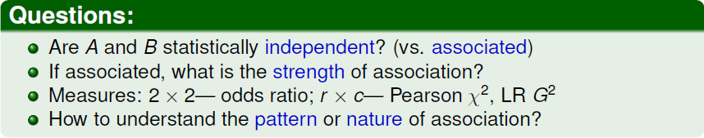
Two-way tables: Overview
Two-way frequency tables are a convenient way to represent a dataset cross-classified by two discrete variables, A & B

Slide 3
Methods
The methods discussed this week are generally simple non-parametric or randomization methods
There is no underlying formal model with parameters
Hypothesis tests based on some test statistic:
Pearson X²
Odds ratio, θ
Cohen’s κ
Friendly’s ☹ or ☺
Arjun’s ψ
p-values, confidence intervals based on:
Large sample theory: X² ~ χ² as N → ∞ (smaller suffices)
Permutation or simulation distributions
Plenty of room for new stats!

Slide 4
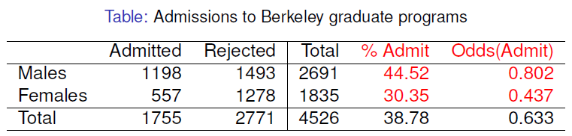
2 × 2 Example: Berkeley admissions
odds ratio (θ) = 1.84
Males were nearly twice as likely to be admitted
Is there an association between gender & admission?
If so, is this evidence for gender bias?
How to measure strength of association?
How to test for significance?
How to visualize?

Slide 5
UCBAdmissions data
In R, the data is contained in UCBAdmissions, a 2 x 2 x 6 table for 6 departments. We collapse over department
> data(UCBAdmissions)
> UCB <- margin.table(UCBAdmissions, 2:1)
> UCB
Admit
Gender Admitted Rejected
Male 1198 1493
Female 557 1278
odds_{M} = 1198 / 1493 = 0.802
odds_{F} = 557 / 1278 = 0.437
Association in 2 x 2 table can be measured by the odds ratio (θ): odds of admission for males vs. females
> oddsratio(UCB, log=FALSE)
odds ratios for Gender and Admit
[1] 1.84
> confint(oddsratio(UCB, log=FALSE))
2.5 % 97.5 %
Male:Female/Admitted:Rejected 1.62 2.09
Note use of confint() for obtaining the CI(θ)

Slide 6
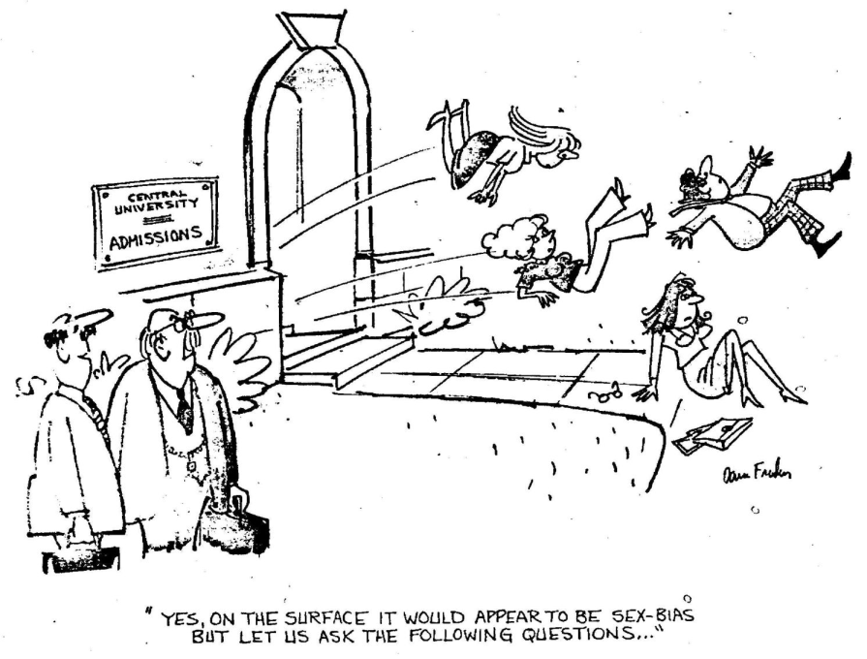
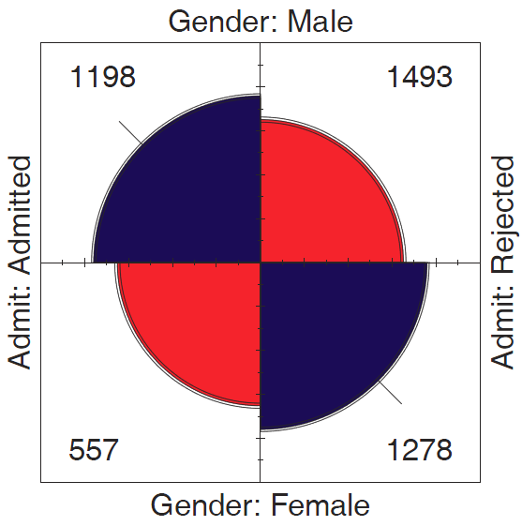
Questions:
How to analyze these results? What tests for odds ratio?
How to visualize & interpret?
Does it matter that we collapsed over Department?

Slide 7
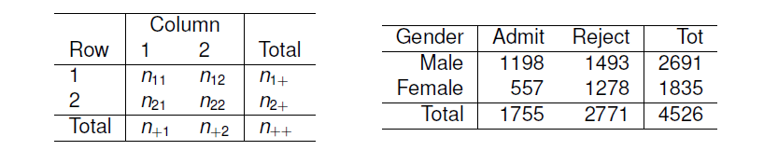
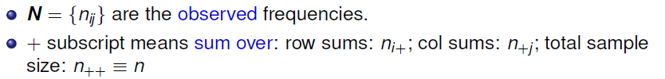
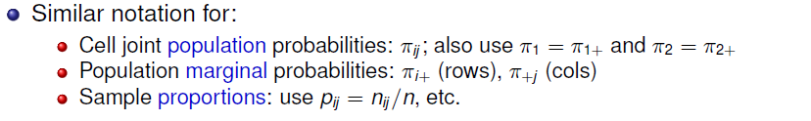
Table notation

Slide 8
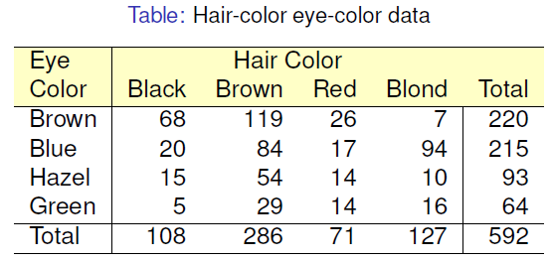
r × c Example: Hair color, eye color
Data from 592 students in a statistics class: write down your hair and eye color
Is there an association between hair color and eye color?
How to measure strength of association?
How to test for significance?
How to visualize?
How to understand the pattern (nature) of association?

Slide 9
HairEyeColor data
In R, the dataset is HairEyeColor, a 4 x 4 x 2 table: Hair x Eye x Sex.
For now, collapse over sex.
> data(HairEyeColor)
> HEC <- margin.table(HairEyeColor, 2:1)
> chisq.test(HEC)
Pearson's Chi-squared test
data: HEC
X-squared = 138, df = 9, p-value <2e-16
Association can be tested by the standard Pearson χ² test. Details later
> MASS::loglm(~Hair + Eye, data=HEC)
Statistics:
X^2 df P(> X^2)
Likelihood Ratio 146 9 0
Pearson 138 9 0
Or, as a loglinear model for independence
Formula: ~ A + B = A ⊥ B

Slide 10
Measures of association
vcd::assocstats() collects tests and measures in a convenient summary
> assocstats(HEC)
X^2 df P(> X^2)
Likelihood Ratio 146.44 9 0
Pearson 138.29 9 0
Phi-Coefficient : NA
Contingency Coeff.: 0.435
Cramer's V : 0.279
For 3+ way tables, it gives the results for the strata defined by all last dimensions
> assocstats(HairEyeColor)
$`Sex:Male`
X^2 df P(> X^2)
Likelihood Ratio 44.445 9 1.168e-06
Pearson 41.280 9 4.447e-06
Phi-Coefficient : NA
Contingency Coeff.: 0.359
Cramer's V : 0.222
$`Sex:Female`
X^2 df P(> X^2)
Likelihood Ratio 112.23 9 0
Pearson 106.66 9 0
Phi-Coefficient : NA
Contingency Coeff.: 0.504
Cramer's V : 0.337

Slide 11
Measures of association
2 × 2 tables
Odds ratio
Phi coefficient
Analog of correlation
ø² = % of variance
r × c tables
Cramer’s V – generalization of phi
Pearson contingency coef

Slide 12
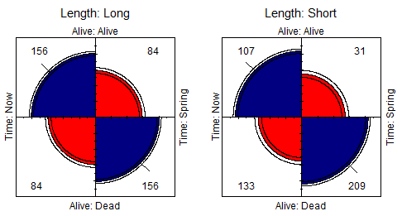
Example: Bartlett data
2 × 2 × 2 Data on plum root cuttings: Length (short|long), planted (Now|Spring), Survived? (Alive|Dead)
– Does survival depend on time of planting?
– Is there a 3-way association, i.e., does (Alive, Time) differ by Length? (θ₁ = θ₁ )
> assocstats(Bartlett)
$`Length:Long`
X^2 df P(> X^2)
Likelihood Ratio 43.87 1 3.50e-11
Pearson 43.20 1 4.94e-11
Phi-Coefficient : 0.3
Contingency Coeff.: 0.287
Cramer's V : 0.3
$`Length:Short`
X^2 df P(> X^2)
Likelihood Ratio 61.31 1 4.88e-15
Pearson 58.74 1 1.80e-14
Phi-Coefficient : 0.35
Contingency Coeff.: 0.33
Cramer's V : 0.35
oddsratio(Bartlett, log=FALSE)
odds ratios for Alive and Time by Length
Long Short
3.45 5.42
Notes:
In 1935, Maurice Bartlett presented the first paper on the topic of interactions in three-way tables.
His main example concerned an agricultural experiment on plum root cuttings …

Slide 13
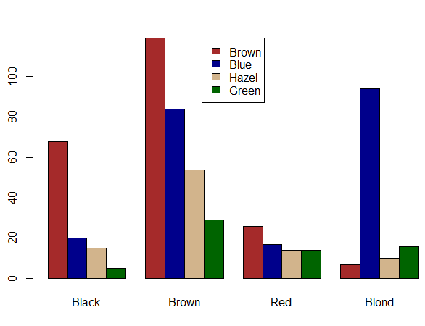
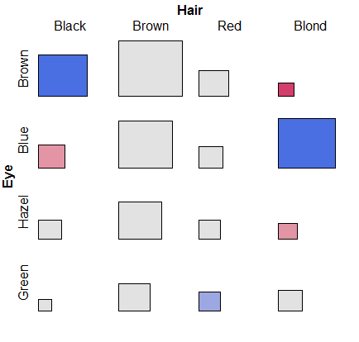
Simple plots for r × c tables
barplot(HEC, beside=TRUE, … )
tile(HEC, shade=TRUE)
But: harder to compare across hair-color groups than within them
Neither of these extend to more than 2 variables

Slide 14
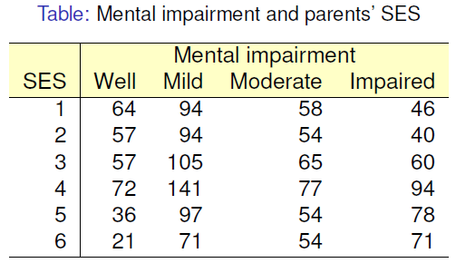
Ordered tables
r x c table with ordered categories: Mental health and Parents’ SES categories (1="High" and 6="Low“)
Mental impairment is the response, SES is a predictor
How to measure strength of association?
How to understand the pattern of association?
How to take ordinal nature of variables into account?

Slide 15
Mental data: Association
The data is contained in vcdExtra::Mental, a frequency data frame, with ordered factors
> data(Mental, package="vcdExtra")
> str(Mental)
'data.frame': 24 obs. of 3 variables:
$ ses : Ord.factor w/ 6 levels "1"<"2"<"3"<"4"<..: 1 1 1 1 2 2 2 2 3 ...
$ mental: Ord.factor w/ 4 levels "Well"<"Mild"<..: 1 2 3 4 1 2 3 4 1 2 ...
$ Freq : int 64 94 58 46 57 94 54 40 57 105 ...
Convert to a contingency table using xtabs(), and test association
> mental.tab <- xtabs(Freq ~ ses + mental, data=Mental)
> chisq.test(mental.tab)
Pearson's Chi-squared test
data: mental.tab
X-squared = 46, df = 15, p-value = 5e-05
This χ² test doesn’t take ordinality into account. It just tests for general association.

Slide 16
Mental data: Ordinal tests
For ordinal factors, more powerful (focused) tests are available with Cochran-Mantel-Haenszel tests in vcdExtra::CMHtest()
> CMHtest(mental.tab)
Cochran-Mantel-Haenszel Statistics for ses by mental
AltHypothesis Chisq Df Prob
cor Nonzero correlation 37.2 1 1.09e-09
rmeans Row mean scores differ 40.3 5 1.30e-07
cmeans Col mean scores differ 40.7 3 7.70e-09
general General association 46.0 15 5.40e-05
both ordinal
cols ordinal
rows ordinal
neither
χ2 / df shows why ordered tests are more powerful
> xx <- CMHtest(mental.tab)
> xx$table[,"Chisq"] / xx$table[,"Df"]
cor rmeans cmeans general
37.16 8.06 13.56 3.06
Think: more df → more diffuse; less focused; less powerful against H₁

Slide 17
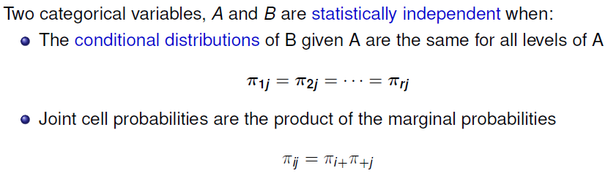
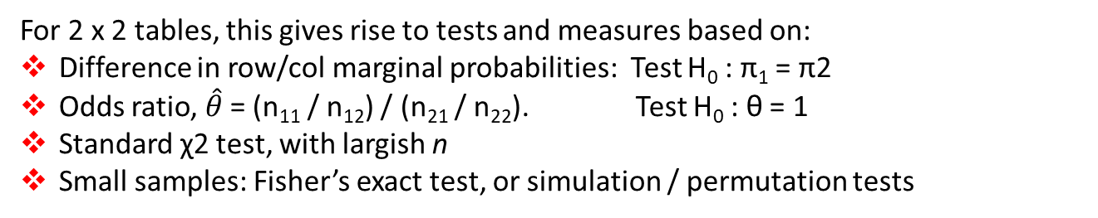
Independence
For 2 x 2 tables, this gives rise to tests and measures based on:
Difference in row/col marginal probabilities: Test H₀ : π₁ = π2
Odds ratio, $\hat{θ}$ = (n₁₁ / n₁₂) / (n₂₁ / n₂₂). Test H₀ : θ = 1
Standard χ2 test, with largish n
Small samples: Fisher’s exact test, or simulation / permutation tests

Slide 18
Independence: Example
A contrived example, where I generate cell frequencies as the product of row and column marginal totals: n_{ij} = n_{i+} x n_{+j}
> educ <- c(50, 100, 50) # marginal frequencies
> names(educ) <- c("Low", "Med", "High")
> party <- c(20, 50, 30) # marginal frequencies
> names(party) <- c("NDP", "Liberal", "Cons")
> table <- outer(educ, party) / sum(party) # cell = row * col / n
> names(dimnames(table)) <- c("Education", "Party")
> table
Party
Education NDP Liberal Cons
Low 10 25 15
Med 20 50 30
High 10 25 15
c
Outer product:
×
outer(r,c)
=
r

Slide 19
Independence: Example
The row proportions of party are the same for each educ group
The col proportions of educ are the same for each party
> prop.table(table, 1)
NDP Liberal Cons
Low 0.2 0.5 0.3
Med 0.2 0.5 0.3
High 0.2 0.5 0.3
> prop.table(table, 2)
NDP Liberal Cons
Low 0.25 0.25 0.25
Med 0.50 0.50 0.50
High 0.25 0.25 0.25
So, the X^2 is exactly zero, and measures of strength are zero
> vcd::assocstats(table)
X^2 df P(> X^2)
Likelihood Ratio 0 4 1
Pearson 0 4 1
Phi-Coefficient : NA
Contingency Coeff.: 0
Cramer's V : 0

Slide 20
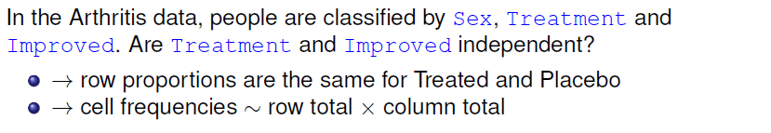
Independence?: Arthritis data
> data(Arthritis, package = "vcd")
> arth.tab <- xtabs(~ Treatment + Improved, data = Arthritis)
> round(prop.table(arth.tab, 1), 3 )
Improved
Treatment None Some Marked
Placebo 0.674 0.163 0.163
Treated 0.317 0.171 0.512
But, more people given the Placebo show no improvement; more people Treated show marked improvement

Slide 21
Independence?: Arthritis data
If Treatment and Improved were independent, frequencies ~ row x col margins
> row.totals <- margin.table(arth.tab, 1)
> col.totals <- margin.table(arth.tab, 2)
> round(outer(row.totals, col.totals)/ sum(arth.tab), 0)
Improved
Treatment None Some Marked
Placebo 22 7 14
Treated 20 7 14
These are the expected frequencies, under independence; but for the data:
> chisq.test(arth.tab)
Pearson's Chi-squared test
data: arth.tab
X-squared = 13.1, df = 2, p-value = 0.0015
Pearson χ²

Slide 22
Sampling models: Poisson, Binomial, Multinomial
Subtle distinctions arise concerning whether the row and/or margins are fixed by design or random
Poisson: each n_{ij} is regarded as an independent Poisson variate; nothing fixed
Binomial: each row (or col) is regarded as an independent binomial dist^{n}, with one fixed margin (group total), other random (response)
Multinomial: only the total sample size, n₊₊, is fixed; frequencies n_{ij} are classified by A and B
Makes a difference in how hypothesis tests are justified & explained
Happily, for most inferential methods, ≈ same results are obtained under the three sampling models
Q: what is an appropriate sampling model for the UCB admissions data? For hair-eye color? For the mental impairment data?
Notes:
A: for the UCB data, hair-eye color and mental impairment, no margins are fixed -> Poisson
But say we screened 600 males and 600 females, 100 in each department applying to UC Berkeley?

Slide 23
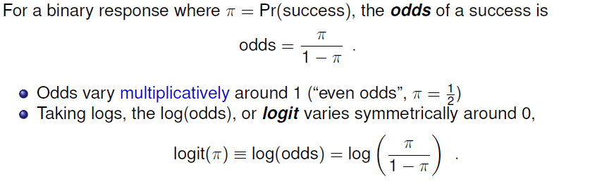
Odds and log(Odds)
> p <- c( 0.05, .1, .25, .50, .75, .9, .95)
> odds <- p / (1-p)
> logodds <- log(odds)
> (odds.df <- data.frame(p, odds, logodds))
p odds logodds
1 0.05 0.0526 -2.94
2 0.10 0.1111 -2.20
3 0.25 0.3333 -1.10
4 0.50 1.0000 0.00
5 0.75 3.0000 1.10
6 0.90 9.0000 2.20
7 0.95 19.0000 2.94

Slide 24
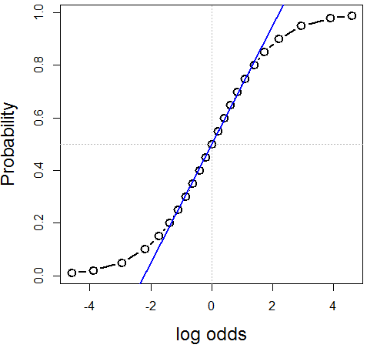
Log odds
plot(logodds, p, type='b', xlab="log odds", ylab="Probability", …)
abline(lm(p ~ logodds, subset=(p>=.2 & p<=.8)), col="blue")
Symmetric around π = ½ :
logit(π) = - logit(1- π)
Fairly linear in the middle,
0.2 ≤ π ≤ 0.8
The logit transformation of probability is the basis for logistic regression
(An alternative, the cumulative normal, Φ⁻¹(π), gives rise to probit regression)

Slide 25
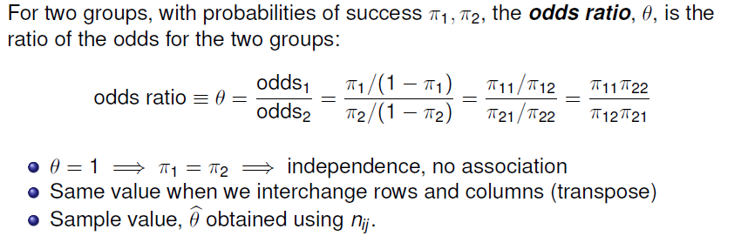
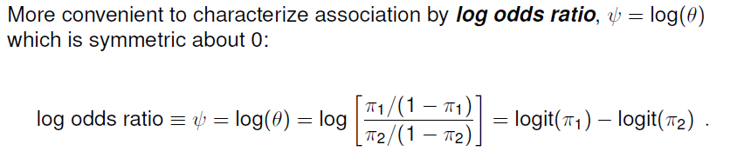
Odds ratio
Cross-product ratio

Slide 26
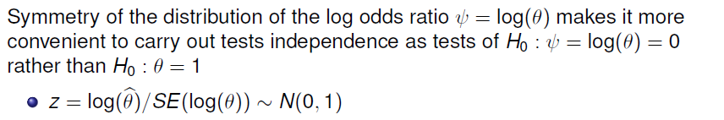
Odds ratio: Inference & hypothesis tests
vcd::oddsratio() has option, log=, TRUE by default
The summary() method calculates z tests
> summary(oddsratio(UCB))
z test of coefficients:
Estimate Std. Error z value Pr(>|z|)
Male:Female/Admitted:Rejected 0.6104 0.0639 9.55 <2e-16 ***
---
Signif. codes: 0 ‘***’ 0.001 ‘**’ 0.01 ‘*’ 0.05 ‘.’ 0.1 ‘ ’ 1

Slide 27
Odds ratio: Confidence intervals
Results should be reported with confidence intervals, either for the odds ratio, θ, or for ψ = log(θ)
> confint(oddsratio(UCB, log = FALSE))
2.5 % 97.5 %
Male:Female/Admitted:Rejected 1.624 2.087
> confint(oddsratio(UCB))
2.5 % 97.5 %
Male:Female/Admitted:Rejected 0.4851 0.7356
Summary in words:
For the Berkeley admissions data:
The Pearson χ² test of association between Gender and Admission was highly significant, χ₁² = 91.6, p < .0001
This corresponded to an odds ratio of admission for Males vs. Females of θ = 1.84 (CI: 1.62, 2.09), meaning that overall, males were 84% more likely to be admitted
On the scale of log odds, ψ = log(θ), the estimate was ψ = 0.610 (CI: 0.485, 0.736), meaning a significant positive association between Gender(Male) and admission.

Slide 28
Small sample size
Pearson χ² and LR G² tests are valid when most expected frequencies > 5
Otherwise, use Fisher’s exact test or simulated p-values
Example: Cholesterol diet and heart disease
> fat <- matrix(c(6, 2,
4, 11), nrow=2, ncol=2)
> dimnames(fat) <- list(cholesterol=c("low", "high"),
disease=c("no", "yes"))
> fat
disease
cholesterol no yes
low 6 4
high 2 11

Slide 29
Small sample size
The standard Pearson χ² test is not significant
For 2 x 2 tables with small n, a correction |O – E | - ½ is standardly applied (Yates)
> chisq.test(fat)
Pearson's Chi-squared test with Yates' continuity correction
data: fat
X-squared = 3.19, df = 1, p-value = 0.074
Yet, we get a warning. Maybe Friendly’s ☹ ?
Warning message:
In chisq.test(fat) : Chi-squared approximation may be incorrect

Slide 30
Small sample size: Simulation
A Monte-Carlo method uses simulation to calculate a p-value, Friendly’s ☺
> chisq.test(fat, simulate=TRUE)
Pearson's Chi-squared test with simulated p-value (based on 2000 replicates)
data: fat
X-squared = 4.96, df = NA, p-value = 0.04
This method repeatedly samples cell frequencies from tables with the same
margins, and calculates a χ² for each.
The p-value compares the observed X² to its’ distribution in the simulations.
The χ² test is now significant; well, barely, but ☺
The main point is that the test no longer depends on large sample theory ☺ ☺
Simulation is a general principle for testing hypotheses ☺ ☺ ☺

Slide 31
Small sample size: Fisher exact test
Fisher’s exact test: calculates probability for all 2 × 2 tables with odds ratio as or more
extreme than that in the data, keeping the margins fixed.
> fisher.test(fat)
Fisher's Exact Test for Count Data
data: fat
p-value = 0.039
alternative hypothesis: true odds ratio is not equal to 1
95 percent confidence interval:
0.86774 105.56694
sample estimates:
odds ratio
7.4019
The p-value is similar to that obtained using simulation.
Fisher’s test is available for larger r × c tables, but the method gets computationally intensive as r * c increases

Slide 32
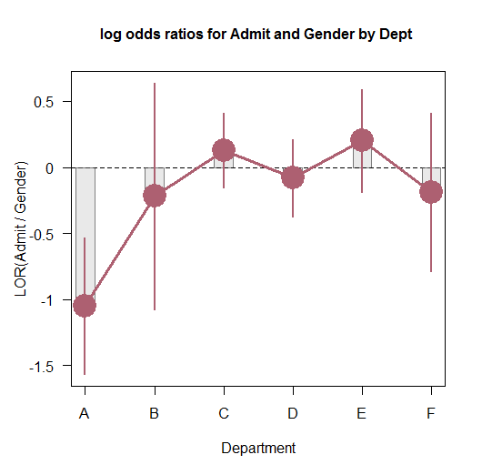
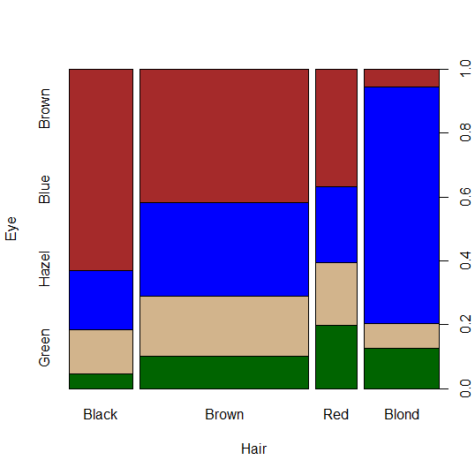
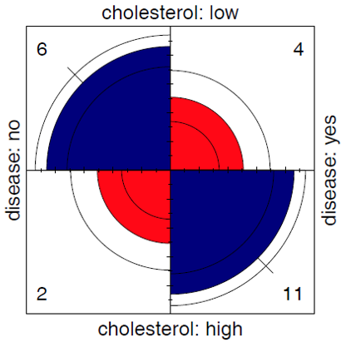
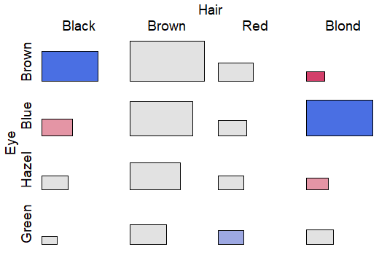
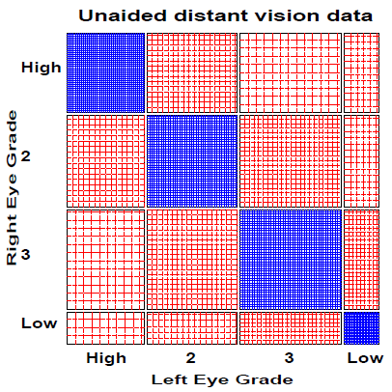
Visualizing association

Slide 33
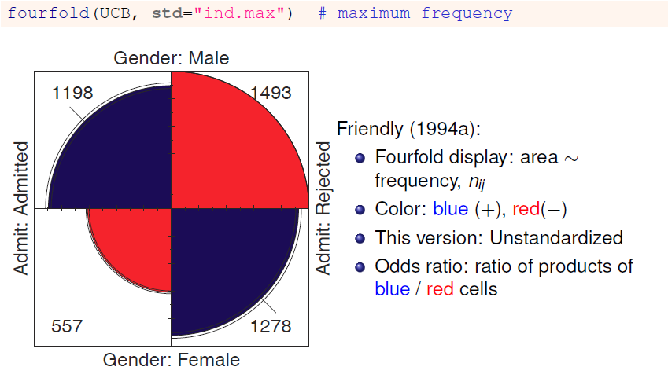
Visualizing: fourfold plots

Slide 34
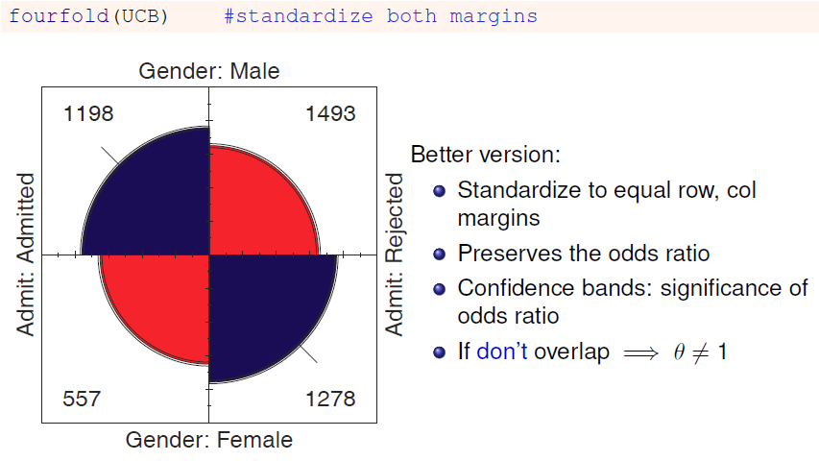
Visualizing: fourfold plots

Slide 35
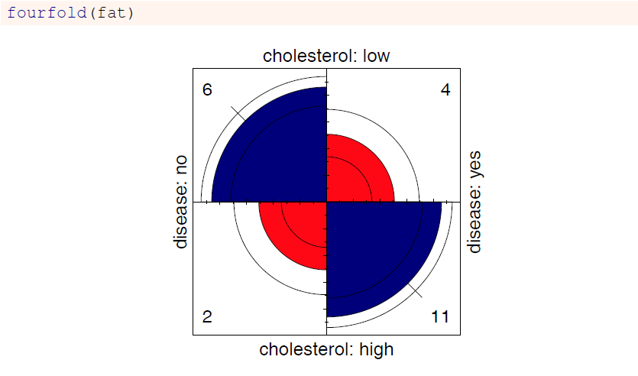
Cholesterol data

Slide 36
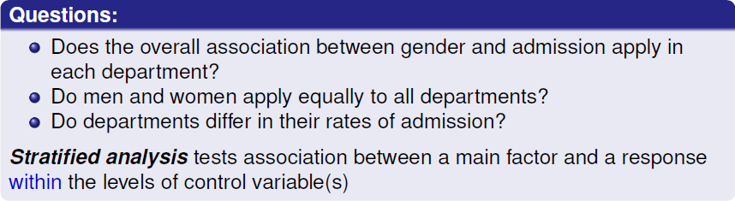
Stratified tables: 2 × 2 × k
The UC Berkeley data was obtained from 6 graduate departments
> ftable(addmargins(UCBAdmissions, 3))
Dept A B C D E F Sum
Admit Gender
Admitted Male 512 353 120 138 53 22 1198
Female 89 17 202 131 94 24 557
Rejected Male 313 207 205 279 138 351 1493
Female 19 8 391 244 299 317 1278

Slide 37
Odds ratios by department
> summary(oddsratio(UCBAdmissions))
z test of coefficients:
Estimate Std. Error z value Pr(>|z|)
A -1.052 0.263 -4.00 6.2e-05 ***
B -0.220 0.438 -0.50 0.62
C 0.125 0.144 0.87 0.39
D -0.082 0.150 -0.55 0.59
E 0.200 0.200 1.00 0.32
F -0.189 0.305 -0.62 0.54
---
Signif. codes: 0 ‘***’ 0.001 ‘**’ 0.01 ‘*’ 0.05 ‘.’ 0.1 ‘ ’ 1
Odds ratio only significant, log(θ) ≠ 0, for department A
For dept. A, men are only exp(-1.05) = .35 times as likely to be admitted as women
The overall analysis (ignoring department) is misleading: falsely assumes no association of {admission, department} and {gender, department}

Slide 38
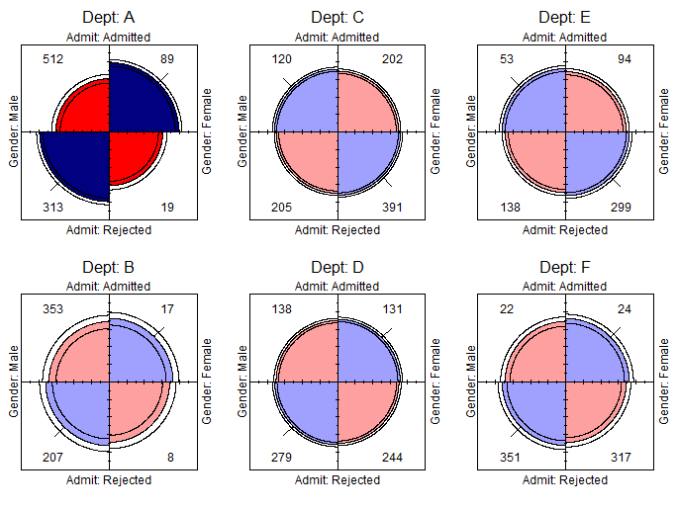
Stratified fourfold plots
Fourfold plots by department (intense shading where significant)
> fourfold(UCBAdmissions)

Slide 39
Log odds ratio plot
Plot the log odds ratios with confidence limits
> plot(oddsratio(UCBAdmissions), cex=2, xlab="Department")

Slide 40
Stratified tables: Homogeneity of association
Questions:
Are the k odds ratios all equal, θ₁ = θ₂ = … = θ_{k} ?
Woolf’s test: vcd::woolftest()
This is the same as the hypothesis of no three-way association
If homogeneous, is the common odds ratio different from 1?
Mantel-Haenszel test: stats::mantelhaen.test()
> woolf_test(UCBAdmissions)
Woolf-test on Homogeneity of Odds Ratios (no 3-Way assoc.)
data: UCBAdmissions
X-squared = 17.9, df = 5, p-value = 0.0031
The odds ratios differ across departments, so no sense testing their common value

Slide 41

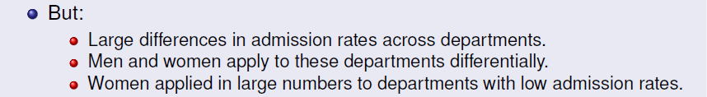
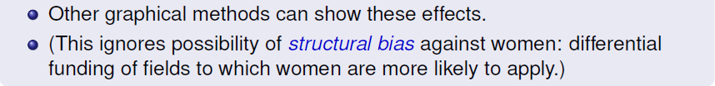
What happened at UC Berkeley?
Why do results collapsed over department disagree with the results by department?

Slide 42
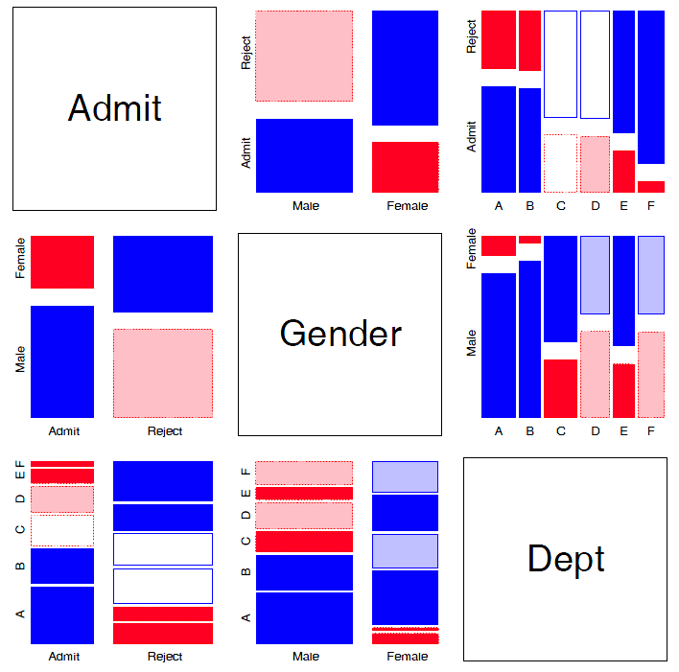
Mosaic matrices
Scatterplot matrix analog for categorical data
All pairwise views
Small multiples → comparison
The answer: Simpson’s Paradox
Depts A, B were easiest
Applicants to A, B mostly male
∴Males more likely to be admitted overall

Slide 43
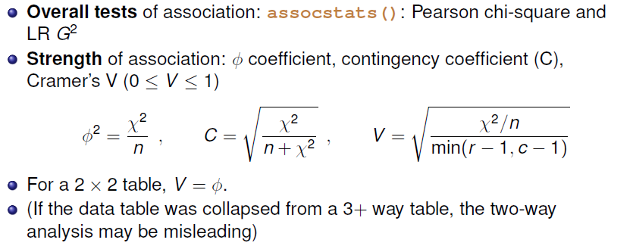
r × c tables: Overall analysis
> assocstats(HEC)
X^2 df P(> X^2)
Likelihood Ratio 146.44 9 0
Pearson 138.29 9 0
Phi-Coefficient : NA
Contingency Coeff.: 0.435
Cramer's V : 0.279

Slide 44
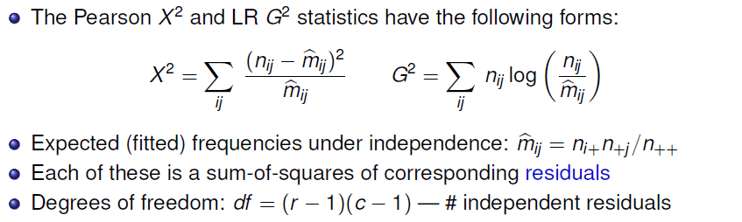
r × c tables: Overall analysis
Residuals, fitted values, test statistics returned by MASS::loglm()
> (mod <- MASS::loglm(~ Hair + Eye, data=HEC, fitted = TRUE))
Call:
MASS::loglm(formula = ~Hair + Eye, data = HEC, fitted = TRUE)
Statistics:
X^2 df P(> X^2)
Likelihood Ratio 146.44 9 0
Pearson 138.29 9 0

Slide 45
Residuals and fitted values are obtained with “extractor” methods
> res.P <- residuals(mod,
type="pearson")
> res.LR <- residuals(mod,
type="deviance")
> res.P
Hair
Eye Black Brown Red Blond
Brown 4.398 1.233 -0.075 -5.851
Blue -3.069 -1.949 -1.730 7.050
Hazel -0.477 1.353 0.852 -2.228
Green -1.954 -0.345 2.283 0.613
> fitted(mod)
Hair
Eye Black Brown Red Blond
Brown 40.1 106.3 26.39 47.2
Blue 39.2 103.9 25.79 46.1
Hazel 17.0 44.9 11.15 20.0
Green 11.7 30.9 7.68 13.7
loglm() returns an object (mod) of class “loglm”
Method functions, *.loglm(), include: residuals(), fitted(), anova(), summary() & various plot methods
Direct calculation of Pearson & LR χ²
> sum(res.P^2) # Pearson chisq
[1] 138.29
> sum(res.LR^2) # LR chisq
[1] 146.44

Slide 46
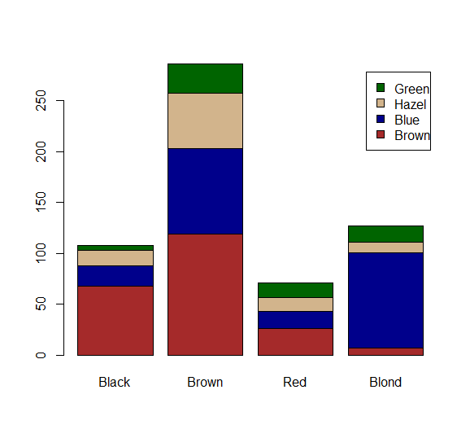
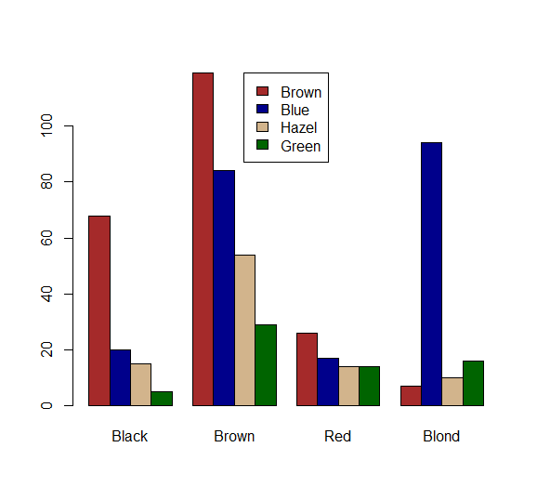
Plots for two-way tables
Barplots are easy, but not often very useful. Why?
col <- c("brown", "darkblue", "tan",
"darkgreen")
barplot(HEC, col = col, legend=TRUE)
barplot(HEC, col = col,
beside=TRUE, legend=TRUE, …)

Slide 47
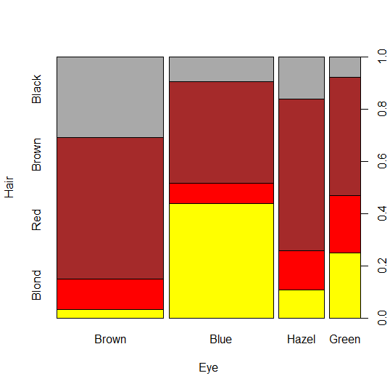
Spine plots
Spine plots show the marginal proportions of one variable, and the conditional proportions of the other.
Independence: cells align
col <- c("darkgrey", "brown", "red",
"yellow")
spineplot(HEC, col=rev(col))
col <- c("brown", "blue", "tan",
"darkgreen")
spineplot(t(HEC), col=rev(col))

Slide 48
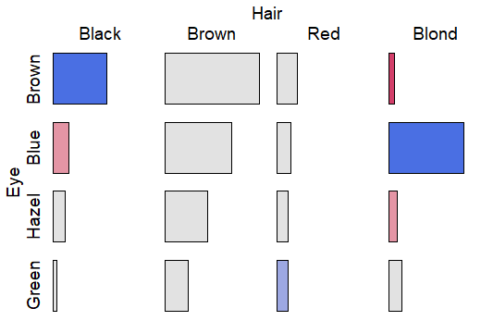
Tile plots
Tile plots show a matrix of rectangular tiles, area ~ frequency.
They can be scaled to facilitate different types of comparisons: cells, rows, cols
They can be shaded to show the sign & magnitude of residuals from independence
tile(HEC, shade=TRUE, legend=FALSE)
tile(HEC, tile_type=“width”, …)

Slide 49
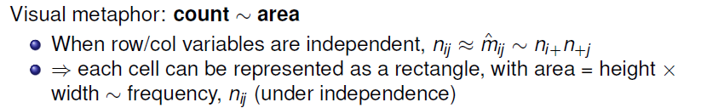
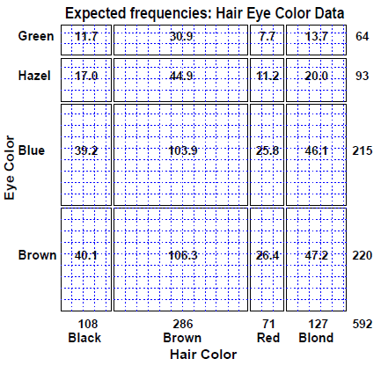
Sieve diagrams
This display shows expected frequencies, m_{ij}, as # boxes within each cell
Under independence, boxes all of the same size & equal density
Real sieve diagrams use # boxes = observed frequencies, n_{ij}

Slide 50
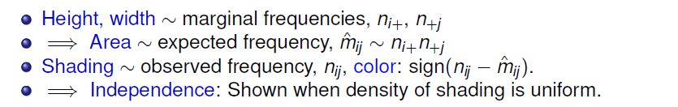
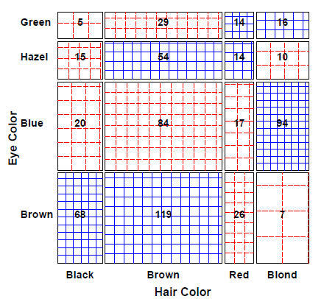
Sieve diagrams
The rectangles have area ~ expected frequency
# boxes = observed frequency
n_{ij} > m_{ij} → greater density
n_{ij} < m_{ij} → less density

Slide 51
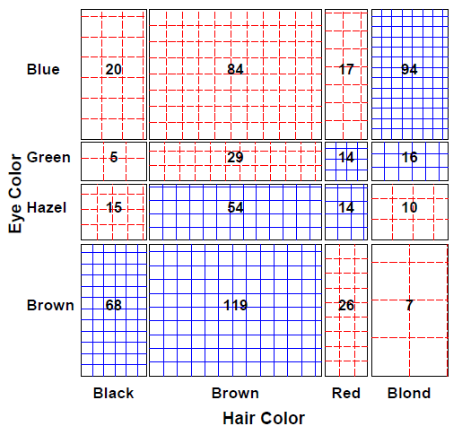
Sieve diagrams: Effect ordering
Permuting the rows / cols to make the pattern more coherent
Here, I reordered the eye colors according to lightness
The opposite-corner pattern suggests an explanation for the association

Slide 52
Sieve diagrams: Subtle patterns
Vision classification of 7477 women in Royal Ordnance factories: visual acuity grade in left & right eyes
The obvious association is apparent in the diagonal cells
A more subtle pattern appears in the off-diagonal cells
Analysis methods for square tables allow testing hypotheses beyond independence
Symmetry
Quasi-symmetry, …

Slide 53
Ordinal factors
The standard Pearson χ² and LR G² give tests of general association, with (r-1) × (c-1) df
More powerful CMH tests:
When either row or col levels are ordered, more specific CMH (Cochran–Mantel–Haentszel) tests which take order into account have greater power to detect ordered relations.
Use fewer df, so ordinal tests are more focused on detecting a particular “signal”
This is similar to testing for linear trends in ANOVA
Essentially, these assign scores to the categories & test for differences in row / col means, or non-zero correlation

Slide 54
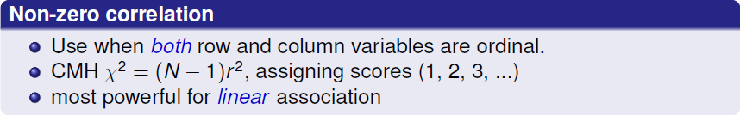


CMH tests for ordinal factors
Three types of CMH tests:

Slide 55

Sample CMH profiles

Slide 56

Sample CMH profiles

Slide 57

Visualizing the association
The association here is U-shaped
Only general association detects this
Higher levels of A are associated with lower levels of B

Slide 58
Example: Mental health data
For the mental health data, both ses and mental are ordinal
All tests are significant, but the nonzero correlation test, with 1 df has the smallest p-value & largest χ2 / df
> CMHtest(mental.tab)
Cochran-Mantel-Haenszel Statistics for ses by mental
AltHypothesis Chisq Df Prob
cor Nonzero correlation 37.2 1 1.09e-09
rmeans Row mean scores differ 40.3 5 1.30e-07
cmeans Col mean scores differ 40.7 3 7.70e-09
general General association 46.0 15 5.40e-05
both ordinal
cols ordinal
rows ordinal
neither
χ2 / df shows why ordered tests are more powerful
> xx <- CMHtest(mental.tab)
> xx$table[,"Chisq"] / xx$table[,"Df"]
cor rmeans cmeans general
37.16 8.06 13.56 3.06

Slide 59


Observer agreement

Slide 60


Cohen’s κ

Slide 61

Example: Cohen’s κ
Q: What would perfect agreement look like?

Slide 62
Example: Cohen’s κ
vcd::Kappa() calculates unweighted and weighted κ, using equal-spacing weights by default
> data(SexualFun, package="vcd")
> Kappa(SexualFun)
value ASE z Pr(>|z|)
Unweighted 0.129 0.0686 1.89 0.05939
Weighted 0.237 0.0783 3.03 0.00244
✗
✓
> Kappa(SexualFun, weights = "Fleiss-Cohen")
value ASE z Pr(>|z|)
Unweighted 0.129 0.0686 1.89 0.059387
Weighted 0.332 0.0973 3.41 0.000643
✗
✓
Unweighted κ is not significant, but both weighted versions are
You can obtain confidence intervals with the confint() method

Slide 63


Observer agreement: Multiple strata
Q: To what extent to the neurologists agree?
Q: Do they agree equally for the patients for the two cities

Slide 64

Observer agreement: Multiple strata
Winnipeg patients
New Orleans patients
Somewhat larger agreement for the New Orleans patients
The irr package (inter-rater-reliability) provides ICC and other measures; also handles the case of k > 2 raters

Slide 65

Bangdiwala’s Observer agreement chart
The observer agreement chart (Bangdiawala, 1987) provides:
A simple graphic representation of the strength of agreement
A measure of strength of agreement with an intuitive interpretation
B = 0.146
B^{w} = 0.498

Slide 66


Bangdiwala’s Observer agreement chart
observed: n_{ii} x n_{ii}
maximum: n_{i+} x n_{+i}

Slide 67

Weighted agreement chart: Partial agreement

Slide 68

The smallest exact agreement occurs for “very often”, but husbands & wives agree more on this allowing ± 1 step disagreement

Slide 69

Marginal homogeneity & observer bias

Slide 70

Looking ahead: Correspondence analysis
Like PCA for categorical data
Account for max % of χ² in few (2-3) dimensions
Finds scores for row and col categories
Plot of row/col scores shows associations
Dim 1: dark to light
Dim 2: something about red hair, green eyes?

Slide 71

Looking ahead: Correspondence analysis
Multiple correspondence analysis extends this to 3+ way tables
Analyses all two-way associations together
Category points: nearness indicates positive associations
UCBadmissions data
Dim 1: Admission
Dim 2: ??? (only 4%)
The relations of Dept to Gender and Admit are easy to interpret

Slide 72
Looking ahead: Models
Loglinear models [loglm()]
Generalize the Pearson χ² and LR G² tests of association to 3-way and larger tables.
Allows a range of models from mutual independence ([A] [B] [C]) to the saturated model ([ABC])
Intermediate models address questions of conditional independence, controlling for some factors
Can test associations in 2-way, 3-way, … terms, analogously to tests of interactions in ANOVA
Generalized linear models [glm()]
Similar to ordinary lm(), but w/ Poisson dist^{n} of counts: family=“poisson”
Formula notation: Freq ~ A + B + C; Freq ~ (A + B + C)^2
Familiar diagnostic methods & plots (outliers, influence)

Slide 73
Looking ahead: Models
Example: UC Berkeley data
Mutual independence: [Admit][Gender][Dept] = ~ A + G + D
Joint independence: [Admit][Gender Dept] = ~ A + G * D
Conditional independence: [D Admit][D Gender] = ~ D * (A + G)
Specific test of absence of gender bias, controlling for department
No three-way association: [A G][A D][G D] = ~ (A + D + G)²
library(MASS)
loglm(~ Admit + Dept + Gender, data=UCBAdmissions) # mutual independence
loglm(~ Admit + Dept * Gender, data=UCBAdmissions) # joint independence
loglm(~ Dept * (Admit + Gender), data=UCBAdmissions) # conditional independence
loglm(~ (Admit + Gender + Dept )^2, data=UCBAdmissions) # all two-way, no three-way
Bracket notation:
terms in the same bracket are allowed to be associated [A G] ≡ A * G
terms in separate brackets are asserted to be independent [A] [G] ≡ A + G

Slide 74

Looking ahead: Mosaic plots
Mosaic plots provide visualizations of associations in 2+ way tables
Tiles ~ frequency; conditioned by A, then B, then C, …
Fit: any loglinear model [A][B][C], [AB][C], [AB][AC], …, [ABC]
Shading: ~ residuals, contributions to χ²
Show: associations not accounted for by model

Slide 75
Summary
Two-way tables summarize frequencies of two categorical factors
2 × 2: a special case, with odds ratio as a measure
r × c: factors can be unordered or ordered
r × c × k: stratified tables, r × c with groups or circumstances
Tests & measures of association
Pearson χ², LR G²: general association
More powerful CMH tests for ordered factors
Visualization
2 × 2: fourfold plots
r × c: sieve diagrams, tile plots, …
More graphical methods to come …

