Slide 1
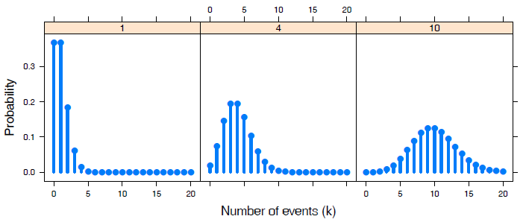

Discrete distributions
Michael Friendly
Psych 6136
http://friendly.github.io/psy6136

Slide 2
Discrete distributions: Basic ideas
Quantitative data: often assumed Normal (μ, σ²) – unreasonable for CDA
Binomial, Poisson, Negative binomial, … are the building blocks for CDA
Form the basis for modeling techniques
logistic regression, generalized linear models, Poisson regression
Data:
outcome variable (k = 0, 1, 2, … )
counts of occurrences (n_{k}): accidents, words in text, males in families of size k

Slide 3
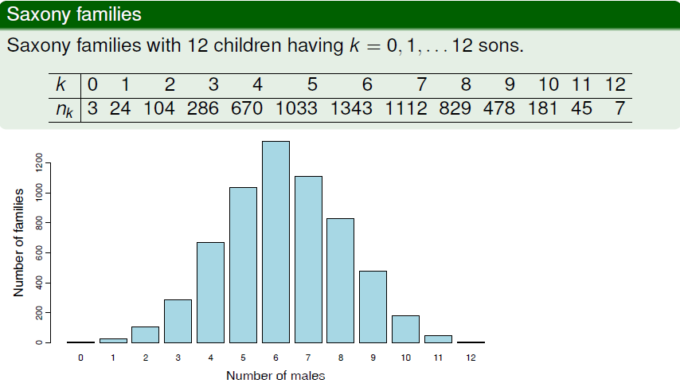
Examples: binomial
Human sex ratio (Geissler, 1889): Is there evidence that Pr(male) = 0.5?

Slide 4
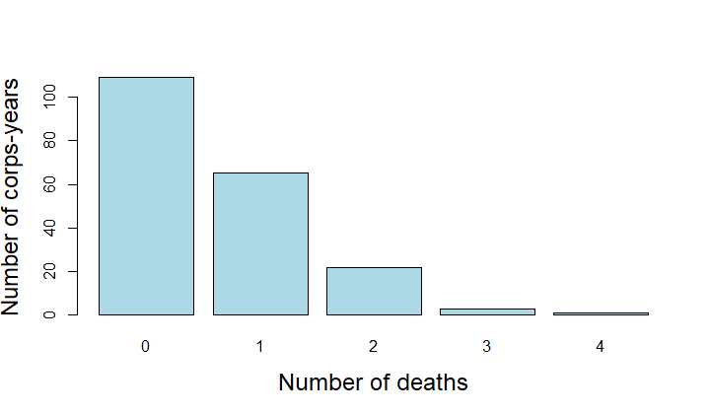
Example: Poisson
L. Von Bortkiewicz (1898) tallied the numbers of deaths by horse or mule kicks in 10 corps of the Prussian army over 20 years, → 200 corps-years
In how many corps-years were there 0, 1, 2, … deaths?
This is among the earliest examples of a Poisson distribution
> data(HorseKicks, package="vcd")
> HorseKicks
nDeaths
0 1 2 3 4
109 65 22 3 1
The Poisson distribution arises as that of the probability of 0, 1, 2, …
Rare events, that
Occur with constant probability

Slide 5
Examples: count data
Federalist papers: Disputed authorship
77 essays by Alexander Hamilton, John Jay, James Madison to persuade voters to ratify the US constitution, all signed with pseudonym “Publius”
Who wrote each?
65 known, 12 disputed (H & M both claimed sole authorship)
Mosteller & Wallace (1984): analysis of frequency dist^{n}s of key “marker” words: from, may, whilst, …
e.g., blocks of 200 words: occurrences (k) of “may” in how many blocks (n_{k})
> data(Federalist, package = "vcd")
> Federalist
nMay
0 1 2 3 4 5 6
156 63 29 8 4 1 1

Slide 6
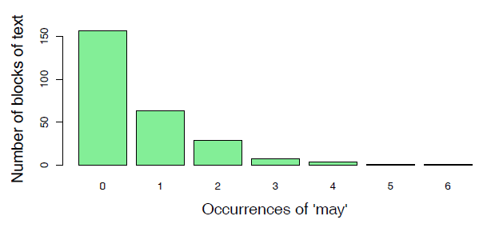
Count data: models
For each word (“from”, “may”, “whilst”, …)
Fit a probability model [Poisson(λ), NegBin(λ, p)]
Estimate parameters (λ,p)
→ Calculate log Odds (Hamilton vs. Madison)
→ All 12 disputed papers most likely written by Madison

Slide 7
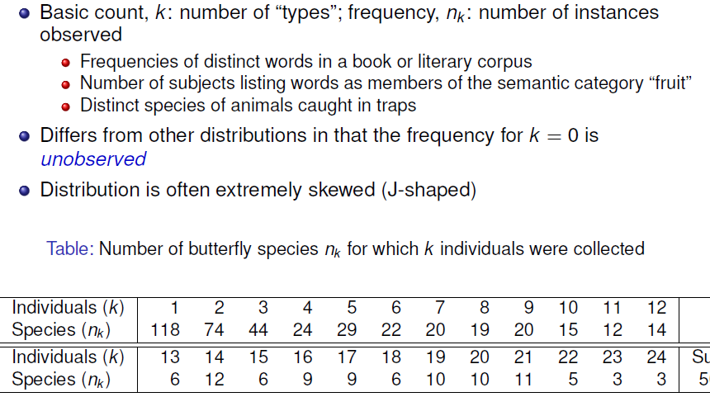
Example: Type-token distributions

Slide 8
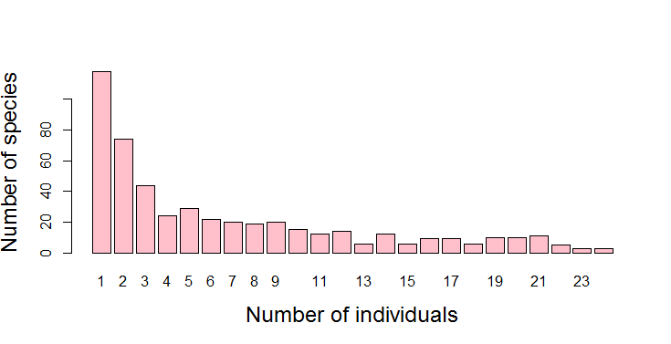
data(Butterfly, package="vcd")
barplot(Butterfly,
xlab = "Number of individuals",
ylab = "Number of species",
col = "pink",
cex.lab = 1.5)
Questions:
What is the total pop. of butterflies in Malaysia?
How many wolves remain in Canada NWT?
How many words did Shakespeare know?
Answers depend on estimating Pr(k=0)

Slide 9
Discrete distributions: Questions
General questions
What process gave rise to the distribution?
What is the form: uniform, binomial, Poisson, negative binomial, … ?
→ Fit & estimate parameters
Visualize goodness of fit
→ Use in some larger context to tell a story
Examples
Families in Saxony: might expect Bin(n=12, p); p=0.5?
HorseKicks: Poisson (λ); here, λ = mean = 0.61
Federalist papers: Perhaps Poisson(λ) or NegBin (λ, p)
Butterfly data: Perhaps a log-series distribution?

Slide 10
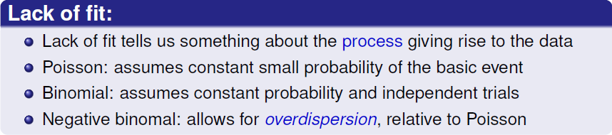
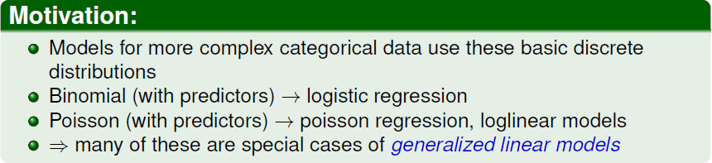
Fitting discrete distributions

Slide 11
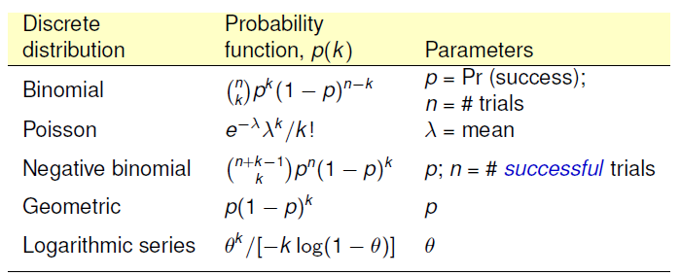
Common discrete distributions
Discrete distributions are characterized by a probability function, Pr(X = k) ≡ p(k), that the random variable X has value k.
Common discrete distributions have the following forms:

Slide 12
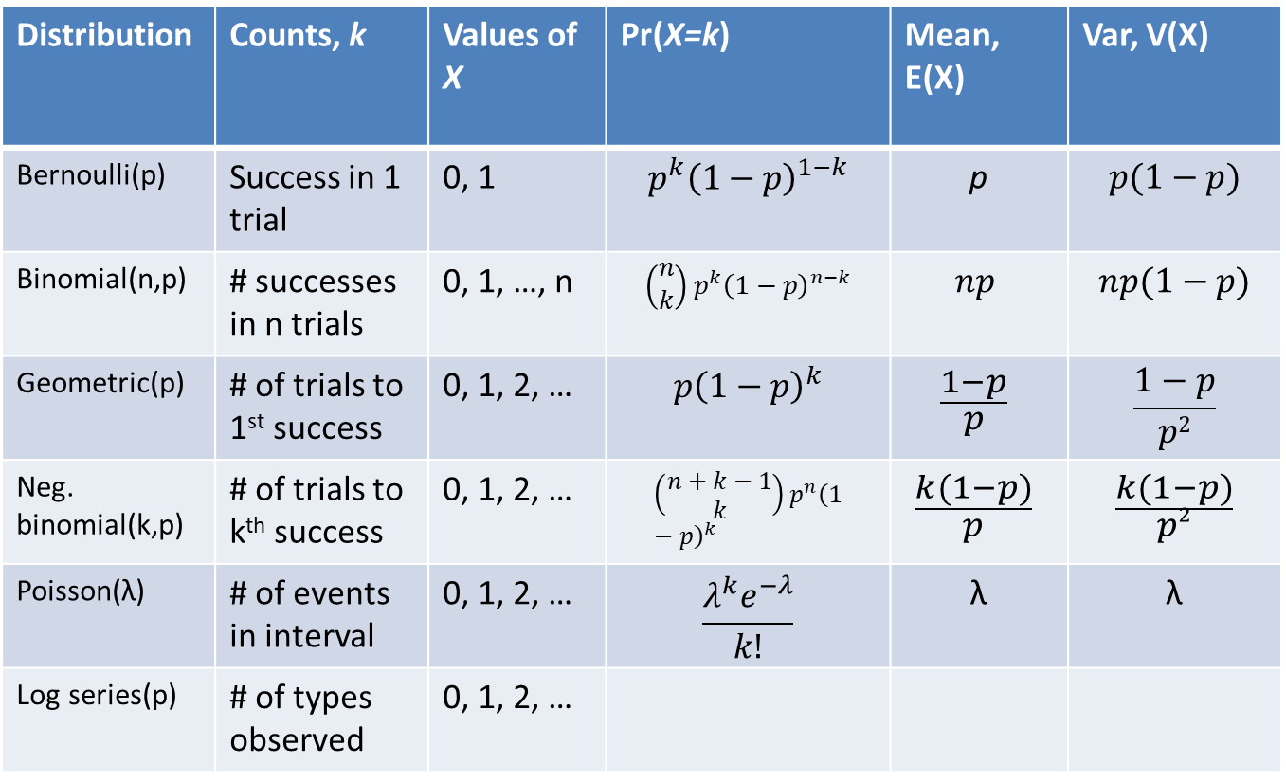
Common discrete distributions
Distribution | Counts, k | Values of X | Pr(X=k) | Mean, E(X) | Var, V(X)
Bernoulli(p) | Success in 1 trial | 0, 1 | $$p^{k}{\left(1−p\right)}^{1−k}$$ | p | $$p(1−p)$$
Binomial(n,p) | # successes in n trials | 0, 1, …, n | $$\left(\begin{matrix}n \\ k\end{matrix}\right)p^{k}{\left(1−p\right)}^{n−k}$$ | $$np$$ | $$np(1−p)$$
Geometric(p) | # of trials to 1st success | 0, 1, 2, … | $$p{\left(1−p\right)}^{k}$$ | $$\frac{1−p}{p}$$ | $$\frac{1−p}{p2}$$
Neg. binomial(k,p) | # of trials to k^{th} success | 0, 1, 2, … | $$\left(\begin{matrix}n+k−1 \\ k\end{matrix}\right)p^{n}{\left(1−p\right)}^{k}$$ | $$\frac{k(1−p)}{p}$$ | $$\frac{k(1−p)}{p2}$$
Poisson(λ) | # of events in interval | 0, 1, 2, … | $$\frac{λ^{k}e^{−λ}}{k!}$$ | λ | λ
Log series(p) | # of types observed | 0, 1, 2, …

Slide 13
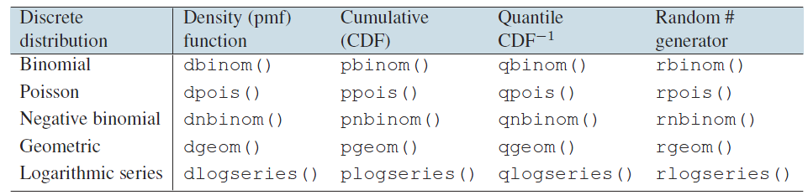
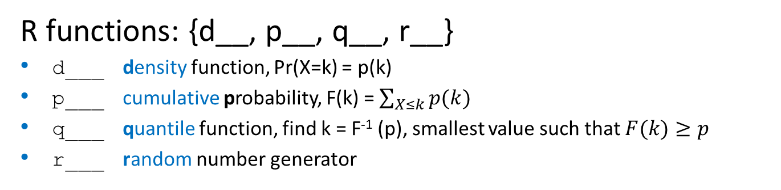
Discrete distributions: R
R functions: {d__, p__, q__, r__}
d___ density function, Pr(X=k) = p(k)
p___ cumulative probability, F(k) = $\sum_{X≤k}{p(k)}$
q___ quantile function, find k = F⁻¹ (p), smallest value such that $F(k)≥p$
r___ random number generator

Slide 14
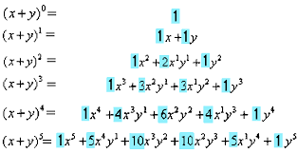

What is “binomial”
Bi-no-mi-al /bīˈnōmēəl/
Taxonomy: A two-part name, (genus, species) e.g., Elephas maximus for the Asian elephant
Mathematics: An algebraic expression of a sum of two terms, (x + y) or expansion, (x + y)^{n}
Coefficients of terms
(Pascal’s triangle)

Slide 15
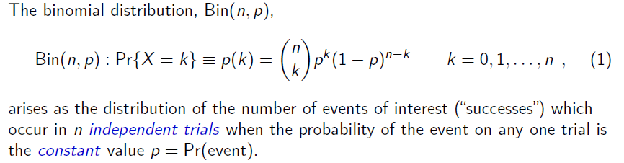
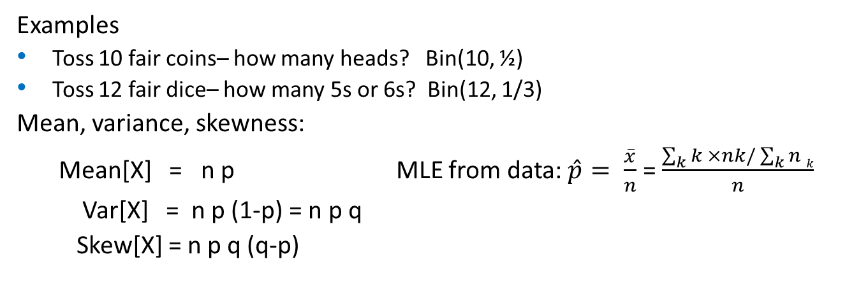
Binomial distribution
# ways to get k out of n
Pr(k events)
Pr(n-k non-events)
Examples
Toss 10 fair coins– how many heads? Bin(10, ½)
Toss 12 fair dice– how many 5s or 6s? Bin(12, 1/3)
Mean, variance, skewness:
Mean[X] = n p MLE from data: $\hat{p}= \frac{\overline{x}}{n}$ = $\frac{\sum_{k}{k ×nk/\sum_{k}{n k}}}{n}$
Var[X] = n p (1-p) = n p q
Skew[X] = n p q (q-p)

Slide 16
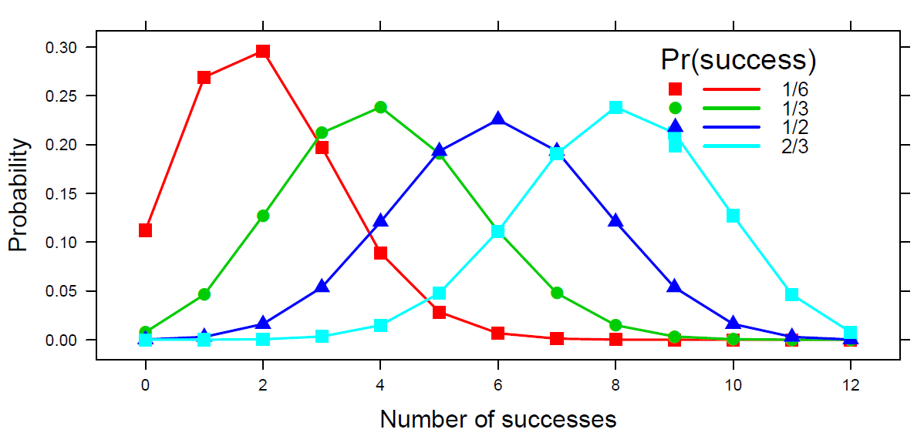
Binomial distribution
Binomial distributions for k = 0, 1, 2, …, 12 successes in n=12 trials, for 4 values of p
Mean = n p
Variance is maximum when p = ½
Skewed when p ≠ ½
DDAR Fig 3.9, pp 76-77

Slide 17
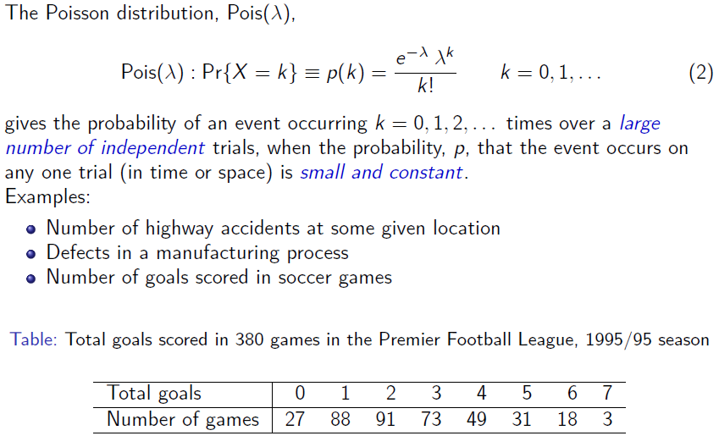
Poisson distribution

Slide 18
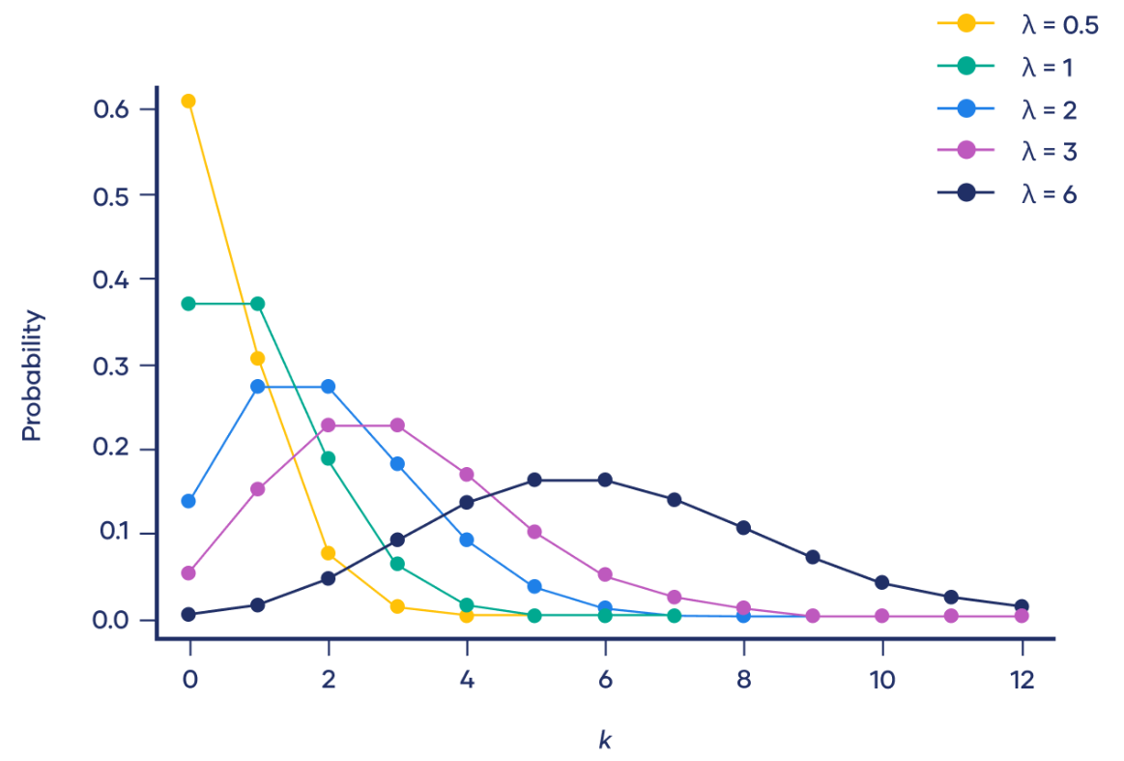
Poisson distribution
Poisson distributions for λ = ½, 1, 2, 3, 6

Slide 19
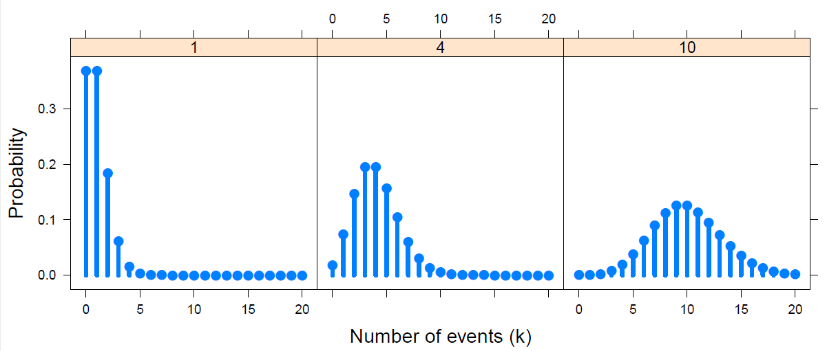

Poisson distribution: Properties
Poisson distributions for λ = 1, 4, 10
DDAR Fig 3.10, p 81
Mean, variance, skewness:
Mean[X] = λ
Var[X] = λ
Skew[X] = λ ^{-1/2}
Properties:
Sum of Pois (λ₁, λ₂,λ₃, …) = Pois(∑λ_{i})
Approaches N(λ, λ) as n → ∞
MLE: $\hat{λ}=\overline{x}$

Slide 20
History: Who discovered the “Poisson” distribution
Stigler’s Law: No discovery in science is ever named for its primary originator
De Moivre (1718) – Approximation to binomial as n gets largish
Poisson (1837) – Reserches sur la Probabilité des jugements en Matière criminelle…
Stigler says main result anticipated by De Moivre
S. Newcomb (1860) – Notes on a Theory of Probability
First attempt at using this as a fit to data
Observations of stars: Pr(any small space) contains s stars, s = 0, 1, 2, …
Von Bortkiewicz (1898) – Law of Small Numbers
Re-derives Poisson as limiting case of binomial
Several data sets (Horse kicks & others) – “agreement between theory and observation leave nothing to be desired”
Gosset (1907): Heamacytometer Counts
“Student”’s first paper – first rigorous treatment of the Poisson for count data
See: Hanley & Bhatnagar (2022) The “Poisson” Distribution: History, Reenactments, Adaptations, The American Statistician, 76:4, 363-371, DOI: 10.1080/00031305.2022.2046159

Slide 21
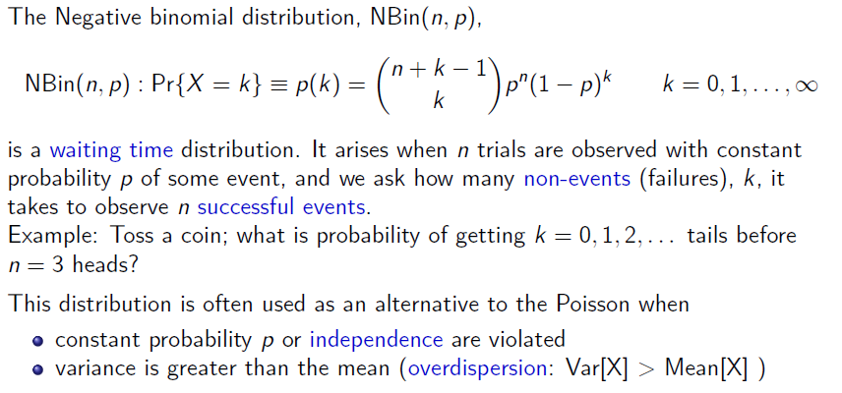
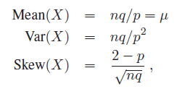
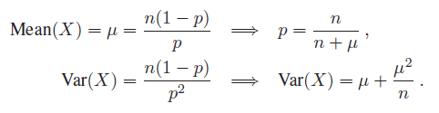
Negative binomial distribution

Slide 22
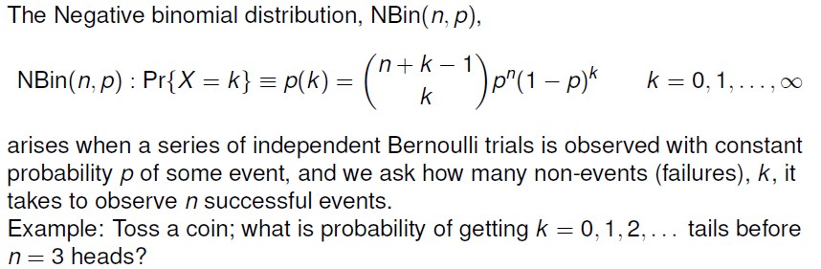

Negative binomial distribution
Properties:

Slide 23
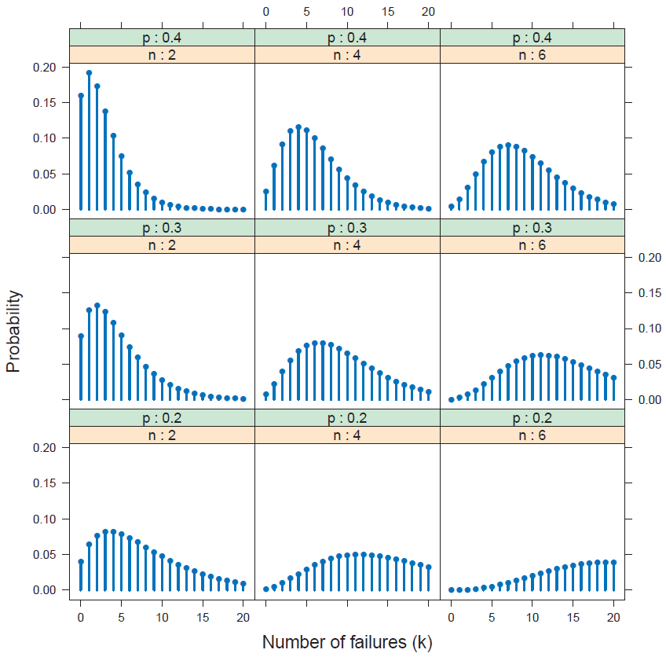
p
Negative binomial distributions for
n = 2, 4, 6
p = 0.2, 0.3, 0.4
Mean:
Increases with n
Decreases with p
n
DDAR Fig 3.13, p 85

Slide 24
Quiz: Name that distribution
1. Weldon tossed 12 dice 26,306 times & tallied the number of times a 5 or 6 occurred
> WeldonDice
n56
0 1 2 3 4 5 6 7 8 9 10+
185 1149 3265 5475 6114 5194 3067 1331 403 105 18
Bin(n=12, p=1/3)
2. Pele practices penalty kicks for the upcoming 1958 FIFA World Cup. His average scoring has been p=0.4. What is the probability it will take him 1, 2, … shots to score a goal?
Nbin(n=1, p=0.4)
> dnbinom(1:5, size=1, p=0.4)
[1] 0.240 0.144 0.086 0.052 0.031
3. A Geiger counter records the number of scintillations of α particles from a radioactive source, with an average rate of 20/msec. What is the probability of observing 40 in a 1 msec. interval?
Pois(λ=20)
4. What is the distribution of the time between Geiger counter ticks?
Exponential dist^{n}, Pr(X=k) = λ e^{-λk} , mean = 1/λ

Slide 25
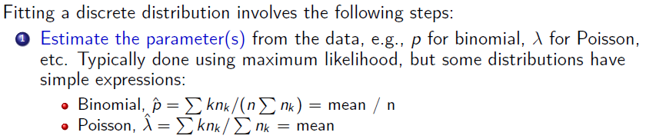
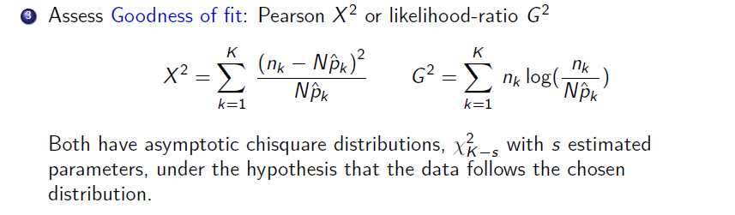
Fitting discrete distributions

Slide 26

Fitting: Weldon’s dice
Basic, naïve calculation of expected frequencies for a binomial distribution
> data(WeldonDice, package="vcd")
> Weldon.df <- as.data.frame(WeldonDice) # convert to data frame
> Prob <- dbinom(0:12, 12, 1/3) # binomial probabilities
> Prob <- c(Prob[1:10], sum(Prob[11:13])) # sum values for 10+
> Exp= round(sum(WeldonDice)*Prob) # expected frequencies
> Diff = Weldon.df[,"Freq"] - Exp # raw residuals
> Chisq = Diff^2 /Exp # contribution to chisquare
> data.frame(Weldon.df, Prob=round(Prob,5), Exp, Diff, Chisq)
n56 Freq Prob Exp Diff Chisq
1 0 185 0.00771 203 -18 1.596
2 1 1149 0.04624 1216 -67 3.692
3 2 3265 0.12717 3345 -80 1.913
4 3 5475 0.21195 5576 -101 1.829
5 4 6114 0.23845 6273 -159 4.030
6 5 5194 0.19076 5018 176 6.173
7 6 3067 0.11127 2927 140 6.696
8 7 1331 0.04769 1255 76 4.602
9 8 403 0.01490 392 11 0.309
10 9 105 0.00331 87 18 3.724
11 10+ 18 0.00054 14 4 1.143
Doesn’t calculate the MLE, $\hat{p}$
Manually sum k ≥ 10

Slide 27
Fitting & graphing discrete distributions
In R, the vcd and vcdExtra packages provide functions to fit, visualize and diagnose discrete distributions
Fitting: goodfit() fits uniform, binomial, Poisson,
neg bin, geometric, logseries, …
Graphing: rootogram() assess departure between
observed, fitted counts
Ord plot: Ordplot() diagnose form of a discrete
distribution
Robust plots: distplot() handle problems with
discrepant counts

Slide 28
Example: Saxony families
> data(Saxony, package="vcd")
> Saxony
nMales
0 1 2 3 4 5 6 7 8 9 10 11 12
3 24 104 286 670 1033 1343 1112 829 478 181 45 7
Use goodfit() to fit the binomial; test with summary()
> Sax.fit <- goodfit(Saxony, type = "binomial", par=list(size=12))
> summary(Sax.fit)
Goodness-of-fit test for binomial distribution
X^2 df P(> X^2)
Likelihood Ratio 97 11 6.98e-16

Slide 29
Example: Saxony families
The print() method for goodfit objects shows the details
> Sax.fit # print
Observed and fitted values for binomial distribution
with parameters estimated by `ML'
count observed fitted pearson residual
0 3 0.933 2.140
1 24 12.089 3.426
2 104 71.803 3.800
3 286 258.475 1.712
4 670 628.055 1.674
5 1033 1085.211 -1.585
6 1343 1367.279 -0.657
7 1112 1265.630 -4.318
8 829 854.247 -0.864
9 478 410.013 3.358
10 181 132.836 4.179
11 45 26.082 3.704
12 7 2.347 3.037
Pay attention to the pattern & magnitudes of residuals, d_{k}
Pearson χ² = ∑ d_{k} ²

Slide 30
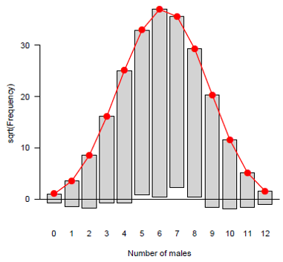
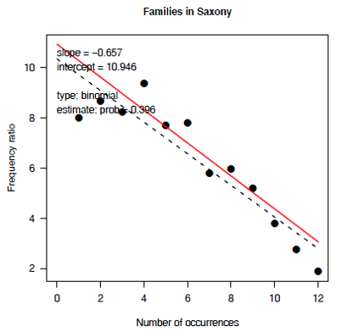
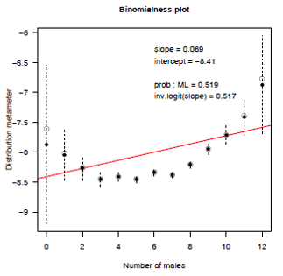
Graphing discrete distributions
Rootograms
Ord plots
Robust distribution plots

Slide 31
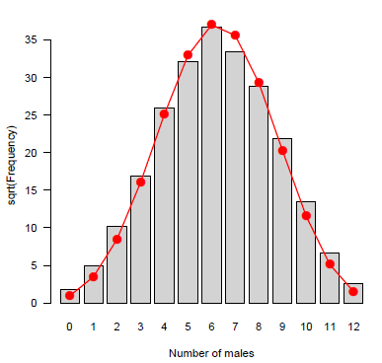
What’s wrong with simple histograms?
Discrete distributions are often graphed as histograms, with a theoretical fitted distribution superimposed
The plot() method for goodfit objects provides some alternatives
> plot(Sax.fit, type = "standing", xlab = "Number of males")
Problems:
Largest frequencies dominate
Must assess deviations vs. the fitted curve

Slide 32
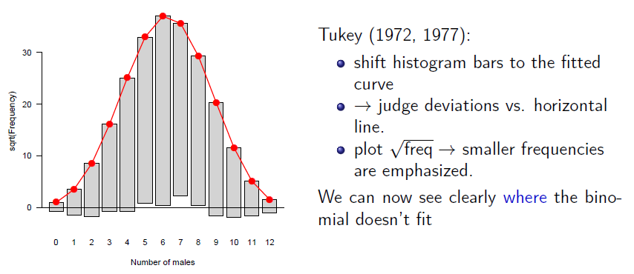
Hanging rootograms
> plot(Sax.fit, type = "hanging", xlab = "Number of males") # default

Slide 33
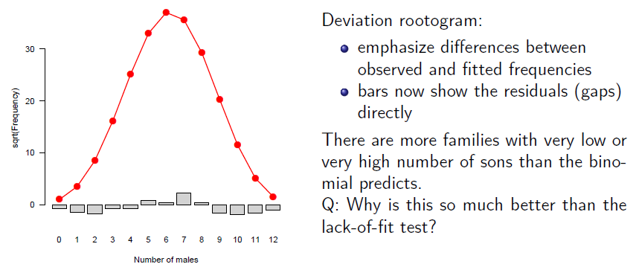
Deviation rootograms
> plot(Sax.fit, type = "deviation", xlab = "Number of males")

Slide 34
Example: Federalist papers
> data(Federalist, package="vcd")
> Federalist
nMay
0 1 2 3 4 5 6
156 63 29 8 4 1 1
Fit the Poisson distribution
> Fed.fit0 <- goodfit(Federalist, type="poisson")
> summary(Fed.fit0)
Goodness-of-fit test for poisson distribution
X^2 df P(> X^2)
Likelihood Ratio 25.2 5 0.000125
This fits very poorly!

Slide 35
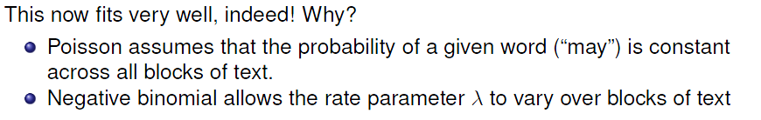
Example: Federalist papers
Try the Negative binomial distribution
> Fed.fit1<- goodfit(Federalist, type="nbinomial")
> summary(Fed.fit1)
Goodness-of-fit test for nbinomial distribution
X^2 df P(> X^2)
Likelihood Ratio 1.96 4 0.742

Slide 36
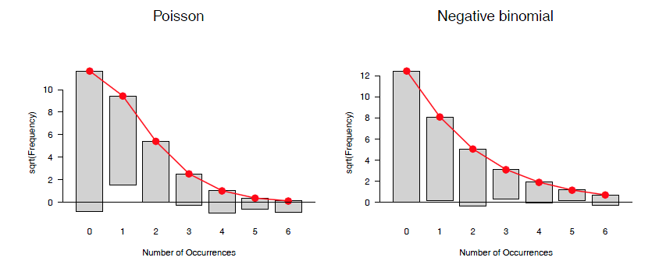
Federalist papers: Rootograms
Hanging rootograms for the Federalist papers data, comparing Poisson and Negative binomial
> plot(Fed.fit0, main = "Poisson")
> plot(Fed.fit1, main = "Negative binomial")

Slide 37
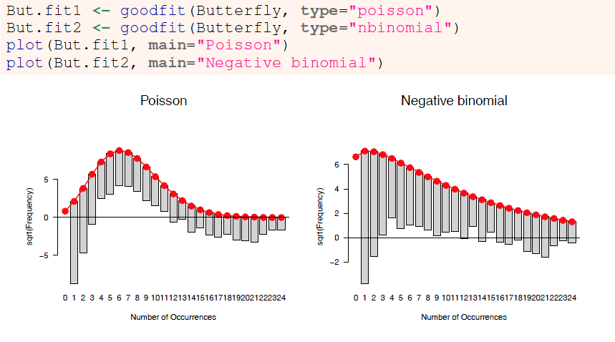
Butterfly data
Both Poisson and Negative binomial are terrible fits! What to do??

Slide 38
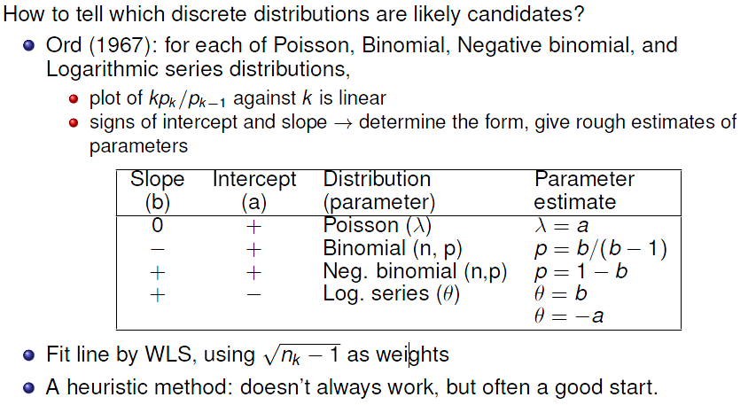
Ord plots: Diagnose form of distribution

Slide 39
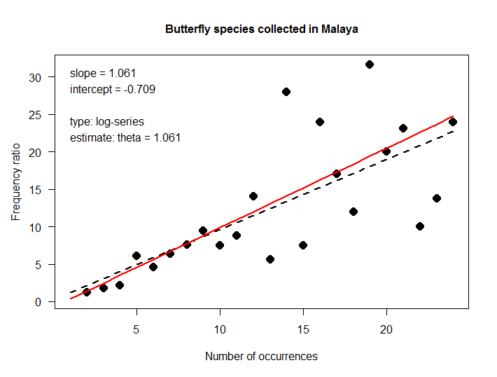
Ord plot: Examples
Butterfly data: The slope and intercept correctly diagnoses the log-series distribution
> Ord_plot(Butterfly,
main = "Butterfly species collected in Malaya",
gp=gpar(cex=1), pch=16)
+ slope
intercept
→ log-series

Slide 40
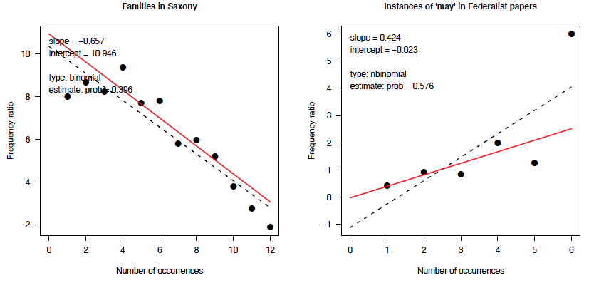
Ord plots: Examples
Ord plots for the Saxony and Federalist data
> Ord_plot(Saxony, main = "Families in Saxony", gp=gpar(cex=1), pch=16)
> Ord_plot(Federalist, main = "Instances of 'may' in Federalist papers", gp=gpar(cex=1), pch=16)

Slide 41
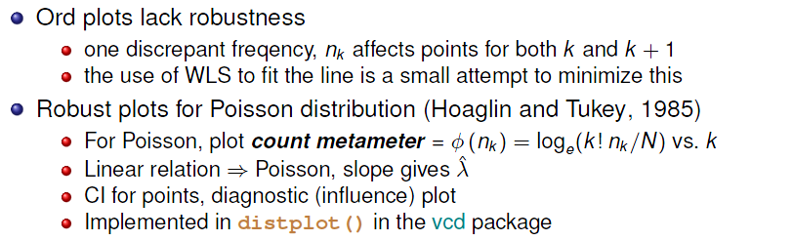
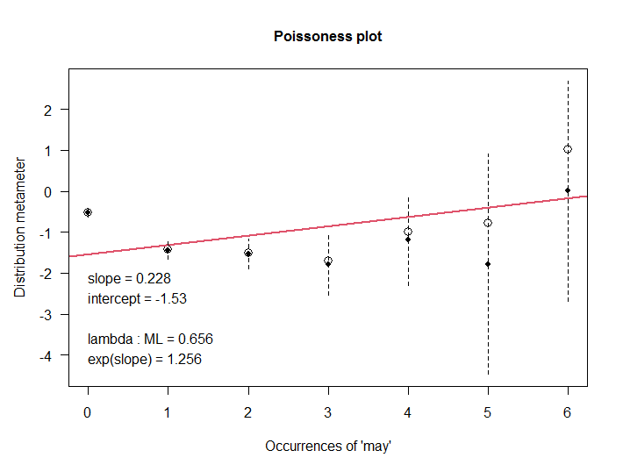
Robust distribution plots
For the Poisson distribution, this is called a “poissonness plot”

Slide 42
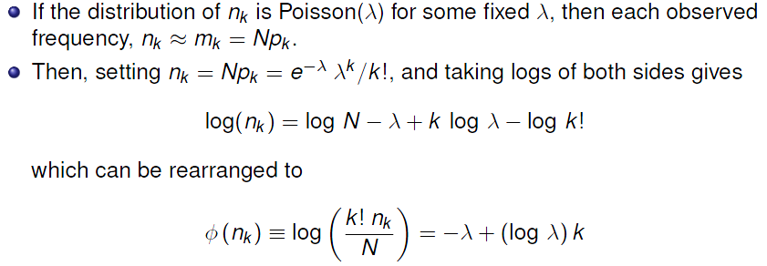
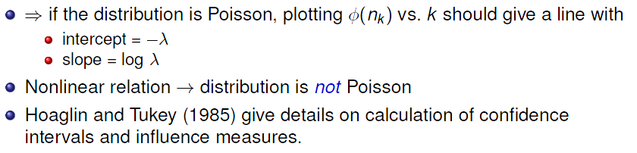
Poissonness plot: Details

Slide 43
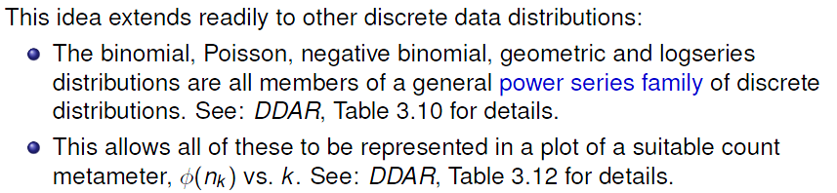
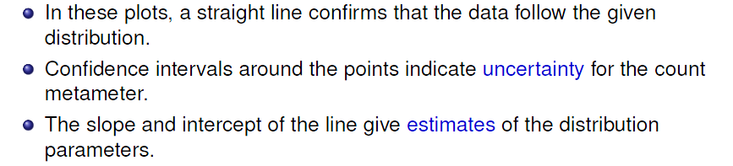
Other distributions

Slide 44
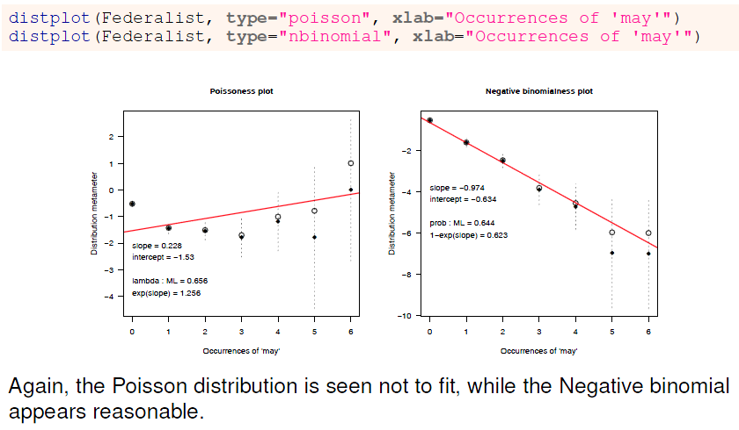
distplot: Federalist
Try both Poisson & Negative binomial

Slide 45
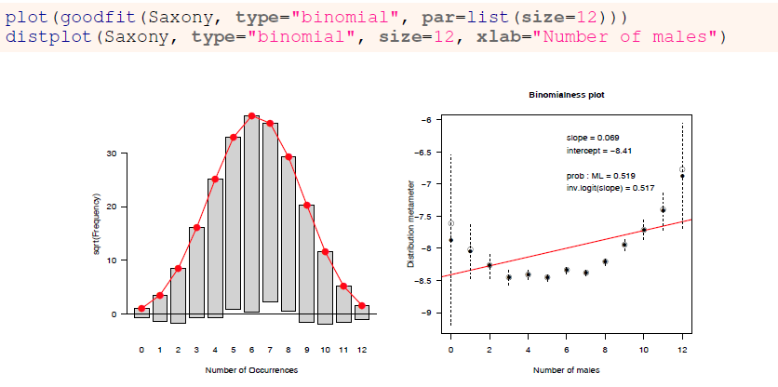
distplot: Saxony
For purported binomial distributions, the result is a “binomialness” plot
Both plots show heavier tails than the binomial distribution. distplot() is more sensitive in diagnosing this

Slide 46
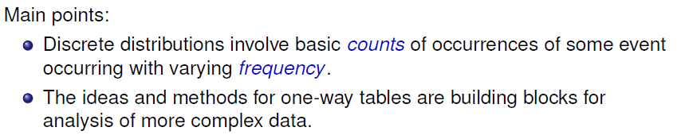
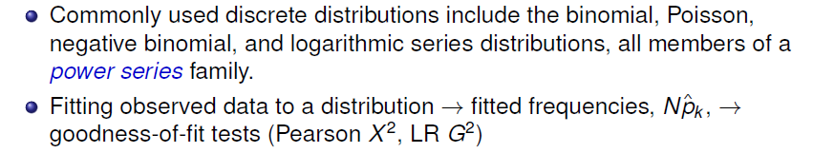
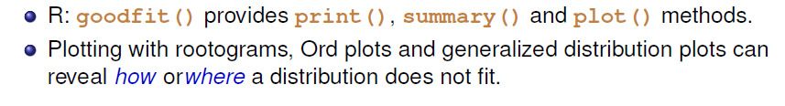
What have we learned?

Slide 47
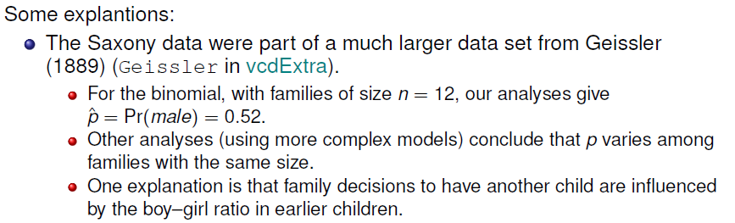

What have we learned?

Slide 48

Looking ahead: PhdPubs data
There are predictors: gender, marital status, number of children, prestige of dept., # pubs by student’s mentor
We fit such models with glm(), but need to specify the form of the distribution
Ignoring the predictors for now, a baseline model could be
glm(articles ~ 1, data=PhdPubs, family = “poisson”)

Slide 49

Looking ahead: PhdPubs
Poisson doesn’t fit: Need to account for excess 0s (some never published)
Neg binomial: Sort of OK, but should take predictors into account

Slide 50

Looking ahead: Count data models
Count data regression models (DDAR Ch 11)
Include predictors
Allow different distributions for unexplained variation
Provide tests of one model vs. another
Special models handle the problems of excess zeros: zeroinlf(), hurdle()

Slide 51

Looking ahead: Effect plots

Slide 52
Summary
Discrete distributions are the building blocks for categorical data analysis
Typically consist of basic counts of occurrences, with varying frequencies
Most common: binomial, Poisson, negative binomial
Others: geometric, log-series
Fit with goodfit(); plot with rootogram()
Diagnostic plots: Ord_plot(), distplot()
Models with predictors
Binomial → logistic regression
Poisson → poisson regression; logliner models
These are special cases of generalized linear models

