Slide 1
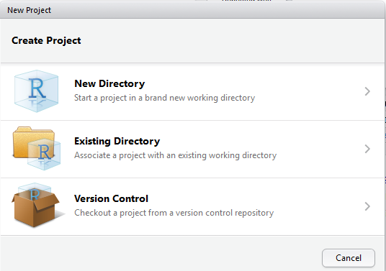

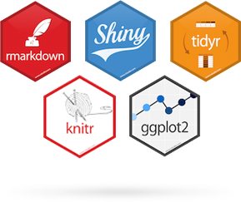
Working with RStudio
Michael Friendly
Psych 6136
http://friendly.github.io/psy6136

Slide 2

Getting started: Tools
To profit best, you need to install both R and R Studio on your computer
The basic R system: R console (GUI) & packages
Download: http://cran.us.r-project.org/
Add my recommended packages: source(“https://friendly.github.io/psy6136//R/install-pkgs.R ”)
The R Studio IDE: analyze, write, publish
Download: https://www.rstudio.com/products/rstudio/download/
Add: R Studio-related packages, as useful

Slide 3

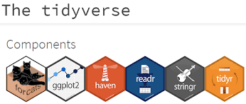
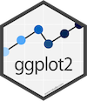





R package tools
Data prep: Tidy data makes analysis and graphing much easier.
Packages: tidyverse, comprised of: tidyr, dplyr, lubridate, …
R graphics: general frameworks for making standard and custom graphics
Graphics frameworks: base graphics, lattice, ggplot2, rgl (3D)
Application packages: car (linear models), vcd (categorical data analysis), heplots (multivariate linear models)
Publish: A variety of R packages make it easy to write and publish research reports and slide presentations in various formats (HTML, Word, LaTeX, …), all within R Studio
Web apps: R now has several powerful connections to preparing dynamic, web-based data display and analysis applications.

Slide 4
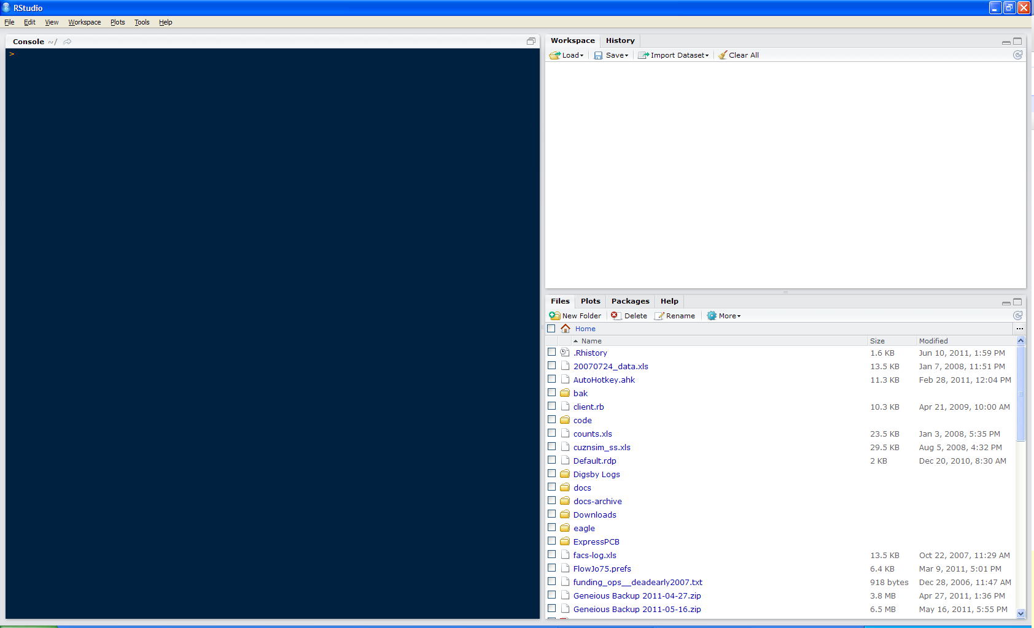
Getting started: R Studio
command history
workspace: your variables
R console
(just like Rterm)
files
plots
packages
help

Slide 5
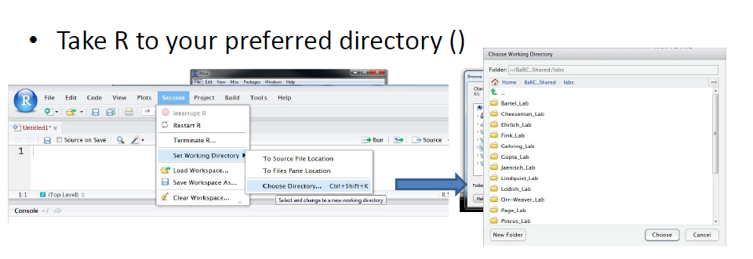
R Studio navigation
R folder navigation commands:
Where am I?
Go somewhere:
> getwd()
[1] "C:/Dropbox/Documents/6136"
Better yet: create an R project!
> setwd("C:/Dropbox")
> setwd(file.choose())
R Studio GUI

Slide 6
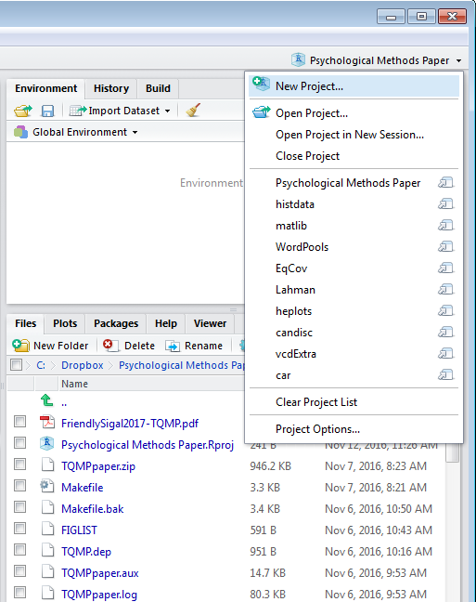
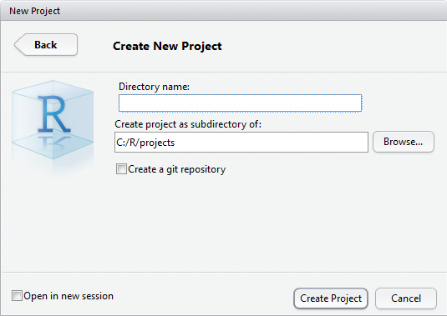
R Studio projects
R Studio projects are a handy way to organize your work
The .Rproj item opens the project in R Studio

Slide 7
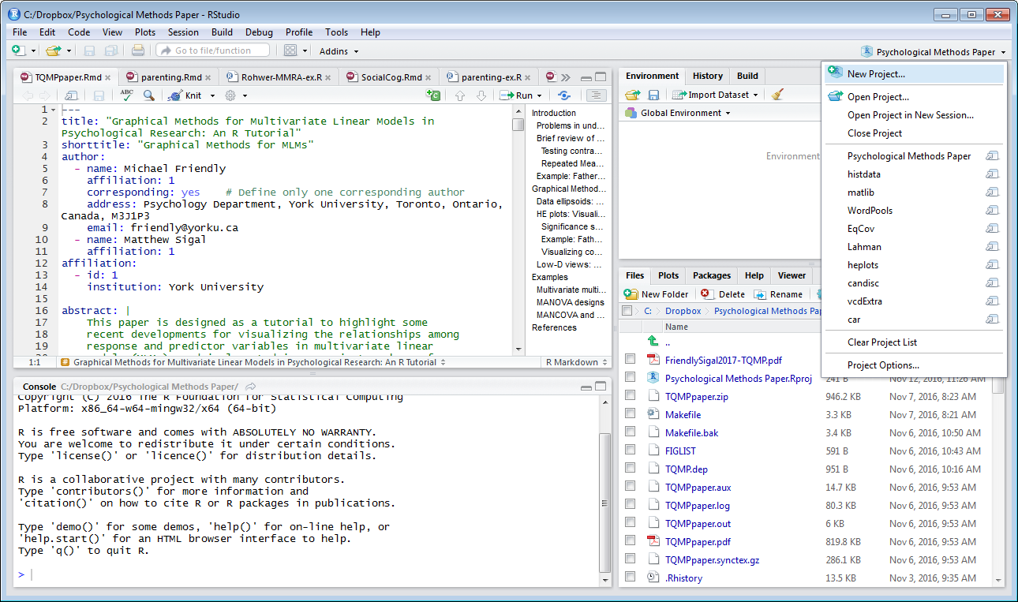
R Studio projects
An R Studio project for a research paper: R files (scripts), Rmd files (text, R “chunks”)

Slide 8
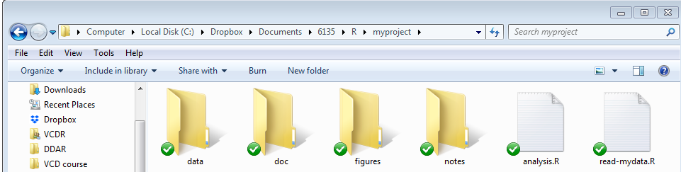

Organizing an R project
Use a separate folder for each project
Use sub-folders for various parts
data files:
raw data (.csv)
saved R data (.Rdata)
figures:
diagrams
analysis plots
R files:
data import
analysis
Write up files will go here (.Rmd, .docx, .pdf)
This project, saved in a Dropbox folder automatically syncs with all my computers & collaborators. I use Git & GitHub for more serious work.

Slide 9
Organizing an R project
Use separate R files for different steps:
Data import, data cleaning, … → save as an RData file
Analysis: load RData, …
read-mydata.R
# read the data; better yet: use RStudio File -> Import Dataset ...
mydata <- read.csv("data/mydata.csv")
# data cleaning:
# filter missing, make factors, transform variables, ....
# save the current state
save("data/mydata.RData")

Slide 10
Organizing an R project
Use separate R files for different steps:
Data import, data cleaning, … → save as an RData file
Analysis: load RData, …
analyse.R
#’ ## load the data
load("data/mydata.RData")
#’ ## do the analysis – exploratory plots
plot(mydata)
#’ ## fit models
mymod.1 <- lm(y ~ X1 + X2 + X3, data=mydata)
#’ ## plot models, extract model summaries
plot(mymod.1)
summary(mymod.1)
NB: #’ ## is a special R comment for a H2 heading in an R “notebook” script

Slide 11
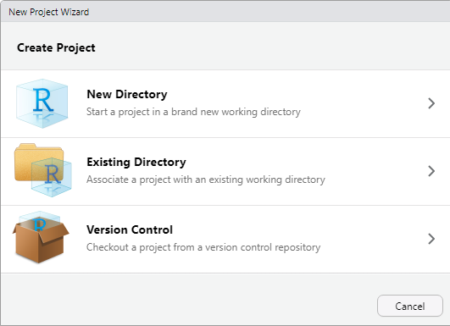
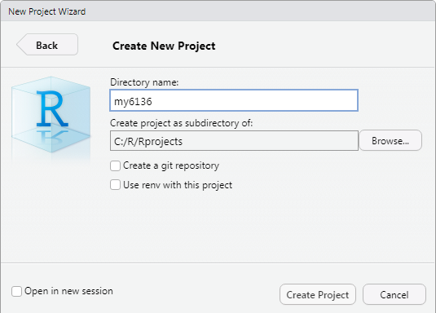
Your psy6136 project
I recommend that you create your own RStudio project for work in this course
This will enable you to keep all your work together, in a structured way
This will create a file, my6136.Rproj
Double-click on this to launch it in RStudio

Slide 12
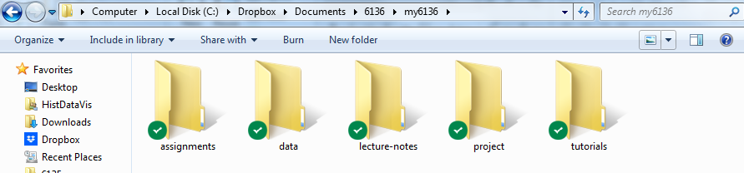
Your psy6136 project
I also recommend that you create sub-folders there to organize your work
What you name them is up to you, but the main thing is for you to keep things organized by topics.
work on tutorials, R examples
R scripts, data, outputs for assignments

Slide 13
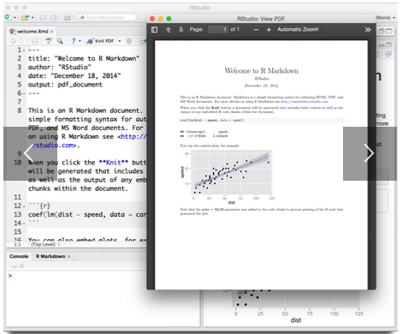
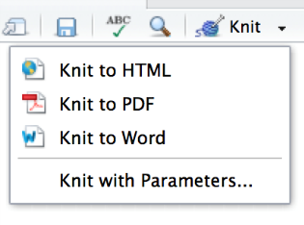
Reproducible analysis & reporting
R Studio, together with the knitr and rmarkdown packages provide an easy way to combine writing, analysis, and R output into complete documents
.Rmd files are just text files, using rmarkdown markup and knitr to run R on “code chunks”
A given document can be rendered in different output formats:

Slide 14
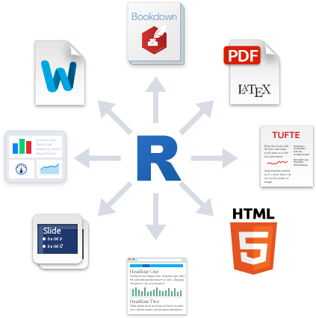
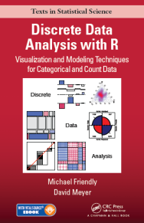
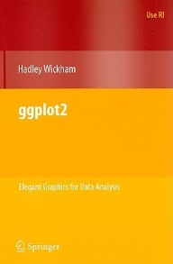
Output formats and templates
The integration of R, R Studio, knitr, rmarkdown and other tools is now highly advanced.
My last book was written entirely in R Studio, using .Rnw syntax → LaTeX → PDF → camera ready copy
The ggplot2 book was written using .Rmd format.
The bookdown package makes it easier to manage a book-length project – TOC, fig/table #s, cross-references, etc.
Also: blogdown, posterdown, …
Templates are available for APA papers, slides, handouts, entire web sites, etc.

Slide 15
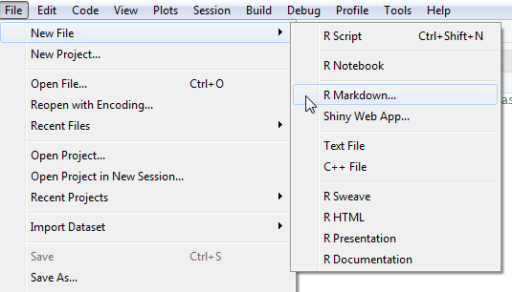
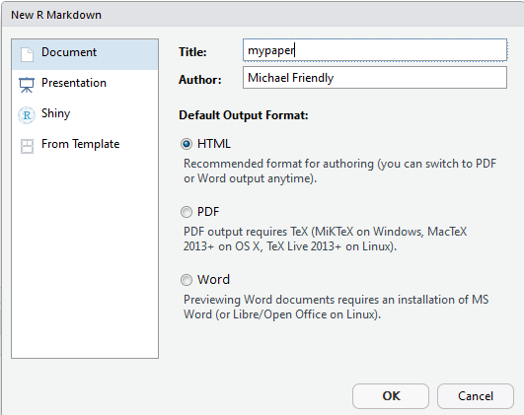
Writing it up
In R Studio, create a .Rmd file to use R Markdown for your write-up
lots of options: HTML, Word, PDF (needs LaTeX)
templates for various pub types

Slide 16
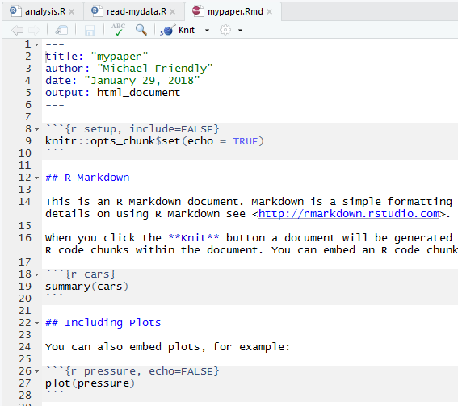
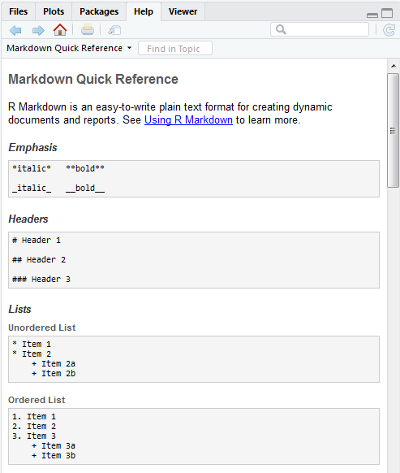
Writing it up
Use simple Markdown to write text
Include code chunks for analysis & graphs
mypaper.Rmd, created from a template
Help -> Markdown quick reference
yaml header
Header 2
output code chunk
plot code chunk

Slide 17
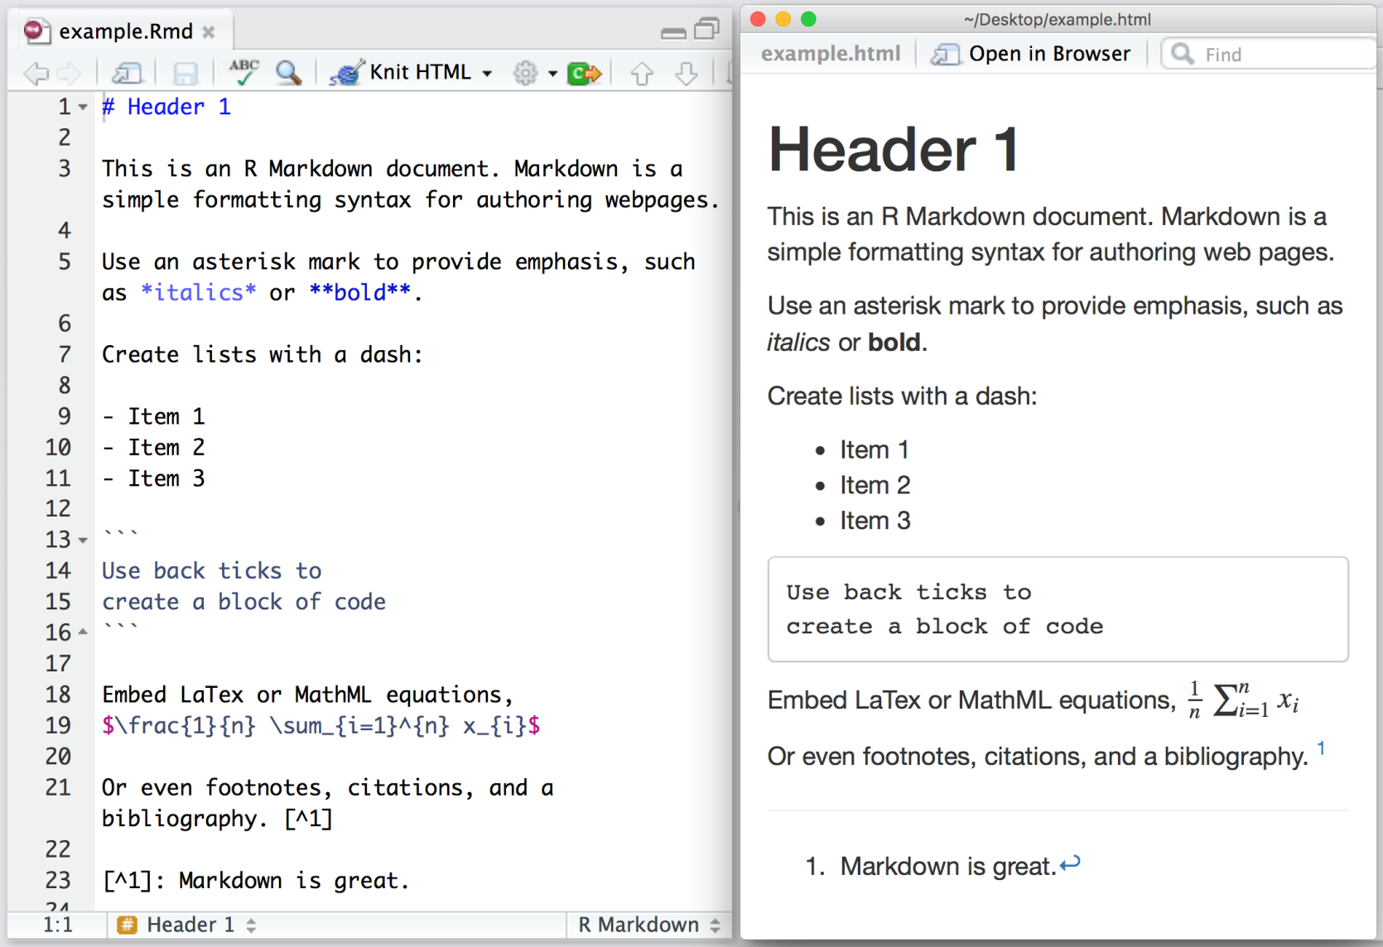
rmarkdown basics
rmarkdown uses simple formatting for all standard document elements

Slide 18
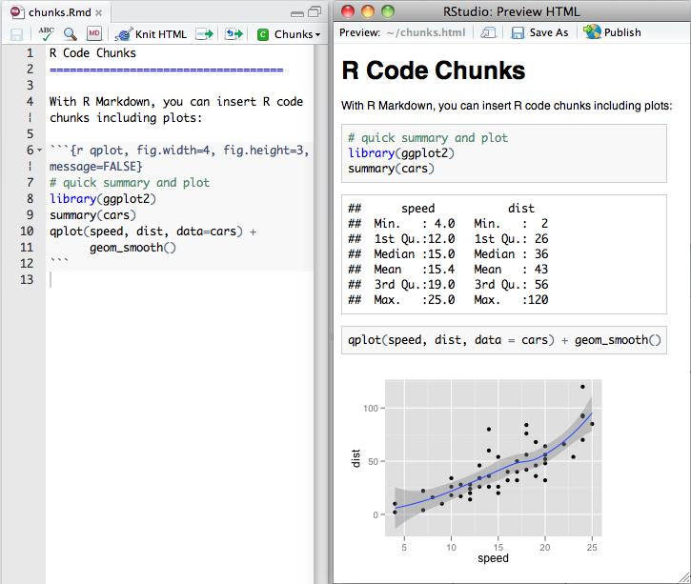
R code chunks
R code chunks are run by knitr, and the results are inserted in the output document
There are many options for controlling the details of chunk output – numbers, tables, graphs
Choose the output format:
An R chunk:
```{r name, options}
# R code here
```

Slide 19
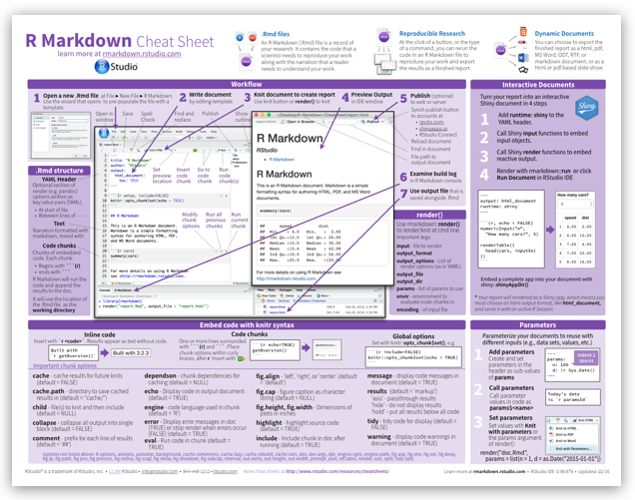
The R Markdown Cheat Sheet provides most of the details
https://www.rstudio.com/wp-content/uploads/2016/03/rmarkdown-cheatsheet-2.0.pdf

Slide 20

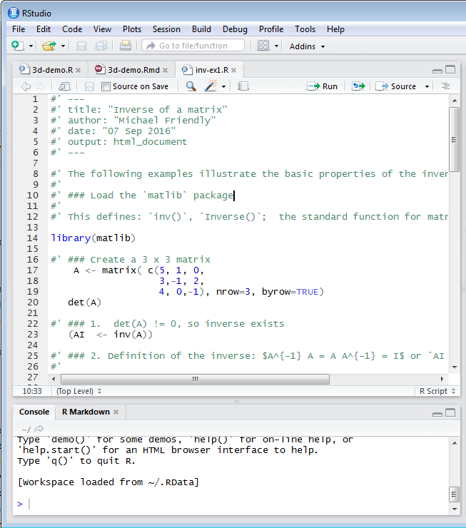
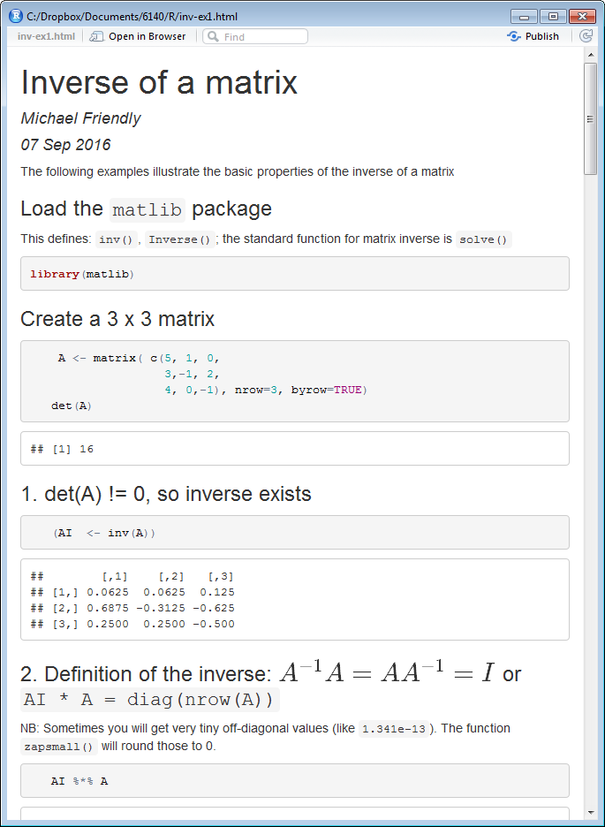
R notebooks
Often, you just want to “compile” an R script, and get the output embedded in the result, in HTML, Word, or PDF. Just type Ctrl-Shift-K or tap the Compile Report button
### header
use math

Slide 21
R Scripts with markdown
#' ---
#' title: "UCBAdmissions: fourfold displays and odds ratios"
#' author: "Michael Friendly"
#' date: "`r format(Sys.Date())`"
#' output:
#' html_document:
#' theme: readable
#' code_download: true
#' ---
#' ## Load data
library(vcd)
data("UCBAdmissions")
#' ## rearrange dimensions
UCB <- aperm(UCBAdmissions, c(2,1,3))
# marginal table, collapsing over Dept
(UCB2 <- margin.table(UCB, c(1,2)))
#’ ## Chisquare test, $\chi^2$
chisq.test(UCB2)
In R scripts you can use special comments (#’) to add headings, text, math, with output to HTML, Word, PDF, …
File -> Compile Report (Ctrl-Shift-K)
runs the script and produces a report with all the output
YAML header
Heading
Math notation
(LaTeX)

