Slide 1
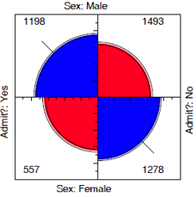
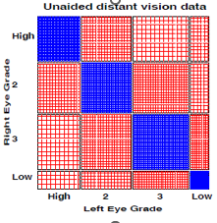
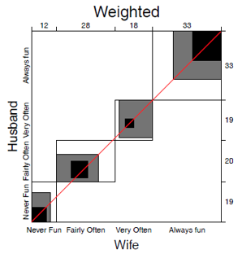
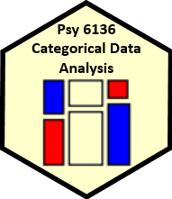
Two-way tables Independence & association
Michael Friendly
Psych 6136
https://friendly.github.io/psy6136

Slide 2
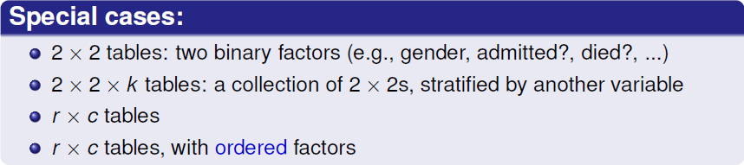
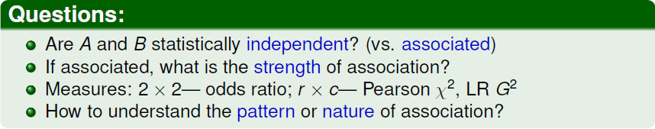
Two-way tables: Overview
Two-way frequency tables are a convenient way to represent a dataset cross-classified by two discrete variables, A & B

Slide 3
Methods
The methods discussed this week are generally simple non-parametric or randomization methods
There is no underlying formal model with parameters
Hypothesis tests based on some test statistic:
Pearson X²
Odds ratio, θ
Cohen’s κ
Friendly’s Smiley 😍 (p<.01), 😄, … 😡(p>.05)
Gabe’s ψ
p-values, confidence intervals based on:
Large sample theory: X² ~ χ² as N → ∞ (smaller suffices)
Permutation tests or simulation distributions
Plenty of room for new stats!

Slide 4
CDA Thinking
When you see a new stat, like X² , θ, Gabe’s ψ:
Think:
What aspect of data is it trying to assess? (What’s H₀?)
Is it appropriately large/small as data deviates from H₀?
How to calculate uncertainty? (conf interval / Bayesian)
Theory, simulation, …
Think: Analogies – what is this like I already know?
Loglinear models: ANOVA of log(Freq)
Logistic regression: Regression of log(odds)
Think: How can I extend something to make it better?

Slide 5
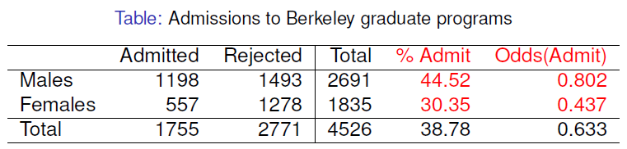
2 × 2 Example: Berkeley admissions
odds ratio (θ) = 1.84
Males were nearly twice as likely to be admitted
Is there an association between gender & admission?
If so, is this evidence for gender bias?
How to measure strength of association?
How to test for significance?
How to visualize?

Slide 6
UCBAdmissions data
In R, the data is contained in UCBAdmissions, a 2 x 2 x 6 table for 6 departments. We collapse over department
> data(UCBAdmissions)
> UCB <- margin.table(UCBAdmissions, 2:1)
> UCB
Admit
Gender Admitted Rejected
Male 1198 1493
Female 557 1278
Margins to compute sums
odds_{M} = 1198 / 1493 = 0.802
odds_{F} = 557 / 1278 = 0.437
Association in 2 x 2 table can be measured by the odds ratio (θ): odds of admission for males vs. females
> oddsratio(UCB, log=FALSE)
odds ratios for Gender and Admit
[1] 1.84
> confint(oddsratio(UCB, log=FALSE))
2.5 % 97.5 %
Male:Female/Admitted:Rejected 1.62 2.09
Note use of confint() for obtaining the CI(θ)

Slide 7
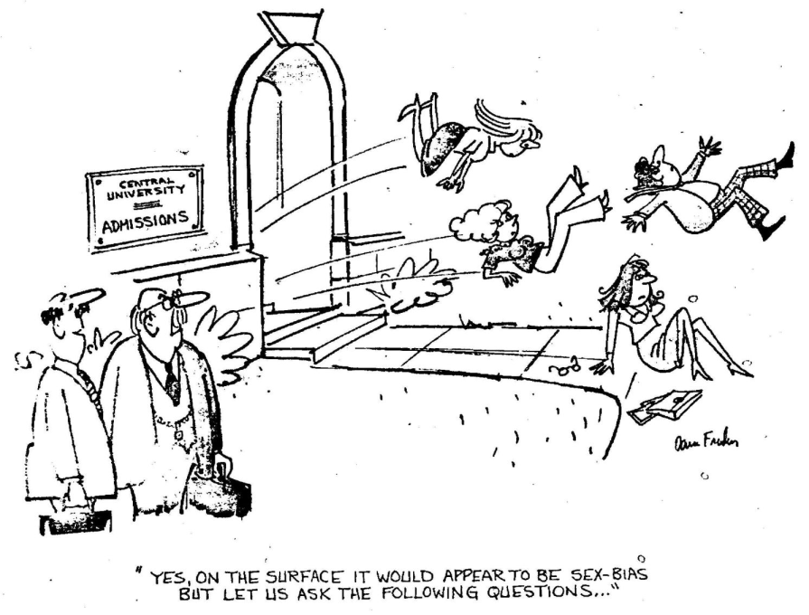
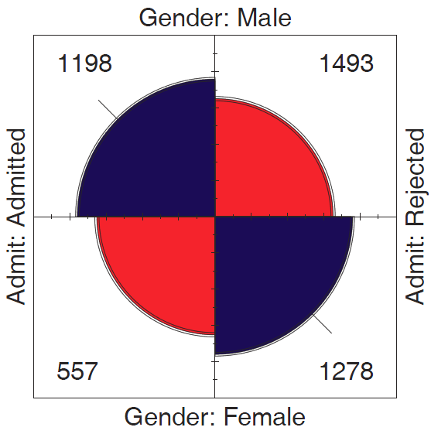
Questions:
How to analyze these results? What tests for odds ratio?
How to visualize & interpret?
Does it matter that we collapsed over Department?

Slide 8
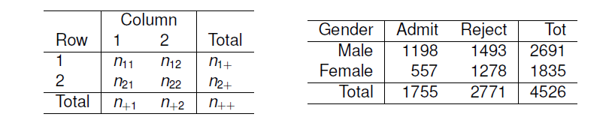
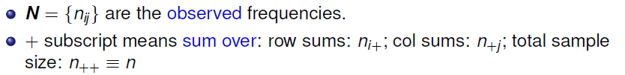
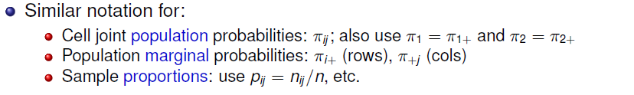
Table notation: n_{ij}, π_{ij}, p_{ij}

Slide 9
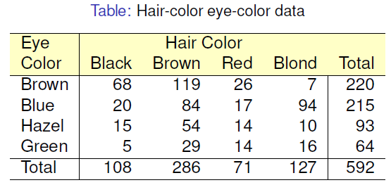
r × c Example: Hair color, eye color
Data from 592 students in a statistics class: write down your hair and eye color
Is there an association between hair color and eye color?
How to measure strength of association?
How to test for significance?
How to visualize?
How to understand the pattern (nature) of association?

Slide 10
HairEyeColor data
In R, the dataset is HairEyeColor, a 4 x 4 x 2 table: Hair x Eye x Sex.
For now, collapse over sex.
Margins to compute sums
> data(HairEyeColor)
> HEC <- margin.table(HairEyeColor, 2:1)
> chisq.test(HEC)
Pearson's Chi-squared test
data: HEC
X-squared = 138, df = 9, p-value <2e-16
Association can be tested by the standard Pearson χ² test. Details later
> MASS::loglm(~Hair + Eye, data=HEC)
Statistics:
X^2 df P(> X^2)
Likelihood Ratio 146 9 0
Pearson 138 9 0
Or, as a loglinear model for independence
Formula: ~ A + B = A ⊥ B
[] notation: [A][B]

Slide 11
Measures of association
vcd::assocstats() collects tests and measures in a convenient summary
> assocstats(HEC)
X^2 df P(> X^2)
Likelihood Ratio 146.44 9 0
Pearson 138.29 9 0
Phi-Coefficient : NA
Contingency Coeff.: 0.435
Cramer's V : 0.279
For 3+ way tables, it gives the results for the strata defined by all last dimensions
> assocstats(HairEyeColor)
$`Sex:Male`
X^2 df P(> X^2)
Likelihood Ratio 44.445 9 1.168e-06
Pearson 41.280 9 4.447e-06
Phi-Coefficient : NA
Contingency Coeff.: 0.359
Cramer's V : 0.222
$`Sex:Female`
X^2 df P(> X^2)
Likelihood Ratio 112.23 9 0
Pearson 106.66 9 0
Phi-Coefficient : NA
Contingency Coeff.: 0.504
Cramer's V : 0.337

Slide 12
Measures of association
2 × 2 tables
Odds ratio
Phi coefficient
Analog of correlation
ø² = % of variance
r × c tables
Cramer’s V – generalization of phi
Pearson contingency coef

Slide 13
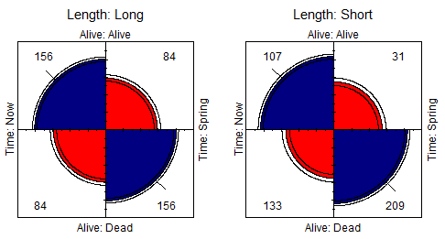
Example: Bartlett data
2 × 2 × 2 Data on plum root cuttings: Length (short|long), planted (Now|Spring), Survived? (Alive|Dead)
– Does survival depend on time of planting?
– Is there a 3-way association, i.e., does (Alive, Time) differ by Length? (θ₁ = θ₁ )
> assocstats(Bartlett)
$`Length:Long`
X^2 df P(> X^2)
Likelihood Ratio 43.87 1 3.50e-11
Pearson 43.20 1 4.94e-11
Phi-Coefficient : 0.3
Contingency Coeff.: 0.287
Cramer's V : 0.3
$`Length:Short`
X^2 df P(> X^2)
Likelihood Ratio 61.31 1 4.88e-15
Pearson 58.74 1 1.80e-14
Phi-Coefficient : 0.35
Contingency Coeff.: 0.33
Cramer's V : 0.35
oddsratio(Bartlett, log=FALSE)
odds ratios for Alive and Time by Length
Long Short
3.45 5.42
Notes:
In 1935, Maurice Bartlett presented the first paper on the topic of interactions in three-way tables.
His main example concerned an agricultural experiment on plum root cuttings …

Slide 14
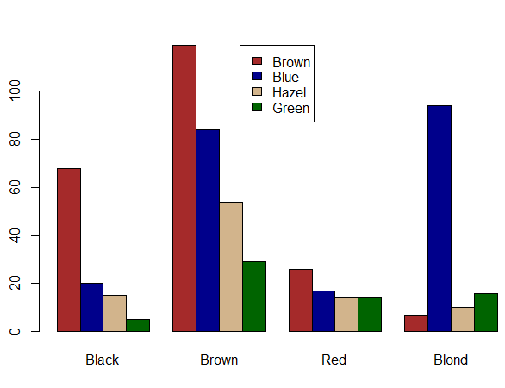
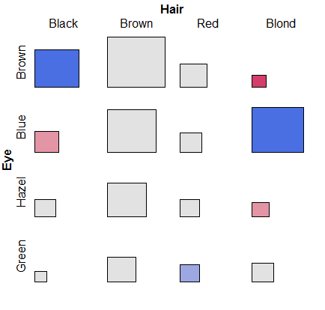
Simple plots for r × c tables
barplot(HEC, beside=TRUE, … )
tile(HEC, shade=TRUE)
But: harder to compare across hair-color groups than within them
Neither of these extend to more than 2 variables

Slide 15
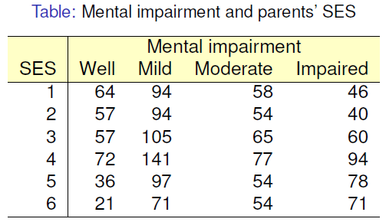
Ordered tables
r x c table with ordered categories: Mental health and Parents’ SES categories (1="High" and 6="Low“)
Mental impairment is the response, SES is a predictor
How to measure strength of association?
How to understand the pattern of association?
How to take ordinal nature of variables into account?

Slide 16
Mental data: Association
The data is contained in vcdExtra::Mental, a frequency data frame, with ordered factors
> data(Mental, package="vcdExtra")
> str(Mental)
'data.frame': 24 obs. of 3 variables:
$ ses : Ord.factor w/ 6 levels "1"<"2"<"3"<"4"<..: 1 1 1 1 2 2 2 2 3 ...
$ mental: Ord.factor w/ 4 levels "Well"<"Mild"<..: 1 2 3 4 1 2 3 4 1 2 ...
$ Freq : int 64 94 58 46 57 94 54 40 57 105 ...
Convert to a contingency table using xtabs(), and test association
> mental.tab <- xtabs(Freq ~ ses + mental, data=Mental)
> chisq.test(mental.tab)
Pearson's Chi-squared test
data: mental.tab
X-squared = 46, df = 15, p-value = 5e-05
This χ² test doesn’t take ordinality into account. It just tests for general association.

Slide 17
Mental data: Ordinal tests
For ordinal factors, more powerful (focused) tests are available with Cochran-Mantel-Haenszel tests in vcdExtra::CMHtest()
> CMHtest(mental.tab)
Cochran-Mantel-Haenszel Statistics for ses by mental
AltHypothesis Chisq Df Prob
cor Nonzero correlation 37.2 1 1.09e-09
rmeans Row mean scores differ 40.3 5 1.30e-07
cmeans Col mean scores differ 40.7 3 7.70e-09
general General association 46.0 15 5.40e-05
both ordinal
cols ordinal
rows ordinal
neither
χ2 / df shows why ordered tests are more powerful (when assoc ~ ordered)
> xx <- CMHtest(mental.tab)
> xx$table[,"Chisq"] / xx$table[,"Df"]
cor rmeans cmeans general
37.16 8.06 13.56 3.06
Think: fewer df → more focused; more powerful against a specific H₁

Slide 18
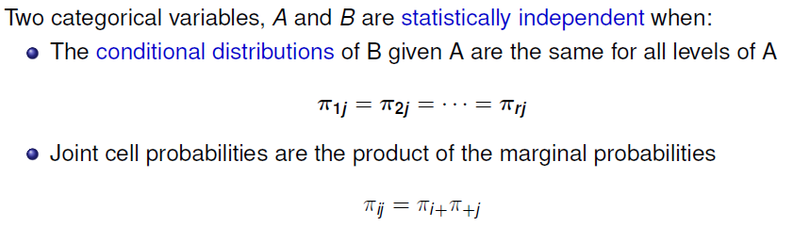
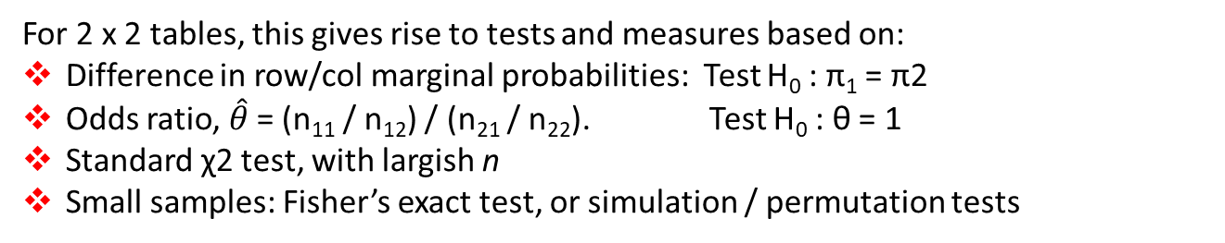
Independence
For 2 x 2 tables, this gives rise to tests and measures based on:
Difference in row/col marginal probabilities: Test H₀ : π₁ = π2
Odds ratio, $\hat{θ}$ = (n₁₁ / n₁₂) / (n₂₁ / n₂₂). Test H₀ : θ = 1
Standard χ2 test, with largish n
Small samples: Fisher’s exact test, or simulation / permutation tests

Slide 19
Independence: Example
A contrived example, where I generate cell frequencies as the product of row and column marginal totals: n_{ij} = n_{i+} x n_{+j}
> educ <- c(50, 100, 50) # marginal frequencies
> names(educ) <- c("Low", "Med", "High")
> party <- c(20, 50, 30) # marginal frequencies
> names(party) <- c("NDP", "Liberal", "Cons")
> table <- outer(educ, party) / sum(party) # cell = row * col / n
> names(dimnames(table)) <- c("Education", "Party")
> table
Party
Education NDP Liberal Cons
Low 10 25 15
Med 20 50 30
High 10 25 15
c
Outer product:
×
outer(r,c)
=
r

Slide 20
Independence: Example
The row proportions of party are the same for each educ group
The col proportions of educ are the same for each party
> prop.table(table, 1)
NDP Liberal Cons
Low 0.2 0.5 0.3
Med 0.2 0.5 0.3
High 0.2 0.5 0.3
> prop.table(table, 2)
NDP Liberal Cons
Low 0.25 0.25 0.25
Med 0.50 0.50 0.50
High 0.25 0.25 0.25
So, the X^2 is exactly zero, and measures of strength are zero
> vcd::assocstats(table)
X^2 df P(> X^2)
Likelihood Ratio 0 4 1
Pearson 0 4 1
Phi-Coefficient : NA
Contingency Coeff.: 0
Cramer's V : 0

Slide 21
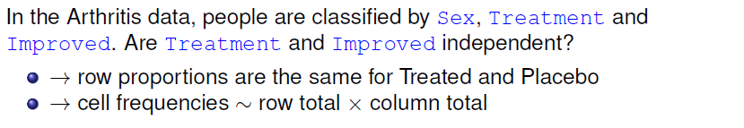
Independence?: Arthritis data
> data(Arthritis, package = "vcd")
> arth.tab <- xtabs(~ Treatment + Improved, data = Arthritis)
> round(prop.table(arth.tab, 1), 3 )
Improved
Treatment None Some Marked
Placebo 0.674 0.163 0.163
Treated 0.317 0.171 0.512
But, more people given the Placebo show no improvement; more people Treated show marked improvement

Slide 22
Independence?: Arthritis data
If Treatment and Improved were independent, frequencies ~ row x col margins
> row.totals <- margin.table(arth.tab, 1)
> col.totals <- margin.table(arth.tab, 2)
> round(outer(row.totals, col.totals)/ sum(arth.tab), 0)
Improved
Treatment None Some Marked
Placebo 22 7 14
Treated 20 7 14
These are the expected frequencies, under independence; but for the data:
> chisq.test(arth.tab)
Pearson's Chi-squared test
data: arth.tab
X-squared = 13.1, df = 2, p-value = 0.0015
Pearson χ²

Slide 23
Sampling models: Poisson, Binomial, Multinomial
Subtle distinctions arise concerning whether the row and/or margins are fixed by design or random
Poisson: each n_{ij} is regarded as an independent Poisson variate; nothing fixed
Binomial: each row (or col) is regarded as an independent binomial dist^{n}, with one fixed margin (group total), other random (response)
Multinomial: only the total sample size, n₊₊, is fixed; frequencies n_{ij} are classified by A and B
Makes a difference in how hypothesis tests are justified & explained
Happily, for most inferential methods, ≈ same results are obtained under the three sampling models
Q: what is an appropriate sampling model for the UCB admissions data? For hair-eye color? For the mental impairment data?
Notes:
A: for the UCB data, hair-eye color and mental impairment, no margins are fixed -> Poisson
But say we screened 600 males and 600 females, 100 in each department applying to UC Berkeley? -> both margins fixed; none of these apply

Slide 24
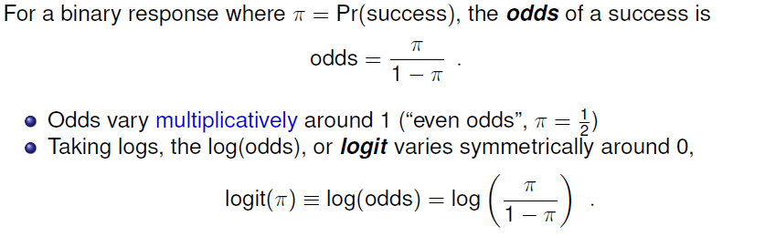
Odds and log(Odds)
> p <- c( 0.05, .1, .25, .50, .75, .9, .95)
> odds <- p / (1-p)
> logodds <- log(odds)
> (odds.df <- data.frame(p, odds, logodds))
p odds logodds
1 0.05 0.0526 -2.94
2 0.10 0.1111 -2.20
3 0.25 0.3333 -1.10
4 0.50 1.0000 0.00
5 0.75 3.0000 1.10
6 0.90 9.0000 2.20
7 0.95 19.0000 2.94

Slide 25
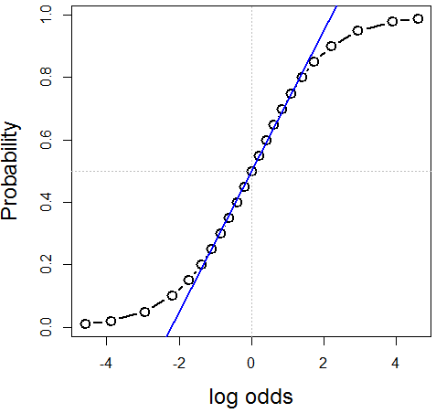
Log odds
plot(logodds, p, type='b', xlab="log odds", ylab="Probability", …)
abline(lm(p ~ logodds, subset=(p>=.2 & p<=.8)), col="blue")
Symmetric around π = ½ :
logit(π) = - logit(1- π)
Fairly linear in the middle,
0.2 ≤ π ≤ 0.8
The logit transformation of probability is the basis for logistic regression
(An alternative, the cumulative normal, Φ⁻¹(π), gives rise to probit regression)

Slide 26
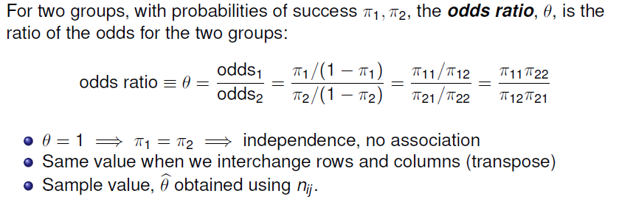
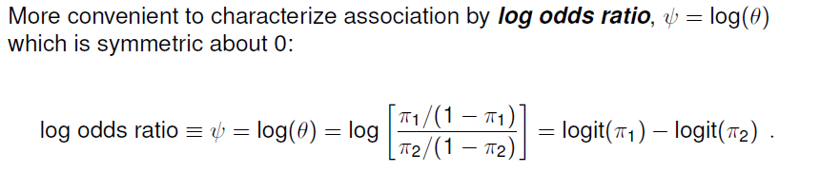
Odds ratio
Cross-product ratio
diff^{ce} in log odds

Slide 27
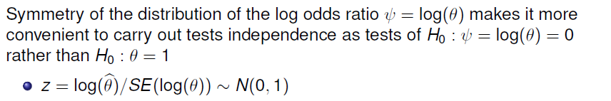
Odds ratio: Inference & hypothesis tests
vcd::oddsratio() has option, log=, TRUE by default
The summary() method calculates z tests
> summary(oddsratio(UCB))
z test of coefficients:
Estimate Std. Error z value Pr(>|z|)
Male:Female/Admitted:Rejected 0.6104 0.0639 9.55 <2e-16 ***
---
Signif. codes: 0 ‘***’ 0.001 ‘**’ 0.01 ‘*’ 0.05 ‘.’ 0.1 ‘ ’ 1

Slide 28
Odds ratio: Confidence intervals
Results should be reported with confidence intervals, either for the odds ratio, θ, or for ψ = log(θ)
> confint(oddsratio(UCB, log = FALSE))
2.5 % 97.5 %
Male:Female/Admitted:Rejected 1.624 2.087
> confint(oddsratio(UCB))
2.5 % 97.5 %
Male:Female/Admitted:Rejected 0.4851 0.7356
Summary in words:
For the Berkeley admissions data:
The Pearson χ² test of association between Gender and Admission was highly significant, χ₁² = 91.6, p < .0001
This corresponded to an odds ratio of admission for Males vs. Females of θ = 1.84 (CI: 1.62, 2.09), meaning that overall, males were 84% more likely to be admitted
On the scale of log odds, ψ = log(θ), the estimate was ψ = 0.610 (CI: 0.485, 0.736), meaning a significant positive association between Gender(Male) and admission.

Slide 29
Small sample size
Pearson χ² and LR G² tests are valid when most expected frequencies > 5
Otherwise, use Fisher’s exact test or simulated p-values
Example: Cholesterol diet and heart disease
> fat <- matrix(c(6, 2,
4, 11), nrow=2, ncol=2)
> dimnames(fat) <- list(cholesterol=c("low", "high"),
disease=c("no", "yes"))
> fat
disease
cholesterol no yes
low 6 4
high 2 11
Does your diet make a diff^{ce}?

Slide 30
Small sample size
The standard Pearson χ² test is not significant
For 2 x 2 tables with small n, a correction |O – E | - ½ is standardly applied (Yates)
> chisq.test(fat)
Pearson's Chi-squared test with Yates' continuity correction
data: fat
X-squared = 3.19, df = 1, p-value = 0.074
And, we get a warning. Maybe this is Friendly’s ☹ ?
Warning message:
In chisq.test(fat) : Chi-squared approximation may be incorrect
Q: What does that warning mean???

Slide 31
Small sample size: Simulation
A Monte-Carlo method uses simulation to calculate a p-value, Friendly’s ☺
> chisq.test(fat, simulate=TRUE)
Pearson's Chi-squared test with simulated p-value (based on 2000 replicates)
data: fat
X-squared = 4.96, df = NA, p-value = 0.04
This method repeatedly samples cell frequencies from tables with the same
margins, and calculates a χ² for each.
The p-value compares the observed X² to its’ distribution in the simulations.
The χ² test is now significant; well, barely, but ☺
The main point is that the test no longer depends on large sample theory ☺ ☺
Simulation is a general principle for testing hypotheses ☺ ☺ ☺

Slide 32
Small sample size: Fisher exact test
Fisher’s exact test: calculates probability for all 2 × 2 tables with odds ratio as or more
extreme than that in the data, keeping the margins fixed.
> fisher.test(fat)
Fisher's Exact Test for Count Data
data: fat
p-value = 0.039
alternative hypothesis: true odds ratio is not equal to 1
95 percent confidence interval:
0.86774 105.56694
sample estimates:
odds ratio
7.4019
The p-value is similar to that obtained using simulation.
Fisher’s test is available for larger r × c tables, but the method gets computationally intensive as r * c increases

Slide 33
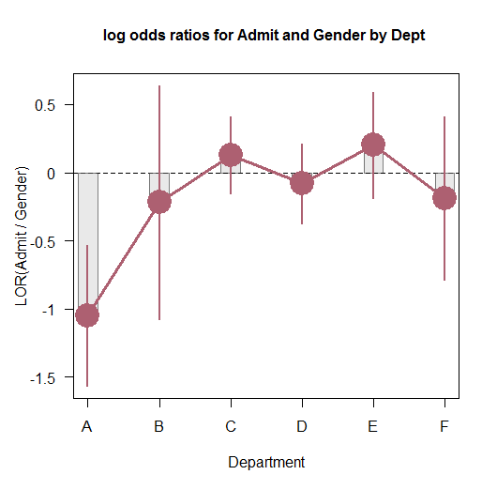
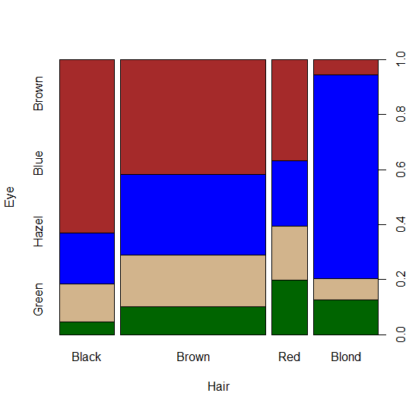
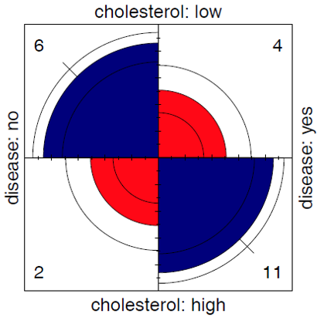
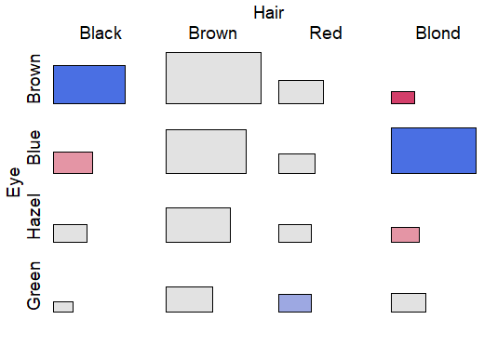
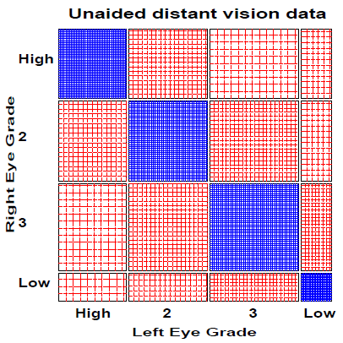
Visualizing association

Slide 34
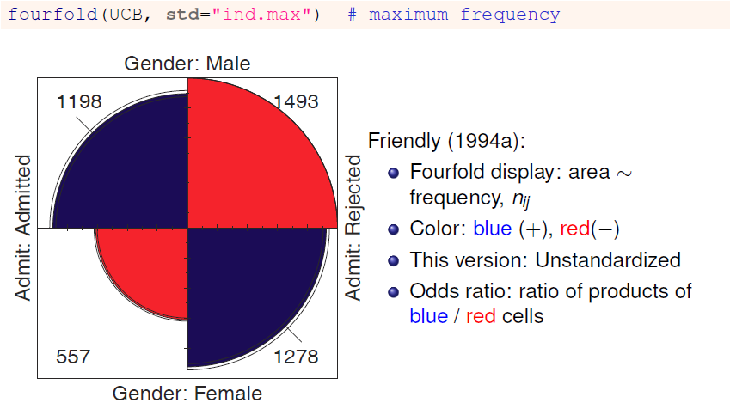
Visualizing: fourfold plots

Slide 35
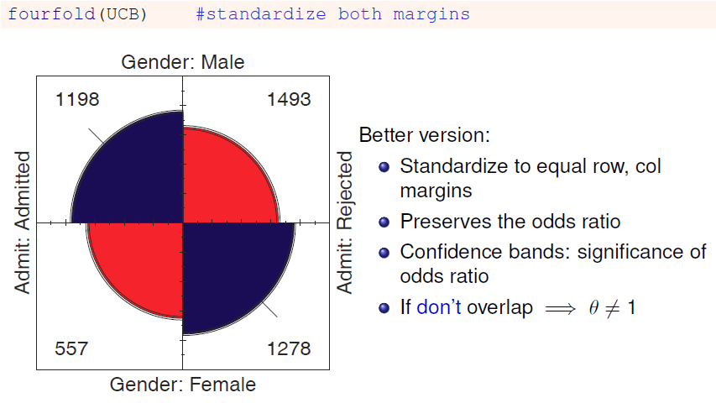
Visualizing: fourfold plots

Slide 36
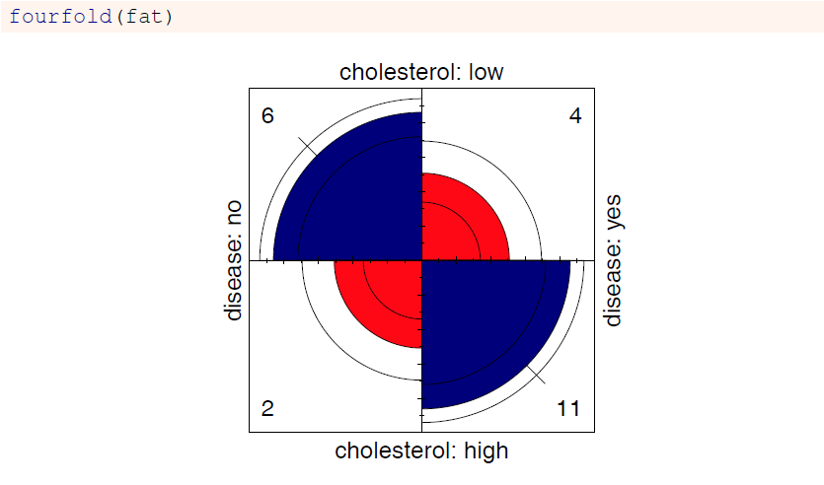
Cholesterol data

Slide 37
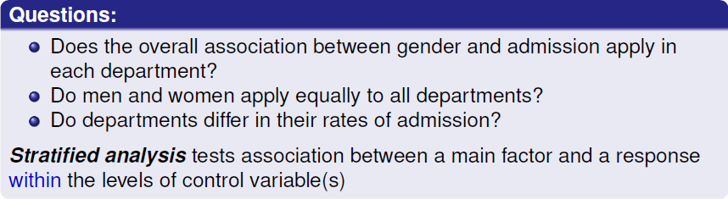
Stratified tables: 2 × 2 × k
The UC Berkeley data was obtained from 6 graduate departments
> ftable(addmargins(UCBAdmissions, 3))
Dept A B C D E F Sum
Admit Gender
Admitted Male 512 353 120 138 53 22 1198
Female 89 17 202 131 94 24 557
Rejected Male 313 207 205 279 138 351 1493
Female 19 8 391 244 299 317 1278

Slide 38
Odds ratios by department
> summary(oddsratio(UCBAdmissions))
z test of coefficients:
Estimate Std. Error z value Pr(>|z|)
A -1.052 0.263 -4.00 6.2e-05 ***
B -0.220 0.438 -0.50 0.62
C 0.125 0.144 0.87 0.39
D -0.082 0.150 -0.55 0.59
E 0.200 0.200 1.00 0.32
F -0.189 0.305 -0.62 0.54
---
Signif. codes: 0 ‘***’ 0.001 ‘**’ 0.01 ‘*’ 0.05 ‘.’ 0.1 ‘ ’ 1
Odds ratio only significant, log(θ) ≠ 0, for department A
For dept. A, men are only exp(-1.05) = .35 times as likely to be admitted as women
The overall analysis (ignoring department) is misleading: falsely assumes no association of {admission, department} and {gender, department}

Slide 39
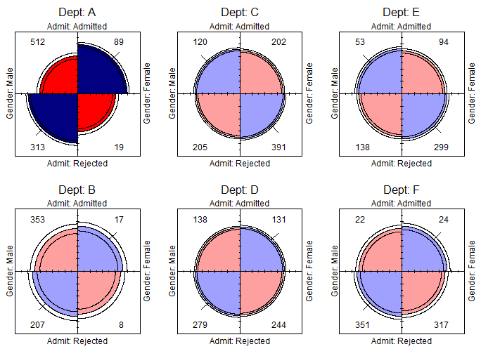
Stratified fourfold plots
Fourfold plots by department (intense shading where significant)
> fourfold(UCBAdmissions)

Slide 40
Log odds ratio plot
Plot the log odds ratios with confidence limits
> plot(oddsratio(UCBAdmissions), cex=2, xlab="Department")
Q: what do you understand from these plots?
Is there evidence that some depts. show diff admission by gender?

Slide 41
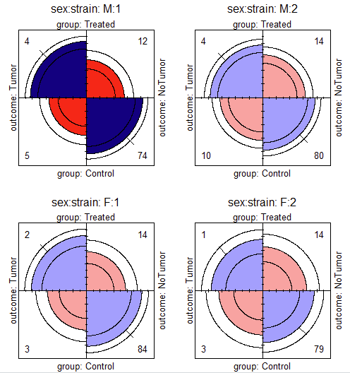
Fungicide data: 2 x 2 x 2 x 2
Does a fungicide affect tumors in mice?
data(Fungicide, package = "vcdExtra")
# rearrange `group` for ease of interpretation
Fungicide <- Fungicide[2:1, , , ]
ftable(sex + strain ~ outcome + group, data=Fungicide)
sex M F
strain 1 2 1 2
group outcome
Treated Tumor 4 4 2 1
NoTumor 12 14 14 14
Control Tumor 5 10 3 3
NoTumor 74 80 84 79
> oddsratio(Fungicide) |> summary()
z test of coefficients:
Estimate Std. Error z value Pr(>|z|)
M:1 1.59601 0.73949 2.1583 0.03091 *
F:1 1.38629 0.95743 1.4479 0.14763
M:2 0.82668 0.65873 1.2550 0.20950
F:2 0.63178 1.19055 0.5307 0.59566
---
Signif. codes: 0 ‘***’ 0.001 ‘**’ 0.01 ‘*’ 0.05 ‘.’ 0.1 ‘ ’ 1

Slide 42
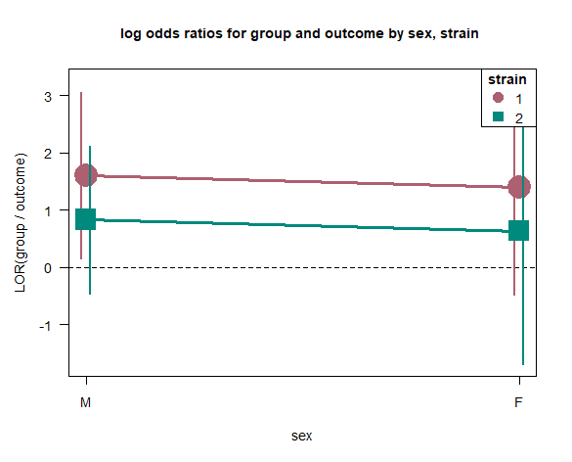
Fungicide: LOR plot
oddsratio(Fungicide) |> plot(cex=2)
Plotting the log odds ratios for 2x2xRxC table gives line graphs of the log θ for other factors
Cis show which are ≠ 0
Lines show overall pattern
Q: How would you summarise the relations here verbally?

Slide 43
Stratified tables: Homogeneity of association
Questions:
Are the k odds ratios all equal, θ₁ = θ₂ = … = θ_{k} ?
Woolf’s test: vcd::woolftest()
This is the same as the hypothesis of no three-way association
If homogeneous, is the common odds ratio different from 1?
Mantel-Haenszel test: stats::mantelhaen.test()
> woolf_test(UCBAdmissions)
Woolf-test on Homogeneity of Odds Ratios (no 3-Way assoc.)
data: UCBAdmissions
X-squared = 17.9, df = 5, p-value = 0.0031
The odds ratios differ across departments, so no sense testing their common value

Slide 44



Woolf’s test: details
Testing H₀: θ₁ = θ₂ = … = θ_{k} (all odds ratios =)
Woolf test: χ² weighted sum of squared diff^{ces} of ln(θ_{i}) around common weighted average,
Weights: inverse variance of log odds ratios, $ln\left\{θ_{i}\right\}$
$${∼χ}_{k−1}^{2}$$
CDA thinking: what does this remind me of?
Isn’t this like a one-way ANOVA, of k group means?
How can I extend this to 2×2 × R × C table?
⟶ test diffs across Rows, Cols!

Slide 45


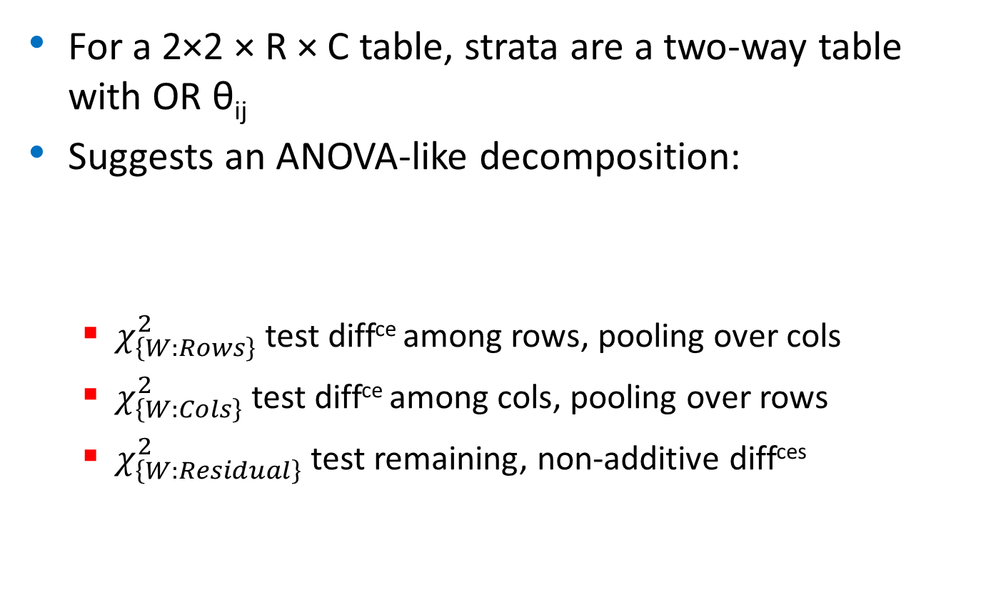
Extended Woolf’s test
For a 2×2 × R × C table, strata are a two-way table with OR θ_{ij}
Suggests an ANOVA-like decomposition:
$χ_{\left\{W:Rows\right\}}^{2}$ test diff^{ce} among rows, pooling over cols
$χ_{\left\{W:Cols\right\}}^{2}$ test diff^{ce} among cols, pooling over rows
$χ_{\left\{W:Residual\right\}}^{2}$ test remaining, non-additive diff^{ces}
BREAKING: This is a novel idea I had & implemented over the holidays.
What should I do to establish this in the CDA literature? Project???

Slide 46
Extended Woolf’s test: Fungicide
The dev version, vcdExtra::woolf_test() implements this for 4-way tables
> # Default: 4-way table without decomposition
> data(Fungicide, package = "vcdExtra")
> woolf_test(Fungicide)
Woolf-test on Homogeneity of Odds Ratios (no 4-way association)
Data: Fungicide
OR variables: group, outcome
Strata: sex, strain
X-squared = 0.8548, df = 3, p-value = 0.8363

Slide 47
Extended Woolf’s test: Fungicide
The dev version, vcdExtra::woolf_test() implements this for 4-way tables
> woolf_test(Fungicide, decompose = TRUE)
Woolf-test on Homogeneity of Odds Ratios (no 4-way association)
Data: Fungicide
OR variables: group, outcome
Strata: sex, strain
Overall homogeneity test:
X-squared = 0.8548, df = 3, p-value = 0.8363
Decomposition:
Rows (sex): X-squared = 0.0086, df = 1, p-value = 0.9261
Cols (strain): X-squared = 0.8257, df = 1, p-value = 0.3635
Residual: X-squared = 0.0205, df = 1, p-value = 0.8861
Note: Overall = Rows + Columns + Residual
NB: compare this with the plot on slide 42

Slide 48

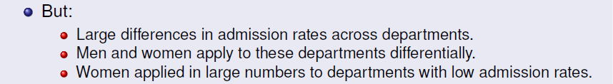
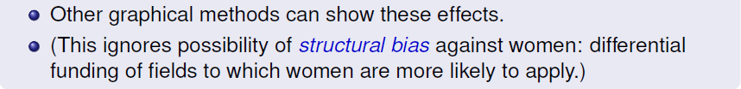
What happened at UC Berkeley?
Why do results collapsed over department disagree with the results by department?

Slide 49
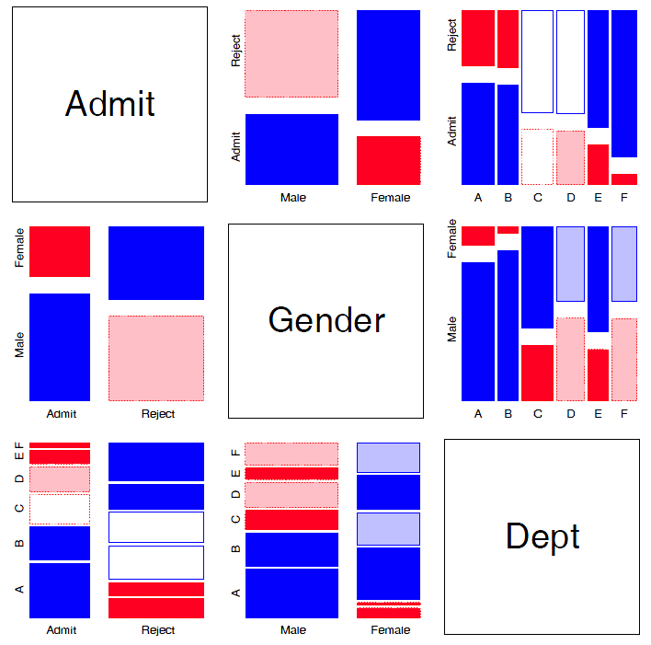
Mosaic matrices
Scatterplot matrix analog for categorical data
All pairwise views
Small multiples → comparison
The answer: Simpson’s Paradox
Depts A, B were easiest
Applicants to A, B mostly male
∴Males more likely to be admitted overall

Slide 50
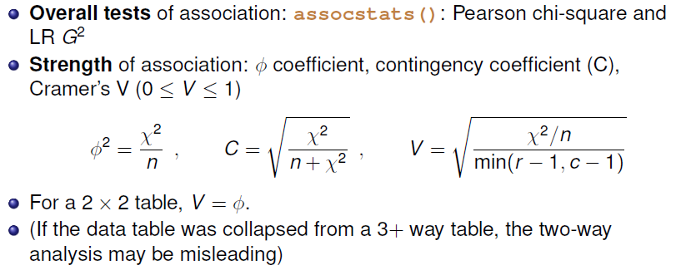
r × c tables: Overall analysis
> assocstats(HEC)
X^2 df P(> X^2)
Likelihood Ratio 146.44 9 0
Pearson 138.29 9 0
Phi-Coefficient : NA
Contingency Coeff.: 0.435
Cramer's V : 0.279

Slide 51
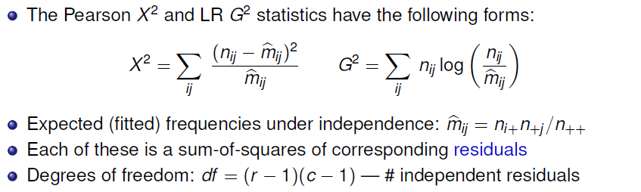
r × c tables: Overall analysis
Residuals, fitted values, test statistics returned by MASS::loglm()
> (mod <- MASS::loglm(~ Hair + Eye, data=HEC, fitted = TRUE))
Call:
MASS::loglm(formula = ~Hair + Eye, data = HEC, fitted = TRUE)
Statistics:
X^2 df P(> X^2)
Likelihood Ratio 146.44 9 0
Pearson 138.29 9 0

Slide 52
Residuals and fitted values are obtained with “extractor” methods
> res.P <- residuals(mod,
type="pearson")
> res.LR <- residuals(mod,
type="deviance")
> res.P
Hair
Eye Black Brown Red Blond
Brown 4.398 1.233 -0.075 -5.851
Blue -3.069 -1.949 -1.730 7.050
Hazel -0.477 1.353 0.852 -2.228
Green -1.954 -0.345 2.283 0.613
> fitted(mod)
Hair
Eye Black Brown Red Blond
Brown 40.1 106.3 26.39 47.2
Blue 39.2 103.9 25.79 46.1
Hazel 17.0 44.9 11.15 20.0
Green 11.7 30.9 7.68 13.7
loglm() returns an object (mod) of class “loglm”
Method functions, *.loglm(), include: residuals(), fitted(), anova(), summary() & various plot methods
Direct calculation of Pearson & LR χ²
> sum(res.P^2) # Pearson chisq
[1] 138.29
> sum(res.LR^2) # LR chisq
[1] 146.44

Slide 53
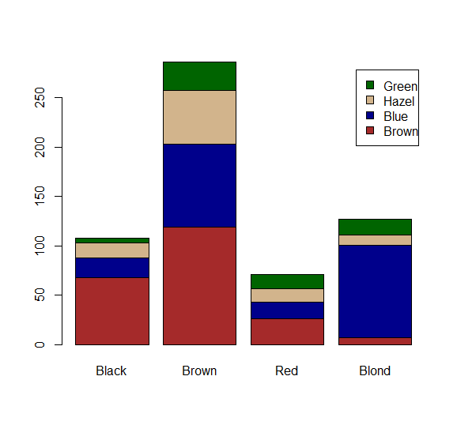
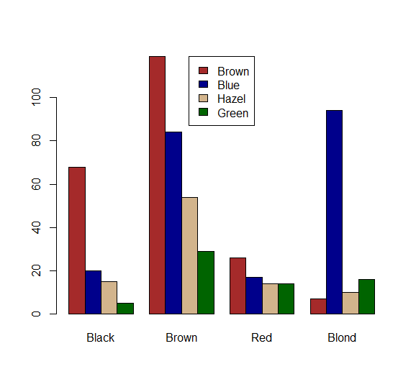
Plots for two-way tables
Barplots are easy, but not often very useful. Why?
col <- c("brown", "darkblue", "tan",
"darkgreen")
barplot(HEC, col = col, legend=TRUE)
barplot(HEC, col = col,
beside=TRUE, legend=TRUE, …)

Slide 54
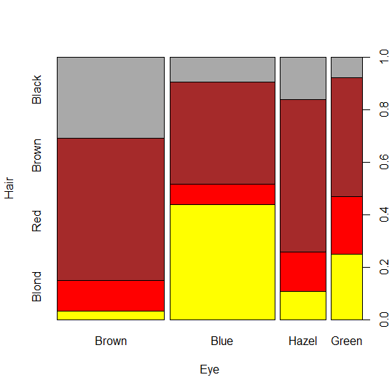
Spine plots
Spine plots show the marginal proportions of one variable, and the conditional proportions of the other.
Independence: cells align
col <- c("darkgrey", "brown", "red",
"yellow")
spineplot(HEC, col=rev(col))
col <- c("brown", "blue", "tan",
"darkgreen")
spineplot(t(HEC), col=rev(col))

Slide 55
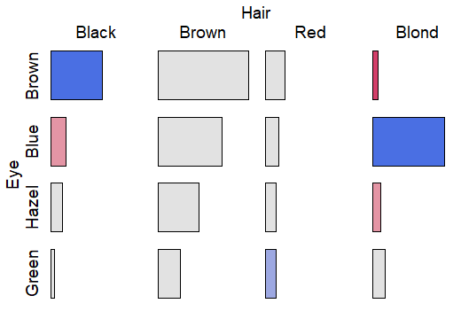
Tile plots
Tile plots show a matrix of rectangular tiles, area ~ frequency.
They can be scaled to facilitate different types of comparisons: cells, rows, cols
They can be shaded to show the sign & magnitude of residuals from independence
tile(HEC, shade=TRUE, legend=FALSE)
tile(HEC, tile_type=“width”, …)

Slide 56
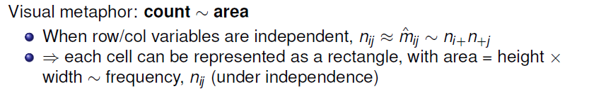
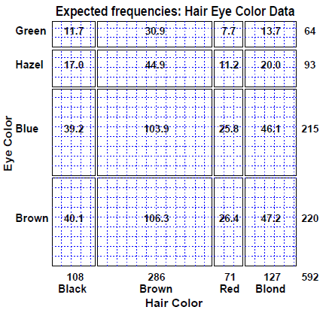
Sieve diagrams
This display shows expected frequencies, m_{ij}, as # boxes within each cell
Under independence, boxes all of the same size & equal density
Real sieve diagrams use # boxes = observed frequencies, n_{ij}

Slide 57


Sieve diagrams
The rectangles have area ~ expected frequency
# boxes = observed frequency
n_{ij} > m_{ij} → greater density
n_{ij} < m_{ij} → less density

Slide 58

Sieve diagrams: Effect ordering
Permuting the rows / cols to make the pattern more coherent
Here, I reordered the eye colors according to lightness
The opposite-corner pattern suggests an explanation for the association

Slide 59
Sieve diagrams: Subtle patterns
Vision classification of 7477 women in Royal Ordnance factories: visual acuity grade in left & right eyes
The obvious association is apparent in the diagonal cells
A more subtle pattern appears in the off-diagonal cells
Analysis methods for square tables allow testing hypotheses beyond independence
Symmetry
Quasi-symmetry, …

Slide 60


Visual metaphor: Area ~ frequency
Urn Model: Multinomial Sampling
Observations sorted into urns by hair color. Provides a basis for bar chart, but does not yield any further insights.
Pressure model
Freq ~ pressure of gas in a chamber
Pressure shown as: Observation density
Energy to compress ~ -log likelihood
Friendly, M. (1995). Conceptual and Visual Models for Categorical Data. The American Statistician, 49, 153–160

Slide 61


Visual metaphor: One-way tables
Observed freq: Unconstrained
Forces balance
df = number of movable partitions
Test hypothesis: Equal probs
G²: energy required to move partitions to constrain the data

Slide 62


Visual metaphor: Two-way tables
Saturated model: fits perfectly
Density is equal in all the cells
Test hypothesis of independence
Force cell freq ~ product of marginals
Deviations shown by density
G²: measures energy required

Slide 63
Ordinal factors
The standard Pearson χ² and LR G² give tests of general association, with (r-1) × (c-1) df
More powerful CMH tests:
When either row or col levels are ordered, more specific CMH (Cochran–Mantel–Haentszel) tests which take order into account have greater power to detect ordered relations.
Use fewer df, so ordinal tests are more focused on detecting a particular “signal”
This is similar to testing for linear trends in ANOVA
Essentially, these assign scores to the categories & test for differences in row / col means, or non-zero correlation

Slide 64



CMH tests for ordinal factors
Three types of CMH tests:

Slide 65

Sample CMH profiles

Slide 66

Sample CMH profiles

Slide 67

Visualizing the association
The association here is U-shaped
Only general association detects this
Higher levels of A are associated with lower levels of B

Slide 68
Example: Mental health data
For the mental health data, both ses and mental are ordinal
All tests are significant, but the nonzero correlation test, with 1 df has the smallest p-value & largest χ2 / df
> CMHtest(mental.tab)
Cochran-Mantel-Haenszel Statistics for ses by mental
AltHypothesis Chisq Df Prob
cor Nonzero correlation 37.2 1 1.09e-09
rmeans Row mean scores differ 40.3 5 1.30e-07
cmeans Col mean scores differ 40.7 3 7.70e-09
general General association 46.0 15 5.40e-05
both ordinal
cols ordinal
rows ordinal
neither
χ2 / df shows why ordered tests are more powerful
> xx <- CMHtest(mental.tab)
> xx$table[,"Chisq"] / xx$table[,"Df"]
cor rmeans cmeans general
37.16 8.06 13.56 3.06

Slide 69


Observer agreement

Slide 70


Cohen’s κ

Slide 71

Example: Cohen’s κ
Q: What would perfect agreement look like?

Slide 72
Example: Cohen’s κ
vcd::Kappa() calculates unweighted and weighted κ, using equal-spacing weights by default
> data(SexualFun, package="vcd")
> Kappa(SexualFun)
value ASE z Pr(>|z|)
Unweighted 0.129 0.0686 1.89 0.05939
Weighted 0.237 0.0783 3.03 0.00244
✗
✓
> Kappa(SexualFun, weights = "Fleiss-Cohen")
value ASE z Pr(>|z|)
Unweighted 0.129 0.0686 1.89 0.059387
Weighted 0.332 0.0973 3.41 0.000643
✗
✓
Unweighted κ is not significant, but both weighted versions are
You can obtain confidence intervals with the confint() method

Slide 73


Observer agreement: Multiple strata
Q: To what extent to the neurologists agree?
Q: Do they agree equally for the patients for the two cities

Slide 74

Observer agreement: Multiple strata
Winnipeg patients
New Orleans patients
Somewhat larger agreement for the New Orleans patients
The irr package (inter-rater-reliability) provides ICC and other measures; also handles the case of k > 2 raters

Slide 75

Bangdiwala’s Observer agreement chart
The observer agreement chart (Bangdiawala, 1987) provides:
A simple graphic representation of the strength of agreement
A measure of strength of agreement with an intuitive interpretation
B = 0.146
B^{w} = 0.498

Slide 76


Bangdiwala’s Observer agreement chart
observed: n_{ii} x n_{ii}
maximum: n_{i+} x n_{+i}

Slide 77

Weighted agreement chart: Partial agreement

Slide 78

The smallest exact agreement occurs for “very often”, but husbands & wives agree more on this allowing ± 1 step disagreement

Slide 79

Marginal homogeneity & observer bias

Slide 80

Looking ahead: Correspondence analysis
Like PCA for categorical data
Account for max % of χ² in few (2-3) dimensions
Finds scores for row and col categories
Plot of row/col scores shows associations
Dim 1: dark to light
Dim 2: something about red hair, green eyes?

Slide 81

Looking ahead: Correspondence analysis
Multiple correspondence analysis extends this to 3+ way tables
Analyses all two-way associations together
Category points: nearness indicates positive associations
UCBadmissions data
Dim 1: Admission
Dim 2: ??? (only 4%)
The relations of Dept to Gender and Admit are easy to interpret

Slide 82
Looking ahead: Models
Loglinear models [loglm()]
Generalize the Pearson χ² and LR G² tests of association to 3-way and larger tables.
Allows a range of models from mutual independence ([A] [B] [C]) to the saturated model ([ABC])
Intermediate models address questions of conditional independence, controlling for some factors
Can test associations in 2-way, 3-way, … terms, analogously to tests of interactions in ANOVA
Generalized linear models [glm()]
Similar to ordinary lm(), but w/ Poisson dist^{n} of counts: family=“poisson”
Formula notation: Freq ~ A + B + C; Freq ~ (A + B + C)^2
Familiar diagnostic methods & plots (outliers, influence)

Slide 83
Looking ahead: Models
Example: UC Berkeley data
Mutual independence: [Admit][Gender][Dept] = ~ A + G + D
Joint independence: [Admit][Gender Dept] = ~ A + G * D
Conditional independence: [D Admit][D Gender] = ~ D * (A + G)
Specific test of absence of gender bias, controlling for department
No three-way association: [A G][A D][G D] = ~ (A + D + G)²
library(MASS)
loglm(~ Admit + Dept + Gender, data=UCBAdmissions) # mutual independence
loglm(~ Admit + Dept * Gender, data=UCBAdmissions) # joint independence
loglm(~ Dept * (Admit + Gender), data=UCBAdmissions) # conditional independence
loglm(~ (Admit + Gender + Dept )^2, data=UCBAdmissions) # all two-way, no three-way
Bracket notation:
terms in the same bracket are allowed to be associated [A G] ≡ A * G
terms in separate brackets are asserted to be independent [A] [G] ≡ A + G

Slide 84

Looking ahead: Mosaic plots
Mosaic plots provide visualizations of associations in 2+ way tables
Tiles ~ frequency; conditioned by A, then B, then C, …
Fit: any loglinear model [A][B][C], [AB][C], [AB][AC], …, [ABC]
Shading: ~ residuals, contributions to χ²
Show: associations not accounted for by model

Slide 85
Summary
Two-way tables summarize frequencies of two categorical factors
2 × 2: a special case, with odds ratio as a measure
r × c: factors can be unordered or ordered
r × c × k: stratified tables, r × c with k groups or circumstances
Tests & measures of association
Pearson χ², LR G²: general association
More powerful CMH tests for ordered factors
Visualization
2 × 2: fourfold plots
r × c: sieve diagrams, tile plots, …
More graphical methods to come …

