Slide 1
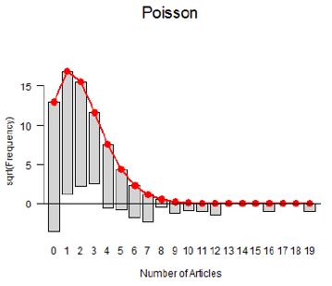
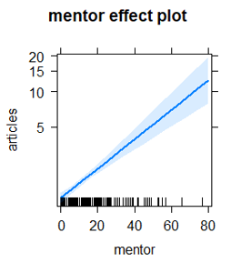
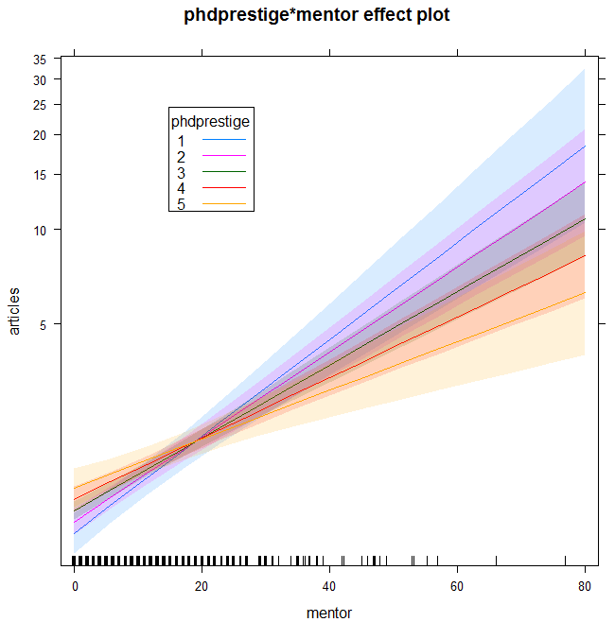

GLMs for Count Data
Michael Friendly
Psych 6136
http://friendly.github.io/psy6136

Slide 2
Topics
Generalized linear models
GLMs for count data
Example: PhD publications
Model diagnostics
Interactions
Nonlinearity
Outliers, leverage & influence
Overdispersion
Quasi-poisson models
Negative binomial models
Excess zeros
Zero-inflated models
Hurdle models

Slide 3



Count data models: Overview
Count data models arise when the basic observation is a frequency, y = 0, 1, 2, … of some event and we have some predictors, x₁, x₂, … to help explain them.
Typically, these counts ~ Poisson() → “poisson regression”
Examples:
Number of articles published by PhD candidates
Predictors: Married?, Female?, Kids < 5?, pubs by mentor
Number of parasites in blood samples of Norwegian cod
Predictors: Catch area, Year, length of fish
Female horseshoe crabs: Number of “satellite” males
Predictors: Female weight, color, spine condition, shell width
Special circumstances
Overdispersion: when the variance > mean
Zero-counts: When excess 0 counts require an extra model

Slide 4
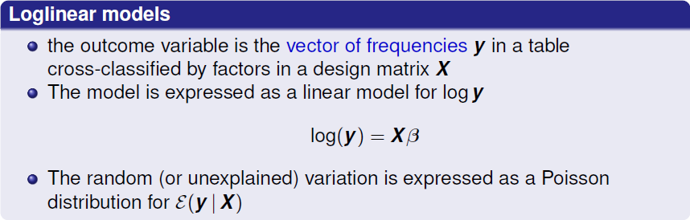
Generalized linear models
We have used generalized linear models fit with glm() in two contexts so far
Hmm. Isn’t the problem with frequency data just that of non-constant variance?
Questions:
Why not just transform y -> log(y) and use standard OLS regression?
Why should I bother with Poisson anyway? He wasn’t even NORMAL !

Slide 5
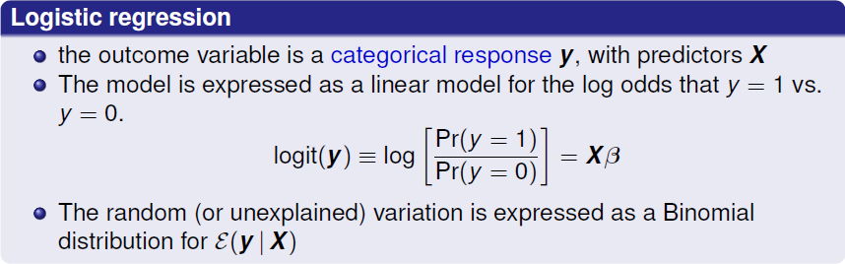

Generalized linear models

Slide 6
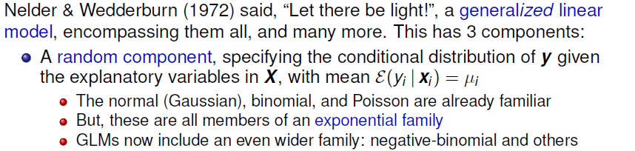
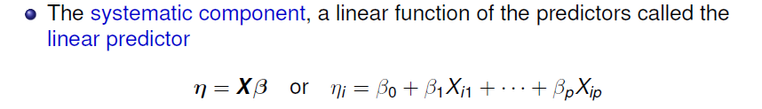
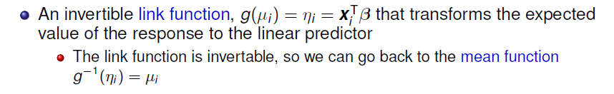
Generalized linear models

Slide 7
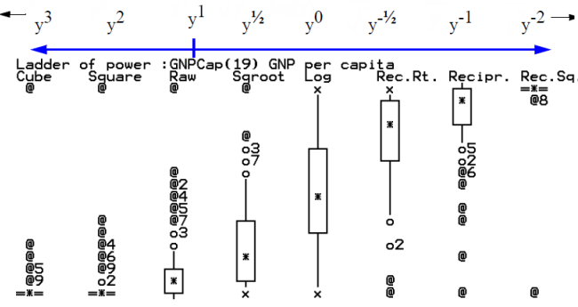
GLMs: The light
No need to consider all those special cases to transform y for homogeneity of variance
EDA approach: ladder of powers, transform to symmetry
Image from: http://www.unige.ch/ses/sococ/cl//stat/eda/ladder.html

Slide 8

GLMs: Families
Papa normal
All GLMs are members of a happy family
They have different technical names, but all share common DNA – The Exponential Family includes direct descendants, uncles, cousins, …
They all have a linear predictor,
η = g(μ) = X β
They differ in their links: how to transform from μ → g(μ) = η
They can get back to their roots with an inverse transformation,
g⁻¹(η) = μ
Ms. Poisson
Daughter Binomial
Cousin Log-normal
Aunt NegBin
Uncle Gamma
Inverse Gaussian
Pet GAM
Base image from: https://portalacademico.cch.unam.mx/ingles1/people-i-love/family-members

Slide 9
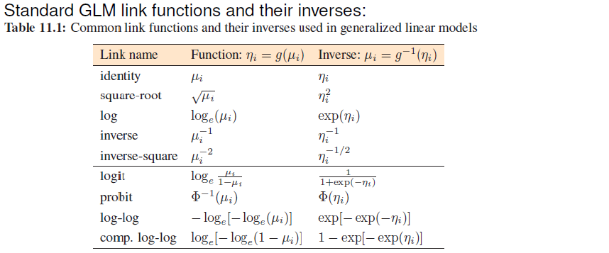
Link functions for the mean
The link function must be invertible
e.g., |μ| is not
The top section recognizes standard transformations of y_{i} often used with classical linear models
The bottom section is for binomial data, where y_{i} represents an observed count in n_{i} trials

Slide 10
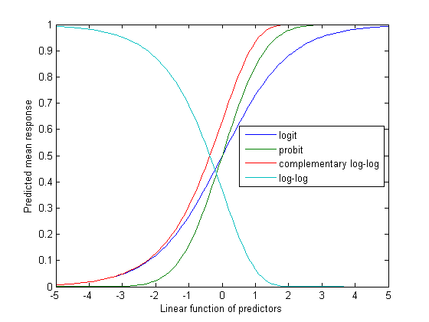
Link functions for binomial data
For binomial data, the logit, probit and c-log-log all have similar shapes
These take a linear predictor on (-∞, +∞)
to the range (0,1) for probability
The logit is most widely used because of its’ simple interpretation as log odds

Slide 11
Example: BeetleMortality
Mortality of adult flour beetle after five hours' exposure to gaseous carbon disulphide.
> data("BeetleMortality",
package = "glmx")
> BeetleMortality
dose died n
1 1.6907 6 59
2 1.7242 13 60
3 1.7552 18 62
4 1.7842 28 56
5 1.8113 52 63
6 1.8369 53 59
7 1.8610 61 62
8 1.8839 60 60
The ‘lapply()’ trick: Apply a function w/ parameters → a list of fitted models
links <- c("logit", "probit", "cloglog")
m <- lapply(links, function(type)
glm(cbind(died, n - died) ~ dose,
data = BeetleMortality,
family = binomial(link = type)))
names(m) <- links
Then, sapply() LRStats to each model:
> t(sapply(m, vcdExtra::LRstats))
AIC BIC LR Chisq Df Pr(>Chisq)
logit 41.4 41.6 11.2 6 0.0815
probit 40.3 40.5 10.1 6 0.12
cloglog 33.6 33.8 3.45 6 0.751
In this example, the cloglog link
fits best

Slide 12
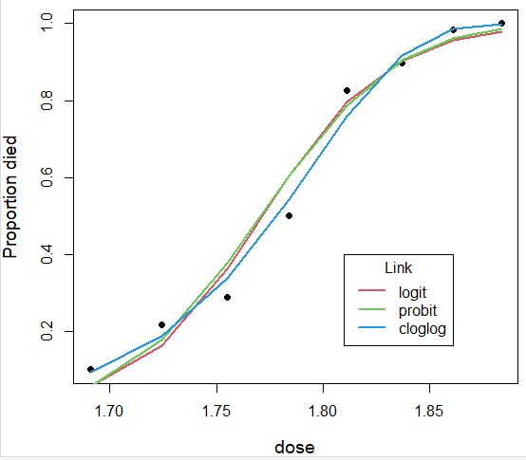
Visualize model fits
plot(I(died/n) ~ dose, data = BeetleMortality,
ylab = "Proportion died", cex.lab = 1.2, pch = 16)
lines(fitted(m[[1]]) ~ dose, data = BeetleMortality, col = 2, lwd = 2)
lines(fitted(m[[2]]) ~ dose, data = BeetleMortality, col = 3, lwd = 2)
lines(fitted(m[[3]]) ~ dose, data = BeetleMortality, col = 4, lwd = 2)
legend(1.81, 0.4,
title = "Link", legend = links,
col = 2:4, lty = 1, lwd=2)
Plot data points
Add fitted lines
We can sort of see why the cloglog link fits best.
But the coefficients in the model do not have as clear an interpretation as log odds in the logit model.
> t(sapply(m, coef))
(Intercept) dose
logit -60.7 34.3
probit -34.9 19.7
cloglog -39.6 22.0

Slide 13
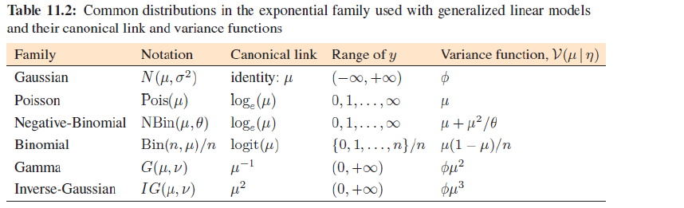
Canonical links and variance functions
For every distribution family, there is a default, canonical link function
Each one also specifies the expected relation between the mean and variance
Choose a basic family:
Get a default, canonical link, g(μ)
Also get a variance function for free!

Slide 14
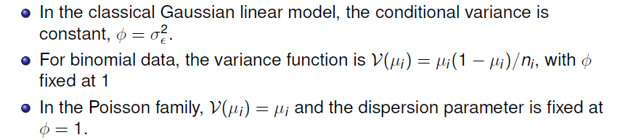
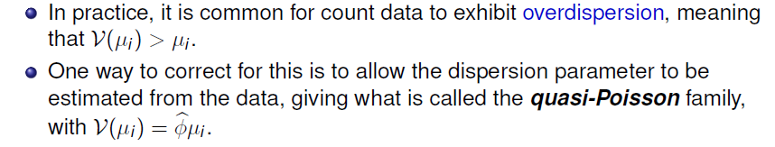
Variance functions & overdispersion

Slide 15
What is overdispersion?
Overdispersion often results from failures of assumptions of the model
Supposedly independent observations may be correlated
The probability of an event may not be constant, or
It may vary with unmeasured or unmodeled variables
Don’t fear overdispersion – embrace it
For Poisson (freq) data, parameter estimates are unchanged; it affects only the std. errors (& z-tests)
It tells you something interesting about your data or analysis
Can lead to better understanding of your model: What did I leave out?

Slide 16


Maximum likelihood estimation
GLMs are fit by the method of maximum likelihood
Likelihood (L) = Pr (data | model), as function of model parameters
For the Poisson distribution with mean μ, the probability that the random variable Y takes the values y = 0, 1, 2, … is
In the GLM with a log link, the mean, μ, depends on the predictors through

Slide 17

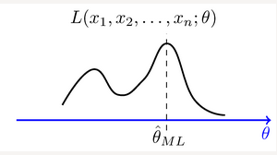
Maximum likelihood estimation
The log-likelihood function is the probability of the data as a function of the parameters, β. It has the form (for Poisson)
Then, find the values of β the maximize log L
Why log L
Easier to work with
Has the same max value
;β)
Unlike OLS, where there is an exact solution, MLEs are found by iteratively reweighted least squares.
β

Slide 18
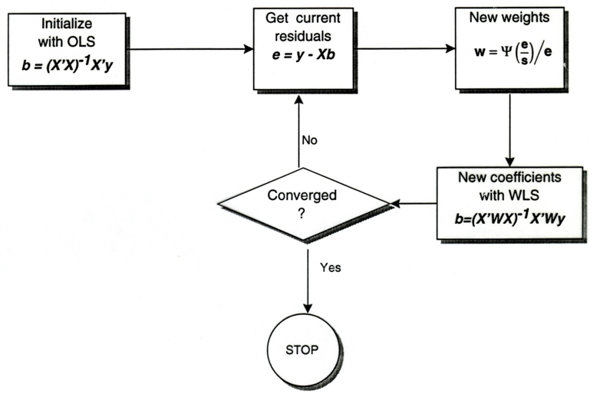
Iteratively reweighted least squares

Slide 19
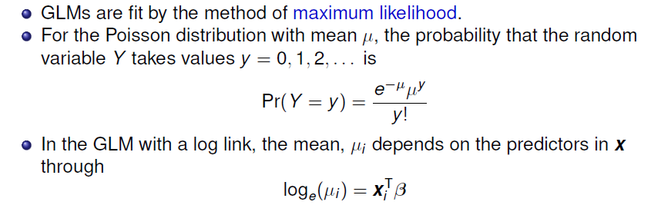
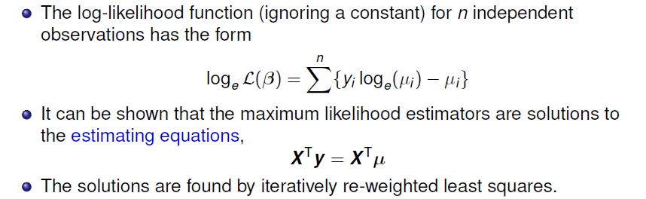
Maximum likelihood estimation

Slide 20
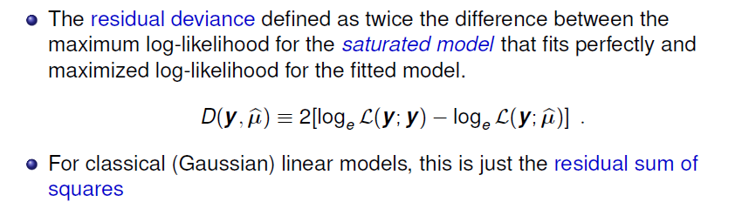
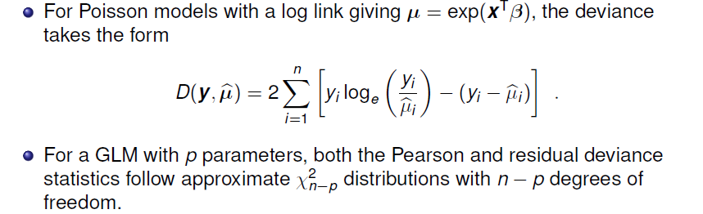
Goodness of fit

Slide 21


GLMs for count data
Typically, these are fit using
glm(y ~ x1 + x2 + …, family=poisson, data=mydata)
As in other linear models, the predictors, x_{i}, can be discrete factors, quantitative variables, interactions, etc.
This fixes the dispersion parameter, φ to 1, assuming the count variable y | x1, x2, … is Poisson distributed
It is possible to relax this, and fit a quasi-Poisson model, allowing φ to be estimated from the data
Specify family=quasipoisson. This allows variance to be proportional to the mean
Another possibility is the negative-binomial model, which has

Slide 22
Example: Publications of PhD candiates
Example 3.24 in DDAR gives data on the number of publications by PhD candidates in biochemistry in the last 3 years of study
> data("PhdPubs", package = "vcdExtra")
> table(PhdPubs$articles)
0 1 2 3 4 5 6 7 8 9 10 11 12 16 19
275 246 178 84 67 27 17 12 1 2 1 1 2 1 1
Predictors are:
gender, marital status
number of young children
prestige of the doctoral department
number of publications by the student’s mentor
Q: Which of these do you think would have strong effects on pubs?

Slide 23
Example: Publications of PhD candidates
Initially, ignore the predictors
This is equivalent to an intercept-only Poisson model
glm(articles ~ 1, family=poisson, data = PhdPubs)
As a check on the Poisson assumption, calculate the mean and variance
> with(PhdPubs, c(mean=mean(articles),
var=var(articles),
ratio=var(articles)/mean(articles)))
mean var ratio
1.69 3.71 2.19
The assumption that mean = variance could be met when we add predictors

Slide 24
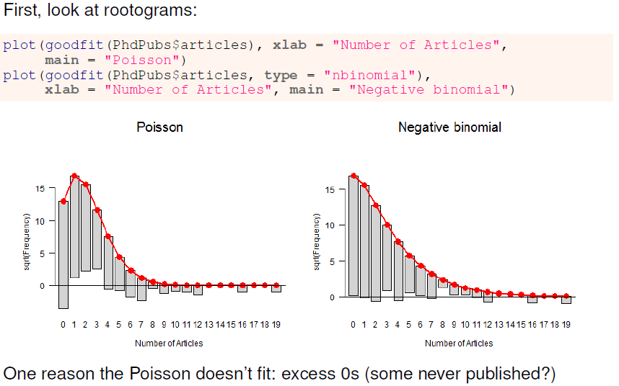
Q: What might some other reasons be?
Think back to assumptions: independent obs; constant probs; unmodelled vars

Slide 25
Fitting the Poisson model
Fit the model with all main effects; note the ~ . notation for this
> phd.pois <- glm(articles ~ ., data=PhdPubs, family=poisson)
> Anova(phd.pois)
Analysis of Deviance Table (Type II tests)
Response: articles
LR Chisq Df Pr(>Chisq)
female 17.1 1 3.6e-05 ***
married 6.6 1 0.01 *
kid5 22.1 1 2.6e-06 ***
phdprestige 1.0 1 0.32
mentor 126.8 1 < 2e-16 ***
---
Signif. codes: 0 ‘***’ 0.001 ‘**’ 0.01 ‘*’ 0.05 ‘.’ 0.1 ‘ ’ 1
Only phdprestige is NS; it does no harm to keep it, for now

Slide 26
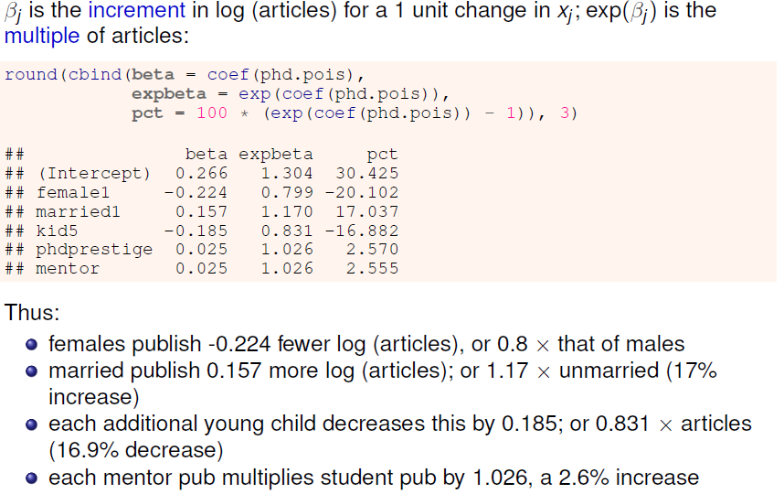
Interpreting coefficients

Slide 27
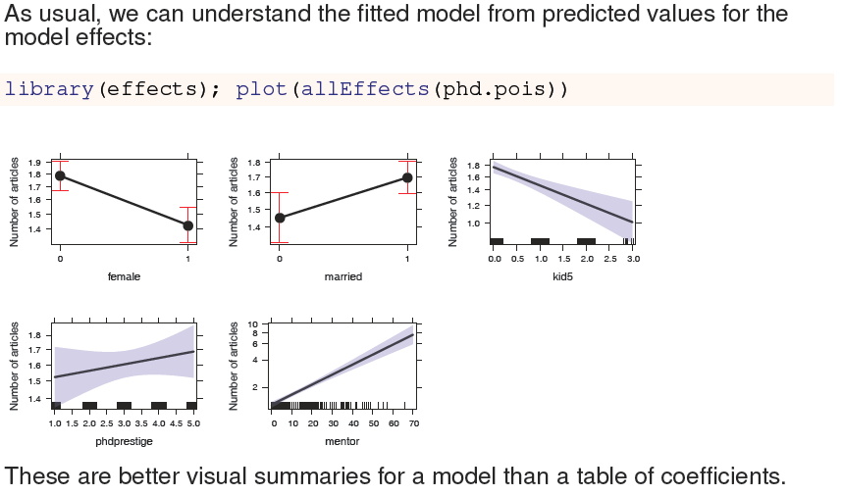
Effect plots
But note that this just displays the fitted model

Slide 28

Model diagnostics

Slide 29
Model diagnostics
Diagnostic methods for count data GLMs are similar to those used for classical linear models
Test for presence of interactions
Fit model(s) with some or all two-way interactions
Non-linear effects of quantitative predictors”
Component-plus-residual plots– car::crPlot() is useful here
Outliers? Influential observations?
car::influencePlot() is your friend
For count data models we should also check for overdispersion
Similar to homogeneity of variance checks in lm()

Slide 30
Checking for interactions
As a quick check for interactions, fit a model with all two-way terms, . ~ .^2
> phd.pois1 <- update(phd.pois, . ~ .^2)
> Anova(phd.pois1)
Analysis of Deviance Table (Type II tests)
Response: articles
LR Chisq Df Pr(>Chisq)
female 14.5 1 0.00014 ***
married 6.2 1 0.01277 *
kid5 19.5 1 9.8e-06 ***
phdprestige 1.0 1 0.32655
mentor 128.1 1 < 2e-16 ***
female:married 0.3 1 0.60995
female:kid5 0.1 1 0.72929
female:phdprestige 0.2 1 0.63574
female:mentor 0.0 1 0.91260
married:kid5 0
married:phdprestige 1.7 1 0.19153
married:mentor 1.2 1 0.28203
kid5:phdprestige 0.2 1 0.68523
kid5:mentor 2.8 1 0.09290 .
phdprestige:mentor 3.8 1 0.05094 .
---
Signif. codes: 0 ‘***’ 0.001 ‘**’ 0.01 ‘*’ 0.05 ‘.’ 0.1 ‘ ’ 1

Slide 31
Compare models
The all main effects and all two-way models are nested, so we can compare them with anova()
> anova(phd.pois, phd.pois1, test="Chisq")
Analysis of Deviance Table
Model 1: articles ~ female + married + kid5 + phdprestige + mentor
Model 2: articles ~ female + married + kid5 + phdprestige + mentor + female:married +
female:kid5 + female:phdprestige + female:mentor + married:kid5 +
married:phdprestige + married:mentor + kid5:phdprestige +
kid5:mentor + phdprestige:mentor
Resid. Df Resid. Dev Df Deviance Pr(>Chi)
1 909 1634
2 900 1618 9 15.2 0.086 .
---
Signif. codes: 0 ‘***’ 0.001 ‘**’ 0.01 ‘*’ 0.05 ‘.’ 0.1 ‘ ’ 1
No evidence that the two-way terms result in a significantly better model
A more principled analysis would consider which interactions might be interesting / important

Slide 32
Compare models
We can also compare using AIC/BIC with vcdExtra::LRstats()
> LRstats(phd.pois, phd.pois1)
Likelihood summary table:
AIC BIC LR Chisq Df Pr(>Chisq)
phd.pois 3313 3342 1634 909 <2e-16 ***
phd.pois1 3316 3388 1618 900 <2e-16 ***
---
Signif. codes: 0 ‘***’ 0.001 ‘**’ 0.01 ‘*’ 0.05 ‘.’ 0.1 ‘ ’ 1
There seems to be no reason to include interactions in this model
All these interactions increase AIC & BIC
We might want to revisit this, after examining other models for the basic count distribution (quasi-poisson, negative-binomial)
We might want to consider some specific interaction(s) that seem substantively interesting or important to test.

Slide 33
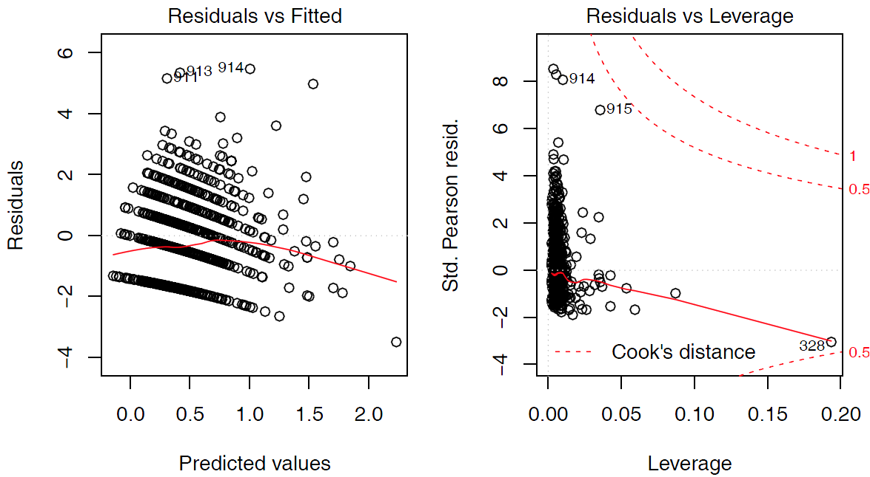
Basic model plots
Only two of the standard model plots are informative for count data models
plot(phd.pois, which=c(1,5))

Slide 34
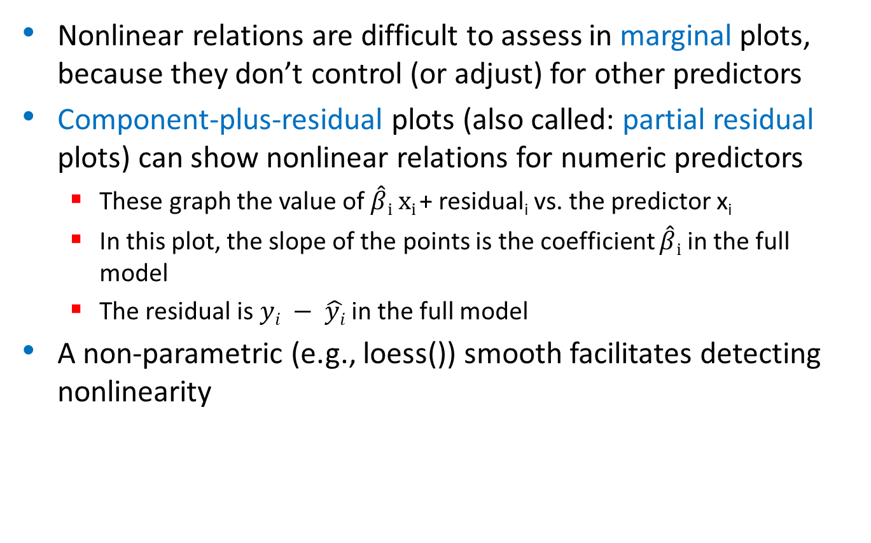
Nonlinearity diagnostics
Nonlinear relations are difficult to assess in marginal plots, because they don’t control (or adjust) for other predictors
Component-plus-residual plots (also called: partial residual plots) can show nonlinear relations for numeric predictors
These graph the value of $\hat{β}i xi$+ residual_{i} vs. the predictor x_{i}
In this plot, the slope of the points is the coefficient $\hat{β}i$ in the full model
The residual is $yi − \hat{yi}$ in the full model
A non-parametric (e.g., loess()) smooth facilitates detecting nonlinearity

Slide 35
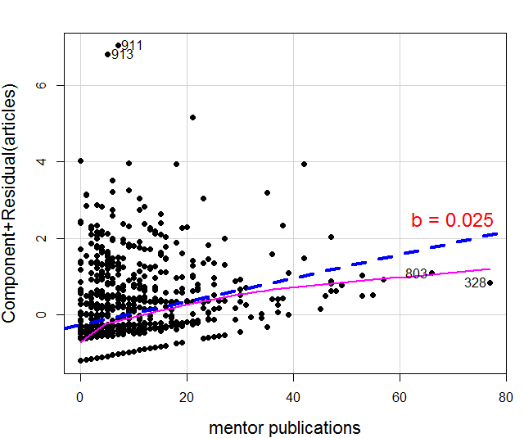
Nonlinearity diagnostics: crPlot()
Is the relation between article published by the student and by the mentor adequately represented as linear?
crPlot(phd.pois, "mentor", pch=16, lwd=4, id = list(n=2))
The smoothed curve doesn’t differ much from the fitted line
A couple of points stand out: 328, 803, 911, 913

Slide 36
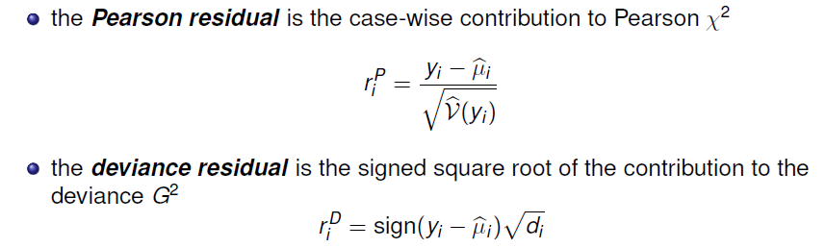
Residuals
Residuals contain all the information about how a model doesn’t fit, and maybe why
For GLMs, there are several types, based on the Pearson and deviance goodness-of-fit statistics
These are raw residuals, on the scale of the counts themselves

Slide 37
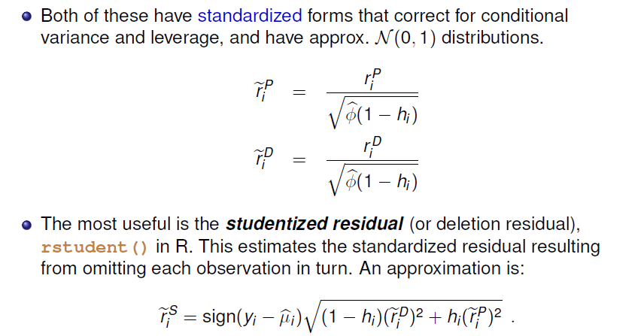
Residuals
Don’t worry about the formulas, but do know the difference among raw, standardized and studentized residuals

Slide 38
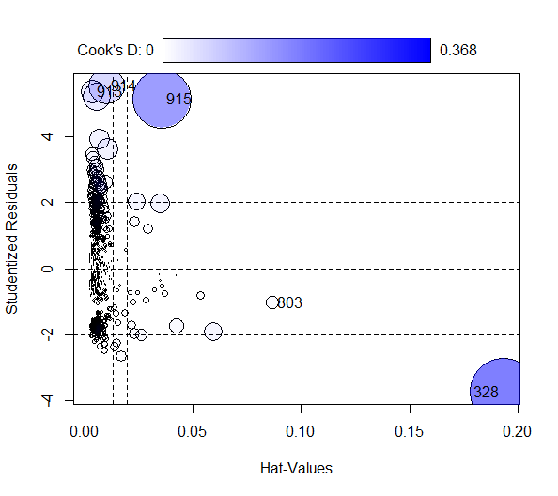
Outliers, leverage & influence
influencePlot(phd.pois, id = list(n=2))
Influence (CookD) =
Leverage (Hat) x |Residual|
Several cases (913-915) stand out with large + residuals
One observation (328) has a large leverage
Why are they unusual? Do they affect conclusions?
Examine data & decide what to do

Slide 39
Who is influential & why?
At the very least, you should examine these flagged observations in the data
> PhdPubs[c(328, 803, 913:915),]
articles female married kid5 phdprestige mentor
328 1 0 1 1 2 77
803 4 0 1 2 5 66
913 12 0 1 1 2 5
914 16 0 1 0 2 21
915 19 0 1 0 2 42
case 328: Mentor published 77 papers! Student, only 1
803: High prestige school, mentor published 66; published a bit less than predicted
913-915: Wow! all published >> than predicted

Slide 40
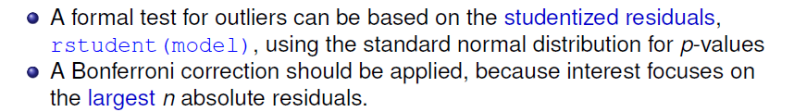
Outlier test
For this Poisson model, 4 observations are flagged as large + residuals
> outlierTest(phd.pois, cutoff = 0.001)
rstudent unadjusted p-value Bonferroni p
914 5.54 2.99e-08 2.73e-05
913 5.38 7.36e-08 6.74e-05
911 5.21 1.92e-07 1.75e-04
915 5.15 2.60e-07 2.38e-04
What to do?
Delete them & refit?
Keep them, but report as unusual?
Fit a better model, hope these will go away?

Slide 41

Overdispersion

Slide 42
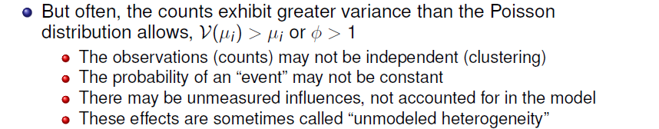

Overdispersion

Slide 43
Testing overdispersion
Statistical tests for overdispersion test H₀: Var(y) = μ vs. the alternative
H₁: Var(y) = μ + φ × f(μ)
Implemented in AER::dispersiontest()
If significant, overdispersion should not be ignored
You can try fitting a more general model
Quasi-poisson
Negative-binomial

Slide 44
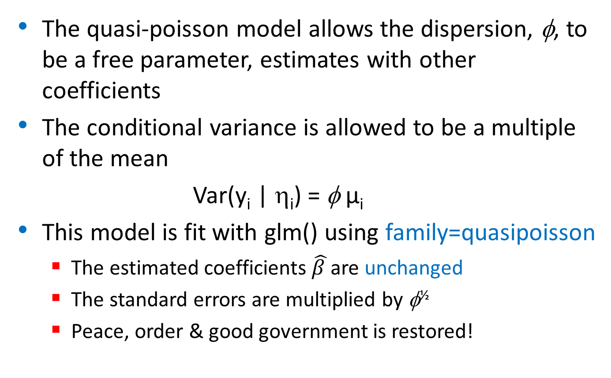
Quasi-poisson models
The quasi-poisson model allows the dispersion, φ, to be a free parameter, estimates with other coefficients
The conditional variance is allowed to be a multiple of the mean
Var(y_{i} | η_{i}) = φ μ_{i}
This model is fit with glm() using family=quasipoisson
The estimated coefficients $\hat{β }$are unchanged
The standard errors are multiplied by φ^{½}
Peace, order & good government is restored!

Slide 45

Quasi-poisson models
A simple estimate of the dispersion parameter is the residual deviance divided by degrees of freedom φ = D(y, μ ) / df
A Pearson χ² statistic has better statistical properties & is more commonly used
For the PhdPubs data, these estimates are quite similar: about 80% overdispersion
> with(phd.pois, deviance/df.residual)
[1] 1.8
> sum(residuals(phd.pois, type = "pearson")^2)/phd.pois$df.residual
[1] 1.83

Slide 46
Fitting the quasi-poisson model
You can fit the quasi-poisson model using glm()
> phd.qpois <- glm(articles ~ ., data = PhdPubs, family = quasipoisson)
The estimate of the dispersion parameter is calculated by the summary() method. You can get it as follows:
> (phi <- summary(phd.qpois)$dispersion)
[1] 1.83
This is much better than variance/mean ratio of 2.91 calculated for the marginal distribution ignoring the predictors.

Slide 47
> summary(phd.qpois)
Call:
glm(formula = articles ~ ., family = quasipoisson, data = PhdPubs)
Deviance Residuals:
Min 1Q Median 3Q Max
-3.488 -1.538 -0.365 0.577 5.483
Coefficients:
Estimate Std. Error t value Pr(>|t|)
(Intercept) 0.26562 0.13478 1.97 0.04906 *
female1 -0.22442 0.07384 -3.04 0.00244 **
married1 0.15732 0.08287 1.90 0.05795 .
kid5 -0.18491 0.05427 -3.41 0.00069 ***
phdprestige 0.02538 0.03419 0.74 0.45815
mentor 0.02523 0.00275 9.19 < 2e-16 ***
---
Signif. codes: 0 ‘***’ 0.001 ‘**’ 0.01 ‘*’ 0.05 ‘.’ 0.1 ‘ ’ 1
(Dispersion parameter for quasipoisson family taken to be 1.83)
Null deviance: 1817.4 on 914 degrees of freedom
Residual deviance: 1633.6 on 909 degrees of freedom
AIC: NA
Consequently, t stats are smaller

Slide 48
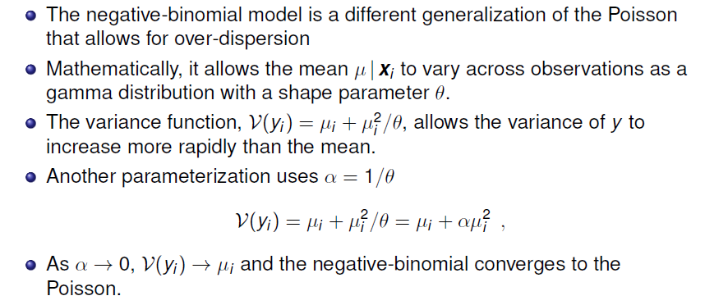
The negative-binomial model

Slide 49
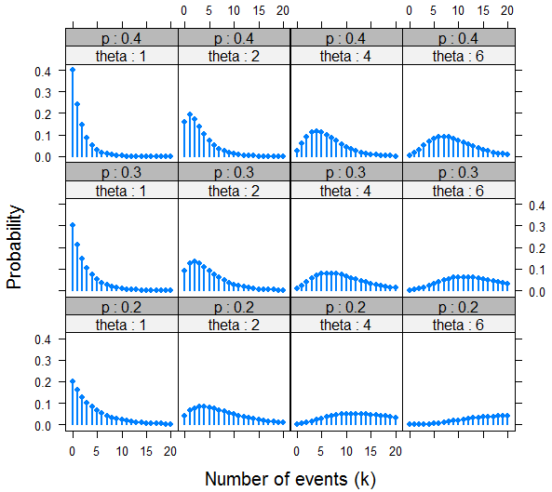
The negative-binomial model
Negative-binomial distributions for varying p & θ
Overdispersion decreases as θ increases

Slide 50

Fitting the negative-binomial
> library(MASS)
> unlist(summary(phd.nbin)[c("theta", "SE.theta")])
theta SE.theta
2.267 0.272
Equivalently: α = 1/θ = 0.44

Slide 51
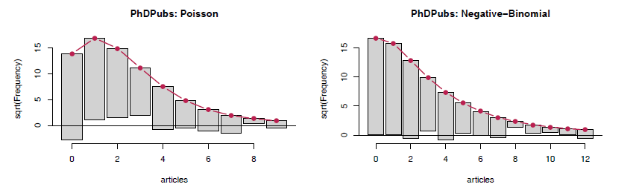
Visualizing goodness-of-fit
The countreg package extends rootogram() to work with fitted models:
countreg::rootogram(phd.pois, main="PhDPubs: Poisson")
countreg::rootogram(phd.nbin, main="PhDPubs: Negative-Binomial")
The Poisson model shows a systematic, wave-like pattern with excess zeros, too few observed frequencies for counts of 1--3.

Slide 52
Comparing models: What difference does it make?
The NB is certainly a better fit than the Poisson; the QP cannot be distinguished by standard tests
> LRstats(phd.pois, phd.qpois, phd.nbin)
Likelihood summary table:
AIC BIC LR Chisq Df Pr(>Chisq)
phd.pois 3313 3342 1634 909 <2e-16 ***
phd.qpois 909
phd.nbin 3135 3169 1004 909 0.015 *
---
Signif. codes: 0 ‘***’ 0.001 ‘**’ 0.01 ‘*’ 0.05 ‘.’ 0.1 ‘ ’ 1
We can also compare coefficients and their standard errors for these models
pois qpois nbin
(Intercept) 0.266 0.266 0.213
female1 -0.224 -0.224 -0.216
married1 0.157 0.157 0.153
kid5 -0.185 -0.185 -0.176
phdprestige 0.025 0.025 0.029
mentor 0.025 0.025 0.029
pois qpois nbin
(Intercept) 0.0996 0.1348 0.1327
female1 0.0546 0.0738 0.0726
married1 0.0613 0.0829 0.0819
kid5 0.0401 0.0543 0.0528
phdprestige 0.0253 0.0342 0.0343
mentor 0.0020 0.0027 0.0032

Slide 53
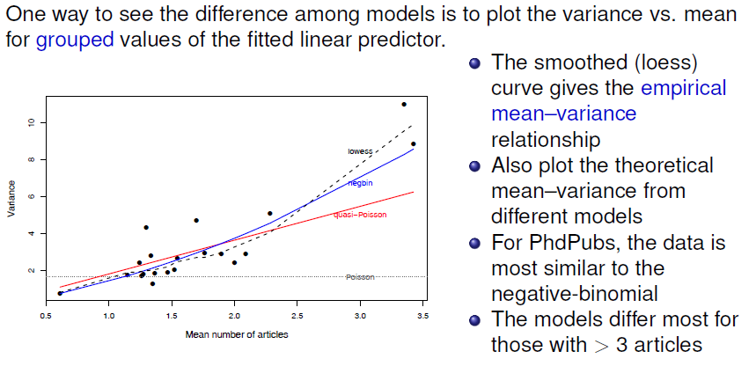
Visualizing the mean-variance relation
I call this a “model sensitivity plot” – how much effect do different assumptions make?

Slide 54
What have we learned?
A summary to this point should use the result of the negative-binomial model
> lmtest::coeftest(phd.nbin)
z test of coefficients:
Estimate Std. Error z value Pr(>|z|)
(Intercept) 0.21295 0.13274 1.60 0.10866
female1 -0.21625 0.07259 -2.98 0.00289 **
married1 0.15279 0.08194 1.86 0.06224 .
kid5 -0.17634 0.05279 -3.34 0.00084 ***
phdprestige 0.02934 0.03427 0.86 0.39192
mentor 0.02868 0.00324 8.86 < 2e-16 ***
For interpretation, examine the coefficients, β, e^{β} and % change
> round(cbind(beta = coef(phd.nbin),
expbeta = exp(coef(phd.nbin)),
pct = 100 * (exp(coef(phd.nbin)) - 1)), 3)
beta expbeta pct
(Intercept) 0.213 1.237 23.73
female1 -0.216 0.806 -19.45
married1 0.153 1.165 16.51
kid5 -0.176 0.838 -16.17
phdprestige 0.029 1.030 2.98
mentor 0.029 1.029 2.91

Slide 55
What have we learned?
The number of articles published by PhD candidates:
Most strongly predicted by mentor pubs, but with a modest effect. On average, each mentor pub increases PhD articles by 2.9%
Next, increasing young children (kids5) results in fewer publications. On average, each additional kid reduces PhD articles by 16%
Being married is marginally NS, but intriguing. Our estimate shows married candidates publish 16.5% more articles than non-married.
Perhaps surprisingly, the prestige of the PhD institution has no significant effect in this purely main-effect model. Yet, a unit change in phdprestige is estimated as a 3% increase in PhD articles
Yet, we still have doubts:
Several cases (328, 913-915) appeared unusual in diagnostic plots. Should we refit w/o them to see if conclusions change?
The NB model might not be the best way to account for the zero counts – students who never published
Is there a better way?

Slide 56

Excess zeros
0
0
0
0
0

Slide 57
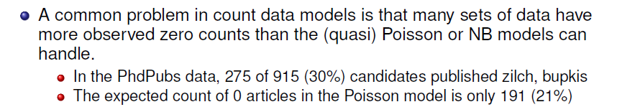
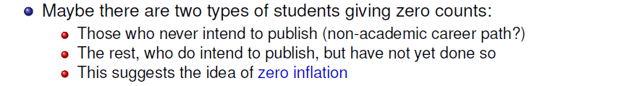

Excess zero counts

Slide 58


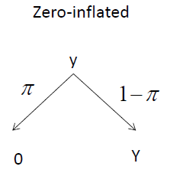
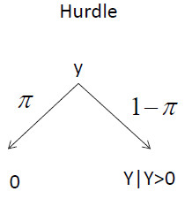
Models for excess zeros
Two types of models, with different mechanisms for zero counts

Slide 59
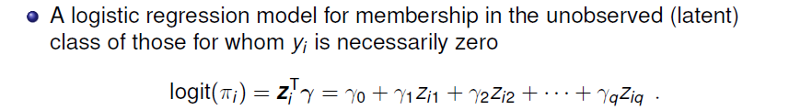
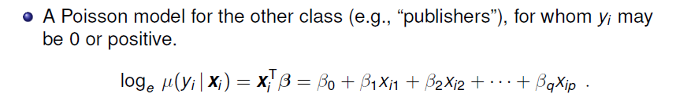
Zero-inflated models
The zero-inflated Poisson (ZIP) model has two components:
In application, the same predictors can be (and often are) used in both models (x = z). But not necessarily!

Slide 60
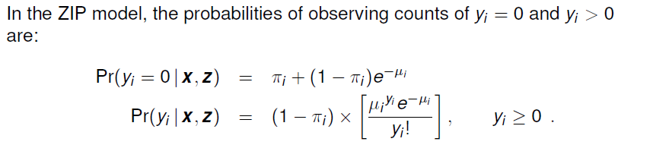
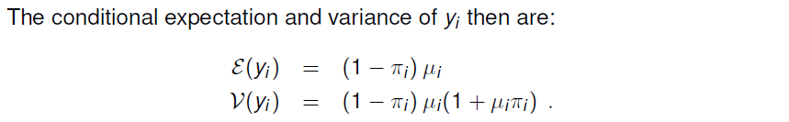
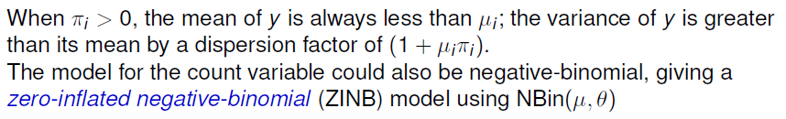
Zero-inflated models: ZIP & ZINB

Slide 61
Exploring zero-inflated data
A little insight can be gained by generating random data from Poisson & zero-inflated analog. The example uses VGAM::rzipois()
Pois(μ=3) = ZIP(μ=3, π=0)
vs. ZIP(μ=3, π=.3)
> set.seed(1234)
> data1 <- VGAM::rzipois(200, 3, 0)
> data2 <- VGAM::rzipois(200, 3, .3)
The tables of counts show far more zeros in data2
> table(data1)
data1
0 1 2 3 4 5 6 7 8 9
10 31 46 54 24 20 7 3 4 1
> table(data2)
data2
0 1 2 3 4 5 6 7 9
62 26 33 31 22 9 8 8 1

Slide 62
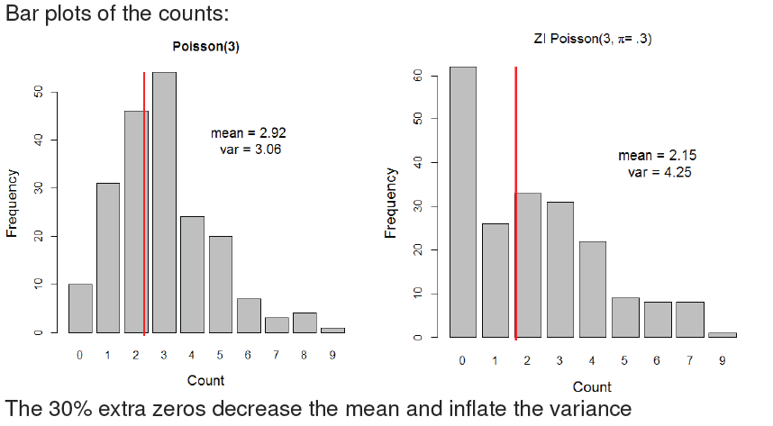
Exploring zero-inflated data

Slide 63
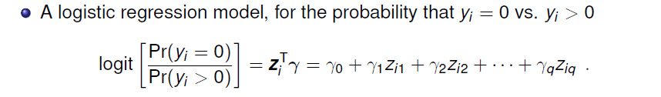
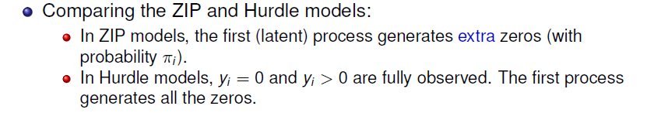
Hurdle models
The Hurdle model has also has two components:

Slide 64
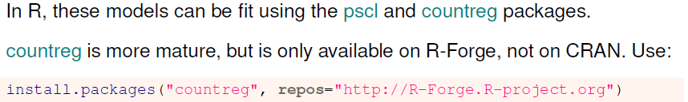


Fitting ZIP & Hurdle models

Slide 65

Visualizing zero counts
It is often useful to plot the data for the binary distinction between y_{i} = 0 vs. y_{i} > 0 as in logistic regression models.
plot(factor(articles==0) ~ mentor, data=PhdPubs,
ylevels=1:2, ylab="Zero articles",
breaks=quantile(mentor, probs=seq(0,1,.2)))
As expected, zero counts decrease with mentor pubs
NB: This gives a spineplot

Slide 66
Fitting models
To illustrate, I fit all four models, the combinations of (ZI, hurdle) × (poisson, nbin) to the phdpubs data.
For simplicity, I use all predictors for both the zero model and the non-zero model.
phd.zip <- zeroinfl(articles ~ ., data=PhdPubs, dist="poisson")
phd.znb <- zeroinfl(articles ~ ., data=PhdPubs, dist="negbin")
phd.hp <- hurdle(articles ~ ., data=PhdPubs, dist="poisson")
phd.hnb <- hurdle(articles ~ ., data=PhdPubs, dist="negbin")

Slide 67
Comparing models
Compare the models, sorting by BIC
> LRstats(phd.pois, phd.nbin, phd.zip, phd.znb, phd.hp, phd.hnb,
sortby="BIC")
Likelihood summary table:
AIC BIC LR Chisq Df Pr(>Chisq)
phd.pois 3313.3 3342.3 3301.3 909 < 2.2e-16 ***
phd.hp 3234.5 3292.4 3210.5 903 < 2.2e-16 ***
phd.zip 3233.5 3291.3 3209.5 903 < 2.2e-16 ***
phd.hnb 3130.9 3193.5 3104.9 902 < 2.2e-16 ***
phd.znb 3125.8 3188.4 3099.8 902 < 2.2e-16 ***
phd.nbin 3135.4 3169.1 3121.4 909 < 2.2e-16 ***
---
Signif. codes: 0 ‘***’ 0.001 ‘**’ 0.01 ‘*’ 0.05 ‘.’ 0.1 ‘ ’ 1
The standard negative binomial model looks best by BIC.
Why do you think this is? (Hint: look at the residual df)

Slide 68
Nevertheless, it is useful to examine the coefficients in the ZIP model
> lmtest::coeftest(phd.zip)
t test of coefficients:
Estimate Std. Error t value Pr(>|t|)
count_(Intercept) 0.59918 0.11861 5.05 5.3e-07 ***
count_female1 -0.20879 0.06353 -3.29 0.0011 **
count_married1 0.10623 0.07097 1.50 0.1348
count_kid5 -0.14271 0.04744 -3.01 0.0027 **
count_phdprestige 0.00700 0.02981 0.23 0.8145
count_mentor 0.01785 0.00233 7.65 5.3e-14 ***
zero_(Intercept) -0.56332 0.49405 -1.14 0.2545
zero_female1 0.10816 0.28173 0.38 0.7011
zero_married1 -0.35558 0.31796 -1.12 0.2637
zero_kid5 0.21974 0.19658 1.12 0.2639
zero_phdprestige -0.00537 0.14118 -0.04 0.9697
zero_mentor -0.13313 0.04643 -2.87 0.0042 **
---
Signif. codes: 0 ‘***’ 0.001 ‘**’ 0.01 ‘*’ 0.05 ‘.’ 0.1 ‘ ’ 1
counts > 0
counts = 0
Only mentor is significant in the ZIP model, simplifying interpretation.

Slide 69
Let’s refit the ZIP and ZNB models using only mentor for the zero models
phd.zip1 <- zeroinfl(articles ~ .| mentor, data=PhdPubs, dist="poisson")
phd.znb1 <- zeroinfl(articles ~ .| mentor, data=PhdPubs, dist="negbin")
Compare models again
> LRstats(phd.pois, phd.nbin, phd.zip, phd.znb, phd.hp, phd.hnb,
+ phd.zip1, phd.znb1, sortby="BIC")
Likelihood summary table:
AIC BIC LR Chisq Df Pr(>Chisq)
phd.pois 3313 3342 3301 909 <2e-16 ***
phd.hp 3235 3292 3211 903 <2e-16 ***
phd.zip 3234 3291 3210 903 <2e-16 ***
phd.zip1 3227 3266 3211 907 <2e-16 ***
phd.hnb 3131 3194 3105 902 <2e-16 ***
phd.znb 3126 3188 3100 902 <2e-16 ***
phd.nbin 3135 3169 3121 909 <2e-16 ***
phd.znb1 3124 3168 3106 906 <2e-16 ***
---
Signif. codes: 0 ‘***’ 0.001 ‘**’ 0.01 ‘*’ 0.05 ‘.’ 0.1 ‘ ’ 1
Now, the phd.znb1 model looks best by BIC. Let’s stick with this.

Slide 70

Model interpretation: Coefficients
Ignoring the NS coefficients in the revised ZNB model (phd.znb1):
> coef(phd.znb1)[c(1,2,4,6,7,8)]
count_(Intercept) count_female1 count_kid5 count_mentor
0.3572 -0.2116 -0.1675 0.0241
zero_(Intercept) zero_mentor
-0.8169 -0.6080
Can you describe these in words?

Slide 71
Model interpretation: Coefficients
Often easier to interpret exp(β)
> exp(coef(phd.znb1)[c(1,2,4,6,7,8)])
count_(Intercept) count_female1 count_kid5 count_mentor
1.429 0.809 0.846 1.024
zero_(Intercept) zero_mentor
0.442 0.544
Female: Women publish .21 fewer log articles, .81 times that of men (20% decrease)
Kids5: Each additional kid<5 → .17 fewer log articles, a 15% decrease
Mentor: Each additional mentor article → .024 more PhD log pubs (2.4% increase)
Count model: Each additional mentor article decreases log odds PhDpubs = 0 by 0.608, a 45% decrease
Get your mentor to publish!!

Slide 72


Model interpretation: Effect plots

Slide 73



Slide 74



What have we learned?

Slide 75


What have we learned?

Slide 76

What have we forgotten?
“All models are wrong, but some are useful” --- GEP Box
Model building and model criticism go hand in hand
But they don’t form a linear series of steps you can put into a flow chart

Slide 77

What have we forgotten?
Sometimes, you have to go back and revisit decisions made earlier:
Fit → Re-think → Re-fit → Re-interpret

Slide 78
What I missed
In the initial model, phdprestige was NS. I decided to keep it
In the check for two-way interactions, the interaction phdprestige:mentor was borderline (p = 0.051)
I did a global test for all interactions together
This was NS (p = 0.08), so I decided to dismiss them all
(I wanted to keep he model simple, to go on to other topics: overdispersion, models for excess zeros)

Slide 79
Back to square TWO
A question in a former class made me reconsider the phdprestige:mentor interaction
Perhaps, the effect of mentor varied with phdprestige?
Try this, starting with the negative-binomial, phd.nbin (update() is your friend)
> phd.nbin2 <- update(phd.nbin, . ~ . + phdprestige:mentor)
> Anova(phd.nbin2)
Analysis of Deviance Table (Type II tests)
Response: articles
LR Chisq Df Pr(>Chisq)
female 9.1 1 0.0026 **
married 3.1 1 0.0762 .
kid5 10.7 1 0.0011 **
phdprestige 0.7 1 0.3921
mentor 72.8 1 <2e-16 ***
phdprestige:mentor 5.6 1 0.0179 *
---
Signif. codes: 0 ‘***’ 0.001 ‘**’ 0.01 ‘*’ 0.05 ‘.’ 0.1 ‘ ’ 1

Slide 80

Visualize the interaction
phd.effnb2 <- allEffects(phd.nbin2)
plot(phd.effnb2[4], x.var="mentor", multiline=TRUE, ci.style="bands", ...)

Slide 81


Visualize the interaction– The other way
phd.effnb2 <- allEffects(phd.nbin2)
plot(phd.effnb2[4], multiline=TRUE, ci.style="bands", ...)

Slide 82
Back to square ONE
Aren’t we done yet?
“All data are wrong, but some are useful” – Sitsofe Tsagbey et al. TAS, 2017
A nagging doubt: what is the coding for phdprestige?
Email from Scott Long: “the higher the number, the more prestigious the program”
“PS: The data I used did not categorize the continuous phd scale into discrete categories”
Found the original Stata data set:
library(foreign)
PhdPubs2 <-
read.dta("http://www.stata-press.com/data/lf2/couart2.dta")

Slide 83


Compare distributions
Histograms with smoothed density estimate of the two versions of phdprestige
They are very different!

Slide 84
What to do?
Re-run the analysis with the new data set, PhdPubs2
This could be called a sensitivity analysis – does the new data alter conclusions?
Q: Are the results of the phd.nbin2 and phd.znb2 models about the same. A: YES!
Q: Is the interaction of phdprestige:mentor about the same. A: YES!
Q: Does the effect plot look about the same? A: YES!

Slide 85
What else is there?
The PhdPubs example was rather simple
There were only a few predictors
Model selection methods could be based on simple Anova(), coeftest(), LRstats()
No need for more complex model selection methods or cross-validation
Of the quantitative predictors, only mentor & kid5 had important effects
The effects of these were sufficiently linear
No need to try non-linear effects (poly(mentor,2), ns(mentor,2))
There turned out to be one important interaction
In Psychology, these are called “moderator” effects
Interpretation often based on post-hoc tests of simple slopes
Interpretation is usually simplified in effect plots

Slide 86


Other methods: Recursive partitioning
Who survived on the Titanic?
Logistic regression tree fit to the Titanic data with partykit::glmtree()

Slide 87

Other methods: Recursive partitioning
Could there be a simpler or different model for the PhdPubs data?
library(partykit)
phd.tree <- glmtree(articles ~ mentor| female+married+kid5+phdprestige,
data=PhdPubs, family=poisson)
plot(phd.tree)
Hmm?
A kid5:mentor interaction?

Slide 88
Summary
GLMs provide a unified framework for linear models
Different families, all estimated in the same way
→link function and associated variance function
For count data, starting from log(μ) = X β, μ|X ~ Poisson:
Overdispersion → quasi-poisson, negative binomial
Standard tools for assessing model fit
Excess zero counts introduce new ideas & methods
ZIP model: structural model for the 0s
Hurdle model: random model for 0s, 2nd model for Y>0
In all this, we rely on data & model plots for understanding

