Slide 1
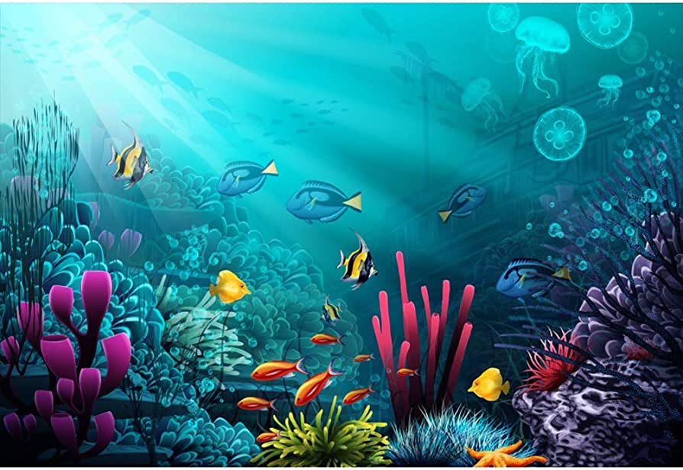
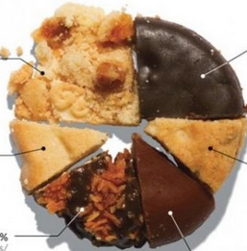

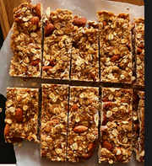
Deep Questions of Data Visualization
??
Michael Friendly

Slide 2
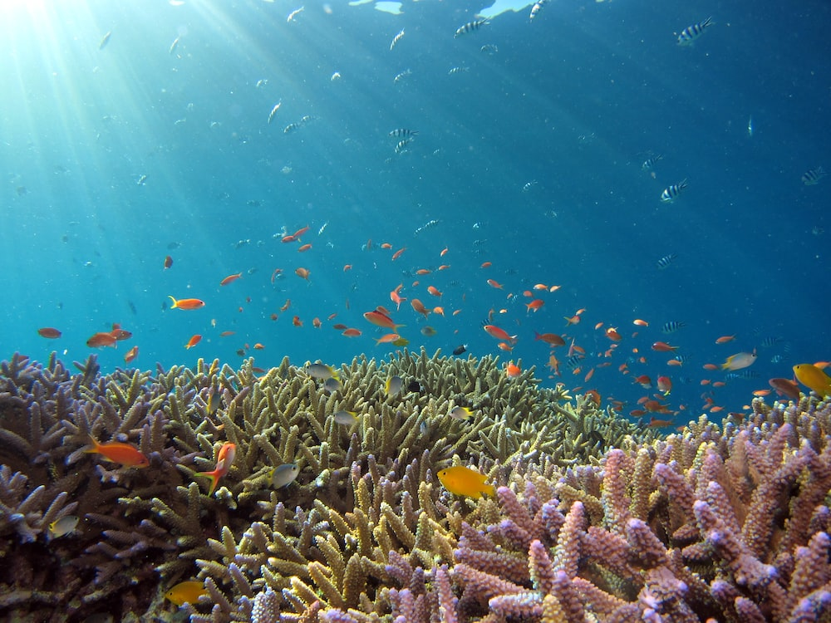

While you were enjoying a relaxing week without classes, I was working hard, pondering the:
Deep Questions of Data Visualization

Slide 3

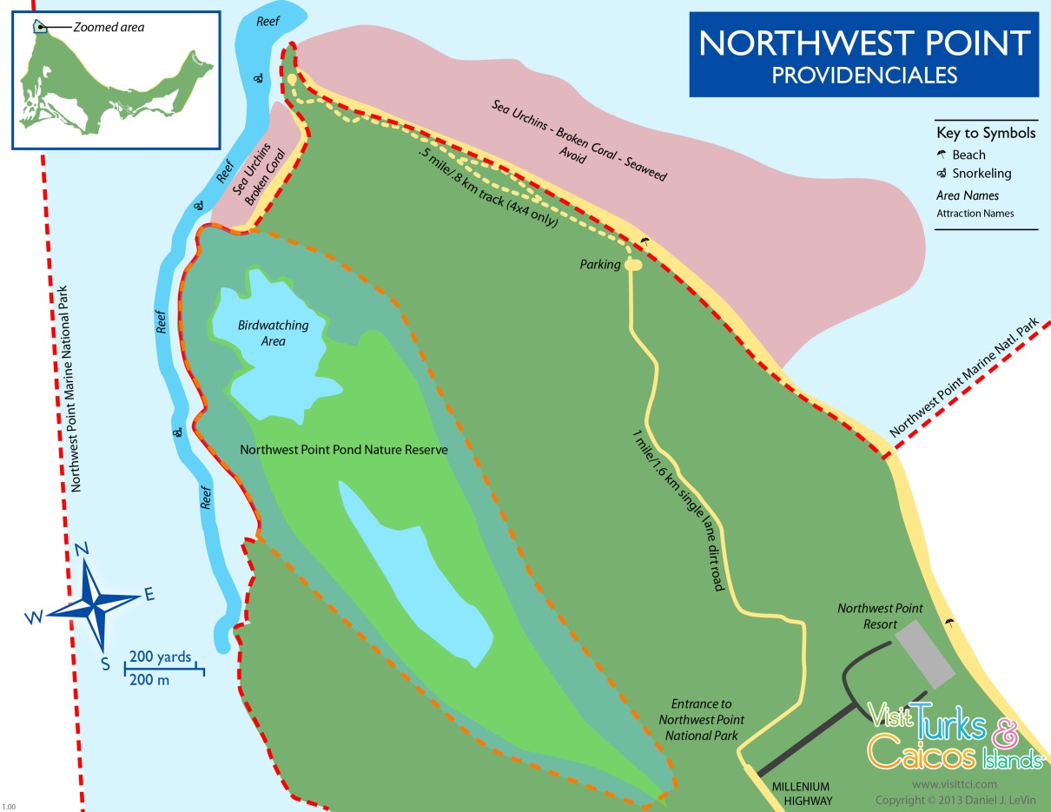


The Deep Question Research Institute,
NorthWest Point, Providenciales, Turks & Caicos
The Wall (6000’)
The first scientific study of graphical preference among marine animals!

Slide 4

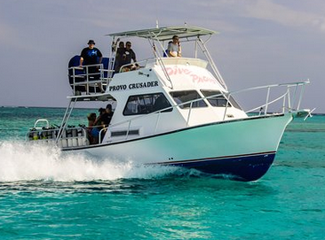
Research team* aboard the MV Playfair
Divers suit up
MV Playfair
* Thanks for technical assistance from Provo Divers

Slide 5
Shark experiment: Pies vs. Bars
Do sharks prefer conch pie charts or granola bar charts?
Design: Two-alternative forced-choice, n=50 trials
Conch pie
Granola bar
Sample stimulus items

Slide 6
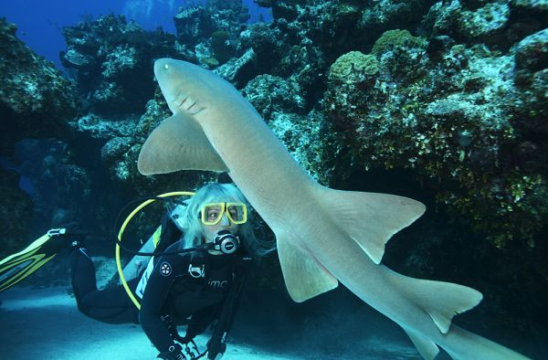
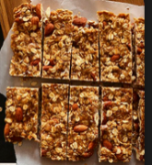
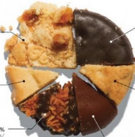
Shark experiment
One experimental trial:
??

Slide 7
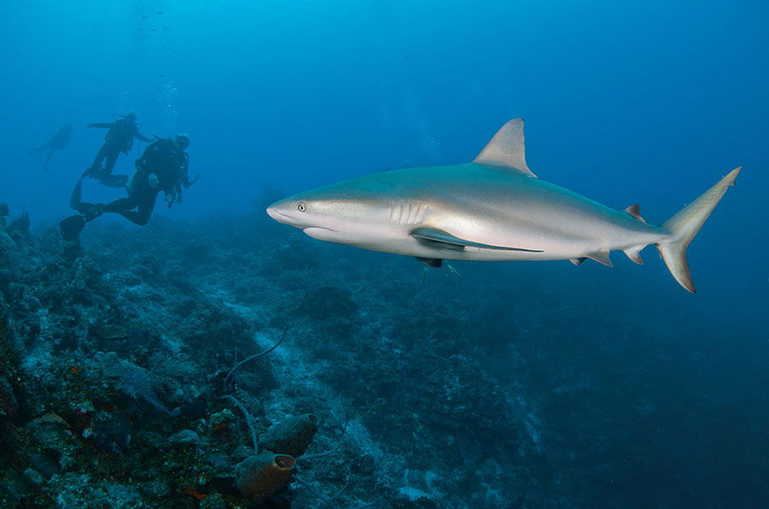
Shark experiment: Pies vs. Bars
Results: Sharks show an overwhelming preference for conch pie
Choice | n
Pie | 45
Bar | 4
Diver * | 1
??
* Ethics disclosure: All divers were volunteers. None were consumed in this experiment.

Slide 8
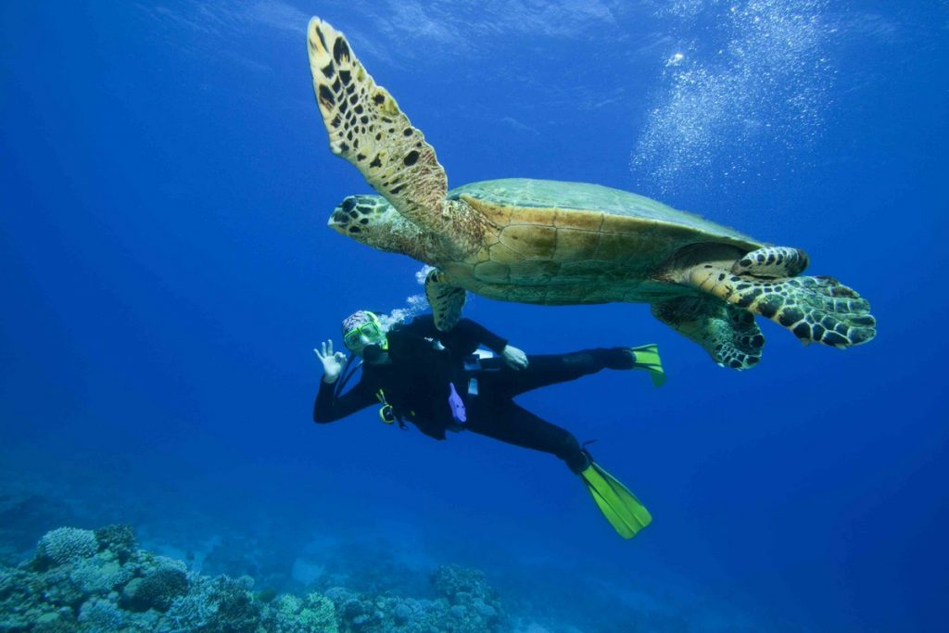
Turtle experiment
Does this generalize? What about turtles?
Results: Turtles show an overwhelming preference for granola bar charts
Choice | n
Pie | 3
Bar | 47
Diver | 0
??

Slide 9

Visualizing the results
Successful visualizations require some time for reflection

Slide 10
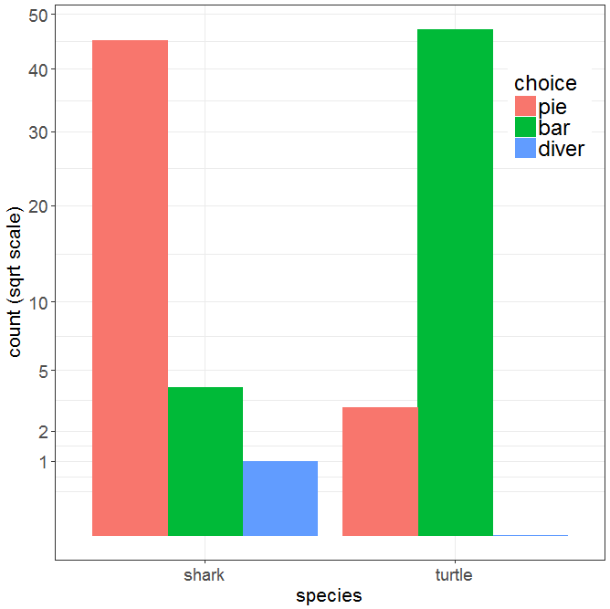
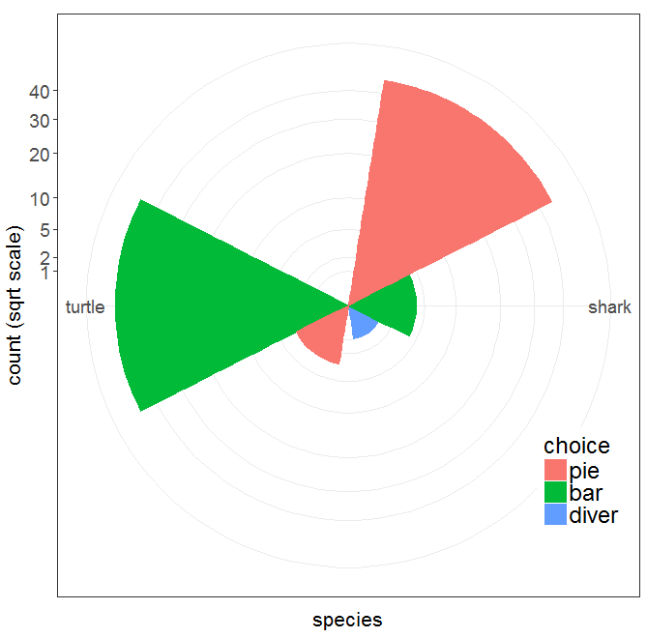
Visualizing the results
Bar chart
Windrose = bar chart + polar coords
Which do you prefer? Is there something better before I publish this?

Slide 11
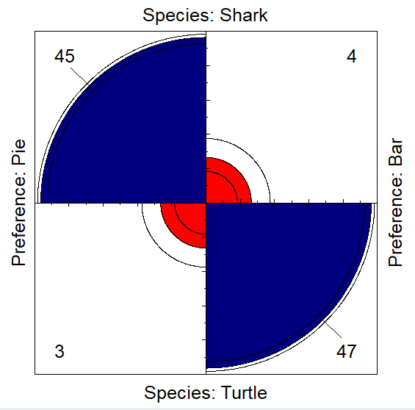
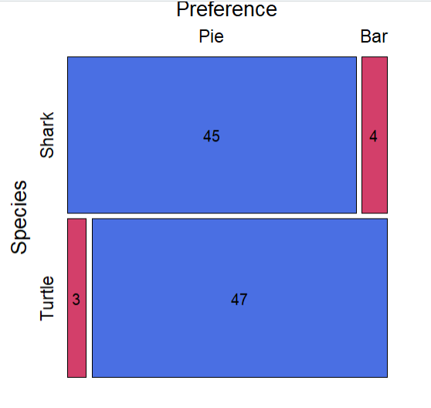
Visualizing the results
What about fourfold plots & mosaic displays?

Slide 12

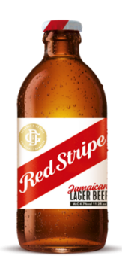
The Red Stripe Award
The research reported* here was given the February 2023 Red Stripe Award by the Deep Question Research Institute
“A Four Stripe research project!”
* This research was not supported by the National Sciences and Engineering Research Council of Canada

Slide 13
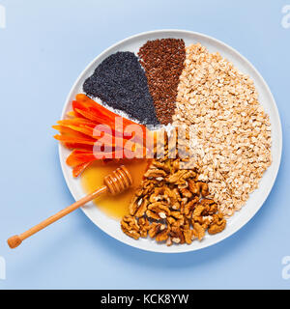

Further research
Include the obvious and necessary control conditions in a 2 x 2 factorial design (chart type × food type):
conch bar charts vs. conch pie charts
granola pie charts vs. granola bar charts
Conch pie
Conch bar
Granola pie
Granola bar

Slide 14
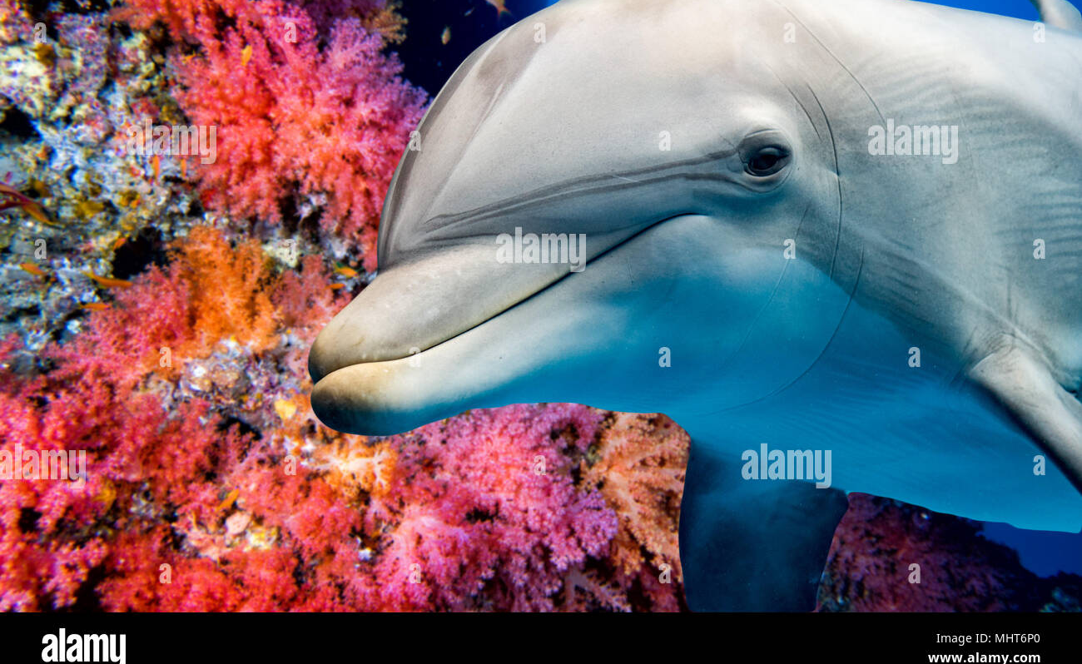
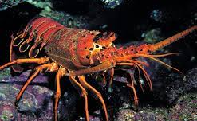
Extend this to other species
Dolphins: known to be much smarter than sharks & turtles
Caribbean lobsters (no claws!) are stupider
Is graphical preference related to intelligence?

Slide 15
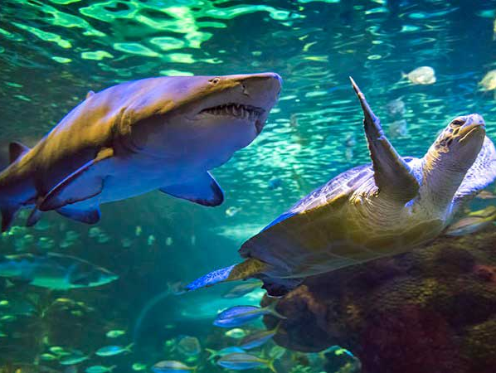
Nellie the nurse shark
Tommy turtle
Dramatis personnae

