Slide 1
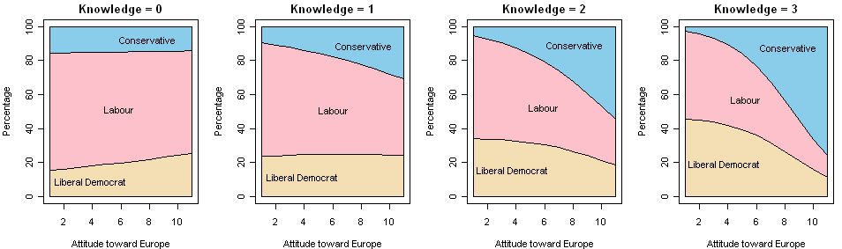

Logistic regression: Extensions
Michael Friendly
Psych 6136
http://friendly.github.io/psy6136

Slide 2
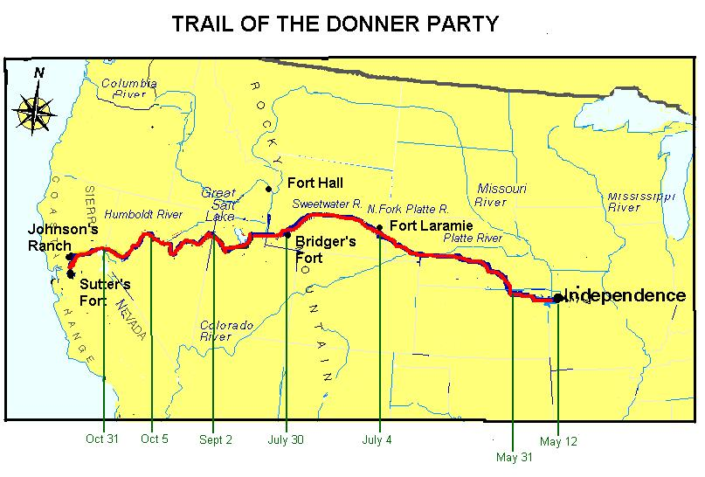
Donner party: A graphic tale of survival & influence
History:
Apr—May, 1846: Donner/Reed families set out from Springfield, IL to CA
July: Reach Bridger’s Fort WY: 87 people, 23 wagons
Notes:
This is a case study, designed to illustrate the ideas behind logistic regression I covered in the last lecture
It is the story of a group of families, led by George Donner, who set out in 1846 to seek their fortune in the American West.
87 people travelled across the open plains in 23 covered wagons.

Slide 3
Donner party: A graphic tale of survival & influence
History:
“Hastings cutoff”: an untried route through Salt Lake desert (90 people)
Worst recorded winter: Oct 31 blizzard; stranded at Truckee Lake (nr Reno)
Rescue parties sent out (“Dire necessity”, “Forelorn hope”, …)
Relief parties from CA: 42 survivors (Mar—Apr 1847)
Who lived? Who died?
Can we explain w/ logistic regression?
Notes:
The route to CA through the Sierra Nevada mountains was largely unknown. They relied on Lansford Hasting to guide them, a choice that proved disastrous.
In October 1846 the worst recorded blizzard struck and they were stranded, just below what is now called the Donner Pass near Reno NV.
By the time they were finally rescued in in the following March, 47 had died, and there was evidence that the 42 who survived had resorted to cannibalism.

Slide 4
Donner party: Data
> data("Donner", package="vcdExtra")
> Donner$survived <- factor(Donner$survived,
labels=c("no", "yes"))
> car::some(Donner, 8)
family age sex survived death
Breen, Peter Breen 3 Male yes <NA>
Donner, Jacob Donner 65 Male no 1846-12-21
Foster, Jeremiah MurFosPik 1 Male no 1847-03-13
Graves, Nancy Graves 9 Female yes <NA>
McCutchen, Harriet McCutchen 1 Female no 1847-02-02
Reed, James Reed 46 Male yes <NA>
Reinhardt, Joseph Other 30 Male no 1846-12-21
Wolfinger, Doris FosdWolf 20 Female yes <NA>
I recoded some families
> xtabs(~fam)
fam
Breen Donner Other Graves MurFosPik Reed
9 14 38 10 12 7

Slide 5
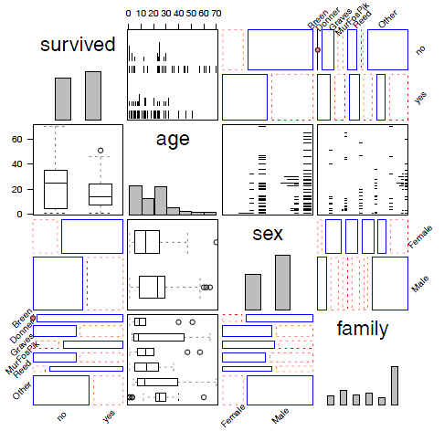
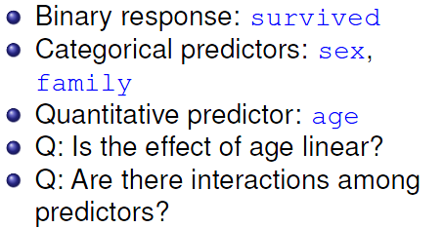
Overview: a gpairs() plot
A generalized pairs plot uses different plot types for pairs of continuous, discrete variables. This plot uses ggpairs::gpairs()

Slide 6

The age-old question

Slide 7
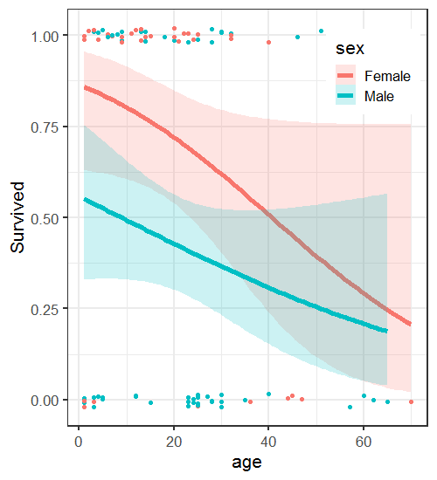
Exploratory plots
Before fitting models, it is useful to explore the data with conditional ggplots
Survival decreases with age for both men and women
Women more likely to survive, particularly the young
Conf. bands show the data is thin at older ages

Slide 8
Using ggplot
Basic plot: survived vs. age, colored by sex, with jittered points
gg <- ggplot(Donner,
aes(age, as.numeric(survived=="yes"), color=sex)) +
ylab("Survived") +
geom_jitter(height = 0.02, width = 0)
To this we can add conditional logistic fits using stat_smooth(method=“glm”)
This is plotted on the probability scale, but reflects a linear relation with log odds.
gg + stat_smooth(method = "glm" ,
method.args = list(family = binomial),
formula = y ~ x,
alpha = 0.2, size=2, aes(fill = sex)) +
theme_bw(base_size = 16) +
theme(legend.position = c(.85, .85))

Slide 9

Questions
Is the relation of survival to age well expressed as a linear logistic regression model?
Allow a quadratic or higher power using poly(age,2), poly(age,3)
Use natural spline functions: ns(age, df) – more flexible shape, with control of number of df
Use non-parametric smooths: loess(age, span, degree)
Is the relation the same for men & women?
Allow an interaction of sex * age or sex * f(age)
Test goodness of fit relative to the main effects model

Slide 10
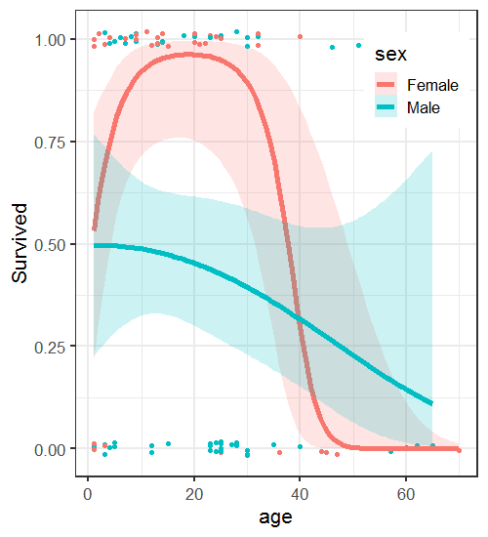
gg + stat_smooth(method = "glm",
method.args = list(family = binomial),
formula = y ~ poly(x,2), alpha = 0.2, size=2, aes(fill = sex)) + …
Fit separate quadratics for M & F
This highlights the very high survival among young women (but not infants)
Using library(splines) and formula=y ~ ns(x,2) gives nearly identical results

Slide 11
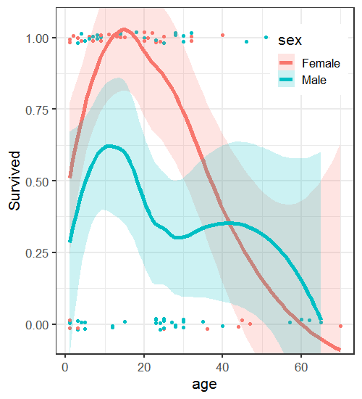
gg + stat_smooth(method = "loess", span=0.9,
alpha = 0.2, size=2,
aes(fill = sex)) + coord_cartesian(ylim=c(-.05,1.05)) +
Fit separate loess smooths for M & F. span controls how smooth
For males, the result is not as smooth as the poly(age,2) suggests
All fitted models give a smoothing of the binary outcome!

Slide 12
Fitting models
Models with linear effect of age, w/, w/o interaction age*sex
> donner.mod1 <- glm(survived ~ age + sex,
data=Donner, family=binomial)
> donner.mod2 <- glm(survived ~ age * sex,
data=Donner, family=binomial)
> Anova(donner.mod2)
Analysis of Deviance Table (Type II tests)
Response: survived
LR Chisq Df Pr(>Chisq)
age 5.52 1 0.0188 *
sex 6.73 1 0.0095 **
age:sex 0.40 1 0.5269
---
Signif. codes: 0 ‘***’ 0.001 ‘**’ 0.01 ‘*’ 0.05 ‘.’ 0.1 ‘ ’ 1

Slide 13
Fitting models
Models with quadratic effect of age:
> donner.mod3 <- glm(survived ~ poly(age,2) + sex,
data=Donner, family=binomial)
> donner.mod4 <- glm(survived ~ poly(age,2) * sex,
data=Donner, family=binomial)
> Anova(donner.mod4)
Analysis of Deviance Table (Type II tests)
Response: survived
LR Chisq Df Pr(>Chisq)
poly(age, 2) 9.91 2 0.0070 **
sex 8.09 1 0.0044 **
poly(age, 2):sex 8.93 2 0.0115 *
---
Signif. codes: 0 ‘***’ 0.001 ‘**’ 0.01 ‘*’ 0.05 ‘.’ 0.1 ‘ ’ 1

Slide 14
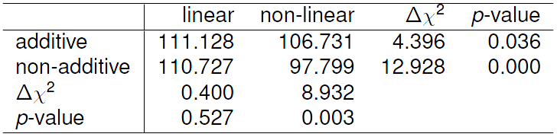
Comparing models
These models are only nested in pairs. We can compare them using AIC & Δχ²
> library(vcdExtra)
> LRstats(donner.mod1, donner.mod2, donner.mod3, donner.mod4)
Likelihood summary table:
AIC BIC LR Chisq Df Pr(>Chisq)
donner.mod1 117 125 111.1 87 0.042 *
donner.mod2 119 129 110.7 86 0.038 *
donner.mod3 115 125 106.7 86 0.064 .
donner.mod4 110 125 97.8 84 0.144
---
Signif. codes: 0 ‘***’ 0.001 ‘**’ 0.01 ‘*’ 0.05 ‘.’ 0.1 ‘ ’ 1
✓
✓
✓
✓
Notes:
mod1 and mod2 are both linear in age.
Mod3 and mod4 are both quadratic in age.

Slide 15
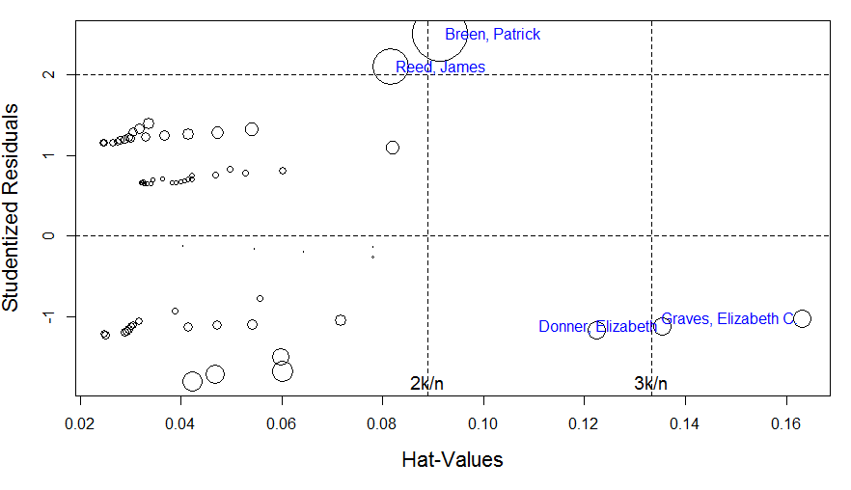
Who was influential?
res <- influencePlot(donner.mod3, id = list(col="blue", n=2), scale=8)
Notes:
I should have done a full range of diagnostic plots, but with a modest sample size it is particularly important to check for influential observations.
I should also have done this with mod4, not mod3 (a slip)

Slide 16
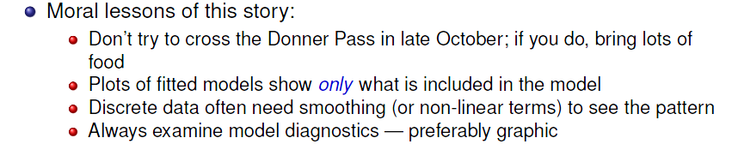
Why were they influential?
> idx <- which(rownames(Donner) %in% rownames(res))
> # show data together with diagnostics
> cbind(Donner[idx,2:4], res)
age sex survived StudRes Hat CookD
Breen, Patrick 51 Male yes 2.50 0.0915 0.3235
Donner, Elizabeth 45 Female no -1.11 0.1354 0.0341
Graves, Elizabeth C. 47 Female no -1.02 0.1632 0.0342
Reed, James 46 Male yes 2.10 0.0816 0.1436

Slide 17
Polytomous responses: Overview
Polytomous responses
m categories → (m-1) independent comparisons (logits)
One part of the model for each logit
Similar to ANOVA where an m-level factor → (m-1) contrasts (df)
Methods differ according to whether the response categories are ordered or unordered
proportional odds model
Nested dichotomies
Generalized multinomial logistic model

Slide 18
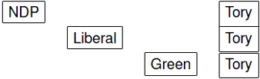


When response categories are
Ordered
Unordered
For example
No improvement
Some
Marked
NDP
Liberal
Conservative
Green
the analysis can use
Multinomial logistic regression
Proportional odds model
Nested dichotomies
we model these logits

Slide 19
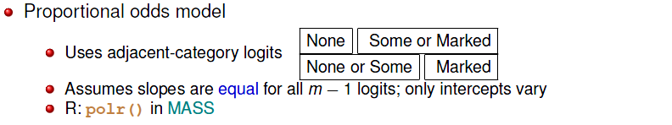
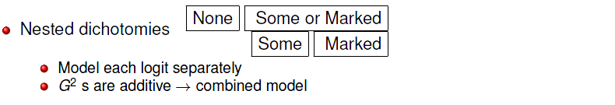
Polytomous responses: Ordered
Polytomous responses
m categories → (m-1) comparisons (logits)
One part of the model for each logit
Similar to ANOVA where an m-level factor → (m-1) contrasts (df)
Ordered response categories, e.g., None, Some, Marked improvement

Slide 20
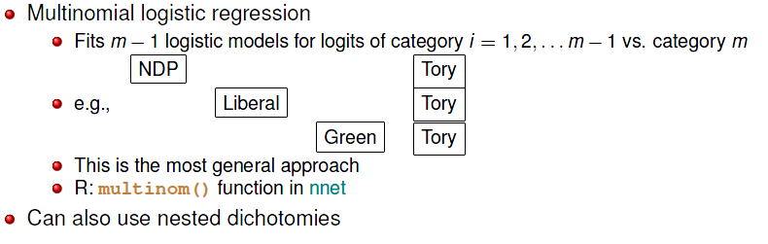
Polytomous responses: Unordered
Unordered response categories, e.g., vote: NDP, Liberal, Green, Tory
These contrasts are orthogonal
Models are independent
G² s add to that for combined model
NDP Liberal Green
Tory
NDP Liberal
Green
NDP
Liberal

Slide 21
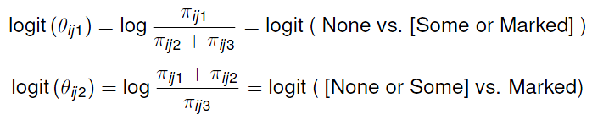
Proportional odds model
Arthritis treatment data:
Improvement
Sex Treatment None Some Marked Total
--- --------- --------------------- -----
F Active 6 5 16 27
F Placebo 19 7 6 32
M Active 7 2 5 14
M Placebo 10 0 1 11
The proportional odds model uses logits for (m-1) = 2 adjacent category cut-points

Slide 22
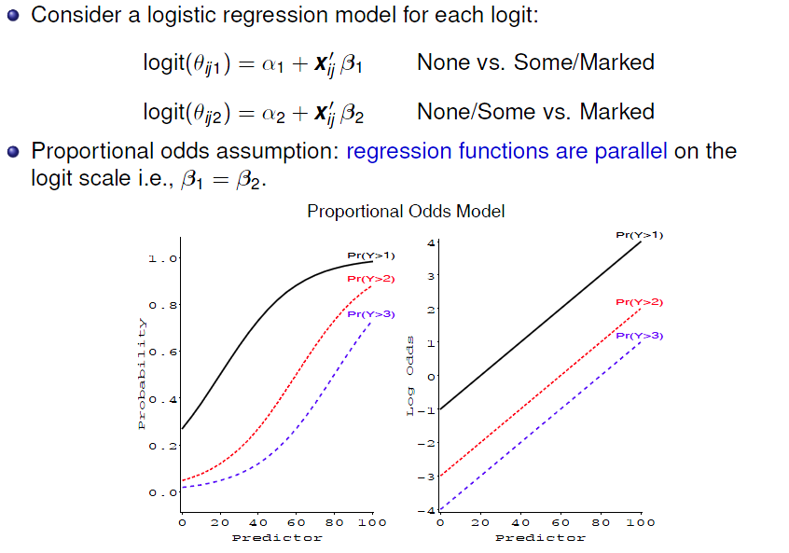

Slide 23
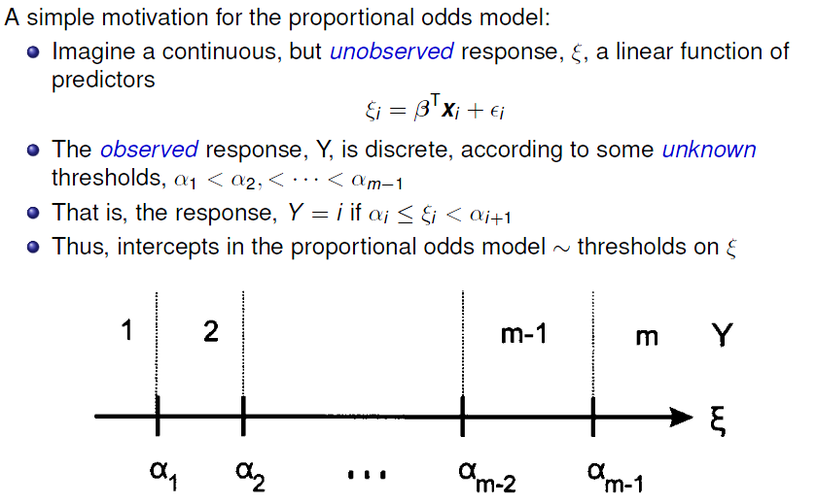
Proportional odds: Latent variable interpretation
1
2

Slide 24
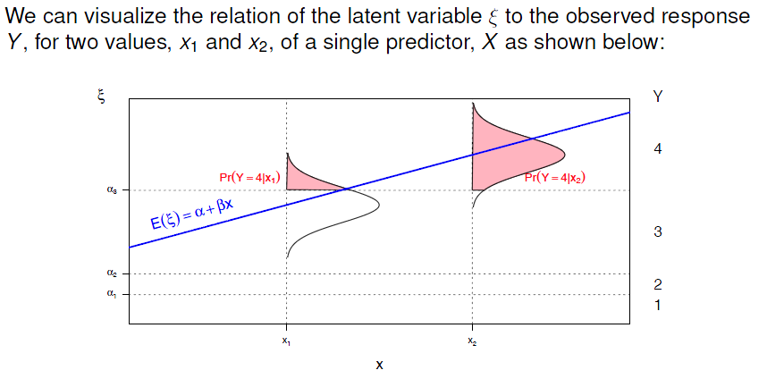
Proportional odds: Latent variable interpretation

Slide 25
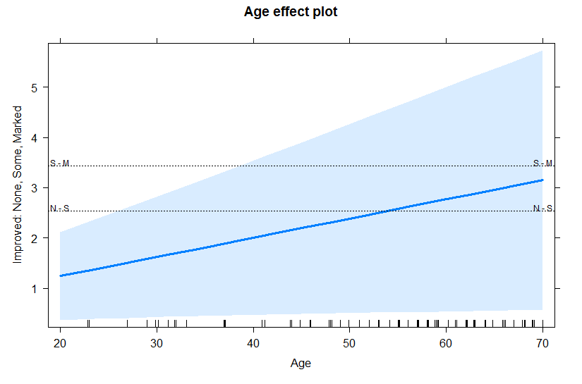
Proportional odds: Latent variable interpretation
Plotting the effect of Age on the latent variable scale
plot(effect("Age", mod = arth.polr, latent = TRUE))
Marked
Latent variable
Some
None

Slide 26
Fitting the proportional odds model
NB: The response Improved has been defined as an ordered factor
> data(Arthritis, package = "vcd")
> head(Arthritis$Improved)
[1] Some None None Marked Marked Marked
Levels: None < Some < Marked
Fit the model with MASS::polr()
> arth.polr <- polr(Improved ~ Sex + Treatment + Age,
data = Arthritis)
> summary(arth.polr) # for coefficients
> Anova(arth.polr) # Type II tests

Slide 27
summary() gives the standard statistical results
> summary(arth.polr) # for coefficients
Call:
polr(formula = Improved ~ Sex + Treatment + Age, data = Arthritis)
Coefficients:
Value Std. Error t value
SexMale -1.2517 0.5464 -2.29
TreatmentTreated 1.7453 0.4759 3.67
Age 0.0382 0.0184 2.07
Intercepts:
Value Std. Error t value
None|Some 2.532 1.057 2.395
Some|Marked 3.431 1.091 3.144
Residual Deviance: 145.46
AIC: 155.46
2.53
3.43
Interpretation of intercepts
None
Some
Marked
0
1
2
3
4
Degree of improvement

Slide 28
car::Anova() gives hypothesis tests for the model terms
> Anova(arth.polr) # Type II tests
Analysis of Deviance Table (Type II tests)
Response: Improved
LR Chisq Df Pr(>Chisq)
Sex 5.69 1 0.01708 *
Treatment 14.71 1 0.00013 ***
Age 4.57 1 0.03251 *
---
Signif. codes: 0 ‘***’ 0.001 ‘**’ 0.01 ‘*’ 0.05 ‘.’ 0.1 ‘ ’ 1
Type II tests are partial tests, controlling for the effects of all other terms
e.g., G² (Sex | Treatment, Age), G² (Treatment | Age, Sex)
NB: anova() gives only Type I (sequential) tests – not usually useful

Slide 29
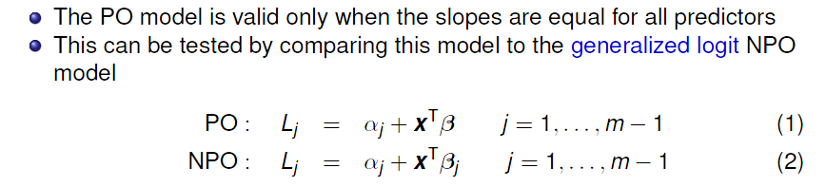
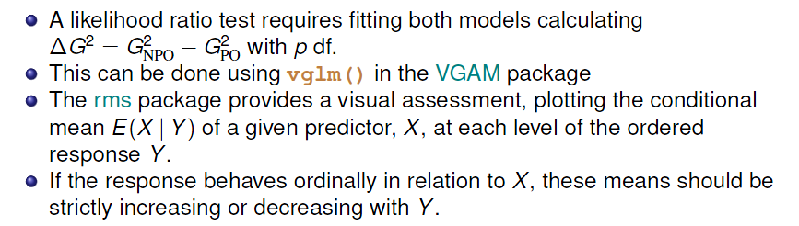
Testing the proportional odds assumption

Slide 30
Testing the proportional odds assumption
In VGAM, the PO model is fit using family = cumulative(parallel=TRUE)
library(VGAM)
arth.po <- vglm(Improved ~ Sex + Treatment + Age, data=Arthritis,
family = cumulative(parallel=TRUE))
The more general NPO model is fit using parallel=FALSE
arth.npo <- vglm(Improved ~ Sex + Treatment + Age, data=Arthritis,
family = cumulative(parallel=FALSE))
The LR test indicates that the proportional odds model is OK
> VGAM::lrtest(arth.npo, arth.po)
Likelihood ratio test
Model 1: Improved ~ Sex + Treatment + Age
Model 2: Improved ~ Sex + Treatment + Age
#Df LogLik Df Chisq Pr(>Chisq)
1 160 -71.8
2 163 -72.7 3 1.88 0.6
✓

Slide 31
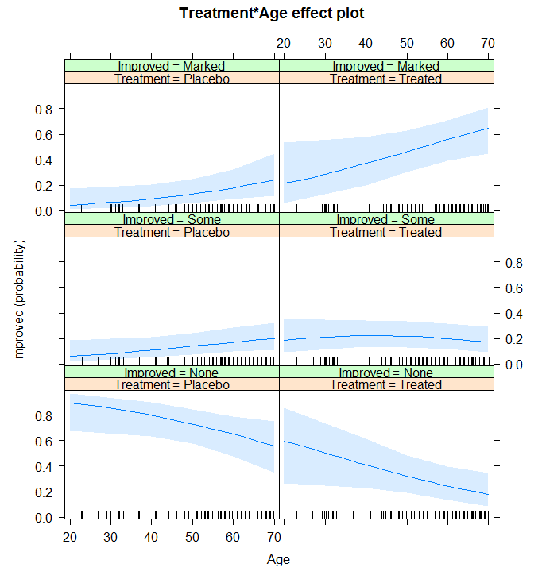
Plotting effects in the PO model
library(effects)
plot(effect("Treatment:Age",
arth.polr))
The default style shows separate curves for the response categories
Difficult to compare these in different panels

Slide 32
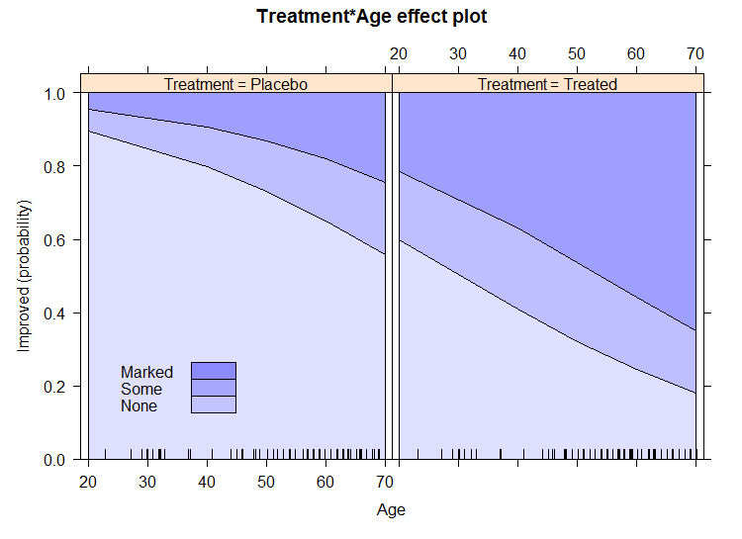
Visual comparisons are easier when the response levels are “stacked”
plot(effect("Treatment:Age", arth.polr), style='stacked’,
colors=scales::alpha("blue", alpha = (1:3)/8) )

Slide 33
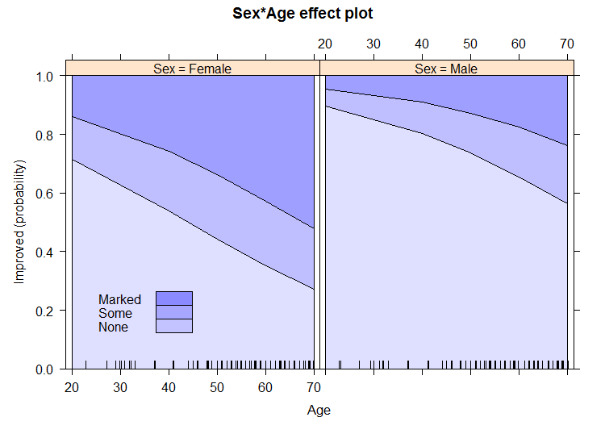
Visual comparisons are easier when the response levels are “stacked”
plot(effect("Sex:Age", arth.polr), style='stacked’,
colors=scales::alpha("blue", alpha = (1:3)/8) )

Slide 34
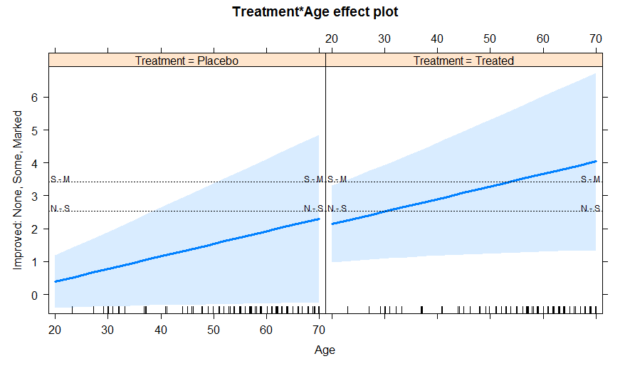
These plots are even simpler on the logit scale, using latent = TRUE to show the cutpoints between adjacent categories
plot(effect("Treatment:Age", arth.polr, latent = TRUE))

Slide 35
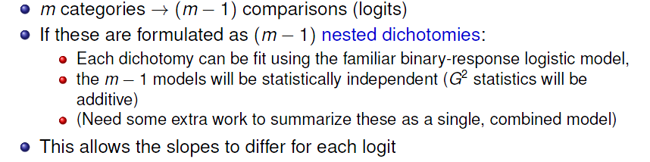
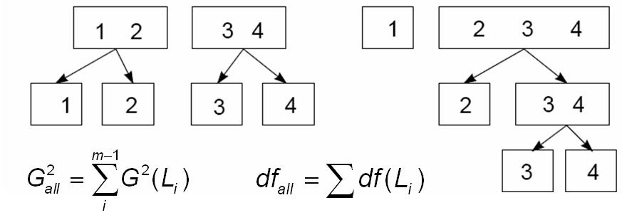
Nested dichotomies

Slide 36
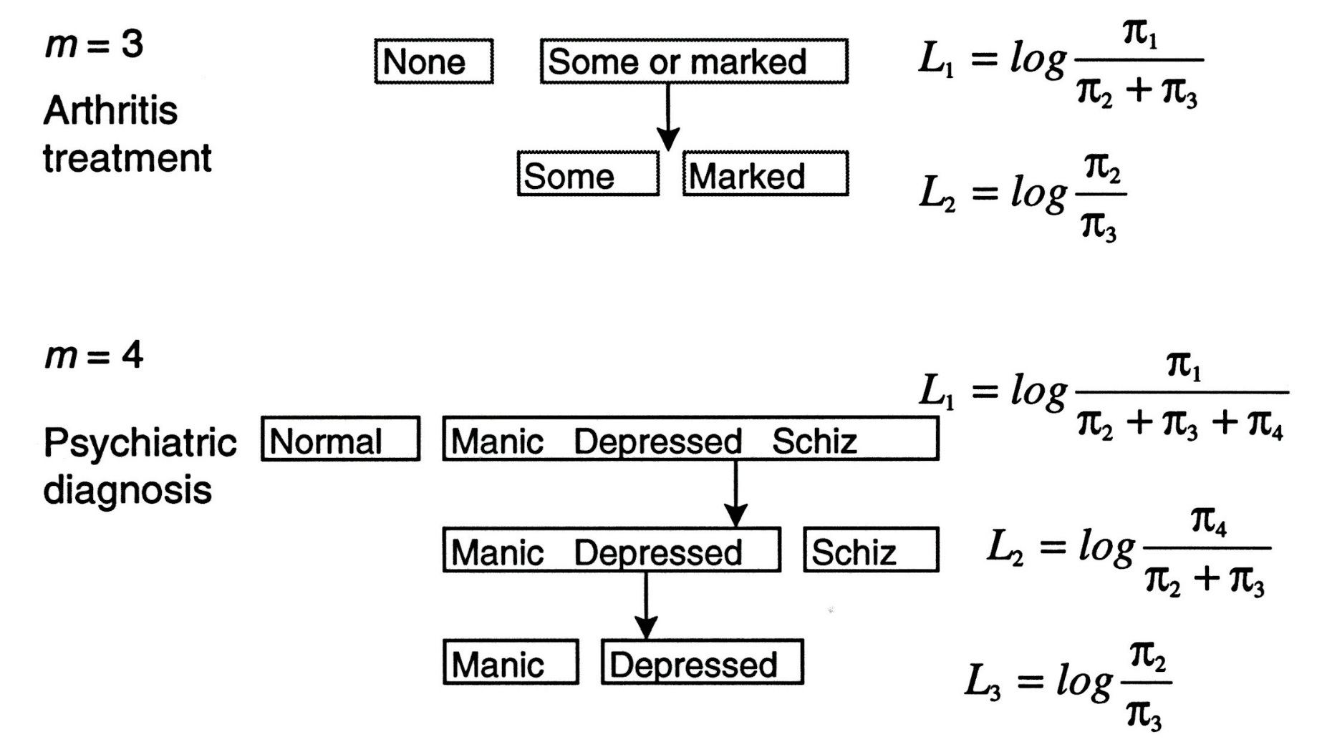
Nested dichotomies: Examples

Slide 37
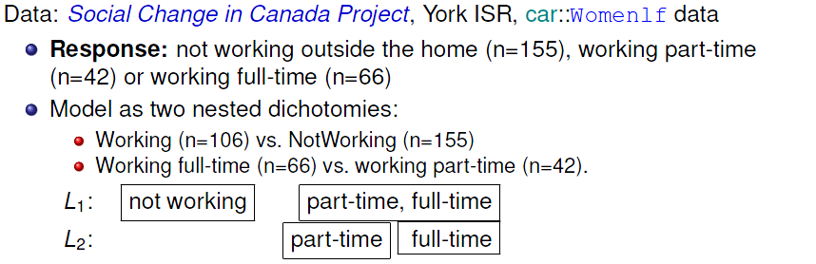
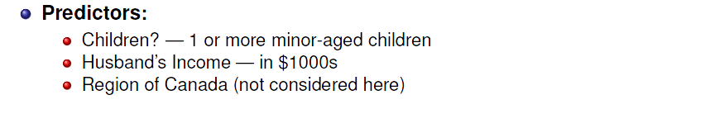
Example: Women’s Labour-force participation
partic hincome children region
31 not.work 13 present Ontario
51 parttime 10 present Prairie
74 not.work 17 present Ontario
108 not.work 19 present Ontario
131 parttime 19 present Ontario
161 not.work 15 present Ontario
178 fulltime 13 absent Ontario

Slide 38
Nested dichotomies: Recoding
In R, need to create new variables, working and fulltime.
> library(dplyr)
> Womenlf <- Womenlf |>
mutate(working = ifelse(partic=="not.work", 0, 1)) |>
mutate(fulltime = case_when(
working & partic == "fulltime" ~ 1,
working & partic == "parttime" ~ 0)
)
> some(Womenlf, 8)
partic hincome children region working fulltime
76 parttime 38 present Ontario 1 0
93 parttime 9 present Ontario 1 0
101 fulltime 11 absent Atlantic 1 1
107 not.work 13 present Prairie 0 NA
109 not.work 19 present Atlantic 0 NA
157 parttime 15 present BC 1 0
220 fulltime 16 absent Quebec 1 1
249 not.work 23 absent Quebec 0 NA

Slide 39
Nested dichotomies: Fitting
Then, fit separate models for each dichotomy:
Womenlf <- within(Womenlf, contrasts(children)<- 'contr.treatment')
mod.working <- glm(working ~ hincome + children, family=binomial, data=Womenlf)
mod.fulltime <- glm(fulltime ~ hincome + children, family=binomial, data=Womenlf)
Some output from summary(mod.working)
Coefficients:
Estimate Std. Error z value Pr(>|z|)
(Intercept) 1.3358 0.3838 3.48 0.0005 ***
hincome -0.0423 0.0198 -2.14 0.0324 *
childrenpresent -1.5756 0.2923 -5.39 7e-08 ***
Some output from summary(mod.fulltime)
Coefficients:
Estimate Std. Error z value Pr(>|z|)
(Intercept) 3.4778 0.7671 4.53 5.8e-06 ***
hincome -0.1073 0.0392 -2.74 0.0061 **
childrenpresent -2.6515 0.5411 -4.90 9.6e-07 ***

Slide 40
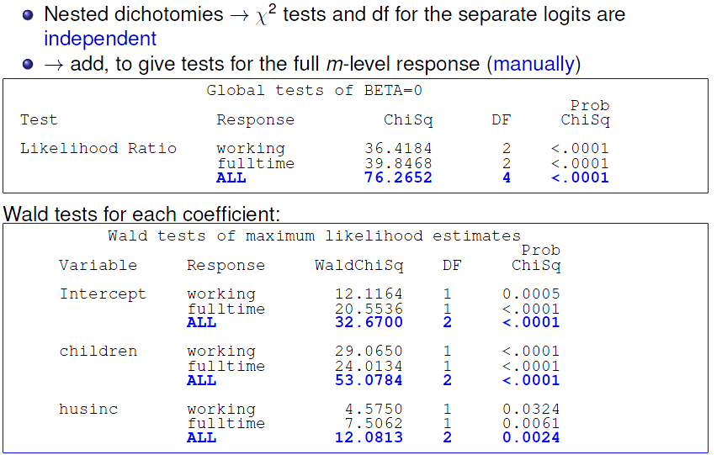
Nested dichotomies: Combined tests

Slide 41
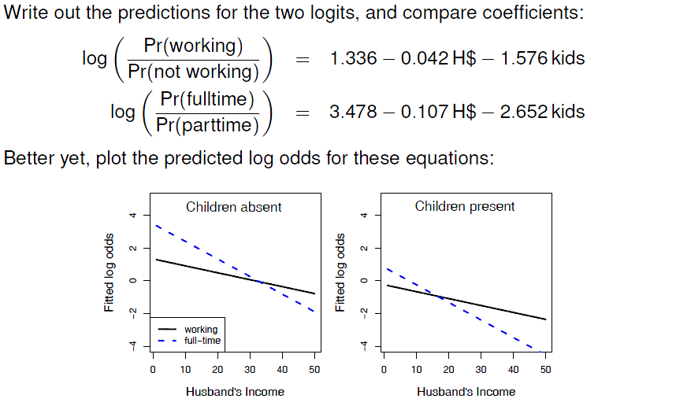
Nested dichotomies: Interpretation

Slide 42
Nested dichotomies: Plotting
For plotting, calculate the predicted probabilities (or logits) over a grid of combinations of the predictors in each sub-model, using predict().
type = “response” gives these on the probability scale
type = “link” (default) gives these on the logit scale
predictors <- expand.grid(hincome=1:45, children=c('absent', 'present'))
# get fitted values for both sub-models
p.work <- predict(mod.working, predictors, type='response')
p.fulltime <- predict(mod.fulltime, predictors, type='response')
The fitted value for the fulltime dichotomy is conditional on working outside the home; multiplying by the probability of working gives the unconditional probability.
p.full <- p.work * p.fulltime
p.part <- p.work * (1 - p.fulltime)
p.not <- 1 - p.work

Slide 43
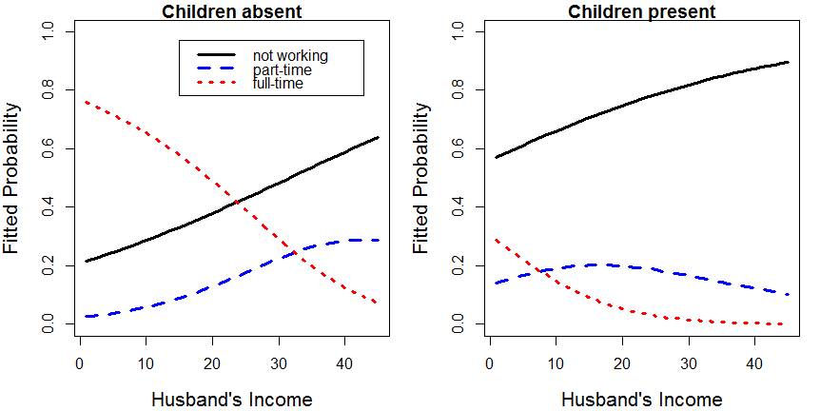
This plot is produced using base R functions plot(), lines() and legend()
See the file: wlf-nested.R on the course web page for details

Slide 44
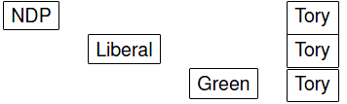
Multinomial logistic regression
Multinomial logistic regression models the probabilities of m response categories as (m-1) logits
Typically, these compare each of the first m-1 categories to the last (reference) category: 1 vs. m, 2 vs. m, … m-1 vs. m
Logits for any pair of categories can be calculated from the m-1 fitted ones
e.g., vote for
( m = 4 )

Slide 45
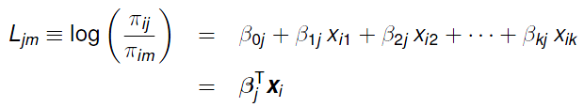

Multinomial logistic regression
with k predictors, x₁, x₂, …, x_{k} and for j=1, 2, …, m-1, the model fits separate slopes for each logit
One set of coefficients, β_{j} for each response category except the last
Each coefficient, β_{hj}, gives effect on log odds that response is j vs. m, for a one unit change in the predictor x_{h}
Probabilities in response categories are calculated as

Slide 46
Fitting multinomial regression models
Fit the multinomial model using nnet::multinom()
For ease of interpretation, make not.work the reference category
> Womenlf$partic <- relevel(Womenlf$partic, ref="not.work")
> library(nnet)
> wlf.multinom <- multinom(partic ~ hincome + children,
data=Womenlf, Hess=TRUE)
The Anova() tests are similar to what we got from summing these tests from the two nested dichotomies
> Anova(wlf.multinom)
Analysis of Deviance Table (Type II tests)
Response: partic
LR Chisq Df Pr(>Chisq)
hincome 15.2 2 0.00051 ***
children 63.6 2 1.6e-14 ***
---
Signif. codes: 0 ‘***’ 0.001 ‘**’ 0.01 ‘*’ 0.05 ‘.’ 0.1 ‘ ’ 1

Slide 47
Interpreting coefficients
As before, interpret coefficients as increments in log odds or exp(coef) as multiples
> coef(wlf.multinom)
(Intercept) hincome childrenpresent
parttime -1.43 0.00689 0.0215
fulltime 1.98 -0.09723 -2.5586
> exp(coef(wlf.multinom))
(Intercept) hincome childrenpresent
parttime 0.239 1.007 1.0217
fulltime 7.263 0.907 0.0774
Each 1000$ of husband’s income:
Increases log odds of parttime by 0.0069; multiplies odds by 1.007 (+0.7%)
Decreases log odds of fulltime by 0.097; multiplies odds by 0.091 (-9%)
Having young children:
Increases odds of parttime by 0.0215; multiplies odds by 1.0217 (+2%)
Decreases odds of fulltime by 2.559; multiplies odds by 0.0774 (-92%)

Slide 48
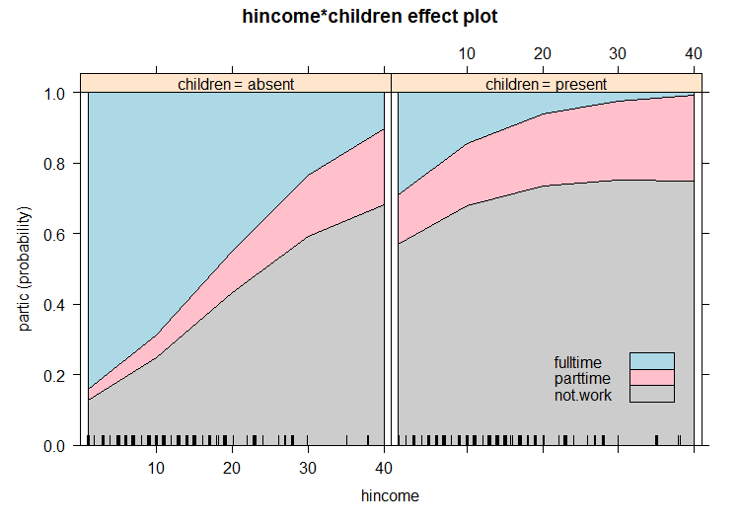
Multinomial models: Plotting
Much easier to interpret a model from a plot, but even more so for polytomous response models
library(effects)
plot(Effect(c("hincome", "children"), wlf.multinom), style = "stacked“)
For multinomial model, style=“stacked” plots cumulative probs.

Slide 49
Multinomial models: Plotting
An alternative is to plot the predicted probabilities of each level of participation over a grid of predictor values for husband’s income and children.
> predictors <- expand.grid(hincome=1:50, children=c('absent', 'present'))
> fit <- data.frame(predictors,
+ predict(wlf.multinom, predictors, type='probs'))
> fit |> filter(hincome %in% c(10, 25, 40)) # show a few observations
hincome children not.work parttime fulltime
10 10 absent 0.250 0.0639 0.68627
25 25 absent 0.520 0.1475 0.33233
40 40 absent 0.683 0.2150 0.10157
60 10 present 0.678 0.1773 0.14427
75 25 present 0.747 0.2164 0.03693
90 40 present 0.750 0.2411 0.00863
We want to plot predicted probability vs. hincome, with separate curves for levels of participation. To do this we need to reshape the fit data from wide to long
plotdat <- fit |>
gather(key="Level", value="Probability", not.work:fulltime)

Slide 50
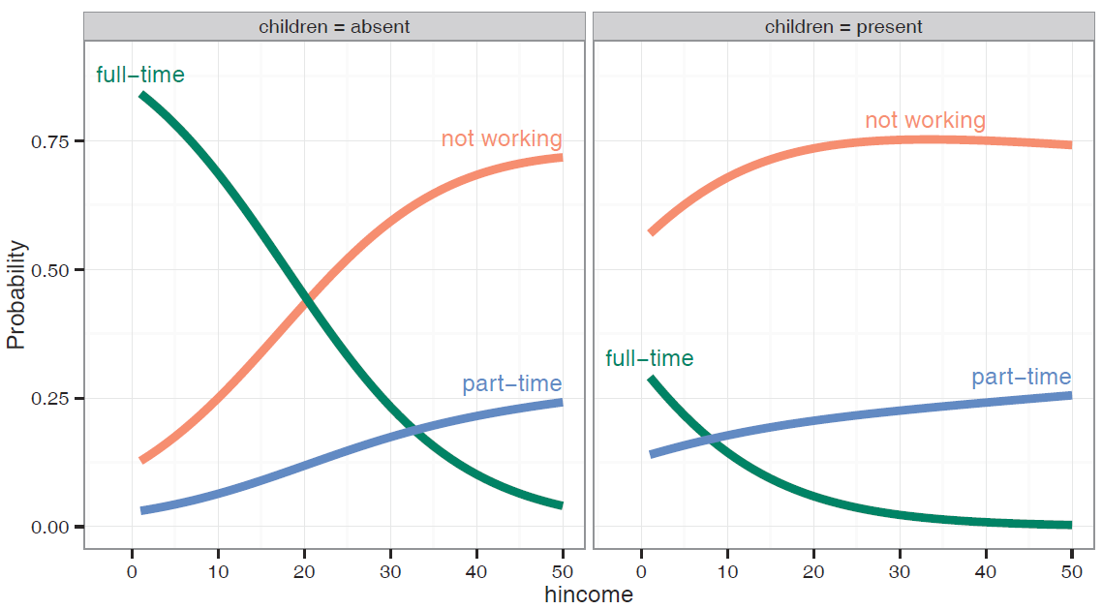
Now, plot Probability ~ hincome, with separate curves for Level of partic
library(directlabels)
gg <- ggplot(plotdat, aes(x = hincome, y = Probability, colour = Level)) +
geom_line(size=1.5) + facet_grid(~ children, labeller = label_both)
direct.label(gg, list("top.bumptwice", dl.trans(y = y + 0.2)))

Slide 51
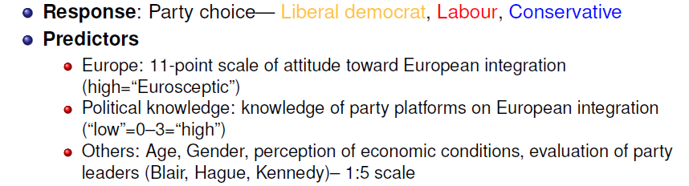
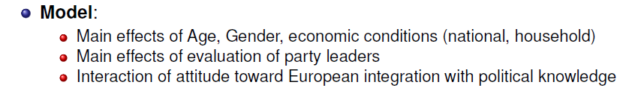
A larger example: BEPS data
Political knowledge & party choice in Britain
Example from Fox & Anderson (2006); data from 1997-2001 British Election Panel Survey (BEPS), N=1325

Slide 52
BEPS data: Fitting
Fit a model with main effects and an interaction of Europe * political knowledge
library(car) # for Anova()
library(nnet) # for multinom()
data(BEPS, package = "carData")
BEPS.mod <- multinom(vote ~ age + gender + economic.cond.national +
economic.cond.household + Blair + Hague + Kennedy +
Europe*political.knowledge, data=BEPS)
Anova(BEPS.mod)
Analysis of Deviance Table (Type II tests)
Response: vote
LR Chisq Df Pr(>Chisq)
age 13.9 2 0.00097 ***
gender 0.5 2 0.79726
economic.cond.national 30.6 2 2.3e-07 ***
economic.cond.household 5.7 2 0.05926 .
Blair 135.4 2 < 2e-16 ***
Hague 166.8 2 < 2e-16 ***
Kennedy 68.9 2 1.1e-15 ***
Europe 78.0 2 < 2e-16 ***
political.knowledge 55.6 2 8.6e-13 ***
Europe:political.knowledge 50.8 2 9.3e-12 ***
---
Signif. codes: 0 ‘***’ 0.001 ‘**’ 0.01 ‘*’ 0.05 ‘.’ 0.1 ‘ ’ 1

Slide 53
BEPS data: Interpretation?
Coefficients give log odds relative of party choice relative to Conservatives
How to understand the nature of these effects?
> coef(BEPS.mod)
(Intercept) age gendermale economic.cond.national
Labour -0.873 -0.0198 0.1126 0.522
Liberal Democrat -0.718 -0.0146 0.0914 0.145
economic.cond.household Blair Hague Kennedy Europe
Labour 0.17863 0.824 -0.868 0.240 -0.00171
Liberal Democrat 0.00773 0.278 -0.781 0.656 0.06841
political.knowledge Europe:political.knowledge
Labour 0.658 -0.159
Liberal Democrat 1.160 -0.183

Slide 54
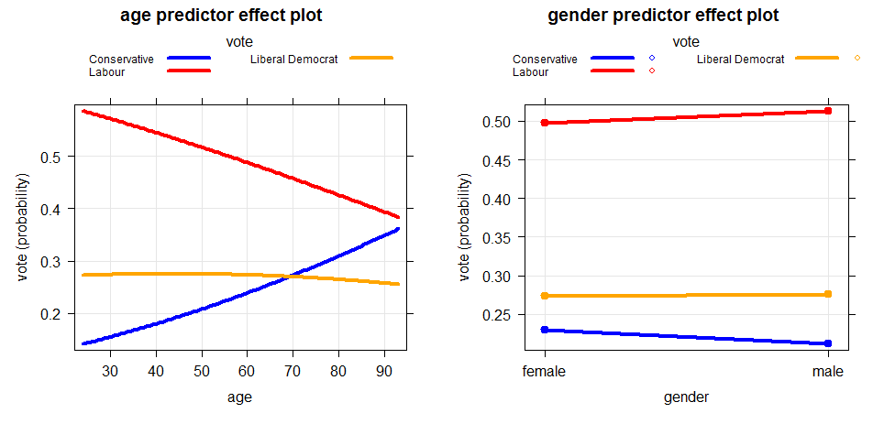
BEPS data: Effect plots
plot(predictorEffects(BEPS.mod, ~ age + gender),
lattice=list(key.args=list(rows=1)),
lines=list(multiline=TRUE, col=c("blue", "red", "orange")))

Slide 55
BEPS data: Effect plots
Examine the interaction between political knowledge and attitude toward European integration
Low knowledge: little relation between attitude and party choice
As knowledge increases: more Eurosceptic view → more likely to support Conservatives
Detailed understanding of complex models depends strongly on visualization!

Slide 56
Summary
Polytomous responses
m response categories → (m-1) comparisons (logits)
Different models for ordered vs. unordered categories
Proportional odds model
Simplest approach for ordered categories
Assumes same slopes for all logits
Fit with MASS::polr()
Test PO assumption with VGAM::vglm()
Nested dichotomies
Applies to ordered or unordered categories
Fit m – 1 separate independent models → Additive G² values
Multinomial logistic regression
Fit m – 1 logits as a single model
Results usually comparable to nested dichotomies, but diff interpretation
R: nnet::multinom()

