Slide 1
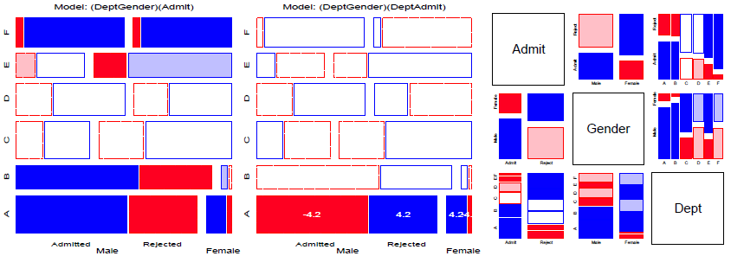
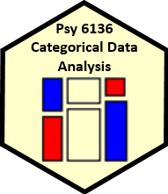
Loglinear models & mosaic displays
Michael Friendly
Psych 6136
https://friendly.github.io/psy6136

Slide 2
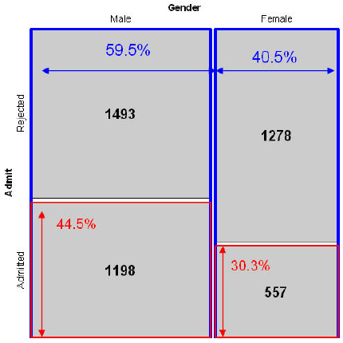
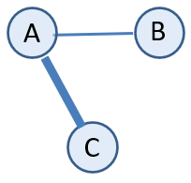
Today’s topics
Mosaic displays: basic ideas
Models for count data
Fitting loglinear models
Two-way tables
Fitting & graphing LLMs
Three-way tables: different kinds of independence
Sequential plots & models
Marginal & partial displays

Slide 3
Mosaic displays
Similar to sieve plot, tile plot, using area ~ frequency
Mosaic plots generalize more readily to n-way tables (subject to resolution of the display)
Intimately connected to loglinear & generalized linear models
Can fit sequential models as variables are entered
Show the pattern of association not accounted for in a given model
Friendly, M. (1994). Mosaic Displays for Multi-way Contingency Tables. Journal of the American Statistical Association, 89, 190–200. http://www.jstor.org/stable/2291215

Slide 4
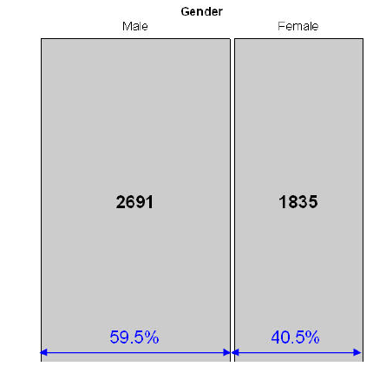
Mosaic displays: basic ideas
Mosaic displays theory: Hartigan & Kleiner (1981); Friendly (1994, 1999)
UCB Admissions: Gender frequencies
Area proportional display for an n-way table
Tiles: recursive splits of a unit square, alternating H, V
V₁: width ~ marginal frequencies, n _{i++}
V₂: height ~ cond freq: V₂| V₁ = n_{ij} / n_{i++}
V₃: width ~ cond freq: V₃ | V₁, V₂ = n_{ikj} / n_{ij+}
→ Area ~ cell frequency, n_{ijk}

Slide 5
Mosaic displays: basic ideas
UCB Admissions: Gender x Admit
Area proportional display for an n-way table
Tiles: recursive splits of a unit square, alternating H, V
V₁: width ~ marginal frequencies, n _{i++}
V₂: height ~ cond freq: V₂| V₁ = n_{ij} / n_{i++}
V₃: width ~ cond freq: V₃ | V₁, V₂ = n_{ikj} / n_{ij+}
→ Area ~ cell frequency, n_{ijk}

Slide 6
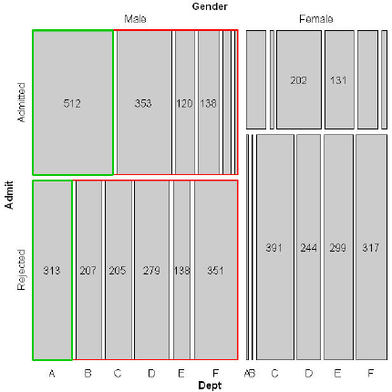
Mosaic displays: basic ideas
Gender x Admit x Dept frequencies
Area proportional display for an n-way table
Tiles: recursive splits of a unit square, alternating H, V
V₁: width ~ marginal frequencies, n _{i++}
V₂: height ~ cond freq: V₂| V₁ = n_{ij} / n_{i++}
V₃: width ~ cond freq: V₃ | V₁, V₂ = n_{ikj} / n_{ij+}
→ Area ~ cell frequency, n_{ijk}

Slide 7
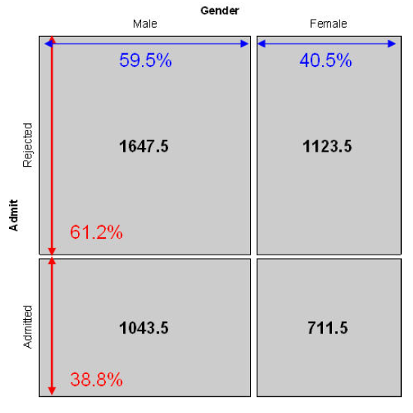

Mosaic displays: Independence
Expected frequencies if Admit ⊥ Gender
Expected frequencies under independence are products of the row / col margins
→ Row and col tiles align when variables are independent

Slide 8

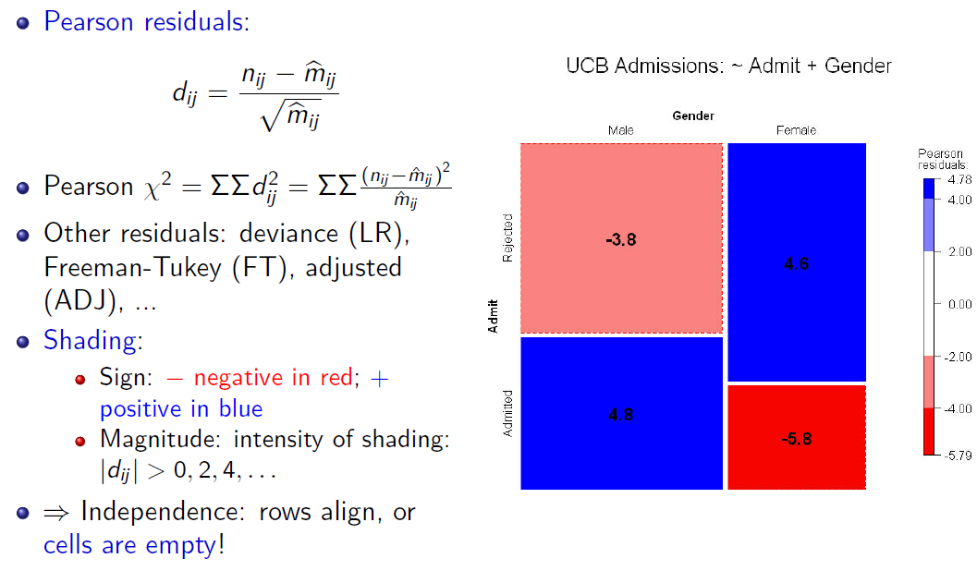
Mosaic displays: Residuals & shading
Idea: Color-encode the mosaic tiles to show the deviations from independence

Slide 9
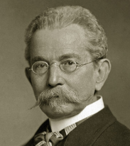
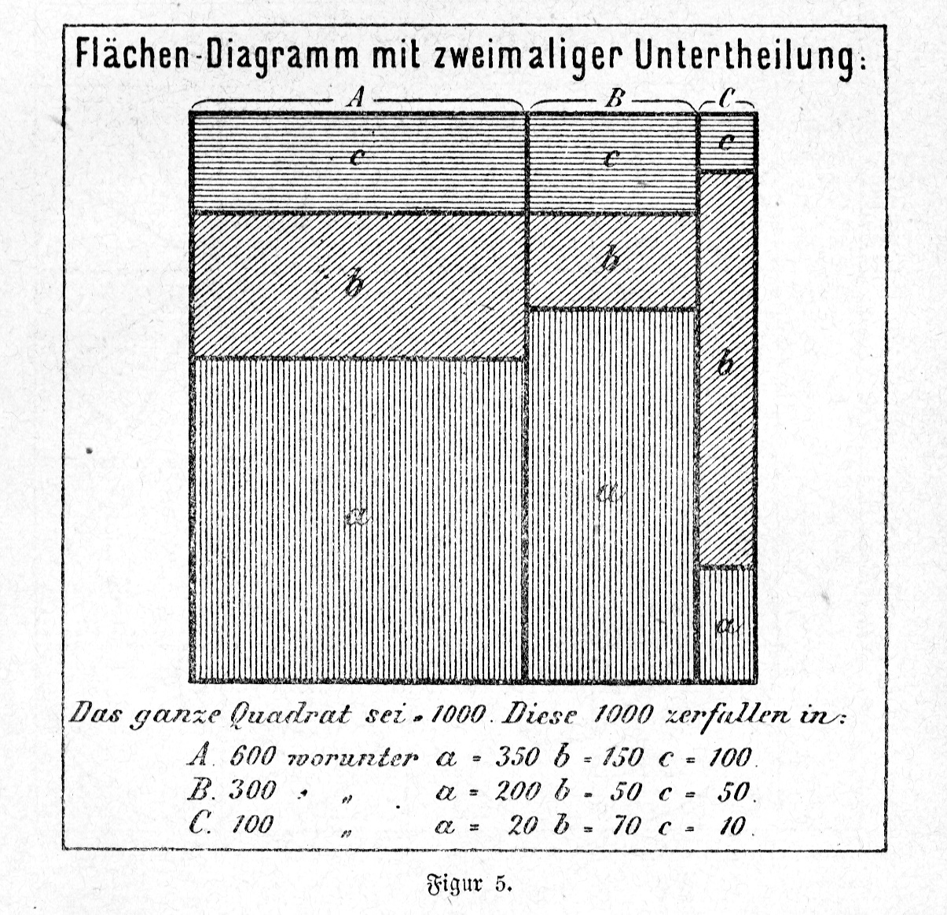
History corner: von Mayr
Georg von Mayr (1877) was the first to suggest an area-proportional display for two categorical variables
Total count = 1000
Divided into (cows, pigs, sheep?)
A = 600, B= 300, C= 100)
Each of these sub-divided by a 2nd variable (region: a, b, c)
The name: “bottle diagram with double divisions” suggests further splits
See: Friendly (2002), “A Brief History of the Mosaic Display”, JCGS, 11:1,89-107, http://dx.doi.org/10.1198/106186002317375631

Slide 10
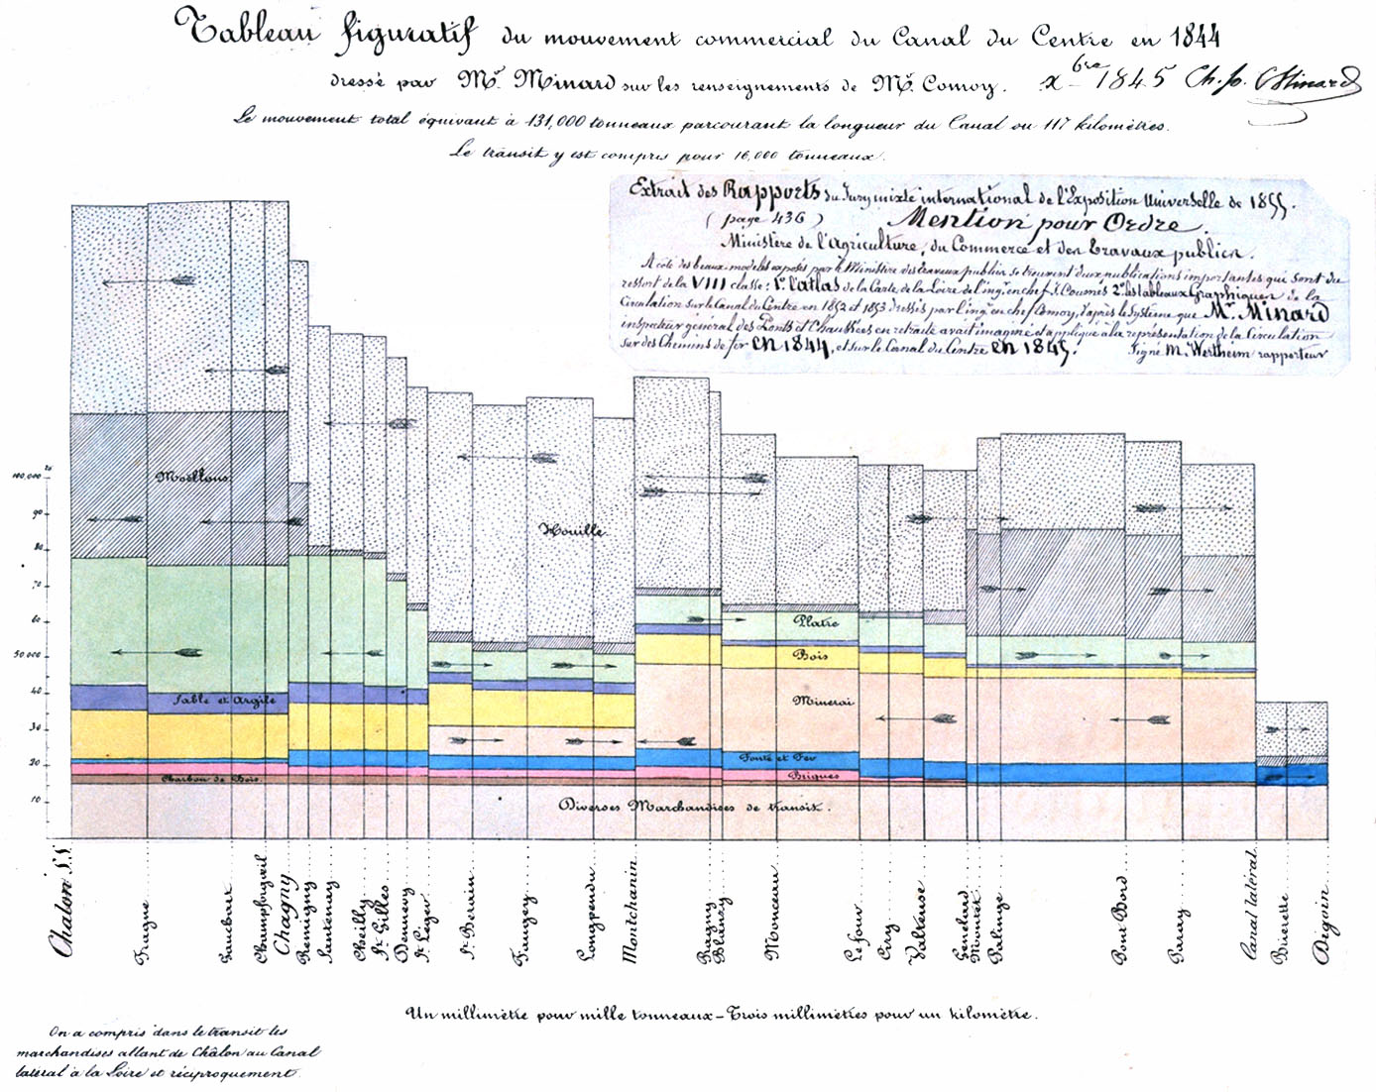
History corner: Minard
Charles Joseph Minard used an early form of an area-proportional plot to show the value of transport of goods along the Canal du Centre, from Chalon to Dijon.
Width ~ distance
Height ~ amount of goods
→ Value = distance × amount

Slide 11
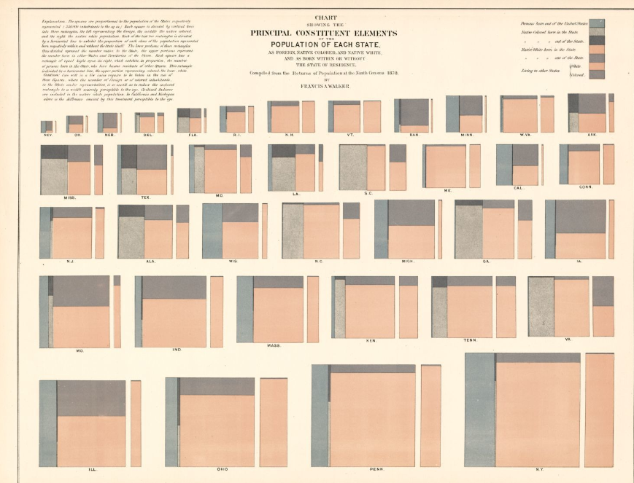
History corner: Francis Walker
In the 1870 Statistical Album of the US Census, Francis Walker wanted to show the populations of the states as comprised of {foreign, native colored, native white}
and born {within, outside} their state of residence.
States are ordered by total pop, shown by area
For each state, a small mosaic, supplemented by a marginal one (w/in, outside)
Ark
Miss
CA
CT
NJ
Tenn
VA
Ill.
Ohio
Penn
NY

Slide 12
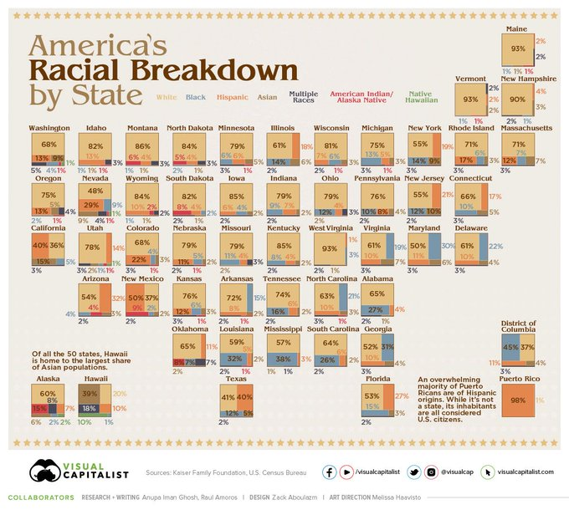
Mosaic cartograms
US map provides a spatial framework for showing the distribution of categorical data
Each mosaic is positioned as in a schematic US map

Slide 13

Loglinear models: Perspectives
Loglinear models grew up and developed from three different ideas and ways of thinking about notions of independence in frequency data
Loglinear approach: analog of ANOVA; associations are ~ interactions
glm() approach: analog of general regression model, for log(Freq), with Poisson dist^{n} of errors
Logit models: Loglinear, simplified for a binary response

Slide 14

Loglinear approach
First developed as analog of classical ANOVA models, where multiplicative relations are re-expressed in additive form as models for log(Freq)
This expresses the independence model for a 2-way table as no A*B association
Short-hand notations: [A][B] = A ⊥ B = ~ A + B
Fit by simple iterative proportional scaling: MASS::loglm()
Parameters aren’t estimated; only fitted frequencies.
loglm(Freq ~ A + B + C) # [A][B][C]
loglm(Freq ~ A * B + C ) # [A B][C]
loglm(Freq ~ A * B * C) # [A B C]

Slide 15
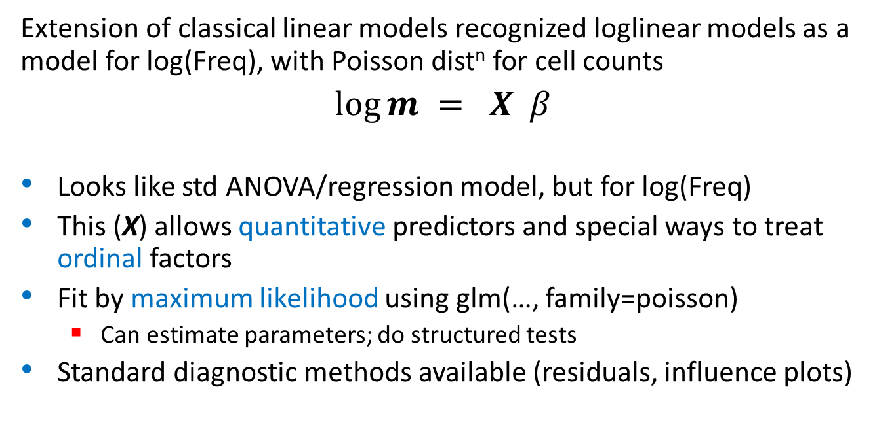
glm() approach
Extension of classical linear models recognized loglinear models as a model for log(Freq), with Poisson dist^{n} for cell counts
$\log{m = X β}$
Looks like std ANOVA/regression model, but for log(Freq)
This (X) allows quantitative predictors and special ways to treat ordinal factors
Fit by maximum likelihood using glm(…, family=poisson)
Can estimate parameters; do structured tests
Standard diagnostic methods available (residuals, influence plots)
glm( Freq ~ A + B + C, family = poisson # [A] [B] [C]
glm( Freq ~ A * B + C, family = poisson) # [A B] [C]
glm( Freq ~ A * (B+C), family = poisson # [A B] [A C]

Slide 16

Logit models
When one variable is a binary response, a logit model is a simpler way to specify a loglinear model
log(m_{1jk}/m_{2jk}) is the log odds of response A₁ vs A₂
The model only includes terms for the effect of A on B & C
Equivalent loglinear model: [AB][AC] [BC]
The logit models assumes the [BC] association;
[AB] → β_{j}^{B} [AC] → β_{k}^{C}
Fit using family=binomial
assumed
glm(outcome==“survived” ~ B + C, family = binomial)

Slide 17
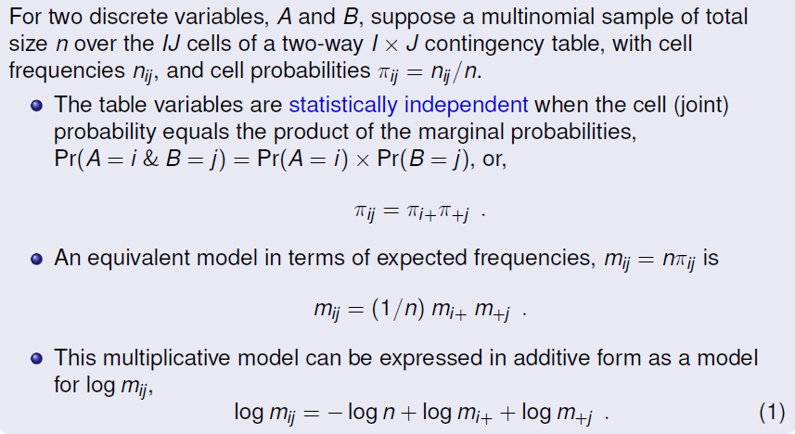
Two-way tables: loglinear approach

Slide 18
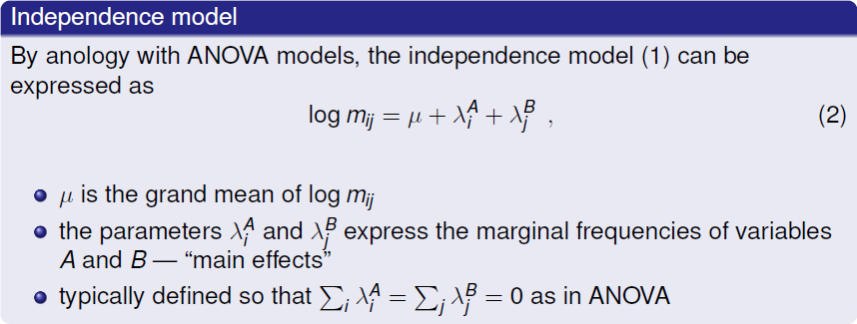
Two-way tables: loglinear approach
≡ [A][B] ≡ ~A + B

Slide 19
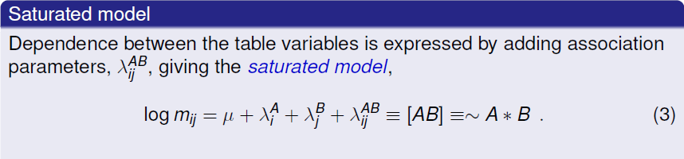


Two-way tables: loglinear approach

Slide 20
Example: Independence
Generate a table of Education by Party preference, strictly independent
> educ <- c(50, 100, 50) # marginal frequencies
> names(educ) <- c("Low", "Med", "High")
> party <- c(20, 50, 30) # marginal frequencies
> names(party) <- c("NDP", "Liberal", "Cons")
> table <- outer(educ, party) / sum(party) # cell = row * col / n
> names(dimnames(table)) <- c("Education", "Party")
> table
Party
Education NDP Liberal Cons
Low 10 25 15
Med 20 50 30
High 10 25 15
Perfect fit:
> MASS::loglm(~ Education + Party, data=table)
Call:
MASS::loglm(formula = ~Education + Party, data = table)
Statistics:
X^2 df P(> X^2)
Likelihood Ratio 0 4 1
Pearson 0 4 1
✓

Slide 21
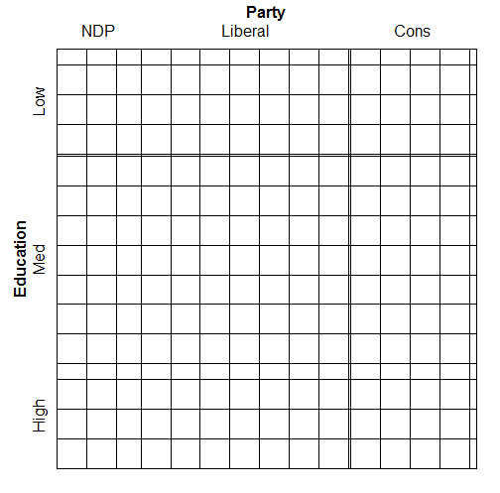
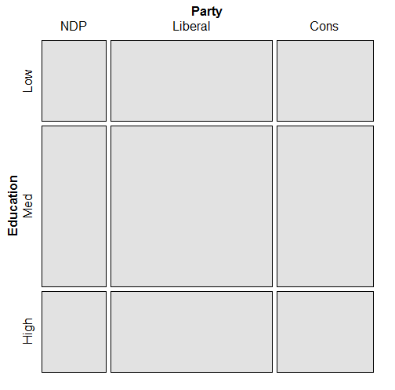
Both sieve diagrams and mosaic plots show what independence “looks like”
> sieve(table, shade=TRUE)
> mosaic(table, shade=TRUE)

Slide 22
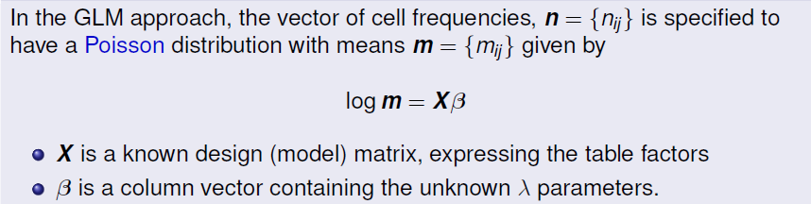
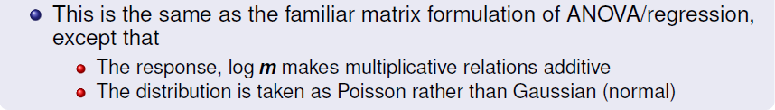
Two-way tables: glm approach

Slide 23
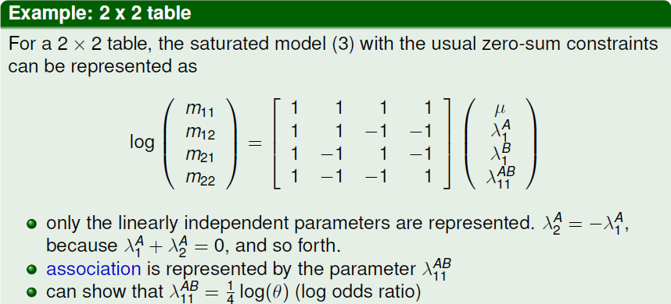

X
β
total n
margin A
margin B
association
i.e., Var(m_{ij}) > m_{ij} then can use NegBin, MASS::glm.nb()

Slide 24
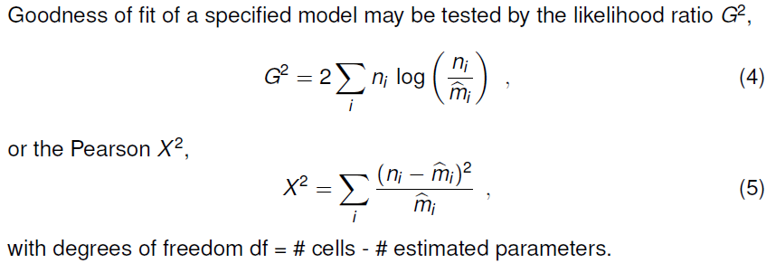
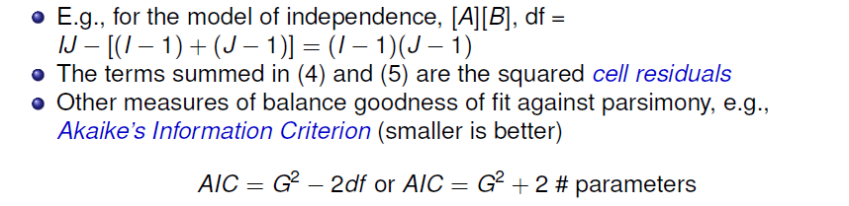
Assessing goodness of fit

Slide 25
Degrees of freedom
Q: Why do degrees of freedom for an r × c table = (r-1) * (c-1)?
A: Because the row & column totals are used to calculate expected frequencies
Only (r-1) independent parameters for each column
→ Only (c-1) independent parameters for each row
> addmargins(HE) |> knitr::kable()
| | Black| Brown| Red| Blond| Sum|
|:-----|-----:|-----:|---:|-----:|---:|
|Brown | 68| 119| 26| 7| 220|
|Blue | 20| 84| 17| 94| 215|
|Hazel | 15| 54| 14| 10| 93|
|Green | 5| 29| 14| 16| 64|
|:-----|-----:|-----:|---:|-----:|---:|
|Sum | 108| 286| 71| 127| 592|

Slide 26
R functions for loglinear models
vcd::assocstats() – only χ² tests for two-way tables; not a model (no parameters; no residuals)
MASS::loglm() – general loglinear models for n-way tables
loglm(formula, data, subset, na.action, …)
glm() – all generalized linear models; loglinear with family = poisson
glm(formula, data, weights, subset, …)
Model formulas have the form:
table form: ~ A + B + … (independence);
~ A * B + C (allow A*B association)
frequency data frame: Freq ~ A * B + C

Slide 27

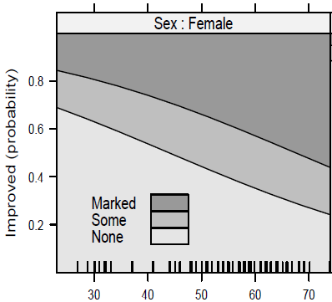

Model-based methods: Fitting & graphing
residuals(mod)
glm()
polr()
multinom()
plot(mod)
plot(f(mod))
input
data
model object
coef(mod)
confint(mod)
model function
data
object
method
output

Slide 28
R functions & methods
loglm() and glm() return an R object with named components and with a class()– here “loglm”
Objects have methods: print(), summary(), coef(), residuals(), plot() and other methods
Methods are specific to the class of the object
print(arth.mod) → print.loglm(arth.mod)
residuals(arth.mod) → residuals.loglm(arth.mod)
> arth.mod <- loglm(~Treatment+Improved, data=arth.tab, fitted=TRUE)
> names(arth.mod)
[1] "lrt" "pearson" "df" "margin" "fitted" "param"
[7] "call" "formula" "frequencies" "deviance" "nobs" "terms“
class(arth.mod)
[1] "loglm"

Slide 29
Example: Arthritis treatment
Data on effects of treatment for rheumatoid arthritis (in case form)
> data(Arthritis, package="vcd")
> str(Arthritis)
'data.frame': 84 obs. of 5 variables:
$ ID : int 57 46 77 17 36 23 75 39 33 55 ...
$ Treatment: Factor w/ 2 levels "Placebo","Treated": 2 2 2 2 2 2 2 2 2 2 ...
$ Sex : Factor w/ 2 levels "Female","Male": 2 2 2 2 2 2 2 2 2 2 ...
$ Age : int 27 29 30 32 46 58 59 59 63 63 ...
$ Improved : Ord.factor w/ 3 levels "None"<"Some"<..: 2 1 1 3 3 3 1 3 1 1 ...
For now, ignore Age; consider the 2 x 3 table of Treatment x Improved
> arth.tab <- with(Arthritis, table(Treatment, Improved))
> arth.tab
Improved
Treatment None Some Marked
Placebo 29 7 7
Treated 13 7 21
arth.tab is a “table” object print.table() gives this output

Slide 30
Arthritis treatment
Fit the independence model, ~ Treatment + Improved
> (arth.mod <- loglm(~Treatment + Improved, data = arth.tab, fitted=TRUE))
Call:
loglm(formula = ~Treatment + Improved, data = arth.tab, fitted = TRUE)
Statistics:
X^2 df P(> X^2)
Likelihood Ratio 13.53 2 0.001154
Pearson 13.06 2 0.001463
The method print.loglm() gives this output
Some methods: residuals(), deviance(), coef(), …
> round(residuals(arth.mod), 3)
Improved
Treatment None Some Marked
Placebo 1.535 -0.063 -2.152
Treated -1.777 0.064 1.837
# Likelihood ratio chisquare
> deviance(arth.mod)
[1] 13.53
> coef(arth.mod)
$`(Intercept)`
[1] 2.543
$Treatment
Placebo Treated
0.0238 -0.0238
$Improved
None Some Marked
0.5014 -0.5972 0.0959

Slide 31
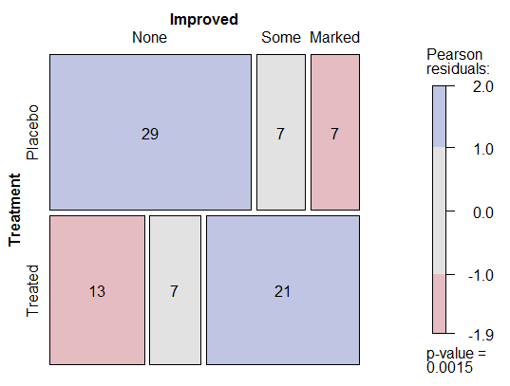
Arthritis treatment: Plots
Visualization: mosaic() or plot() the model or table
> mosaic(arth.mod, shade=TRUE, gp_args=list(interpolate=1:4),
labeling = labeling_values)
Splits by the response, Treatment first
Custom scheme for shading levels; normally
c(2, 4) for |residual|
Cells can be labeled by freq, residual, …

Slide 32
Arthritis treatment: glm()
glm() for loglinear models easiest w/ the data as a data.frame in frequency form, family=poisson
> arth.df <- as.data.frame(xtabs(~ Treatment + Improved,
data=Arthritis))
> arth.df
Treatment Improved Freq
1 Placebo None 29
2 Treated None 13
3 Placebo Some 7
4 Treated Some 7
5 Placebo Marked 7
6 Treated Marked 21
> arth.glm <- glm(Freq ~ Treatment + Improved, data = arth.df,
family = poisson)
More on glm() models later

Slide 33
Example: Hair color & Eye color
> haireye <- margin.table(HairEyeColor, 1:2)
> (HE.mod <- loglm(~ Hair + Eye, data=haireye))
Call:
loglm(formula = ~Hair + Eye, data = haireye)
Statistics:
X^2 df P(> X^2)
Likelihood Ratio 146.4 9 0
Pearson 138.3 9 0
> round(residuals(HE.mod), 2)
Re-fitting to get frequencies and fitted values
Eye
Hair Brown Blue Hazel Green
Black 4.00 -3.39 -0.49 -2.21
Brown 1.21 -2.02 1.31 -0.35
Red -0.08 -1.85 0.82 2.04
Blond -7.33 6.17 -2.47 0.60

Slide 34
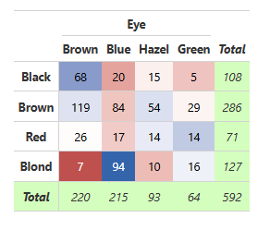
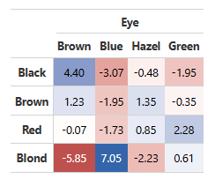
New in vcdExtra: color_table()
Idea: Semi-graphic “heatmap” display of a frequency table or residuals, shading background ~ residuals (remaining association, not fit by a model)
color_table(haireye)
color_table(haireye,
values = "residuals")

Slide 35

Mosaic displays: Seeing patterns
In two-way models, residuals contain the info on lack of independence ⟶ where the action is!!
Equivalently: help to understand the pattern of association
Effect ordering: permuting the rows / cols often makes the pattern more apparent
Correspondence analysis: → reorder by scores on Dim 1
seriation::permute(order=“CA”) does this for two-way tables
> haireye
Eye
Hair Brown Blue Hazel Green
Black 68 20 15 5
Brown 119 84 54 29
Red 26 17 14 14
Blond 7 94 10 16
> library(seriation)
> permute(haireye, "CA")
Eye
Hair Brown Hazel Green Blue
Black 68 15 5 20
Brown 119 54 29 84
Red 26 14 14 17
Blond 7 10 16 94

Slide 36
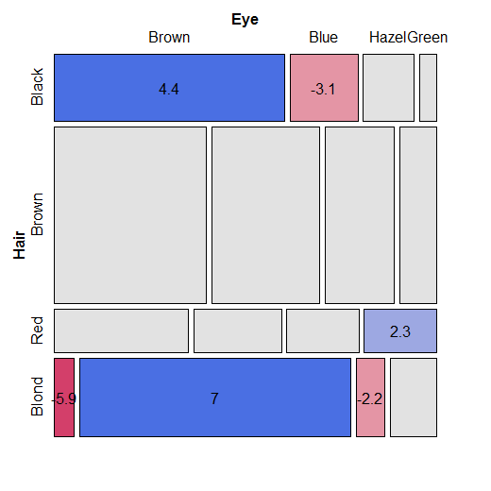
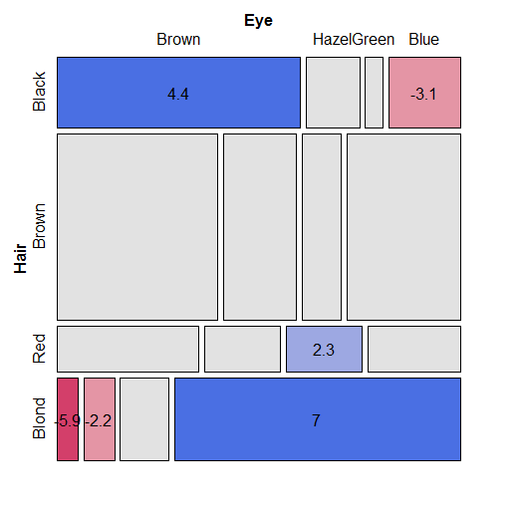
Mosaic displays: Seeing patterns
mosaic(haireye, shade=TRUE, labeling=labeling_residuals)
mosaic(permute(haireye, "CA"), shade=TRUE, labeling=labeling_residuals)
Look for: opposite corner pattern

Slide 37

Bee abundance data
A study by Taylor Kerekes examined the abundance of bee species in Ontario over three periods of time.
Q: Does relative abundance of species differ over years?
A: Do a chi-square test
# A tibble: 14 x 4
species `2002` `2005` `2021`
<chr> <dbl> <dbl> <dbl>
1 Affinis 508 0 0
2 Bimaculatus 362 345 137
3 Borealis 30 6 11
4 Fervidus 634 19 10
5 Griseocollis 35 21 21
6 Impatiens 638 564 616
7 Pensylvanicus 112 0 0
8 Perplexus 160 57 9
9 Rufocinctus 51 46 17
10 Ternarius 9 16 9
11 Terricola 119 1 4
12 Vagans 713 82 39
13 Ashtoni (M) 27 0 0
14 Citrinus (M) 234 38 5
chisq.test(bees[,-1])
Pearson's Chi-squared test
data: bees[, -1]
X-squared = 1981, df = 26, p-value <2e-16
✓✓
How to understand the pattern of association?

Slide 38
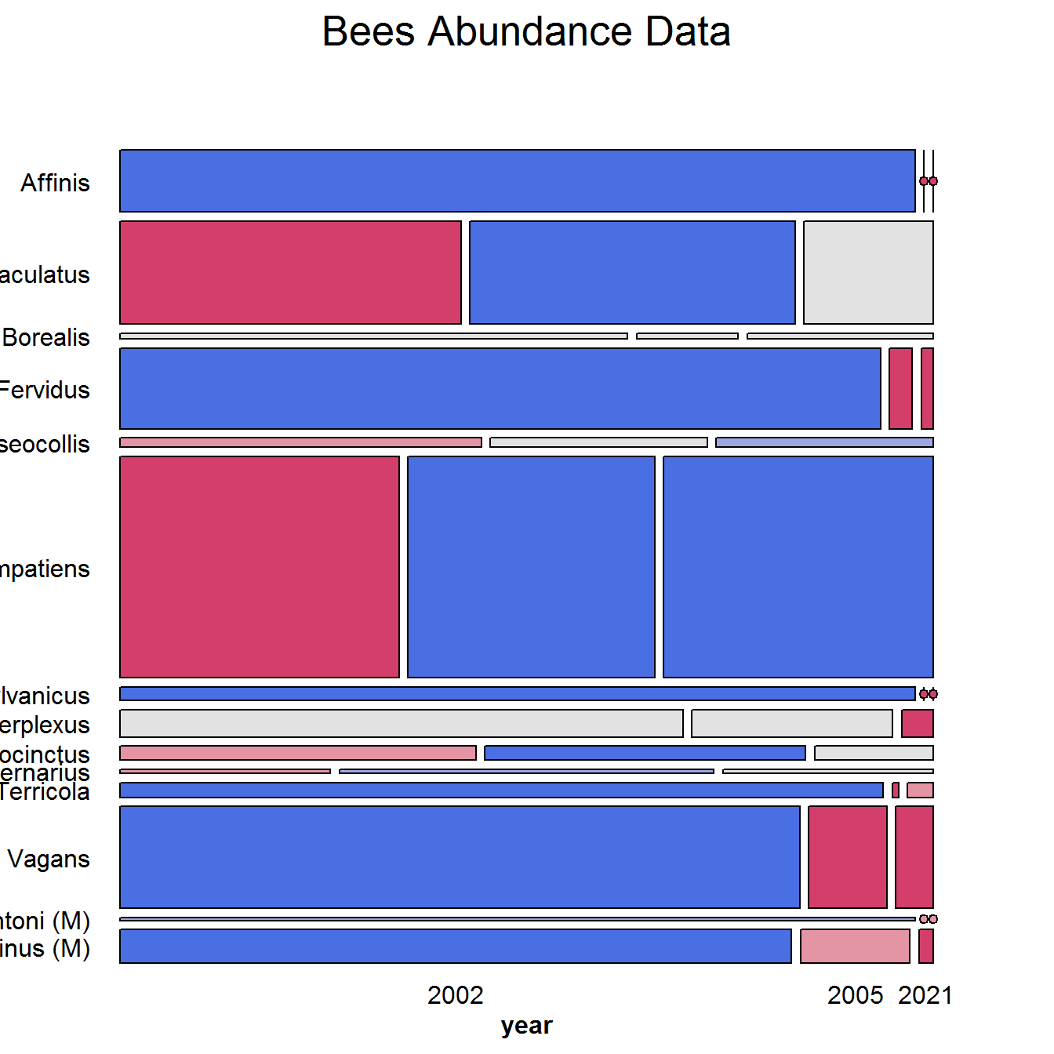
mosaic(bees.mat, shade=TRUE, …)
Alphabetic order of species:
No clear pattern

Slide 39
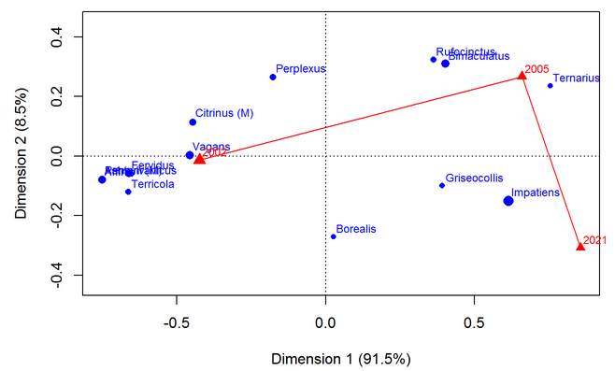
Correspondence analysis finds scores for the row & col categories to account for maximum χ²
Library(ca)
bees.ca <- ca(bees.mat)
plot(bees.ca,
lines=c(FALSE,TRUE), # join years with lines
mass = c(TRUE, TRUE)) # symbol size ~ marginal frequency

Slide 40
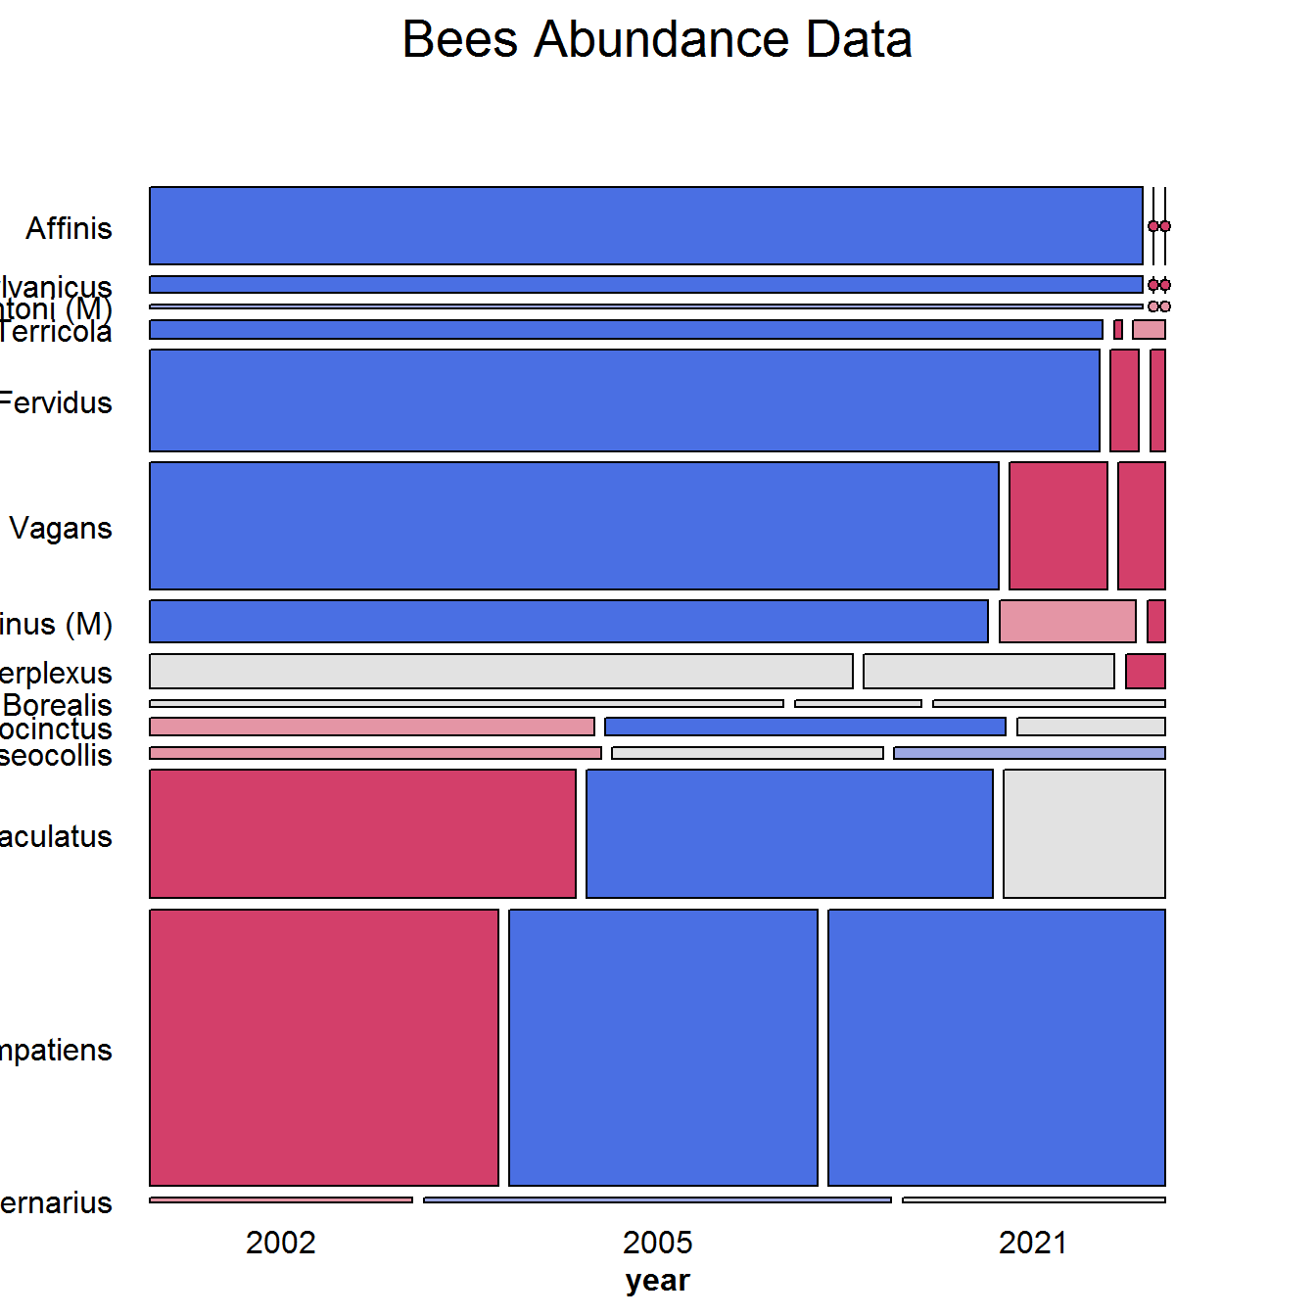
mosaic(permute(bees.mat, “CA”), shade=TRUE, …)
One main cluster was very prevalent in 2002
A few species became prominent in later years

Slide 41
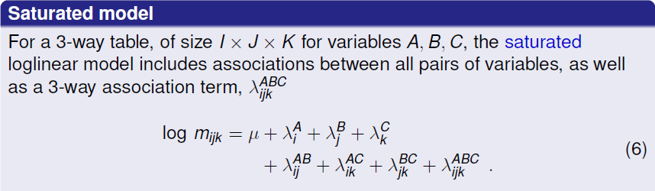
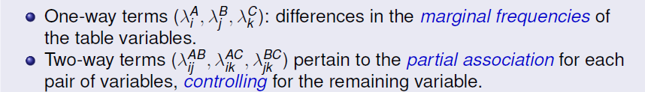
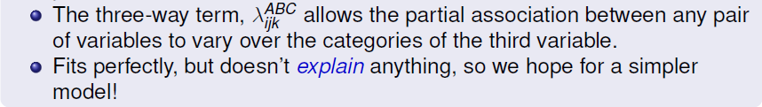
Three-way tables

Slide 42
Reduced models
Goal: fit the smallest model sufficient to explain/describe the observed frequencies
Similar to Anova models, e.g., ~(A + B + C)³ with all interactions
Do we need all those interaction terms?
Hierarchical models
Most loglinear models are taken to be hierarchical:
A high-order term, like λ_{ijk} ^{ABC} → all lower order terms included
Why: principle of marginality– hard to interpret w/o low order relatives
Thus, a shorthand notation for a loglinear model lists only the high-order terms. For example:
[ABC] → A + B + C + AB + AC + BC + ABC
[AB][AC] → A + B + C + AB + AC

Slide 43
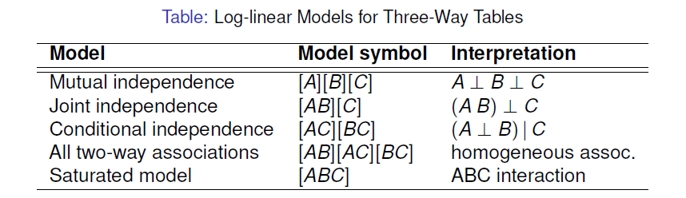
Reduced models
For a three-way table there is a range of models between mutual independence, [A][B][C], and the saturated model, [ABC]
Each model has an independence interpretation:
[A][B] ≡ A ⊥ B ≡ A independent of B
Special names for various submodels

Slide 44
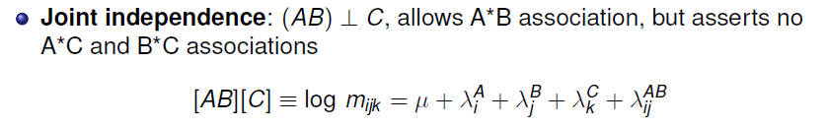

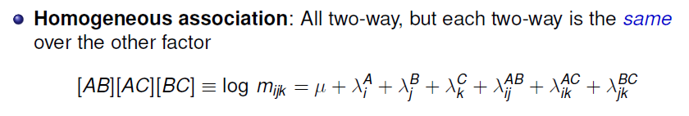
Model types

Slide 45
Association graphs
An association graph represents variables in an n-way frequency table by an undirected graph
Nodes are the variables
Edges are first-order (2-way) associations
→ two variables are independent if not joined by an edge
A
B
A
B
A
B
[A] [B]
[A B]
C
Under-solved problem: Use an association graph to represent strength of conditional associations or as a widget for model fitting
[A B] [A C]

Slide 46
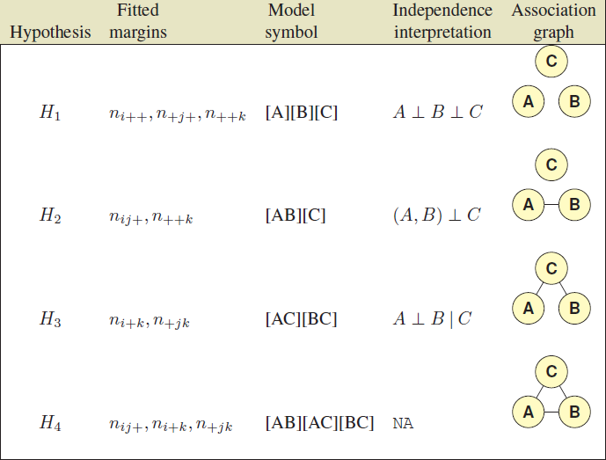
Model types & association graphs

Slide 47
Model types: loglm()
Each of these have simple translations into the model formulae for loglm()
loglm(~ A + B + C) # mutual independence [A][B][C]
loglm(~ A * B + C) # joint independence [AB][C]
loglm(~ A*C + B*C) # conditional independence [AC][BC]
loglm(~ (A + B + C)^2) # homogeneous, all 2-way [AB][AC][BC]
loglm(~ A * B * C) # saturated model [ABC]
Association graph
e.g., Berkeley data
loglm(~ (Admit + Gender) * Dept)
loglm(~Admit*Dept + Gender * Dept)
A
D
G
A ⊥ G | D
(just put your finger over D)

Slide 48
Collapsibility: Marginal & conditional associations
Q: When can we legitimately collapse a table, {ABC}, over some variable (C)?
A: When the marginal association of AB is the same as the conditional association, AB | C
Recall the Berkeley data
Margin of [Admit, Gender] ignoring Dept showed strong association
The partial assoc. within Dept were mostly NS
Conditional association [Admit, Gender | Dept] ≠ marginal [A, G]
Three-way tables: The AB marginal and AB | C conditional associations are the same, if either:
A & C are conditionally independent, A ⊥ C| B = [AB][CB]
B & C are conditionally independent, B ⊥ C | A = [AB][AC]
→ no three-way association

Slide 49
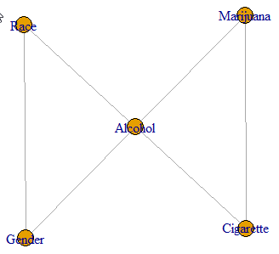
Higher-way tables
DaytonSurvey data: A 2⁵ table
2,276 HS seniors asked if they had ever used cigarettes, alcohol, or marijuana
cigarette Yes No
alcohol Yes No Yes No
marijuana Yes No Yes No Yes No Yes No
sex race
female white 405 268 1 17 13 218 1 117
other 23 23 0 1 2 19 0 12
male white 453 228 1 17 28 201 1 133
other 30 19 1 8 1 18 0 17
Suppose we wish to fit the model:
[A M] [A C] [M C] [A R] [A G] [R G]
The association graph implies:
{race, gender} ⊥ {marijuana, cigarette} | alcohol
If it fits, we can collapse the table over {race, gender} to study associations among A, M & C.

Slide 50
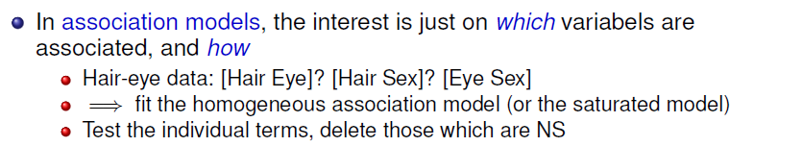
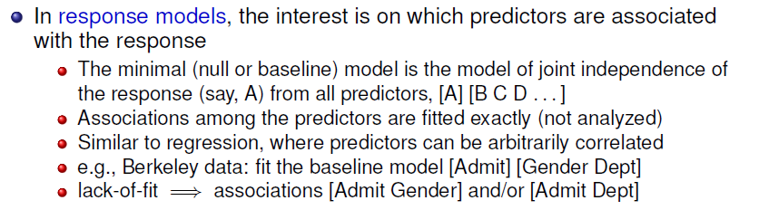
Response vs. Association models

Slide 51
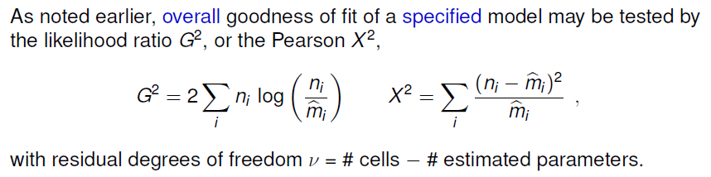
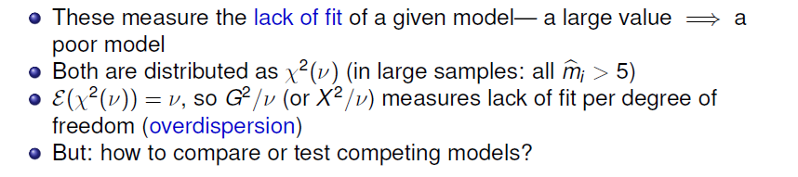
Goodness of fit tests

Slide 52
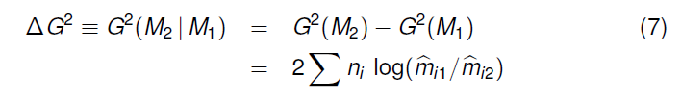
Nested models & ANOVA-type tests
Two models, M₁ and M₂ are nested when one (say, M₂) is a special case of the other
Model M₂ (w/ ν₂ df) fits a subset of the parameters of M₁ (w/ ν₁ df)
M₂ is more restrictive – cannot fit better than M₁: G²(M₂) ≥ G²(M₁)
The least restrictive model is the saturated model [ABC …], w/ G² = 0
Therefore, we can test the difference in G² as a specific test of the added restrictions in M₂ compared to M₁.
This test has a χ² distribution with df = ν₂ - ν₁

Slide 53
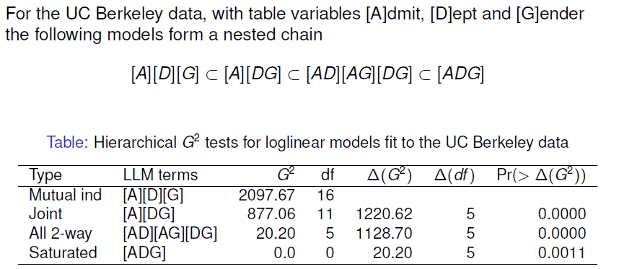
Example: Berkeley admissions
✓
✓
✓
Only testing the decrease in G² from one model to the next
Here, each model is significantly better than the previous
Joint vs. all two-way: Does Admit depend on Dept and/or Gender?
Absolute fit of all 2-way model is not terrible. Investigate this further!

Slide 54
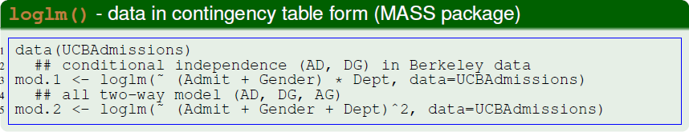
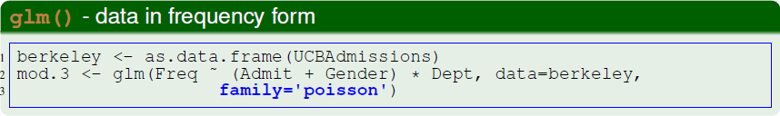
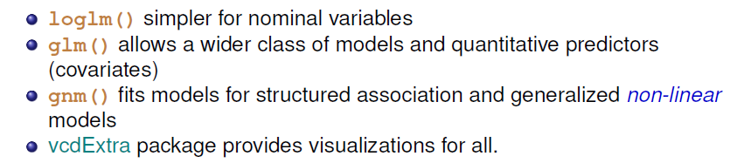
Fitting these in R

Slide 55
Example: Berkeley admissions
Fit the model of mutual independence, using loglm()
> berk.loglm0 <- loglm(~ Admit + Dept + Gender, data=UCBAdmissions)
> berk.loglm0
Call:
loglm(formula = ~Admit + Dept + Gender, data = UCBAdmissions)
Statistics:
X^2 df P(> X^2)
Likelihood Ratio 2097.7 16 0
Pearson 2000.3 16 0
Conditional independence [AD] [AG]
> berk.loglm1 <- loglm(~ Admit * (Dept + Gender), data=UCBAdmissions)
> berk.loglm1
Call:
loglm(formula = ~Admit * (Dept + Gender), data = UCBAdmissions)
Statistics:
X^2 df P(> X^2)
Likelihood Ratio 1148.9 10 0
Pearson 1015.7 10 0

Slide 56
Conditional independence, [AD] [AG]
> berk.loglm2 <- loglm(~ Admit + (Dept * Gender), data=UCBAdmissions)
> berk.loglm2
Call:
loglm(formula = ~Admit + (Dept * Gender), data = UCBAdmissions)
Statistics:
X^2 df P(> X^2)
Likelihood Ratio 877.06 11 0
Pearson 797.70 11 0
All two-way model, [AD] [AG] [DG]
> berk.loglm3 <-loglm(~(Admit+Dept+Gender)^2, data=UCBAdmissions)
> berk.loglm3
Call:
loglm(formula = ~(Admit + Dept + Gender)^2, data = UCBAdmissions)
Statistics:
X^2 df P(> X^2)
Likelihood Ratio 20.204 5 0.0011441
Pearson 18.823 5 0.0020740

Slide 57
ANOVA tests
These are nested. Compare with anova()
> aov1 <- anova(berk.loglm0, berk.loglm1, berk.loglm3, test="Chisq")
> aov1
LR tests for hierarchical log-linear models
Model 1:
~Admit + Dept + Gender
Model 2:
~Admit * (Dept + Gender)
Model 3:
~(Admit + Dept + Gender)^2
Deviance df Delta(Dev) Delta(df) P(> Delta(Dev)
Model 1 2097.671 16
Model 2 1148.901 10 948.770 6 0.00000
Model 3 20.204 5 1128.697 5 0.00000
Saturated 0.000 0 20.204 5 0.00114
✓
✓
✓
These are tests of relative fit, ΔG² = G² (M_{i} | M_{i-1} )

Slide 58

LRstats: AIC & BIC
vcdExtra::LRstats() gives one-line summaries of a collection of models
These are tests of absolute goodness of fit
> LRstats(berk.loglm0, berk.loglm1, berk.loglm2, berk.loglm3)
Likelihood summary table:
AIC BIC LR Chisq Df Pr(>Chisq)
berk.loglm0 2273 2282 2098 16 <2e-16 ***
berk.loglm1 1336 1352 1149 10 <2e-16 ***
berk.loglm2 1062 1077 877 11 <2e-16 ***
berk.loglm3 217 240 20 5 0.0011 **
---
Signif. codes: 0 ‘***’ 0.001 ‘**’ 0.01 ‘*’ 0.05 ‘.’ 0.1 ‘ ’ 1

Slide 59

Mosaic displays: Visual fitting
Each mosaic shows:
The DATA – size of tiles
(some) marginal frequencies – initial splits (visual grouping)
RESIDUALS (shading) – what associations have been omitted?
Visual fitting
Start with a simple model: mutual independence or joint independence for response models
Pattern of residuals: suggest a better model → smaller residuals
Add terms: → smaller residuals, less shading: “cleaning the mosaic”
Good fitting model will have mostly unshaded tiles

Slide 60

Mosaic displays: Predictor variables
In response models, the mosaic of the predictors gives a graphic summary of background variables

Slide 61

Baseline response model
For the Berkeley data, start with the model of joint independence, [A][DG]
Fits badly: G² ₍₁₁₎ = 877.1
This is the null, or baseline model when Admit is the response variable.
Allows/fits assoc. of [Dept Gender], not shown in shading
Remaining shading suggests:
[AD] : Admit varies w/ Dept
[AG] : Admit varies w/ Gender

Slide 62

Add an association term…

Slide 63

Double decker plots
Visualize dependence of one response variable (typically binary) on combinations of predictors
Formally: mosaic plots with vertical splits for all predictors, highlighting the response by shading
doubledecker(Admit ~ Dept + Gender, data = UCBAdmissions[2:1, ,])
An exploratory plot
Highlights the M-F diff^{ce} in Admit for Dept A
DDAR Fig 5.34, p 211

Slide 64

Survival on the Titanic
HELP! I need a loglinear model
An epic data set, revealed with loglinear models

Slide 65
4-way tables: Survival on the Titanic
Data on the fate of passengers & crew on the HMS Titanic: a 4 × 2 × 2 × 2 table
> data(Titanic, package=“datasets”)
> str(Titanic)
'table' num [1:4, 1:2, 1:2, 1:2] 0 0 35 0 0 0 17 0 118 154 ...
- attr(*, "dimnames")=List of 4
..$ Class : chr [1:4] "1st" "2nd" "3rd" "Crew"
..$ Sex : chr [1:2] "Male" "Female"
..$ Age : chr [1:2] "Child" "Adult"
..$ Survived: chr [1:2] "No" "Yes"
What proportion survived? Ans: 711/2201 = 32.3%
> addmargins(margin.table(Titanic, 4))
Survived
No Yes Sum
1490 711 2201
> margin.table(Titanic, 4) / sum(Titanic)
Survived
No Yes
0.677 0.323

Slide 66
Zero cells
> structable(Titanic)
Sex Male Female
Survived No Yes No Yes
Class Age
1st Child 0 5 0 1
Adult 118 57 4 140
2nd Child 0 11 0 13
Adult 154 14 13 80
3rd Child 35 13 17 14
Adult 387 75 89 76
Crew Child 0 0 0 0
Adult 670 192 3 20
Two types of zero cells:
Structural zeros: could not occur (children in crew)
Sampling zeros: did not happen to occur (children in 1st & 2nd who died)
Beware: zeros can cause problems:
Loss of df
0/0 → NaN in χ2 tests

Slide 67

Exploratory plots

Slide 68

Exploratory plots

Slide 69

Fitting & visualizing models
mod0 <- loglm(~ 1 + 2 + 3 + 4, data=Titanic)
mosaic(mod0, main="Titanic: Model [C][G][A][S]")
In the model formulas, I’m using variable numbers 1-4 for Class, Gender, Age and Survived
The independence model serves only as a background for the total associations in the table
Let’s clean this mosaic!!
Note the scale of residuals:
+26 -- -11

Slide 70

Baseline model for Survived
mod1 <- loglm(~ 1*2*3 + 4, data=Titanic)
mosaic(mod1, main="Titanic: Model [CGA][S]")
With S as response, the baseline model includes all associations among [CGA]
But this model asserts survival is independent of all of these
G² ₍₁₅₎ = 671.96, a very poor fit
Pattern of residuals shows all associations with Surv

Slide 71




Adding associations: Main effects
mod2 <- loglm(~ 1*2*3 + (1+2+3)*4, data=Titanic)
mosaic(mod2, main="Titanic: Model [CGA] [CS][GS][AS]")

Slide 72


Final model
mod3 <- loglm(~ 1*2*3 + (1*2)*4 + (1*3)*4, data=Titanic)
mosaic(mod3, main="Titanic: Model [CGA] [CGS][CAS]")
Now I understand
Nice & clean!
G² ₍₄₎ = 1.69, p=0.79
Before accepting this, should compare models, and consider
parsimony
model explanations
✓

Slide 73
Comparing models
As usual, anova() give compact relative comparisons of a set of nested models
> anova(mod0, mod1, mod2, mod3)
LR tests for hierarchical log-linear models
Model 1:
~1 + 2 + 3 + 4
Model 2:
~1 * 2 * 3 + 4
Model 3:
~1 * 2 * 3 + (1 + 2 + 3) * 4
Model 4:
~1 * 2 * 3 + (1 * 2) * 4 + (1 * 3) * 4
Deviance df Delta(Dev) Delta(df) P(> Delta(Dev)
Model 1 1243.66 25
Model 2 671.96 15 571.70 10 0.000
Model 3 112.57 10 559.40 5 0.000
Model 4 1.69 4 110.88 6 0.000
Saturated 0.00 0 1.69 4 0.793
Q: Please help me interpret these results ☺

Slide 74
Comparing models
LRstats() gives absolute GOF tests; also provides AIC, BIC stats: model parsimony
> LRstats(mod0, mod1, mod2, mod3)
Likelihood summary table:
AIC BIC LR Chisq Df Pr(>Chisq)
mod0 1385 1395 1244 25 <2e-16 ***
mod1 833 858 672 15 <2e-16 ***
mod2 284 316 113 10 <2e-16 ***
mod3 185 226 2 4 0.79
---
Signif. codes: 0 ‘***’ 0.001 ‘**’ 0.01 ‘*’ 0.05 ‘.’ 0.1 ‘ ’ 1
mod3 [CGA] [CGS] [CAS] wins!
Acceptable G²
Looks best by AIC & BIC

Slide 75

Model interpretation
Recall that the goal of analysis is to tell a story
Greatest impact: lower class → decreased survival, regardless of Gender & Age
Differences in survival by Class were moderated by both Gender & Age
Term [CGS]: Women in 3rd class did not have an advantage, while men in 1st class did vs. other classes
Term [CAS]: No children in 1st or 2nd class died, but nearly 2/3 in 3rd class did
Summary:
Not so much “women & children first”, rather
Women & children, ordered by class, and 1st class men!

Slide 76

Historical note
The Titanic sank on Apr. 15, 1912
On May 4, the technical illustrator, G. Bron published this graph in The Sphere, a popular magazine.
He used a remarkably modern graph to show the differences in survival by class, gender & age
died
survived
Read the story:
Friendly, Symanzik, Onder, Visualizing the Titanic Disaster, Significance, Feb., 2019

Slide 77

Sequential plots & models

Slide 78

Sequential plots & models
Mosaic for an n-way table → hierarchical decomposition of association
Joint cell probabilities are decomposed as:
First 2 terms: → mosaic for {v₁, v₂}
First 3 terms: → mosaic for {v₁, v₂, v₃}
… and so on
Roughly analogous to sequential fitting in regression: X₁ ; X₂|X₁ ; X₃|X₁,X₂
Order of variables matters for interpretation
Mosaics: 1st split: easiest to see the marginal proportions
Mosaics: 2nd variable seen as conditional proportions, given the 1st
Friendly (1999), Extending Mosaic Displays: Marginal, Conditional, and Partial Views of Categorical Data, JCGS, 8:3, 373-395, DOI: 10.1080/10618600.1999.10474820

Slide 79

Sequential plots & models
Sequential models of joint independence
Give an additive decomposition of total association – mutual independence [v₁][v₂] … [v_{p}]
E.g., for Hair Eye color data

Slide 80

Sequential plots & models
Hair color × Eye color marginal table (ignoring Sex)

Slide 81

Sequential plots & models
3-way table, Joint independence model [Hair Eye][Sex]

Slide 82

Sequential plots & models
3-way table, Mutual independence [Hair] [Eye][Sex]

Slide 83

Sequential plots & models
Putting these together:
TIP: vcdExtra::seq_loglm() generates a variety of sequential models

Slide 84


Sequential models: Applications

Slide 85
Example: Marital status, pre- & extra-marital sex
Thornes and Collard (1979) studied divorce patterns in relation to premarital
and extramarital sex, a 2⁴ table, PreSex in vcd ( G × P × E × M )
> data("PreSex", package="vcd")
> structable(Gender + PremaritalSex + ExtramaritalSex ~
MaritalStatus, data = PreSex)
Gender Women Men
PremaritalSex Yes No Yes No
ExtramaritalSex Yes No Yes No Yes No Yes No
MaritalStatus
Divorced 17 54 36 214 28 60 17 68
Married 4 25 4 322 11 42 4 130
Submodels:
[G][P] : Do men & women differ by pre-marital sex?
[GP][E]: Given G & P, are there differences in extra-marital sex?
[GPE][M]: Are there differences in divorce among the G, P, E groups?

Slide 86


Debugging color_table()
> color_table(PreSex, formula = Gender + PremaritalSex + ExtramaritalSex ~ MaritalStatus)
Shading based on residuals from model of complete independence, X^2 = 270.14, df = 11, p = 0
> color_table(PreSex, formula = MaritalStatus + Gender ~ PremaritalSex + ExtramaritalSex)
What’s missing here?
Rows & cols each have nested categories
Need to reflect this in the labels, as is done in structable()
But: what cells stand out?

Slide 87

Example: Marital status, pre- & extra-marital sex
Order the table variables as G → P → E → M
> names(dimnames(PreSex)) # table variable names
[1] "MaritalStatus" "ExtramaritalSex" "PremaritalSex" "Gender“
> PreSex <- aperm(PreSex, 4:1) # order variables G, P, E, M
Fit each sequential model to the marginal sub-table. vcdExtra::seq_loglm() generates these models of joint independence
PreSex.mods <- seq_loglm(PreSex,
type="joint",
marginals = 2:4)
LRstats(PreSex.mods)

Slide 88


Mosaic plots
# (Gender Pre)
mosaic(margin.table(PreSex, 1:2), shade=TRUE,
main = "Gender and Premarital Sex")
# (Gender Pre)(Extra)
mosaic(margin.table(PreSex, 1:3),
expected = ~Gender * PremaritalSex + ExtramaritalSex,
main = "Gender*Pre + ExtramaritalSex")

Slide 89
Mosaic plots
# (Gender Pre)
mosaic(margin.table(PreSex, 1:2), shade=TRUE,
main = "Gender and Premarital Sex")
Twice as many women in this sample
Men far more likely to report pre-marital sex than women (odds ratio = 3.7)

Slide 90
Mosaic plots
# (Gender Pre)(Extra)
mosaic(margin.table(PreSex, 1:3),
expected = ~Gender * PremaritalSex + ExtramaritalSex,
main = "Gender*Pre + ExtramaritalSex")
Men & women who reported Pre- far more likely to report Extra- sex
Odds ratio of Extra- given Pre- about the same for men & women
(3.61 vs. 3.56)

Slide 91


Mosaic plots: Full table
mosaic(PreSex,
expected = ~Gender * PremaritalSex * ExtramaritalSex
+ MaritalStatus,
main = "Gender*Pre*Extra + MaritalStatus")
# (GPE)(PEM)
mosaic(PreSex,
expected = ~ Gender * PremaritalSex * ExtramaritalSex
+ MaritalStatus * PremaritalSex * ExtramaritalSex,
main = "G*P*E + P*E*M")

Slide 92
Mosaic plots: Full table
mosaic(PreSex,
expected = ~Gender * PremaritalSex * ExtramaritalSex + MaritalStatus,
main = "Gender*Pre*Extra + MaritalStatus")
In the model [GPE][M], marital status depends in a complex way
Among women, those reporting Pre- more likely to be divorced
Among men, those reporting Pre- only more likely to be divorced if Extra-
This suggests adding associations of M with P and E: [PEM] term

Slide 93
Mosaic plots: Full table
# (GPE)(PEM)
mosaic(PreSex,
expected = ~ Gender * PremaritalSex * ExtramaritalSex
+ MaritalStatus * PremaritalSex * ExtramaritalSex,
main = "G*P*E + P*E*M")
This model fits well, G²(4) = 5.26, p=0.26
Loglinear thinking: once we take GPE into account, are there simpler models for association with M?
Looking forward: logit models for MaritalStatus often provide an easier path

Slide 94

Partial association, partial mosaics
Sometimes useful to do a stratified analysis
How does association between two (or more) variables vary over levels of other variables?
Mosaic plots for main variables show partial association at each level of others
E.g., Hair color, Eye color, subset by Sex

Slide 95

Partial association, partial mosaics

Slide 96
Partial association: Summary
Overall, there is a strong association of hair color and eye color, controlling for sex, G²₍₁₈₎ = 156.67
For F, G²₍₉₎ = 112.23 accounts for 72% of this association
The pattern of association is similar for M & F
The largest difference is for blue-eyed blonds, much more prevalent among F than M. Is there a hair dye effect?

Slide 97
Summary: What we’ve learned
Mosaic plots use sequential splits to show marginal and conditional frequencies in an n-way table
Shading: sign and magnitude of residuals → contributions to χ²
Shows the pattern of association not accounted for
Permuting rows/cols often helps
Loglinear models
Express associations with ANOVA-like interaction terms: A*B, A*C
Joint independence: [AB][C] ≡ A * B + C
Conditional independence: [AC][BC] ≡ A ⊥ B | C
Fitting models ≅ “cleaning the mosaic”
Response models: include all associations among predictors
Sequential / partial plots & models
Sequential: Decompose all associations: V₁; V₂|V₁; V₃|{V₁, V₂}, …
Partial: Decompose conditional associations: [V₁, V₂ ]| V₃= {a, b, …}

