Slide 1
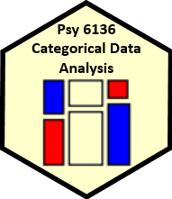
The Last Waltz
Michael Friendly
Psych 6136
http://friendly.github.io/6136

Slide 2

The Last Waltz
Where did we start?
What have I tried to teach?
What did you learn?

Slide 3
My goals
Start with descriptive, hypothesis testing methods, then progress to model-based methods
Visual tools for thinking & understanding
Sieve plots, mosaic plots, spineplots, …
Correspondence analysis: best 2D summary
Effect plots, Data + Model plots
Build from simple, loglinear models to more complex ones

Slide 4
01: Overview
Categorical data involves some new ideas
Discrete variables: unordered or ordered
Counts, frequencies as outcomes
New / different data structures & functions
tables – 1-way, 2-way, 3-way, … table(), xtabs()
similar in matrices or arrays matrix(), array()
datasets:
frequency form
case form
Graphical methods: often use area ~ Freq
Consider: graphical comparisons, effect order
Models: Most are ≅ natural extensions of lm()

Slide 5
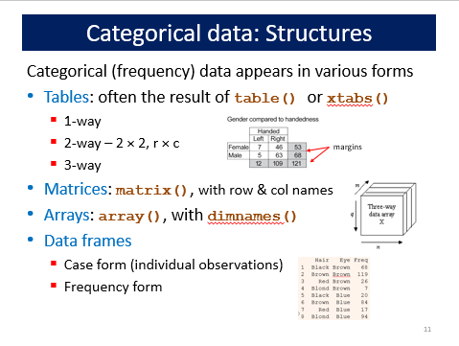
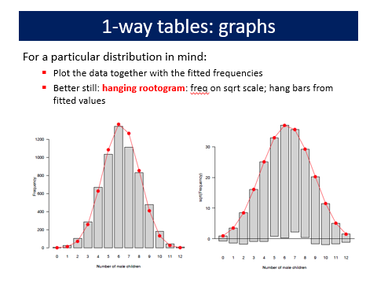
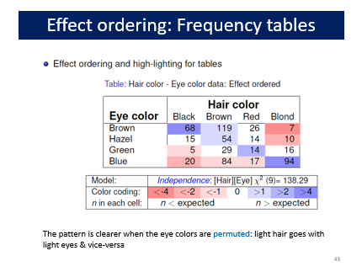
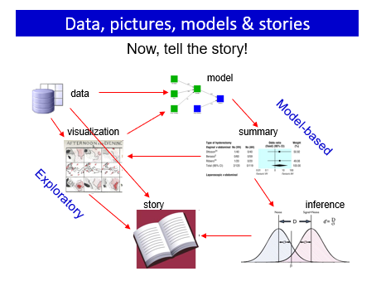

Slide 6
02: Discrete distributions
Discrete distributions are the building blocks for categorical data analysis
Typically consist of basic counts of occurrences, with varying frequencies
Most common: binomial, Poisson, negative binomial
Others: geometric, log-series
Fit with goodfit(); plot with rootogram()
Diagnostic plots: Ord_plot(), distplot()
Models with predictors
Binomial → logistic regression
Poisson → poisson regression; logliner models
These are special cases of generalized linear models

Slide 7
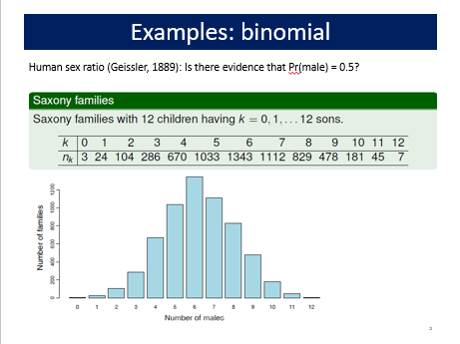
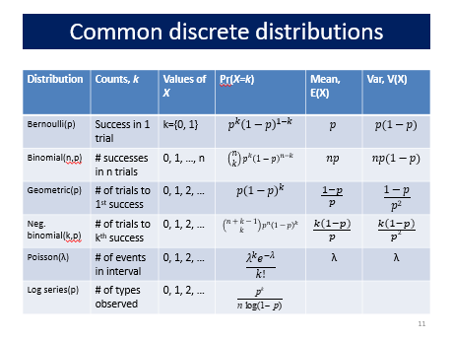
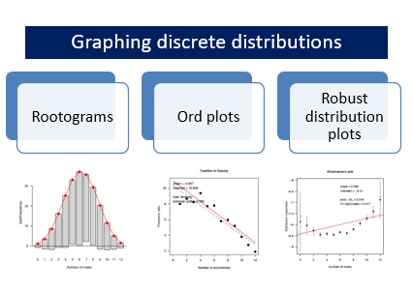
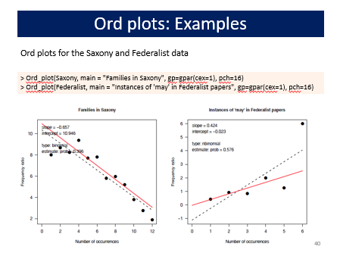

Slide 8
03: Two-way tables
Two-way tables summarize frequencies of two categorical factors
2 × 2: a special case, with odds ratio as a measure
r × c: factors can be unordered or ordered
r × c × k: stratified tables, r × c with groups or circumstances
Tests & measures of association
Pearson χ², LR G²: general association
More powerful CMH tests for ordered factors
Visualization
2 × 2: fourfold plots
r × c: sieve diagrams, tile plots, …
More graphical methods to come …

Slide 9
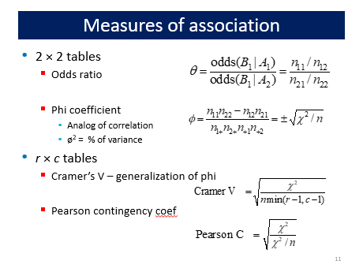
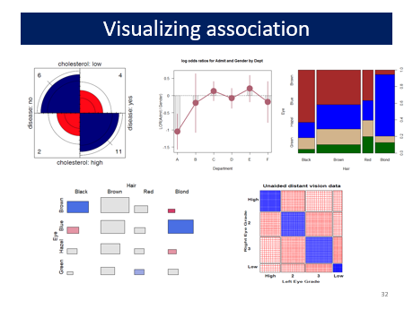
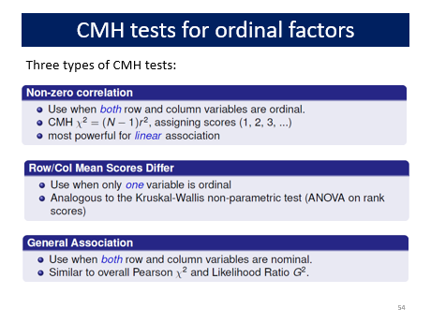
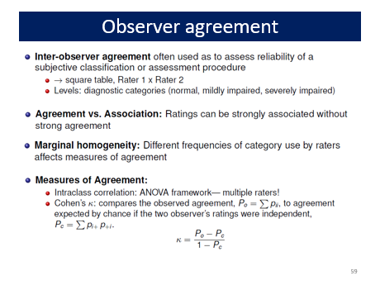

Slide 10
04: Loglinar models, mosaic displays
Mosaic plots use sequential splits to show marginal and conditional frequencies in an n-way table
Shading: sign and magnitude of residuals → contributions to χ²
Shows the pattern of association not accounted for
Permuting rows/cols often helps
Loglinear models
Express associations with ANOVA-like interaction terms: A*B, A*C
Joint independence: [AB][C] ≡ A * B + C
Conditional independence: [AC][BC] ≡ A ⊥ B | C
Fitting models ≅ “cleaning the mosaic”
Response models: include all associations among predictors
Sequential / partial plots & models
Sequential: Decompose all associations: V₁; V₂|V₁; V₃|{V₁, V₂}, …
Partial: Decompose conditional associations: [V₁, V₂ ]| V₃= {a, b, …}

Slide 11
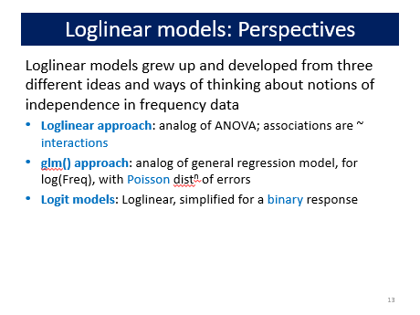
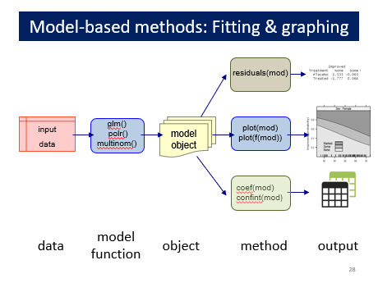
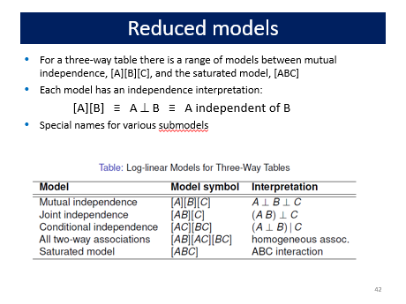
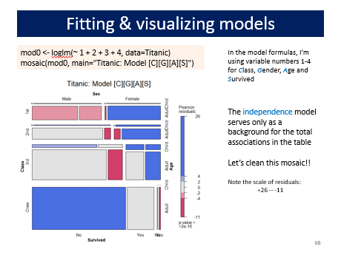

Slide 12
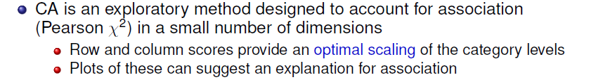
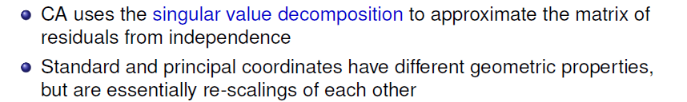
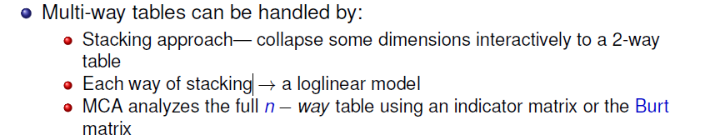
05: Correspondence analysis
Given a new 2-way table, my first thought is nearly always: plot(ca(mytable))

Slide 13
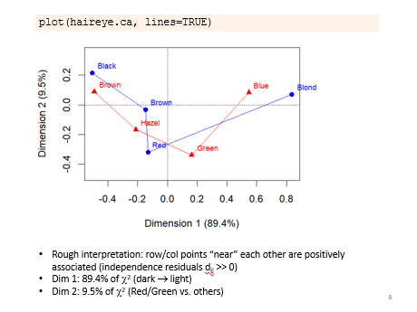
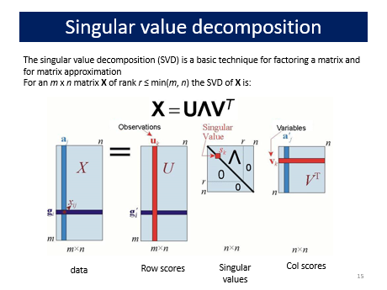
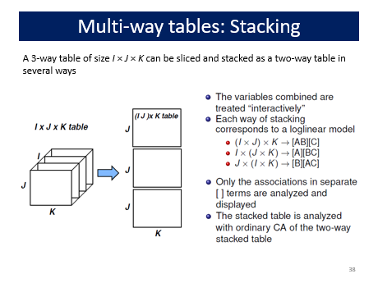
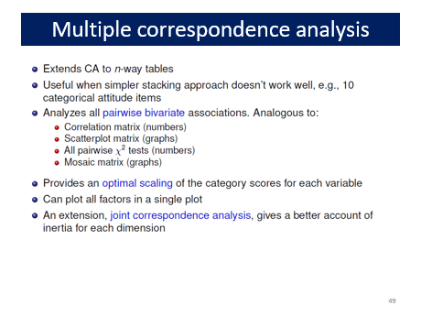

Slide 14
06: Logistic regression
loglm() provides only overall tests of model fit
Model-based methods, glm(), provide hypothesis tests, CIs & tests for individual terms
Logistic regression: A glm() for a binary response
linear model for the log odds Pr(Y=1)
All similar to classical ANOVA, regression models
Plotting
Conditional, full-model plots show data and fits
Effect plots show predicted effects averaged over others
Model diagnostics
Influence plots are often informative

Slide 15
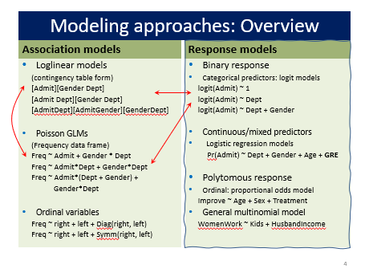
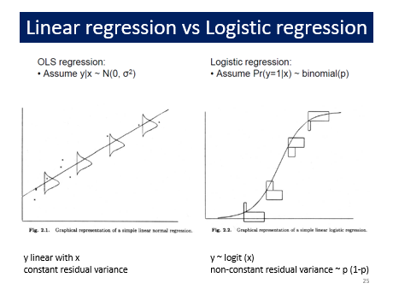
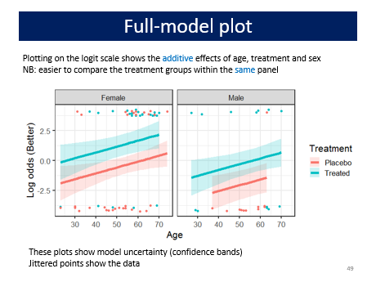
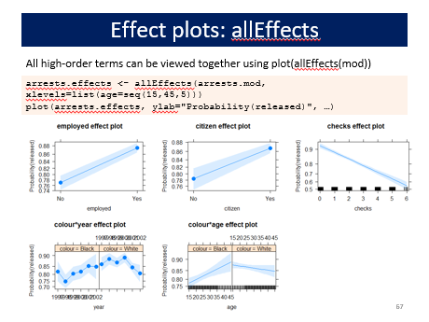

Slide 16
07: Logistic regression: Extensions
Polytomous responses
m response categories → (m-1) comparisons (logits)
Different models for ordered vs. unordered categories
Proportional odds model
Simplest approach for ordered categories
Assumes same slopes for all logits
Fit with MASS::polr()
Test PO assumption with VGAM::vglm()
Nested dichotomies
Applies to ordered or unordered categories
Fit m – 1 separate independent models → Additive G² values
Multinomial logistic regression
Fit m – 1 logits as a single model
Results usually comparable to nested dichotomies, but diff interpretation
R: nnet::multinom()

Slide 17
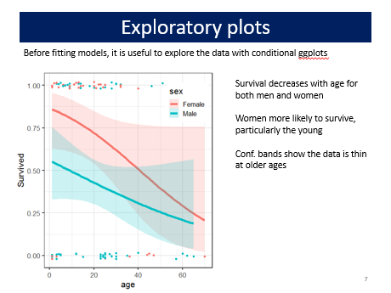
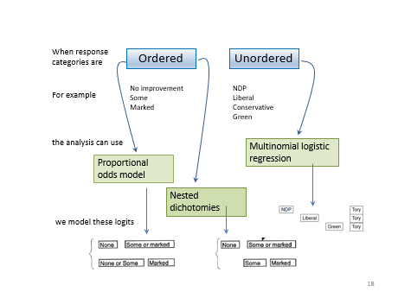
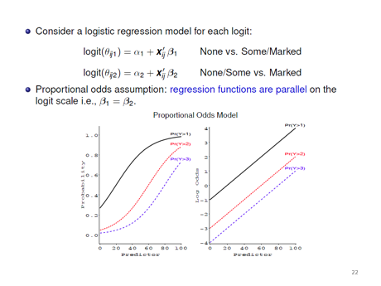
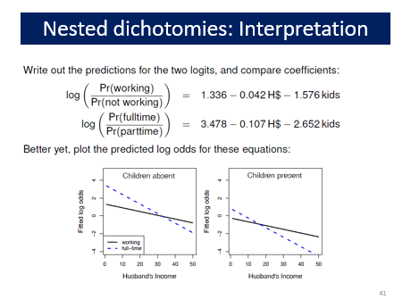

Slide 18
08: Extending loglinear models
Loglinear models, as originally formulated, were quite general, but treated all table variables as unordered factors
The GLM perspective is more general, allowing quantitative predictors and handling ordinal factors
The logit model give a simplified approach when one variable is a response
Models for ordered factors give more powerful & focused tests
L × L, R, C and R+C models assign scores to the factors
RC(1) and RC(2) models estimate the scores from the data
Models for square tables allow testing structured questions
Quasi-independence: ignoring diagonals
symmetry & quasi-symmetry
theory-specific “topological” models
These methods can be readily combined to analyze complex tables

Slide 19
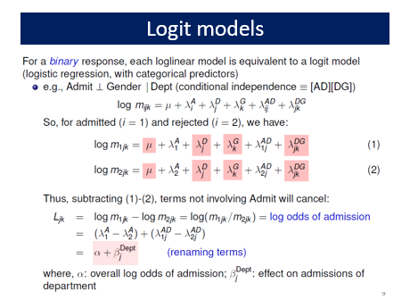
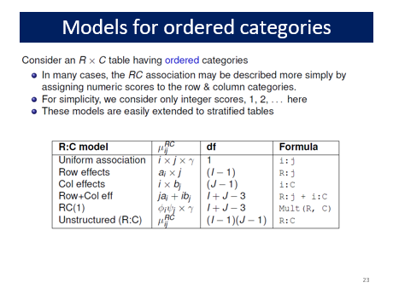
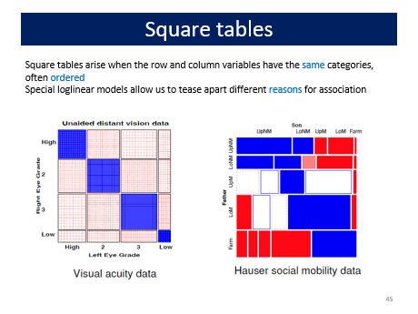
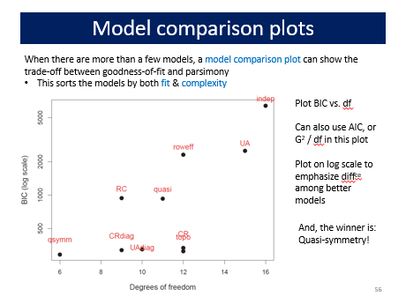

Slide 20
09: GLMs for Count Data
GLMs provide a unified framework for linear models
Different families, all estimated in the same way
→link function and associated variance function
For count data, starting from log(μ) = X β, μ|X ~ Poisson:
Overdispersion → quasi-poisson, negative binomial
Standard tools for assessing model fit
Excess zero counts introduce new ideas & methods
ZIP model: structural model for the 0s
Hurdle model: random model for 0s, 2nd model for Y>0
In all this, we rely on data & model plots for understanding

Slide 21
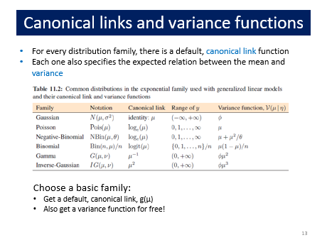
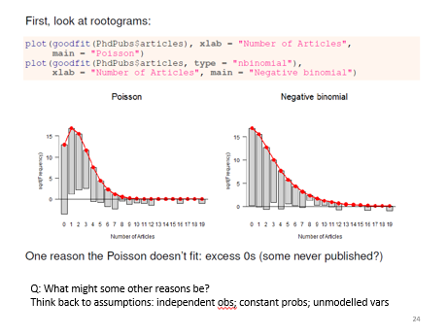
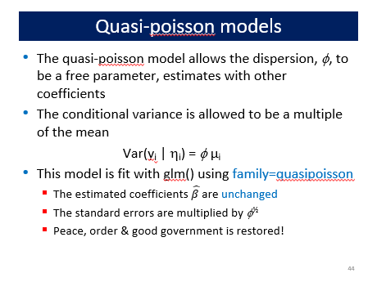
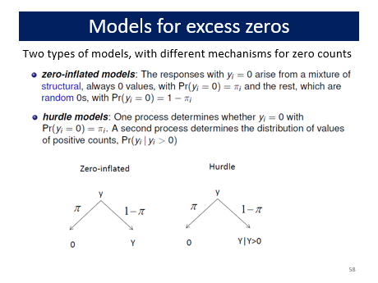

Slide 22
10: Models for log odds & LORs
Logit models for a binary response generalize readily to a polytomous response
→Models for log odds, familiar interpretation
Handles 3+ way table, ordinal variables
Simple plots for interpretation
Generalized odds ratios handle bivariate responses
Simple linear models for LOR
Easy to model log odds for each response and the LOR simultaneously
Easy to visualize results

Slide 23

Your turn: Feedback?

Slide 24
What did you like/dislike about 6136?
Topics: what were the:
most interesting?
most boring?
Most challenging?
What did you learn most from?
What gave you the most difficulty?
How does this relate to your own work?

Slide 25
Tips for next time …
What should I try to differently the next time?
More of X?
Less of Y?
Aspects of how the course is structured?
Evaluation?

