Slide 1
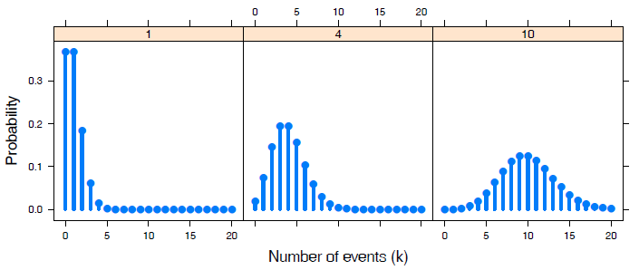

Discrete distributions
Michael Friendly
Psych 6136
https://friendly.github.io/6135/

Slide 2
Discrete distributions: Basic ideas
Quantitative data: often assumed Normal (μ, σ²) – unreasonable for CDA
Binomial, Poisson, Negative binomial, … are the building blocks for CDA
They form the basis for modeling techniques
logistic regression, generalized linear models, Poisson regression
Data: One-way tables
outcome variable (k = 0, 1, 2, … )
counts of occurrences (n_{k}): accidents, words in text, males in families of size k

Slide 3
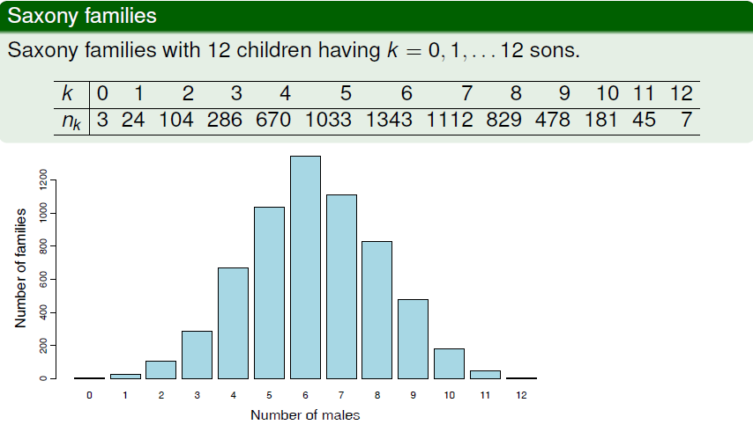
Examples: binomial?
Human sex ratio (Geissler, 1889): Is there evidence that Pr(male) = 0.5?

Slide 4
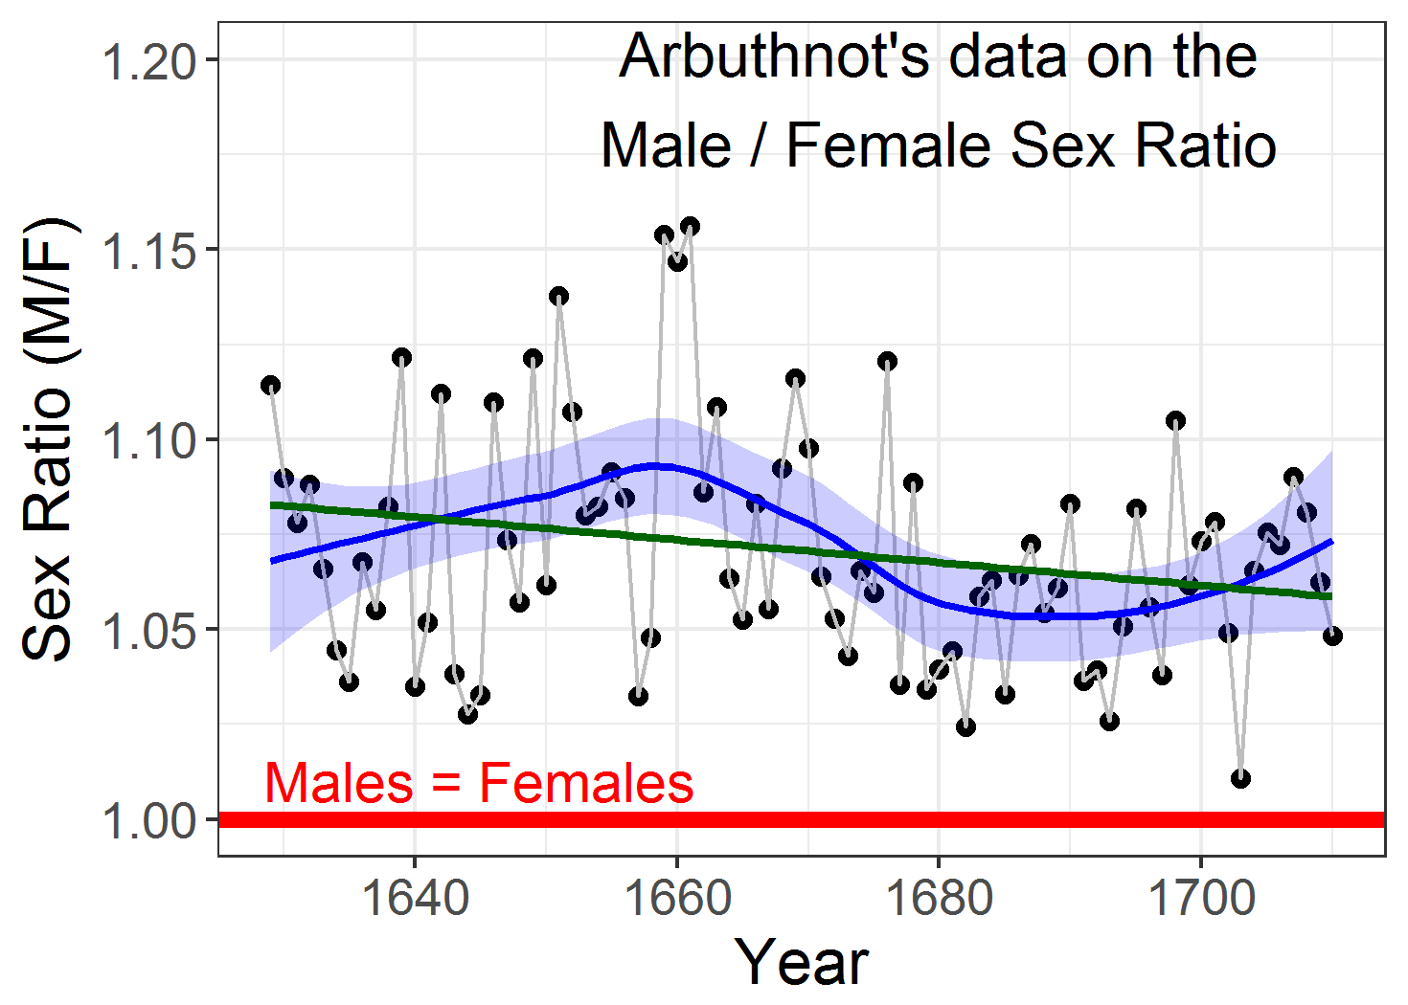
Why did this matter? -- Arbuthot
John Arbuthot (1710) had gathered data on the ratios of male to female christenings in London from 1629-1710, 81 years
He showed that in EVERY year Males > Females
Calculated the FIRST significance test: like tossing 81 coins, and getting all heads
Argued that the result must be due to divine providence: God likes more boys than girls!
Data: HistData::Arbuthnot
ggplot script: https://friendly.github.io/6135/R/arbuthnot-gg.html

Slide 5
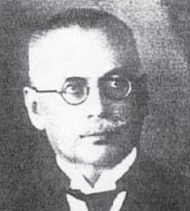
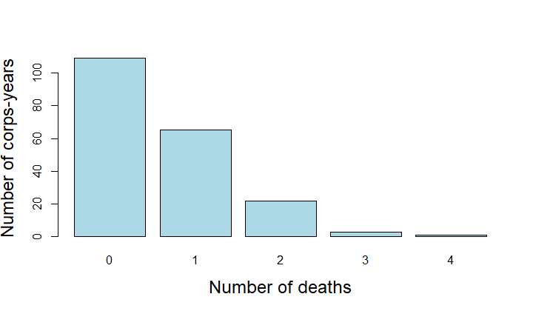
Example: Poisson
L. Von Bortkiewicz (1898) tallied the numbers of deaths by horse or mule kicks in 10 corps of the Prussian army over 20 years, → 200 corps-years
In how many corps-years were there 0, 1, 2, … deaths?
This is among the earliest examples of a Poisson distribution
> data(HorseKicks, package="vcd")
> HorseKicks
nDeaths
0 1 2 3 4
109 65 22 3 1
The Poisson distribution arises as that of the probability of 0, 1, 2, …
Rare events, that
Occur with constant probability
Forms the basis for glm() models with a count outcome.

Slide 6
Examples: count data
Federalist papers: Disputed authorship
77 essays by Alexander Hamilton, John Jay, James Madison to persuade voters to ratify the US constitution, all signed with pseudonym “Publius”
Who wrote each?
65 known, 12 disputed (H & M both claimed sole authorship)
Mosteller & Wallace (1984): analysis of frequency dist^{n}s of key “marker” words: from, may, whilst, upon, …
e.g., blocks of 200 words: occurrences (k) of “may” in how many blocks (n_{k})
> data(Federalist, package = "vcd")
> Federalist
nMay
0 1 2 3 4 5 6
156 63 29 8 4 1 1
Notes:
1787: The Federalist Papers were written and published to urge New Yorkers to ratify the proposed United States Constitution, which was drafted in Philadelphia in the summer of 1787.

Slide 7
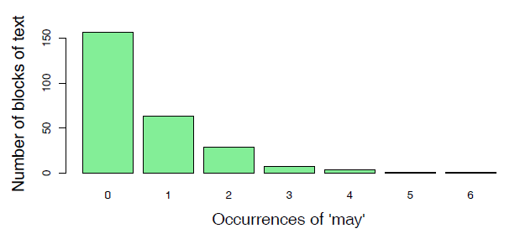
Count data: models
For each word (“from”, “may”, “whilst”, …)
Fit a probability model [Poisson(λ), NegBin(λ, p)]
Estimate parameters (λ,p)
→ Calculate log Odds (Hamilton vs. Madison)
→ All 12 disputed papers most likely written by Madison
(pioneered the use of cross-validation to assess model fit)

Slide 8
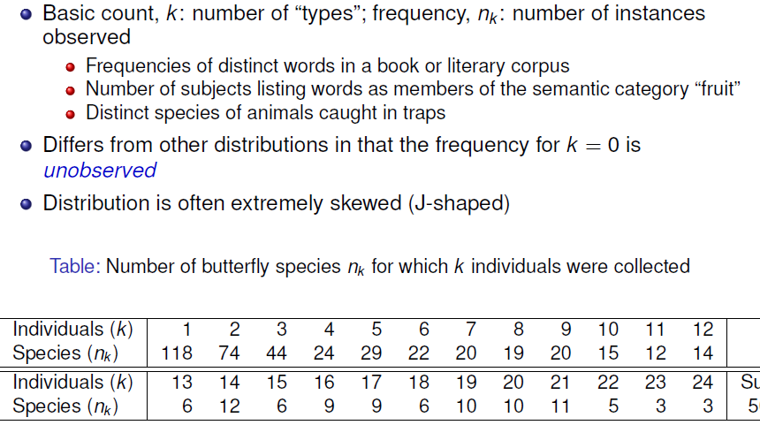
Example: Type-token distributions

Slide 9
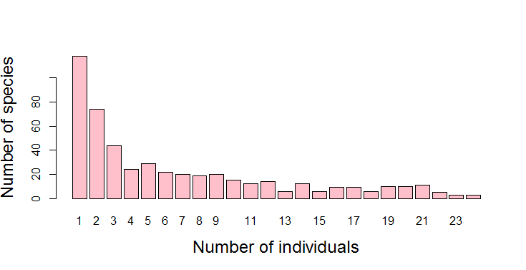
data(Butterfly, package="vcd")
barplot(Butterfly,
xlab = "Number of individuals",
ylab = "Number of species",
col = "pink",
cex.lab = 1.5)
Questions:
What is the total pop. of butterflies in Malaysia?
How many wolves remain in Canada NWT?
How many words did Shakespeare know?
Answers depend on estimating Pr(k=0), so you can find the total

Slide 10
Discrete distributions: Questions
General questions
What process gave rise to the distribution?
What is the form: uniform, binomial, Poisson, negative binomial, … ?
→ Fit & estimate parameters
Visualize goodness of fit
→ Use in some larger context to tell a story
Examples
Families in Saxony: might expect Bin(n=12, p); p=0.5?
HorseKicks: Poisson (λ); here, λ = mean = 0.61
Federalist papers: Perhaps Poisson(λ) or NegBin (λ, p)
Butterfly data: Perhaps a log-series distribution?

Slide 11
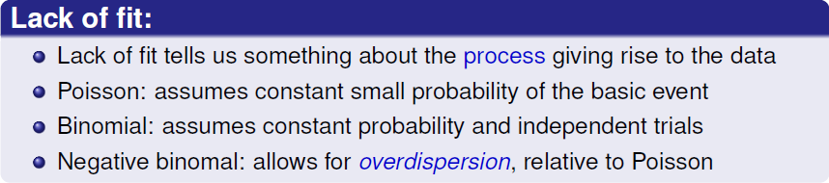
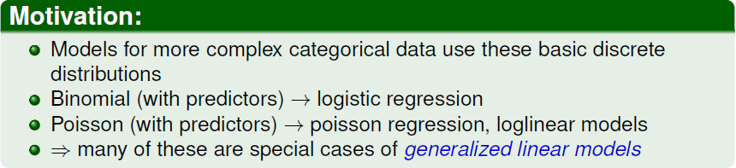
Fitting discrete distributions
Notes:
Usually, we hope a given type of distribution will fit the data well. But lack-of-fit is also important

Slide 12
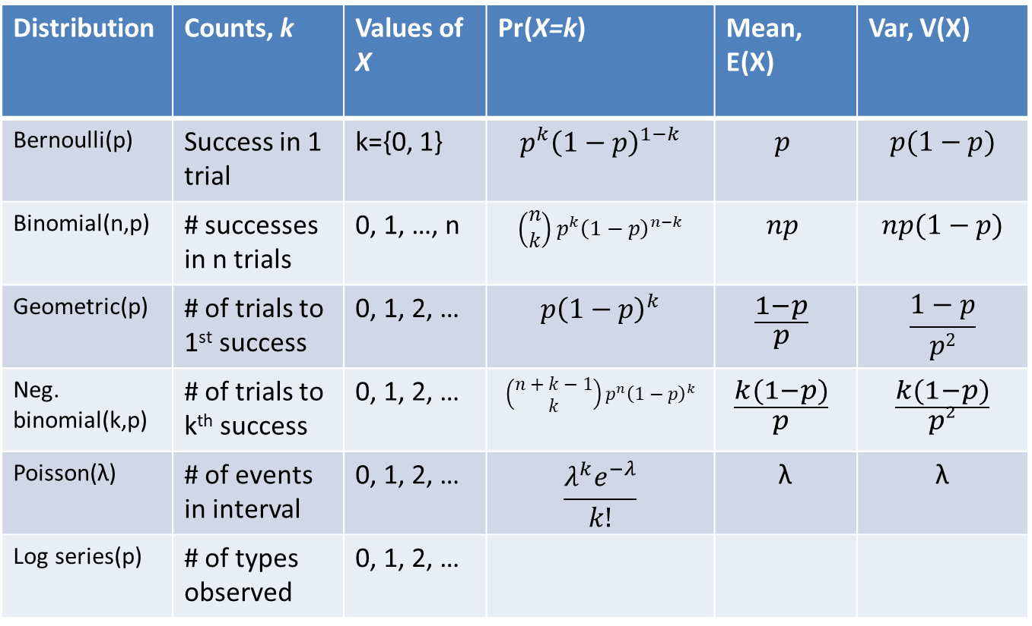
Common discrete distributions
Distribution | Counts, k | Values of X | Pr(X=k) | Mean, E(X) | Var, V(X)
Bernoulli(p) | Success in 1 trial | k={0, 1} | $$p^{k}{\left(1−p\right)}^{1−k}$$ | $$p$$ | $$p(1−p)$$
Binomial(n,p) | # successes in n trials | 0, 1, …, n | $$\left(\begin{matrix}n \\ k\end{matrix}\right)p^{k}{\left(1−p\right)}^{n−k}$$ | $$np$$ | $$np(1−p)$$
Geometric(p) | # of trials to 1st success | 0, 1, 2, … | $$p{\left(1−p\right)}^{k}$$ | $$\frac{1−p}{p}$$ | $$\frac{1−p}{p2}$$
Neg. binomial(k,p) | # of trials to k^{th} success | 0, 1, 2, … | $$\left(\begin{matrix}n+k−1 \\ k\end{matrix}\right)p^{n}{\left(1−p\right)}^{k}$$ | $$\frac{k(1−p)}{p}$$ | $$\frac{k(1−p)}{p2}$$
Poisson(λ) | # of events in interval | 0, 1, 2, … | $$\frac{λ^{k}e^{−λ}}{k!}$$ | λ | λ
Log series(p) | # of types observed | 0, 1, 2, …

Slide 13
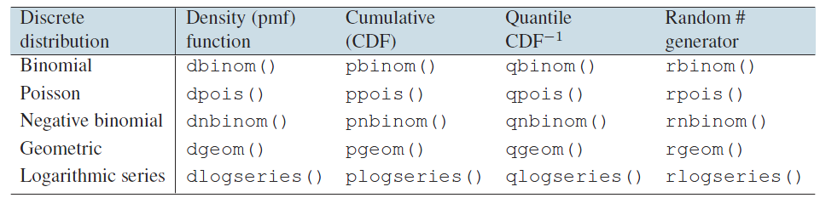
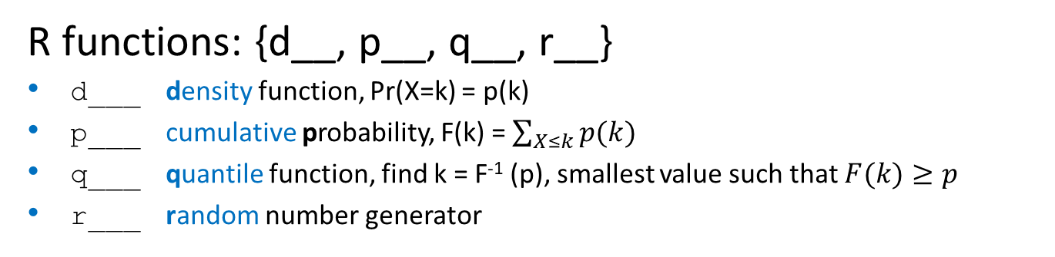
Discrete distributions: R
R functions: {d__, p__, q__, r__}
d___ density function, Pr(X=k) = p(k)
p___ cumulative probability, F(k) = $\sum_{X≤k}{p(k)}$
q___ quantile function, find k = F⁻¹ (p), smallest value such that $F(k)≥p$
r___ random number generator
e.g.,
> dbinom(0:4, size=4, p=1/2) # number of H in 4 coin tosses
[1] 0.0625 0.2500 0.3750 0.2500 0.0625
> dpois(0:4, lambda=3) # poisson, with λ = 3
[1] 0.0498 0.1494 0.2240 0.2240 0.1680

Slide 14
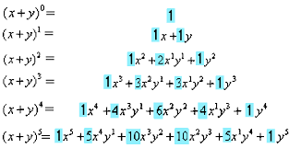

What is “binomial”
Bi-no-mi-al /bīˈnōmēəl/
Taxonomy: A two-part name, (genus, species) e.g., Elephas maximus for the Asian elephant; Canis familiaris for domestic dog
Mathematics: An algebraic expression of a sum of two terms, (x + y) or expansion, (x + y)^{n}
Coefficients of terms
(Pascal’s triangle)
Stats: A distribution of number of “successes” in n Bernouili trials w/ prob = p

Slide 15
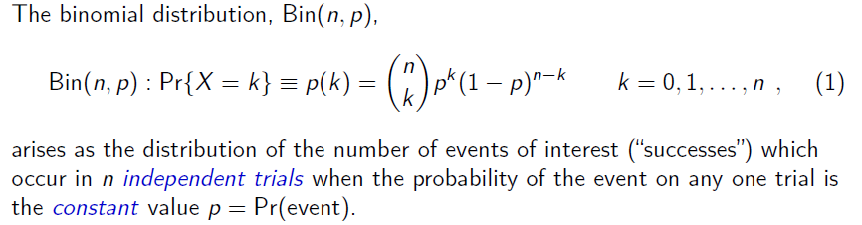
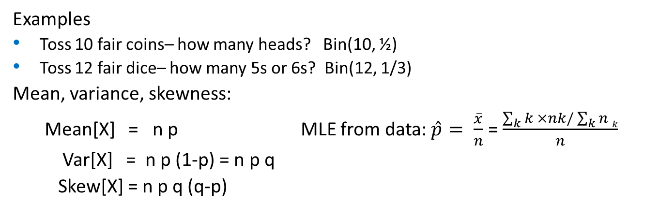
Binomial distribution
# ways to get k out of n
Pr(k events)
Pr(n-k non-events)
Examples
Toss 10 fair coins– how many heads? Bin(10, ½)
Toss 12 fair dice– how many 5s or 6s? Bin(12, 1/3)
Mean, variance, skewness:
Mean[X] = n p MLE from data: $\hat{p}= \frac{\overline{x}}{n}$ = $\frac{\sum_{k}{k ×nk/\sum_{k}{n k}}}{n}$
Var[X] = n p (1-p) = n p q
Skew[X] = n p q (q-p)

Slide 16
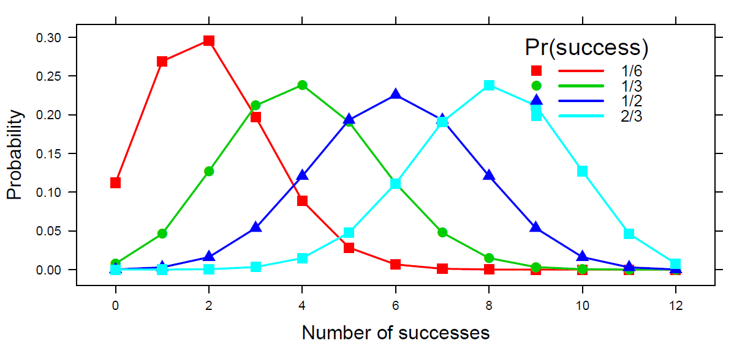
Binomial distribution
Binomial distributions for k = 0, 1, 2, …, 12 successes in n=12 trials, for 4 values of p
Mean = n p
Variance: n p q is maximum when p = ½
Skewed when p ≠ ½
Code: binomial.html
DDAR Fig 3.9, pp 76-77

Slide 17
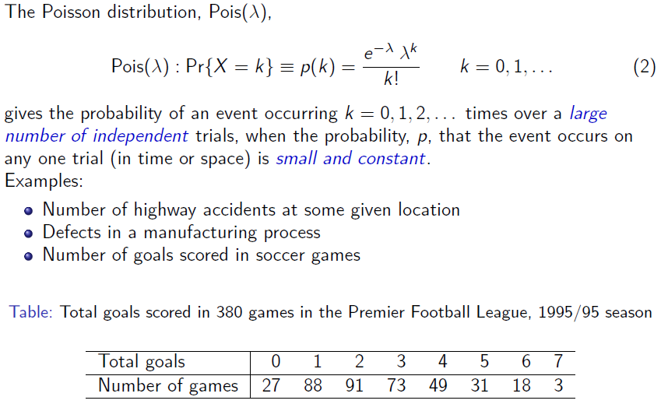
Poisson distribution

Slide 18
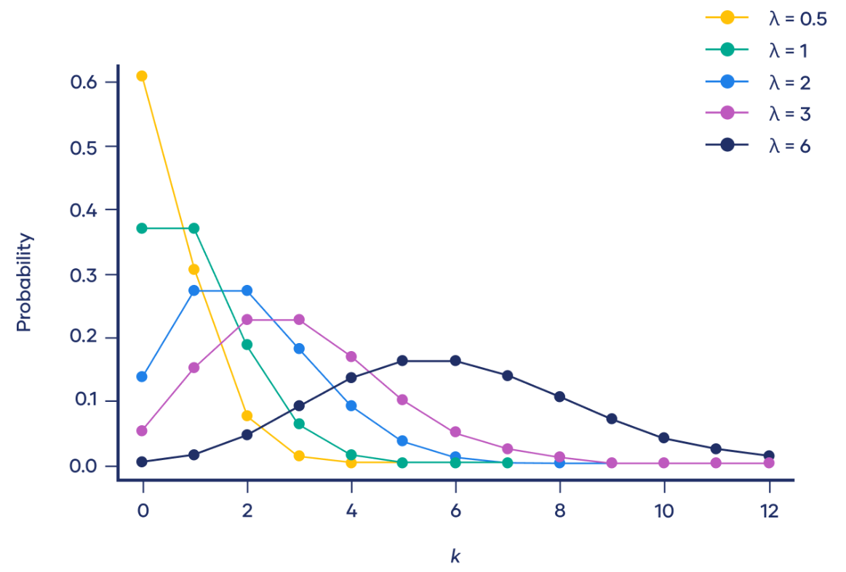
Poisson distribution
Poisson distributions for λ = ½, 1, 2, 3, 6
λ=0.5
Q: What happens here as λ increases?
λ=2
λ=6

Slide 19
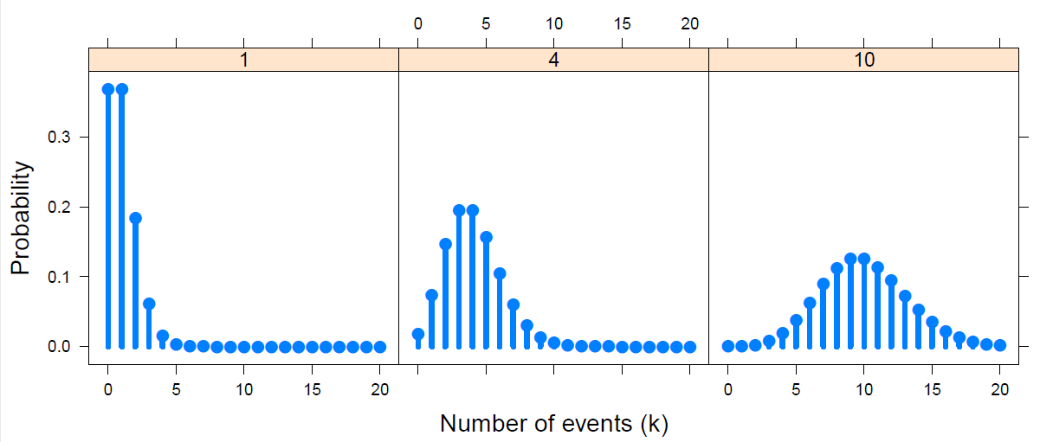

Poisson distribution: Properties
Poisson distributions for λ = 1, 4, 10
DDAR Fig 3.10, p 81
Mean, variance, skewness:
Mean[X] = λ
Var[X] = λ
Skew[X] = λ ^{-1/2}
Properties:
Sum of Pois (λ₁, λ₂,λ₃, …) = Pois(∑λ_{i})
Approaches N(λ, λ) as n → ∞
MLE: $\hat{λ}=\overline{x}$

Slide 20
History: Who discovered the “Poisson” distribution
Stigler’s Law: No discovery in science is ever named for its primary originator
De Moivre (1718) – Approximation to binomial as n gets largish
Poisson (1837) – Reserches sur la Probabilité des jugements en Matière criminelle… -- Derives e^{-λ} λ^{k} / k!
Stigler says main result anticipated by De Moivre
S. Newcomb (1860) – Notes on a Theory of Probability
First attempt at using this as a fit to data
Observations of stars: Pr(any small space, 1º) contains s stars, s = 0, 1, 2, …
Von Bortkiewicz (1898) – Law of Small Numbers
Re-derives Poisson as limiting case of binomial
Several data sets (Horse kicks & others) – “agreement between theory and observation leave nothing to be desired”
Gosset (1907): Heamacytometer Counts
“Student”’s first paper – first rigorous treatment of the Poisson for count data
See: Hanley & Bhatnagar (2022) The “Poisson” Distribution: History, Reenactments, Adaptations, The American Statistician, 76:4, 363-371, DOI: 10.1080/00031305.2022.2046159
Notes:
Stigler’s law examples : Pythagorean theorem, Occam's razor, Halley's comet, Avogadro's number, Coriolis force, Gresham's law, Venn diagrams,

Slide 21
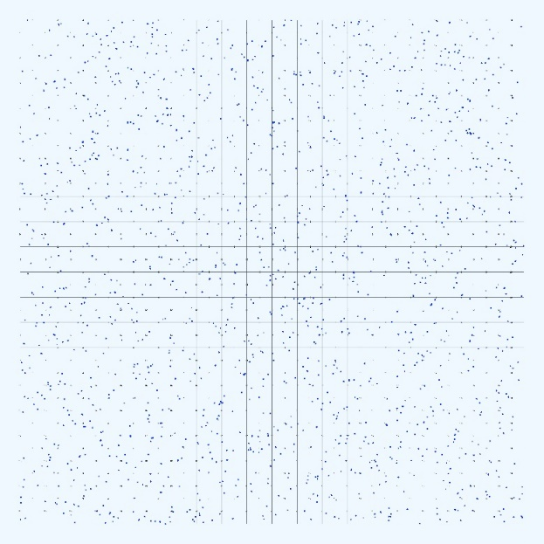
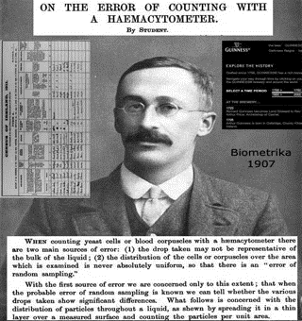
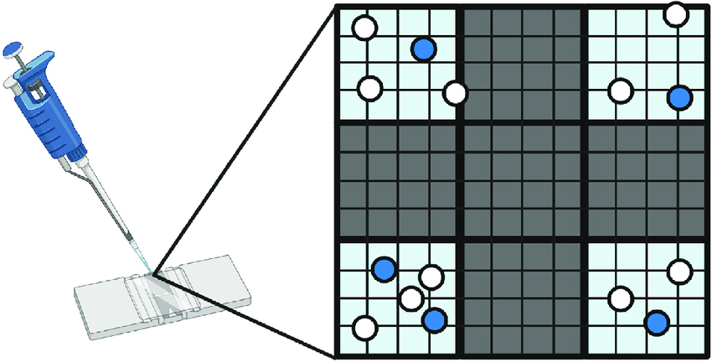
Gosset: Heamacytometer Counts
Number of blood cells observed in a 20 x 20 grid on a slide
Source: http://www.medicine.mcgill.ca/epidemiology/hanley/Gosset/

Slide 22


Geometric distribution
Distribution of the number of trials before the first occurrence of some event
Flip a coin: how many trials before 1st head?
Toss a die: number of tosses before 1st “6”?
Quality control: number of items inspected before finding a defective one
Geom(p): Pr{X=k} = 𝑝(1−𝑝)^{𝑘}
Mean: E(X) =
Variance: V(X) =
1st head
k tails
Assumptions:
Binary trials: Event / No event
Independent trials
Constant prob, p, on any trial

Slide 23
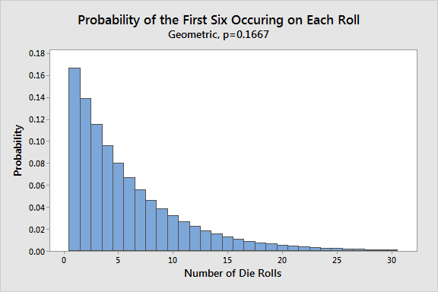
Geometric distribution: Tossing dice
> p <- 1/6
> x <- 0:10
> probs <- dgeom(x, prob = p)
> names(probs) <- x
> round(probs, 3)
0 1 2 3 4 5 6 7 8 9 10
0.167 0.139 0.116 0.096 0.080 0.067 0.056 0.047 0.039 0.032 0.027
For dgeom(), x is failures before first success, so k=1 (success on trial 1) means x=0 failures
Q: Can you use this to test if dice are “fair”, i.e., p(k) = 1/6 ?
How?
What dist^{n} would give an easier test?
Ans: Binomial– obs. counts of 1:6

Slide 24
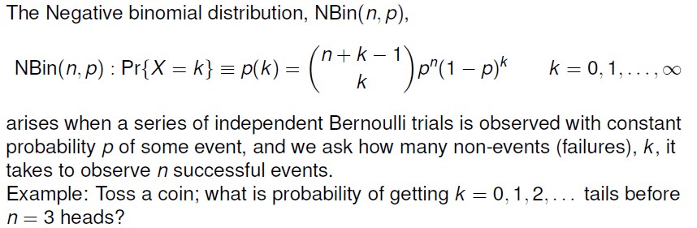

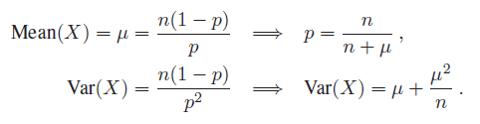
Negative binomial distribution
Pr(n success)
Pr(k failures)
Properties:

Slide 25
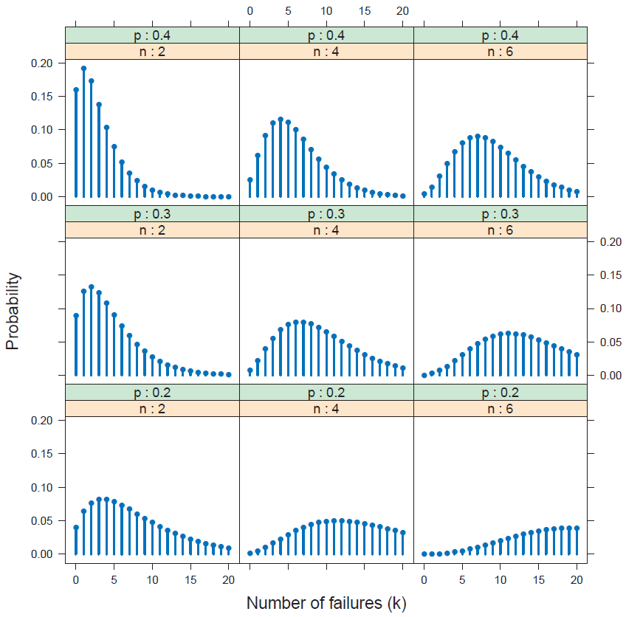
p
n
Negative binomial distributions for
n = 2, 4, 6
p = 0.2, 0.3, 0.4
Mean:
Increases with n
Decreases with p
DDAR Fig 3.13, p 85

Slide 26
Quiz: Name that distribution
1. Weldon tossed 12 dice 26,306 times & tallied the number of times a 5 or 6 occurred
> WeldonDice
n56
0 1 2 3 4 5 6 7 8 9 10+
185 1149 3265 5475 6114 5194 3067 1331 403 105 18
Bin(n=12, p=1/3)
2. Pele practices penalty kicks for the upcoming 1958 FIFA World Cup. His average scoring has been p=0.4. What is the probability it will take him 1, 2, … shots to score a goal?
Nbin(n=1, p=0.4)
> dnbinom(1:5, size=1, p=0.4)
[1] 0.240 0.144 0.086 0.052 0.031
3. A Geiger counter records the number of scintillations of α particles from a radioactive source, with an average rate of 20/msec. What is the probability of observing 40 in a 1 msec. interval?
Pois(λ=20)
4. What is the distribution of the time between Geiger counter ticks?
Exponential dist^{n}, Pr(X=k) = λ e^{-λk} , mean = 1/λ

Slide 27
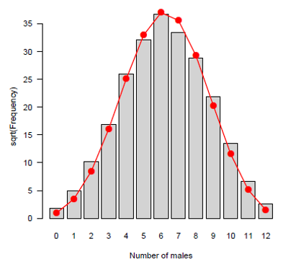
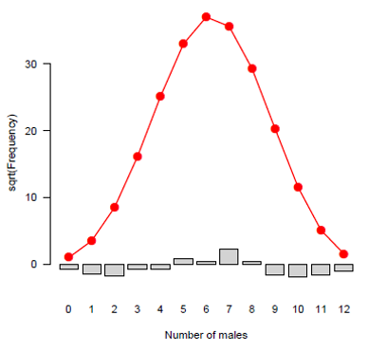
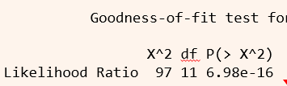
Fitting discrete distributions
Fitting discrete distributions generally follows four main steps:
Visualize the data to suggest candidate distributions.
Estimate the parameters of the chosen distribution.
Evaluate the quality of the fit graphically.
Perform goodness-of-fit statistical tests to determine how well the chosen model represents the data

Slide 28
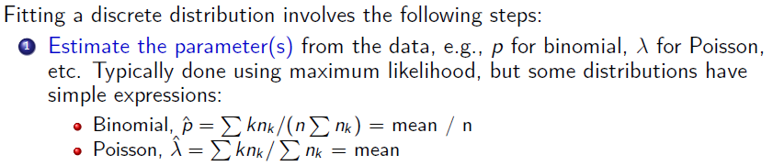
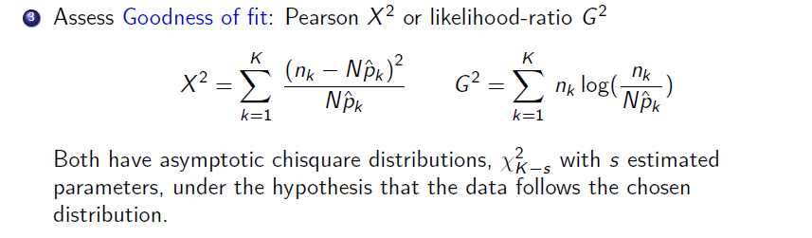
Fitting discrete distributions: Details

Slide 29

Fitting: Weldon’s dice
Basic, naïve calculation of expected frequencies for a binomial dist^{n} using dbinom()
> data(WeldonDice, package="vcd")
> Weldon.df <- as.data.frame(WeldonDice) # convert to data frame
> Prob <- dbinom(0:12, 12, 1/3) # binomial probabilities
> Prob <- c(Prob[1:10], sum(Prob[11:13])) # sum values for 10+
> Exp= round(sum(WeldonDice)*Prob) # expected frequencies
> Diff = Weldon.df[,"Freq"] - Exp # raw residuals
> Chisq = Diff^2 /Exp # contribution to chisquare
> data.frame(Weldon.df, Prob=round(Prob,5), Exp, Diff, Chisq)
n56 Freq Prob Exp Diff Chisq
1 0 185 0.00771 203 -18 1.596
2 1 1149 0.04624 1216 -67 3.692
3 2 3265 0.12717 3345 -80 1.913
4 3 5475 0.21195 5576 -101 1.829
5 4 6114 0.23845 6273 -159 4.030
6 5 5194 0.19076 5018 176 6.173
7 6 3067 0.11127 2927 140 6.696
8 7 1331 0.04769 1255 76 4.602
9 8 403 0.01490 392 11 0.309
10 9 105 0.00331 87 18 3.724
11 10+ 18 0.00054 14 4 1.143
Doesn’t calculate the MLE, $\hat{p}$
Manually sum k ≥ 10

Slide 30
Fitting & graphing discrete distributions
In R, the vcd and vcdExtra packages provide functions to fit, visualize and diagnose discrete distributions
Fitting: goodfit() fits uniform, binomial, Poisson,
neg bin, geometric, logseries, …
Graphing: rootogram() assess departure between
observed, fitted counts
Ord plot: Ordplot() diagnose form of a discrete
distribution
Robust plots: distplot() handle problems with
discrepant counts

Slide 31
Example: Saxony families
> data(Saxony, package="vcd")
> Saxony
nMales
0 1 2 3 4 5 6 7 8 9 10 11 12
3 24 104 286 670 1033 1343 1112 829 478 181 45 7
Use goodfit() to fit the binomial; test with summary()
> Sax.fit <- goodfit(Saxony, type = "binomial", par=list(size=12))
> summary(Sax.fit)
Goodness-of-fit test for binomial distribution
X^2 df P(> X^2)
Likelihood Ratio 97 11 6.98e-16
Specify parameters
Doesn’t fit. Why?

Slide 32
Example: Saxony families
The print() method for goodfit objects shows the details
> Sax.fit # print
Observed and fitted values for binomial distribution
with parameters estimated by `ML'
count observed fitted pearson residual
0 3 0.933 2.140
1 24 12.089 3.426
2 104 71.803 3.800
3 286 258.475 1.712
4 670 628.055 1.674
5 1033 1085.211 -1.585
6 1343 1367.279 -0.657
7 1112 1265.630 -4.318
8 829 854.247 -0.864
9 478 410.013 3.358
10 181 132.836 4.179
11 45 26.082 3.704
12 7 2.347 3.037
Pay attention to the signs & magnitudes of residuals, d_{k}
Pearson χ² = ∑ d_{k} ²

Slide 33
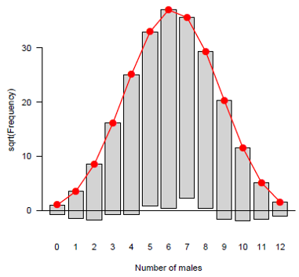
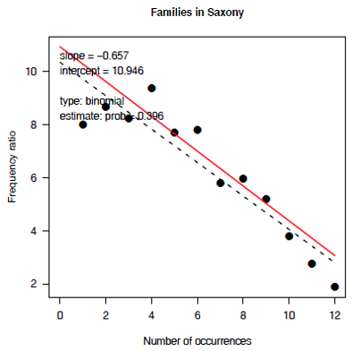
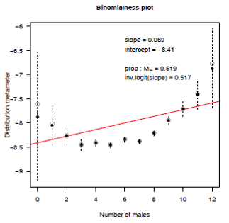
Graphing discrete distributions
Rootograms
Ord plots
Robust distribution plots

Slide 34
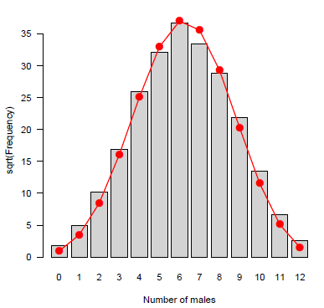
What’s wrong with simple histograms?
Discrete distributions are often graphed as histograms, with a theoretical fitted distribution superimposed
The plot() method for goodfit objects provides some alternatives
> plot(Sax.fit, type = "standing", xlab = "Number of males")
Problems:
Largest frequencies dominate
Must assess deviations vs. the fitted curve

Slide 35
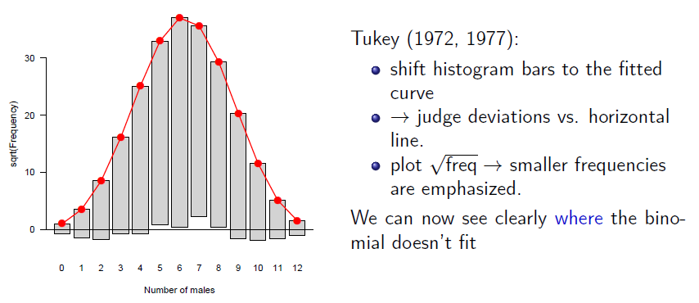
Hanging rootograms
> plot(Sax.fit, type = "hanging", xlab = "Number of males") # default

Slide 36
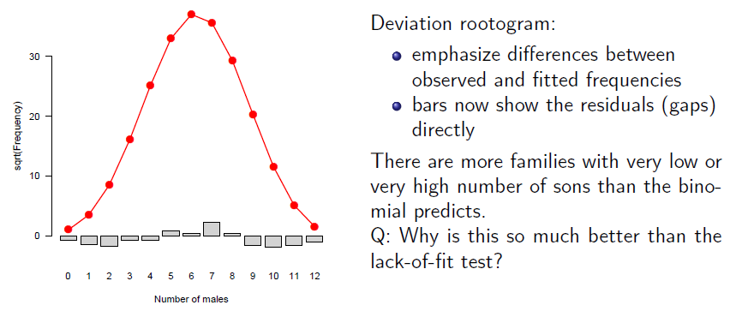
Deviation rootograms
> plot(Sax.fit, type = "deviation", xlab = "Number of males")
Q: What does this suggest about sex distribution of families in Saxony?

Slide 37
Example: Federalist papers
> data(Federalist, package="vcd")
> Federalist
nMay
0 1 2 3 4 5 6
156 63 29 8 4 1 1
Fit the Poisson distribution
> Fed.fit0 <- goodfit(Federalist, type="poisson")
> summary(Fed.fit0)
Goodness-of-fit test for poisson distribution
X^2 df P(> X^2)
Likelihood Ratio 25.2 5 0.000125
This fits very poorly!
Why might this be the case?

Slide 38
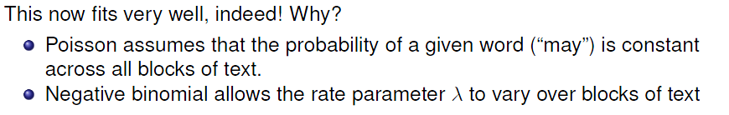
Example: Federalist papers
Try the Negative binomial distribution
> Fed.fit1<- goodfit(Federalist, type="nbinomial")
> summary(Fed.fit1)
Goodness-of-fit test for nbinomial distribution
X^2 df P(> X^2)
Likelihood Ratio 1.96 4 0.742
In their landmark study, Mosteller & Wallace used a number of such words to distinguish between papers written by Madison & Hamilton and then assign the “unknown” author papers --- all to James Madison

Slide 39
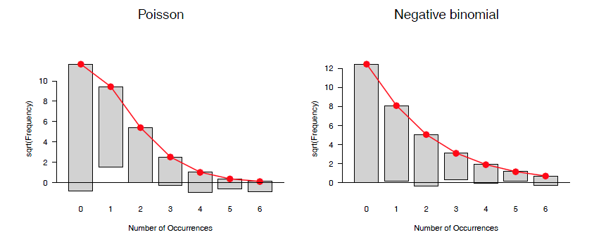
Federalist papers: Rootograms
Hanging rootograms for the Federalist papers data, comparing Poisson and Negative binomial
> plot(Fed.fit0, main = "Poisson")
> plot(Fed.fit1, main = "Negative binomial")

Slide 40
History corner: Why important?
Resolved a long-standing historical debate
Authorship of 12 of 85 papers had been disputed: Madison or Hamilton?
Analysis of word frequencies ⟶ strong evidence all by Madison
Established “stylometry” – statistical analysis of text for authorship
Word frequencies of “marker” words (by, upon, may) as reliable indicators
Did Shakespeare write all his plays? Or did Francis Bacon or Christopher Marlow write some?
Pioneered Bayesian analysis: First large-scale Bayesian application
Prior prob: p(Hamilton) = p(Madison) = ½
Update via parameters estimated from Nbin() distribution
Introduced the idea of cross-validation
Leave-one-out ⟶ predict from the rest
Heralded the age of computer-intensive methods

Slide 41
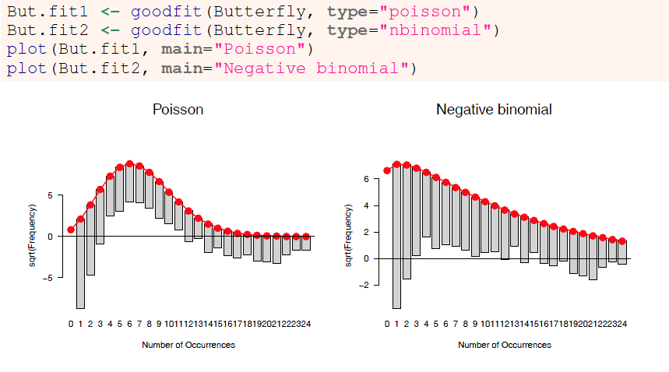
Butterfly data
Both Poisson and Negative binomial are terrible fits! What to do??

Slide 42
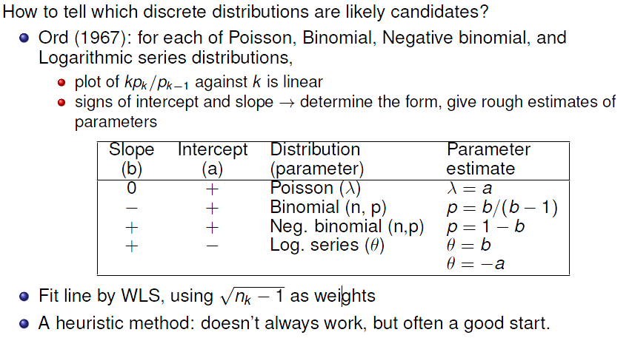
Ord plots: Diagnose form of distribution

Slide 43
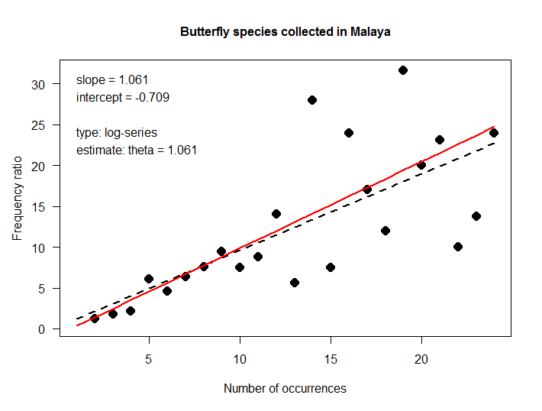
Ord plot: Examples
Butterfly data: The slope and intercept correctly diagnoses the log-series distribution
> Ord_plot(Butterfly,
main = "Butterfly species collected in Malaya",
gp=gpar(cex=1), pch=16)
+ slope
- intercept
→ log-series
OLS line shown in black
WLS line shown in red

Slide 44
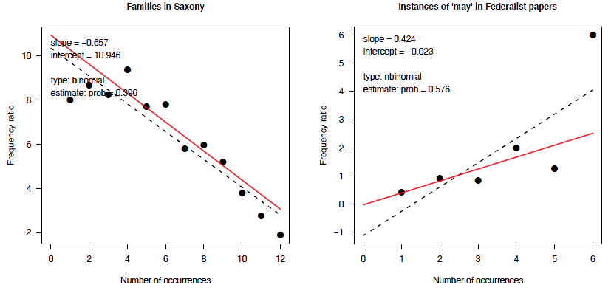
Ord plots: Examples
Ord plots for the Saxony and Federalist data
> Ord_plot(Saxony, main = "Families in Saxony", gp=gpar(cex=1), pch=16)
> Ord_plot(Federalist, main = "Instances of 'may' in Federalist papers", gp=gpar(cex=1), pch=16)

Slide 45
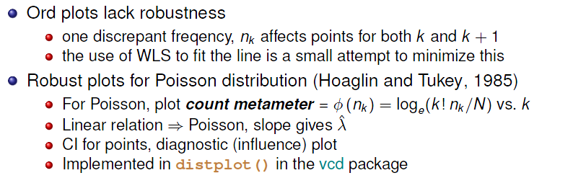
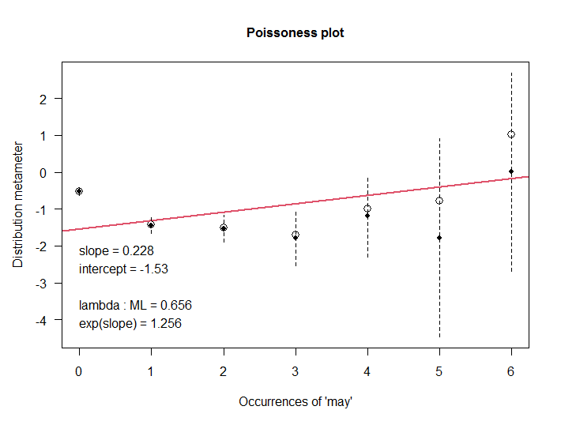
Robust distribution plots
For the Poisson distribution, this is called a “poissonness plot”

Slide 46
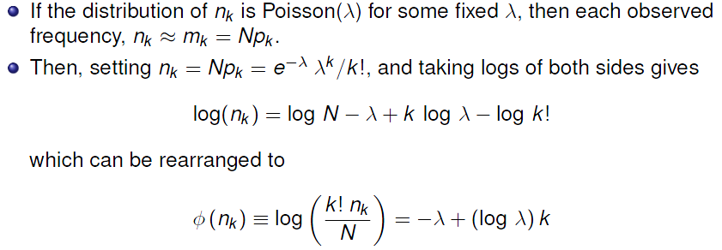
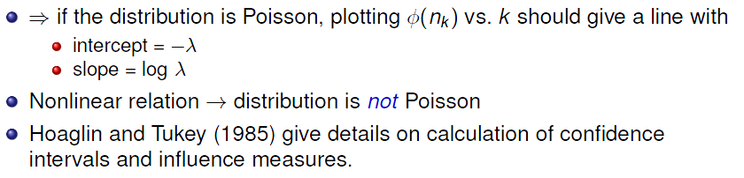
Poissonness plot: Details

Slide 47
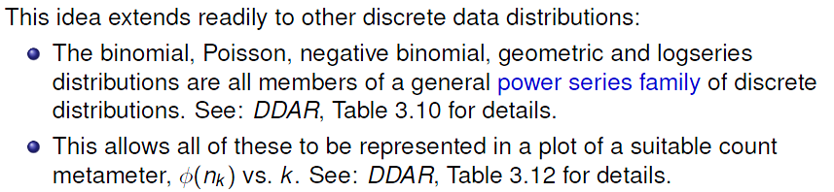
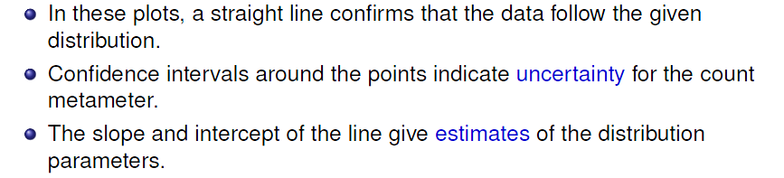
Other distributions

Slide 48



Other distributions
$$p\left(k\right)=a\left(k\right) θ^{k} / f\left(θ\right) k=0,1,…$$
Math trick: This allows properties of the members of a family to be studied, related to each other and solve larger problems!

Slide 49

Other distributions
This allows all of these to be represented in a plot of a suitable count metameter, φ(n_{k}) vs k. DDAR Table 3.12 gives details

Slide 50

distplot: Federalist
Try both Poisson & Negative binomial

Slide 51

distplot: Saxony
For purported binomial distributions, the result is a “binomialness” plot
Both plots show heavier tails than the binomial distribution. distplot() is more sensitive in diagnosing this

Slide 52



What have we learned?

Slide 53


What have we learned?

Slide 54

Looking ahead: The GLM family
These discrete distributions are also part of a larger family, the exponential family
This is the basis for the extension to generalized linear models, the GLM family
Families share:
Same structure: canonical form, “natural” parameters
Sufficient statistics: all you need to estimate
Conjugate priors in Bayesian analysis
Families allow:
Generic estimation, like glm()
Common diagnostics and graphical methods
Families provide: ❤️mutual love , 👨‍👩‍👧sense of belonging & identity, procreation!

Slide 55

Looking ahead: PhdPubs data
N = 915, mean(articles) = 1.69
There are predictors: gender, marital status, number of children, prestige of dept., # pubs by student’s mentor
We fit such models with glm(), but need to specify the form of the distribution
Ignoring the predictors for now, a baseline model could be
glm(articles ~ 1, data=PhdPubs, family = “poisson”)

Slide 56

Looking ahead: PhdPubs
Poisson doesn’t fit: Need to account for excess 0s (some never published)
Neg binomial: Sort of OK, but should take predictors into account

Slide 57

Looking ahead: Count data models
Count data regression models (DDAR Ch 11)
Include predictors
Allow different distributions for unexplained variation
Provide tests of one model vs. another
Special models handle the problems of excess zeros: zeroinlf(), hurdle()

Slide 58

Looking ahead: Effect plots

Slide 59
Summary
Discrete distributions are the building blocks for categorical data analysis
Typically consist of basic counts of occurrences, with varying frequencies
Most common: binomial, Poisson, negative binomial
Others: geometric, log-series
Fit with goodfit(); plot with rootogram()
Diagnostic plots: Ord_plot(), distplot()
Models with predictors
Binomial → logistic regression
Poisson → poisson regression; logliner models
These are special cases of generalized linear models

