Slide 1
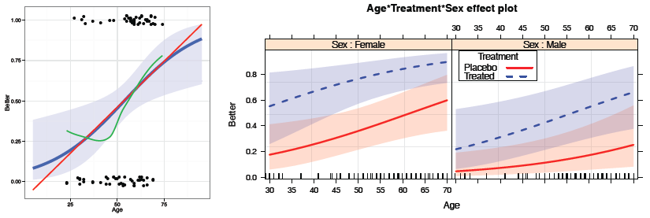

Logistic regression
Michael Friendly
Psych 6136
https://friendly.github.io/psy6136

Slide 2
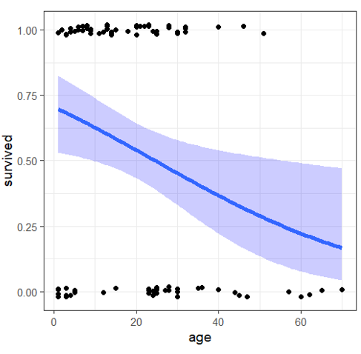
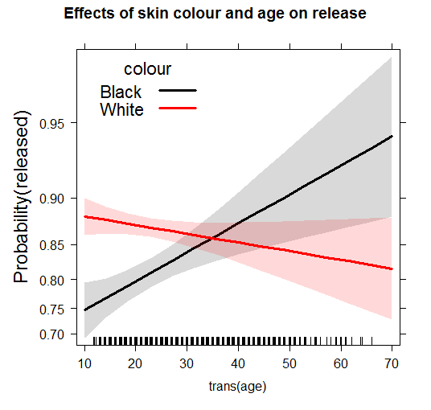
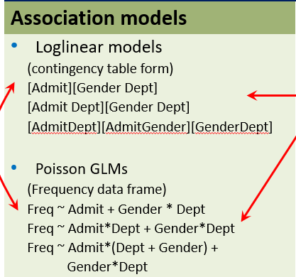
Today’s topics
Model-based methods: Overview
Logistic regression: one predictor, multiple predictors, fitting
Visualizing logistic regression
Effect plots
Case study: Racial profiling & marijuana arrests
Model diagnostics
Notes:
We’re at about the half-way point of the course.
I covered exploratory methods involving visualizing catgegorical data and the largely non-parametric methods of hypothesis testing.
From here on in, the emphasis will be on parametric models, and the simplest case is that of logistic regression for a binary outcome: lived/died; got better with treatment vs. didn’t

Slide 3
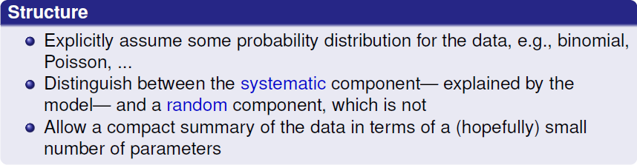
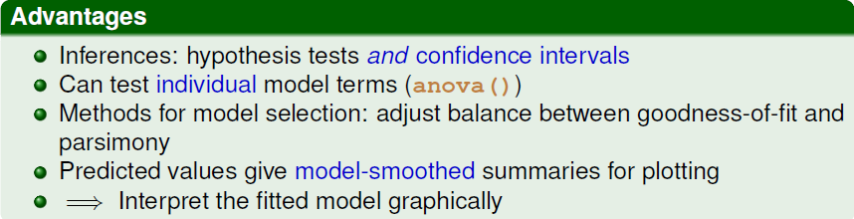
Model-based methods: Overview
Notes:
To set the stage, let’s consider some general ideas behind model-based methods.

Slide 4
Modeling approaches: Overview
Association models
Response models
Loglinear models
(contingency table form)
[Admit][Gender Dept]
[Admit Dept][Gender Dept]
[AdmitDept][AdmitGender][GenderDept]
Poisson GLMs
(Frequency data frame)
Freq ~ Admit + Gender * Dept
Freq ~ Admit*Dept + Gender*Dept
Freq ~ Admit*(Dept + Gender) +
Gender*Dept
Ordinal variables
Freq ~ right + left + Diag(right, left)
Freq ~ right + left + Symm(right, left)
Binary response
Categorical predictors: logit models
logit(Admit) ~ 1
logit(Admit) ~ Dept
logit(Admit) ~ Dept + Gender
Continuous/mixed predictors
Logistic regression models
Pr(Admit) ~ Dept + Gender + Age + GRE
Polytomous response
Ordinal: proportional odds model
Improve ~ Age + Sex + Treatment
General multinomial model
WomenWork ~ Kids + HusbandIncome

Slide 5
loglm() vs. glm()
With loglm() you can only test overall fit (anova()) or difference between models (Lrstats() )
> berk.mod1 <- loglm(~ Dept * (Gender + Admit), data=UCBAdmissions)
> berk.mod2 <- loglm(~(Admit + Dept + Gender)^2, data=UCBAdmissions)
> anova(berk.mod2)
Call:
loglm(formula = ~(Admit + Dept + Gender)^2, data = UCBAdmissions)
Statistics:
X^2 df P(> X^2)
Likelihood Ratio 20.20 5 0.001144
Pearson 18.82 5 0.00207
What we can say:
Even the model with all pairwise associations fits poorly ☹

Slide 6
Comparing models with anova() and LRstats()
> anova(berk.mod1, berk.mod2, test="Chisq")
LR tests for hierarchical log-linear models
Model 1:
~Dept * (Gender + Admit)
Model 2:
~(Admit + Dept + Gender)^2
Deviance df Delta(Dev) Delta(df) P(> Delta(Dev)
Model 1 21.74 6
Model 2 20.20 5 1.531 1 0.21593
Saturated 0.00 0 20.204 5 0.00114
> LRstats(berk.mod1, berk.mod2)
Likelihood summary table:
AIC BIC LR Chisq Df Pr(>Chisq)
berk.mod1 217 238 21.7 6 0.0014 **
berk.mod2 217 240 20.2 5 0.0011 **
---
Signif. codes: 0 ‘***’ 0.001 ‘**’ 0.01 ‘*’ 0.05 ‘.’ 0.1 ‘ ’ 1
Q: What can we say from this?

Slide 7
loglm() vs. glm()
With glm() you can test individual terms using anova() or car::Anova()
> berkeley <- as.data.frame(UCBAdmissions)
> berk.glm2 <- glm(Freq ~ (Dept+Gender+Admit)^2, data=berkeley,
family="poisson")
> anova(berk.glm2, test="Chisq")
Analysis of Deviance Table
Model: poisson, link: log
Response: Freq
Terms added sequentially (first to last)
Df Deviance Resid. Df Resid. Dev Pr(>Chi)
NULL 23 2650
Dept 5 160 18 2491 <2e-16 ***
Gender 1 163 17 2328 <2e-16 ***
Admit 1 230 16 2098 <2e-16 ***
Dept:Gender 5 1221 11 877 <2e-16 ***
Dept:Admit 5 855 6 22 <2e-16 ***
Gender:Admit 1 2 5 20 0.22
---
Signif. codes: 0 ‘***’ 0.001 ‘**’ 0.01 ‘*’ 0.05 ‘.’ 0.1 ‘ ’ 1
NB: anova() gives Type I, sequential tests
Not interested in these
Q: Can someone help interpret the term for Gender:Admit ?
How could I enhance the vcdExtra package to do this for loglm() models?

Slide 8
Dropping & adding terms
A useful strategy for model-building is to start with some model, and consider
The effect of dropping high-order terms, one at a time
The effect of adding terms w/in the scope of a larger model, one at a time
MASS:dropterm() and MASS::addterm() do this for both glm() and loglm() models
> MASS::dropterm(berk.glm2, test="Chisq")
Single term deletions
Model:
Freq ~ (Dept + Gender + Admit)^2
Df Deviance AIC LRT Pr(Chi)
<none> 20.20 217.26
Dept:Gender 5 1148.90 1335.96 1128.70 <2e-16 ***
Dept:Admit 5 783.61 970.67 763.40 <2e-16 ***
Gender:Admit 1 21.74 216.80 1.53 0.2159
---
Signif. codes: 0 ‘***’ 0.001 ‘**’ 0.01 ‘*’ 0.05 ‘.’ 0.1 ‘ ’ 1

Slide 9
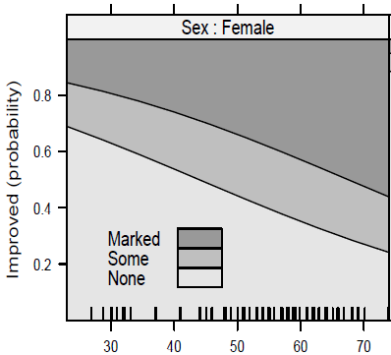
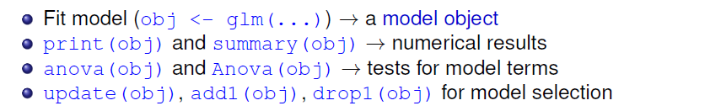
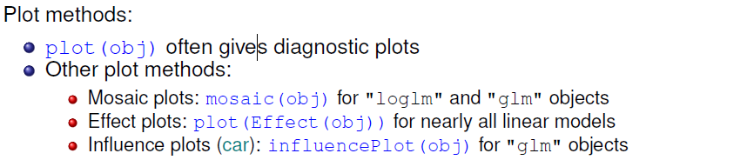
Fitting & graphing models: Overview
Object-oriented approach in R:
input
data
glm()
polr()
multinom()
plot(mod)
plot(f(mod))
model object

Slide 10
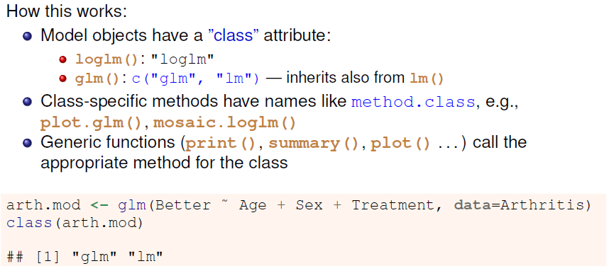
Objects & methods

Slide 11
Objects & methods
Methods for “glm” objects
> library(MASS); library(vcdExtra)
> methods(class="glm")
[1] add1 addterm anova Anova
[5] asGnm assoc avPlot avPlot3d
[9] Boot bootCase brief ceresPlot
[13] coerce confidenceEllipse confint Confint
[17] cooks.distance deviance drop1 dropterm
[21] effects extractAIC family formula
[25] gamma.shape influence initialize leveragePlot
[29] linearHypothesis logLik mcPlot mmp
[33] model.frame modFit mosaic ncvTest
[37] nobs predict print profile
[41] qqPlot residualPlot residualPlots residuals
[45] rootogram rstandard rstudent S
[49] show sieve sigmaHat slotsFromS3
[53] summary vcov weights
see '?methods' for accessing help and source code

Slide 12

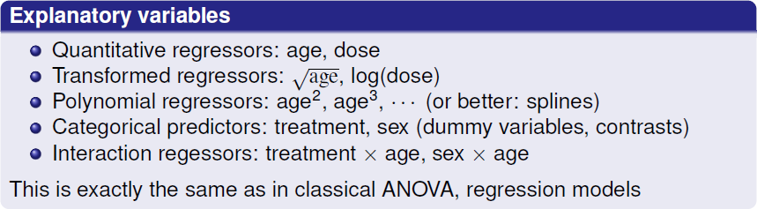
Logistic regression
glm(success ~ …, family=binomial)
glm(cbind(Nsuccess, Nfail) ~ …, family=binomial)

Slide 13

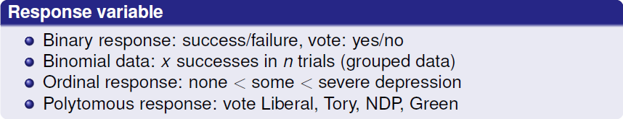
Logistic regression: Extensions
Extensions of the framework for logistic regression allow us to handle more than two discrete outcomes. Explanatory variable remain the same

Slide 14
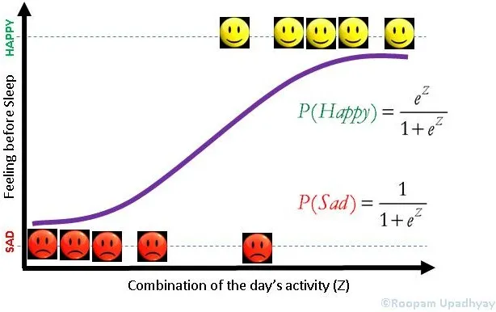
Logistic regression examples

Slide 15
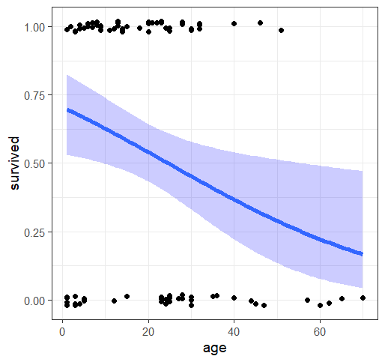
Survival in the Donner Party
Data on the Donner Party records the fate of 90 people who set out to CA in 1846.
They were trapped in an early winter storm near Reno, NV. Only 48 survived.
Who survived? Why?
Logistic regression can model the probability of the binary (0/1) outcome of survival
The model is linear in log-odds, but non-linear on the probability scale.
A quantitative predictor like age gives predicted probabilities (& CI)
Other predictors – sex, family, … can give a more detailed understanding

Slide 16
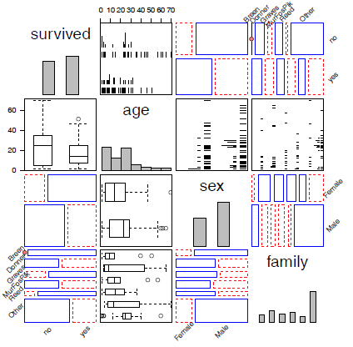
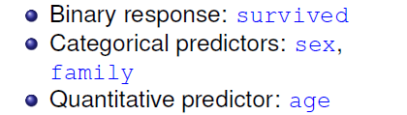
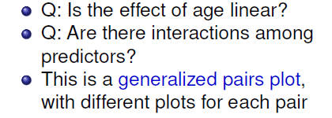
Survival in the Donner Party
Some possible models:
glm(survived ~ age, data=Donner, family=binomial)
glm(survived ~ age + sex + family, data=Donner, family=binomial)
glm(survived ~ age * sex, data=Donner, family=binomial)

Slide 17
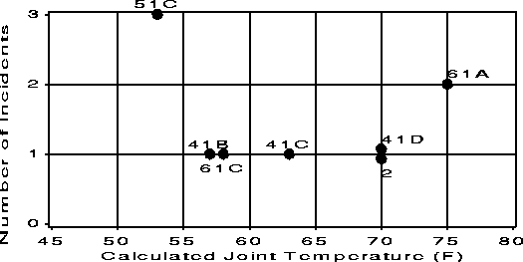
Challenger: A dataviz disaster
The space shuttle Challenger exploded 73 sec. after takeoff on January 28, 1986, killing all 7 crew
Subsequent investigation revealed the proximal cause: Low temperature → failures of the rubber O-rings joining rocket stages
The anterior cause was a failure of data analysis & visualization
Data: 24 previous flights: temperature, # of “incidents”
Morton-Thiokol engineers prepared this bad graph
But, they also excluded all flights where there was no damage

Slide 18
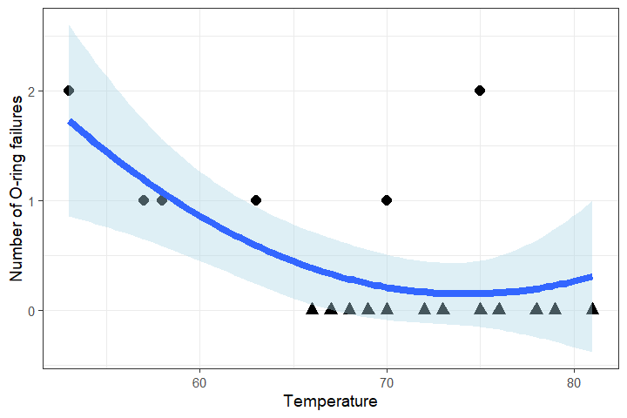
Challenger: A better graph
This graph plots the number of failures out of 6 O-rings in all previous flights, including those with 0 failures
It fits a simple quadratic regression, nFailures ~ poly(Temperature, 2)
It should have been a warning that failures increase as temperature gets lower
But it doesn’t take into account that nFailures ~ Bin(p, n=6)

Slide 19
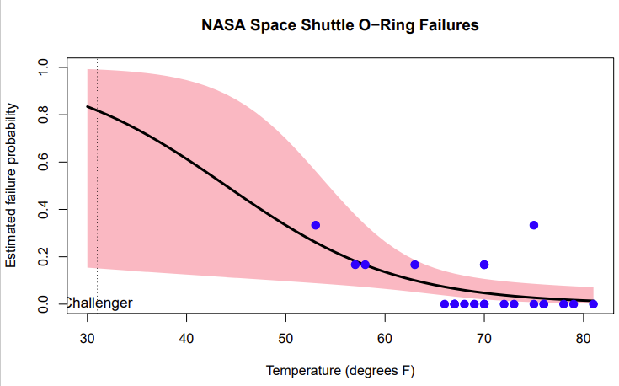
Challenger: A better analysis
Logistic regression treats the # failures as a binomial outcome with n = 6 trials
The model provides
Predicted probabilities outside the range of the data
Confidence intervals, to judge model uncertainty
When the challenger was launched, the temp was 31º F
The CI band is very wide, but the predicted value is uncomfortably high
This analysis & graph might have saved lives!

Slide 20
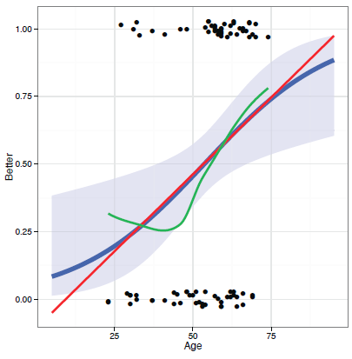
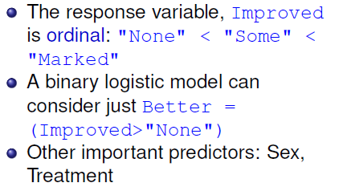
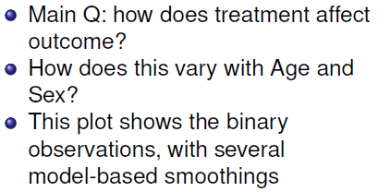
Example: Arthritis treatment

Slide 21
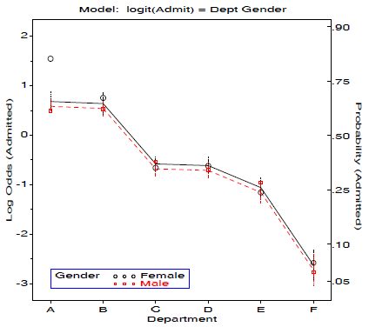
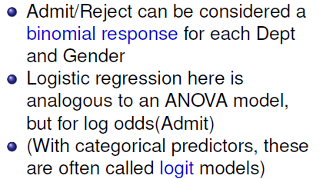
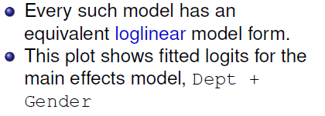
Example: Berkeley admissions
WOW! This logit model has such a simple interpretation compared to loglinear
Can you describe it?

Slide 22

The Logistic Regression Model

Slide 23
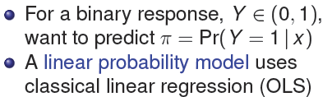
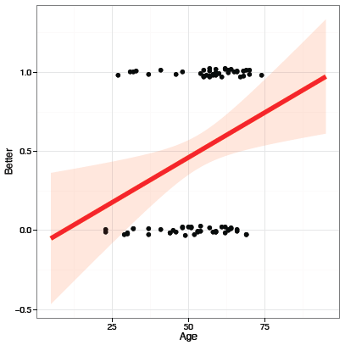
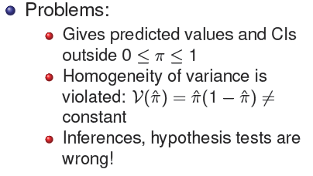
Binary response: What’s wrong with OLS?

Slide 24
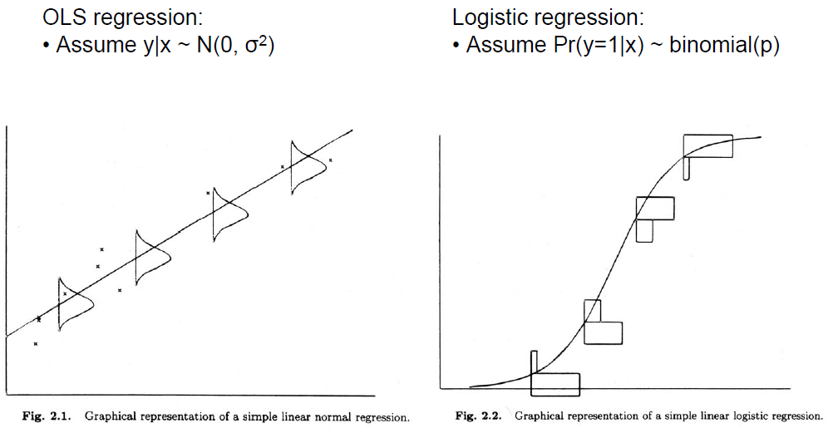
Linear regression vs Logistic regression
y linear with x
constant residual variance
y ~ logit (x)
non-constant residual variance ~ p (1-p)

Slide 25
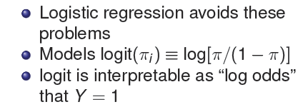
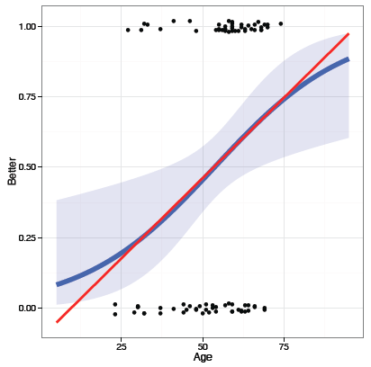
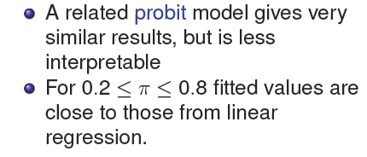
Logistic regression

Slide 26
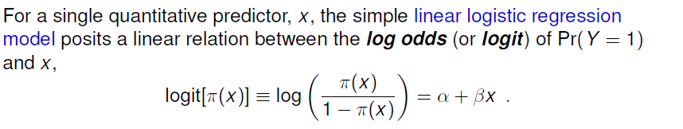
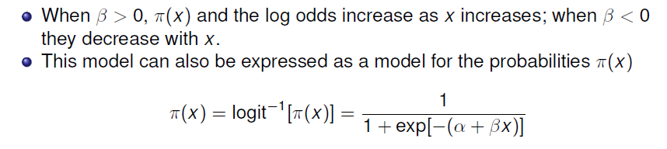
Logistic regression: One predictor
Thinking logistically:
Model is for the log odds of the marked response, Y = 1
Can always back transform with logit⁻¹ to get probability of Y = 1

Slide 27


Logistic regression: One predictor
The coefficients, α, β of this model have simple interpretations in terms of odds & log odds
is the change in log odds for a unit increase in x
→The odds of Y=1 are multiplied by e^{β} for each unit increase in x
is the log odds when x=0
→The odds of Y=1 when x=0 is e^{α}
In R, use exp(coef(model)) to get these values
Another interpretation: In terms of probability, the slope of the logistic regression curve is βπ(1-π)
This has the maximum value β/4 when π = ½

Slide 28
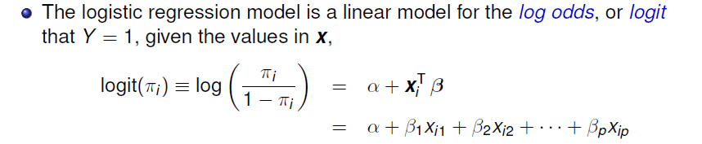
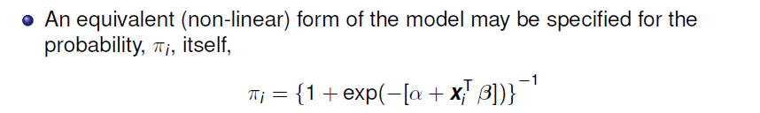
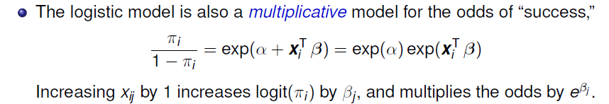
Logistic regression: Multiple predictors

Slide 29
Fitting the logistic regression model
Logistic regression models are the special case of generalized linear models, fit in R using glm(..., family=binomial)
For this example, we define Better as any improvement at all
> data(Arthritis, package="vcd")
> Arthritis$Better <- as.numeric(Arthritis$Improved > "None")
Fit and print:
> (arth.logistic <- glm(Better ~ Age, data=Arthritis, family=binomial))
Call: glm(formula = Better ~ Age, family = binomial, data = Arthritis)
Coefficients:
(Intercept) Age
-2.6421 0.0492
Degrees of Freedom: 83 Total (i.e. Null); 82 Residual
Null Deviance: 116
Residual Deviance: 109 AIC: 113

Slide 30
The summary()method gives details and tests of coefficients
> summary(arth.logistic)
Call:
glm(formula = Better ~ Age, family = binomial, data = Arthritis)
Deviance Residuals:
Min 1Q Median 3Q Max
-1.5106 -1.1277 0.0794 1.0677 1.7611
Coefficients:
Estimate Std. Error z value Pr(>|z|)
(Intercept) -2.6421 1.0732 -2.46 0.014 *
Age 0.0492 0.0194 2.54 0.011 *
---
Signif. codes: 0 ‘***’ 0.001 ‘**’ 0.01 ‘*’ 0.05 ‘.’ 0.1 ‘ ’ 1
(Dispersion parameter for binomial family taken to be 1)
Null deviance: 116.45 on 83 degrees of freedom
Residual deviance: 109.16 on 82 degrees of freedom
G² for H₀: β_{Age} = 0
G² for H₁: β_{Age} ≠ 0
How much better is this than the null model?
∆G²₍₁₎ = 116.45 – 109.16 = 7.29

Slide 31
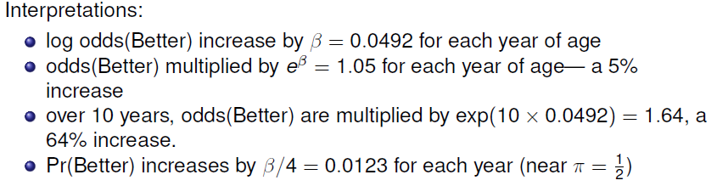
Interpreting coefficients
> coef(arth.logistic)
(Intercept) Age
-2.64207 0.04925
> exp(coef(arth.logistic))
(Intercept) Age
0.07121 1.05048
> exp(10*coef(arth.logistic)[2])
Age
1.636

Slide 32
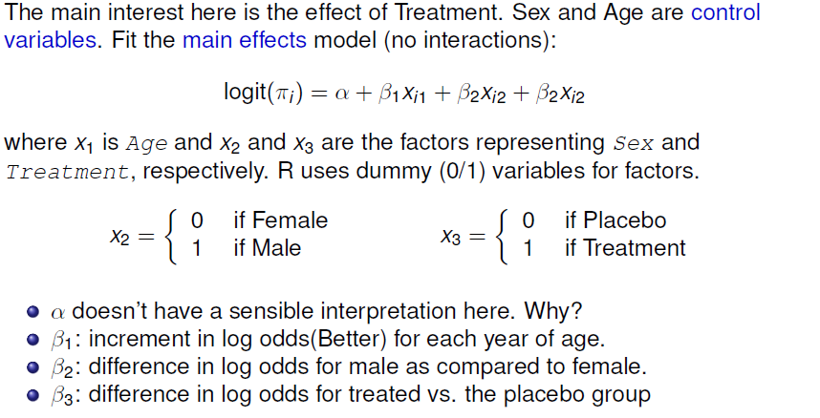
Multiple predictors

Slide 33
Multiple predictors: Fitting
Fit the main effects model. Use I(Age – 50) to center Age, making α interpretable
arth.logistic2 <- glm(Better ~ I(Age - 50) + Sex + Treatment,
data=Arthritis, family=binomial)
lmtest::coeftest() gives just the tests of coefficients provided by summary()
> lmtest::coeftest(arth.logistic2)
z test of coefficients:
Estimate Std. Error z value Pr(>|z|)
(Intercept) -0.5781 0.3674 -1.57 0.116
I(Age - 50) 0.0487 0.0207 2.36 0.018 *
SexMale -1.4878 0.5948 -2.50 0.012 *
TreatmentTreated 1.7598 0.5365 3.28 0.001 **
broom::glance() gives model fit statistics
> broom::glance(arth.logistic2)
# A tibble: 1 x 8
null.deviance df.null logLik AIC BIC deviance df.residual nobs
<dbl> <int> <dbl> <dbl> <dbl> <dbl> <int> <int>
1 116. 83 -46.0 100. 110. 92.1 80 84

Slide 34
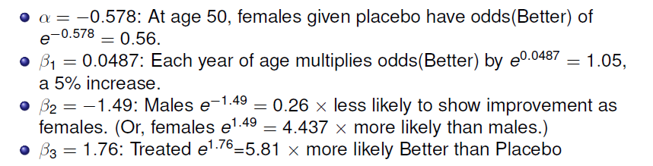
Interpreting coefficients
> cbind(coef=coef(arth.logistic2),
OddsRatio=exp(coef(arth.logistic2)),
exp(confint(arth.logistic2)))
coef OddsRatio 2.5 % 97.5 %
(Intercept) -0.5781 0.561 0.2647 1.132
I(Age - 50) 0.0487 1.050 1.0100 1.096
SexMale -1.4878 0.226 0.0652 0.689
TreatmentTreated 1.7598 5.811 2.1187 17.727
❶
❷
❸
❹
❶
❷
❸
❹

Slide 35
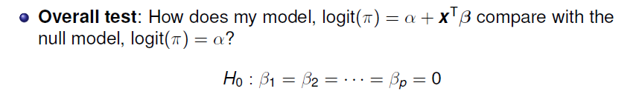

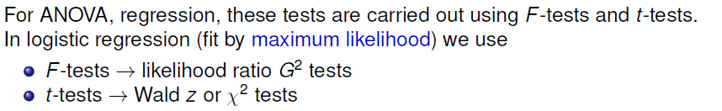
Hypothesis testing: Questions

Slide 36
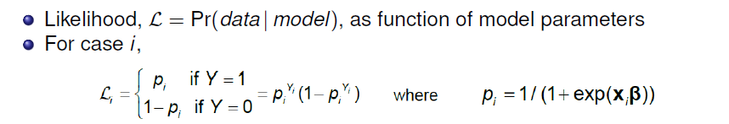
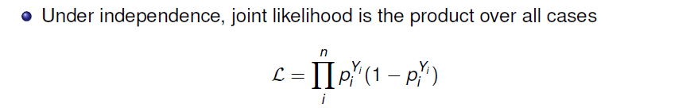
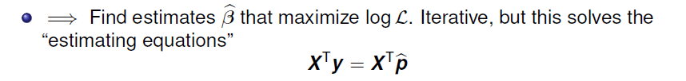
Maximum likelihood estimation
In classical linear models using lm(), we fit using ordinary least squares.
All glm() models use maximum likelihood estimation– better properties

Slide 37
Overall model tests
Likelihood ratio test (G²)
Compare nested models, similar to F tests in OLS
Let L₁ = maximized value for our model
logit(π_{i}) = β₀ + x^{T}_{i} β w/ k predictors
Let L₀ = maximized likelihood for the null model
logit(π_{i}) = β₀ under H₀: β₁ = β₂ = … = β_{k}
Likelihood ratio test statistic:

Slide 38
Wald tests & confidence intervals
Analogous to t-tests in OLS
Test H₀: β_{i} = 0
Confidence interval
> r1 <- lmtest::coeftest(arth.logistic2)
> r2 <- confint(arth.logistic2)
Waiting for profiling to be done...
> cbind(r1, r2)
Estimate Std. Error z value Pr(>|z|) 2.5 % 97.5 %
(Intercept) -0.578 0.367 -1.6 0.116 -1.33 0.124
I(Age - 50) 0.049 0.021 2.4 0.018 0.01 0.092
SexMale -1.488 0.595 -2.5 0.012 -2.73 -0.372
TreatmentTreated 1.760 0.536 3.3 0.001 0.75 2.875

Slide 39
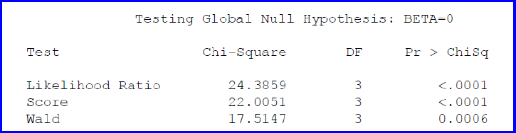
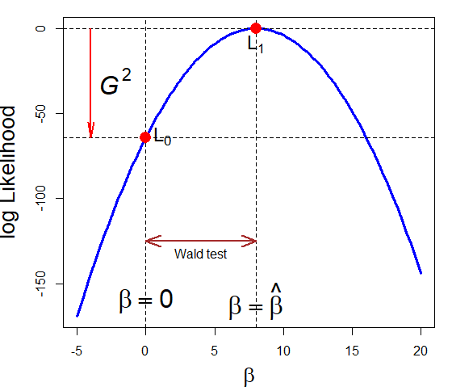
LR, Wald & Score tests
H0: β₁ = β₂ = β₃ = 0
Different ways to measure departure from H₀: β = 0
LR test: diff^{ce} in log L
Wald test: (β – β₀)²
Score test: slope at β = 0
Score test

Slide 40
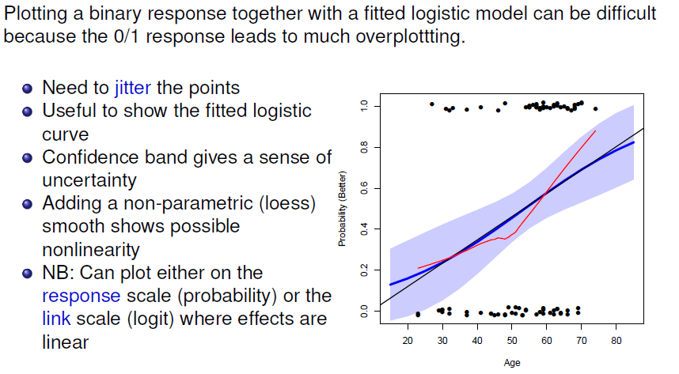
Plotting logistic regression data

Slide 41
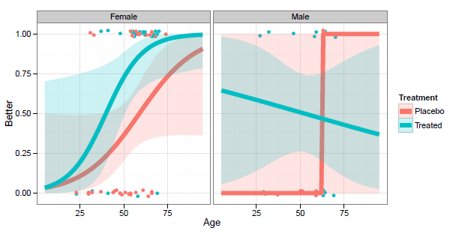
Types of plots
Conditional plots: Stratified plot of Y or logit(Y) vs. one X, conditioned by other predictors--- only that subset is plotted for each panel

Slide 42

Types of plots
Full-model plots: Plot of fitted response surface, showing all effects; usually shown in several panels

Slide 43

Types of plots
Effect plots: plots of predicted effects for terms in the model, averaged over predictors not shown in a given plot

Slide 44

Conditional plots with ggplot2
Plot Arthritis data by Treatment, ignoring Sex; overlay fitted logistic reg. lines
gg <- ggplot(Arthritis, aes(Age, Better, color=Treatment)) +
xlim(15, 85) +
geom_jitter(height = 0.02, width = 0, size=2) +
stat_smooth(method = "glm", method.args=(family = “binomial”), alpha = 0.2,
aes(fill=Treatment), size=2.5, fullrange=TRUE) +
theme_bw(base_size = 16) + theme(legend.position = c(.85, .2))
gg # show the plot
geom_jitter() shows the observations more distinctly
Fitted lines use method=“glm”, family=binomial

Slide 45

Conditional plots with ggplot2
Can show the conditional plots for M & F, simply by faceting by Sex
gg + facet_wrap(~ Sex)
Only the data for each Sex is used in each plot
Plotting the data points shows that the data for males is too thin to give good estimates of separate regression

Slide 46

Full-model plots
> arth.fit2 <- cbind(Arthritis,
+ predict(arth.logistic2, se.fit = TRUE))
> head(arth.fit2[,-9], 4)
ID Treatment Sex Age Improved Better fit se.fit
1 57 Treated Male 27 Some 1 -1.43 0.758
2 46 Treated Male 29 None 0 -1.33 0.728
3 77 Treated Male 30 None 0 -1.28 0.713
4 17 Treated Male 32 Marked 1 -1.18 0.684

Slide 47
Plotting with ggplot2
Plot the fitted log odds, confidence band and observations
arth.fit2 <- arth.fit2 |>
mutate(obs = ifelse(Better==0, -4, 4)) # show obs at -4, 4
ggplot( arth.fit2, aes(x=Age, y=fit, color=Treatment)) +
geom_line(size = 2) +
geom_ribbon(aes(ymin = fit - 1.96 * se.fit,
ymax = fit + 1.96 * se.fit,
fill = Treatment), alpha = 0.2,
color = "transparent") +
labs(x = "Age", y = "Log odds (Better)") +
geom_jitter(aes(y=obs), height=0.25, width=0) +
facet_wrap(~ Sex) +
theme_bw(base_size = 16)
Using color=Treatment gives separate points and lines for the two groups

Slide 48

Full-model plot
Plotting on the logit scale shows the additive effects of age, treatment and sex
NB: easier to compare the treatment groups within the same panel
These plots show model uncertainty (confidence bands)
Jittered points show the data

Slide 49

Full-model plot
Plotting on the probability scale may be simpler to interpret
Use predict(… type = “response”) to get fitted probabilities
arth.fit2r <- cbind(Arthritis,
predict(arth.logistic2, se.fit = TRUE, type="response"))

Slide 50
Models with interactions
Is the linear effect of age the same for females, males?
We can test this by adding an interaction of Sex × Age
update() makes it easy to add/subtract terms from a model
car::Anova() gives partial tests of each term after all others
> arth.logistic4 <- update(arth.logistic2, . ~ . + I(Age-50):Sex)
> car::Anova(arth.logistic4)
Analysis of Deviance Table (Type II tests)
Response: Better
LR Chisq Df Pr(>Chisq)
I(Age - 50) 6.16 1 0.01308 *
Sex 6.98 1 0.00823 **
Treatment 11.90 1 0.00056 ***
I(Age - 50):Sex 3.42 1 0.06430 .
---
Signif. codes: 0 ‘***’ 0.001 ‘**’ 0.01 ‘*’ 0.05 ‘.’ 0.1 ‘ ’ 1
The interaction term Age:Sex is not quite significant, but plot the fitted model anyway

Slide 51

Models with interactions

Slide 52


Effect plots: Basic ideas
Show a given marginal effect, controlling / adjusting for other model effects

Slide 53


Effect plots: Details
In R, there are now other packages: marginaleffects, jtools::effect_plot(), sjplot (mixed models), …

Slide 54

Plotting main effects
allEffects() calculates effects for all high-order terms in the model
The response is plotted on the logit scale, but labeled with probabilities
library(effects)
arth.eff2 <- allEffects(arth.logistic2)
plot(arth.eff2, rows=1, cols=3, lwd=2)
Averaged Sex Age Age
over: Treatment Treatment Sex

Slide 55

Full-model plot
The full-model plot is simply the Effect() of the highest-order interaction of factors
arth.full <- Effect(c("Age", "Treatment", "Sex"), arth.logistic2)
plot(arth.full, multiline=TRUE, ci.style="bands",
colors = c("red", "blue"), lwd=3, . . .)

Slide 56

Model with interaction of Age × Sex
arth.eff4 <- allEffects(arth.logistic4)
plot(arth.eff4, lwd=2)
Only the high-order terms: Treatment & Age * Sex are shown & need to be interpreted
Q: How would you describe this?

Slide 57

Race & Crime
Toronto Star investigation of racial disparities in treatment by Toronto Police Services
FOI request → > ½ M arrests, 1997—2002
Evidence for racial profiling?
Only look at discretionary charges:
Simple marijuana possession
Non-moving auto infractions
Notes:
- Began with press release in 1999 - yellow skin, FOI in 2000, two years to get data, cost $800
- looked at differences in treatment in situations where police have discretion
- 5 reporters, two editors, one stats expert, three database specialists, one lawyer

Slide 58
Case study: Arrests for marijuana
In Dec. 2002, the Toronto Star examined the issue of racial profiling, by analyzing a data base of 600,000+ arrest records from 1997-2002.
They focused on a subset of arrests for which police action was discretionary, e.g., simple possession of small quantities of marijuana, where the police could:
Release the arrestee with a summons – like a parking ticket
Bring to police station, hold for bail, … -- harsher treatment
Response variable: released: “Yes”, “No”
Main predictor of interest: skin-colour of arrestee (black, white)
Other predictors: year, age, sex, …

Slide 59

Toronto Star meets mosaic displays
How to communicate these results most effectively?
What is the message? What features are directly comprehensible to the audience?
Graphic designer’s early attempts
My early attempts

Slide 60

Racial profiling: Presentation graphic
Together, we created this (nearly) self-explaining infographic
Legend gives a layman’s description of shading levels
Title gives the main conclusion
Text description gives details
Bar width ~ charges
Divided by % release
numbers shown in the cells

Slide 61
Arrests for marijuana: Data
Response variable: released
Control variables:
year, age, sex
employed, citizen: Yes, No
checks: # of police databases (previous arrests, convictions, parole status) where the arrestee’s name was found
> library(car) # for Anova()
> data(Arrests, package = "carData")
> some(Arrests)
released colour year age sex employed citizen checks
218 Yes White 2000 24 Male Yes Yes 0
1301 No Black 1999 17 Male Yes No 1
1495 Yes White 1998 23 Male Yes Yes 0
1732 Yes Black 2000 18 Male Yes Yes 2
1838 Yes Black 1997 27 Male No Yes 5
2257 No White 2001 19 Male No Yes 2
3100 No Black 2000 19 Male No Yes 4
3843 Yes White 1999 20 Male Yes Yes 0
4580 Yes Black 1999 26 Male Yes Yes 1
4833 Yes Black 1998 38 Male Yes Yes 0

Slide 62
Arrests for marijuana: Model
year is numerical. But may be non-linear. Convert to a factor
Fit model with all main effects, but allow interactions of colour:year and colour:age
> Arrests$year <- as.factor(Arrests$year)
> arrests.mod <- glm(released ~ employed + citizen + checks +
colour*year + colour*age,
family=binomial, data=Arrests)
> Anova(arrests.mod)
Analysis of Deviance Table (Type II tests)
Response: released
LR Chisq Df Pr(>Chisq)
employed 72.7 1 < 2e-16 ***
citizen 25.8 1 3.8e-07 ***
checks 205.2 1 < 2e-16 ***
colour 19.6 1 9.7e-06 ***
year 6.1 5 0.29785
age 0.5 1 0.49827
colour:year 21.7 5 0.00059 ***
colour:age 13.9 1 0.00019 ***
---
Signif. codes: 0 ‘***’ 0.001 ‘**’ 0.01 ‘*’ 0.05 ‘.’ 0.1 ‘ ’ 1
Adjust for all other low-order effects
year, age: NS, but must be included in model for interactions to be interpretable

Slide 63

Effect plot: Skin colour
plot(Effect("colour", arrests.mod), lwd=3, ci.style="bands”, ...)
Effect plot for colour shows average effect controlling (adjusting) for all other factors simultaneously
(The Star analysis controlled for these one at a time.)
Evidence for different treatment of blacks & whites
Even Francis Nunziata could understand this.
However, effect smaller than reported by the Star

Slide 64

Effect plots: Interactions
The story turned out to be more nuanced than reported by the Toronto Star
plot(Effect(c("colour","year"), arrests.mod), multiline=TRUE, ...)
Up to 2000, strong evidence for differential treatment of blacks & whites
Also: evidence to support Police claim of effect of training to reduce racial effects in treatment

Slide 65
Effect plots: Interactions
A more surprising finding …
plot(Effect(c("colour","year"), arrests.mod), multiline=TRUE, ...)
Opposite age effects for blacks & whites:
Young blacks treated more harshly than young whites
Older blacks treated less harshly than older whites

Slide 66

Effect plots: allEffects
All high-order terms can be viewed together using plot(allEffects(mod))
arrests.effects <- allEffects(arrests.mod, xlevels=list(age=seq(15,45,5)))
plot(arrests.effects, ylab="Probability(released)", …)

Slide 67

Model selection
Model selection methods: aim to identify the best subset of predictors or terms for a parsimonious, predictive model.
GOAL: maximize fit, minimize overfitting
Stepwise methods: forward / backward selection
Info criteria: minimize AIC, BIC (model fit + parsimony)
Regularization methods (LASSO / Ridge) + cross-validation
add1(mod1, scope= .^2, test = “Chisq”) # add best 2-way terms
drop1(mod2, test = “Chisq”) # drop worst terms
MASS::stepAIC(mod2, direction = “backward”) # select for lowest AIC
glmnet::glmnet(x, y, family=“binomial) # LASSO / Ridge
Automated model selection methods are dangerous if used blindly
F & χ² values may be invalid
R² biased high, std. errors & p-values biased small
Variable selection may be arbitrary under multicollinearity
Allow you not to think about the problem!!!
If you use those p-values blindly, you go straight to HELL

Slide 68
Model selection: Arrests data
# all main effects
arrests.mod1 <- glm(released ~ ., family=binomial, data=Arrests)
# try adding single two-way interactions
add1(arrests.mod1, scope= ~.^2, test="Chisq")
Single term additions
Model:
released ~ colour + year + age + sex + employed + citizen + checks
Df Deviance AIC LRT Pr(>Chi)
<none> 4292.4 4316.4
colour:year 5 4270.9 4304.9 21.4324 0.0006710 ***
colour:age 1 4278.8 4304.8 13.6001 0.0002262 ***
colour:sex 1 4291.9 4317.9 0.4583 0.4983969
colour:employed 1 4292.1 4318.1 0.2761 0.5992589
colour:citizen 1 4292.2 4318.2 0.1450 0.7033531
colour:checks 1 4290.2 4316.2 2.1864 0.1392356
year:age 5 4278.7 4312.7 13.6326 0.0181198 *
year:sex 5 4286.5 4320.5 5.8453 0.3215599
year:employed 5 4287.3 4321.3 5.1167 0.4018001
year:citizen 5 4283.0 4317.0 9.3982 0.0941972 .
…
employed:checks 1 4290.8 4316.8 1.6254 0.2023424
citizen:checks 1 4280.4 4306.4 11.9269 0.0005533 ***
---
Signif. codes: 0 ‘***’ 0.001 ‘**’ 0.01 ‘*’ 0.05 ‘.’ 0.1 ‘ ’ 1
Code: https://friendly.github.io/psy6136/R/arthritis-logistic.R

Slide 69

Model Diagnostics

Slide 70


Model diagnostics

Slide 71

Diagnostic plots in R
In R, plotting a glm object gives the “regression quartet” – 4 basic diagnostic plots
arth.mod1 <- glm(Better ~ Age + Sex + Treatment, data=Arthritis,
family='binomial')
plot(arth.mod1)
These plots often look peculiar for logistic regression models
Better versions are available in the car package

Slide 72



Unusual data: Leverage & Influence
“Unusual” observations can have dramatic effects on least-squares estimates in linear models
Three archetypal cases:
Typical X (low leverage), bad fit -- Not much harm
Unusual X (high leverage), good fit -- Not much harm
Unusual X (high leverage), bad fit -- BAD, BAD, BAD
Influential observations: unusual in both X & Y
Heuristic formula:
Influence = X leverage × Y residual

Slide 73

Influence plots
Influence (Cook’s D) measures impact of individual obs. on coefficients, fitted values
Influence ∼ Residual (y -ŷ) × Hat-value
High leverage
Bubble size ~ influence
High influence
Bad fit
OK ✓
influencePlot(mod1)
Bad fit

Slide 74

Influence plots in R
library(car)
influencePlot(arth.logistic2, …)
X axis: Leverage (“hat values”)
notable values: > 2k/n, 3k/n
Y axis: Studentized residuals
Notable values: outside ± 2
Bubble size ~ Cook’s D (influence on coefficients)
2k/n
3k/n

Slide 75
Which cases are influential?
Treatment Sex Age Better StudRes Hat CookD
1 Treated Male 27 1 1.92 0.0897 0.1128
4 Treated Male 32 1 1.79 0.0840 0.0818
15 Treated Female 23 0 -1.18 0.1416 0.0420
16 Treated Female 32 0 -1.36 0.0926 0.0381
39 Treated Female 69 0 -2.17 0.0314 0.0690
case 1: younger male: moderate Hat, better than predicted → large Cook D
case 15: very young treated female: large Hat; did not improve
case 39: older female: small Hat, but did not improve with treatment

Slide 76

UCB data: Influence plot
Recall that for the Berkeley data, the model Freq ~ Dept * (Gender + Admit) fit badly: G² = 21.7. What caused this?
berk.mod <- glm(Freq ~ Dept * (Gender+Admit), data=berkeley, family="poisson")
influencePlot(berk.mod, id=list(n=3, labels=cellID))
It was the 4 cells for dept A
Code: https://friendly.github.io/psy6136/R/output/berkeley-diag.R

Slide 77
Looking ahead
Logistic regression models need not always have linear effects– models nonlinear in Xs sometimes useful
Polytomous outcomes can be handled as well
e.g., Improved = {“None”, “Some”, “Marked”}
If ordinal,
the proportional odds model is a simple extension
nested dichotomies provides an alternative approach
Otherwise, multinomial logistic regression is the way

Slide 78
Summary
loglm() provides only overall tests of model fit
Model-based methods, glm(), provide hypothesis tests, CIs & tests for individual terms
Logistic regression: A glm() for a binary response
linear model for the log odds Pr(Y=1)
All similar to classical ANOVA, regression models
Plotting
Conditional, full-model plots show data and fits
Effect plots show predicted effects averaged over others
Model diagnostics
Influence plots are often informative

