Slide 1
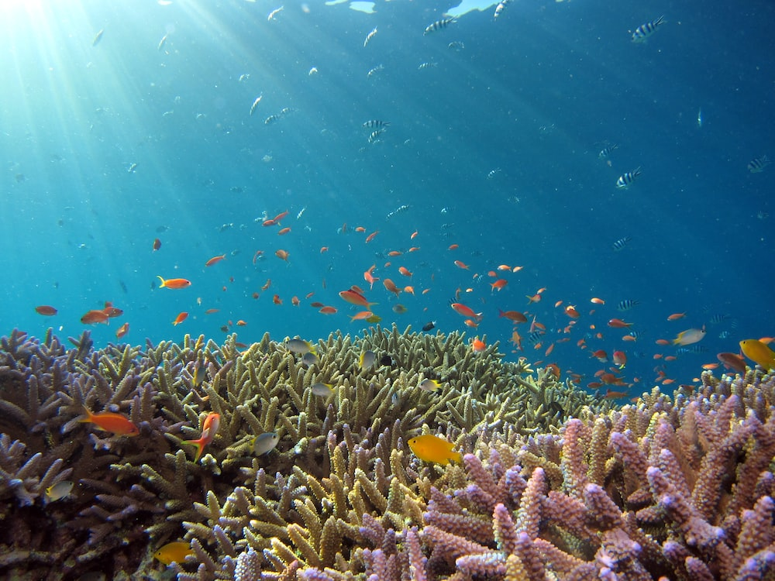
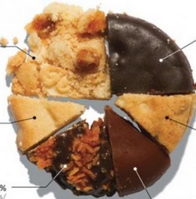
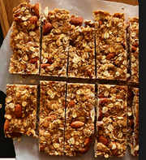
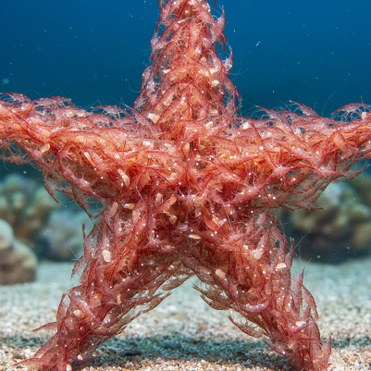


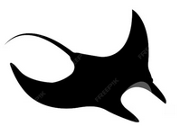

??
??
Deep Questions of Data Visualization
Michael Friendly

Slide 2
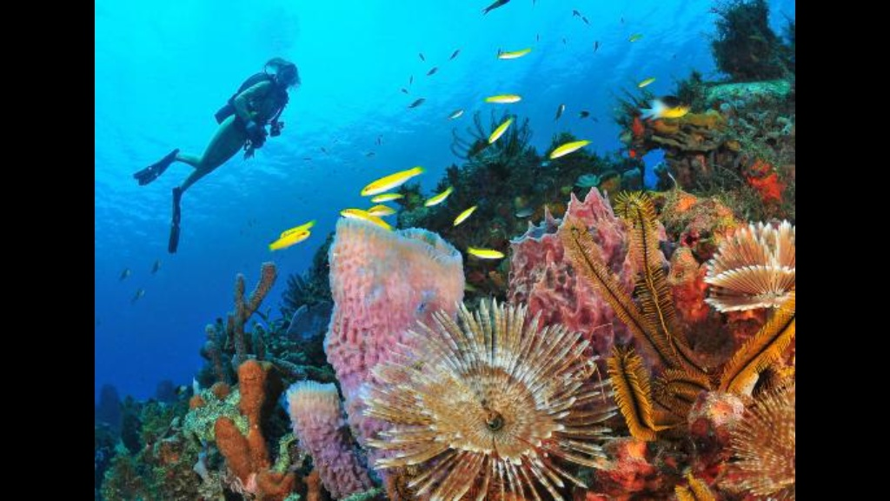
While you were enjoying a relaxing week without classes, I was working hard, pondering the:
Deep questions of data visualization
Preference for graphic forms among marine animals

Slide 3
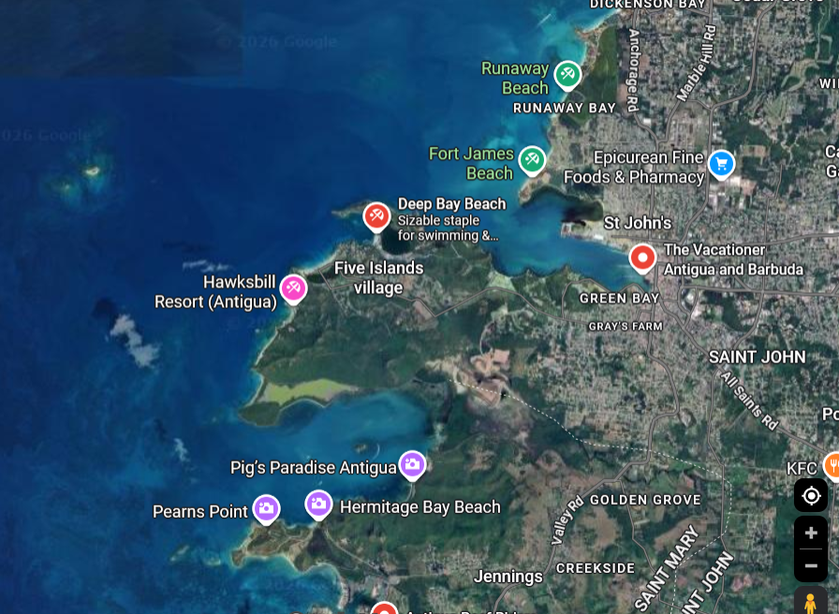
The Deep Question Research Institute,
Hawksbill Resort, Antigua
The first scientific study of graphical preference among marine animals!

Slide 4

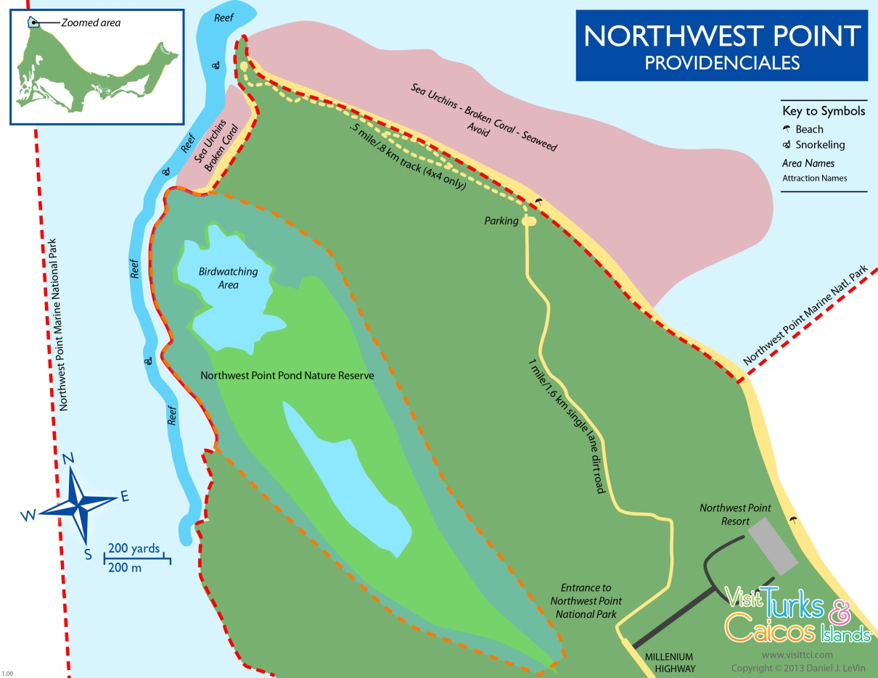

The Deep Question Research Institute,
NorthWest Point, Providenciales, Turks & Caicos
The Wall (6000’)
The first scientific study of graphical preference among marine animals!

Slide 5

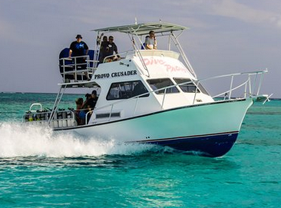
Research team aboard the MV Playfair
Divers suit up
MV Playfair

Slide 6
Shark experiment: Pies vs. Bars
Do sharks prefer conch pie charts or granola bar charts?
Design: Two-alternative forced-choice, n=50 trials
Sample stimulus items
Subjects
Conch pie
Granola bar

Slide 7
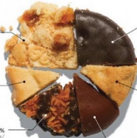
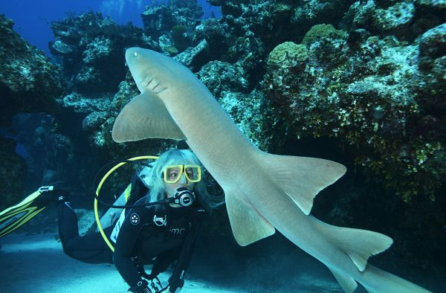
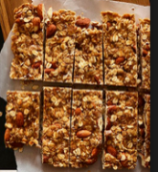
Shark experiment
One experimental trial:
??

Slide 8
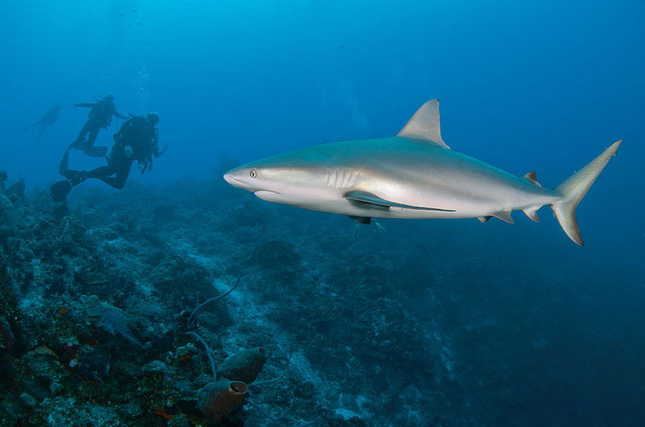
Shark experiment: Pies vs. Bars
Results: Sharks show an overwhelming preference for conch pie
Choice | n
Pie | 45
Bar | 4
Diver * | 1
??
* Ethics disclosure: All divers were volunteers. None were consumed in this experiment.

Slide 9
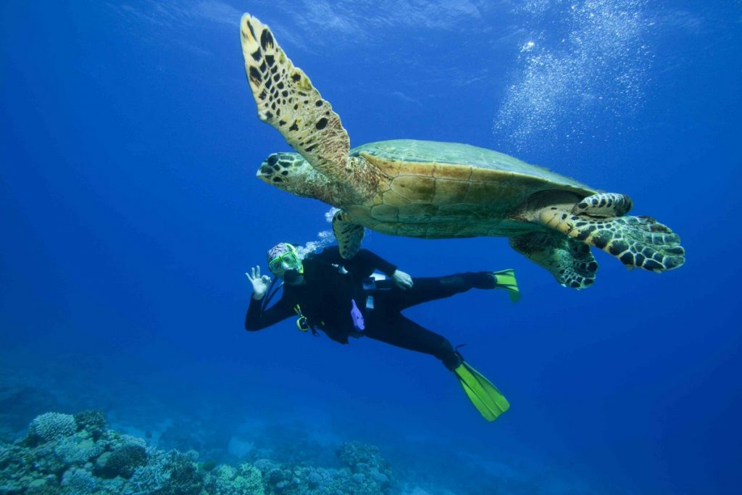
Turtle experiment
Does this generalize? What about turtles?
Results: Turtles show an overwhelming preference for granola bar charts
Choice | n
Pie | 3
Bar | 47
Diver | 0
??

Slide 10
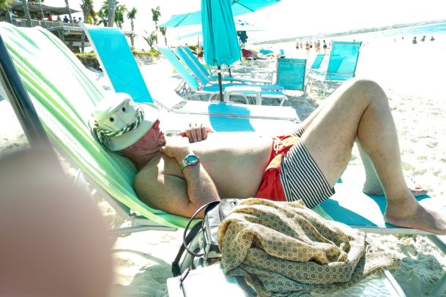
Visualizing the results
Successful visualizations require some time for reflection

Slide 11
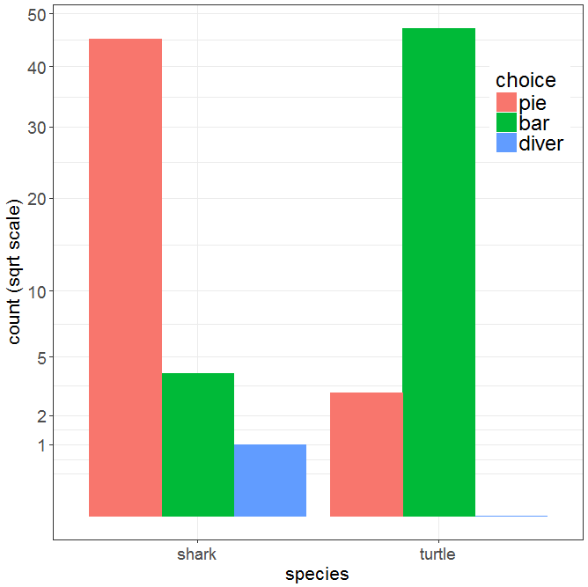
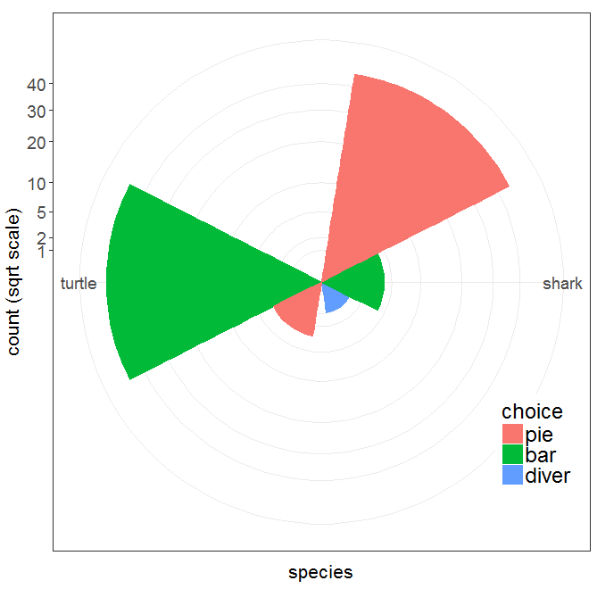
Visualizing the results
Bar chart
Windrose = bar chart + polar coords
Which do you prefer? Is there something better before I publish this?

Slide 12
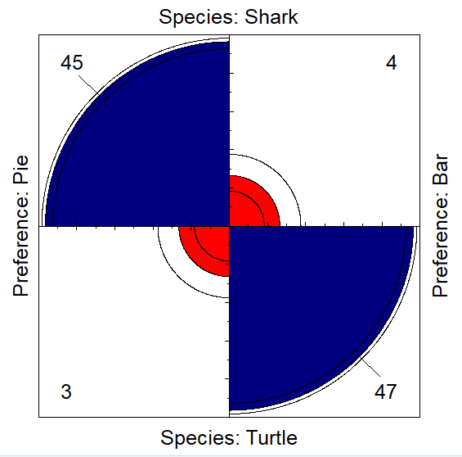
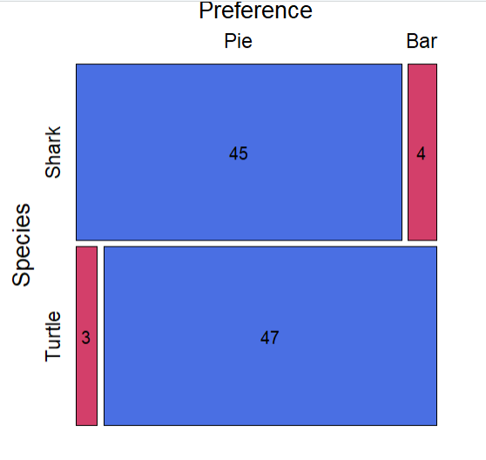
Visualizing the results
What about fourfold plots & mosaic displays?

Slide 13

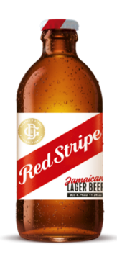
The Red Stripe Award
The research reported* here was given the February 2026 Red Stripe Award by the Deep Question Research Institute
“A Four Stripe research project!”
* This research was not supported by the National Sciences and Engineering Research Council of Canada

Slide 14
Expanding scope: Antigua experiment
A new, more comprehensive experiment was just conducted in Antigua
Species
shark
turtle
stingray
Stimuli
Conch pie
Granola bar
Shrimp star charts
n = 100 trials for each species

Slide 15
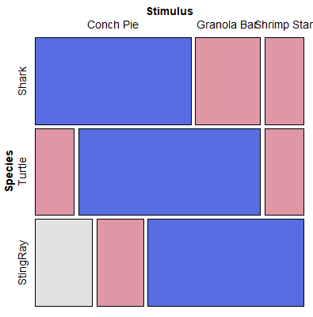
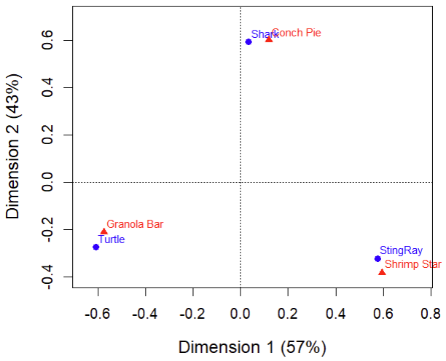
Antigua experiment: Results
> addmargins(freq)
Stimulus
Species Conch Pie Granola Bar Shrimp Star Sum
Shark 60 25 15 100
Turtle 15 70 15 100
StingRay 22 18 60 100
Sum 97 113 90 300
mosaic(freq)
ca(freq)|> plot()

Slide 16
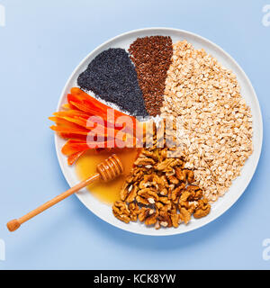

Further research
Include the obvious and necessary control conditions in a 2 x 2 factorial design (chart type × food type):
conch bar charts vs. conch pie charts
granola pie charts vs. granola bar charts
Conch pie
Conch bar
Granola pie
Granola bar

Slide 17
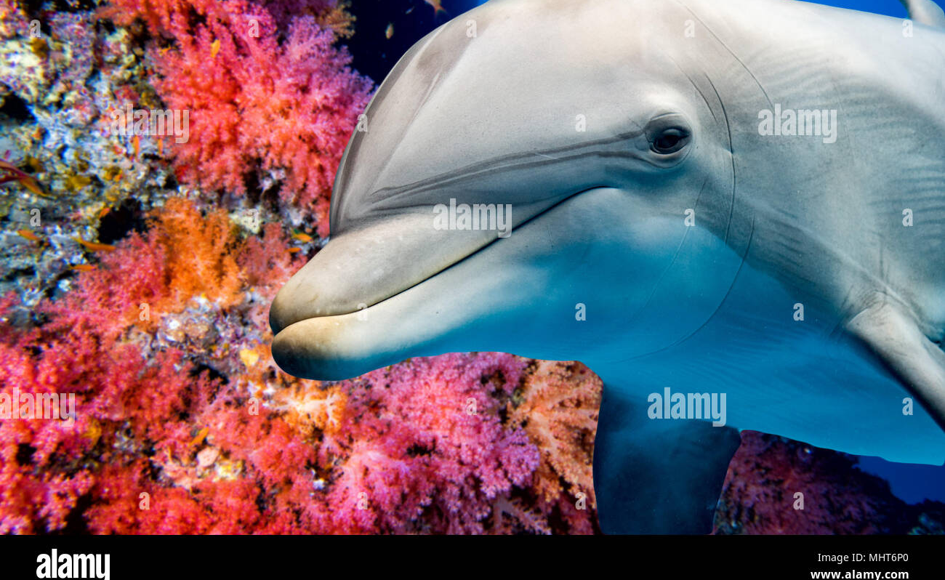
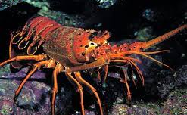
Extend this to other species
Dolphins: known to be much smarter than sharks & turtles
Caribbean lobsters (no claws!) are stupider
Is graphical preference related to intelligence?

Slide 18
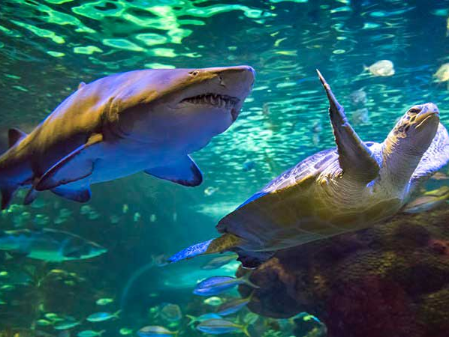
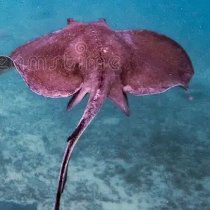
Sammy Sting Ray
Author
Nellie Nurse shark
Tommy turtle
Dramatis personnae

