Slide 1
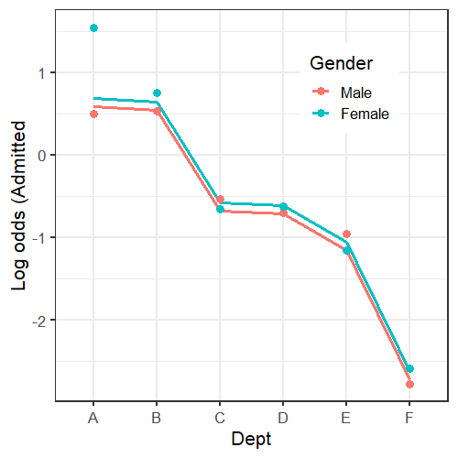
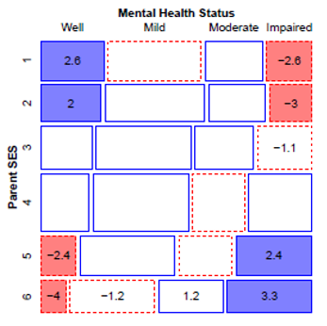
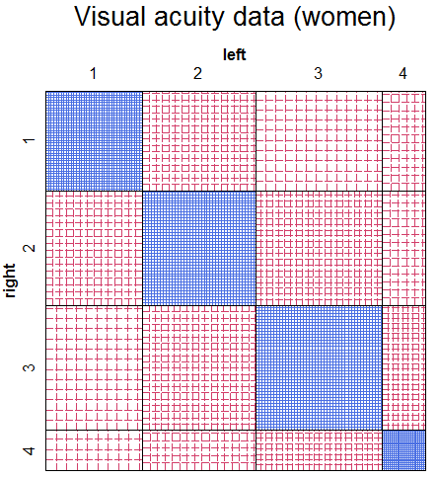
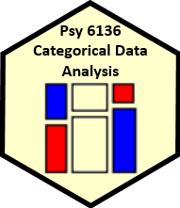
Extending loglinear models
Michael Friendly
Psych 6136
http://friendly.github.io/psy6136

Slide 2
Today’s topics
Overview of extended loglinear models
Logit models for response variables
Models for ordinal factors
RC models, estimating row/col scores
Models for square tables
More complex models

Slide 3
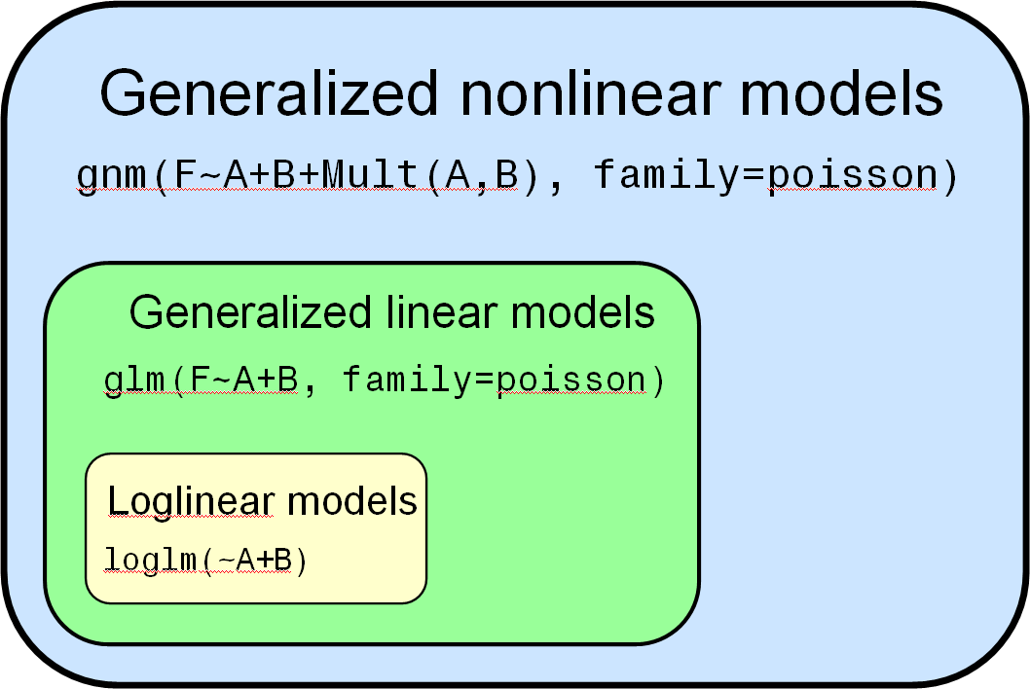
Visual overview: Models for frequency tables
Related models: logistic regression, polytomous regression, log odds models, …
Goal: connect all with visualization methods

Slide 4
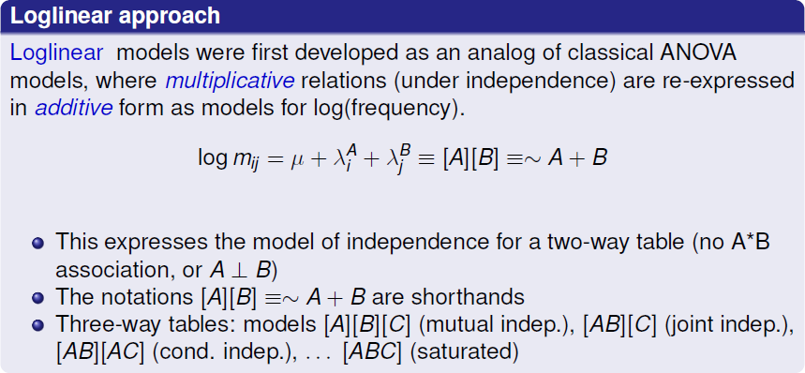
Loglinear models: Perspectives

Slide 5
Extending loglinear models
Loglinear models can be extended in a variety of ways
Models for ordinal factors allow a more parsimonious description of association (linear association)
Specialized models for square tables provide more nuanced hypotheses (symmetry, quasi-symmetry)
These ideas apply to higher-way tables
Some of these extensions are more easily understood when loglinear models are re-cast in an equivalent but simpler or more general form (logit models)

Slide 6
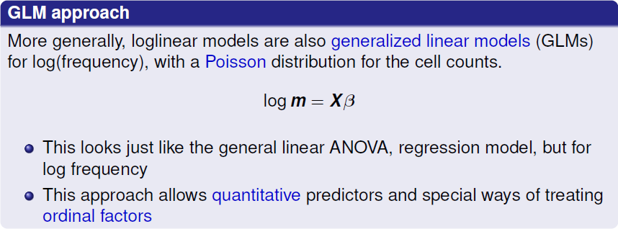
Loglinear models: Perspectives

Slide 7
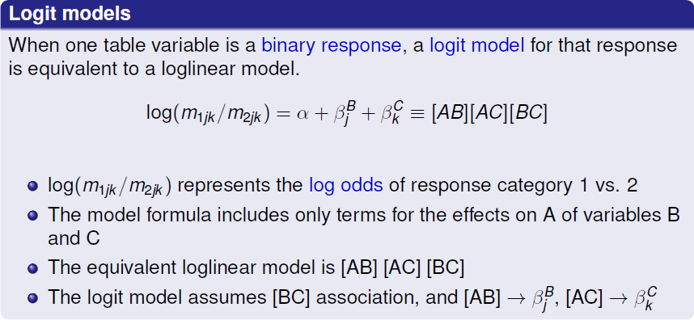
Loglinear models: Perspectives

Slide 8
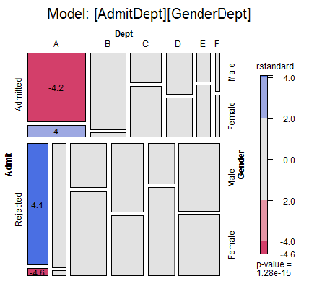
Logit models

Slide 9
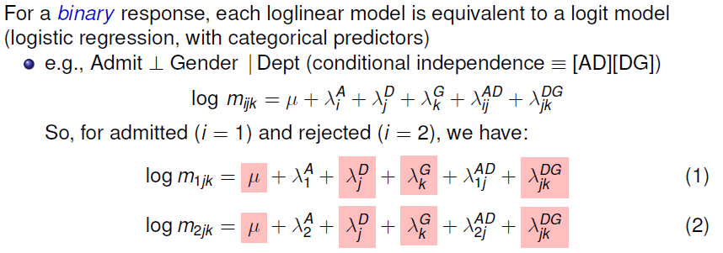
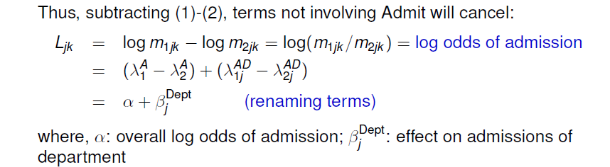
Logit models

Slide 10
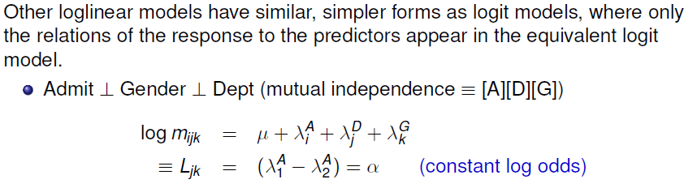
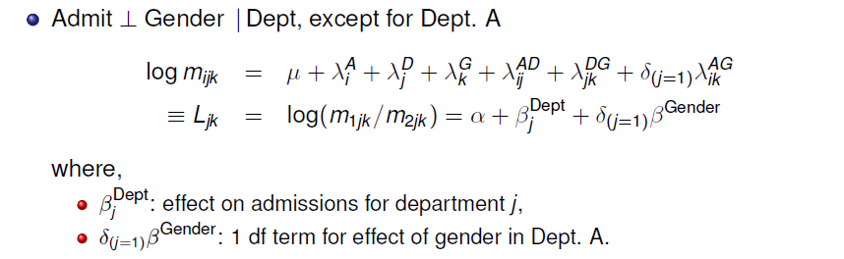
Logit models

Slide 11
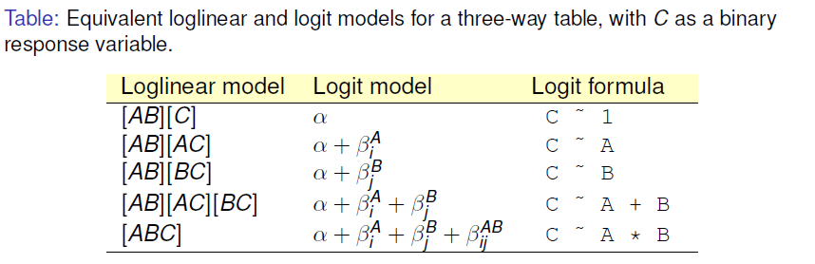
Logit models
Each logit model for a binary response, C, ≡ a loglinear model
The loglin model must include the [AB] association of predictors
When the response, C, has m>2 levels, multinomial models have equivalent loglinear form

Slide 12
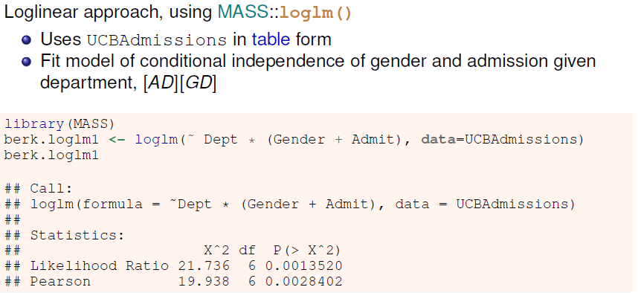
Berkeley data: loglinear approach

Slide 13
Berkeley data: glm() approach
GLM approach, using glm()
Convert UCBadmissions to a frequency data frame
The Freq variable is used at the response variable
> berkeley <- as.data.frame(UCBAdmissions)
> head(berkeley)
Admit Gender Dept Freq
1 Admitted Male A 512
2 Rejected Male A 313
3 Admitted Female A 89
4 Rejected Female A 19
5 Admitted Male B 353
6 Rejected Male B 207

Slide 14
Berkeley data: glm() approach
GLM approach, using glm()
Fit the same model of conditional independence, [AD][GD]
This uses family = “poisson” to give model for log(Freq)
> berk.glm1 <- glm(Freq ~ Dept * (Gender+Admit),
data=berkeley, family="poisson")
> vcdExtra::LRstats(berk.glm1)
Likelihood summary table:
AIC BIC LR Chisq Df Pr(>Chisq)
berk.glm1 217 238 21.7 6 0.0014 **
---
Signif. codes: 0 ‘***’ 0.001 ‘**’ 0.01 ‘*’ 0.05 ‘.’ 0.1 ‘ ’ 1
Hmm, doesn’t look like a very good fit!

Slide 15

What does the mosaic plot tell us?
For a glm() model, mosaic() uses residuals from that model
Standardized residuals (“rstandard”) have better statistical properties
Here, we see that the lack of fit is confined to Dept A

Slide 16
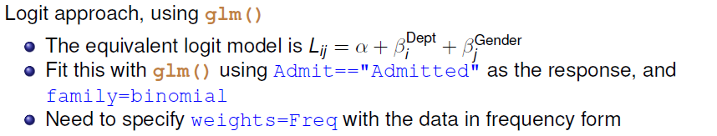
Berkeley data: Logit approach
> berk.logit2 <- glm(Admit=="Admitted" ~ Dept+Gender,
data=berkeley, weights=Freq, family="binomial")
> Anova(berk.logit2, test="Wald")
Analysis of Deviance Table (Type II tests)
Response: Admit == "Admitted"
Df Chisq Pr(>Chisq)
Dept 5 534.71 <2e-16 ***
Gender 1 1.53 0.22
---
Signif. codes: 0 ‘***’ 0.001 ‘**’ 0.01 ‘*’ 0.05 ‘.’ 0.1 ‘ ’ 1

Slide 17
Plots for logit models
Logit models are easier to interpret because there are fewer parameters
Easiest to interpret from plots of the fitted & observed odds
Get these using the predict() method for the model
> obs <- log(UCBAdmissions[1,,] / UCBAdmissions[2,,])
> pred2 <- cbind(berkeley[,1:3],
fit=predict(berk.logit2))
> pred2 <- cbind(subset(pred2, Admit=="Admitted"),
obs=as.vector(obs))
> head(pred2)
Admit Gender Dept fit obs
1 Admitted Male A 0.58 0.49
3 Admitted Female A 0.68 1.54
5 Admitted Male B 0.54 0.53
7 Admitted Female B 0.64 0.75
9 Admitted Male C -0.68 -0.54
11 Admitted Female C -0.58 -0.66

Slide 18
ggplot(pred2, aes(x=Dept, y=fit, group=Gender, color=Gender)) +
geom_line(linewidth=1.4) +
geom_point(aes(y=obs), size=3) + …
Large effect of Dept on admission
Small effect of Gender (NS)
Reason for lack of fit: Dept A

Slide 19
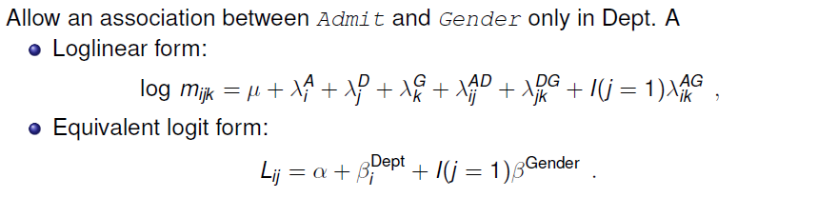
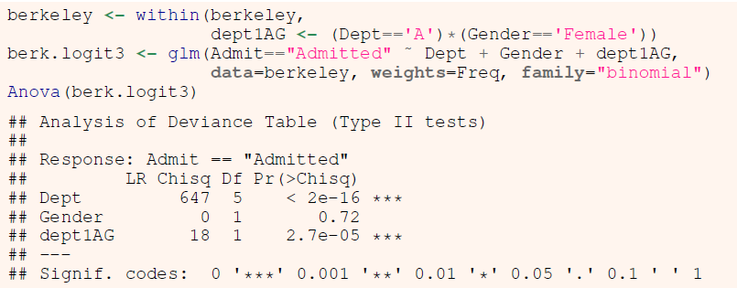
A better model

Slide 20
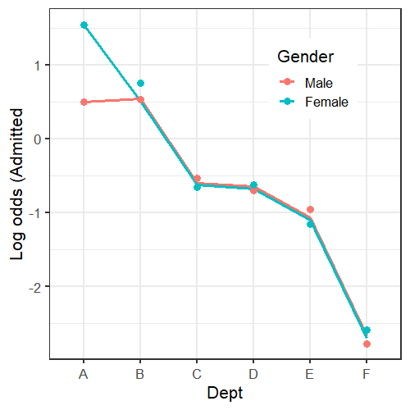
Plot observed and fitted values from this model
Large effect of Dept on admission
No effect of Gender
Perfect fit now for Dept A (at the expense of 1 df)

Slide 21
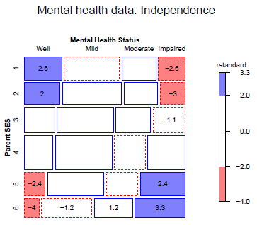
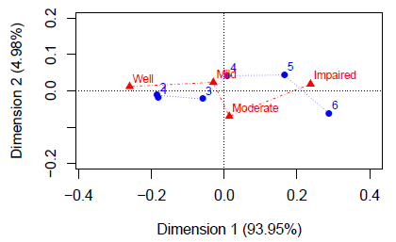
Loglinear models for ordinal variables
Ordinal variables reveal themselves in different ways in exploratory plots
In correspondence analysis, one large dimension accounting for most of χ²
In mosaic plots, an opposite corner pattern of residuals

Slide 22
Advantages of ordinal models
More focused tests → greater power to detect
Use fewer df → can fit different models between independence [A][B] and saturated [AB]
Fewer parameters → easier interpretation
Fewer parameters → smaller std. errors
These are similar to reasons for using:
Cochran-Mantel-Haenzel (CMH) tests
Testing linear (or polynomial) contrasts in ANOVA

Slide 23
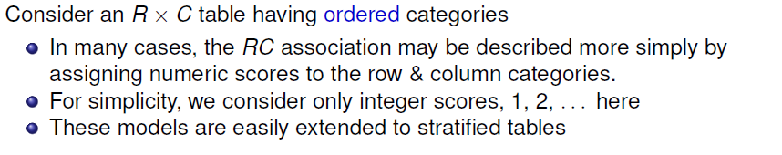
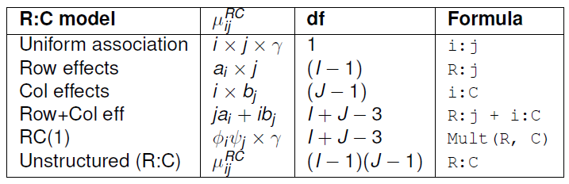
Models for ordered categories

Slide 24
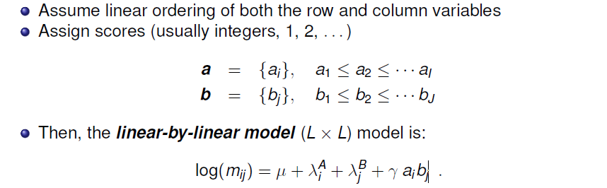
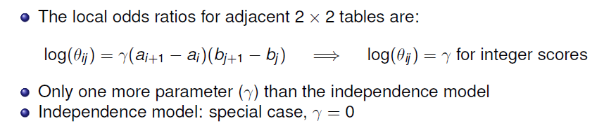
Linear x Linear Model (Uniform association)

Slide 25
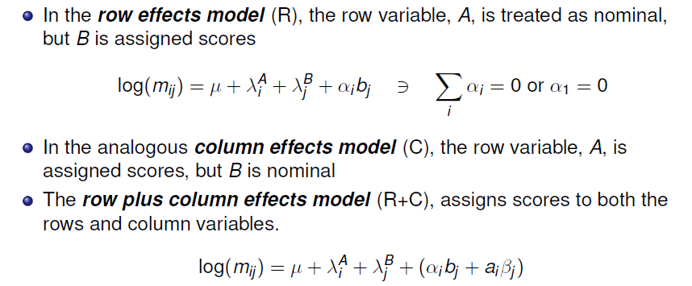
Row effects & column effects: R, C, R+C

Slide 26
Models for ordered categories
Nesting relations among models for ordinal variables
I-1
(I-1)+(J-1)-1
R
RC(1)
estimated scores
RC(2)
[A][B]
L × L
integer scores
R+C
0
1
df for association term
C
(I-1)+(J-1)
J-1

Slide 27
Example: Mental impairment & SES
Data on mental health status of NYC youth in relation to parents’ SES
Note that ses & mental have been declared as ordered factors
> str(Mental)
'data.frame': 24 obs. of 3 variables:
$ ses : Ord.factor w/ 6 levels "1"<"2"<"3"<"4"<..: 1 1 1 1 2 2 2 2 3 3 ...
$ mental: Ord.factor w/ 4 levels "Well"<"Mild"<..: 1 2 3 4 1 2 3 4 1 2 ...
$ Freq : int 64 94 58 46 57 94 54 40 57 105 ...
Display it as a 2-way table
> (Mental.tab <- xtabs(Freq ~ mental+ses, data=Mental))
ses
mental 1 2 3 4 5 6
Well 64 57 57 72 36 21
Mild 94 94 105 141 97 71
Moderate 58 54 65 77 54 54
Impaired 46 40 60 94 78 71

Slide 28
Example: Mental impairment & SES
Fit and test the independence model using glm()
> indep <- glm(Freq ~ mental+ses,
family = poisson, data = Mental)
> vcdExtra::LRstats(indep)
Likelihood summary table:
AIC BIC LR Chisq Df Pr(>Chisq)
indep 209.59 220.19 47.418 15 3.155e-05 ***
---
Signif. codes: 0 ‘***’ 0.001 ‘**’ 0.01 ‘*’ 0.05 ‘.’ 0.1 ‘ ’ 1

Slide 29
Yoda: Look at the mosaic, Luke!
> mosaic(indep, residuals_type="rstandard",
labeling=labeling_residuals,
main="Mental health data: Independence")
Departures from independence show the classic opposite corner pattern
The mosaic uses discrete shading levels, so it is useful to show residuals in the cells

Slide 30
Local odds ratios
For ordered tables, useful to examine the local log odds ratios for successive 2 x 2 sub-tables
These would all be ≈ 0 under independence
> (LMT <- loddsratio(t(mental.tab)))
log odds ratios for mental and ses
ses
mental 1:2 2:3 3:4 4:5 5:6
Well:Mild 0.1158 0.1107 0.0612 0.3191 0.227
Mild:Moderate -0.0715 0.0747 -0.1254 0.0192 0.312
Moderate:Impaired -0.0683 0.2201 0.2795 0.1682 -0.094
> mean(LMT$coefficients)
[1] 0.103
> mean(LMT$coefficients) |> exp()
[1] 1.11
On average, a one-unit step down the SES scale multiplies the odds of one worse mental health classification by exp(0.103) = 1.11 (11% increase)

Slide 31
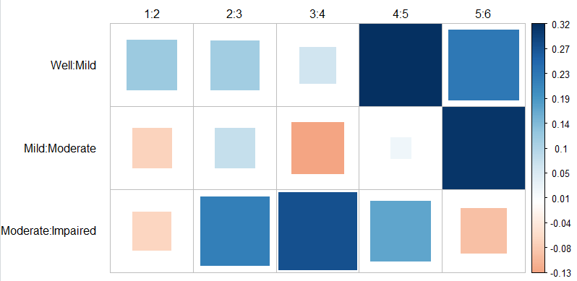
Local odds ratios
We can plot these as area- and color-proportional shaded squares using corrplot()
corrplot(as.matrix(LMT), method="square", is.corr = FALSE,
tl.col = "black", tl.srt = 0, tl.offset=1)

Slide 32
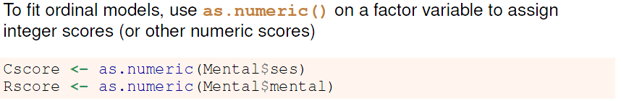
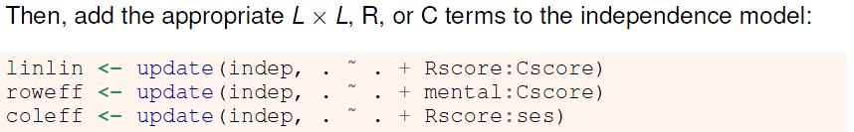
Fitting ordinal models
Recall: in R, an interaction term, A:B is represented by the product, a_{i} × b_{j} of the parameters, a_{i}, b_{j}, for the factors.
Rscore, Cscore here are just numbers, so are not estimated parameters

Slide 33
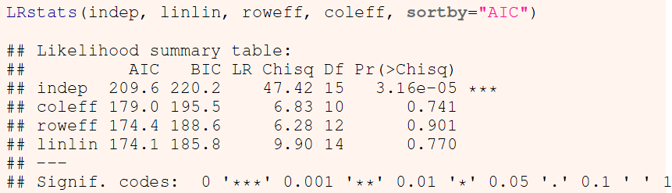

Comparing models

Slide 34
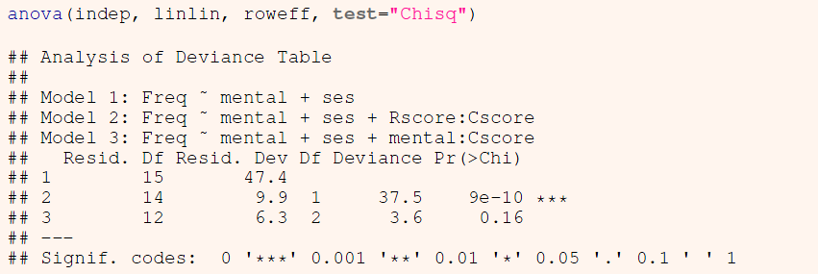
Comparing models
When overall tests are unclear, you can carry out tests of nested sets of models using anova(), giving tests of ΔG².
The indep, linlin and row effect models are one nested set:
The L × L model is a signif. improvement; the R model is not

Slide 35
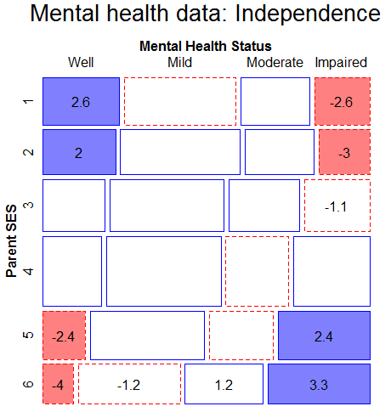
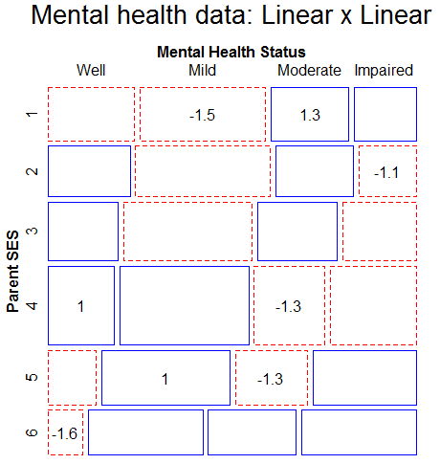
Comparing models: Mosaic plots
Beyond statistical tests, mosaic plots show the remaining structure in the residuals, unaccounted for in a given model.

Slide 36
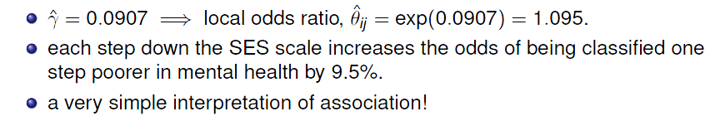
Interpreting the L × L model
In the L × L model, the parameter γ is the constant local odds ratio. e^{γ} is the multiplier of the odds for a one-step change in mental or ses
> coef(linlin)[["Rscore:Cscore"]]
[1] 0.09069
> exp(coef(linlin)[["Rscore:Cscore"]])
[1] 1.095

Slide 37
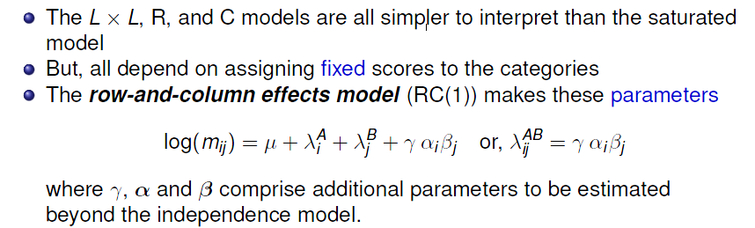
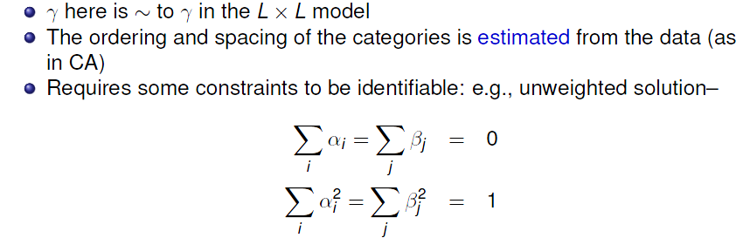
Log-multiplicative (RC) models

Slide 38
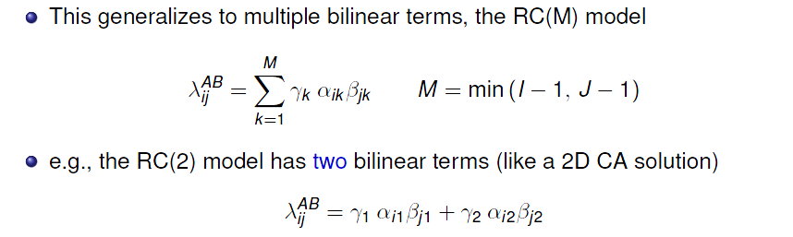
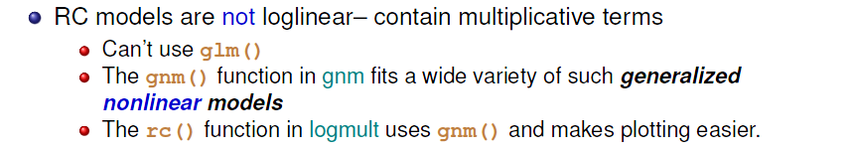
Log-multiplicative (RC) models

Slide 39
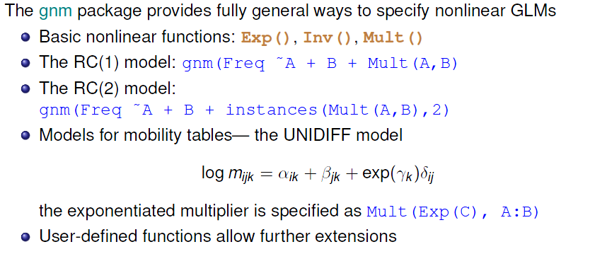
Generalized nonlinear models

Slide 40
Example: Mental impairment & SES
Fit the RC(1) and RC(2) model by adding terms using Mult() to the independence model
> library(gnm)
> indep <- gnm(Freq ~ mental + ses,
family = poisson, data = Mental, verbose=FALSE)
> RC1 <- update(indep, . ~ . + Mult(mental, ses))
> RC2 <- update(indep, . ~ . + instances(Mult(mental, ses),2))
Compare models with GOF tests and AIC, BIC
> vcdExtra::LRstats(indep, linlin, roweff, coleff, RC1, RC2)
Likelihood summary table:
AIC BIC LR Chisq Df Pr(>Chisq)
indep 210 220 47.4 15 3.2e-05 ***
linlin 174 186 9.9 14 0.77
roweff 174 189 6.3 12 0.90
coleff 179 196 6.8 10 0.74
RC1 180 199 3.6 8 0.89
RC2 187 211 0.5 3 0.91
---
Signif. codes: 0 ‘***’ 0.001 ‘**’ 0.01 ‘*’ 0.05 ‘.’ 0.1 ‘ ’ 1

Slide 41
Comparing models
anova() again gives tests of Δχ² for nested models
Are estimated RC scores better than integer scores in the L x L model?
If so, do we need more than one dimension?
> anova(linlin, RC1, RC2, test="Chisq")
Analysis of Deviance Table
Model 1: Freq ~ mental + ses + Rscore:Cscore
Model 2: Freq ~ mental + ses + Mult(mental, ses)
Model 3: Freq ~ mental + ses + Mult(mental, ses, inst = 1) +
Mult(mental, ses, inst = 2)
Resid. Df Resid. Dev Df Deviance Pr(>Chi)
1 14 9.90
2 8 3.57 6 6.32 0.39
3 3 0.52 5 3.05 0.69
Neither RC model shows a significant advantage over the L x L model

Slide 42
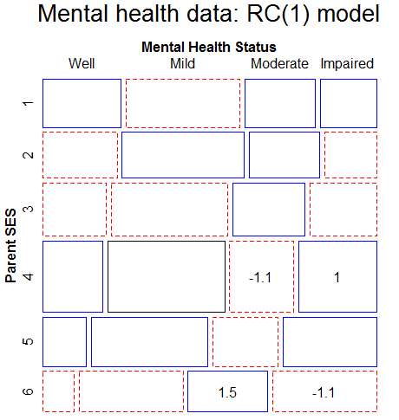
Comparing models: Mosaic plots

Slide 43
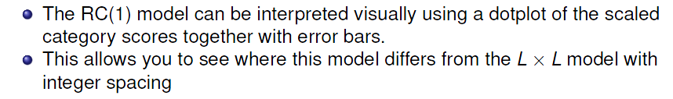
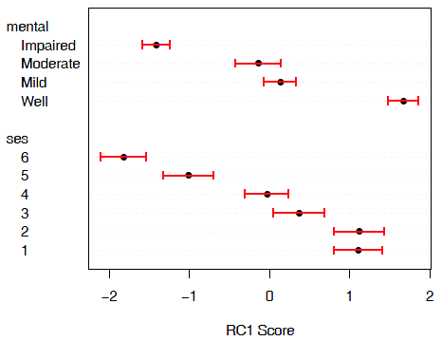
Visualizing RC scores
mental: mild & moderate not that different, but ordered correctly
ses: approx. linear, except for
ses = (1,2), which don’t differ
Similar to what we saw in CA
When this matters, RC models provide the statistical machinery for inference

Slide 44
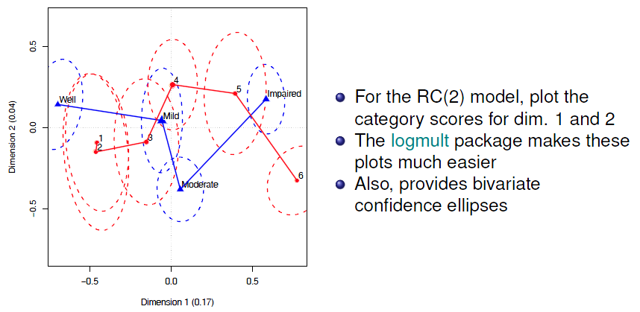
Visualizing RC scores
rc2 <- rc(Mental.tab, nd=2, weighting="marginal", se="jackknife")
coords <- plot(rc2, conf.ellipses=0.68, cex=1.5,
rev.axes=c(TRUE, FALSE))

Slide 45
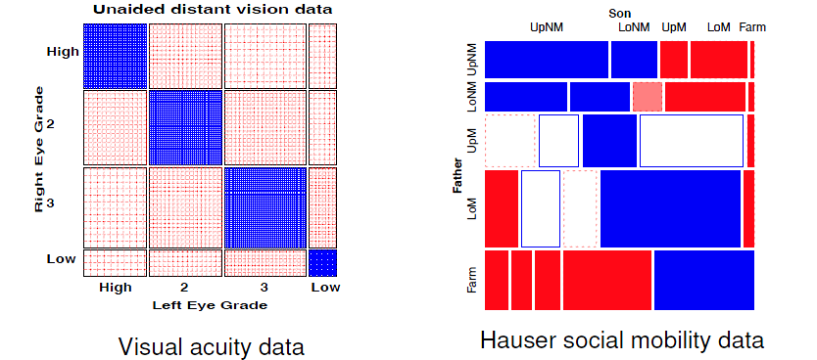
Square tables
Square tables arise when the row and column variables have the same categories, often ordered
Special loglinear models allow us to tease apart different reasons for association

Slide 46
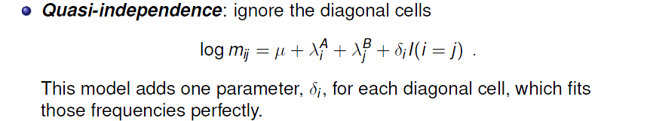
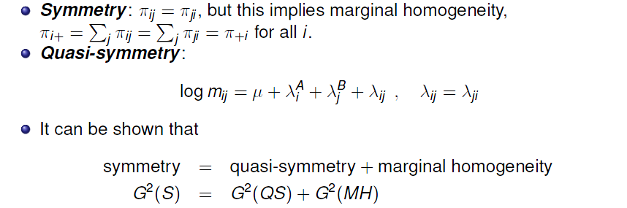
Square tables: Models
In such cases, general association is a given, because of the diagonal cells
More interesting models concern the nature of association in off-diagonal cells

Slide 47
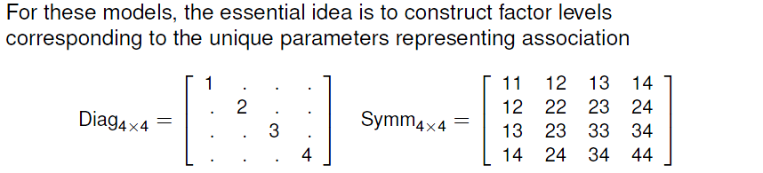
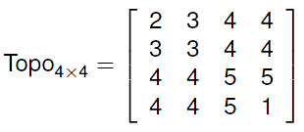
Square tables: Models
Diag adds k parameters to fit diagonal cells, beyond independence
Symm adds k x (k+1) parameters to fit a symmetric pattern of association
More general topological models allow an arbitrary pattern of association, but more parsimonious than the independence model

Slide 48
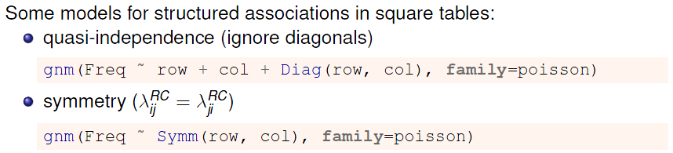
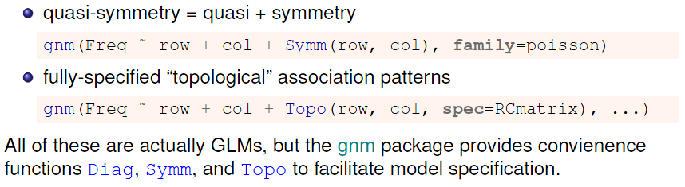
Square tables: Using gnm()

Slide 49
Example: Visual acuity
data("VisualAcuity", package="vcd")
women <- subset(VisualAcuity, gender=="female", select=-gender)
sieve(Freq ~ right + left, data=women, shade = TRUE,
main = "Unaided distance vision data")
Diagonal cells clearly dominate
What associations remain, ignoring these?
Is there evidence for quasi-symmetry?
A more complete analysis could examine gender in relation to these
associations

Slide 50
Fitting models
Start with the independence model, then update() to add other terms
> indep <- glm(Freq ~ right + left, data = women, family = poisson)
> quasi <- update(indep, . ~ . + Diag(right, left))
> symm <- glm(Freq ~ Symm(right, left), data = women, family = poisson)
> qsymm <- update(symm, . ~ right + left + .)
The quasi-symmetry model (qsymm) fits reasonably well; none of the others do by LR G² tests or AIC, BIC; qsymm is best by AIC, BIC
> vcdExtra::LRstats(indep, quasi, symm, qsymm)
Likelihood summary table:
AIC BIC LR Chisq Df Pr(>Chisq)
indep 6803 6808 6672 9 <2e-16 ***
quasi 338 347 199 5 <2e-16 ***
symm 157 164 19 6 0.0038 **
qsymm 151 161 7 3 0.0638 .
---
Signif. codes: 0 ‘***’ 0.001 ‘**’ 0.01 ‘*’ 0.05 ‘.’ 0.1 ‘ ’ 1

Slide 51


Visualizing model fits
Quasi-independence: The diagonal cells are forced to fit exactly.
Lack-of-fit appears in the symmetrically opposite cells

Slide 52
More models, more mosaics
For the Hauser79 data on occupational mobility, there are a wide variety of models to consider
library(gnm)
hauser.indep <- gnm(Freq ~ Father + Son,
data=Hauser79, family=poisson)
hauser.quasi <- update(hauser.indep, ~ . + Diag(Father,Son))
hauser.qsymm <- update(hauser.indep, ~ . + Diag(Father,Son) + Symm(Father,Son) )
# numeric scores
Fscore <- as.numeric(Hauser79$Father)
Sscore <- as.numeric(Hauser79$Son)
hauser.UA <- update(hauser.indep, ~ . + Fscore*Sscore)
hauser.roweff <- update(hauser.indep, ~ . + Father*Sscore)
hauser.UAdiag <- update(hauser.UA, ~ . + Diag(Father,Son))
# RC models, estimating category scores
hauser.RC <- update(hauser.indep, ~ . + Mult(Father, Son), verbose=FALSE)
hauser.RCdiag <- update(hauser.RC, ~ . + Diag(Father, Son), verbose=FALSE)
# crossings models
hauser.CR <- update(hauser.indep, ~ . + Crossings(Father,Son))
hauser.CRdiag <- update(hauser.CR, ~ . + Diag(Father,Son))

Slide 53




More models, more mosaics
Mosaic plots reveal the pattern of lack-of-fit
For more sensitive comparisons, we need model fit statistics
Q:
How to interpret quasi-independence?
Quasi-symmetry?
RC?
RC+Diag()?

Slide 54
Model comparisons
Collect the models in a glmlist() and compare them using LRstats():
modlist <- glmlist(hauser.indep, hauser.roweff, hauser.UA,
hauser.UAdiag, hauser.quasi, hauser.qsymm,
hauser.topo, hauser.RC, hauser.CR, hauser.CRdiag)
LRstats(modlist, sortby = "BIC")
Sorting by BIC shows the best models at the bottom:
Likelihood summary table:
AIC BIC LR Chisq Df Pr(>Chisq)
hauser.indep 6390.8 6401.8 6170.1 16 < 2.2e-16 ***
hauser.UA 2503.4 2515.6 2280.7 15 < 2.2e-16 ***
hauser.roweff 2308.9 2324.7 2080.2 12 < 2.2e-16 ***
hauser.RC 920.2 939.7 685.4 9 < 2.2e-16 ***
hauser.quasi 914.1 931.1 683.3 11 < 2.2e-16 ***
hauser.CR 318.6 334.5 89.9 12 5.131e-14 ***
hauser.UAdiag 305.7 324.0 73.0 10 1.161e-11 ***
hauser.CRdiag 298.9 318.5 64.2 9 2.030e-10 ***
hauser.topo 295.3 311.1 66.6 12 1.397e-09 ***
hauser.qsymm 268.2 291.3 27.4 6 0.0001193 ***
---
Signif. codes: 0 ‘***’ 0.001 ‘**’ 0.01 ‘*’ 0.05 ‘.’ 0.1 ‘ ’ 1
The quasi-symmetry model is best, but still shows some lack of fit

Slide 55

Model comparison plots
When there are more than a few models, a model comparison plot can show the trade-off between goodness-of-fit and parsimony
This sorts the models by both fit & complexity
Plot BIC vs. df
Can also use AIC, or G² / df in this plot
Plot on log scale to emphasize diff^{ce} among better models
And, the winner is:
Quasi-symmetry!

Slide 56
More complex models
Extensions of these methods occur in a variety of contexts:
Panel surveys, where attitude items are analyzed over time & space
Social mobility data, where occupational status of parents and children may admit subtly different models across strata
Migration data, where geographical & political factors require special treatment (e.g., mover-stayer models)
These often involve:
ordinal variables: support for abortion, occupational status
square tables: husbands/wives, fathers/sons
strata or layers to control for other factors or analyze change over time or differences over geography

Slide 57


More complex models

Slide 58



Models for stratified mobility tables

Slide 59
Example: Social mobility in US, UK & Japan
Data from Yamaguchi (1987): Cross-national comparison of occupational mobility
> data(Yamaguchi87, package="vcdExtra")
> Yama.tab <- xtabs(Freq ~ Father + Son + Country, data=Yamaguchi87)
> structable(Country+Son~Father, Yama.tab[,,1:2])
Country US UK
Son UpNM LoNM UpM LoM Farm UpNM LoNM UpM LoM Farm
Father
UpNM 1275 364 274 272 17 474 129 87 124 11
LoNM 1055 597 394 443 31 300 218 171 220 8
UpM 1043 587 1045 951 47 438 254 669 703 16
LoM 1159 791 1323 2046 52 601 388 932 1789 37
Farm 666 496 1031 1632 646 76 56 125 295 191
Questions:
Is occupational mobility the same for all countries? (No layer effects)
If not, how do they differ?
Are there simple models that describe mobility?
See: demo(“yamaguchi-xie”, package=“vcdExtra”)

Slide 60

Explore: Try MCA
library(ca)
Yama.dft <- expand.dft(Yamaguchi87)
yama.mjca <- mjca(Yama.dft)
plot(yama.mjca, what=c("none","all"))
Dimensions have reasonable interpretations
Farm differs from others
All sons seem to move up!
How does this relate to theories of mobility?
How to understand country effects?

Slide 61

Yamaguchi data: Baseline models
The minimal, null model asserts Father ⊥ Son | Country = [FC][SC] = (F+S)*C
Within country, diagonal cells for F=S dominate
Much more data for US; least for Japan

Slide 62

Yamaguchi data: Baseline models
We expect F ≈ S. Ignore diagonal cells with quasi-independence → Quasi-perfect mobility
The term Diag(F, S):Country fits diagonal cells perfectly w/in each country

Slide 63

Models for homogeneous associations
gnm(): easy to fit collections of models using update() to the yamaDiag model.
These have no Country term, so they assert same associations for all countries
Rscore <- as.numeric(Yamaguchi87$Father)
Cscore <- as.numeric(Yamaguchi87$Son)
yamaRo <- update(yamaDiag, ~ . + Father:Cscore)
yamaCo <- update(yamaDiag, ~ . + Rscore:Son)
yamaRpCo <- update(yamaDiag, ~ . + Father:Cscore + Rscore:Son)
yamaRCo <- update(yamaDiag, ~ . + Mult(Father,Son))
yamaFIo <- update(yamaDiag, ~ . + Father:Son)

Slide 64
Models for heterogeneous associations
Can combine these with models including layer (Country) effects
Log-multiplicative (UNIDIFF) models add a term Mult(…, Exp(Country))
yamaRx <- update(yamaDiag, ~ . + Mult(Father:Cscore, Exp(Country)))
yamaCx <- update(yamaDiag, ~ . + Mult(Rscore:Son, Exp(Country)))
yamaRpCx <- update(yamaDiag, ~ . + Mult(Father:Cscore +
Rscore:Son, Exp(Country)))
yamaRCx <- update(yamaDiag, ~ . + Mult(Father, Son, Exp(Country)))
yamaFIx <- update(yamaDiag, ~ . + Mult(Father:Son, Exp(Country)))
We now have quite a collection of alternative models
How to compare them?
How to interpret the associations they imply about Father, Son mobility across countries?

Slide 65
Yamaguchi data: Comparing models
LRstats() and related methods facilitate model comparisons
> models <- glmlist(yamaNull, yamaDiag,
yamaRo, yamaRx, yamaCo, yamaCx, yamaRpCo,
yamaRpCx, yamaRCo, yamaRCx, yamaFIo, yamaFIx)
> LRstats(models)
Likelihood summary table:
AIC BIC LR Chisq Df Pr(>Chisq)
yamaNull 6168 6231 5592 48 < 2e-16 ***
yamaDiag 1943 2040 1336 33 < 2e-16 ***
yamaRo 771 877 156 29 < 2e-16 ***
yamaRx 766 877 148 27 < 2e-16 ***
yamaCo 682 789 68 29 6.1e-05 ***
yamaCx 677 789 59 27 0.00038 ***
yamaRpCo 659 773 39 26 0.05089 .
yamaRpCx 658 776 33 24 0.10341
yamaRCo 658 772 38 26 0.06423 .
yamaRCx 657 775 32 24 0.12399
yamaFIo 665 788 36 22 0.02878 *
yamaFIx 664 791 31 20 0.05599 .
---
Signif. codes: 0 ‘***’ 0.001 ‘**’ 0.01 ‘*’ 0.05 ‘.’ 0.1 ‘ ’ 1
Baseline models
Homogeneous,
Father:Son models
Heteroogeneous,
Father:Son models

Slide 66

Yamaguchi data: Comparing models
Easier to understand by plotting the criteria for these models
BIC <- matrix(LRstats(models)$BIC[-(1:2)], 5, 2, byrow=TRUE)
matplot(BIC, …)
BIC strongly prefers homogeneous models
Little diffce among Col, Row+Col, RC(1) models
R:C association ~ Row scores (fathers’ status)

Slide 67

Yamaguchi data: Comparing models
Easier to understand by plotting the criteria for these models
AIC <- matrix(LRstats(models)$AIC[-(1:2)], 5, 2, byrow=TRUE)
matplot(AIC, …)
AIC slightly prefers heterogeneous models
Row + Col & RC(1) fit best
R:C association ~ ordinal scores
Model summary plots make sense of multiple models

Slide 68
Interpreting associations
logmult::unidiff() uses gnm() for fitting, but makes summaries & plotting easier
> library(logmult)
> (yamaUni <- unidiff(as.table(Yama.tab)))
Layer coefficients:
US UK Japan
1.000 1.206 0.931
Layer intrinsic association coefficients:
US UK Japan
0.412 0.497 0.383
Full two-way interaction coefficients:
Son
Father UpNM LoNM UpM LoM Farm
UpNM 1.0063 0.3024 -0.4399 -0.6048 -0.4394
LoNM 0.4644 0.5228 -0.2547 -0.3856 -0.5121
UpM 0.0214 -0.0268 0.2557 -0.0972 -0.5828
LoM -0.2056 -0.1028 0.0891 0.2632 -0.6504
Farm -0.5320 -0.3026 0.0101 0.2592 2.074

Slide 69

Visualizing associations
Plotting the unidiff object plots the layer association coefficients
plot(yamaUni, cex=3, col="red", pch=16)
Father – Son association is ordered UK > US > Japan

Slide 70
Visualizing associations
The common association parameters, δ_{ij}^{RC} are contained in the unidiff object.
Can extract these and plot in various ways
> inter <- yamaUni$unidiff$interaction
> names(inter)
[1] "Estimate" "Std. Error"
> inter.mat <- matrix(inter$Estimate, 5, 5,
dimnames=dimnames(Yama.tab)[1:2])
> inter.mat
Son
Father UpNM LoNM UpM LoM Farm
UpNM 1.0063 0.3024 -0.4399 -0.6048 -0.439
LoNM 0.4644 0.5228 -0.2547 -0.3856 -0.512
UpM 0.0214 -0.0268 0.2557 -0.0972 -0.583
LoM -0.2056 -0.1028 0.0891 0.2632 -0.650
Farm -0.5320 -0.3026 0.0101 0.2592 2.075

Slide 71

Visualizing associations
Plot these as shaded squares using corrplot()

Slide 72

Visualizing associations
Plot these as a line plot using matplot()
matplot(t(inter.mat), type="b", pch=15:19, cex=1.5, xaxt="n"
xlab="Father's status", ylab="Association estimate" )

Slide 73
Summary
Loglinear models, as originally formulated, were quite general, but treated all table variables as unordered factors
The GLM perspective is more general, allowing quantitative predictors and handling ordinal factors
The logit model give a simplified approach when one variable is a response
Models for ordered factors give more powerful & focused tests
L × L, R, C and R+C models assign scores to the factors
RC(1) and RC(2) models estimate the scores from the data
Models for square tables allow testing structured questions
Quasi-independence: ignoring diagonals
symmetry & quasi-symmetry
theory-specific “topological” models
These methods can be readily combined to analyze complex tables

