Slide 1
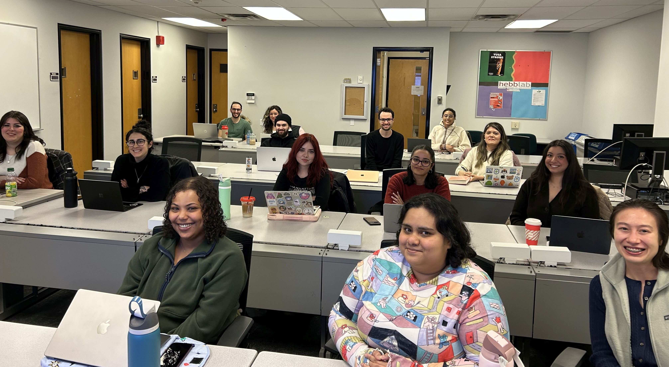


Team 3136: Winter 2026
Felicia
Nathaniel
Gavin
Ryley
Gabe
Naomi
Haley
Kura
Vanessa
Riya
Kiran
Kayla
Sarah
Patricia

