Slide 1

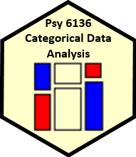
The Last Waltz
Michael Friendly
Psych 6136
https://friendly.github.io/6136

Slide 2


The Last Waltz
Where did we start?
What have I tried to teach?
What did you learn?
What else is there?

Slide 3
My goals
Start with descriptive, hypothesis testing methods, then progress to model-based methods
Visual tools for thinking & understanding
Sieve plots, mosaic plots, spineplots, …
Correspondence analysis: best 2D summary
Effect plots, Data + Model plots
Build from simple, loglinear models to more complex ones

Slide 4
01: Overview
Categorical data involves some new ideas
Discrete variables: unordered or ordered
Counts, frequencies as outcomes
New / different data structures & functions
tables – 1-way, 2-way, 3-way, … table(), xtabs()
similar in matrices or arrays matrix(), array()
datasets:
frequency form
case form
Graphical methods: often use area ~ Freq
Consider: graphical comparisons, effect order
Models: Most are ≅ natural extensions of lm()

Slide 5
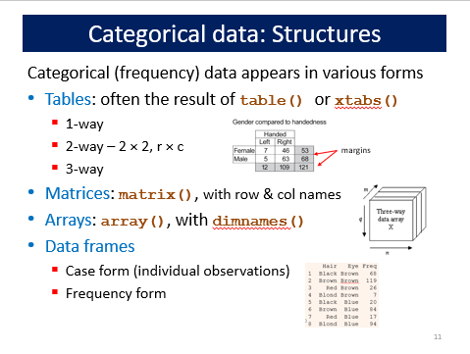
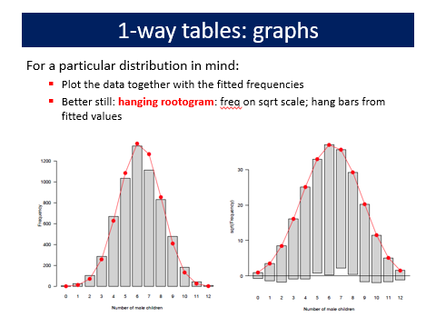
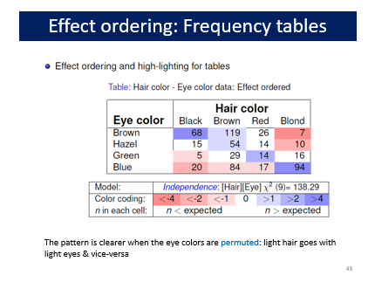
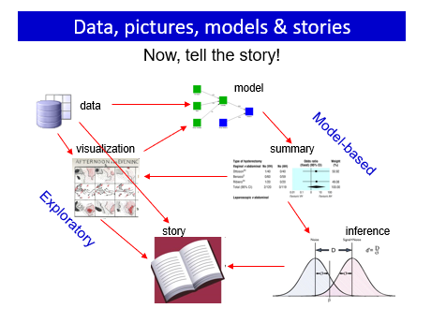

Slide 6
02: Discrete distributions
Discrete distributions are the building blocks for categorical data analysis
Typically consist of basic counts of occurrences, with varying frequencies
Most common: binomial, Poisson, negative binomial
Others: geometric, log-series
Fit with goodfit(); plot with rootogram()
Diagnostic plots: Ord_plot(), distplot()
Models with predictors
Binomial → logistic regression
Poisson → poisson regression; logliner models
These are special cases of generalized linear models

Slide 7
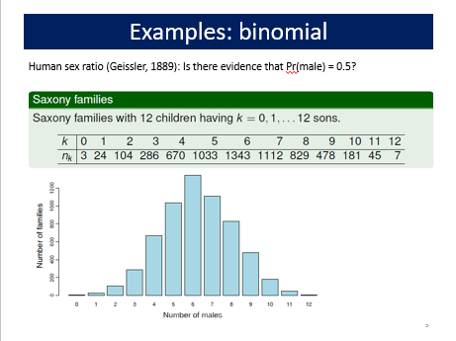
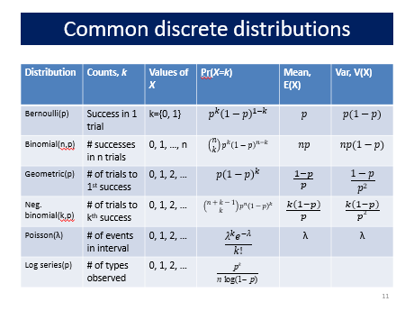
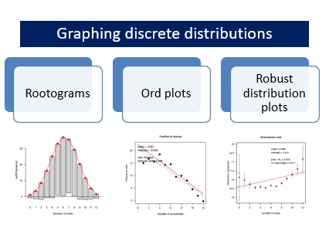
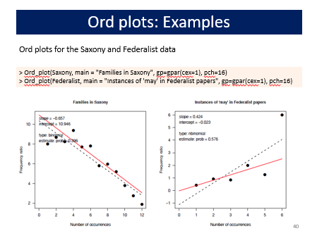

Slide 8
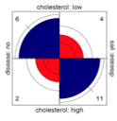
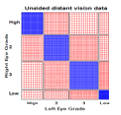
03: Two-way tables
Two-way tables summarize frequencies of two categorical factors
2 × 2: a special case, with odds ratio as a measure
r × c: factors can be unordered or ordered
r × c × k: stratified tables, r × c with groups or circumstances
Tests & measures of association
Pearson χ², LR G²: general association
More powerful CMH tests for ordered factors
Visualization
2 × 2: fourfold plots
r × c: sieve diagrams, tile plots, …
More graphical methods to come …

Slide 9
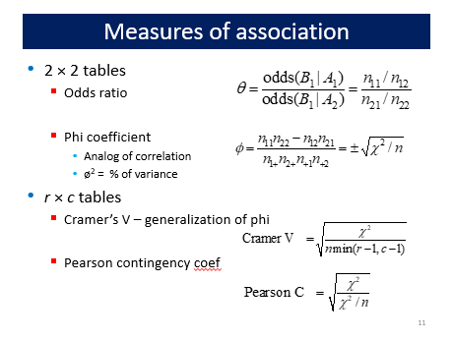
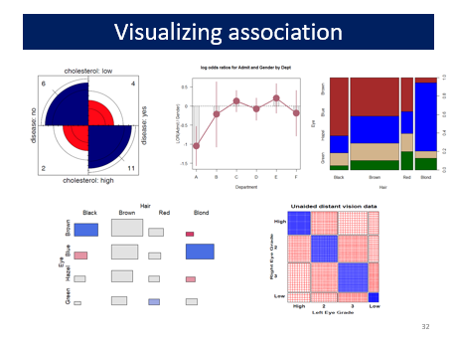
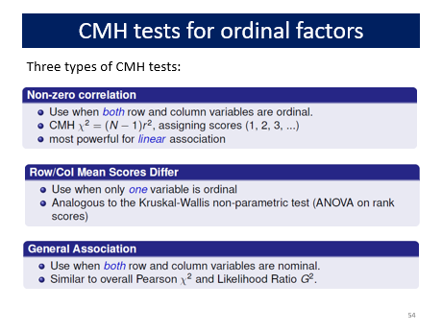
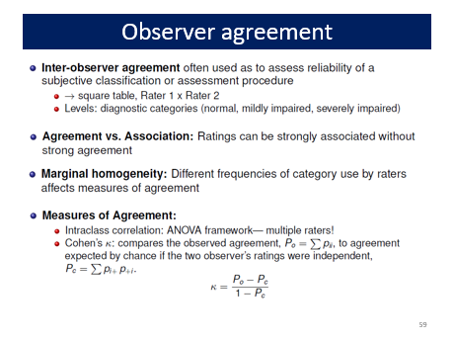

Slide 10
04: Loglinar models, mosaic displays
Mosaic plots use sequential splits to show marginal and conditional frequencies in an n-way table
Shading: sign and magnitude of residuals → contributions to χ²
Shows the pattern of association not accounted for
Permuting rows/cols often helps
Loglinear models
Express associations with ANOVA-like interaction terms: A*B, A*C
Joint independence: [AB][C] ≡ A * B + C
Conditional independence: [AC][BC] ≡ A ⊥ B | C
Fitting models ≅ “cleaning the mosaic”
Response models: include all associations among predictors
Sequential / partial plots & models
Sequential: Decompose all associations: V₁; V₂|V₁; V₃|{V₁, V₂}, …
Partial: Decompose conditional associations: [V₁, V₂ ]| V₃= {a, b, …}

Slide 11
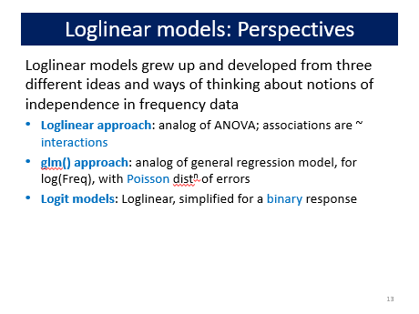
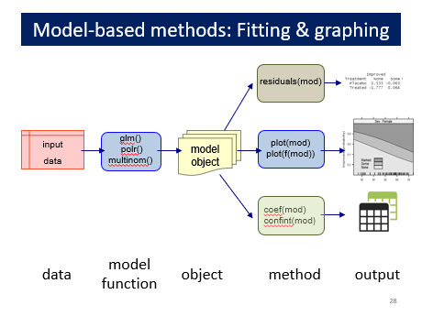
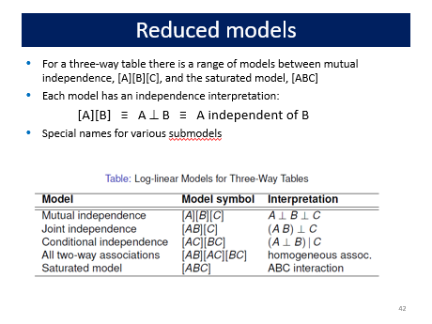
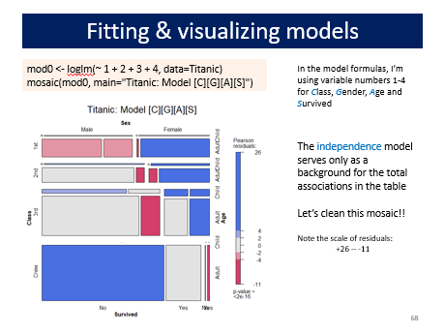

Slide 12
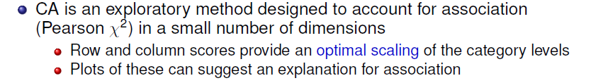
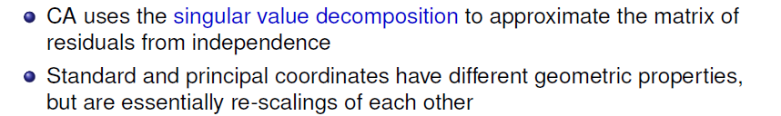
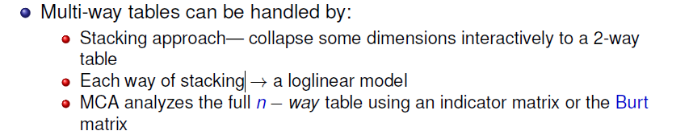
05: Correspondence analysis
Given a new 2-way table, my first thought is nearly always: plot(ca(mytable))

Slide 13
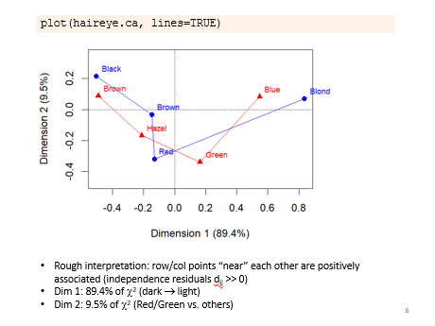
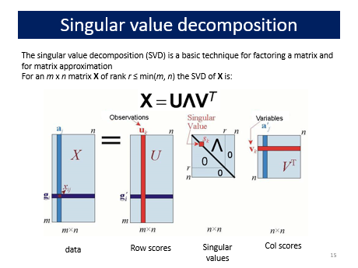
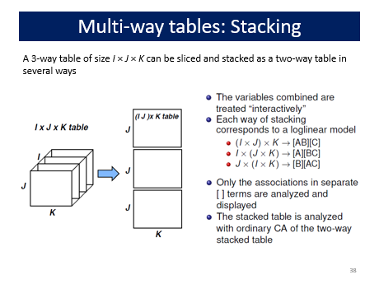
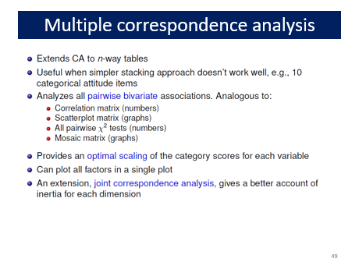

Slide 14
06: Logistic regression
loglm() provides only overall tests of model fit
Model-based methods, glm(), provide hypothesis tests, CIs & tests for individual terms
Logistic regression: A glm() for a binary response
linear model for the log odds Pr(Y=1)
All similar to classical ANOVA, regression models
Plotting
Conditional, full-model plots show data and fits
Effect plots show predicted effects averaged over others
Model diagnostics
Influence plots are often informative

Slide 15
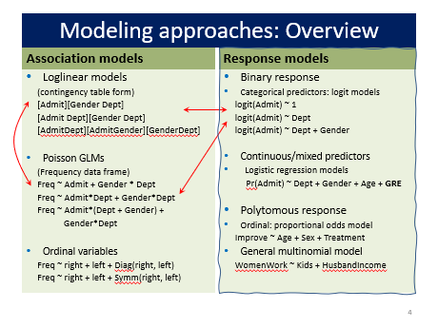
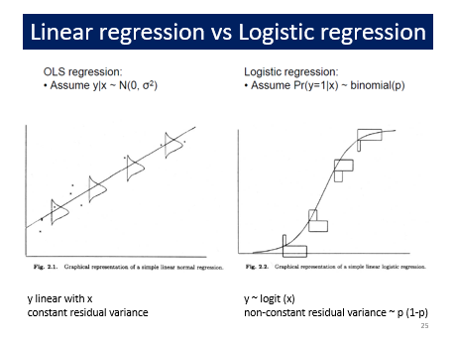
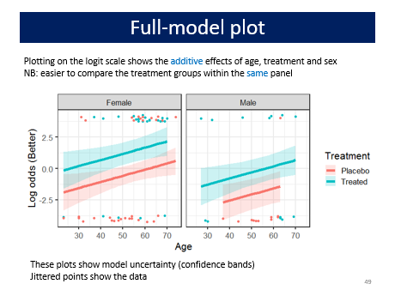
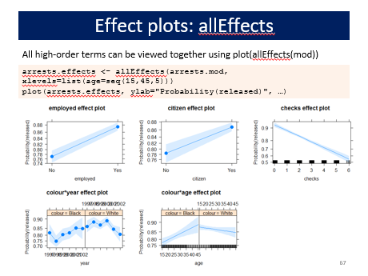

Slide 16
07: Logistic regression: Extensions
Polytomous responses
m response categories → (m-1) comparisons (logits)
Different models for ordered vs. unordered categories
Proportional odds model
Simplest approach for ordered categories
Assumes same slopes for all logits
Fit with MASS::polr()
Test PO assumption with VGAM::vglm()
Nested dichotomies
Applies to ordered or unordered categories
Fit m – 1 separate independent models → Additive G² values
Multinomial logistic regression
Fit m – 1 logits as a single model
Results usually comparable to nested dichotomies, but diff interpretation
R: nnet::multinom()

Slide 17
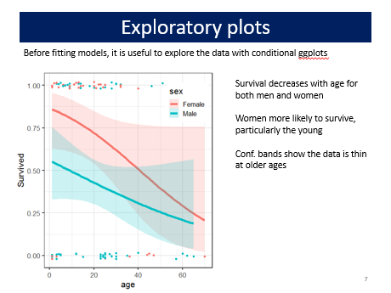
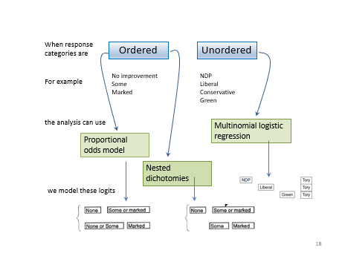
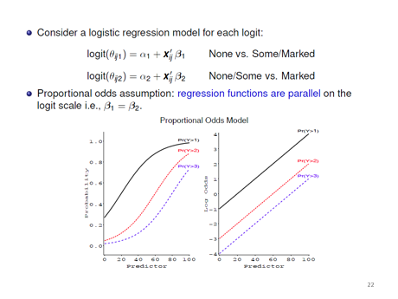
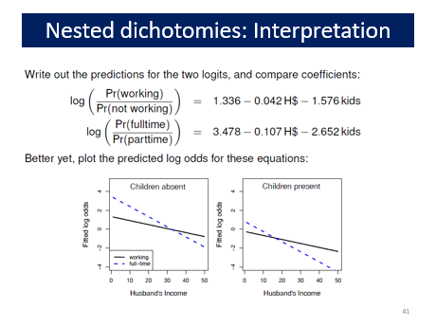

Slide 18
08: Extending loglinear models
Loglinear models, as originally formulated, were quite general, but treated all table variables as unordered factors
The GLM perspective is more general, allowing quantitative predictors and handling ordinal factors
The logit model give a simplified approach when one variable is a response
Models for ordered factors give more powerful & focused tests
L × L, R, C and R+C models assign scores to the factors
RC(1) and RC(2) models estimate the scores from the data
Models for square tables allow testing structured questions
Quasi-independence: ignoring diagonals
symmetry & quasi-symmetry
theory-specific “topological” models
These methods can be readily combined to analyze complex tables

Slide 19
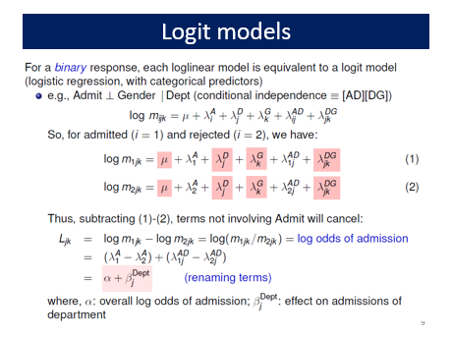
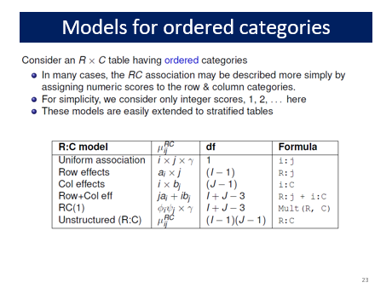
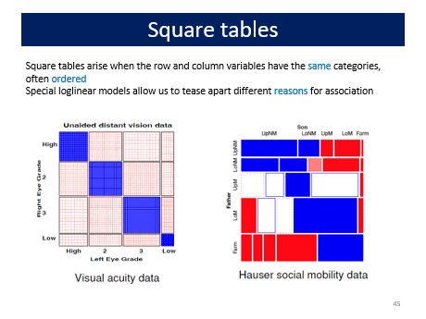
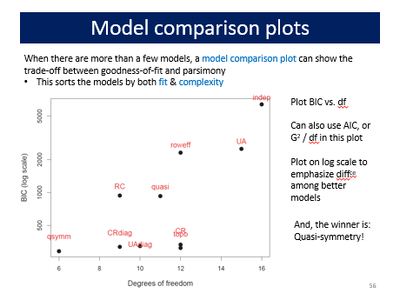

Slide 20
09: GLMs for Count Data
GLMs provide a unified framework for linear models
Different families, all estimated in the same way
→link function and associated variance function
For count data, starting from log(μ) = X β, μ|X ~ Poisson:
Overdispersion → quasi-poisson, negative binomial
Standard tools for assessing model fit
Excess zero counts introduce new ideas & methods
ZIP model: structural model for the 0s
Hurdle model: random model for 0s, 2nd model for Y>0
In all this, we rely on data & model plots for understanding

Slide 21
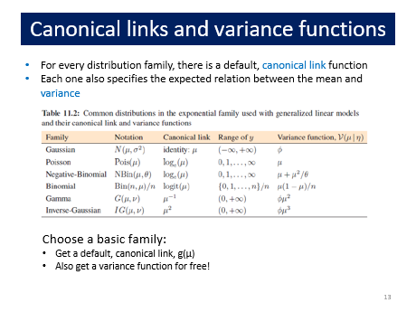
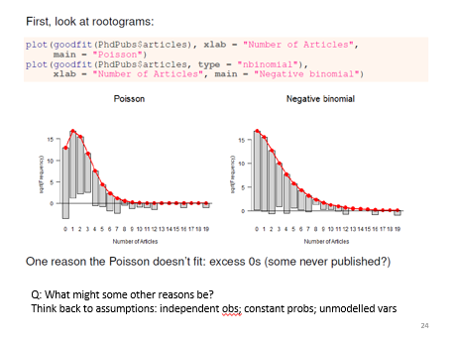
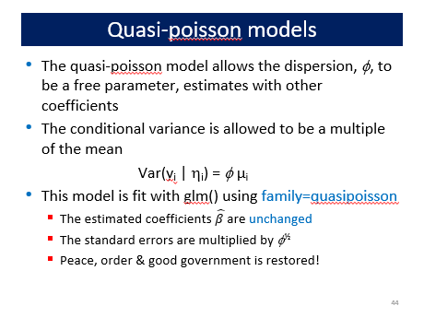
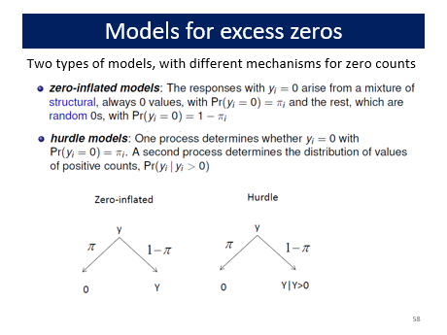

Slide 22
10: Models for log odds & LORs
Logit models for a binary response generalize readily to a polytomous response
→Models for log odds, familiar interpretation
Handles 3+ way table, ordinal variables
Simple plots for interpretation
Generalized odds ratios handle bivariate responses
Simple linear models for LOR
Easy to model log odds for each response and the LOR simultaneously
Easy to visualize results

Slide 23
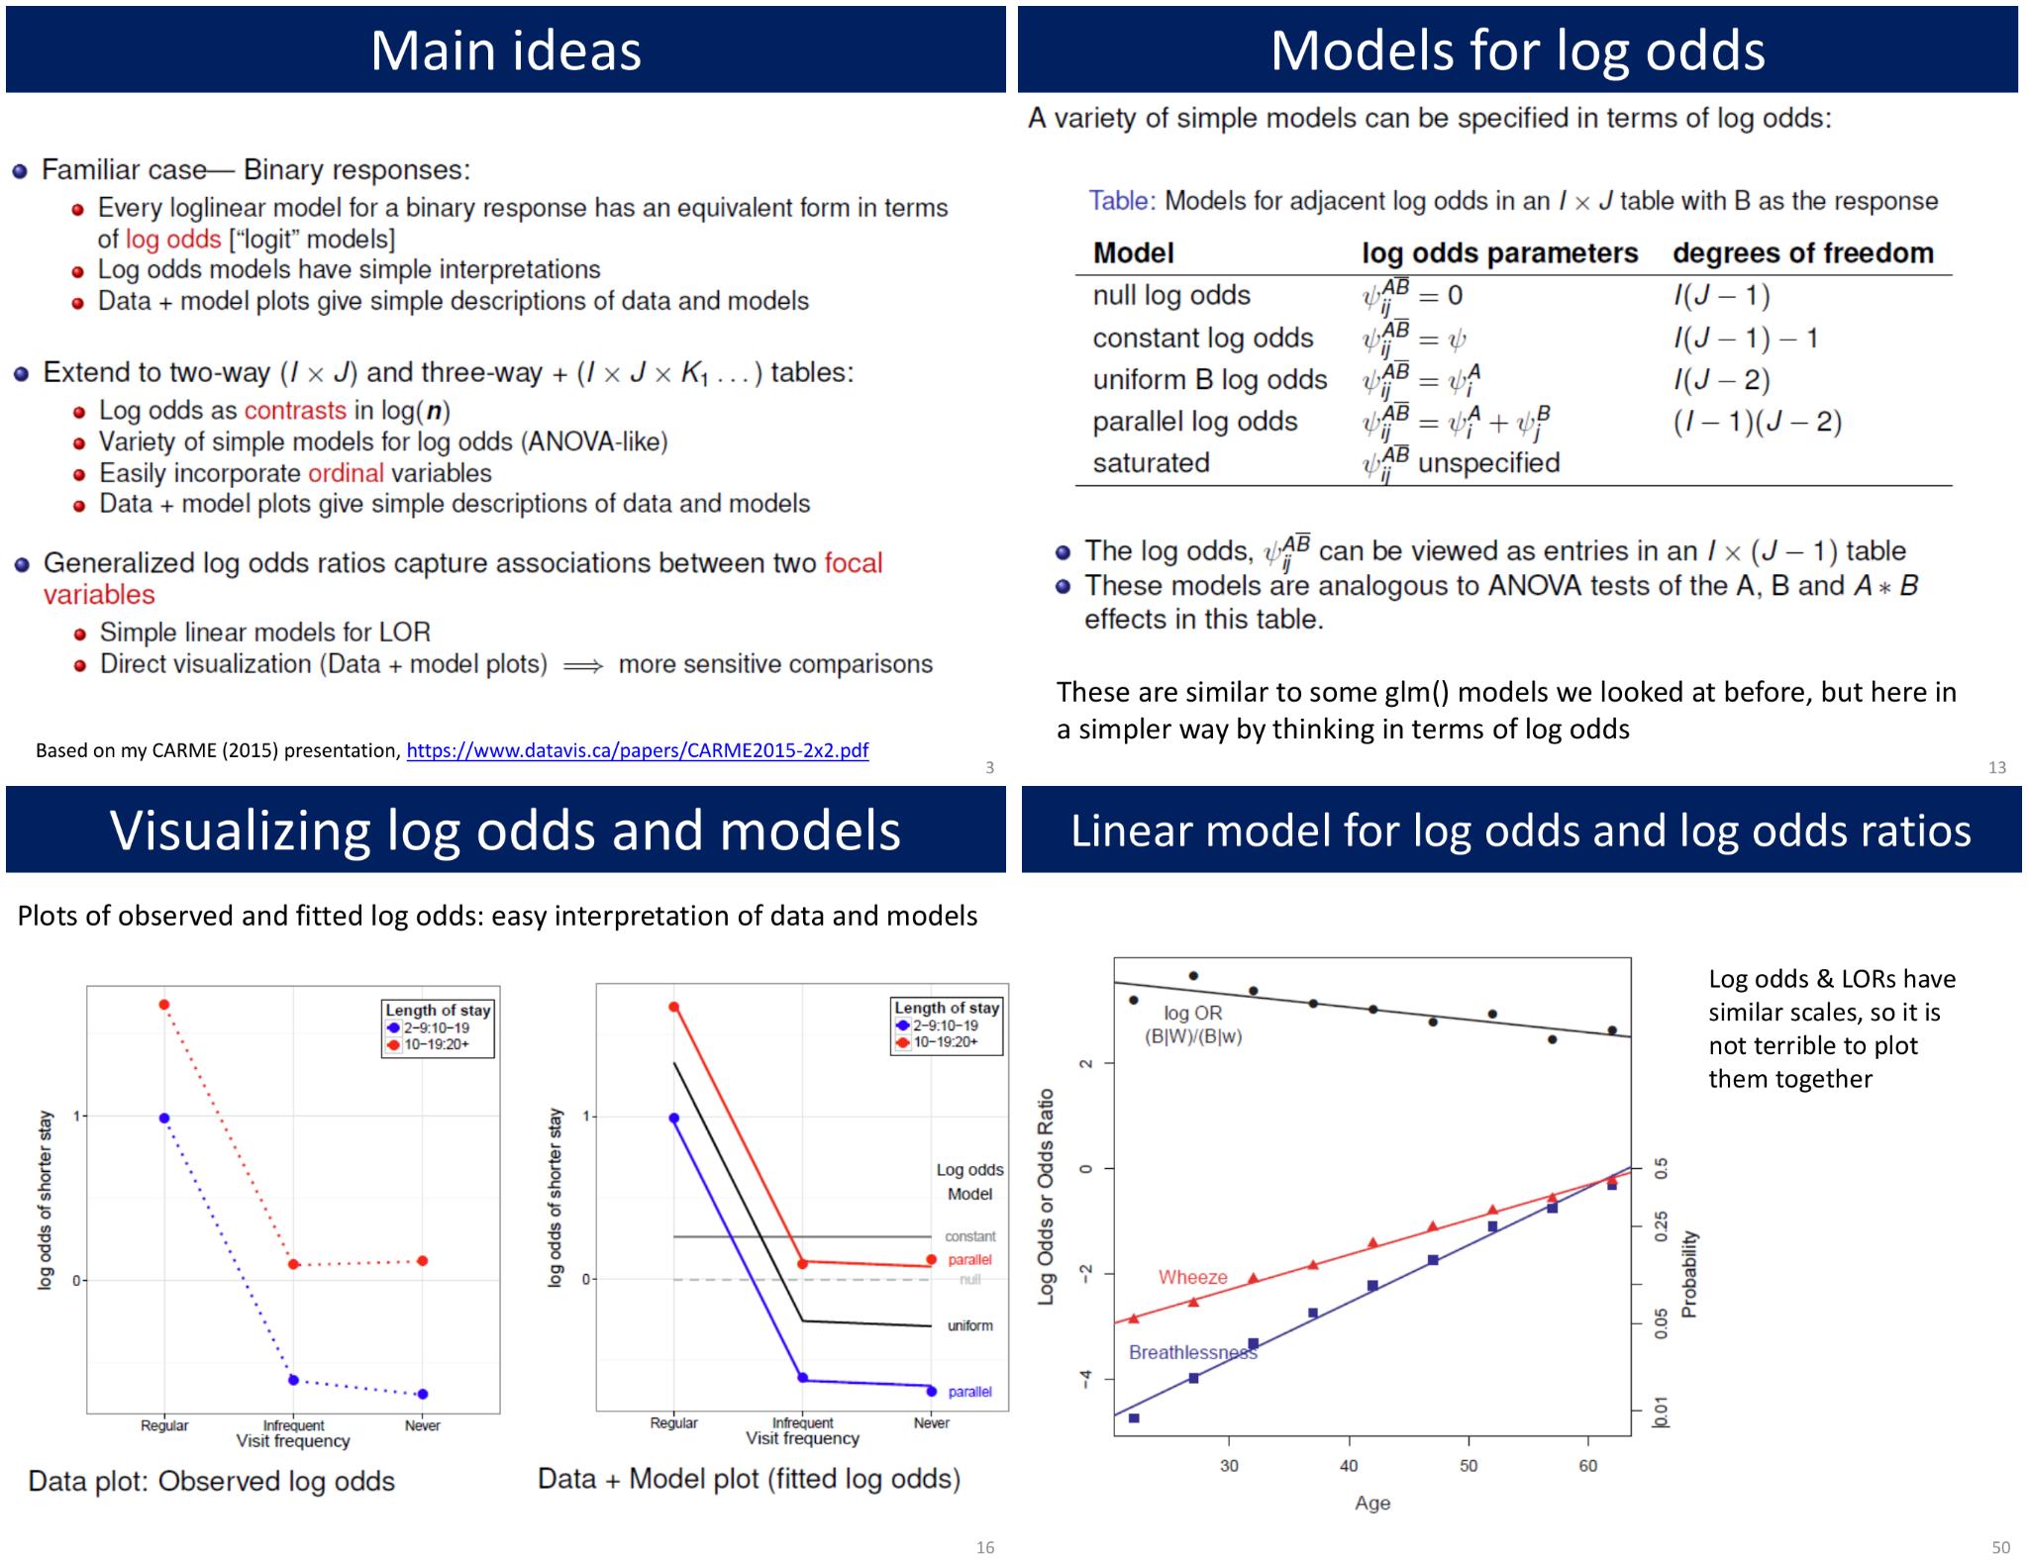

Slide 24
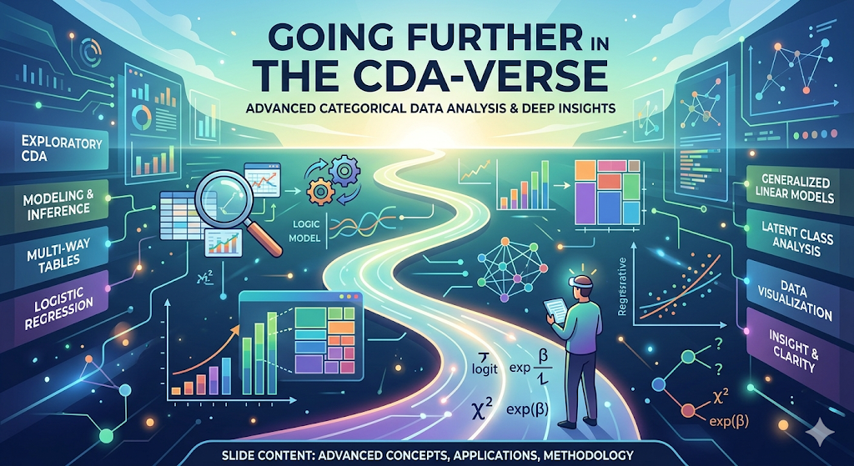

Slide 25
Going further: What did I leave out?
This course, like DDAR, takes an entirely frequentist approach
Treats model parameters as fixed, constants
p-values, CIs interpreted as “over many repeated samples …” --- 95% would contain the true value
Never really know if your sample gives correct inferences
Bayesian approach
Treat parameters as random variables, incorporating prior beliefs and updating them with observed data to produce a posterior distribution. Much more intuitive.
A Bayesian 95% credible interval directly states there is a 95% probability the parameter lies within that range

Slide 26
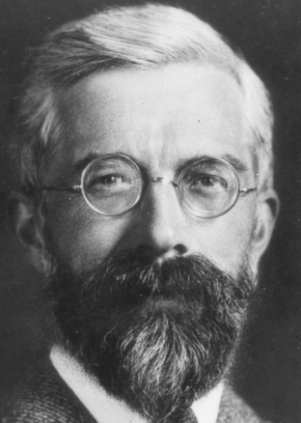
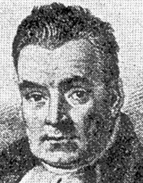
Fisher vs. Bayes
Small samples, sparse data
Frequentist methods may fail to converge, or require fixups (add 0.5 to avoid 0 cells) for χ² tests to be valid
Bayesian approaches use priors to "smooth" empty cells, → more robust estimates in high-dimensional tables
Logistic regression
Frequentist: relies on large-sample asymptotics for inference
Bayesian: provides full posterior dist^{n} for odds ratios, βs
Computation
Frequentist: very fast, particularly for large datasets
Bayesian:
Requires Bayesian sampling, e.g., MCMC; did my chains converge??
Originally (in DDAR): software quite limited, awkward to use
Now, much easier to use.

Slide 27
Bayesian advances
Regularization methods: stabilize inference with small or zero counts
New variable selection methods
Effect clustering: merge levels of categorical predictor that have the same effect → more stable in high-D problems
Applications:
Clinical trials: Bayesian adaptive designs can use historical data to speed up decision on efficacy of drug or treatment
Epidemiology: Bayesian hierarchical models used in disease mapping (estimating risk across areas), pooling strength

Slide 28
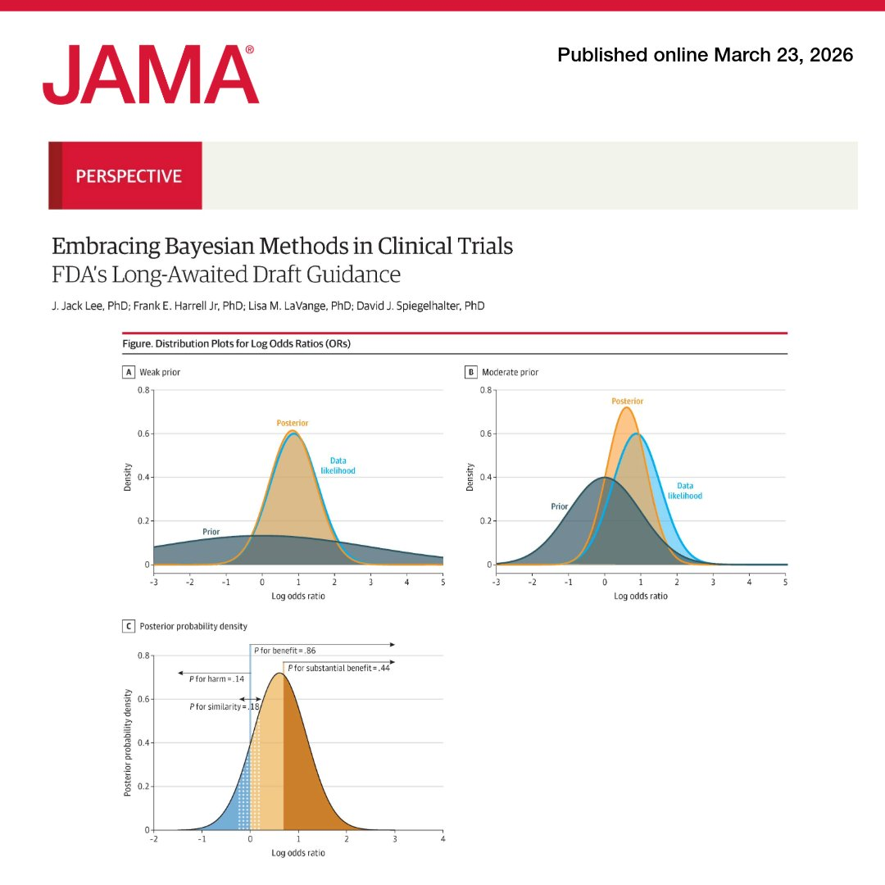
BREAKING NEWS: Bayesian methods adopted in JAMA recommendations to FDA
https://t.co/7mMecV2EI1

Slide 29
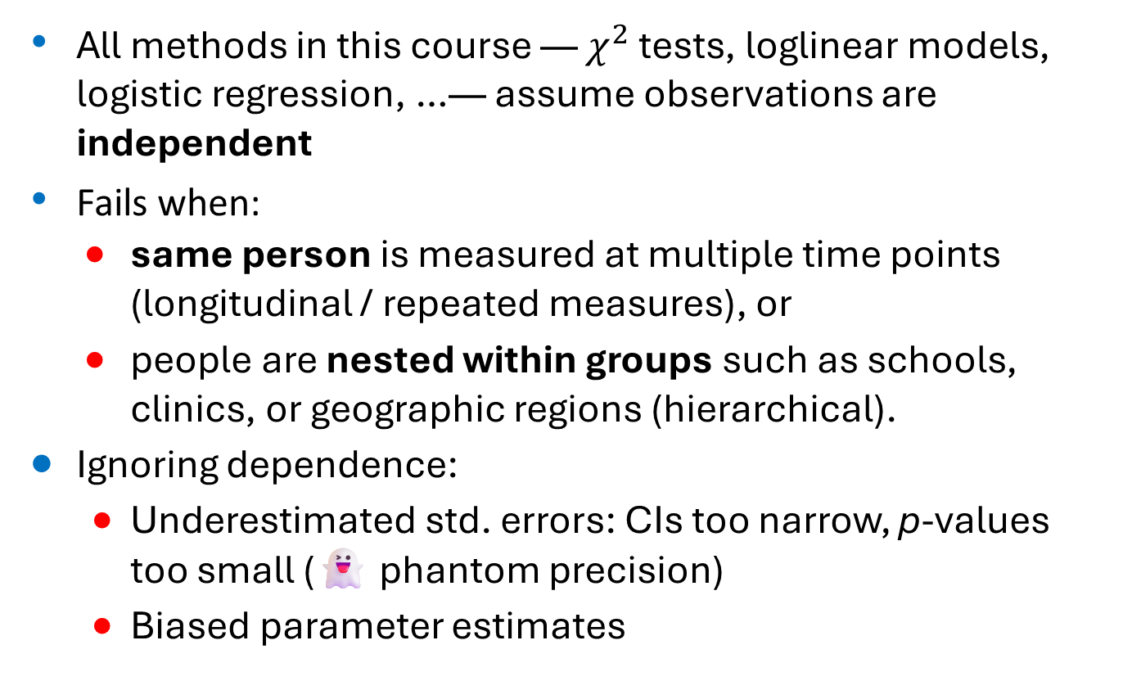
Hierarchical, longitudinal data
All methods in this course — $χ^{2}$ tests, loglinear models, logistic regression, …— assume observations are independent
Fails when:
same person is measured at multiple time points (longitudinal / repeated measures), or
people are nested within groups such as schools, clinics, or geographic regions (hierarchical).
Ignoring dependence:
Underestimated std. errors: CIs too narrow, p-values too small (👻 phantom precision)
Biased parameter estimates

Slide 30
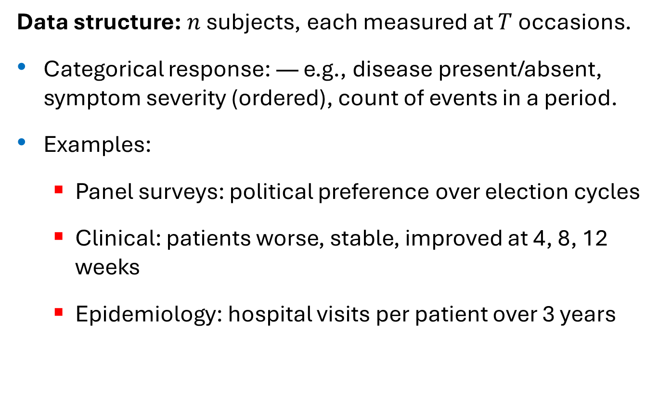
Longitudinal CDA designs
Data structure: $n$ subjects, each measured at $T$ occasions.
Categorical response: — e.g., disease present/absent, symptom severity (ordered), count of events in a period.
Examples:
Panel surveys: political preference over election cycles
Clinical: patients worse, stable, improved at 4, 8, 12 weeks
Epidemiology: hospital visits per patient over 3 years

Slide 31
Modeling approaches: GEE
Marginal models via Generalized Estimating Equations (GEE)
Fit a population-average GLM (logistic, Poisson, ordinal, …) as usual, but explicitly model the within-S correlation structure (exchangeable, AR(1), unstructured, …).
GEE adjusts standard errors so inference is valid even if the correlation structure is mis-specified (robust/“sandwich” SEs).
Interpretation: coefficients describe the average effect in the population, not effects for a specific individual.
R: : geepack::geeglm(), gee::gee()

Slide 32
Hierarchical (clustered / multilevel) designs
Data structure: Individuals at level 1 are nested within groups at level 2 (maybe: level 3, …).
The grouping creates dependence: two students in same school, or two patients at same clinic, share unmeasured contextual influences.
Examples:
Students (level 1) nested in classrooms (level 2) nested in schools (level 3); binary outcome = passed a standardized test.
Patients nested in hospitals; ordinal outcome = satisfaction rating.
Why standard methods fail:
Observations within the same cluster are positively correlated (intraclass correlation, ICC)
Std. logistic / Poisson regression treats all as independent, inflating the effective sample size, giving over-confident inference
Group-level predictors tested against wrong error term.

Slide 33
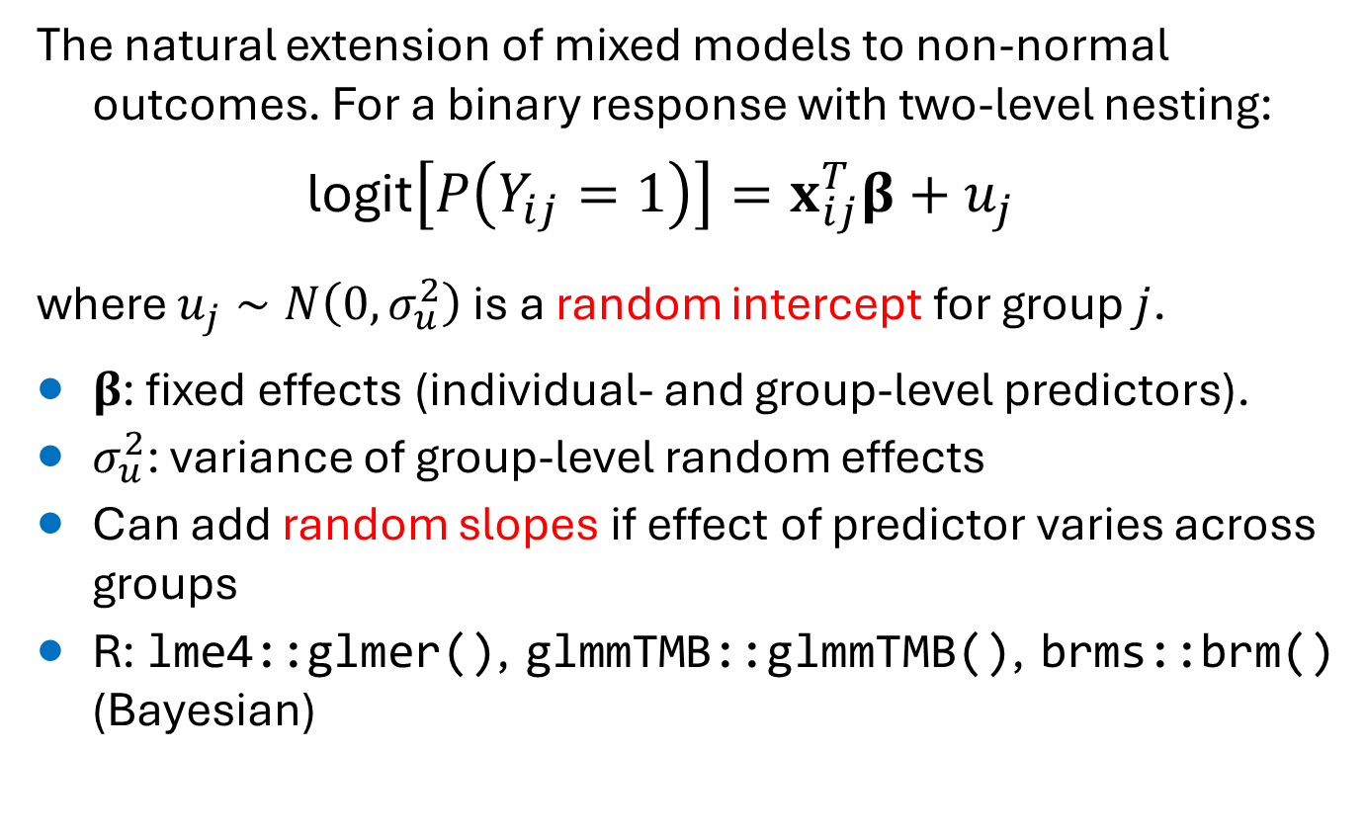
General Linear Mixed Models (GLMM)
The natural extension of mixed models to non-normal outcomes. For a binary response with two-level nesting:
$$\text{logit}\left[P\left(Y_{ij}=1\right)\right]=x_{ij}^{T}β+u_{j}$$
where $u_{j}∼N\left(0,σ_{u}^{2}\right)$ is a random intercept for group $j$.
$β$: fixed effects (individual- and group-level predictors).
$σ_{u}^{2}$: variance of group-level random effects
Can add random slopes if effect of predictor varies across groups
R: lme4::glmer(), glmmTMB::glmmTMB(), brms::brm() (Bayesian)

Slide 34

Transition (Markov) models
Model response at time $t$ as a function of covariates and the lagged response $Y_{i,t−1}$ (or several lags).
Directly captures how prior state predicts current state
Natural for panel /clinical data where change over time is the scientific focus.
Equivalent to a conditional logistic regression on each transition.

Slide 35
Connections to course topics
Course topic | Longitudinal/hierarchical extension
Logistic regression (binary) | GLMM with logit link; GEE with binary family
Ordinal logistic (proportional odds) | Mixed proportional-odds model (ordinal::clmm())
Poisson / negative binomial (counts) | Poisson GLMM; NB GLMM (glmmTMB)
Multinomial logistic | Mixed multinomial (mclogit::mblogit())
Loglinear models | Mixed log-linear for repeated cross-classifications

Slide 36
R software summary
Package | Primary use
lme4 | GLMMs: glmer() for binary/count; fast, widely used
glmmTMB | GLMMs with more families (NB, zero-inflated, ordinal), random slopes
geepack | GEE: geeglm(); marginal models, robust SEs
ordinal | Mixed ordinal models: clmm()
brms | Bayesian GLMMs via Stan; full posterior for all variance components

Slide 37
WHAT! There’s even more??
Five other areas in a totally comprehensive CDA course:
Latent Class Analysis (LCA)
Survival Analysis / Event History Models
Item Response Theory (IRT)
Missing Data & Multiple Imputation
Regularized Logistic Regression

Slide 38
Latent Class Analysis & Survival Analysis
Latent Class Analysis (LCA)
Factor analysis for categorical indicators: finds latent subgroups explaining associations among observed variables
Widely used for diagnostic categories, behavioral typologies, health risk profiles
R: poLCA, mclust
Agresti Ch. 13; Collins & Lanza (2010), Latent Class and Latent Transition Analysis
Survival Analysis / Event History Models
Outcome is time to event (relapse, death, dropout, recovery) — possibly censored
Workhorses: discrete-time logistic regression; Cox proportional hazards
Very common in clinical and health psychology
R: survival, flexsurv; Agresti Ch. 12; Hosmer, Lemeshow & May (2008)

Slide 39

Item Response Theory & Missing Data
Item Response Theory (IRT)
Models $P\left(\text{correct} \text{or} \text{endorsed} \text{response}\right)$ as a function of a latent trait (ability, attitude)
Rasch, 2PL, 3PL models are logistic regression with a latent predictor
Natural extension of GLMs — directly relevant to psychometrics
R: ltm, mirt, TAM; Embretson & Reise (2000)
Missing Data / Multiple Imputation
Cannot mean-impute a categorical variable; complete-case analysis distorts association estimates
MICE (multiple imputation via chained equations) handles categorical predictors and outcomes directly
R: mice; van Buuren (2018), Flexible Imputation of Missing Data (free online)

Slide 40

Regularized Logistic Regression
The problem: when ordinary logistic regression fails
Many predictors → instability, perfect separation, near-collinearity
LASSO ($L_{1}$) shrinks coefficients to zero → automatic variable selection
Ridge ($L_{2}$) shrinks toward zero → stable estimation, all predictors retained
Elastic net combines both penalties
Tools and further reading
Frequentist complement to Bayesian regularization (shrinkage priors)
R: glmnet
Hastie, Tibshirani & Friedman (2009), The Elements of Statistical Learning, Ch. 4, 18

Slide 41
CDA Dad Jokes
Q: What did the χ² statistic say to her p-value?
A: Only you can tell me if our relationship is real
Q: Why was the mosaic plot so calm?
A: He had already made peace with all his residuals.
Q: Why did logistic regression break up with his linear regression?
A: It's not you honey, it's me! My love is binary — I can only give you 0 or 1.
A loglinear model walks into a bar.
Bartender says: "We don't serve your type here.“
Model says: “Fine — I'll just fit a main effects model and assume no one here is associated."

Slide 42

Your turn: Feedback?
FINALLY!!

Slide 43
What did you like/dislike about 6136?
Topics: what were the:
most interesting?
most boring?
most challenging/difficult?
How useful were the web materials for the course?
Quizes? R scripts? Resources / extra readings?
What topics/activities did you learn most from?
What gave you the most difficulty?
How does this relate to your own work?

Slide 44
Tips for next time …
What should I try to differently the next time?
More of X?
Less of Y?
Aspects of how the course is structured?
Evaluation?

