Slide 1
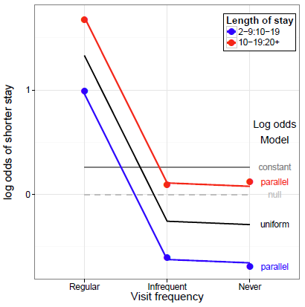
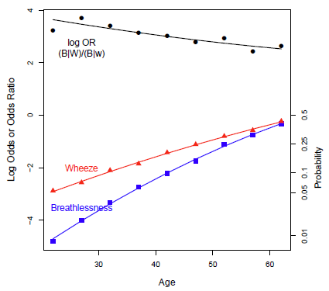
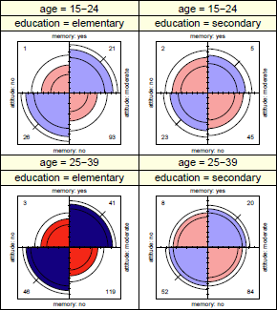
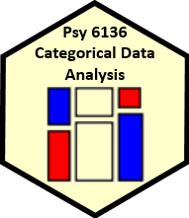
Models & graphs for log odds and log odds ratios
Michael Friendly
Psych 6136
https://friendly.github.io/6136

Slide 2
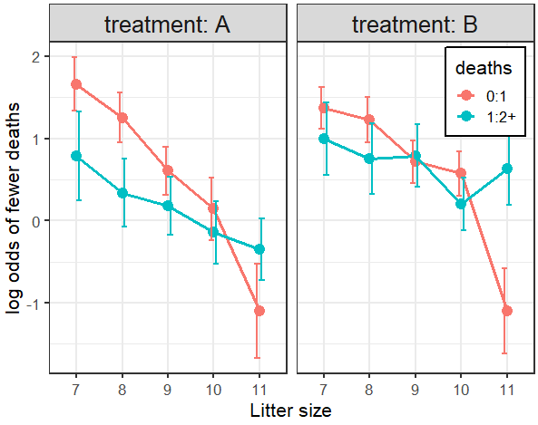
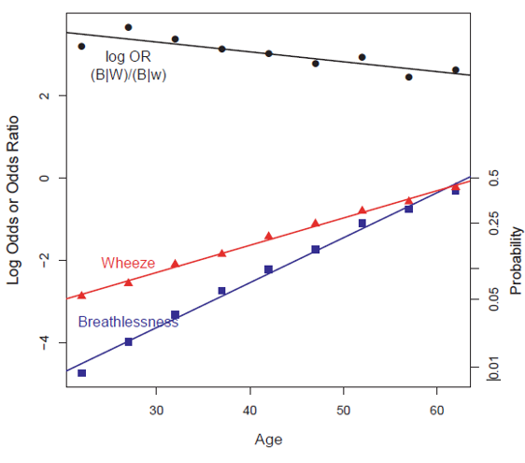
Today’s topics
We’ve come a long way, but there is more…
Logit models → general models for log odds
Two-way tables
Three-way + tables
Log odds plots
Models for generalized odds ratios
Log odds ratios
Bivariate response models

Slide 3
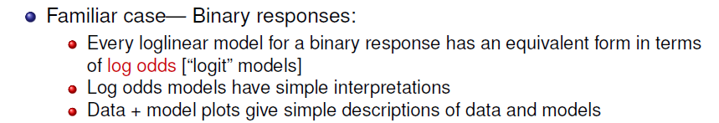
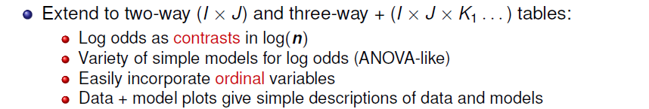
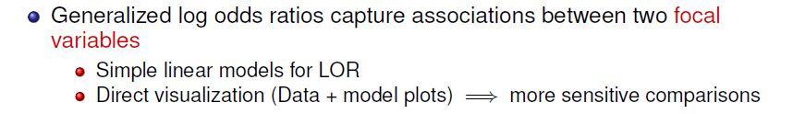
Main ideas
Based on my CARME (2015) presentation, https://www.datavis.ca/papers/CARME2015-2x2.pdf

Slide 4
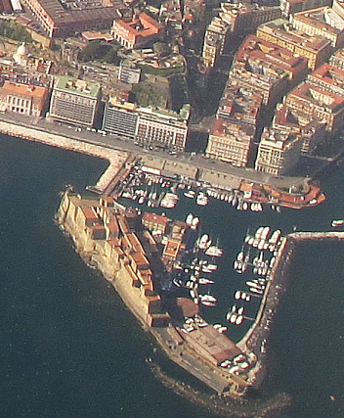
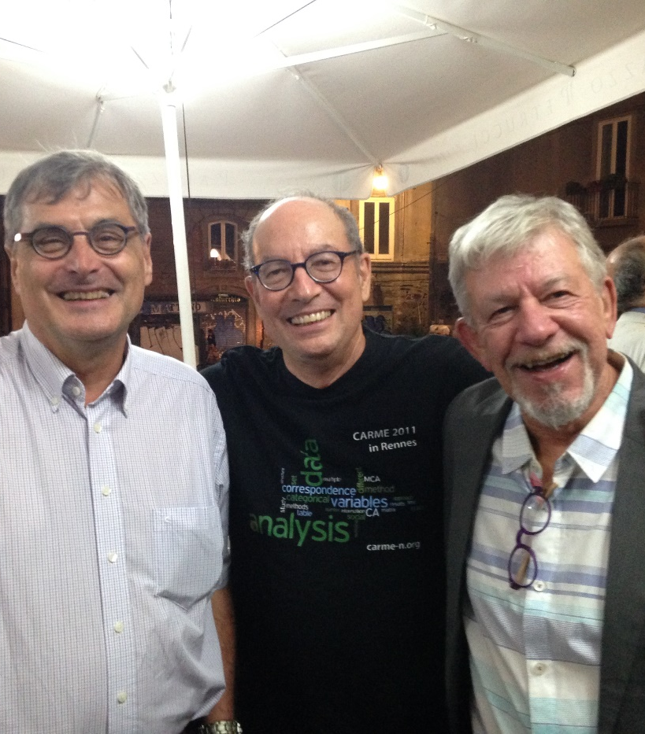
CARME 2015, Naples
Correspondence Analysis and Related MEthods

Slide 5
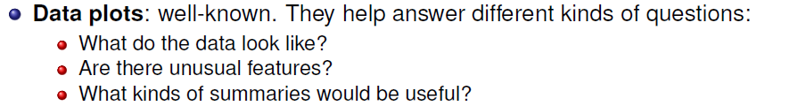
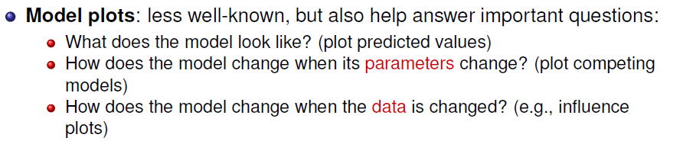
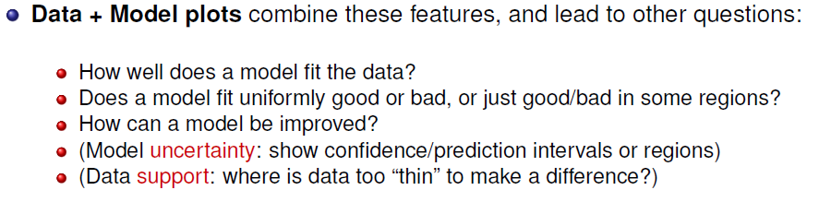
Plots: Data, Model, Data+Model

Slide 6
Plots: Data, Model, Data+Model
Example: Linear model-- Prestige ~ Income + Education + Type
Data plot: marginal relation of Income on occ Prestige, ignoring others
Model (effect) plot: conditional fitted values, controlling for other variables
Data + Model plot: Effect of Income (model) + partial residuals

Slide 7
Logit models → Log odds models
In an I × 2 table for variables[A B], where B is a binary response, the logit model expresses the log odds that B=1 vs. B=2
Models pertain to the one-way log odds
This generalizes to I × J tables, where we consider (J-1) log odds for each level of A, e.g.,
Adjacent categories
In general, I × J → (J-1) log odds contrasts of the B categories for each level of A
Similar to how polytomous responses treated in logistic regression
Can also use comparisons with a baseline category

Slide 8
J responses → J-1 contrasts/logits
Adjacent-category logits
b1 | b2 | b3 | b4
1 | -1
 | 1 | -1
 |  | 1 | -1
Reference-level logits
b1 | b2 | b3 | b4
1 |  |  | -1
 | 1 |  | -1
 |  | 1 | -1
Generalized logit models extend the advantages of the standard one to a polytomous response
Nested logits might also be useful

Slide 9
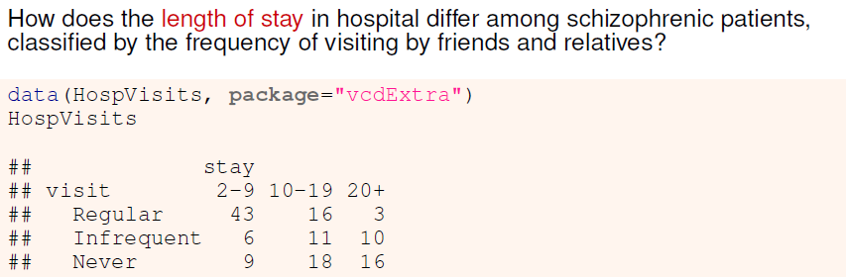
2-way example: Hospital visits
Length of stay is the response, and it is ordered
Can model the adjacent odds or log odds that stay is category j vs (j+1)
E.g., stay= 2-9 vs. 10-19; stay= 10-19 vs. 20+
In general, I x J → I x (J-1) adjacent comparisons
visit is also ordered. Can consider simpler (e.g., linear) models for the log odds

Slide 10
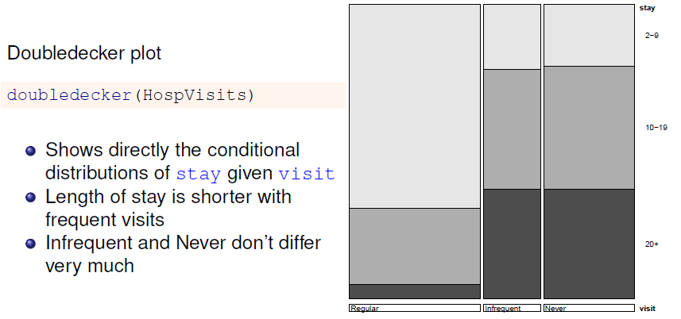
Exploratory plots: Doubledecker

Slide 11
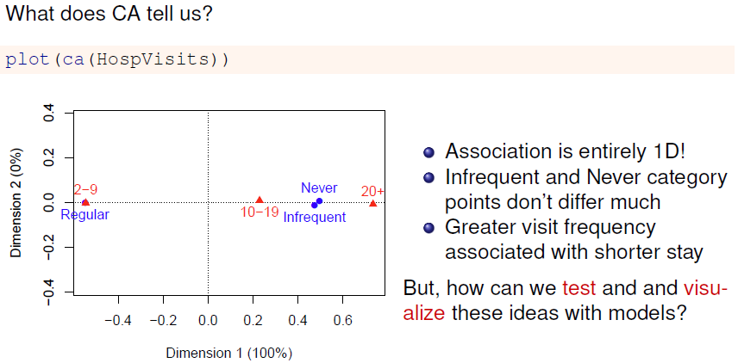
Exploratory plots: ca

Slide 12
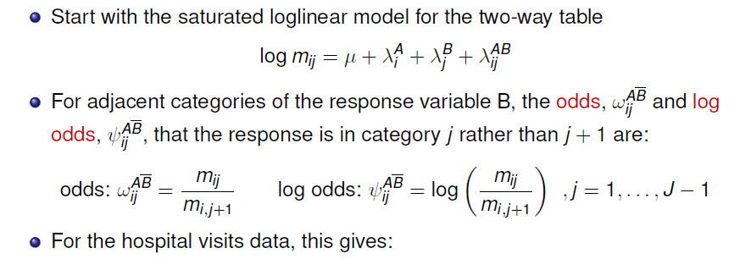
Models for log odds
> t(lodds(HospVisits, response = "stay"))
log odds for stay by visit
stay
visit 2-9:10-19 10-19:20+
Regular 0.989 1.6740
Infrequent -0.606 0.0953
Never -0.693 0.1178
Code for this example: https://friendly.github.io/psy6136/R/output/hospvisits-logodds.html

Slide 13
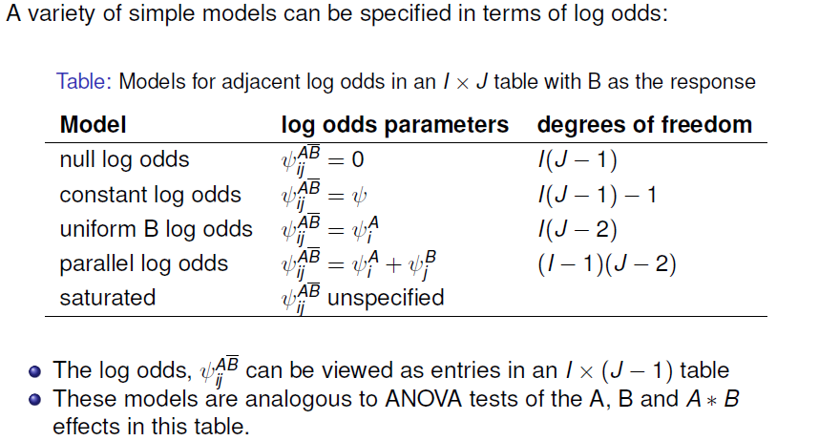
Models for log odds
These are similar to some glm() models we looked at before, but here in a simpler way by thinking in terms of log odds

Slide 14
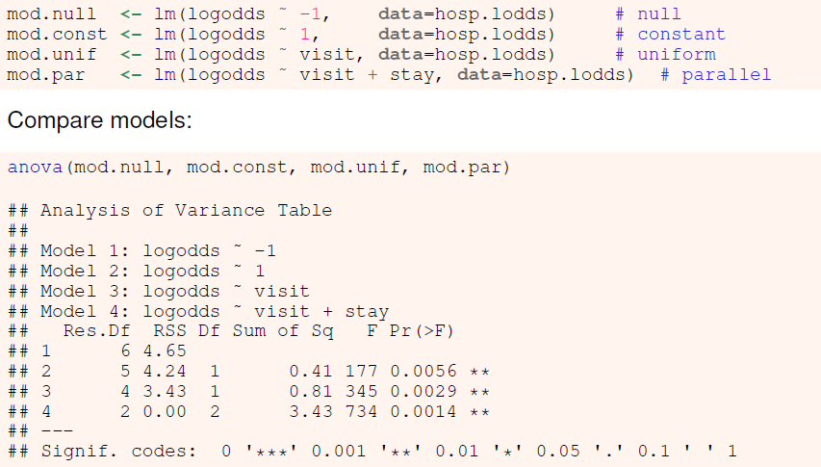
Fit some models
I’m simply using lm() here. Should use WLS: weights = 1/ASE²

Slide 15
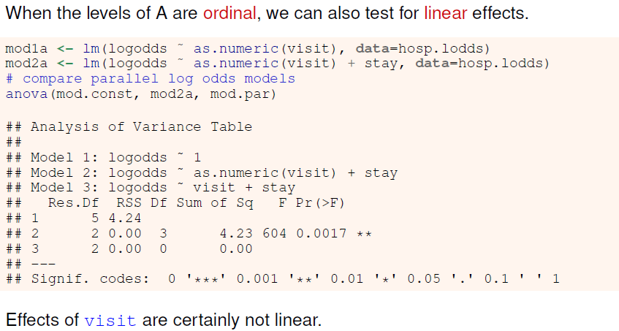
Ordinal variables

Slide 16
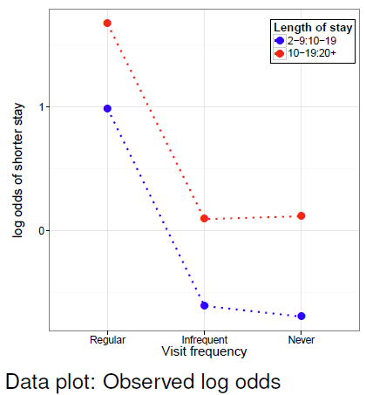
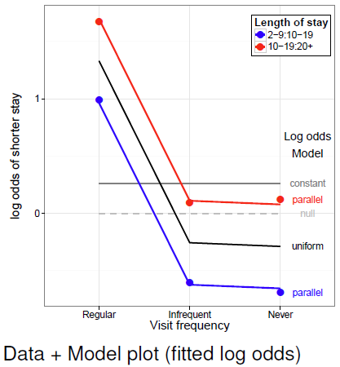
Visualizing log odds and models
Plots of observed and fitted log odds: easy interpretation of data and models

Slide 17
Visualizing log odds and models
Basic plot:
gg <- ggplot(hosp.lodds, aes(x=visit, y=logodds,
group=stay, color=stay)) +
geom_point(size=5) +
geom_line(size=1.2, linetype="dotted") +
ylab("log odds of shorter stay\n") +
xlab("Visit frequency") + theme_bw() + …
Add lines for predicted values from the models
grid <- hosp.lodds[,1:2]
gg_lines <- function(grid, mod, size=1.2, color=NULL, ...) {
grid$logodds <- stats::predict(mod, grid)
if(is.null(color)) geom_line(data=grid, size=size, ...)
else geom_line(data=grid, size=size, color=color, ...)
}
gg + gg_lines(grid, mod.null, color="gray", size=1, linetype="dashed") +
gg_lines(grid, mod.const, color=gray(.5), size=1) +
gg_lines(grid, mod.unif, color="black", size=1) +
gg_lines(grid, mod.par)

Slide 18
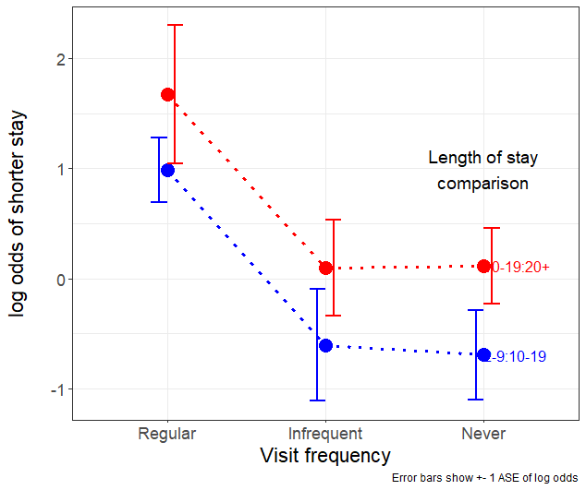
Graph-craft: Error bars, direct labels
The initial graphs I showed could be improved by:
Adding error bars for observed log odds: ± 1 ASE works here
Using direct labels rather than a legend
library(directlabels)
gg1 <- gg +
geom_errorbar(
aes(ymin = logodds - ASE,
ymax = logodds + ASE),
width = 0.2,
position = "dodge")
direct.label(gg1, method= "last.qp") + …
Code for this example: https://friendly.github.io/psy6136/R/output/hospvisits-logodds.html

Slide 19
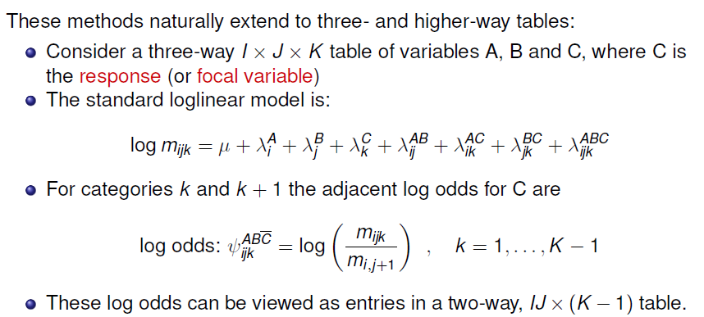
Three-way+ tables: Log odds

Slide 20
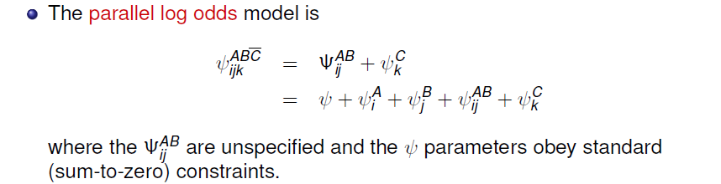
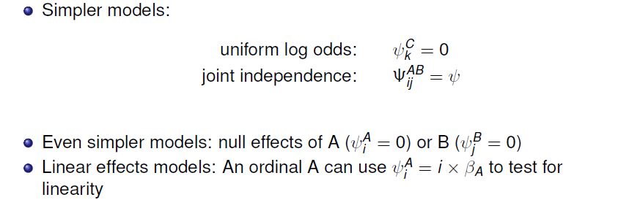
Three-way+ tables: Log odds

Slide 21
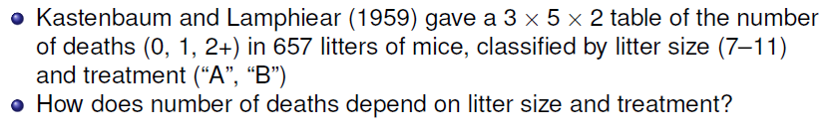
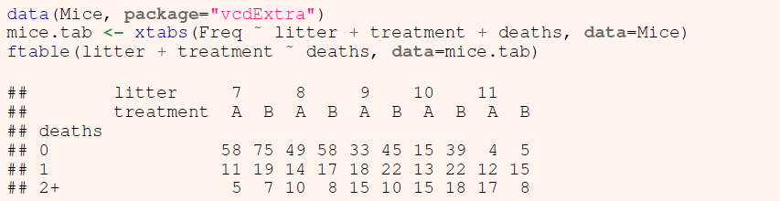
3-way example: Mice depletion data
0 vs 1
1 vs 2+
→ Adjacent categories:
Odds or log odds of 0 vs. 1 deaths
Odds or log odds of 1 vs. 2+ deaths
How do these differ with litter size & treatment?

Slide 22
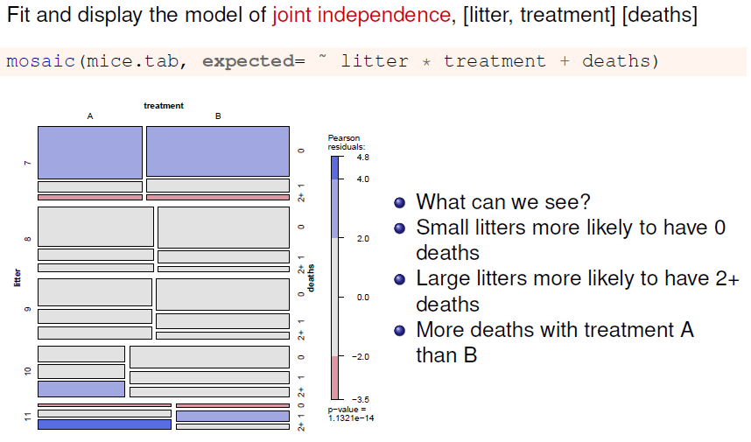
Mice data: mosaic plot

Slide 23
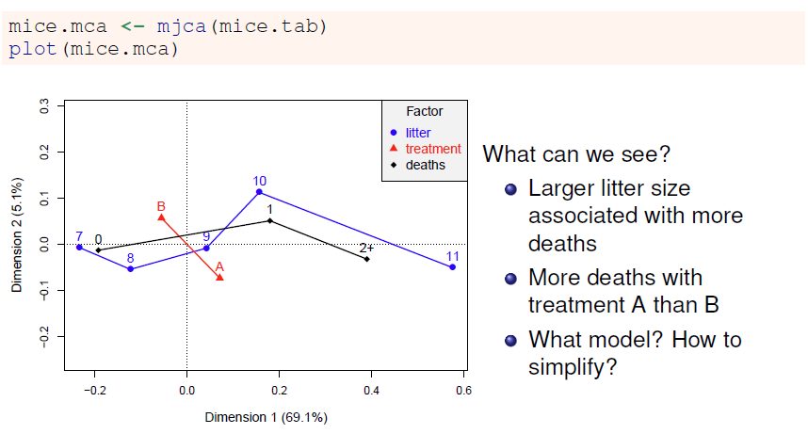
Mice data: MCA
Deaths

Slide 24
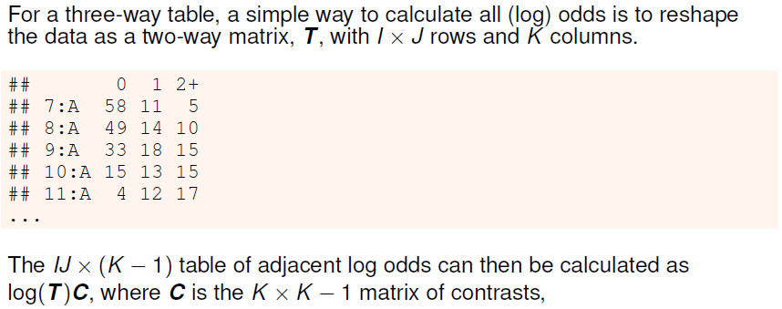
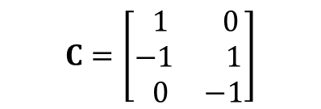
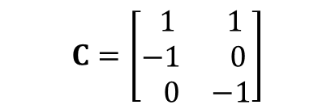
Calculating log odds
$$C=\left[\begin{matrix} 1 & 0 \\ −1 & 1 \\ 0 & −1\end{matrix}\right]$$
$$C=\left[\begin{matrix} 1 & 1 \\ −1 & 0 \\ 0 & −1\end{matrix}\right]$$
In general, any set of K-1 {1, 0, -1} contrasts can be used
Adjacent categories
Reference level = 0
Code for this example: https://friendly.github.io/psy6136/R/output/mice-ex.html

Slide 25
Calculating log odds
mice.tab <- xtabs(Freq ~ litter + treatment + deaths, data=Mice)
# reshape table to matrix, with deaths as cols
T <- matrix(mice.tab,
nrow=prod(dim(mice.tab)[1:2]),
ncol=dim(mice.tab)[3])
colnames(T) <- dimnames(mice.tab)[[3]]
rn <- expand.grid(dimnames(mice.tab)[1:2])
rownames(T) <- apply(rn, 1, paste, collapse=":")
C <- matrix(c(1, -1, 0,
0, 1, -1), nrow=3)
lodds <- log(T) %*% C
colnames(lodds) <- c("0:1", "1:2+")
> lodds
0:1 1:2+
7:A 1.663 0.788
8:A 1.253 0.336
9:A 0.606 0.182
10:A 0.143 -0.143
11:A -1.099 -0.348
7:B 1.373 0.999
8:B 1.227 0.754
9:B 0.716 0.788
10:B 0.573 0.201
11:B -1.099 0.629

Slide 26
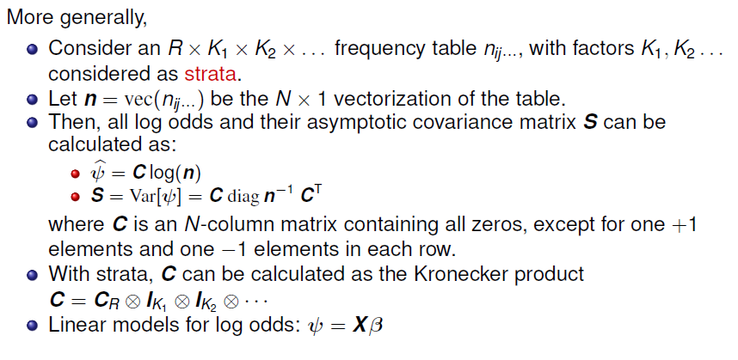
Calculating log odds: General case

Slide 27
Mice data: Log odds
The vcd package contains a general implementation of these ideas:
odds() and lodds() : calculate odds or log odds for 1 variable in an n-way table
Provides methods (coef(), vcov(), confint(), …) for “lodds” objects
> (mice.lodds <- as.data.frame(lodds(mice.tab, response="deaths")))
deaths litter treatment logodds ASE
1 0:1 7 A 1.663 0.329
2 1:2+ 7 A 0.788 0.539
3 0:1 8 A 1.253 0.303
4 1:2+ 8 A 0.336 0.414
5 0:1 9 A 0.606 0.293
6 1:2+ 9 A 0.182 0.350
7 0:1 10 A 0.143 0.379
8 1:2+ 10 A -0.143 0.379
9 0:1 11 A -1.099 0.577
10 1:2+ 11 A -0.348 0.377

Slide 28
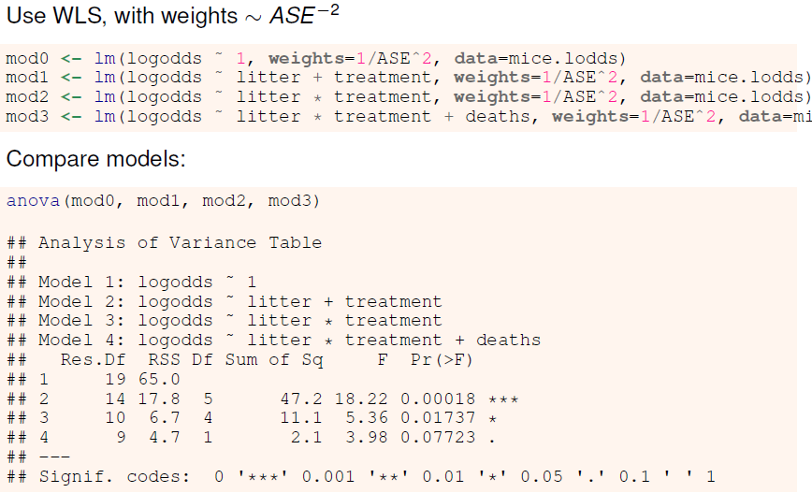
Mice data: Fit models

Slide 29
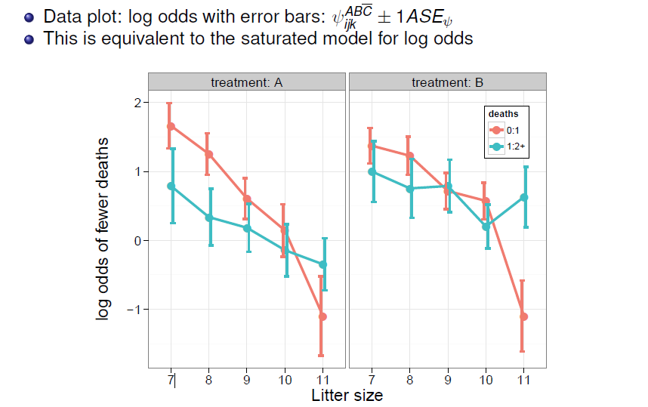
Visualize log odds & models: Data plot

Slide 30
Basic plot:
gg <- ggplot(mice.lodds, aes(x=litter, y=logodds,
color=deaths, group=deaths)) +
geom_point(size=4) +
ylab("log odds of fewer deaths") +
xlab("Litter size") +
theme_bw(base_size = 16) +
theme(legend.position = c(.9, .85),
legend.background = element_rect(colour = "black")) +
facet_grid(. ~ treatment, labeller=label_both) +
theme(strip.text = element_text(size = rel(1.2)))
Add error bars, dodged
bars <- aes(ymin=logodds-ASE,
ymax=logodds+ASE)
gg + geom_line(size=1.2) +
geom_errorbar(bars,
width=0.25, size=1,
position=position_dodge(width=.2))
ggplot thinking:
gg is my basic plot of points
I can add other layers to it

Slide 31
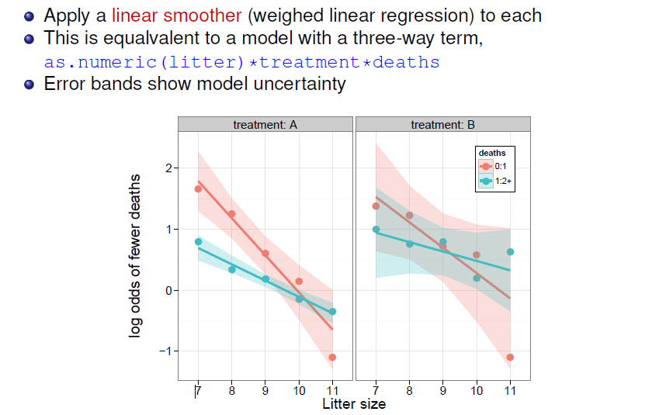
Visualize log odds & models: Smoothing

Slide 32
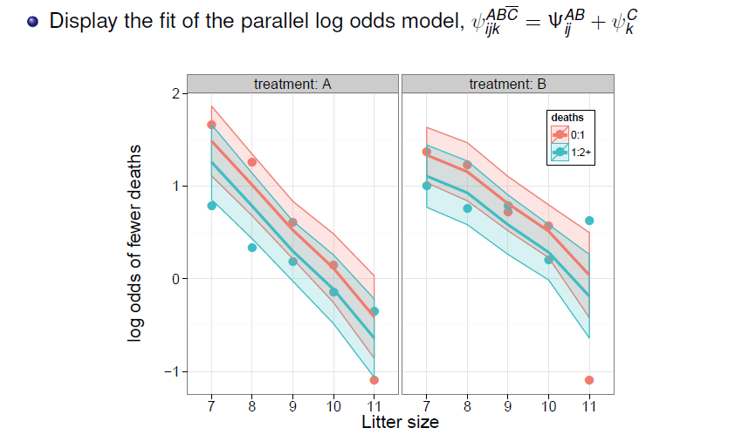
Visualize log odds & models: Data + Model
One unusual point

Slide 33
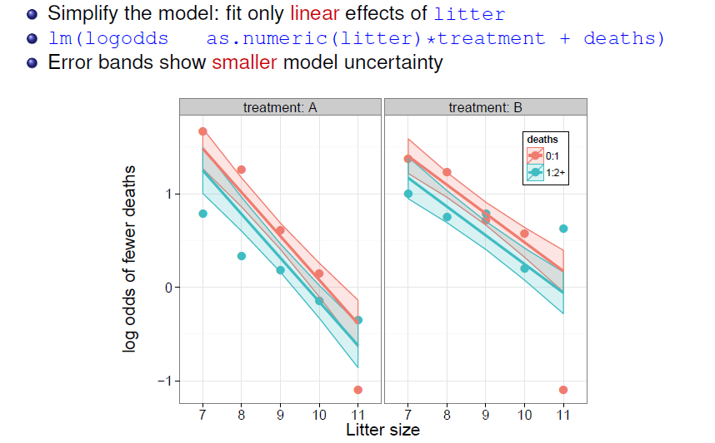
Visualize log odds & models: Data + Model
~

Slide 34
Another Viz: Biplots of log odds ratios
Previous plots: separate panels for each factor combination — hard to see the joint structure
Can we display rows (litter × treatment) and columns (log-odds contrasts) together in one plot?
A biplot for LOR is your friend 𐦂𖨆𐀪𖠋
Arrange the log odds as a matrix L with rows = obs units, cols = response contrasts
Apply the SVD to L to find a low-D approximation
Display result as a biplot: rows as points, cols (LOR contrasts) as arrows
Why a biplot?
Compress a multi-dimensional log-odds structure into 2D
Rows that are similar in their log-odds profiles cluster together
Column arrows show which contrasts vary most and how they co-vary
Treatment and litter effects can be seen simultaneously

Slide 35
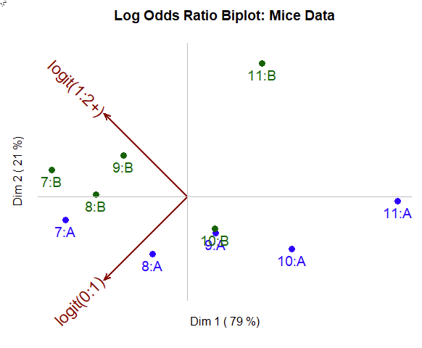
Here’s the result:
Interpretation:
2D biplot solution accts for 100% !!!
Dim 1: Litter size
Dim 2: Treatment (A vs B)
LOR Contrasts: (0-1), (1-2+) aligned with Dim 2
Outlier for 11:B stands out
Litter size
These methods were presented at CARME 2015 by Jose Villardon, implemented in {MultBiplotR}

Slide 36
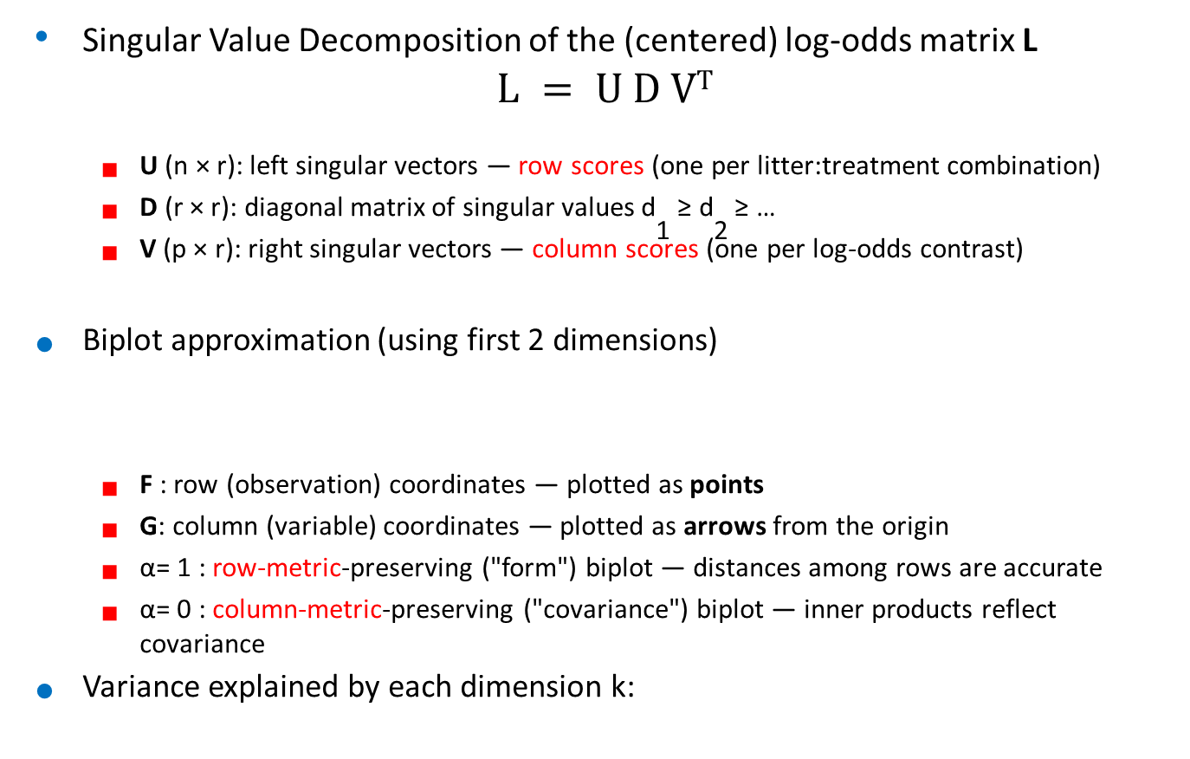

SVD and the biplot approximation
Singular Value Decomposition of the (centered) log-odds matrix L
$$L = U D VT$$
U (n × r): left singular vectors — row scores (one per litter:treatment combination)
D (r × r): diagonal matrix of singular values d₁ ^{≥ d}₂ ≥ …
V (p × r): right singular vectors — column scores (one per log-odds contrast)
Biplot approximation (using first 2 dimensions)
F : row (observation) coordinates — plotted as points
G: column (variable) coordinates — plotted as arrows from the origin
α= 1 : row-metric-preserving ("form") biplot — distances among rows are accurate
α= 0 : column-metric-preserving ("covariance") biplot — inner products reflect covariance
Variance explained by each dimension k:
$$L≈FG^{⊤}, F=U_{2}D_{2}^{α}, G=V_{2}D_{2}^{1−α}$$
$$r_{k}={d_{k}^{2}}/{\sum_{j}{d_{j}^{2}}}$$

Slide 37
Biplot of Mice log odds: Code
Using MultBiplotR::PCA.Biplot(), which applies PCA (SVD of the centered matrix) and provides a biplot plot method:
library(MultBiplotR)
bip_mice <- PCA.Biplot(biplot_mat)
bip_mice # prints variance explained by each PC
plot(bip_mice,
Title = "Log Odds Ratio Biplot: Mice Data",
CexInd = 1.2,
ColorInd = c("blue", "darkgreen")[as.numeric(mice_df$treatment)],
CexVar = 1.4,
ColorVar = "darkred",
xpd = TRUE)
abline(h = 0, v = 0, col = "gray")

Slide 38
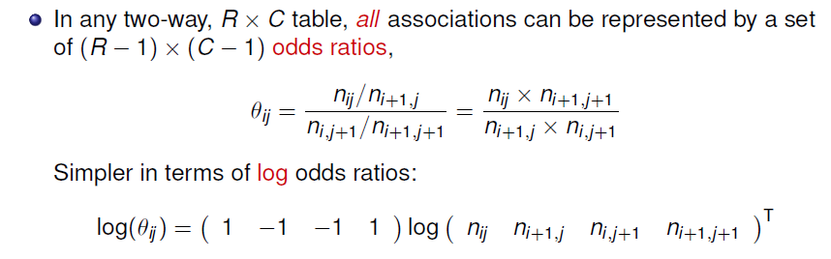
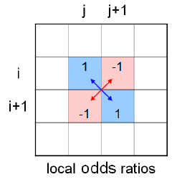
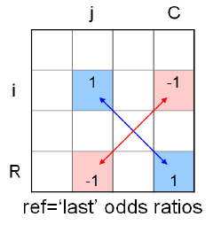
Generalized log odds ratios

Slide 39
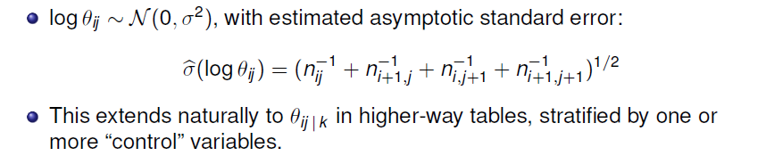
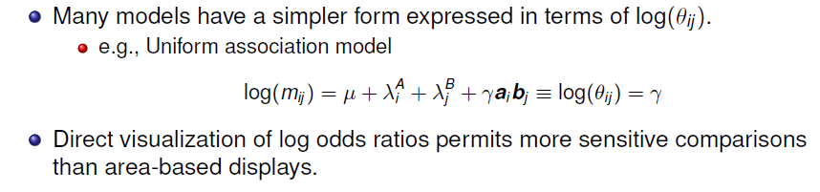
Generalized log odds ratios

Slide 40
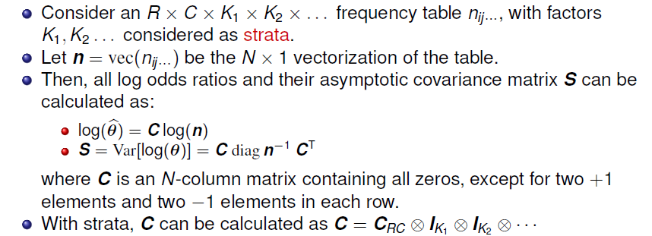

Models for log odds ratios: Computation

Slide 41
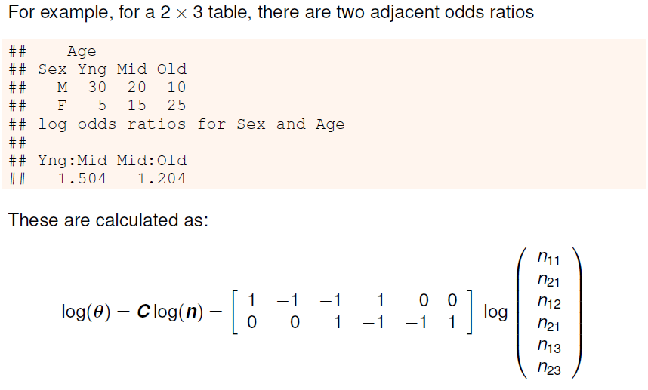
Models for log odds ratios: Computation

Slide 42

Models for log odds ratios: Estimation
Technical note: for simplicity, I use lm() for WLS, with S⁻¹ = diag(1/ASE²)
Should use nlme::gls() instead using the full S⁻¹

Slide 43

Example: Breathlessness & wheeze in coal miners

Slide 44

Example: Breathlessness & wheeze in coal miners

Slide 45



Coal miners: Log odds & models
Should be using gls() here

Slide 46

Coal miners: LOR plot

Slide 47

Coal miners: Model comparisons

Slide 48

Going further: Bivariate response models
(👁,‿,👁) See: DDAR, Example 10.9; Section 10.4.1.2 for these examples

Slide 49
Calculating…
Logits and log odds for a bivariate response can be calculated with vcdExtra::blogits()
data(coalminers, package = "VGAM")
coalminers <- transform(coalminers, Age = (age - 42) / 5)
logitsCM <- vcdExtra::blogits(coalminers[, 1:4], add = 0.5)
colnames(logitsCM)[1:2] <- c("logitB", "logitW")
logitsCM <- cbind(logitsCM,
coalminers[, c("age", "Age")])
logitsCM
logitB logitW logOR age Age
1 -4.736 -2.868 3.20 22 -4
2 -3.977 -2.557 3.66 27 -3
3 -3.317 -2.094 3.38 32 -2
4 -2.733 -1.848 3.13 37 -1
5 -2.215 -1.420 3.01 42 0
6 -1.739 -1.109 2.78 47 1
7 -1.101 -0.797 2.92 52 2
8 -0.758 -0.572 2.44 57 3
9 -0.319 -0.226 2.63 62 4

Slide 50

Linear model for log odds and log odds ratios
Log odds & LORs have similar scales, so it is not terrible to plot them together

Slide 51

Linear model for log odds and log odds ratios

Slide 52

Quadratic model for log odds and log odds ratios

Slide 53

Plotting …
With the data in this form, we can use matplot() to plot each column against age
matplot(age, logitsCM[, 1:3], type = "p",
col = col, pch = pch, cex = 1.2, cex.lab = 1.25,
xlab = "Age", ylab = "Log Odds or Odds Ratio")
abline(lm(logitsCM[,1] ~ age), col = col[1], lwd = 2)
abline(lm(logitsCM[,2] ~ age), col = col[2], lwd = 2)
abline(lm(logitsCM[,3] ~ age), col = col[3], lwd = 2)
To plot the quadratic fit, simply use
lm(logitsCM[,1] ~ poly(age,2)
But: this is NOT a model. It simply fits each set of odds separately

Slide 54
Fitting: VGAM::vglm()
VGAM::vglm() can fit a wide class of models for a vector of multivariate responses
The family binom2.or() is used for bivariate logistic models
An argument zero= allows the logit or odds ratio submodels to be constrained to intercept-only
cm.vglm <- vglm(cbind(nBnW, nBW, BnW, BW) ~ Age,
binom2.or(zero = NULL), data = coalminers)
exp(coef(cm.vglm, matrix = TRUE))
logitlink(mu1) logitlink(mu2) loglink(oratio)
(Intercept) 0.104 0.226 20.530
Age 1.673 1.385 0.877
Each 5 years of age:
Multiplies odds of breathlessness by 1.67, a 67% increase
Multiplies odds of wheeze by 1.38, a 38% increase
Multiplies the OR for association by 0.88, a 12 % decrease

Slide 55

Plotting the model fit
VGAM::fitted() returns the fitted values on the probability scale
VGAM::depvar() returns the observed values on the probability scale
> P <- fitted(cm.vglm)
> colnames(P) <- c("bw", "bW",
"Bw", "BW")
> P
bw bW Bw BW
1 0.94 0.049 0.0046 0.0085
2 0.91 0.064 0.0070 0.0148
3 0.88 0.080 0.0105 0.0254
4 0.84 0.097 0.0158 0.0428
5 0.79 0.114 0.0239 0.0704
…
The plot is made using matplot()
You can get these on the logit scale using the inverse logit function, qlogis()
LP <- qlogis(P)
LY <- qlogis(Y)

Slide 56
Other possibilities
We can also model the relations with age as a quadratic, cubic, …
cm.vglm2 <- vglm(cbind(nBnW, nBW, BnW, BW) ~ poly(Age,2),
binom2.or(zero = NULL),
data = coalminers)
VGAM also implements vector generalized additive models, fit using vgam()
cm.vgam <- vgam(cbind(nBnW, nBW, BnW, BW) ~ s(Age, df = 2),
binom2.or(zero = NULL),
data = coalminers)

Slide 57

Example: Attitudes toward corporal punishment
(👁,‿,👁) See: DDAR, Example 5.11, 5.20 for some examples

Slide 58


Attitudes: Questions
~

Slide 59

Log odds model for attitude
Q: Is this sufficient to rule out all interactions?
What could I have done instead?

Slide 60

Attitude: Effect plots

Slide 61

Association of attitude with memory: Fourfold plots
Education
How does the association of attitude and memory vary with education and age?
Each fourfold plot visualizes the log odds ratio between them
What’s going on here?
Can you see a pattern?
Age

Slide 62

Log odds ratio plot
40+

Slide 63
Summary
Logit models for a binary response generalize readily to a polytomous response
→Models for log odds, familiar interpretation
Handles 3+ way table, ordinal variables
Simple plots for interpretation
Generalized odds ratios handle bivariate responses
Simple linear models for LOR
Easy to model log odds for each response and the LOR simultaneously
Easy to visualize results

