Slide 1
HEplot3d movies
Visualizing H & E variation in 3D space

Slide 2
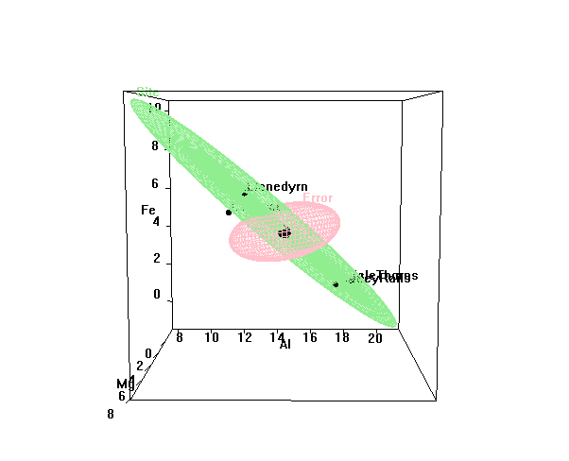
Pottery data: variable space
3D view, showing H and E ellipsoids for Al, Fe and Mg
Variation due to Site (3 df) is 3 D
Rotated views show a 2D subspace

Slide 3
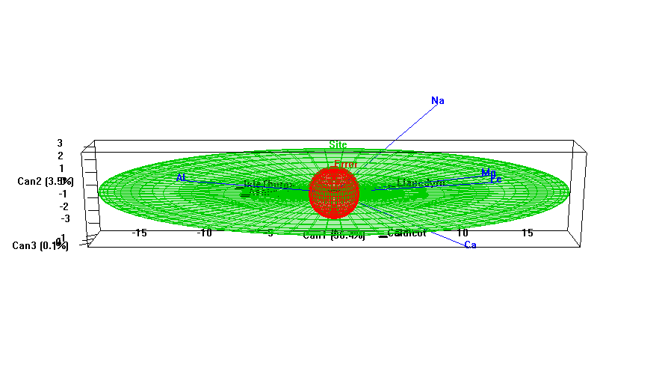
Pottery data: canonical space
3D view: H and E ellipsoids and variable vectors in canonical space, HE⁻¹
Variation due to Site is still 3D
Here we see directly how small the 3rd dimension is
Variable vectors show relations of variates to canonical space

