Slide 1
Linear Regression
With Python

Slide 2
Simple Linear Regression

Slide 3
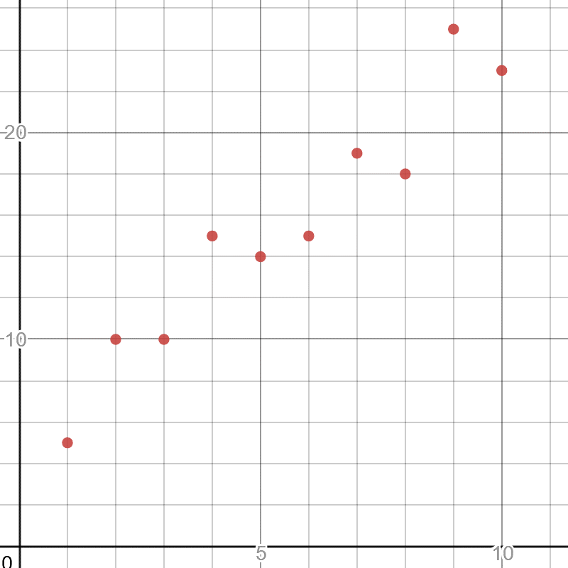
Simple Linear Regression
In practicality, machine learning is often about two tasks: regression and classification.
Let’s start with regression, particularly the simplest one called linear regression which finds the best fit straight line through some points.
Here is a simple 2-dimensional plot of two variables, where x is independent and y is dependent.
Independent variables are observed values that will serve as inputs into a function.
Dependent variables are the outputted variables derived off the independent variables.
https://www.desmos.com/calculator/fmhotfn3qm

Slide 4
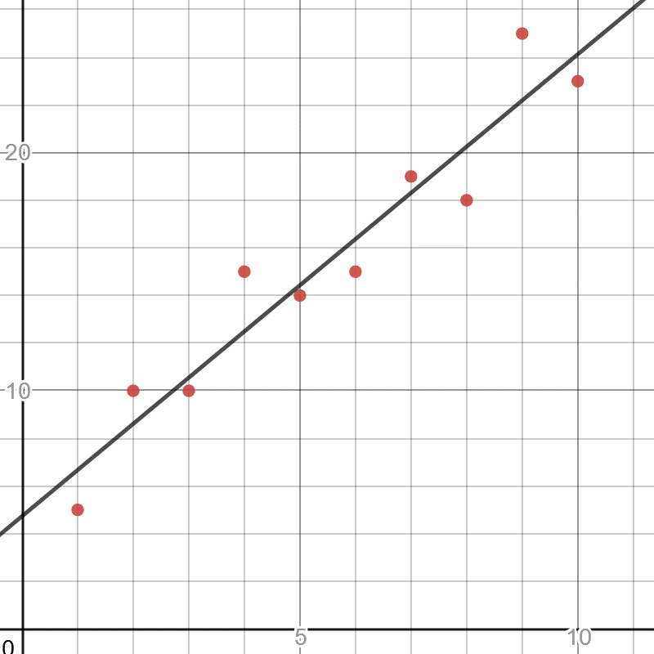
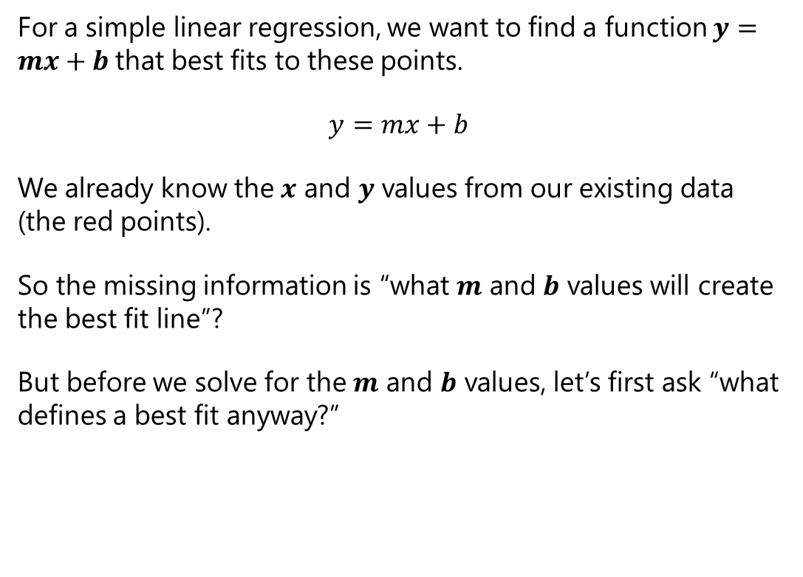
Simple Linear Regression
For a simple linear regression, we want to find a function $y=mx+b$that best fits to these points.
$$y=mx+b$$
We already know the $x$ and $y$ values from our existing data (the red points).
So the missing information is “what $m$ and $b$ values will create the best fit line”?
But before we solve for the $m$ and $b$ values, let’s first ask “what defines a best fit anyway?”
https://www.desmos.com/calculator/fmhotfn3qm

Slide 5

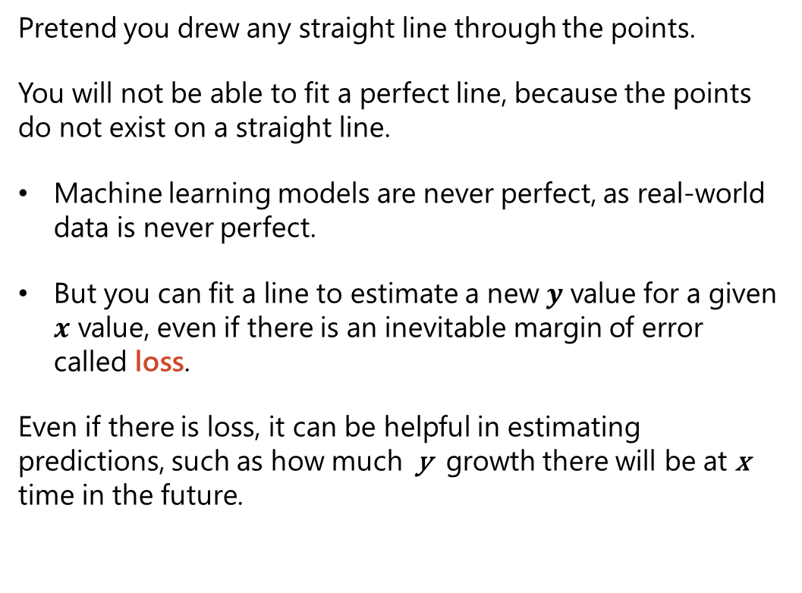
Simple Linear Regression
Pretend you drew any straight line through the points.
You will not be able to fit a perfect line, because the points do not exist on a straight line.
Machine learning models are never perfect, as real-world data is never perfect.
But you can fit a line to estimate a new $y$ value for a given $x$ value, even if there is an inevitable margin of error called loss.
Even if there is loss, it can be helpful in estimating predictions, such as how much y growth there will be at x time in the future.
https://www.desmos.com/calculator/fmhotfn3qm

Slide 6
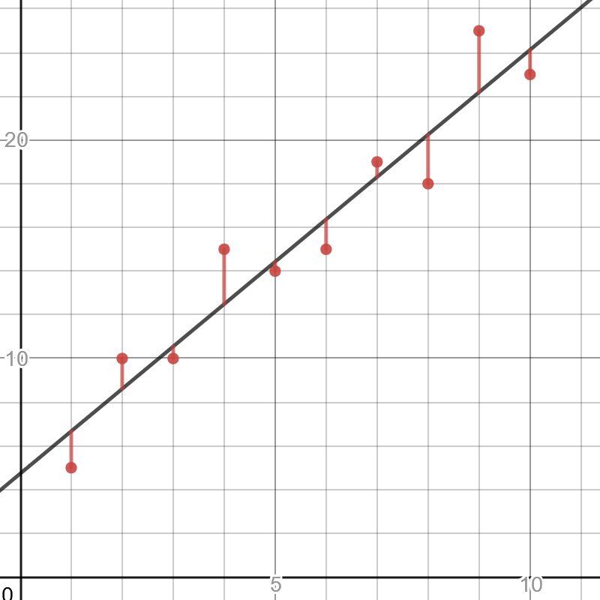

Simple Linear Regression
When you plot a given line, notice that there is a difference between the predicted $y$ values and actual $y$ values with our observed data.
These are called residuals, and in machine learning we want to minimize them.
So how do we minimize residuals in aggregate?
https://www.desmos.com/calculator/fmhotfn3qm

Slide 7
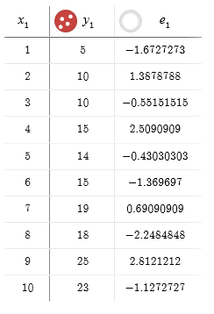
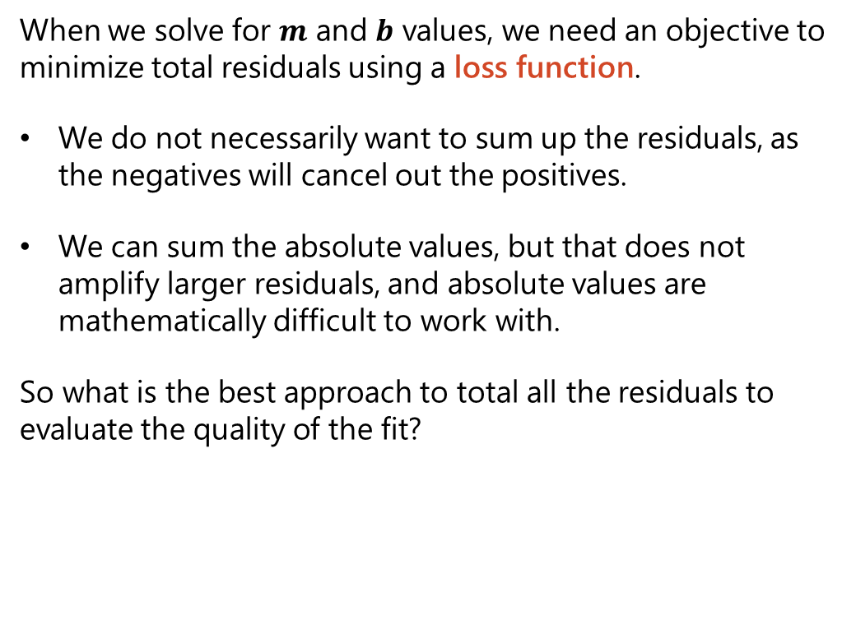
Sum of Least Squares
When we solve for $m$ and $b$ values, we need an objective to minimize total residuals using a loss function.
We do not necessarily want to sum up the residuals, as the negatives will cancel out the positives.
We can sum the absolute values, but that does not amplify larger residuals, and absolute values are mathematically difficult to work with.
So what is the best approach to total all the residuals to evaluate the quality of the fit?

Slide 8
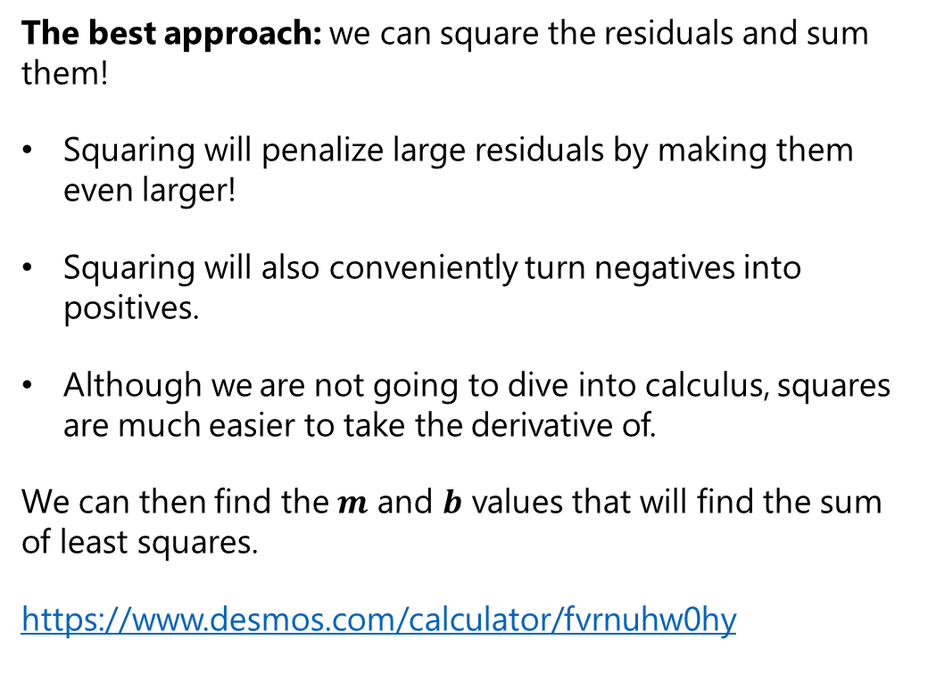
Sum of Least Squares
The best approach: we can square the residuals and sum them!
Squaring will penalize large residuals by making them even larger!
Squaring will also conveniently turn negatives into positives.
Although we are not going to dive into calculus, squares are much easier to take the derivative of.
We can then find the $m$ and $b$ values that will find the sum of least squares.
https://www.desmos.com/calculator/fvrnuhw0hy

Slide 9
Calculating Sum of Squares

Slide 10
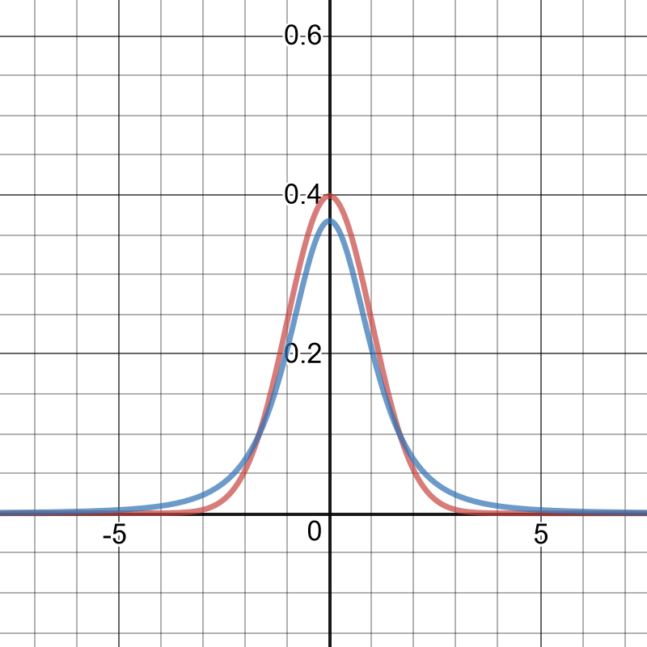
Solving for a Fit
Now that we have a loss function (the sum of squared residuals), how do we find the m and b values to minimize it?
We randomly increase/decrease m and b with random values from a standard normal distribution, or even better a T-Distribution which has fatter tails.
Fatter tails = more smaller/larger values = more diverse moves.
We can use these random adjustments to m and b as our moves in hill climbing.
Normal distribution
T-distribution
https://www.desmos.com/calculator/xm56tvvalh

Slide 11

Hill Climbing – A Simple Optimization Algorithm
Start with a random or initial solution, even if it is poor quality.
Repeat the following steps for a number of iterations and/or until the solution cannot improve anymore.
Select a random part of the solution and change it.
If that results in an improvement, keep it.
1
2

Slide 12
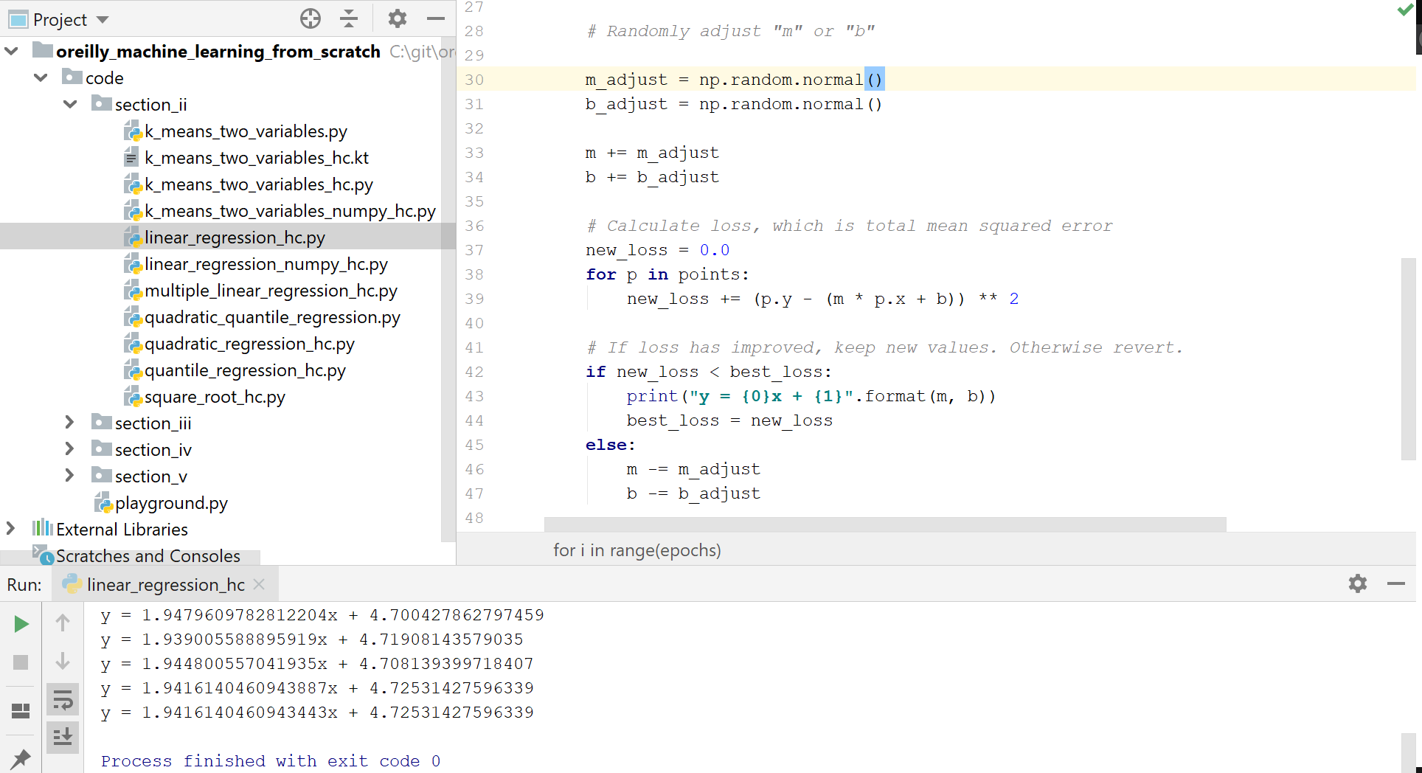
Hands-On: Simple Linear Regression

Slide 13
Simple Linear Regression: Scikit-Learn
Performing a simple linear regression using Scikit-Learn is straightforward.
Creating a LinearRegression() and then calling its fit() function will return a trained model that can predict new values.
You can extract the coefficients for m and b by calling and flattening the coef_ and intercept_ properties.
import pandas as pd from sklearn.linear_model import LinearRegression # Import points df = pd.read_csv('https://bit.ly/3cIH97A', delimiter=",") # Extract input variables (all rows, all columns but last column) X = df.values[:, :-1] # Extract output column (all rows, last column) Y = df.values[:, -1] # Plain ordinary least squares fit = LinearRegression().fit(X, Y) # Print "m" and "b" coefficients print("m = {0}".format(fit.coef_.flatten())) print("b = {0}".format(fit.intercept_.flatten())) # Predict a new "y" value for x = 3.5 print("x = 3.5, y = {0}".format(fit.predict([[3.5]]).flatten()))

Slide 14
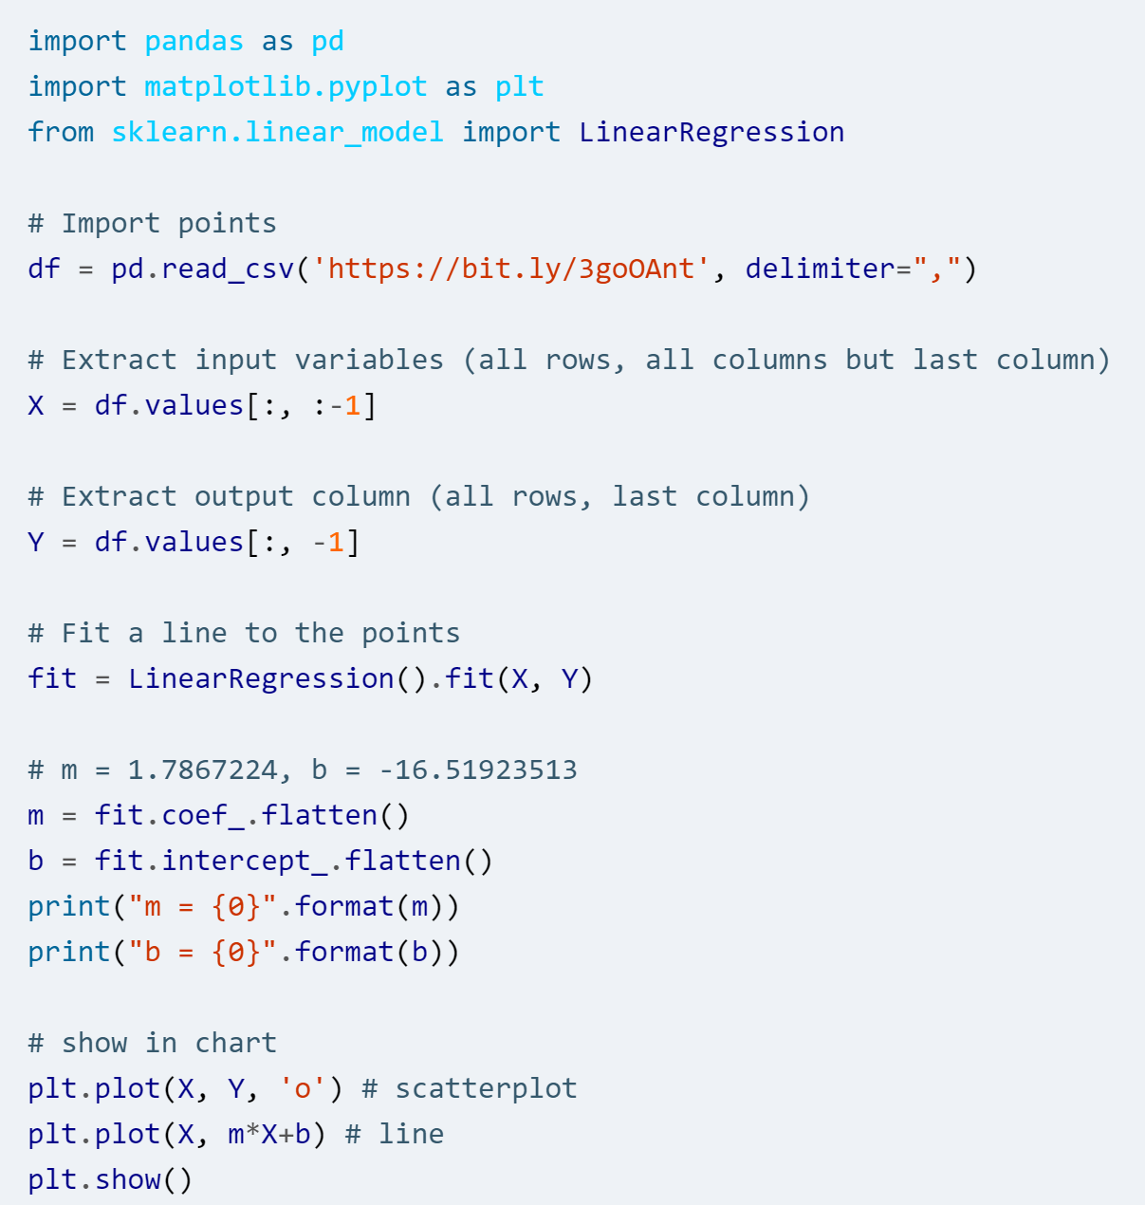
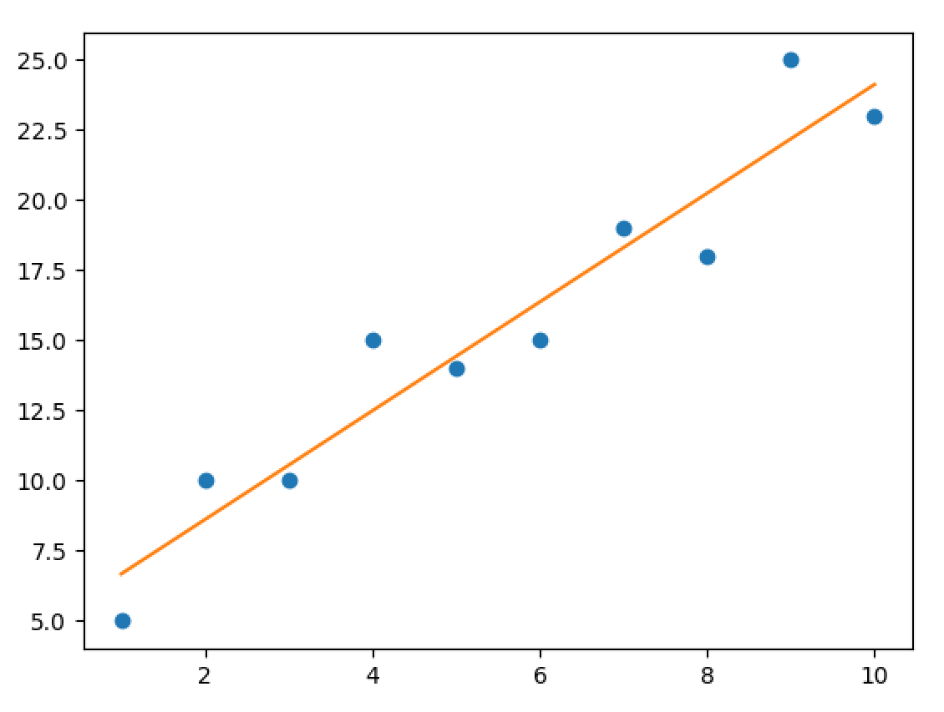
Charting Using matplotlib
Matplotlib can be used to easily show a line with a scatterplot, effectively to display a linear regression.

Slide 15
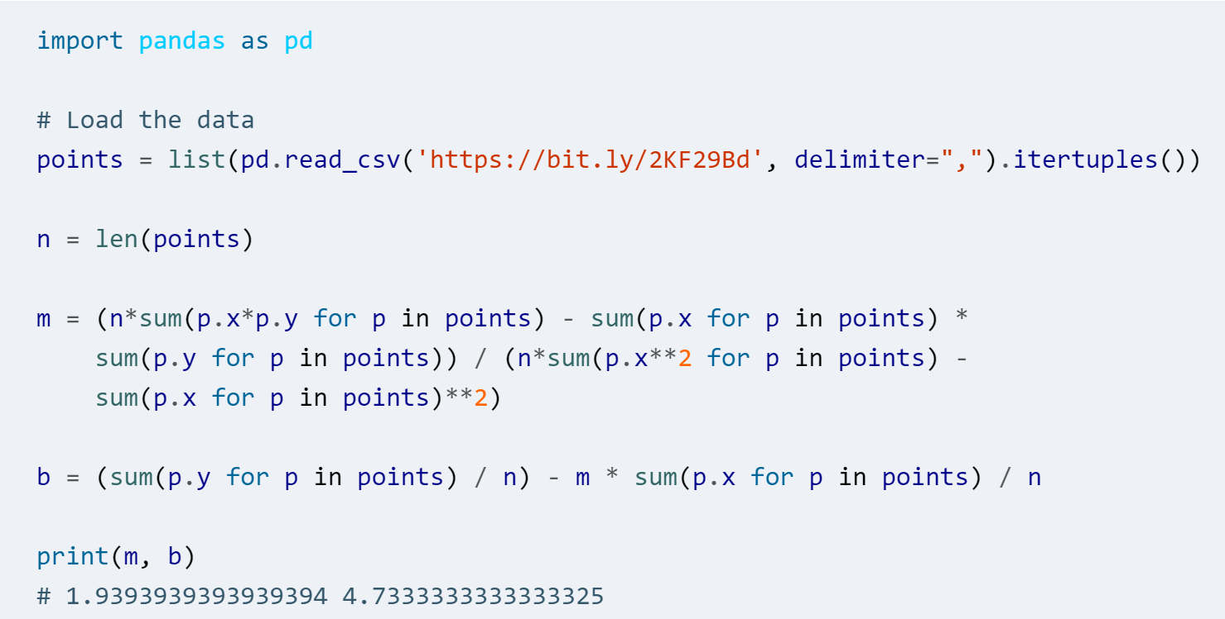
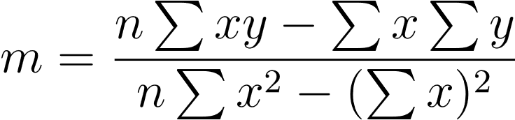
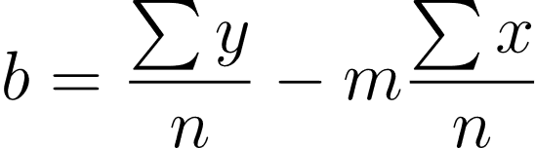
Simple Linear Regression – Closed Form Equation
For a simple linear regression with only one input variable and one output variable, there is a simple formula to solve for m and b.

Slide 16
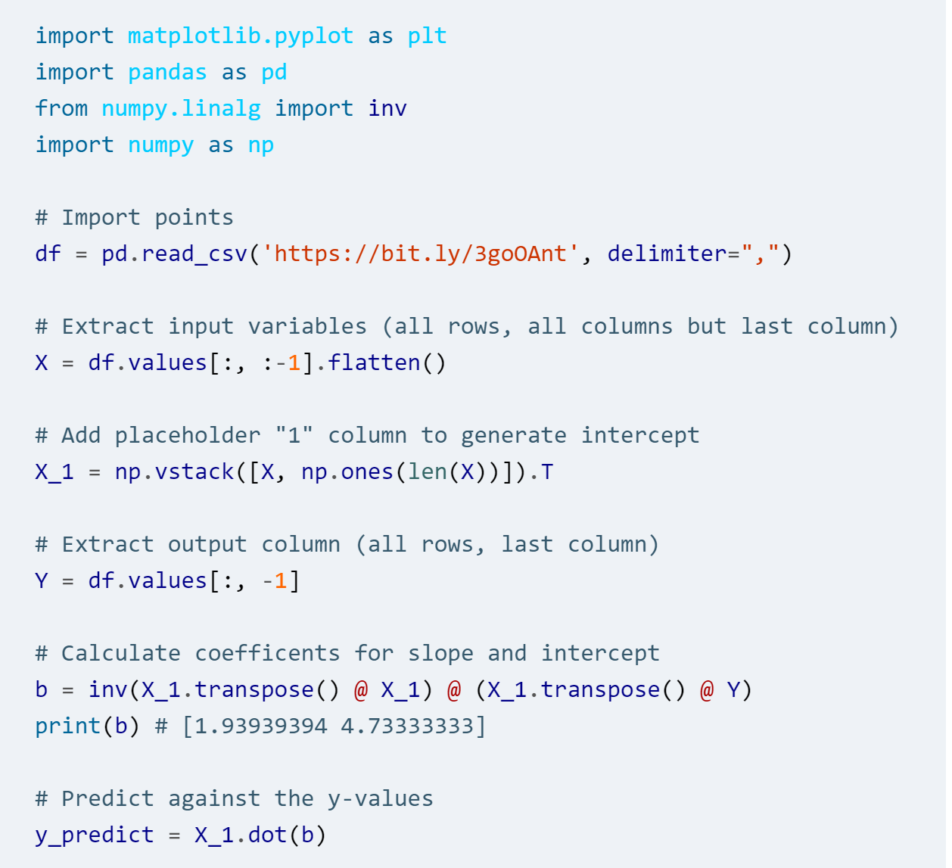

Inverse Matrix Technique
You can also use inverse matrices to perform a linear regression.
To get the coefficients as a vector b with slope(s) and intercept:
Note you will have to add a column of 1’s to the input variable vector X, so the intercept can be generated.

Slide 17
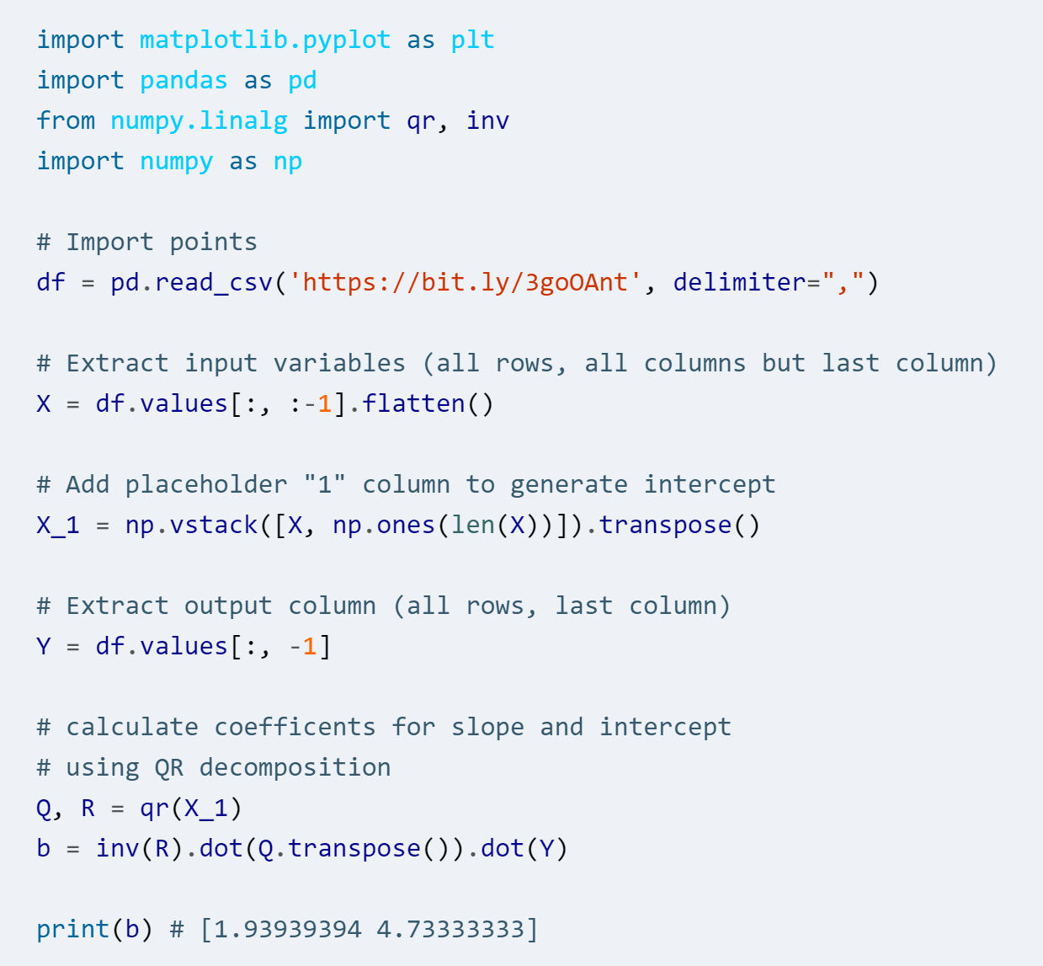

QR Decomposition Technique
A more computationally stable method is to use QR Decomposition.
Use NumPy’s qr() function to break up a matrix into Q and R components.
Plug it into this formula to get the vector b containing the slope(s) and intercept.

Slide 18
When Do We Use Linear Regression?
Data should somewhat have the following qualities for a linear regression to be appropriate:
1) Input variables are continuous, not binary or class (use logistic regression if latter)
2) Input variables follow a Gaussian (bell curve) distribution
3) Input variables are relevant to the output variables, and not highly correlated with each other (known as collinearity).

Slide 19
Multiple Linear Regression

Slide 20
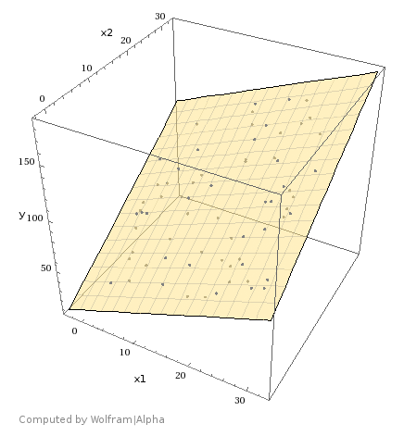
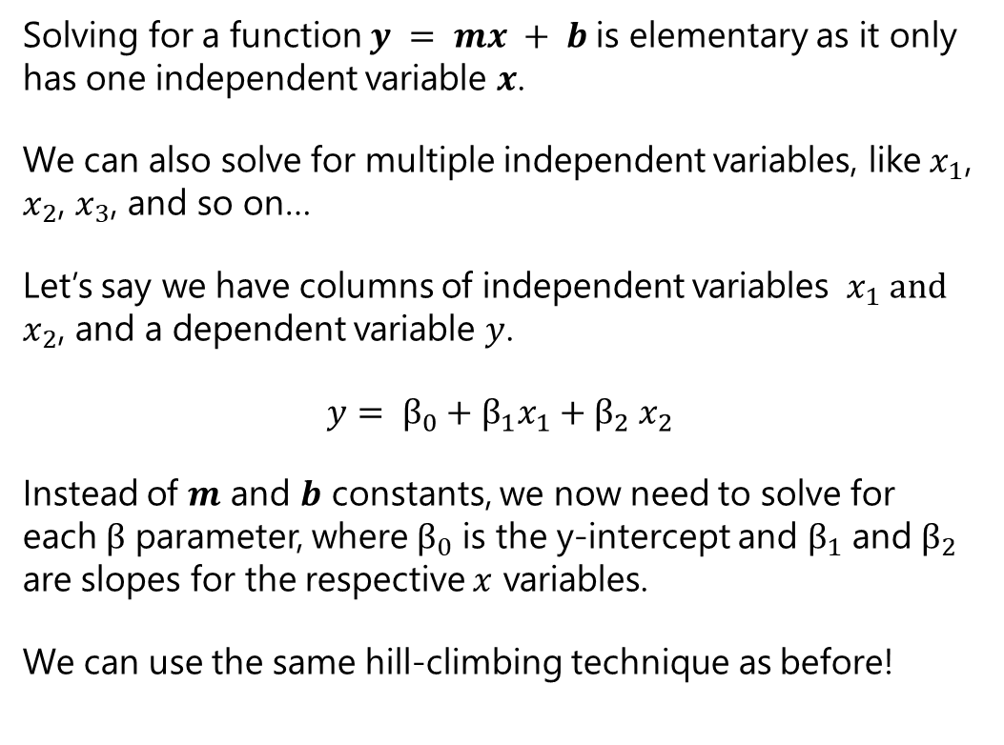
Multiple Linear Regression
Solving for a function $y = mx + b$is elementary as it only has one independent variable $x$.
We can also solve for multiple independent variables, like${ x}_{1}$, $x_{2}$, $x_{3}$, and so on…
Let’s say we have columns of independent variables ${ x}_{1} and$ $x_{2}$, and a dependent variable $y$.
$$y= β_{0}+β_{1}x_{1}{+ β}_{2}x_{2}$$
Instead of $m$ and $b$ constants, we now need to solve for each $β$ parameter, where $β_{0}$ is the y-intercept and $β_{1}$ and $β_{2}$ are slopes for the respective $x$ variables.
We can use the same hill-climbing technique as before!

Slide 21
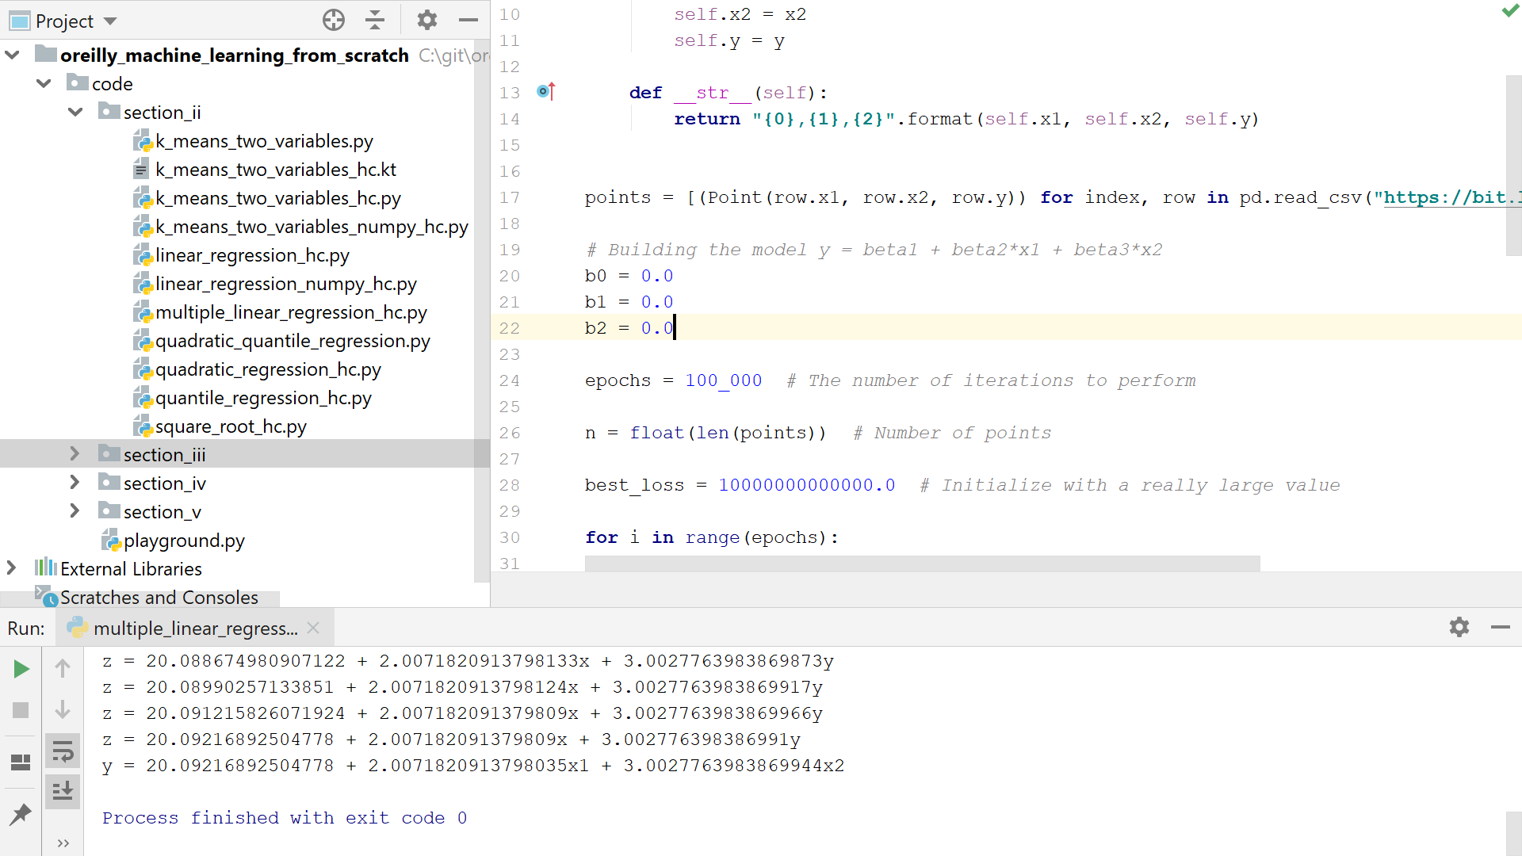
Hands-On: Multiple Linear Regression

Slide 22
Multiple Linear Regression: Scikit-Learn
Just like a simple linear regression, Scikit-Learn supports multiple linear regression.
Fit the independent variables as the first argument to the fit() function, and the dependent variable to the second argument.
import pandas as pd from sklearn.linear_model import LinearRegression # Load the data df = pd.read_csv('https://bit.ly/2X1HWH7', delimiter=",") # Extract input variables (all rows, all columns but last column) X = df.values[:, :-1] # Extract output column (all rows, last column)\ Y = df.values[:, -1] # Plain ordinary least squares fit = LinearRegression().fit(X, Y) # Print "m" and "b" coefficients print("Coefficients = {0}".format(fit.coef_)) print("Intercept = {0}".format(fit.intercept_)) print("z = {0} + {1}x + {2}y".format(fit.intercept_, fit.coef_[0], fit.coef_[1])) # Predict a new “z" value for x = 3.5 print("x = 3.5, y = 4.5, z = {0}".format(fit.predict([[3.5, 4.5]])))

Slide 23
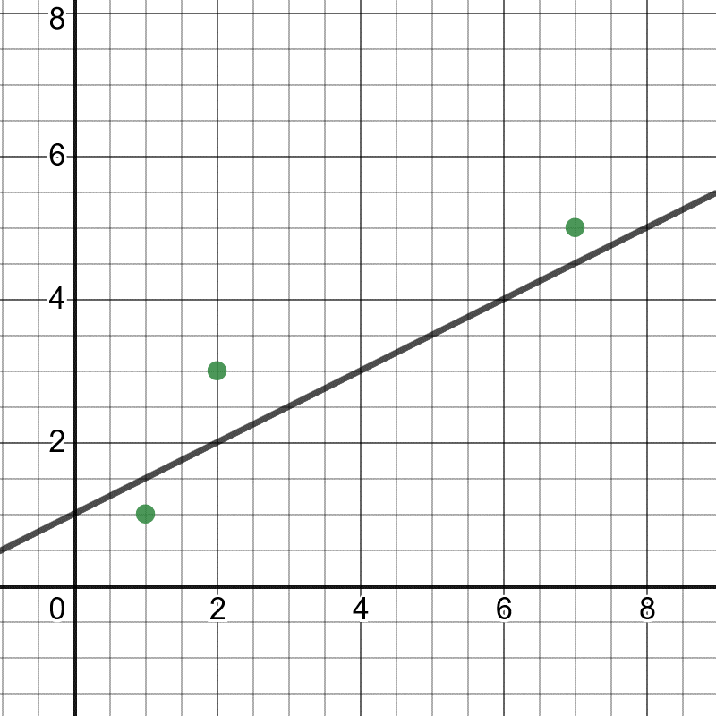

Quiz Time!
You have three points (1,1), (2,3), and (7,5). You are testing a fit for a line$y = \frac{1}{2}x + 1$. What is the loss calculated by sum of squares?
1.5
1.75
1.0
-1.5

Slide 24
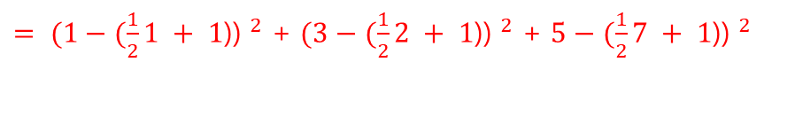
Quiz Time!
You have three points (1,1), (2,3), and (7,5). You are testing a fit for a line$y = \frac{1}{2}x + 1$. What is the loss calculated by sum of squares?
1.5
1.75
1.0
-1.5
${= (1−(\frac{1}{2}1 + 1\text{)) }}^{2}$ + ${(3−(\frac{1}{2}2 + 1\text{)) }}^{2}$ + ${5−(\frac{1}{2}7 + 1\text{)) }}^{2}$

Slide 25
Separating Training/Testing Data

Slide 26
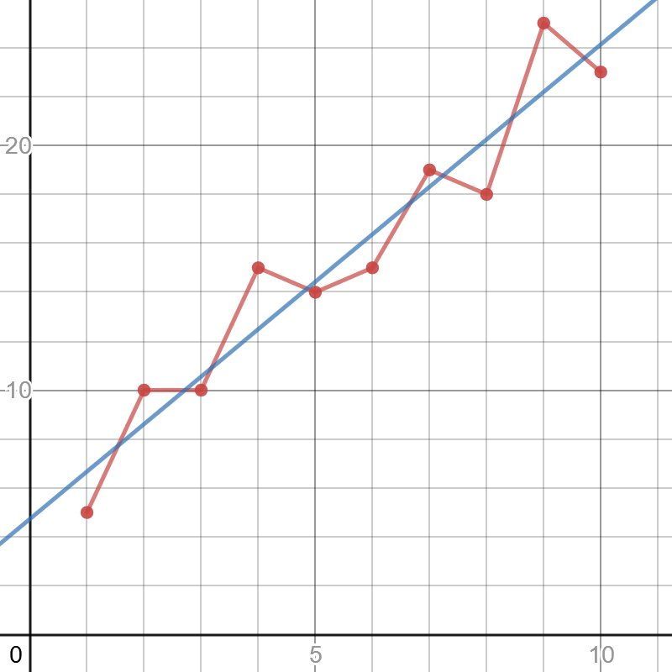
Overfitting
Overfitting means that our ML model works well with the data it was trained on but fails to predict correctly with new data.
This can be due to many factors, but a common cause is the sampled data does not represent the larger population and more data is needed.
The red line has high variance, meaning its predictions are sensitive to outliers and therefore can vary greatly.
The blue line has high bias, meaning the model is less sensitive to outliers because it prioritizes a method (maintaining a straight line) rather than bend and respond to variance.
The red line to the right is likely overfitted (high variance, low bias), but the blue linear regression line (low variance, high bias) is less likely to be overfit.
https://www.desmos.com/calculator/wmwfolbvdk

Slide 27

Overfitting
Linear regression is a highly biased method and is resilient to overfitting.
There are other remedies to mitigate overfitting, the most basic being separating training data and test data.
The model is fit to the training data, and then is tested with the test data.
If the test data performs poorly compared to the training data, there is a possibility of overfit (or just no correlation altogether).
You can also try to train with more data as well as utilize cross-validation, regularization, bagging, boosting, and other techniques.

Slide 28
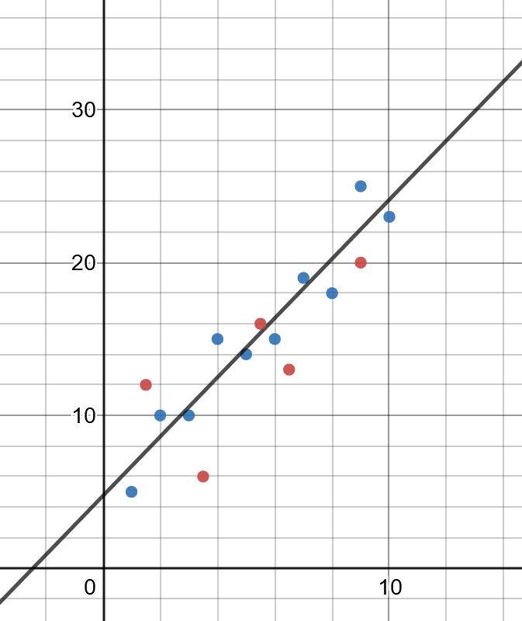
Training and Testing Data
A common practice to proactively prevent overfitting in machine learning is to separate training data and testing data.
Training data is data used to fit a model and is typically 2/3 of the data.
Test data is used to test the model and is the remaining 1/3 of the data.
By omitting the testing data from training, we see how well the model works on data it has not seen before and change our parameters accordingly.
DATA
TRAINING
TESTING

Slide 29
Train/Test Split
import pandas as pd from sklearn.linear_model import LinearRegression from sklearn.model_selection import train_test_split # Load the data df = pd.read_csv('https://bit.ly/3cIH97A', delimiter=",") # Extract input variables (all rows, all columns but last column) X = df.values[:, :-1] # Extract output column (all rows, last column) Y = df.values[:, -1] # Separate training and testing data to evaluate performance and reduce overfitting # This leaves a third of the data out for testing # Set a random seed just to make the randomly selected split consistent X_train, X_test, Y_train, Y_test = train_test_split(X, Y, test_size=.33, random_state=10) model = LinearRegression() model.fit(X_train, Y_train) result = model.score(X_test, Y_test) print("Accuracy Mean: %.3f" % result)

Slide 30
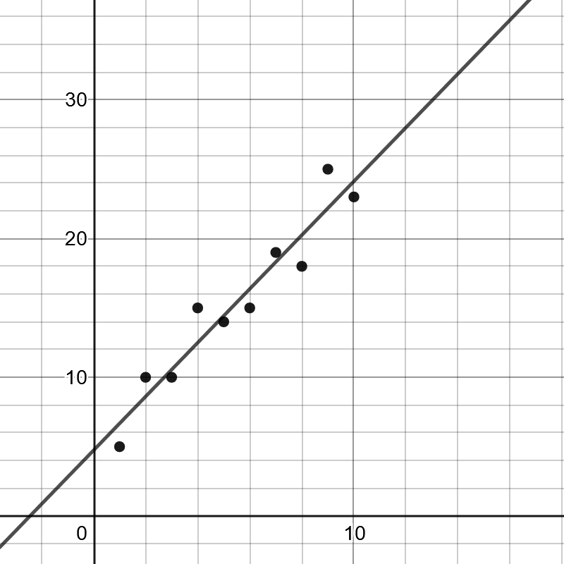
Cross Validation
We can take this concept of training/testing data a step further, and test different combinations of training and testing data.
This is known as cross-validation, the gold standard of validation techniques.
To the right we have 3-fold cross validation which breaks the data into thirds and uses one of the pieces for testing.
We can then evaluate how well each of these perform, being able to compare different parameters and models (e.g. linear regression vs decision trees) and see which setup produces the best performance.
DATA
TRAINING
TRAINING
TESTING
TRAINING
TESTING
TRAINING
TESTING
TRAINING
TRAINING

Slide 31

Cross Validation
To the right we see a typical K-fold validation, where k=3 resulting in 2/3 of the data being used for training and 1/3 being used for testing.
We can summarize the performance by taking the mean and standard deviation of each set on the performance metric we choose (which by default is R-square).
We will talk about performance metrics shortly.
import pandas as pd from sklearn.linear_model import LinearRegression from sklearn.model_selection import KFold, cross_val_score df = pd.read_csv('https://bit.ly/3cIH97A', delimiter=",") # Extract input variables (all rows, all columns but last column) X = df.values[:, :-1] # Extract output column (all rows, last column)\ Y = df.values[:, -1] # Perform a simple linear regression kfold = KFold(n_splits=3, random_state=7, shuffle=True) model = LinearRegression() results = cross_val_score(model, X, Y, cv=kfold) print(results) print("MSE: mean=%.3f (stdev-%.3f)" % (results.mean(), results.std()))

Slide 32
Cross Validation
TRAINING
Note that k-fold cross validation allows us to slice our data into any number and not just 3 (typically 3, 5, or 10).
For example we can do 10-fold cross validation and validate 10 different combinations of training/test data.
The most extreme form of folding is leave-one-out cross validation, which omits one data record for testing and uses the remaining records for training, and this is done repeatedly.
TRAINING
TRAINING
TRAINING
TRAINING
TRAINING
TRAINING
TRAINING
TRAINING
TESTING

Slide 33
Leave-one-out Cross-Validation in Scikit-Learn
import pandas as pd from sklearn.linear_model import LinearRegression from sklearn.model_selection import KFold, cross_val_score, LeaveOneOut df = pd.read_csv('https://bit.ly/3cIH97A', delimiter=",") # Extract input variables (all rows, all columns but last column) X = df.values[:, :-1] # Extract output column (all rows, last column) Y = df.values[:, -1] # Perform a simple linear regression kfold = KFold(n_splits=3, random_state=7, shuffle=True) model = LinearRegression() results = cross_val_score(model, X, Y, cv=LeaveOneOut()) print(results) print("mean= %.3f (stdev= %.3f)" % (results.mean(), results.std()))

Slide 34
Random Fold Validation
As you may be noticing, machine learning often tries to overcome data variance with randomness.
A variant with fold validation is repeated random fold validation, where we randomly shuffle the data and create random train/test folds as many times as desired.
This is helpful when we need to mitigate variance in the model.
DATA

Slide 35
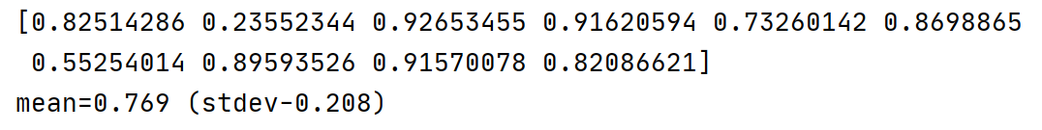
Random Fold Validation
import pandas as pd from sklearn.linear_model import LinearRegression from sklearn.model_selection import cross_val_score, ShuffleSplit df = pd.read_csv('https://bit.ly/38XwbeB', delimiter=",") # Extract input variables (all rows, all columns but last column) X = df.values[:, :-1] # Extract output column (all rows, last column)\ Y = df.values[:, -1] # Perform a simple linear regression kfold = ShuffleSplit(n_splits=10, test_size=.33, random_state=7) model = LinearRegression() results = cross_val_score(model, X, Y, cv=kfold) print(results) print("mean=%.3f (stdev-%.3f)" % (results.mean(), results.std())

Slide 36
Which Validation to Use?
TRAINING
Generally, you will want to prefer k-fold validation as it is the gold standard.
A single train/test split might be warranted if performance of machine learning algorithm is slow and has enough data with lower bias.
Use the random fold split to mitigate variance in the model while balancing training speed and dataset sizes.
TESTING
TRAINING
TRAINING
TESTING
TRAINING
TESTING
TRAINING
TESTING
TRAINING
TRAINING

Slide 37
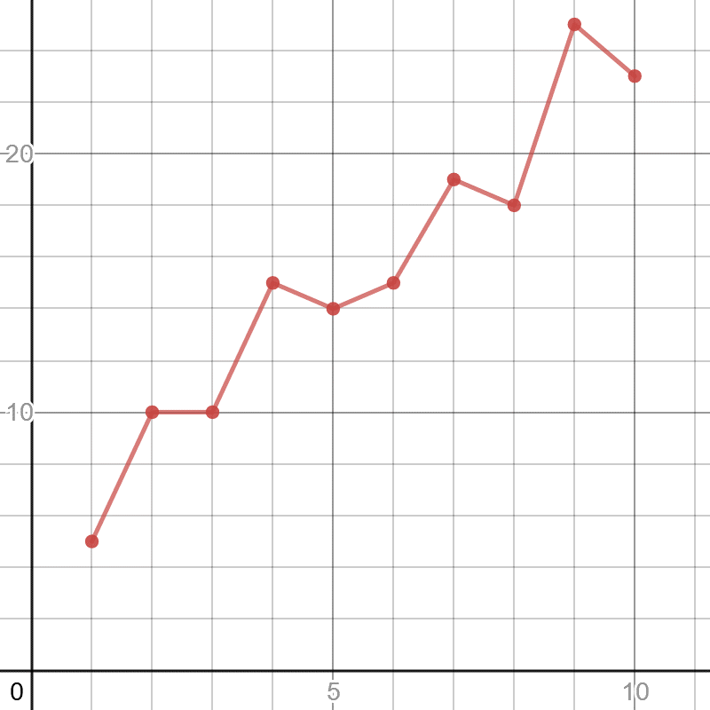
Quiz Time!
It is good to fit a regression as close to the points as possible, even if you just connect the points as shown to the right.
True
False

Slide 38

Quiz Time!
It is good to fit a regression as close to the points as possible, even if you just connect the points as shown to the right.
True
False
Doing a regression is a balancing act between fitting exactly to your data (variance) versus leaving some wiggle room (bias) to predict new data that will be different. Otherwise you will risk overfitting even if you have zero loss.
You might be better doing a linear regression (blue line) as shown to the right, which has a loss but is more likely to predict new data accurately.

Slide 39
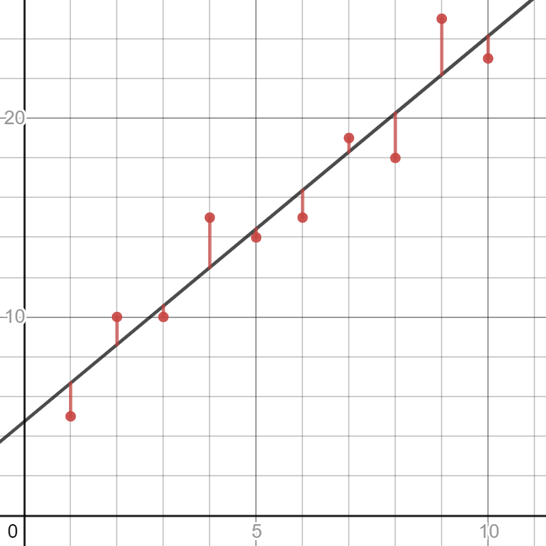
Quiz Time!
If we have a dataset and want to create a linear regression off it, we want to train it with the entire dataset
True
False

Slide 40
Quiz Time!
If we have a dataset and want to create a linear regression off it, we want to train it with the entire dataset
True
False
We want to separate our training and testing data from a dataset, typically using a 3-fold where 2/3 is used for training and 1/3 is used for testing.
As we learned we can do more complicated fold strategies too.

Slide 41
Performance Metrics

Slide 42
Evaluating Performance
We learned how to separate training and testing data in a myriad of ways, but there are several ways we can measure the testing dataset.
Typically across the test dataset, or through multiple test datasets achieved through k-fold or random folds, we will average the performance metrics.

Slide 43
Mean Absolute Error
Mean absolute error (MAE) simply measures the sum of absolute values of residuals (difference between predicted values and actual values).
import pandas as pd from sklearn.linear_model import LinearRegression from sklearn.model_selection import KFold, cross_val_score, validation_curve df = pd.read_csv('https://bit.ly/3cIH97A', delimiter=",") # Extract input variables (all rows, all columns but last column) X = df.values[:, :-1] # Extract output column (all rows, last column)\ Y = df.values[:, -1] # Perform a simple linear regression kfold = KFold(n_splits=3, random_state=7, shuffle=True) model = LinearRegression() # Use negative mean absolute error # It is negative because it is inverted results = cross_val_score(model, X, Y, cv=kfold, scoring='neg_mean_absolute_error') print("MAE: mean=%.3f (stdev-%.3f)" % (results.mean(), results.std())) # prints MAE: mean=-2.446 (stdev-0.791)

Slide 44
Mean Squared Error
Mean squared error (MSE) simply measures the average squared values of residuals (difference between predicted values and actual values).
import pandas as pd from sklearn.linear_model import LinearRegression from sklearn.model_selection import KFold, cross_val_score, validation_curve df = pd.read_csv('https://bit.ly/3nJBdj9', delimiter=",") # Extract input variables (all rows, all columns but last column) X = df.values[:, :-1] # Extract output column (all rows, last column) Y = df.values[:, -1] # Perform a simple linear regression kfold = KFold(n_splits=3, random_state=7, shuffle=True) model = LinearRegression() # Use negative mean squared error # It is negative because it is inverted results = cross_val_score(model, X, Y, cv=kfold, scoring='neg_mean_squared_error') print("MAE: mean=%.3f (stdev-%.3f)" % (results.mean(), results.std())) # prints MSE: mean=-7.664 (stdev-3.110)

Slide 45
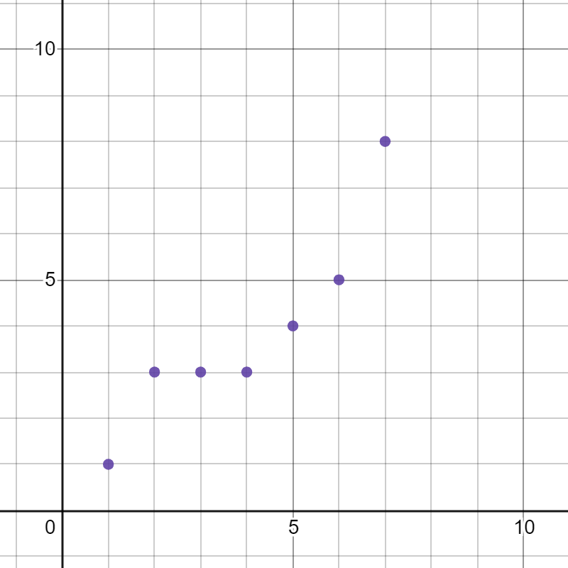
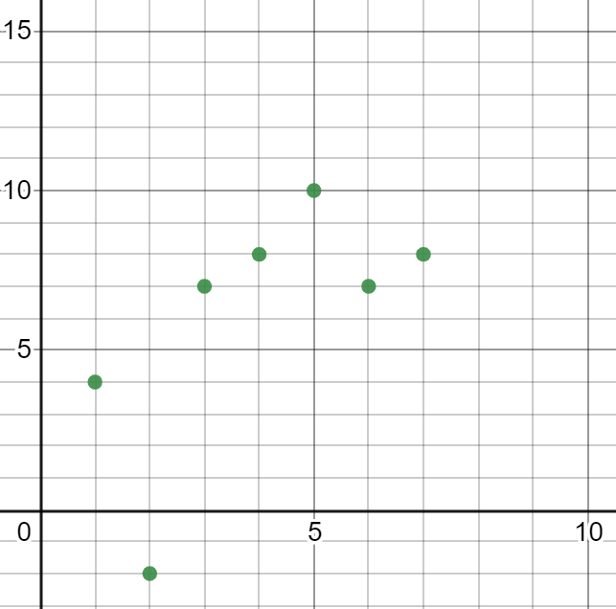
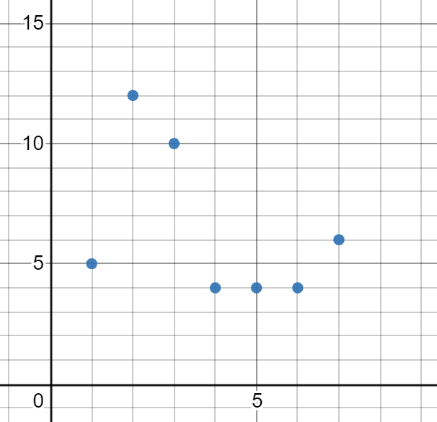
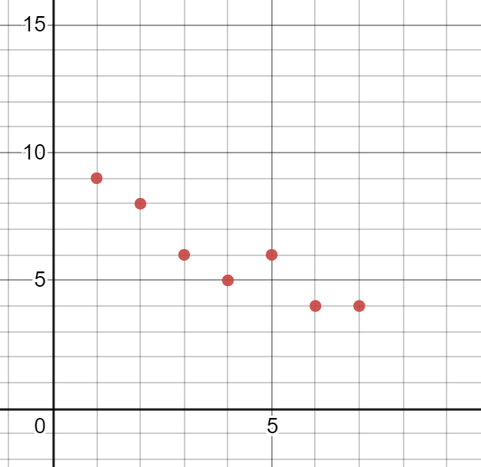
Pearson Correlation
Using a Pearson correlation, we can measure the strength of a correlation between two variables (from a range of -1.0 to 1.0).
A correlation closer to 1.0 means a strong positive correlation, 0.0 means no correlation, and closer to -1.0 indicates negative correlation.
PEARSON CORRELATION: .923133
PEARSON CORRELATION: .643237
PEARSON CORRELATION: -.44984
PEARSON CORRELATION: -.9267

Slide 46
Pearson Correlation
The more data you collect, the more confident you can be in your correlation value.
If our correlation is unlikely to have happened at random, that means we are more likely to have discovered something meaningful rather than by chance.
PEARSON CORRELATION: .923133
PEARSON CORRELATION: .643237
PEARSON CORRELATION: -.44984
PEARSON CORRELATION: -.9267

Slide 47
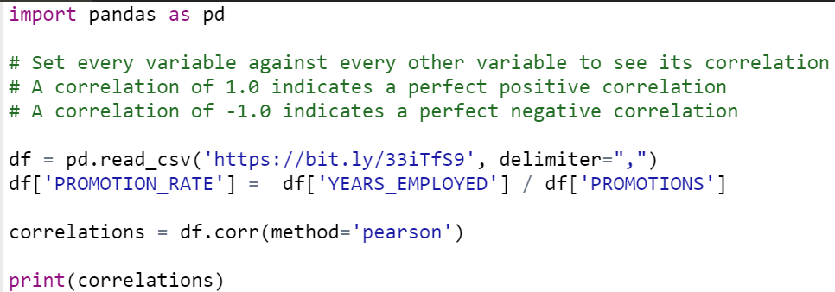
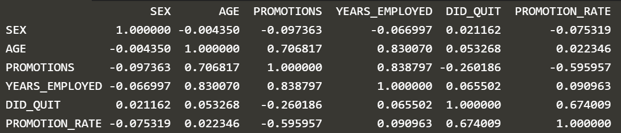
Pearson Correlation Matrix

Slide 48
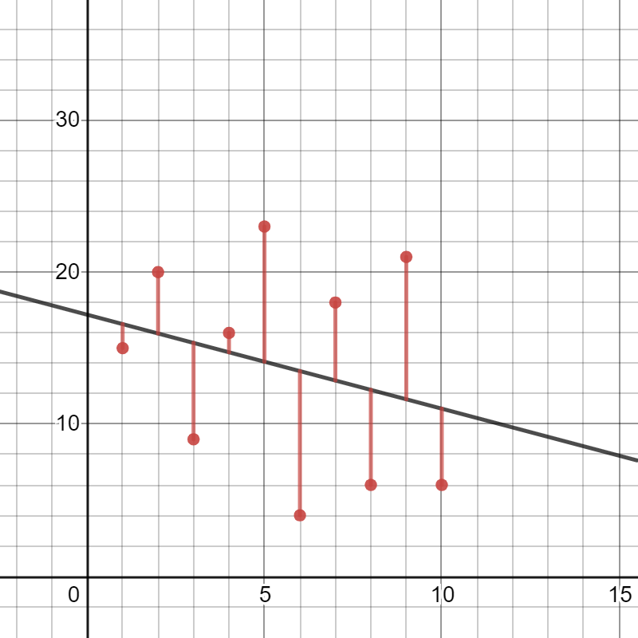
R²
Probably the most useful performance metric is the R-square (R²), which ratios the average y-value to the average of the residuals.
Note R² is also called the coefficient of determination and is the square of the Pearson correlation.
It’s used to evaluate the quality of a model.
Think of R² as a measurement (between 0.0 and 1.0) of how well independent variables explain a dependent variable, rather than predicting with a simple average.
An R² of 1.0 indicates a variable perfectly explains a variable while 0.0 indicates there’s no explanatory connection at all.
EXAMPLE: If x was calories consumed and y was number of pounds gained, and I got an R² of .85 on my test data, that means calories explains weight gain 85% better than just predicting with the average weight y.

Slide 49
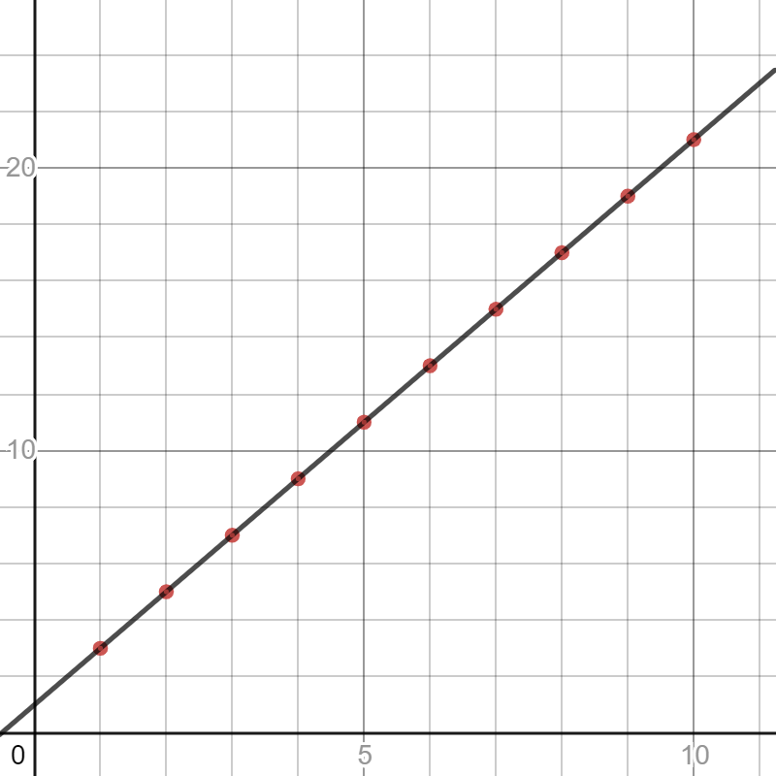
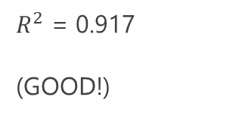
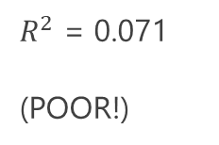

R² Visual Examples
$R^{2}$ = 1.0
(PERFECT!)
$R^{2}$ = 0.917
(GOOD!)
$R^{2}$ = 0.071
(POOR!)

Slide 50
How to Calculate R² by Hand
Separate training and test data, perform linear regression on training data.
Calculate sum of squares for regression: using test data, subtract each predicted y value from each actual y value, square and sum
Calculate sum of squares for average: using test data, subtract the average y value from each actual y value, square and sum
Divide the sum of squares for regression by the sum of squares for average, subtract that from 1.0.
Now you calculated R² from scratch!
# Calculating R-square from scratch slope = 1.73333333 y_intercept = 5.49999999999999 x_test = [9, 3, 6, 7] y_test = [25, 10, 15, 19] y_test_avg = sum(y_test) / len(y_test) # 17.25 y_test_predict = [(slope * x) + y_intercept for x in x_test] # [21.099999969999992, 10.699999989999991, 15.89999997999999, 17.63333330999999] sum_sq_regression = sum((y_test[i] - y_test_predict[i])**2 for i in range(0,len(y_test))) sum_sq_total = sum((y_test[i] - y_test_avg)**2 for i in range(0,len(y_test))) r_square = 1.0 - sum_sq_regression / sum_sq_total # 0.8478030805337009 print(r_square)

Slide 51
Scikit-Learn and R²
Using 3-Fold
Using Cross Validation
import pandas as pd from sklearn.linear_model import LinearRegression from sklearn.model_selection import KFold, cross_val_score, train_test_split df = pd.read_csv('https://bit.ly/3m20B31', delimiter=",") # Extract input variables (all rows, all columns but last column) X = df.values[:, :-1] # Extract output column (all rows, last column) Y = df.values[:, -1] X_train, X_test, Y_train, Y_test = train_test_split(X, Y, test_size=.33) # Perform a simple linear regression model = LinearRegression() model.fit(X_train, Y_train) result = model.score(X_test, Y_test) print(result) # prints 0.8478030825856914
import pandas as pd from sklearn.linear_model import LinearRegression from sklearn.model_selection import KFold, cross_val_score df = pd.read_csv('https://bit.ly/3nJBdj9', delimiter=",") # Extract input variables (all rows, all columns but last column) X = df.values[:, :-1] # Extract output column (all rows, last column)\ Y = df.values[:, -1] # Perform a simple linear regression kfold = KFold(n_splits=3, random_state=7, shuffle=True) model = LinearRegression() # Use R-square to evaluate the performance # An R-square of 0 is no-fit, and 1 is perfect fit results = cross_val_score(model, X, Y, cv=kfold, scoring='r2') print("R^2: mean=%.3f (stdev-%.3f)" % (results.mean(), results.std())) # prints R^2: mean=0.590 (stdev-0.219)

Slide 52
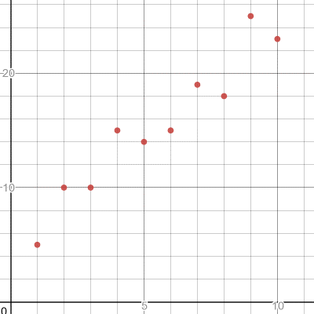
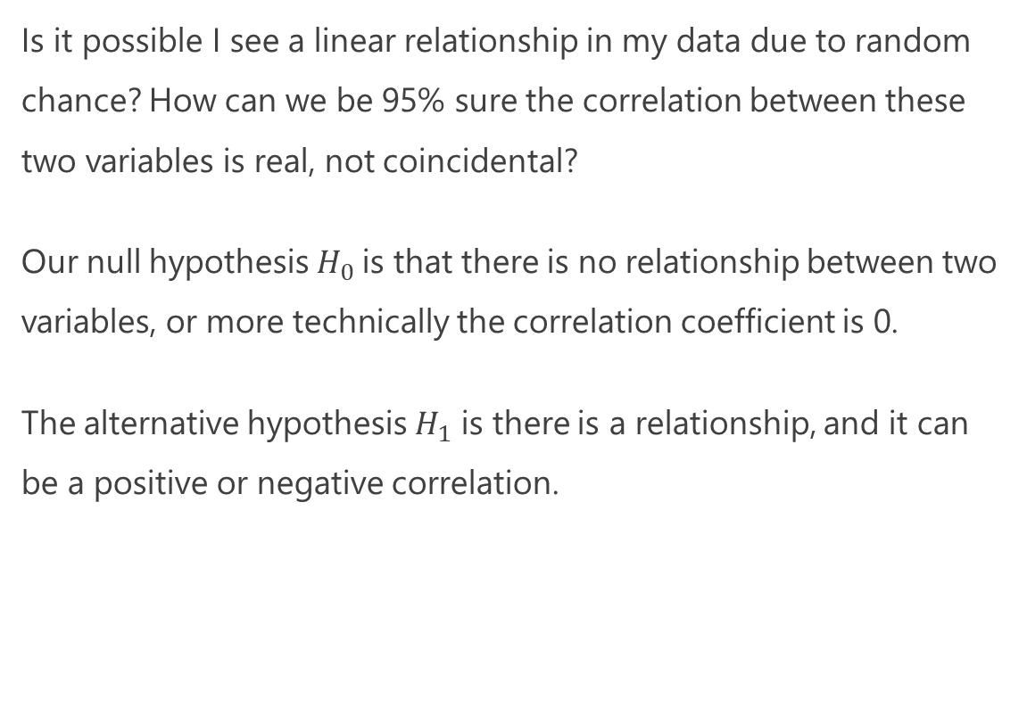
P-Value and Statistical Significance
Is it possible I see a linear relationship in my data due to random chance? How can we be 95% sure the correlation between these two variables is real, not coincidental?
Our null hypothesis${ H}_{0}$ is that there is no relationship between two variables, or more technically the correlation coefficient is 0.
The alternative hypothesis $H_{1}$ is there is a relationship, and it can be a positive or negative correlation.

Slide 53
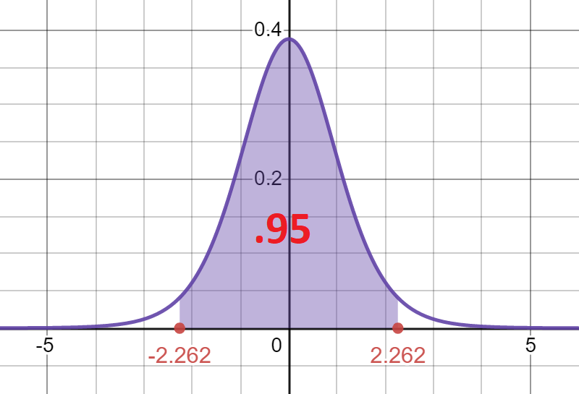
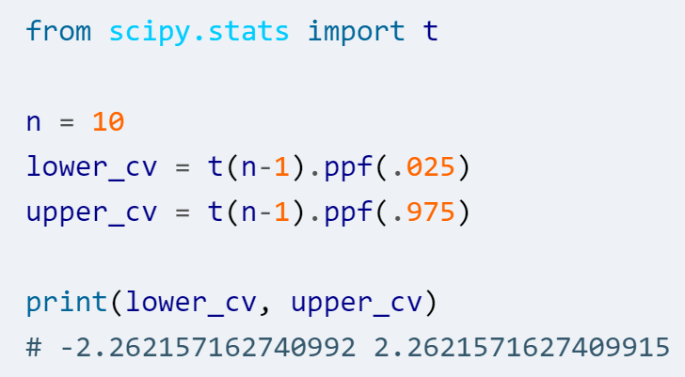
P-Value and Statistical Significance
Our data to the right has a correlation of 0.957586, which is strong but is it by random luck?
How can we be sure with 95% confidence?
Let's plot a T-distribution with a 95% critical value range, and since there are 10 data points that will be 9 degrees of freedom (10 -1 = 9).

Slide 54
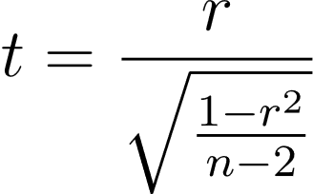
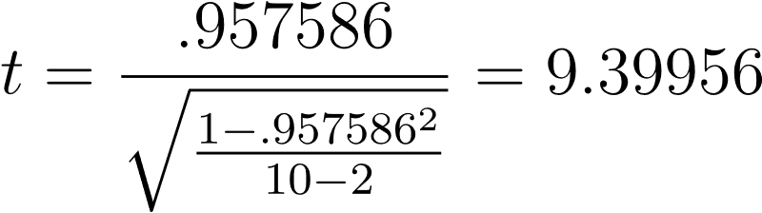
P-Value and Statistical Significance
If our test value happens to fall outside this range of (-2.262, 2.262) we can reject our null hypothesis and say our correlation is real (not coincidental) with at least 95% confidence.
To calculate the test value t, we need to use this formula below, with r as the correlation coefficient and n as the sample size.
The test value above is approximately 9.39956, which is outside the range of (-2.262, 2.262) so we can reject the null hypothesis and say our correlation is real.
The p-value is remarkably significant: .000005976.

Slide 55
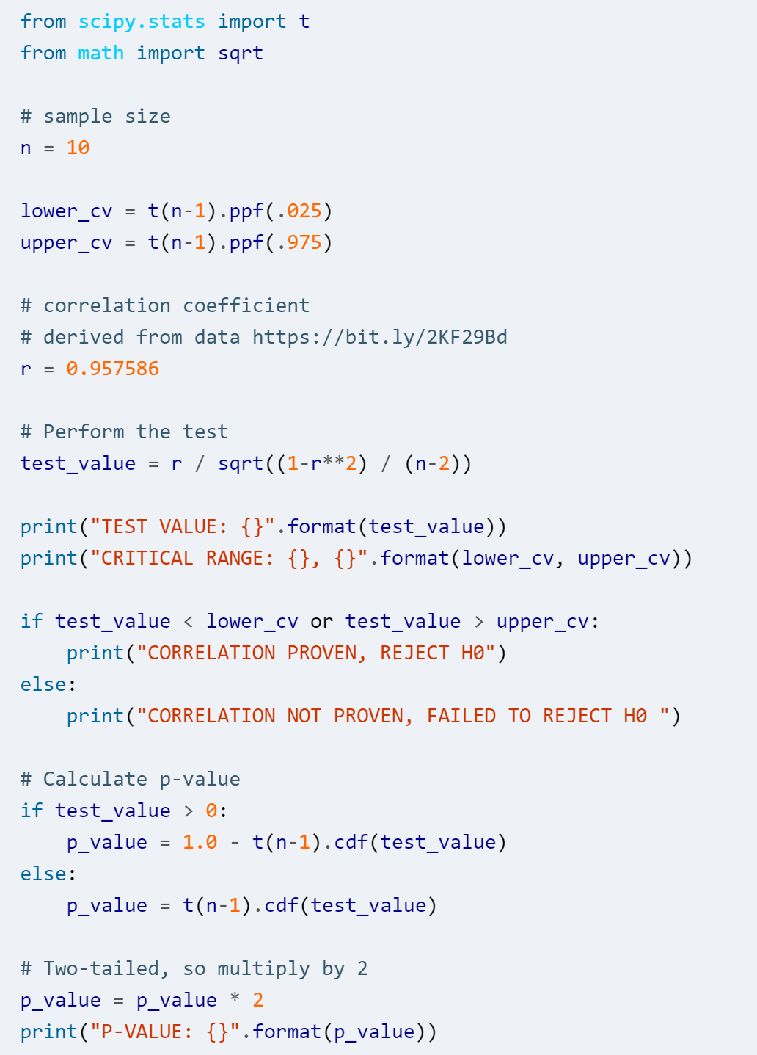
P-Value and Statistical Significance

Slide 56

Exercise
A dataset of red wine quality data is stored here, where the last column is a quality score: https://bit.ly/2Xov2ph
Perform a linear regression using cross-validation (3 splits) and test using R² as an evaluation metric.
If we use all independent variables does this linear regression perform well? Why or why not?

Slide 57
Exercise: ANSWER
When we train and perform a cross-validation, we don’t get a great fit.
Our R² is about .348 depending on your random seeding, which is much closer to 0 than 1.
It’s possible some variables are adding noise and useless information to our regression.
We can use Pearson correlation to try and remove these variables, as well as try Lasso regression which we will discuss later.
from sklearn.linear_model import LinearRegression from sklearn.model_selection import KFold, cross_val_score df = pd.read_csv('https://bit.ly/2Xov2ph', delimiter=",") # Extract input variables (all rows, all columns but last column) X = df.values[:, :-1] # Extract output column (all rows, last column)\ Y = df.values[:, -1] # Perform a simple linear regression kfold = KFold(n_splits=3, random_state=7, shuffle=True) model = LinearRegression() # Use R-square to evaluate the performance # An R-square of 0 is no-fit, and 1 is perfect fit results = cross_val_score(model, X, Y, cv=kfold, scoring='r2') print("R^2: mean=%.3f (stdev-%.3f)" % (results.mean(), results.std())) # R: mean=0.348 (stdev-0.015)

Slide 58
Transforming and Feature Engineering

Slide 59

Normalization
Normalization is scaling and converting the values of each variable, so they are relatively close together.
Imagine you had a variable age whose values typically range in 0-99.
But you had another variable income that typically ranges from 30,000 to 1,000,000.
Because these ranges are so drastically different, fitting a model is not going to be productive until you transform them somehow.
There are a variety of techniques you can employ from linear scaling to fitting to a standard normal distribution.

Slide 60
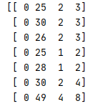
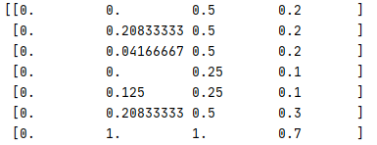
Rescaling
When you have different fields with varying scales, it can be helpful to rescale, or normalize, the data by compressing it between 0.0 and 1.0.
This can be helpful for optimization algorithms that perform training, making it easier to iterate parameters to fit the data more productively.
Note you do not always have to rescale, but sometimes it can give a better result especially for data with fields that vary in scale.
import pandas as pd from sklearn.preprocessing import MinMaxScaler df = pd.read_csv('https://bit.ly/33iTfS9', delimiter=",") # Extract input variables (all rows, all columns but last column) X = df.values[:, :-1] # Extract output column (all rows, 5th column) Y = df.values[:, 4] # Rescale all the input variables to be between 0 and 1 scaler = MinMaxScaler(feature_range=(0.0, 1.0)) rescaled_X = scaler.fit_transform(X) print(rescaled_X)
Doing a simple rescale between 0.0 and 1.0 above in scikit-learn

Slide 61


Standardization
Standardization is transforming numeric variables to fit a standard normal distribution (with a mean of 0 and standard deviation of 1) and express each value in standard deviations.
It can be preferable to rescaling, if the data can assume a normal distribution for each variable.
In other words, standardization is finding the z-scores for each variable.
import pandas as pd from sklearn.preprocessing import StandardScaler df = pd.read_csv('https://bit.ly/3flZJSR', delimiter=",") # Extract input variables (all rows, all columns but last column) X = df.values[:, :-1] # Extract output column (all rows, last column) Y = df.values[:, -1] # Rescale all the input variables to be between 0 and 1 scaler = StandardScaler().fit(X) rescaled_X = scaler.fit_transform(X) print(rescaled_X)
Doing a standardization on all data fields

Slide 62


Unit Vector Normalization
Not to be confused with standardization, unit vector normalization is rescaling each data record to have a vector length of 1.0.
This is probably the most complicated transformation, as it involves some understanding of linear algebra.
It works well for sparse data sets and it compresses the data into a smaller space, which is especially helpful for high-dimension datasets.
It is often used for neural networks, k-nearest neighbors, and a few other ML algorithms.
import pandas as pd from sklearn.preprocessing import Normalizer df = pd.read_csv('https://bit.ly/3flZJSR', delimiter=",") # Extract input variables (all rows, all columns but last column) X = df.values[:, :-1] # Extract output column (all rows, last column) Y = df.values[:, -1] # Rescale all the input variables to be normalized scaler = Normalizer().fit(X) rescaled_X = scaler.fit_transform(X) print(rescaled_X)
Doing a normalization on all data fields

Slide 63
Regularization

Slide 64
Ridge Regression (L2)
Sometimes we want to increase the bias of our model, so it is less sensitive to variance in the training data.
This can especially be the case when we do not have much data and are worried about overfitting.
This is where ridge regression can be used, which minimizes not just on the sum/mean of squares but also a penalty value that is introduced.

Slide 65
Ridge Regression (L2)
Notice to the right how we have trained our linear regression with the training data (red points) to the right.
But we are concerned with actual/testing data (blue points) which shows this linear regression is not predicting very well.
One thing we can do is increase the bias of our linear regression and make it less sensitive to the training data.

Slide 66

Ridge Regression (L2)
A ridge regression might adjust our linear regression as shown with the green line to the right.
This way it reduces the fit to our training data, increasing our bias and dropping our variance.
To implement our ridge regression, we modify our loss function as follows:
Loss = (Sum of squares) + $λ$ $×$ slope²
If we have multiple independent variables, each one gets its own $λ$ $×$ slope² term.

Slide 67

Ridge Regression (L2)
Loss = (Sum of squares) + $λ$ $×$ slope²
This $λ$ $×$ slope² is a penalty to the least squares which prevents overfitting.
The lambda $λ$ is a parameter to define how severe our penalty is (higher = less overfitting), and often optimized based on cross validation.
When we execute training on our data, we will get a less overfitted result.

Slide 68
Ridge Regression (L2)
import pandas as pd from sklearn.linear_model import Ridge, LinearRegression from sklearn.model_selection import KFold, cross_val_score # Wine quality data df = pd.read_csv('https://bit.ly/39uuK7J', delimiter=",") print(df) # Extract input variables (all rows, all columns but last column) X = df.values[:, :-1] # Extract output column (all rows, last column) Y = df.values[:, -1] kfold = KFold(n_splits=3, random_state=7, shuffle=True) # Ridge regression with 1.0 penalty model = Ridge(alpha=1.0) results = cross_val_score(model, X, Y, cv=kfold, scoring='neg_mean_squared_error') print("Accuracy Mean: %.3f (stdev=%.3f)" % (results.mean(), results.std()))

Slide 69

Lasso Regression (L1)
Lasso regression is similar to ridge regression, except it takes the absolute values of the slope(s) rather than square them.
Loss = (Sum of squares) + $λ$ $×$ |slope|
If there are several independent variables, each variable gets its own $λ$ $×$ |slope|
Lasso regression is handy when you may have variables that create noise and are irrelevant, and it will exclude those useless variables.

Slide 70
Lasso Regression (L1)
import pandas as pd from sklearn.linear_model import Lasso from sklearn.model_selection import KFold, cross_val_score # Wine quality data df = pd.read_csv('https://bit.ly/39uuK7J', delimiter=",") print(df) # Extract input variables (all rows, all columns but last column) X = df.values[:, :-1] # Extract output column (all rows, last column) Y = df.values[:, -1] kfold = KFold(n_splits=3, random_state=7, shuffle=True) # Lasso regression with 0.1 penalty model = Lasso(alpha=0.1) results = cross_val_score(model, X, Y, cv=kfold, scoring='neg_mean_squared_error') print("Accuracy Mean: %.3f (stdev=%.3f)" % (results.mean(), results.std()))

Slide 71
Stochastic Gradient Descent

Slide 72

Gradient Descent - Making Calculus Useful
Gradient descent is a continuous/nonlinear optimization method that uses Calculus derivatives to find a local minimum/maximum.
This methodology has become highly popular due to the need to optimize thousands and even millions of machine learning variables, like neural networks and their node weight values.
While you can use simulated annealing to do these ML optimizations, gradient descent offers a more guided methodology that scales well with extremely large numbers of variables, at the cost of finding a better optimum.
The main drawback of gradient descent is it is very mathy and easily gets stuck in local minima, which is why stochastic approaches are used to add randomness.

Slide 73


A Crash Course in Calculus Derivatives
A derivative tells the slope of a function (rate of change) at a given value for variable x.
For example, the derivative of $x^{2}$ is $2x$.
$$\frac{ⅆ}{ⅆx}x^{2}=2x$$
This means at $x=1$, the slope of the function is 2.
At $x=2$, the slope is 4.
At x = 3, it is 6.
And so on…
Derivatives can be very useful for optimization. Can you imagine why? (Hint: where are we if the slope is 0?)
https://www.desmos.com/calculator/ruvtlp9zk6

Slide 74




The Essence of Gradient Descent
Notice how when the slope is zero, we are at a local minimum/maximum!
As the slope gets closer to zero, the closer we are to the local minimum /maximum.
Oppositely, the larger/steeper the slope the farther we are from the local minimum.
m =-0.4
m = 0
m = 0.4
m = 4.0
https://www.desmos.com/calculator/ruvtlp9zk6

Slide 75
The Essence of Gradient Descent
Starting our search in a random or arbitrary location, we want it to step towards the local minimum.
The slope is like a compass providing direction to the local minimum/maximum. We step in directions that make the slope smaller, leading it to 0.
To make this process quicker, we can take bigger steps for bigger slopes, and smaller steps for smaller slopes.
This is the basic idea behind gradient descent.
m =-0.4
m = 0
m = 0.4
m = 4.0
https://www.desmos.com/calculator/ruvtlp9zk6

Slide 76


Gradient Descent for Linear Regression
For a simple linear regression fitting to y = mx + b, let’s use the following mean of squares loss function:
$$E=\frac{1}{n}\sum_{i=0}^{n}{{\left(y_{i}−\overline{y_{i}}\right)}^{2}}$$
The derivative with respect to m is as follows:
$$D_{m}=\frac{−2}{n}\sum_{1=0}^{n}{x_{i}\left(y_{i}−\overline{y_{i}}\right)}$$
The derivative with respect to b is:
$$D_{b}=\frac{−2}{n}\sum_{i=0}^{n}{\left(y_{i}−\overline{y_{i}}\right)}$$
To the right is how we use these two partial derivatives to do gradient descent on a simple linear regression.
import pandas as pd # Input data data = pd.read_csv('https://tinyurl.com/yaxgfjzt', header=None) X = data.iloc[:, 0] Y = data.iloc[:, 1] # Building the model m = 0.0 b = 0.0 L = .00001 # The learning Rate epochs = 1000000 # The number of iterations to perform gradient descent n = float(len(X)) # Number of elements in X # Performing Gradient Descent for i in range(epochs): Y_pred = m * X + b # The current predicted value of Y D_m = (-2 / n) * sum(X * (Y - Y_pred)) # d/dm derivative of loss function D_b = (-2 / n) * sum(Y - Y_pred) # d/dc derivative of loss function m = m - L * D_m # Update m b = b - L * D_b # Update b print(m, b) # 1.786000956883716 -16.422581112886167

Slide 77
Gradient Descent
import pandas as pd # Input data data = pd.read_csv('https://bit.ly/3n1FKgE', header=0) X = data.iloc[:, 0] Y = data.iloc[:, 1] # Building the model m = 0.0 b = 0.0 L = .00001 # The learning Rate epochs = 1000000 # The number of iterations to perform gradient descent n = float(len(X)) # Number of elements in X # Performing Gradient Descent for i in range(epochs): Y_pred = m * X + b # The current predicted value of Y D_m = (-2 / n) * sum(X * (Y - Y_pred)) # d/dm derivative of loss function D_b = (-2 / n) * sum(Y - Y_pred) # d/dc derivative of loss function m = m - L * D_m # Update m b = b - L * D_b # Update b # print progress if i % 10000 == 0: print(i, m, b) print(m, b)

Slide 78
Stochastic Gradient Descent
In practice, it can be expensive to process an entire data set at every iteration during training with gradient descent.
Fitting the entire training data on each iteration is also more likely to get stuck in a local minimum/maximum.
This is why stochastic gradient descent is how gradient descent is often used in practice (with neural networks, logistic regression, support vector machines, etc), as it randomly selects only a few training samples at every iteration, adding some randomized benefits to find a better local minimum as well as avoid saddles.
Learn more:
https://en.wikipedia.org/wiki/Stochastic_gradient_descent

Slide 79
Stochastic Gradient Descent
import pandas as pd import numpy as np # Input data data = pd.read_csv('https://bit.ly/3n1FKgE', header=0) X = data.iloc[:, 0].values Y = data.iloc[:, 1].values n = data.shape[0] # rows # Building the model m = 0.0 b = 0.0 sample_size = 10 # sample size L = .00001 # The learning Rate epochs = 1000000 # The number of iterations to perform gradient descent # Performing Stochastic Gradient Descent for i in range(epochs): idx = np.random.choice(n, sample_size, replace=False) x_sample = X[idx] y_sample = Y[idx] Y_pred = m * x_sample + b # The current predicted value of Y D_m = (-2 / sample_size) * sum(x_sample * (y_sample - Y_pred)) # d/dm derivative of loss function D_b = (-2 / sample_size) * sum(y_sample - Y_pred) # d/dc derivative of loss function m = m - L * D_m # Update m b = b - L * D_b # Update b # print progress if i % 10000 == 0: print(i, m, b) print(m, b)

