Slide 1
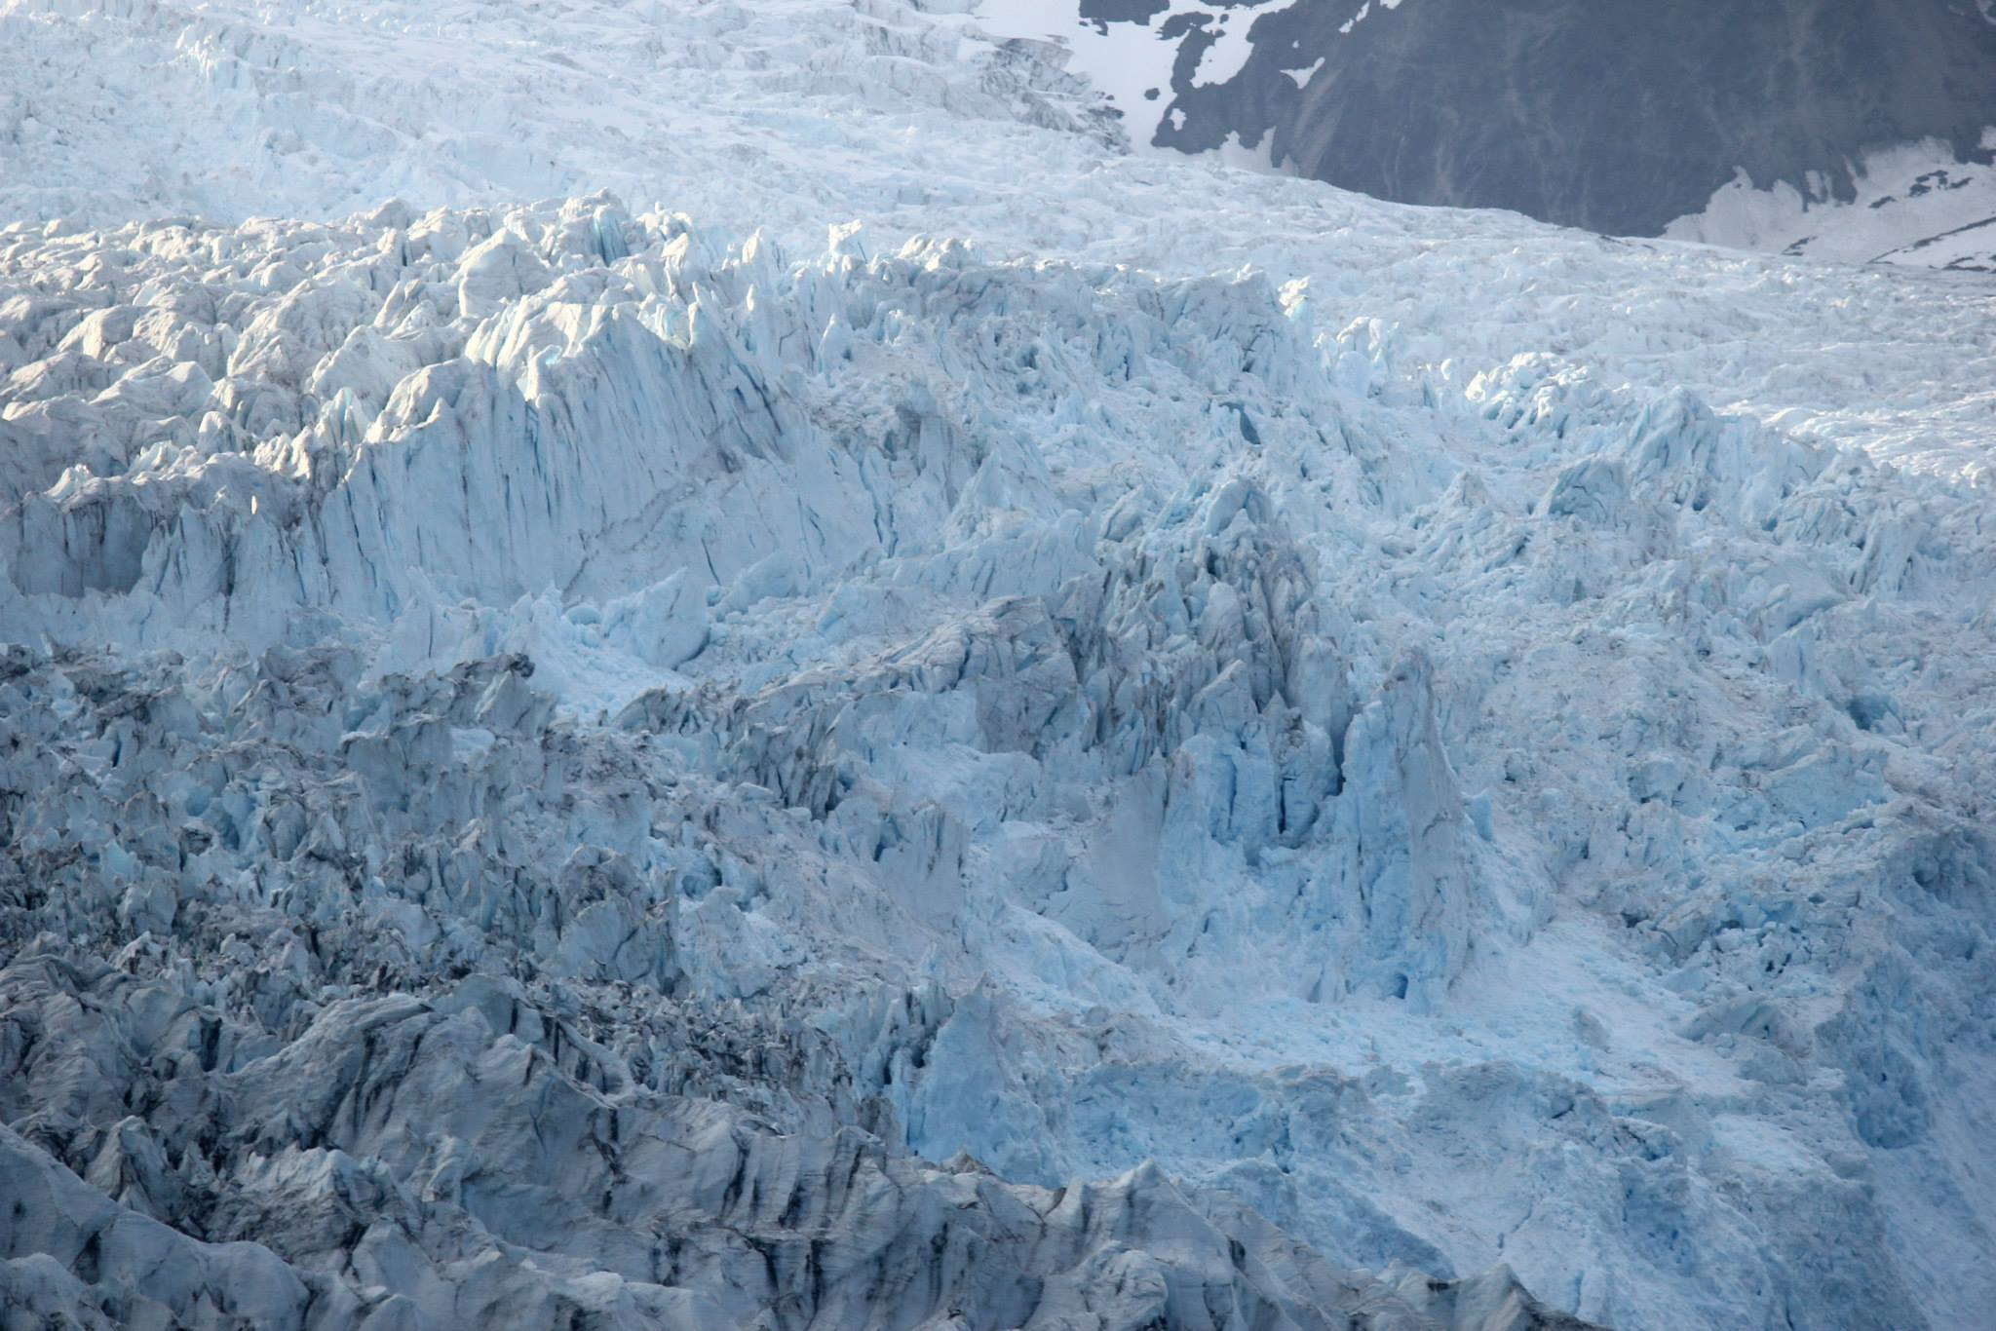
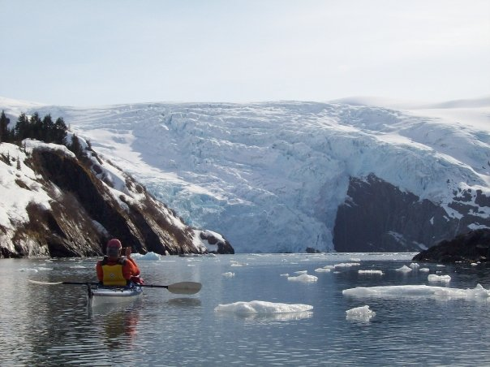
Tidewater glacier periodicity
Tidewater glaciers vs land-terminating
Marine Instability Hypothesis
Stages of the Tidewater Glacier Cycle
Temperate regions (Alaska)
Polar regions (Arctic/Antarctic)

Slide 2
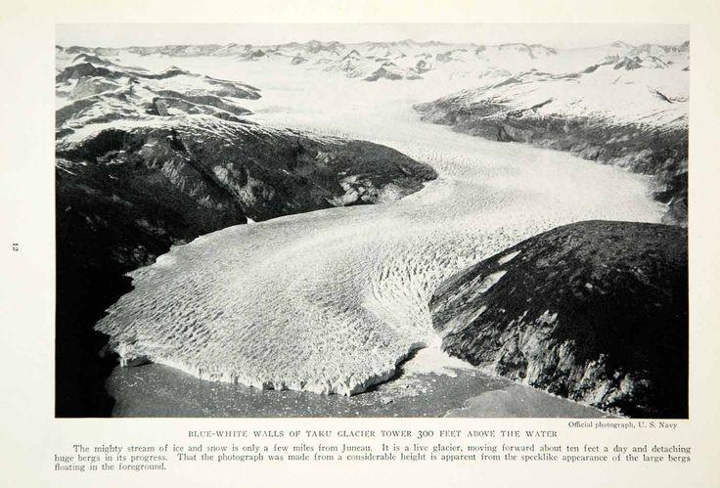
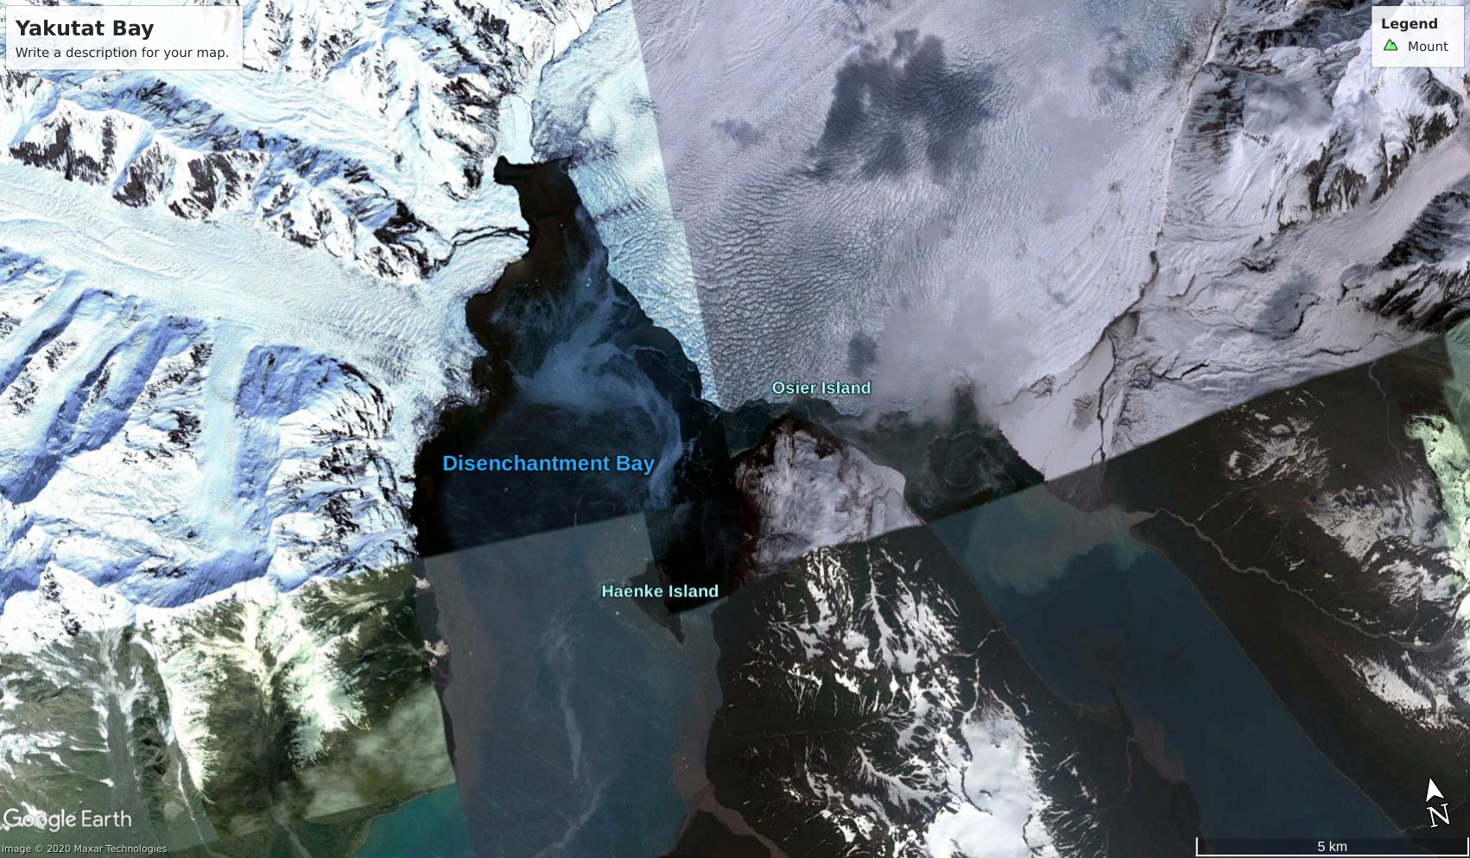
Tidewater Glacier Characteristics
Contemporary Tidewater glaciers exist at higher lattitudes ( >45), where the ELA is at low elevations
Mass loss is dominated by iceberg calving, frontal ablation, and sub-shelf melt
Flow speeds can occur on the order of several kilometers per year
Rapid changes can occur within a few seasons, resulting in rapid retreat, flow acceleration and surface thinning
Pro-glacial bathymetry, water temperature, and currents within a glacial fjord can result in very different behavior among neighboring glaciers

Slide 3
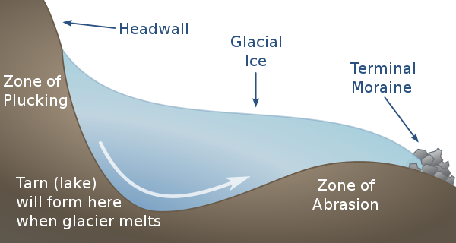
The Marine Instability Hypothesis
Over-deepening results in particularly interesting behavior for tidewater glaciers
Retreat into deeper water can lead to an increase in ice flux,thinning, and further retreat, a positive feedback known as the “Marine Instability Hypothesis”
Ice thinning can result in two consequences: glacier slow down from lower mass or there is a reduction in effective pressure at bed, resulting in an increase in velocity.

Slide 4
Advance Stage
Shoal advection (both sub-aqueous and sub-aerial) reduces calving flux, inducing thickening and advance

Slide 5
Extended Phase
Accumulation and ablation balance out ~ the mass balance is nearly zero. Typically occurs when there is a specific portion of the glacier’s mass below the ELA.

Slide 6
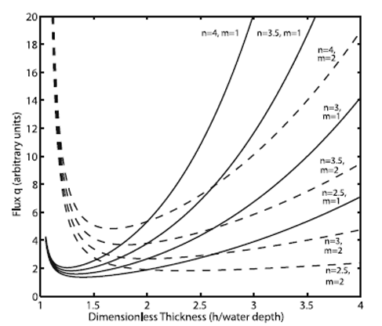
Retreat Phase
A glacier enters the retreat phase when it’s mass is diminished to the point that it is no longer grounded to the shoal, causing retreat into progressively deeper water and initiating the marine instability phenomena
Retreat continues until the terminus reaches shallow water

Slide 7
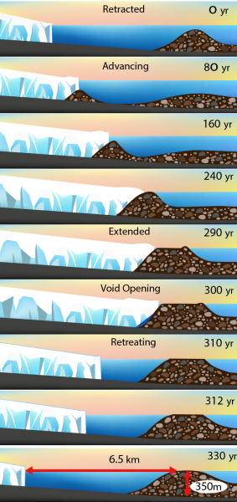
The Tidewater Cycle is Independent of Climate
It has been observed that warmer temperatures induce higher rates of sediment transport at the bed, accelerating the shoal forming process and thus inducing the advance stage (the tidewater cycle has a stronger influence in more temperate climates)
In polar climates, glaciers are comparatively dry and thus the sediment transport driven by ablation is low
The contribution of ablation to mass loss is relatively small; undercutting from water is the predominate mechanism for calving flux
Photo Credits: Meghan Murphy

Slide 8
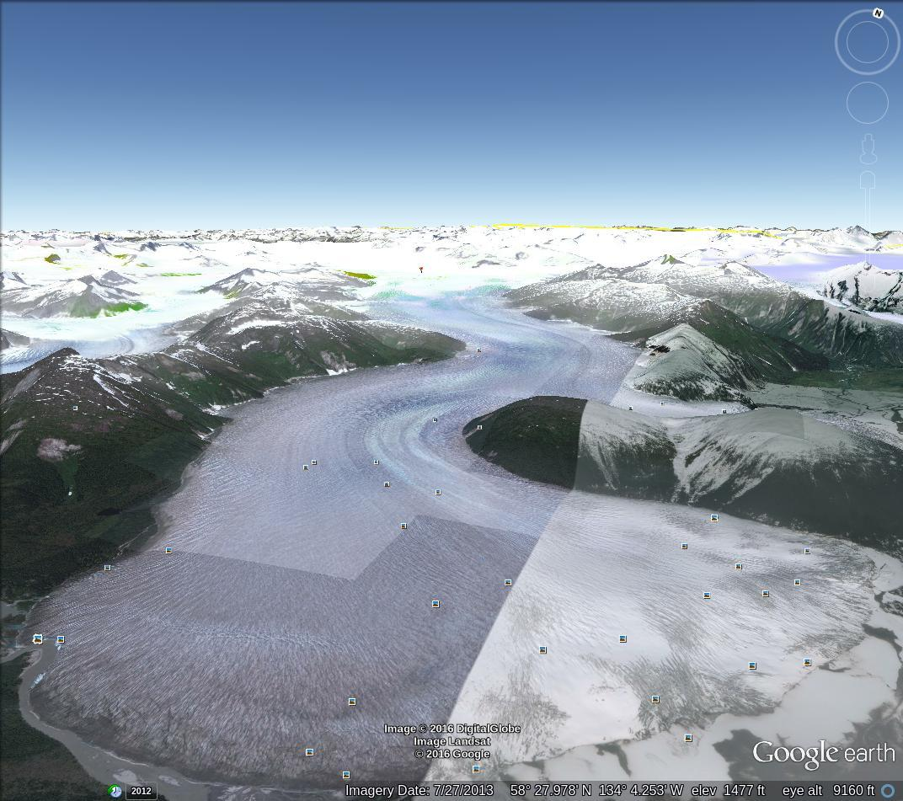
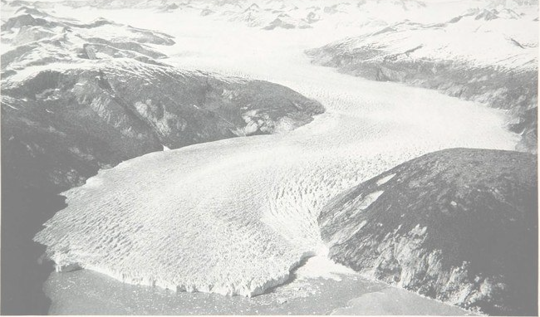
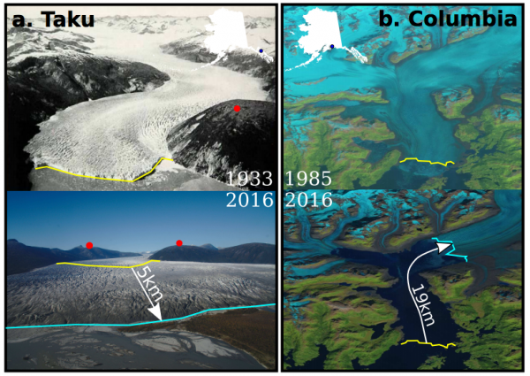
Alaska
~1/3 of Alaska’s tidewater glaciers are advancing (Brinkerhoff et al 2017), despite overwhelming regional mass loss
The Taku has been advancing around 17m/year since 1988
The Columbia has been retreating since the mid 1980’s, but it is believed that it has recently entered a stable phase
The Hubbard glacier (SE Alaska) has been advancing around 8m/year since observation began

Slide 9
Take Home Points
There are 3 main phases of tidewater glaciers : (Advance, Extended, Retreat)
Fluvial sediment transport drives tidewater glacier periodicity
Temperate tidewater glaciers exhibit behavior that is independent of regional trends
Tidewater glaciers in polar regions exhibit low periodicity relative to their temperate counterparts

