Slide 1
WebstraurantStore
JMeter Assignment
Run by Kristian Frikke-Schmidt
On 7/17/2024

Slide 2
Assignment
Task:
Using JMeter, generate a performance report for a load test of Outlet product pages. The load test
should run with a maximum of 5 RPM for a duration of 15 minutes, using a randomized sampling of
product pages. The report should provide an assessment of the performance of these pages along with
an explanation of the included metrics.
You may obtain sample pages using the following url, which lists all available Outlet products under the
heading “WebstaurantStore Scratch and Dent Outlet.” Clicking on any of the items will load the product
page you will be testing.
https://www.webstaurantstore.com/outlet.html.

Slide 3
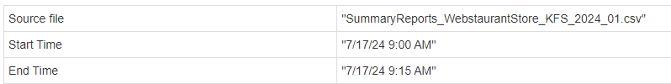
Test Summary
The test was run between the times seen here:
The test did not reveal any issues, all response times were consistent throughout the test
The goal was to run 5 request/minute. 1 request was equal to 1 page and when creating the script, it was found that 1 page had an average of 13 individual transactions (equal to 975 transactions in 15 minutes)
As seen over the following slides, the page response time was under 2.5 seconds average and under 3.08 seconds 95% of the time.
The for the individual transactions, 922 of these (or 94.3% of the total) had a response time under or equal to 500ms, and the remaining 55 (or 5.7% of the total) were between 500 and 1500ms.

Slide 4
Test plan
Create a scrip with the following pages (steps)
Navigate to https://www.webstaurantstore.com/outlet.html
Select a product category by random
Select a product by random (but within the category)
Each of these pages represent a request
Load requirement: 5 request per minute which is interpreted as 5 pages per minute
Run the test for 15 minutes.

Slide 5
Test setup
The script is created in JMeter based on the test case described on the test plan slide
The scrip tests 3 pages and randomly selects a product category and product (done by using the boundary extractor and choosing to select a random value)
JMeter setup considerations based on the script
The script contains a total of 39 transactions split between the 3 pages.
For the test, 1 page = 1 request, giving 39/3 = 13 transactions per request
The goal is to reach 5 requests per minute and run for 15 minutes. This is equal to 65 transactions per minute or 975 transactions in 15 minutes.
The test is setup with 5 users ramping up over 1 minute and then run for 15 minutes. The ramp is used to distribute the load better
The test is run using the Custom Thread Group plugin. I usually use “bzm - Concurrency Thread Group” (see next slide for the screenshot)
The table below shows the setup used for the test

Slide 6
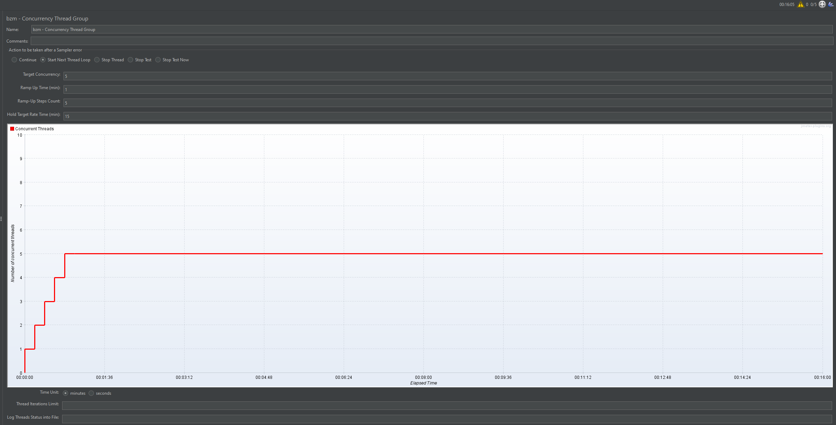
JMeter load profile image bzm – Concurrency Thread Group

Slide 7
Response times tables
Below is a sample of the tables on the following pages – these are taken from the HTML report JMeter can create based on your test (and can be modified as needed)
The Requests and Label fields specifies the name of the transaction or request.
Executions shows the number of actual requests (#Samples), how many that failed (FAIL) and the Error% based on the number of samples
The response time columns shows different types of response time values(average, min, max etc). In performance test the most used are average and any of the percentile values are used.
Throughput shows the number of transactions per second and is used to show the throughput you had.
Network (KB/sec) shows the Kilobytes/seconds sent and received.
These values alone and combined can help determine if the application under test met the requirements set by the project owners and can also help identify potential issues

Slide 8
Test results. Page response times
The following results were found during the 15 minutes JMeter test
This table shows the total number of samples on the 3 pages that were selected for the 15-minute test. Please note that the test had a 1-minute ramp-up to slowly increase the load and that the #samples columns only shows the completed (but as seen on the following slides there were 25 calls per transaction).
From the response time columns, the focus is the average and the 95th percentile response times. It is found that the total load time per page was under 2.5 seconds average and around 3 seconds or less for the 95th percentile.

Slide 9
Test results. Page response times
The following slides shows the details from the individual transactions
The goal was to hit 75 requests in 15 minutes (5 per minute). With the number of transactions per webpage that equates to 975 (average 13 transactions per page request). The test got 977 transactions in the 15-minute window
All transactions are found to be equal to or under 1.017 seconds, with most being under 0.5 seconds.

Slide 10
Test results: Transaction response times
This slide shows the overall test results found during the test

Slide 11
Test results: Transaction response times Cont.
This slide shows the overall test results found during the test

Slide 12
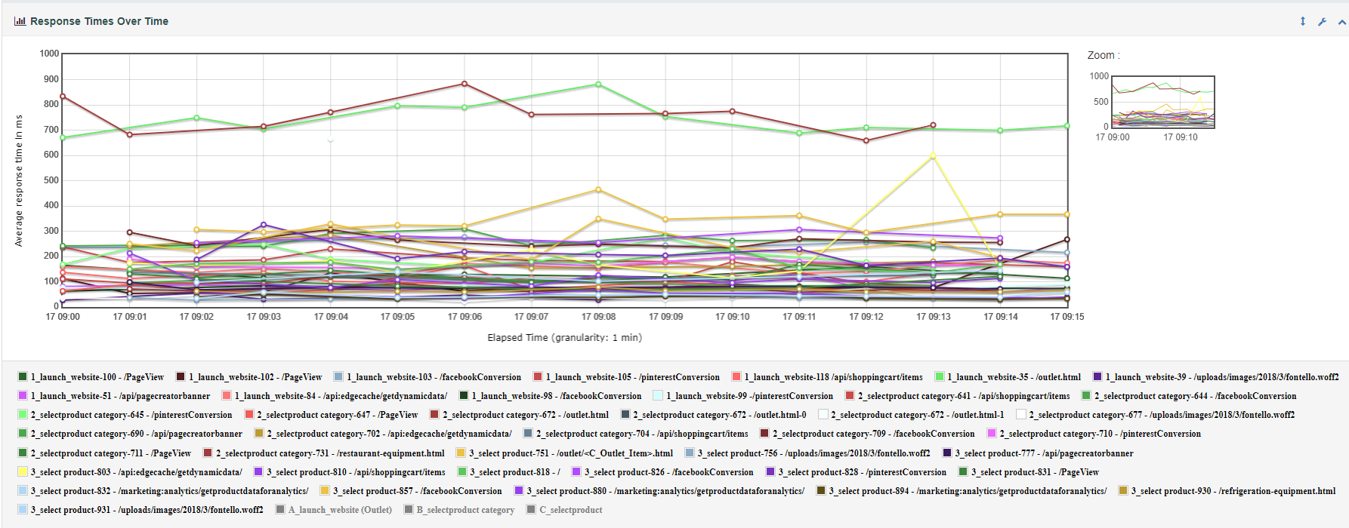
Test results: Response times over time.
The following graph shows the response time over time. It is found that the response times stay consistent during the test.
The 2 top lines are the /outlet.html pages which are also the 2 main calls. They both have an average response time under 900 ms.
One transactions does stick out (the yellow line – related to “3_select product-803 - /api:edgecache/getdynamicdata/”). This one has a spike that goes from under 200ms to 600 ms. More testing will be needed to determine if this is a problem)

Slide 13
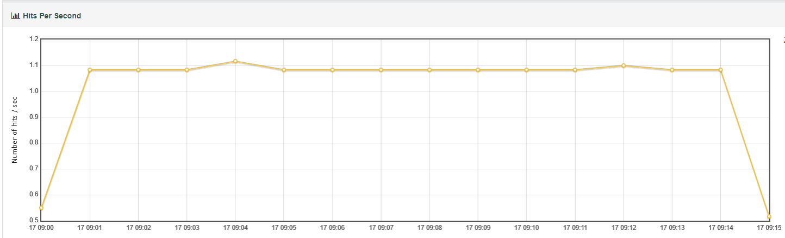
Test results: Hits per second.
The following graph shows the hits per second seen during the test. It is found that we keep a stabile hits per second during the test indicating the load is evenly distributed within the test window

Slide 14
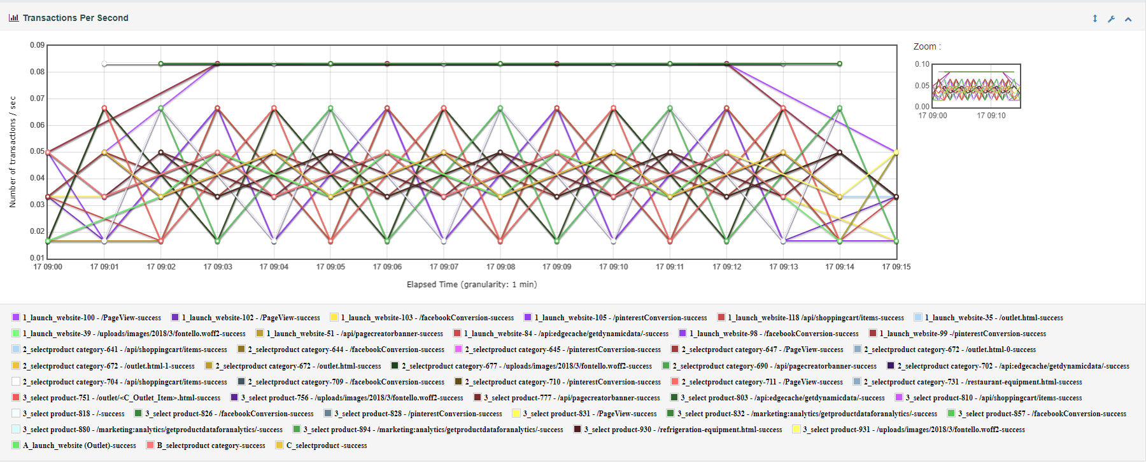
Test results: Transactions per second.
The following graph shows the Transactions per second seen during the test. These are for the individual transactions within the different page requests. This is used to show how many calls there were to the individual transactions during the test.

Slide 15
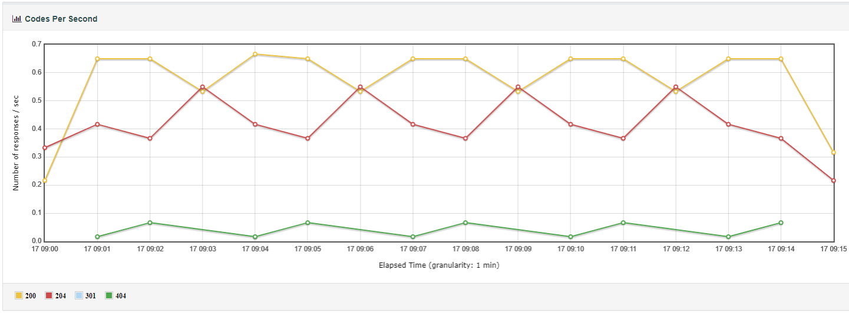
Test results: Codes per second.
The following graph shows the Codes per second seen during the test. This is useful when you want to see which HTTP codes were hit during the test and the distribution.
200 indicates success, 204 also indicates success but that there were no response body (in this case it relates to calls like /pinterestConversion, /facebookConversion and /PageView and is expected), 301 is a redirect (we had one happen during test) and finally the 404 which is page not found (one call returned a 404 - cdnimg.webstaurantstore.com/ also during the recording of the script)

Slide 16
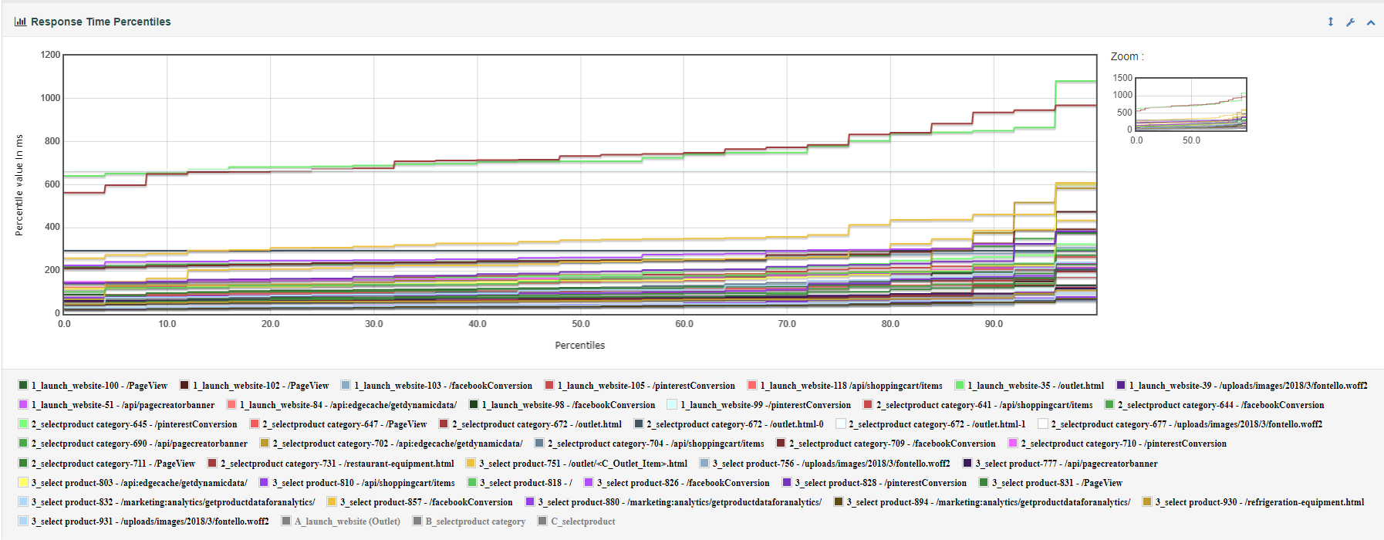
Test results: Response time percentiles.
The following graph shows the response time percentiles seen during the test. This is useful when you want to see the response time distribution.
Many performance tests focus on the 90th, 95th and sometimes the 99th percentile response time instead of the max response time. Sometimes the percentile graph has a slight increase (like below) and sometimes you may see the it rise exponentially the closer you get to 100%

Slide 17
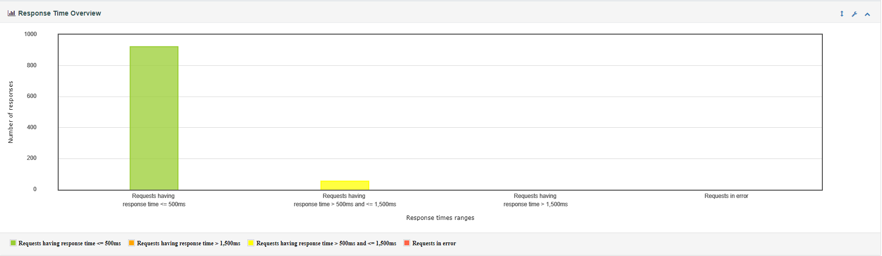
Test results: Response time overview
The following graph shows the response time overview seen during the test. This is, like the percentile graph useful when you want to see the response time distribution.
From the graph it is found that 922 requests had a response time under or equal to 500ms, 55 were between 500 and 1500ms. We did not have any response times over 1500ms and no errors. We had a total of 977 requests

