Slide 1
TOME
COSC-4303
September 20, 2006
Curtis “Fjord” Hawthorne
Craig “Fargo” Miller
Clint Olson
A. Axel “fREW” Schmidt

Slide 2
Why?
Sharing because Jesus said to
  Verse
  Verse
It saves money
  Your books may already be in TOME
Love your neighbor
  Donate books, other people save

Slide 3
So what already exists?
Robust working database
  Hasn't needed changes in a long time
  Checks data for consistency
Perl Core
  API to interact with the database
  API for the web UI to interact with
Mostly friendly Web-based User Interface
  AJAX Autocompletion
  Automatic guiding through various forms
    Example: Book doesn't exists

Slide 4
Round II
A relatively large userbase
  Circa 7 floors
A relatively large “Book base”
  800 books in the current collection
  Books checked out right now: 356
    17,800 dollars in savings if the average price per book is 50 dollars

Slide 5
What will we change this semester?
“Fix” InterTOME Loans
Improved User Interface
Install Script
Test Framework
TOMEkeeper Page (Not required)
ISBN Based System
Class Based Verification

Slide 6
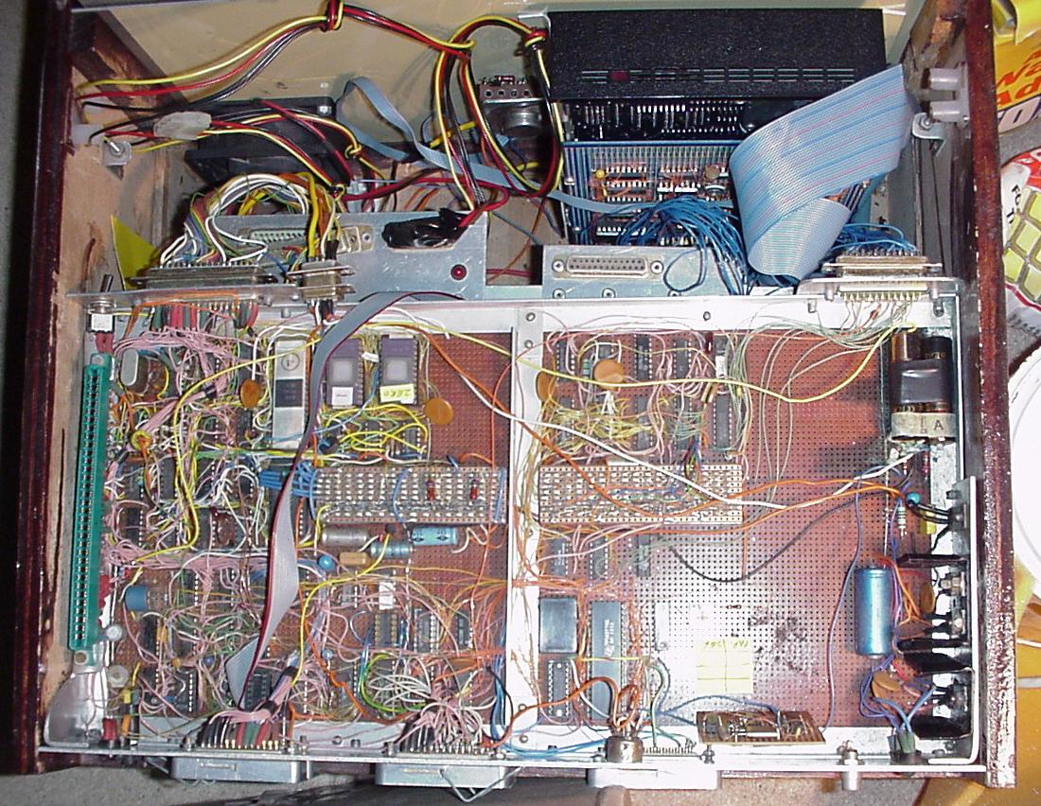
“Fix” InterTOME Loans
Currently:
  Chaos
  Inconsistency between floors
  Not enough application based restraints

Slide 7
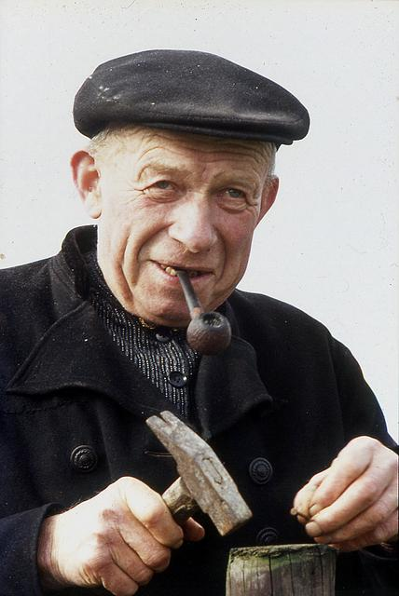
Improved User Interface
More User-friendly
  More autocompletion
  More “hand-holding”
CSS Based
  Good looking
  Better Bandwidth usage

Slide 8

Install Script
Simple Install for Developers
  Set up database
  Configures TOME

Slide 9
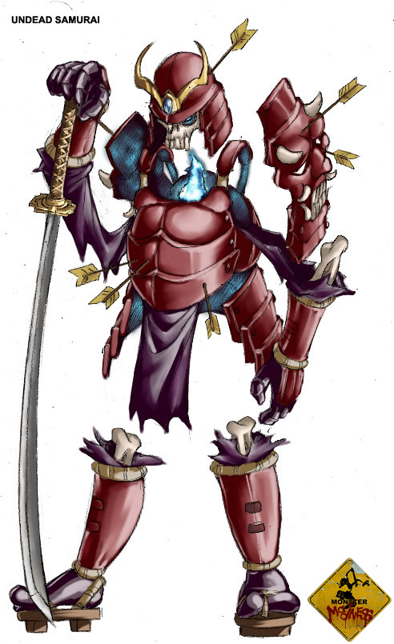
Test Framework
Basic Framework
Unit Tests
  Database Tests
  Website tests

Slide 10
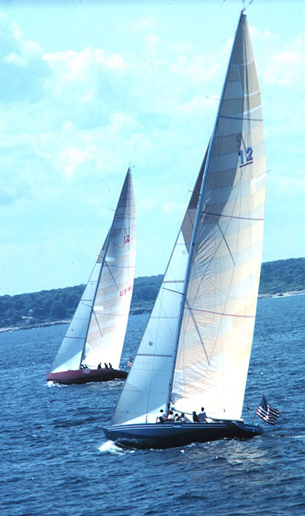
Patron Page
Major Effort for reworking the System
  New Focal Point
    Add Books to Patrons
    Not Find books and reserve it to patron
    See also: Class Based Verification

Slide 11

TOMEkeeper Page
Easier way to manage TOMEkeepers
Easier way to send TOME emails
Improved Efficiency

Slide 12

ISBN Based System
Manage book types instead of specific books
  Reduces TOMEkeeper searching time
  Also simplifies reserving process

Slide 13
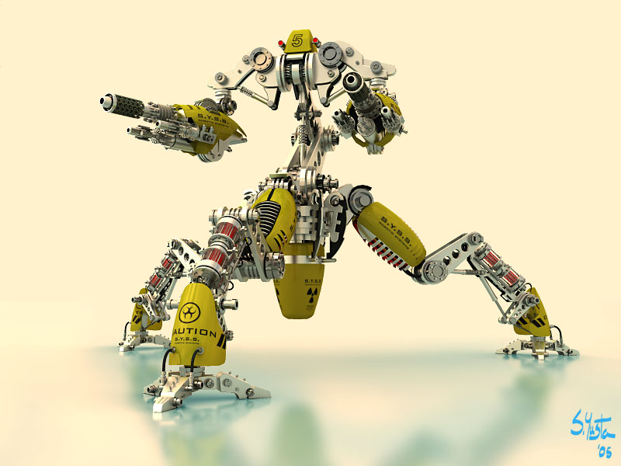
Class Based Verification
Allows for automated reserving of books
  Thus simplifying TOMEkeepers job
  Allows for Patron Page
Easier viewing of what classes need updating

Slide 14
In Conclusion...
You have no questions!

