Slide 1
TOME
COSC-4303
December 5, 2006
Curtis “Fjord” Hawthorne
Craig “Fargo” Miller
Clint Olson
A. Axel “fREW” Schmidt

Slide 2
Verses!
Matthew 6:20
Matthew 7:7
Matthew 11:28-30
James 1:2f
Psalm 27:1
Happy Un-Heaven Week!

Slide 3
Why?
Sharing because Jesus said to
  Acts 2:44-46
  Acts 4:34
It saves money
  Your books may already be in TOME
Love your neighbor
  Donate books, other people save

Slide 4
In the Beginning there was...
Robust working database
  Hasn't needed changes in a long time
  Checks data for consistency
Perl Core
  API to interact with the database
  API for the web UI to interact with
Mostly friendly Web-based User Interface
  AJAX Autocompletion
  Automatic guiding through various forms
    Example: Book doesn't exists

Slide 5
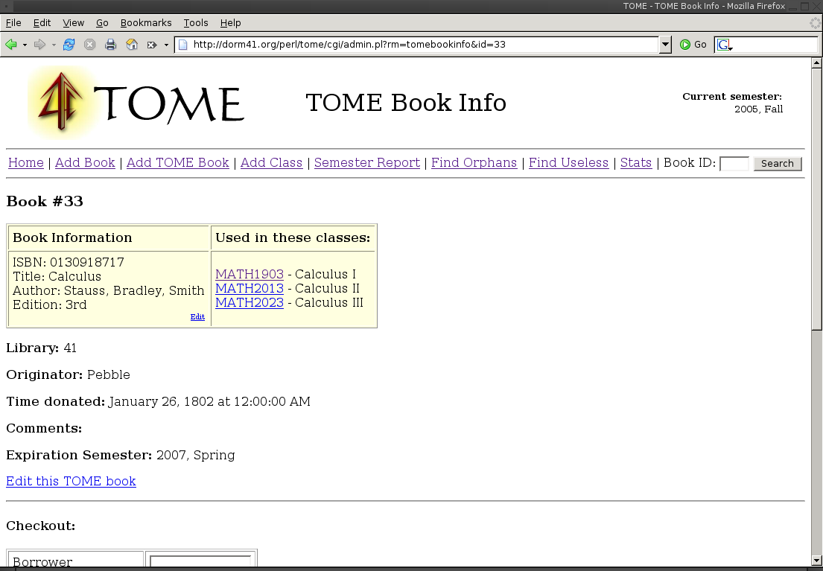
Book Reservation/Checkout Workflow

Slide 6
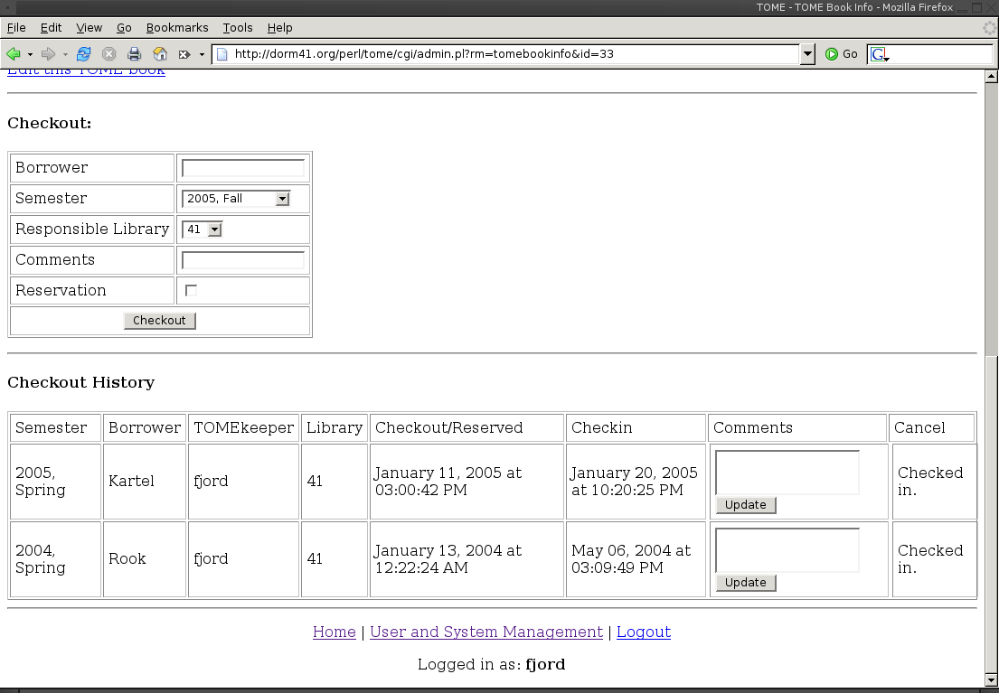
Book Reservation/Checkout Workflow

Slide 7
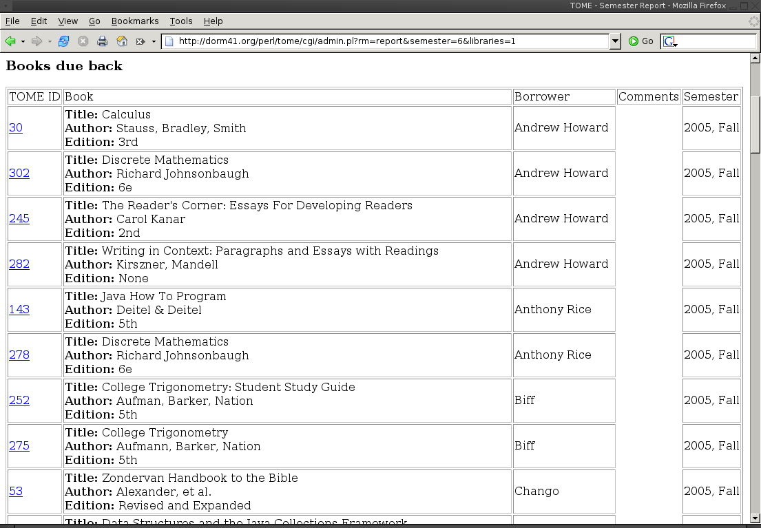
End of Semester Report

Slide 8
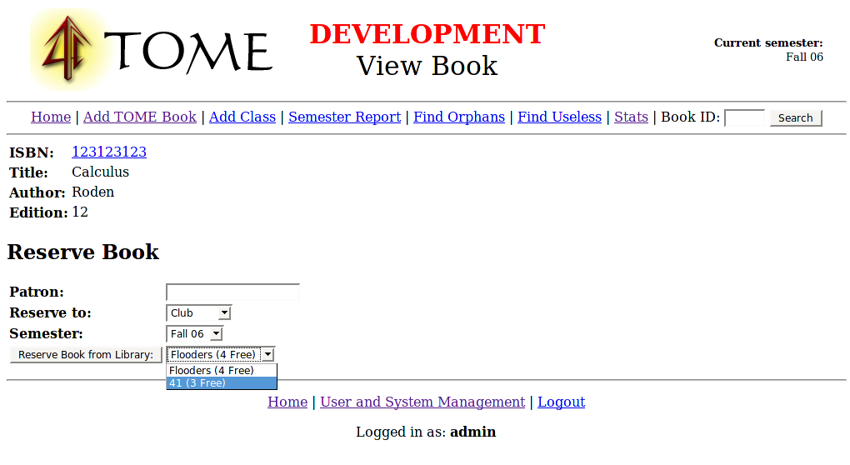
New Reservation

Slide 9
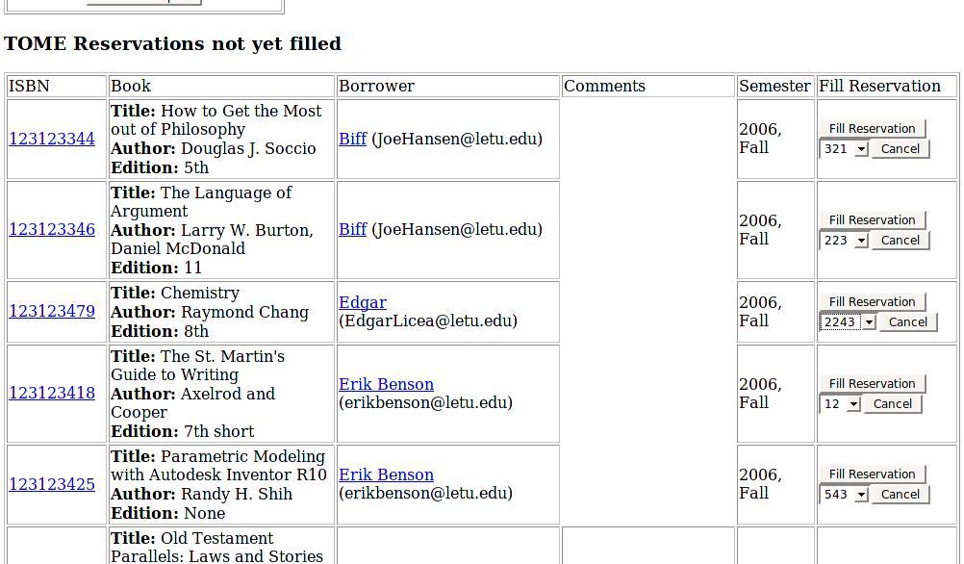
New Report

Slide 10
New Report – slide 2
Also contains:
  InterTOME reservations not yet filled
    From this floor to others
    To this floor from others
  Books Expiring (not new)
  InterTOME books due back
    From this floor to others
    To this floor from others

Slide 11
Database Backend
PostgreSQL rocks my socks off
It allows us to do Consistency Checks of Power

Slide 12
Reservation Consistency Check
CREATE FUNCTION reservation_insert() RETURNS "trigger" AS $$
BEGIN
IF tomebooks_reserved(NEW.isbn, NEW.library_to, NEW.semester) + 1 <= tomebooks_available_to_reserve(NEW.isbn, NEW.library_to, NEW.semester) THEN
return NEW;
else
raise exception 'All available books are already reserved';
end if;
RETURN NEW;
end;
$$ Language plpgsql;

Slide 13
TOME.pm
The C of the MVC
Interacts with the database and TOME::Interface
Example method:
sub book_info {
my $self = shift;
my %params = validate(@_, {
isbn => { type => SCALAR },
});
my $dbh = $self->dbh;
my $sth = $dbh->prepare(
"SELECT isbn, title, author, edition FROM books WHERE isbn = ?");
$sth->execute($params{isbn});
return $sth->fetchrow_hashref;
}

Slide 14
Responsibilities
Install Script
Automated Test Suite

Slide 15
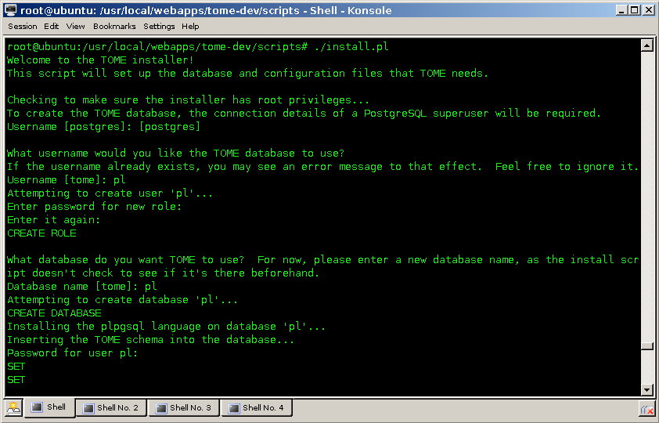
Install Script

Slide 16
Testing
New changes can break old code
Manual tests tend to be unevenly applied
Automated testing solves both problems

Slide 17
Automated Testing Suite
Standard Perl test suite using Test::More
Automation via Test::Framework

Slide 18
Interface.pm
Middleman between TOME.pm and Templates
Example

Slide 19
Templates
Abstraction layer for HTML
Use Callbacks for simplicity
Example

Slide 20
VIM: The Ultimate IDE
Specialize TOME Programming Environment
  Template abbreviations
  perl macros
  etc

Slide 21
POD
Build the Documentation in...
Example

Slide 22
Postmortem
More Pair Programming
Portability
Stricter Project Deadlines within Team
Papers Tended to Slow Project Down

Slide 23
Questions?

