Slide 1
PRAMET Tools ECatalog
The VB.NET + SQL + ADO.NET application + ASP.NET web interface

Slide 2
Features
The interactive catalog to support CAM application
Assembling the tools with the indexable cutting inserts
Common shopping features like basket and favorites
The export to the SolidCAM environment.

Slide 3
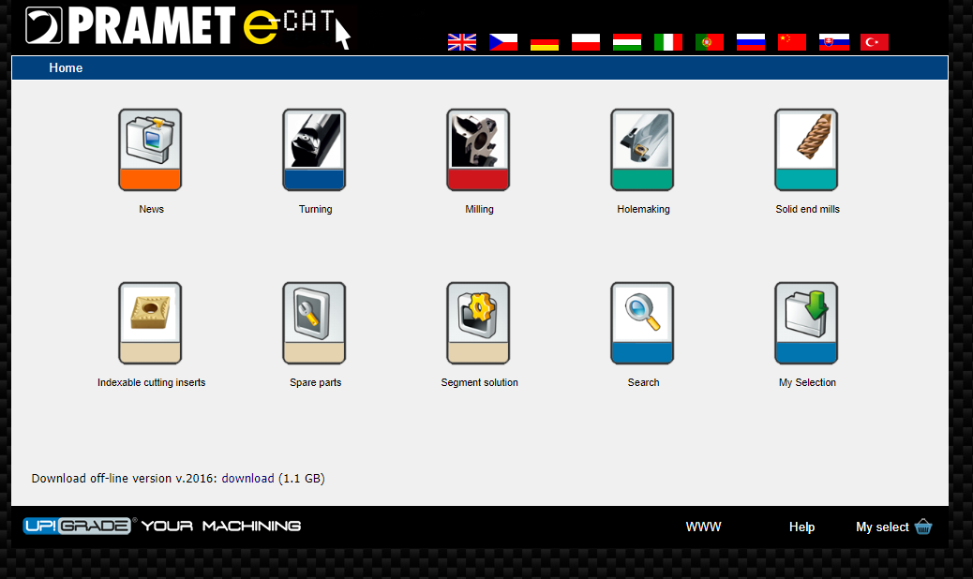
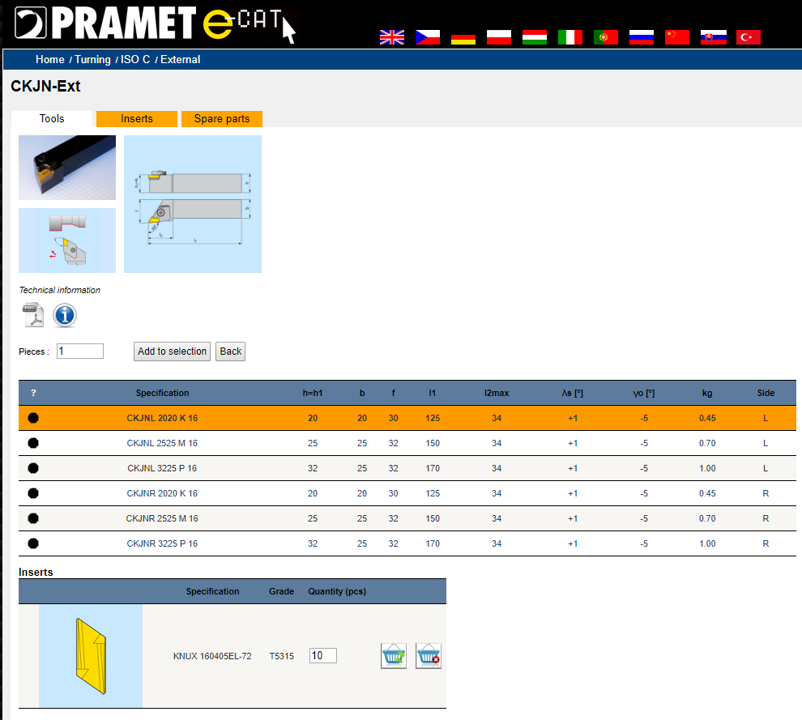
Web interface

Slide 4
References & Links
The link: http://ecat.pramet.com/

