Slide 1
CAN traffic application
The C# + WPF + MVVM application using the VectorXL driver

Slide 2
Features
User interface WPF, Entity Framework Databinding.
Change request management (MS Access, OLEDB)
The monitoring of the CAN traffic to the instrumental cluster (Vecotr XL Driver)
The sending the CAN sequences to the instrumental cluster (Vector XL Driver)

Slide 3
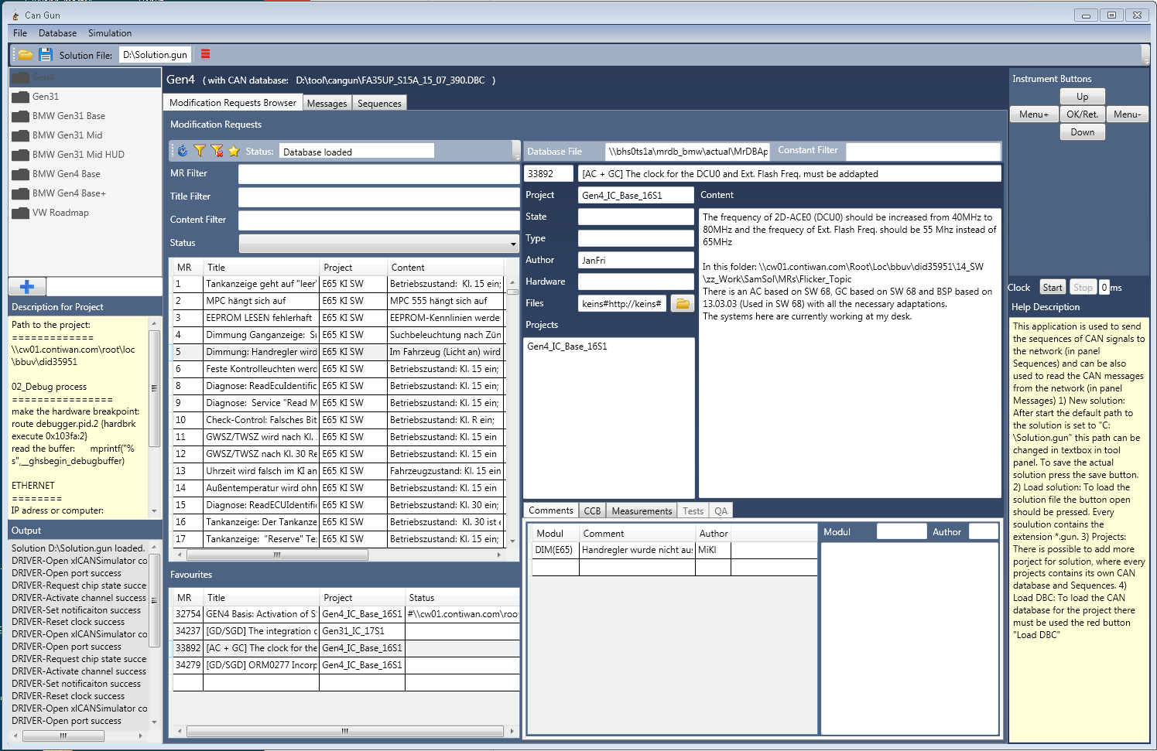
Change Request Management
Load change requests
Filtering
Save the items
Control the change req. process.

Slide 4
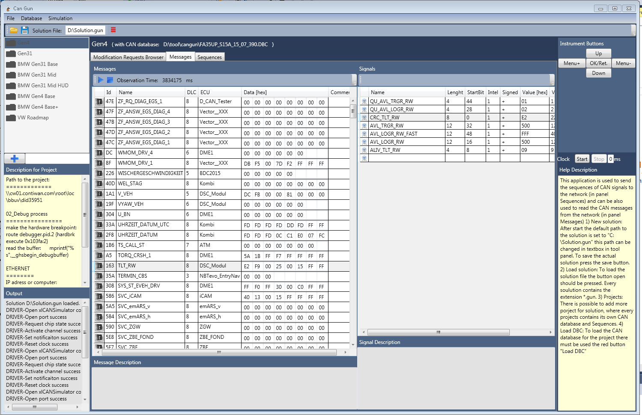
CAN Traffic application
Observer function
Parsing the messages
Load DBF file
Sequence creation
Control the cluster buttons

Slide 5
References & Links
The source code on the GIT : https://github.com/frisa/CANgun_IC2017
The Video …

