Slide 1
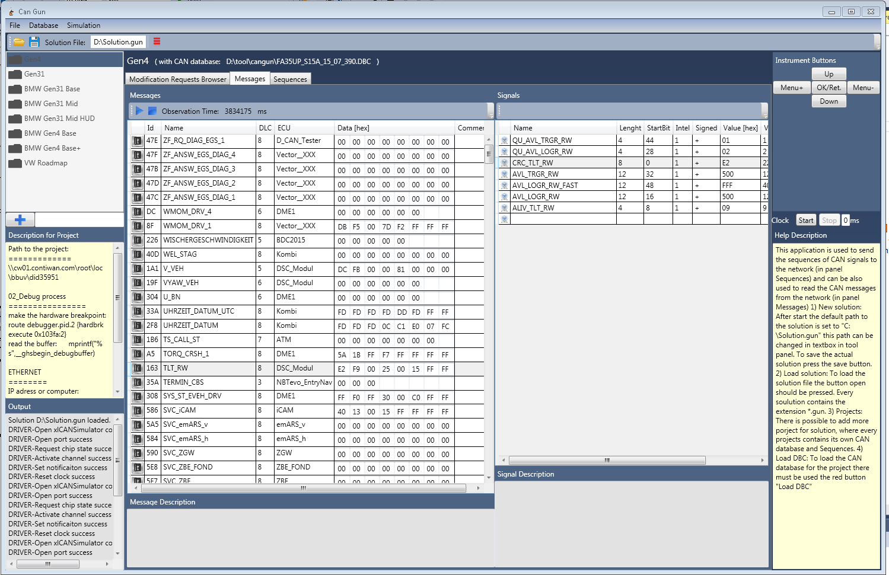
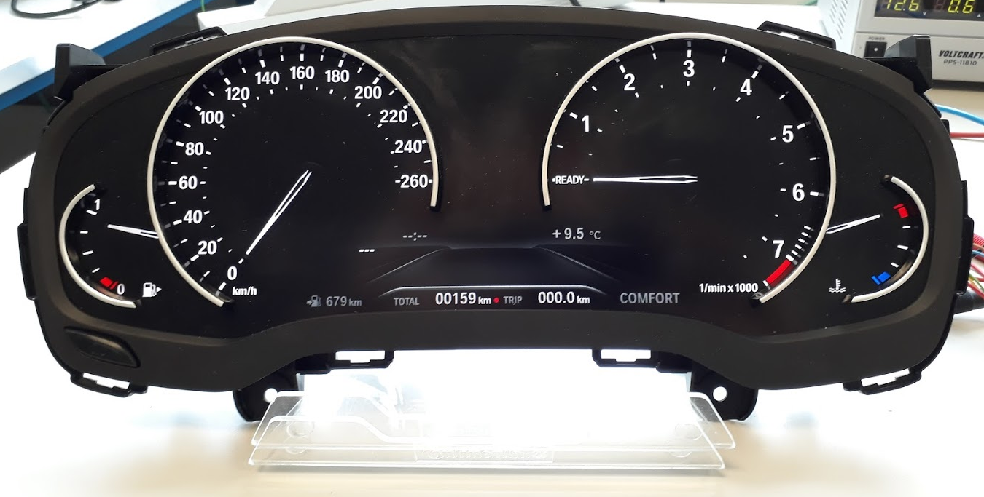
CAN traffic application
The C# + WPF + MVVM application using the VectorXL driver

Slide 2
The Presentation - Movie
https://photos.google.com/photo/AF1QipNN4augVIkNRuqQB4MrBjyjtlnABMrCFrvkBbYO

Slide 3
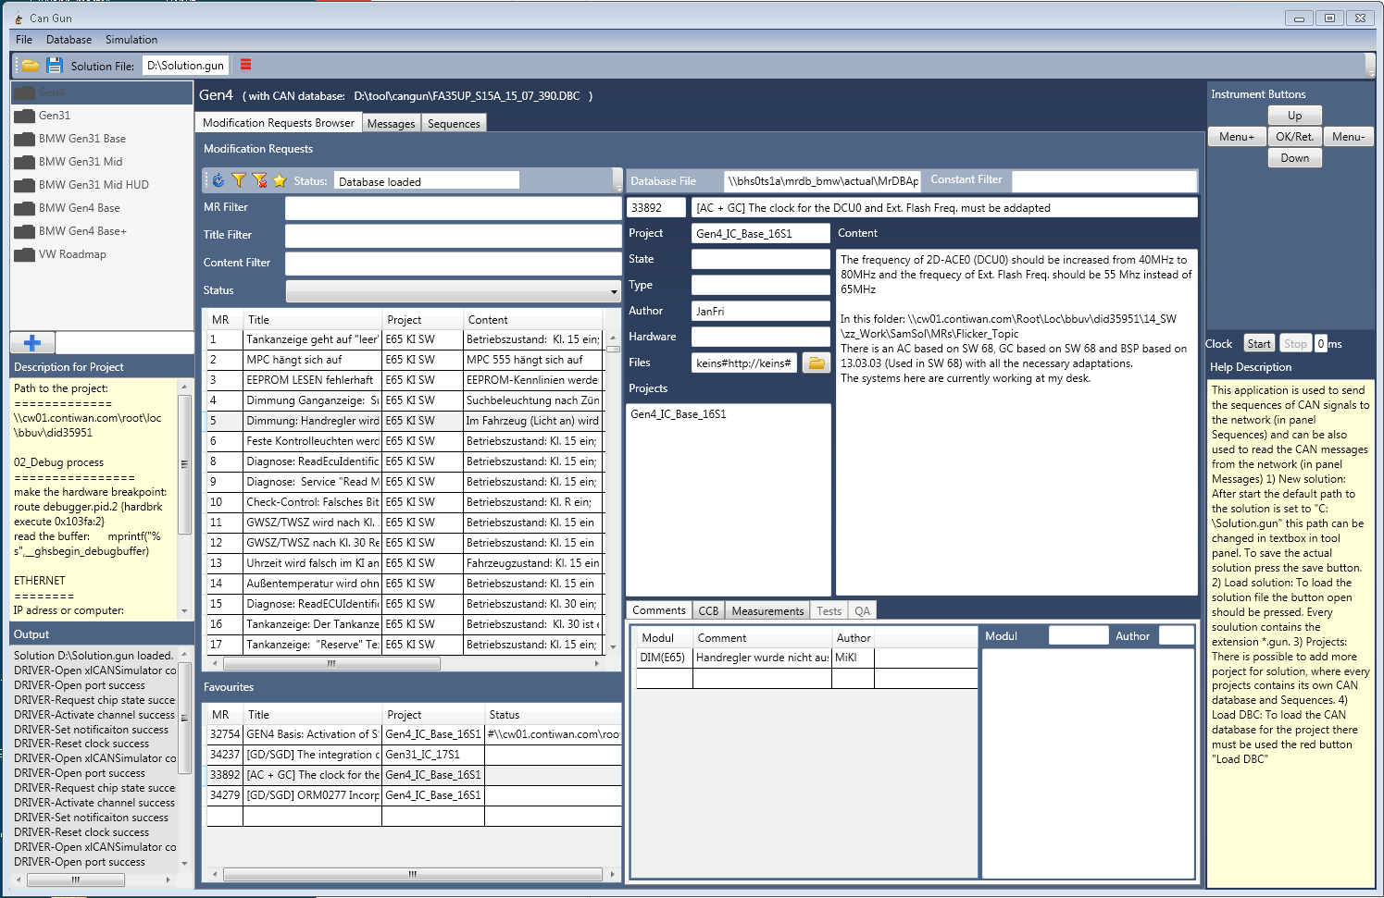
Change Request Management
Load change requests
Filtering
Save the items
Control the change req. process.

Slide 4
CAN Traffic application
Observer function
Parsing the messages
Load DBF file
Sequence creation
Control the cluster buttons

Slide 5
References & Links
The source code on the GIT : https://github.com/frisa/CANgun_IC2017
The Video …

