Slide 1

Welcome!
This is CMSE 201-###
Sit anywhere for now!
Notes:
Introduce myself and TA/LAs!

Slide 2
Welcome!
CMSE 201-###
Computational Modeling
and Data Analysis I
Dr. <INSTRUCTOR NAME>
<TA NAME> (TA)
<LA NAME> (LA)
<LA NAME> (LA)
Notes:
Introduce myself and TA/LAs!

Slide 3

About Me
You can put some bullets about yourself here, and maybe some pictures.
You can include information about your research
Or your hobbies
This helps students to get to know you!

Slide 4
How to Contact Me
Include information about how students can find you and get a hold of you.
Encourage them to come to office hours for anything and everything. It shouldn’t just be a place for when they have specific issues or problems with the course.

Slide 5
COVID Safety (this is from past semesters, but you might want to highlight you policy for illness and how to keep it out of the classroom)
Correctly worn masks are REQUIRED
  University Policy
    Students who do not wear properly fitting masks will be dismissed from class
    The entire class will be dismissed if the student refuses to leave
Please do not come to class if you are sick or have had a COVID exposure
  I will maintain a Zoom room to participate remotely

Slide 6
The Three Threads of CMSE 201
Coding in Python: By the end of the CMSE 201 you will be a proficient programmer/coder in Python. You should be able to use Python to help you in all of future classes.
Modeling: You will learn how to build models that allow you to quantitatively solve complex problems in science, engineering and beyond. Combined with the coding aspect of the course, these models will be turned into computational models.
Data Analysis: You will learn how to handle real-world data: find it, analyze it, and draw quantitative conclusions from it. You will use your coding skills for this analysis and build models that reveal deeper insights into the data.

Slide 7
Course Structure
This course will require a lot of work. There is a huge amount to learn. That is why it is a four credit course!
Flipped classroom: The class is structured to have pre-class assignments, which you will do before coming to class and in-class assignments done during class, as part of a group.
There will be a homework roughly every few weeks. You will also complete a code portfolio as part of your homework grade.
Also, the only way to learn to code is to code. We will code in class every day. We will provide opportunities for additional practice.
We will have 4 quizzes based on class assignments every few weeks
There is a project: projects will be presented at the end of the semester, although we will plan your projects throughout the semester

Slide 8
Inclusive Classrooms
Inclusive classroom: Where instructors and students work together to create and sustain an environment in which everyone feels safe, supported, and encouraged to express their views and concerns (UMich CTL definition)

Slide 9
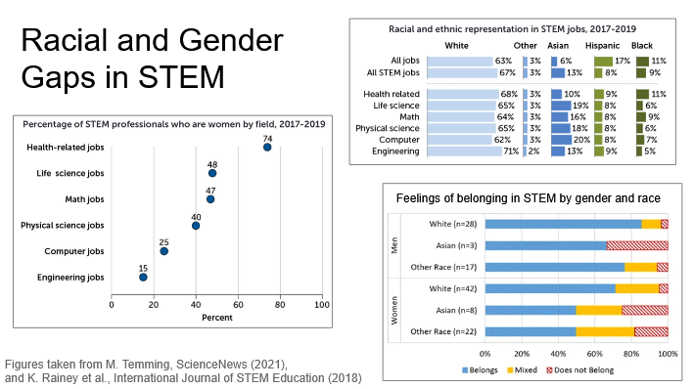
Inclusive Classrooms
Inclusive classroom: Where instructors and students work together to create and sustain an environment in which everyone feels safe, supported, and encouraged to express their views and concerns (UMich CTL definition)

Slide 10
Inclusive Classrooms
Inclusive classroom: Where instructors and students work together to create and sustain an environment in which everyone feels safe, supported, and encouraged to express their views and concerns (UMich CTL definition)
Here in CMSE, we strive to create inclusive classroom spaces, but we can't do it without you
As group members, you will need to work together to solve the problems we present while making sure that everyone has the chance to contribute to the effort

Slide 11
Common Student Concerns
I’ve never programmed before! Most of your classmates have not programmed before either! This is an intro course and is designed to accommodate any amount of prior knowledge.
What if I fall behind? You do need to do your best to keep up with the material. However, there are office hours every week day with TAs/LAs and professors. If you are having challenges that make it difficult to keep up with material, please reach out to Dr. <INSTRUCTOR NAME>!
How do I get help? Come to office and help room hours, post in our section Teams channel or the general CMSE 201 help Teams channel, email/DM Dr. <INSTRUCTOR NAME>!
What resources do I have for class? Important course content will be posted on the class website and, in some cases, D2L. Look at those resources first, but if you can’t find what you’re looking for, contact me!

Slide 12
A few notes about
the flipped classroom
The flipped classroom environment may like feel very different than what you may be used to.
Learning takes place in a collaborative manner in which you learn by doing, using knowledge you acquire before coming to class
Pre-class assignments are critical for maximizing your in-class experience

Slide 13
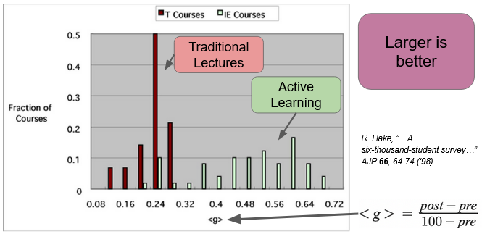
Measuring Student Learning

Slide 14
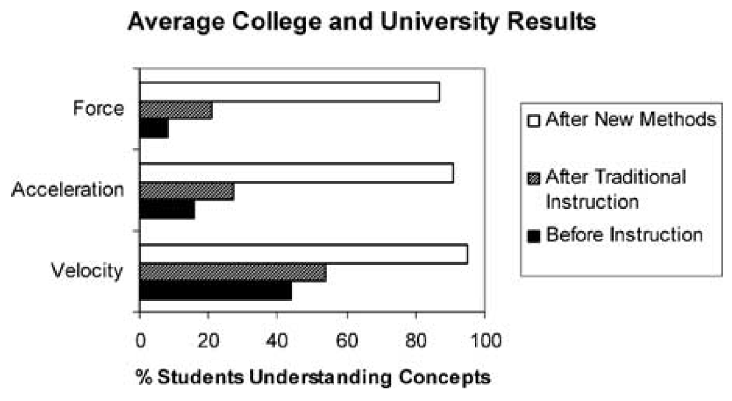
Interactive engagement leads to more learning!
Active engagement
Active-engagement vs. traditional instruction for improving students’ conceptual understanding of basic physics concepts (taken from Laws et al., 1999)

Slide 15
Getting the most out of the flipped classroom
You are responsible for monitoring your own learning — only you can ensure that you are mastering the content!
  This goes for In Class Participation and Pre-class Preparation In particular

Slide 16
You’ll learn more about flipped classrooms in the Day 2 pre-class assignment!

Slide 17
CMSE 201 Sections
Section | Time | Lead | TA | LA | LA
2 | MW 10:20 AM - 12:10 PM | Devin Silvia | Rachel Roca | Bryan Jurado | Maddie Bloch
3 | MW 12:40 - 2:30 PM | Huan Lei | Omeiza Olumoye | Connor Trask | Maddy Nomer
4 | MW 3:00 - 4:50 PM | Patti Hamerski | Stephen Lee | Erin Syerson | Petra Johnson
5 | TuTh 8:00 - 9:50AM | Luciano Silvestri | Nic Heilman | Emma Oswald | Vivian Pavlica
6 | TuTh 10:20 AM - 12:10 PM | Sai Ravishankar | Steven Strachan | Corinne Kershaw | Keerthi Gogineni
7 | TuTh 12:40 - 2:30 PM | Yingda Cheng | Zenas Huang | Jack Jackson | Subhroja Roy
8 | TuTh 3:00– 4:50pm | Luciano Silvestri | Nic Heilman | Jason Nitkiewicz
The times and locations for office hours can be found on the course website
(check regularly for most up-to-date times)
Office and help room hour calendar has room locations and Zoom links as appropriate.

Slide 18
Grades
 | Participation, attendance, in-class assignments | Pre-class assignments | Quizzes (4) | Homework (4) | Semester project
Percentage | 15% | 15% | 20% | 25% | 25%
4.0 | >90%
3.5 | >85%
3.0 | >80%
2.5 | >75%
2.0 | >70%
1.5 | >65%
1.0 | >60%
0.0 | <60%

Slide 19

Spartan Code of Honor
As Spartans, we continually strive to hold ourselves to values of the highest ethical honor. As students, we will empower an atmosphere as future leaders to uphold honesty in our work, hold our peers accountable to the highest standard, and take pride that integrity is worth more than our grade. We pledge that these ethics will carry beyond our time as students at Michigan State University, fostering an improved recognition for personal best and integrity in our society.
Please review the pledge at: https://honorcode.msu.edu/about/

Slide 20
Accommodations
If you have a university-documented learning difficulty or require other accommodations, please provide me with your VISA as soon as possible and speak with me about how I can assist you in your learning.
If you do not have a VISA but have been documented with a learning difficulty or other problems for which you may still require
accommodation, please contact MSU’s Resource Center for People with Disabilities (355-9642) in order to acquire current documentation.
If you need accommodations but do not yet have documentation, please contact me!

Slide 21
Honors Option
This course has an honors option. The option involves completing second project that highlights a different aspect of the course (e.g., if you do modeling for your normal project, you should do data science for you honors option).
You will also be expected to received a minimum grade of 80% on your honors option project and a minimum of a 3.0 in the course as a whole.
Contact me if you are interested (within the first two weeks of the course).

Slide 22
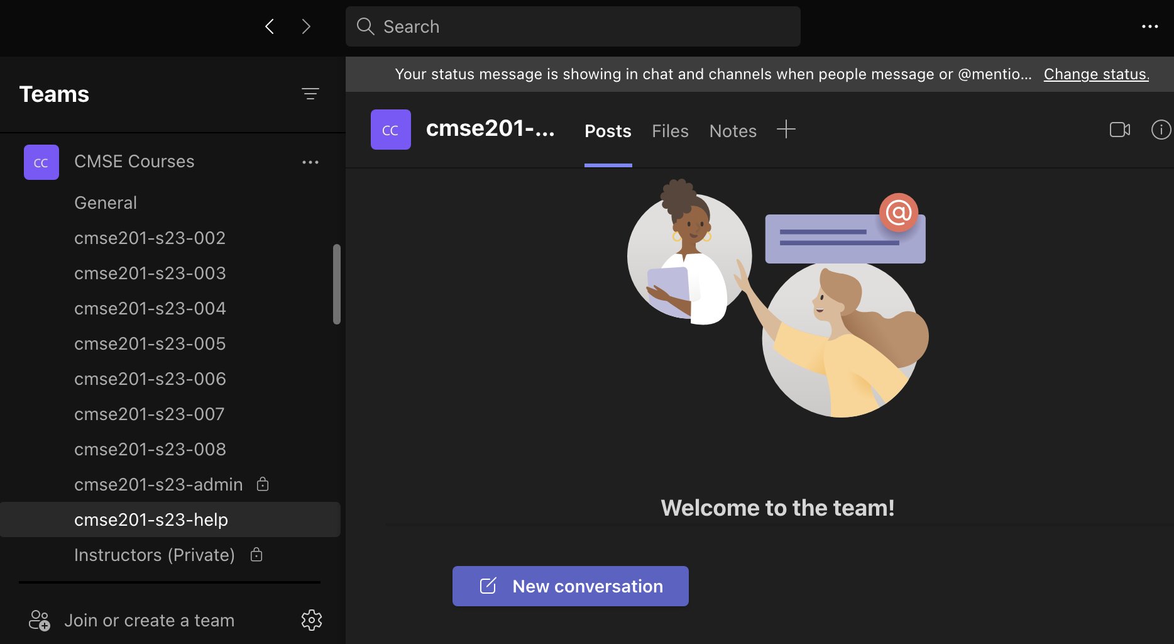
Teams
We will be using Teams in this course.
The primary goal of Teams is to support communication between the students, but it will also enable instructor support.
Use the Teams channels to show ideas/tips/plots or to ask questions about syntax, error messages.
The Teams usage rules are in the syllabus.
Notes:
When you join the Slack channel (or if you haven’t already), please post a message with your name, year, major! Slack is primarily for you all to work among yourselves, but we (TA/Las and I) will monitor it and answer questions

Slide 23
CATME Survey
We’ll be using CATME as a means of forming productive groups for in-class assignments.
You should have received an email about this and completed a survey. If not, please let me know.

Slide 24
The Main Tool We Will Use: Python
In this course, we will cover some aspects of Python.
If you want more advanced Python knowledge when this course is completed, please consider CMSE 202.
The environment we will work in is called a “Jupyter Notebook”, and we will walk through one in-class today.

Slide 25
Getting Started
The syllabus is available on the “Course Information” section of the course webpage
You should have installed Anaconda on your laptops before coming to class today. You should also have received instructions for getting this set up via email. The “Software Setup Guide” is also available on the course webpage
If you ever lose track of information for the course, you can also refer to the course website: cmse.msu.edu/cmse201

Slide 26
Zoom Guidelines (no longer relevant unless you plan to have a consistent remote option for students)

Slide 27
Plan For Today
Downloading, using and submitting a Jupyter notebook
  Go to the Course Website
  Download the Jupyter notebook
  Read the notebook, answer everything in it, and submit the final notebook into the submission folder on D2L.
  - NOTE: See “Downloading and Uploading Notebooks” on the course website for step-by-step instructions
In-class activity: “Algorithms". Instructions are in the notebook. We will be dropping into breakout rooms or you can ask for help!
I have randomly created groups for today. We will establish more permanent groups in a week or so.

Slide 28


It’s going to be a great semester!

Slide 29
Next Class (Tuesday 1/17) is CANCELED

