Slide 1
Using Jupyter Book
Navigate to the course webpage
Navigate to the Notebook for the appropriate day using the navigation bar on the left hand side of the course website.
Main Course Page link:
https://cmse.msu.edu/cmse201

Slide 2
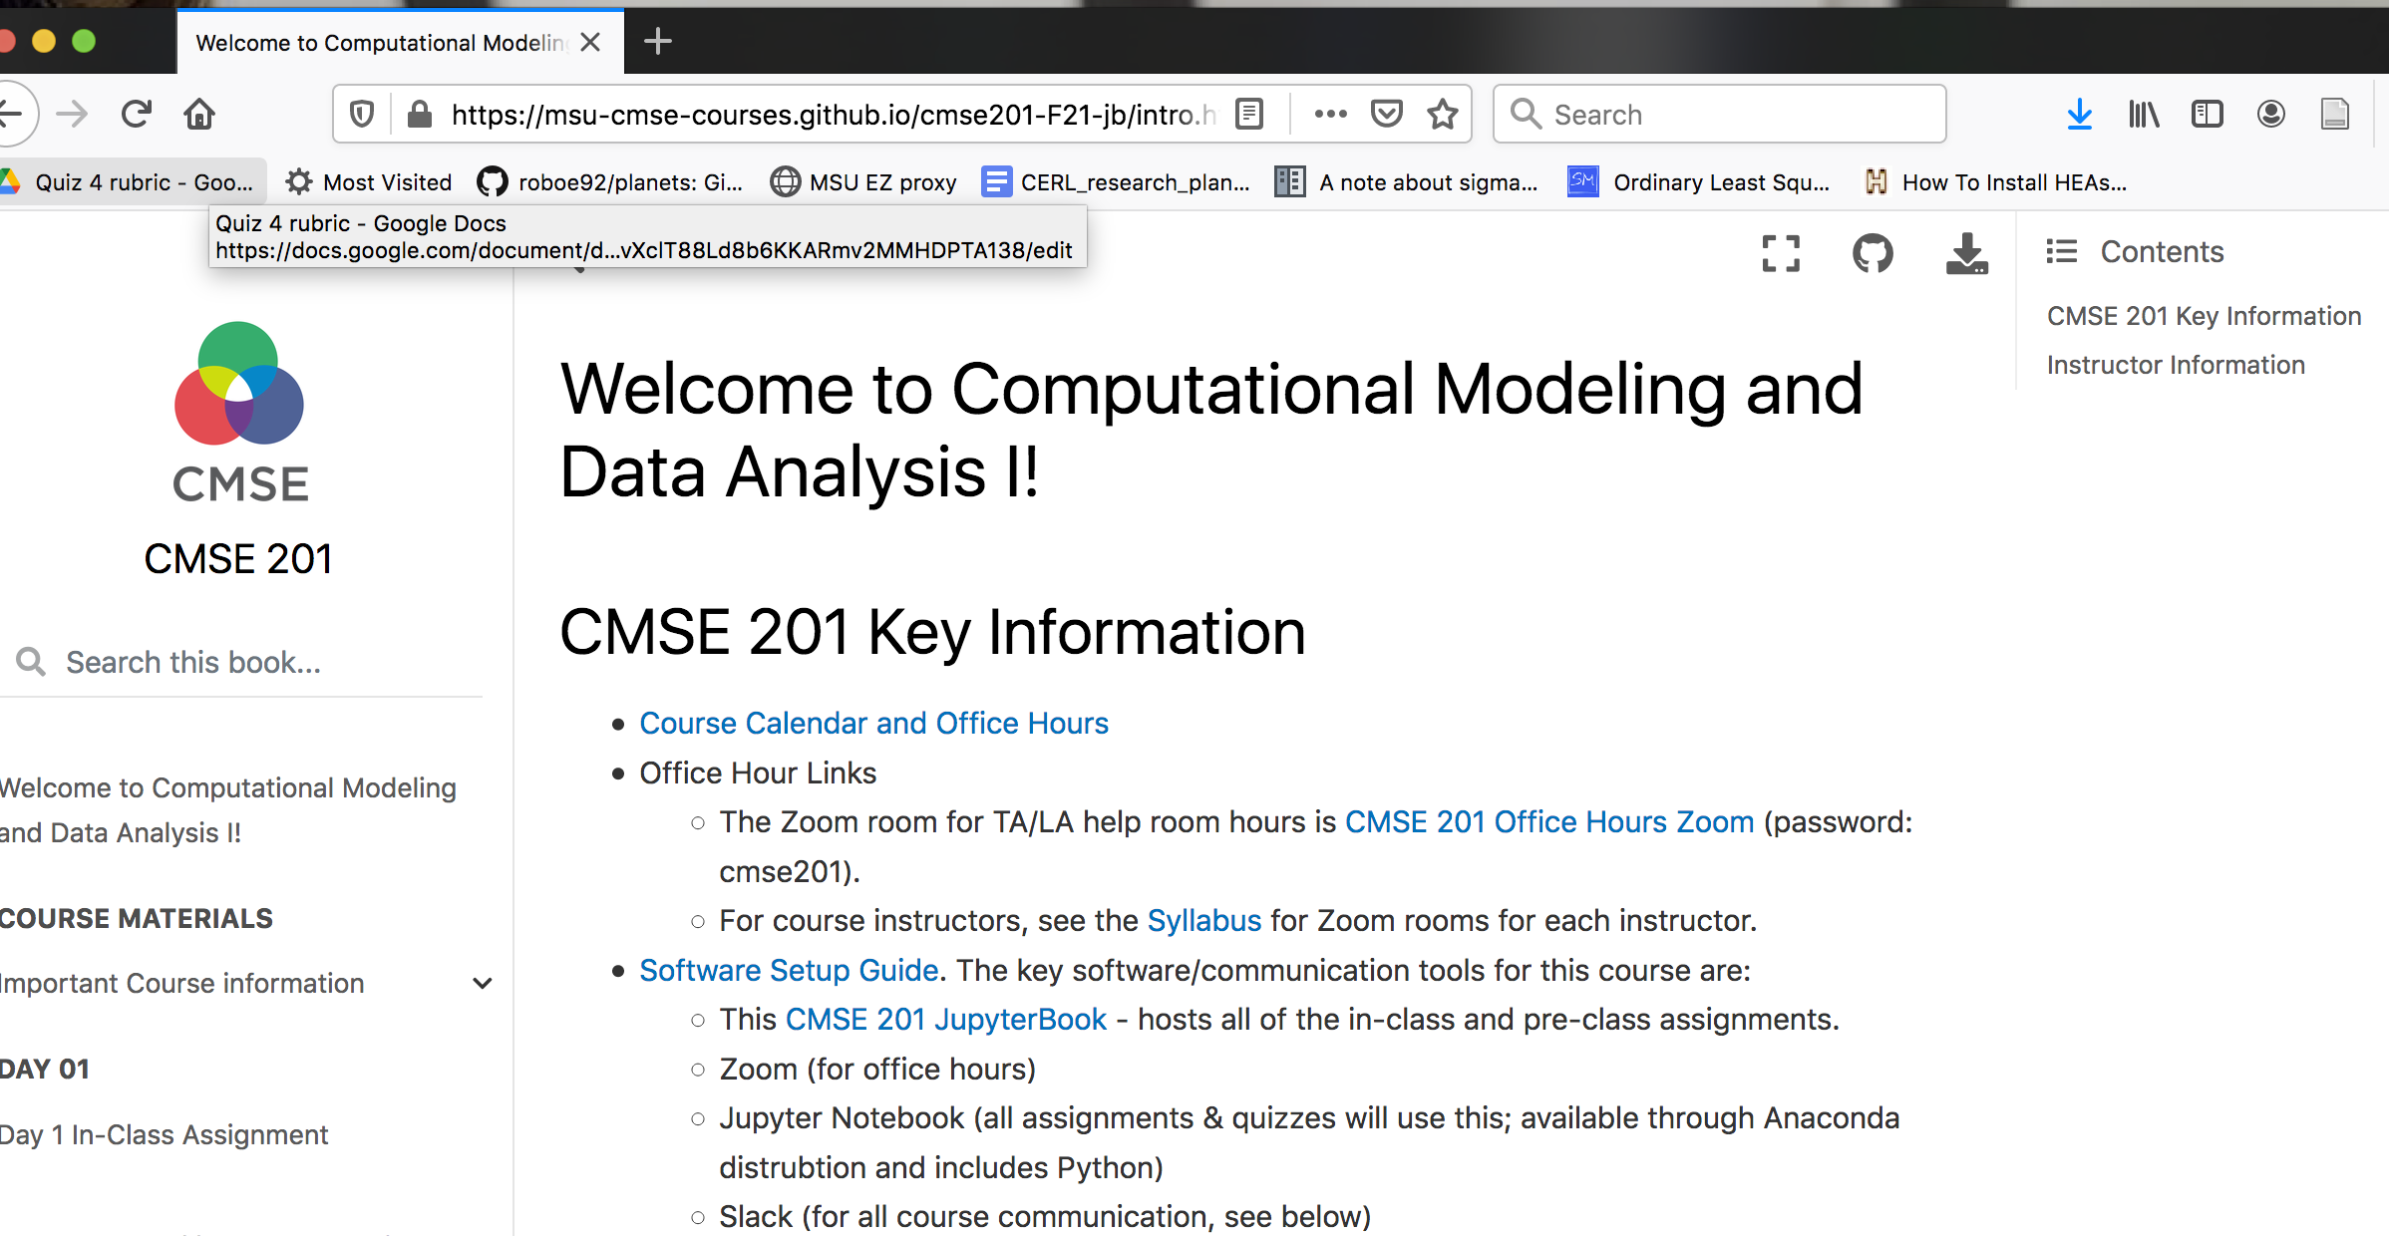
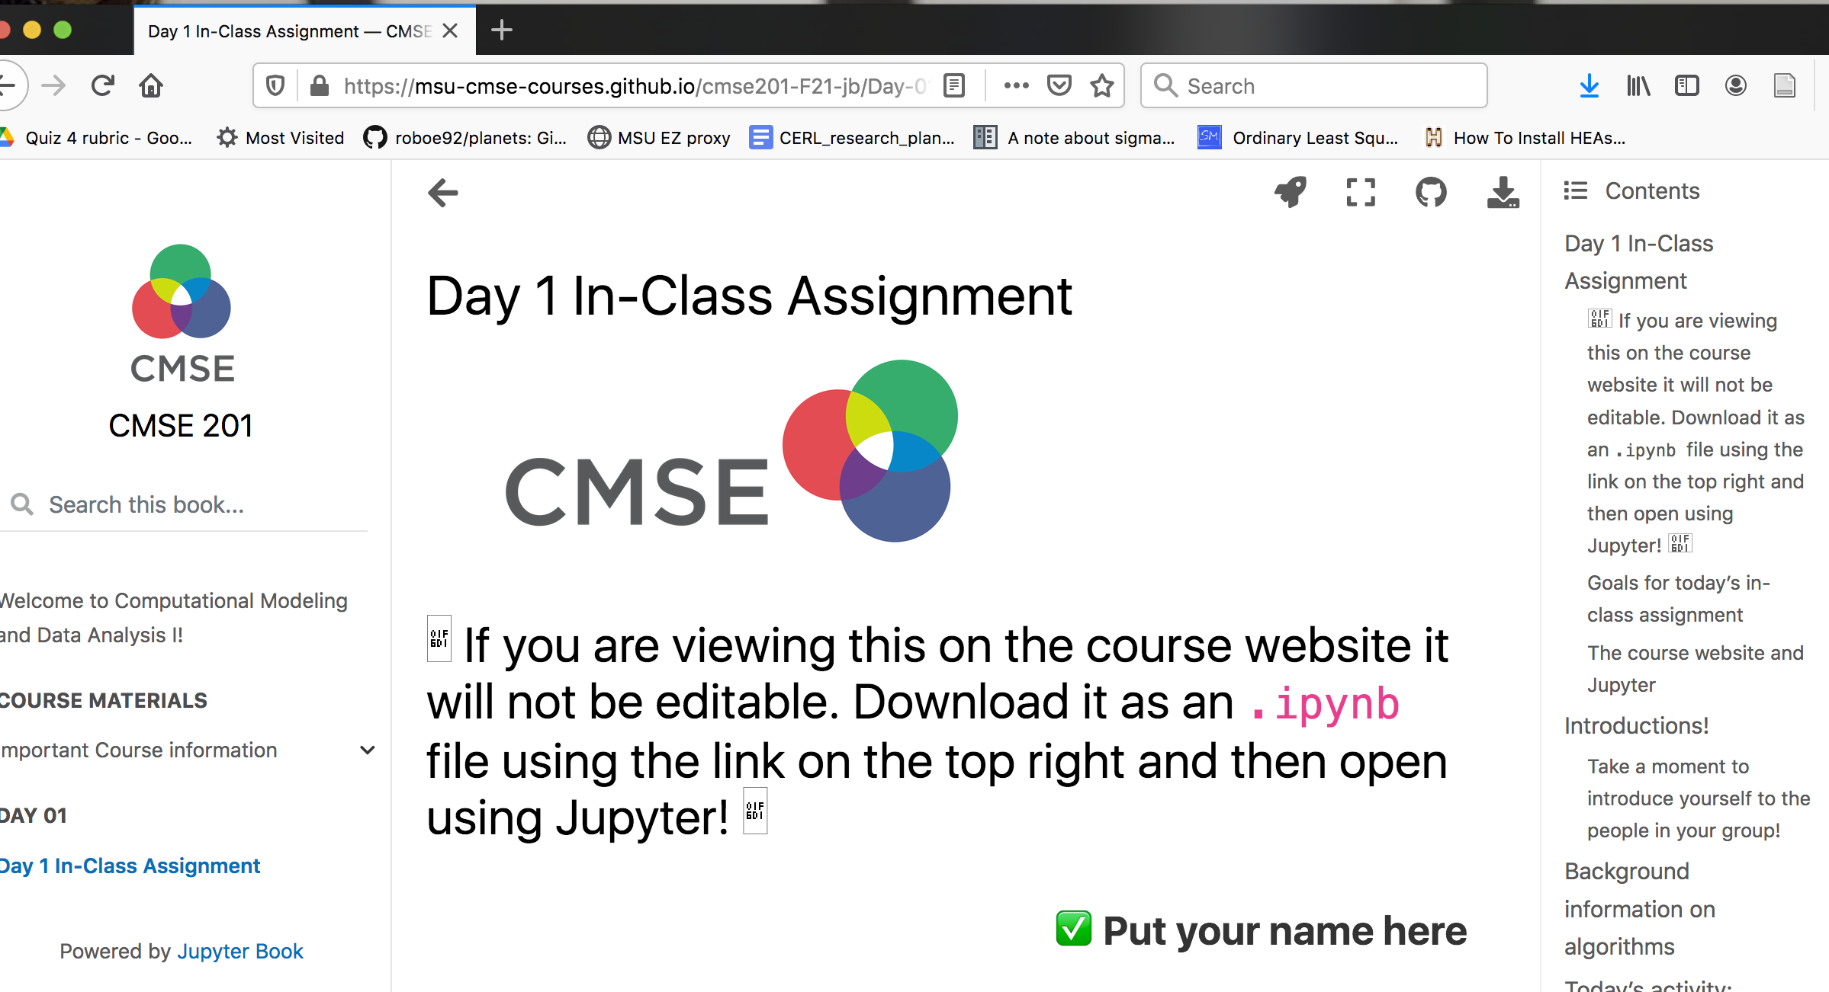
Course Webpage
Day 1 In Class Assignment

Slide 3
Downloading an Assignment
Click the “Download” button here and choose .ipynb

Slide 4
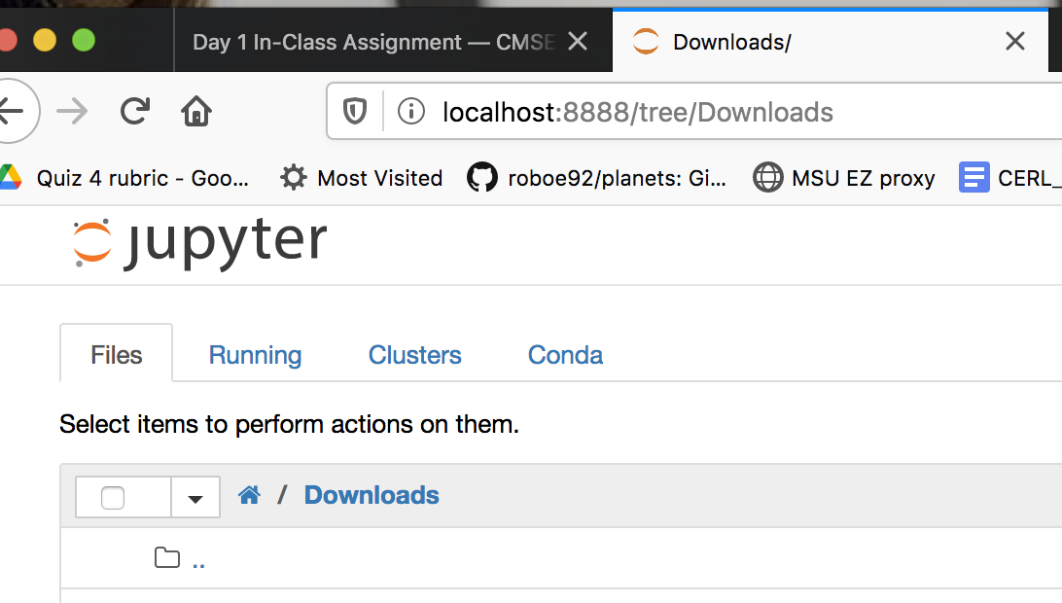
Opening a File in Jupyter
Start Jupyter Notebook following the instructions in the Software set up guide
Navigate to the place you downloaded the notebook (“Downloads” folder in this example)
Click on the file to open it in Jupyter Notebook

Slide 5
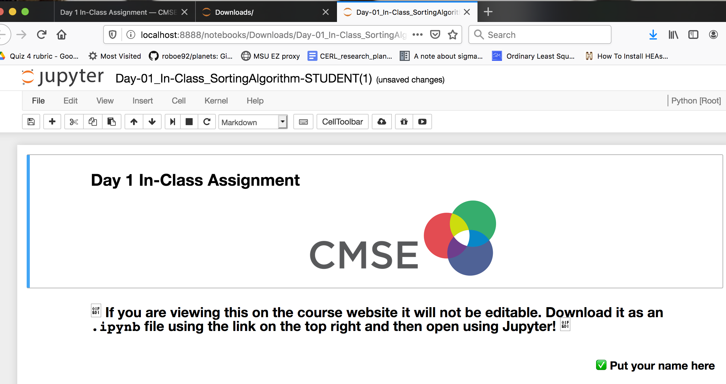
Editing
A working Jupyter notebook looks like this!
Click on the cells to edit (more info in the assignment)
Strongly recommended: Change the filename and replace “STUDENT” with your name to make sure you turn in the version you are working on.

Slide 6
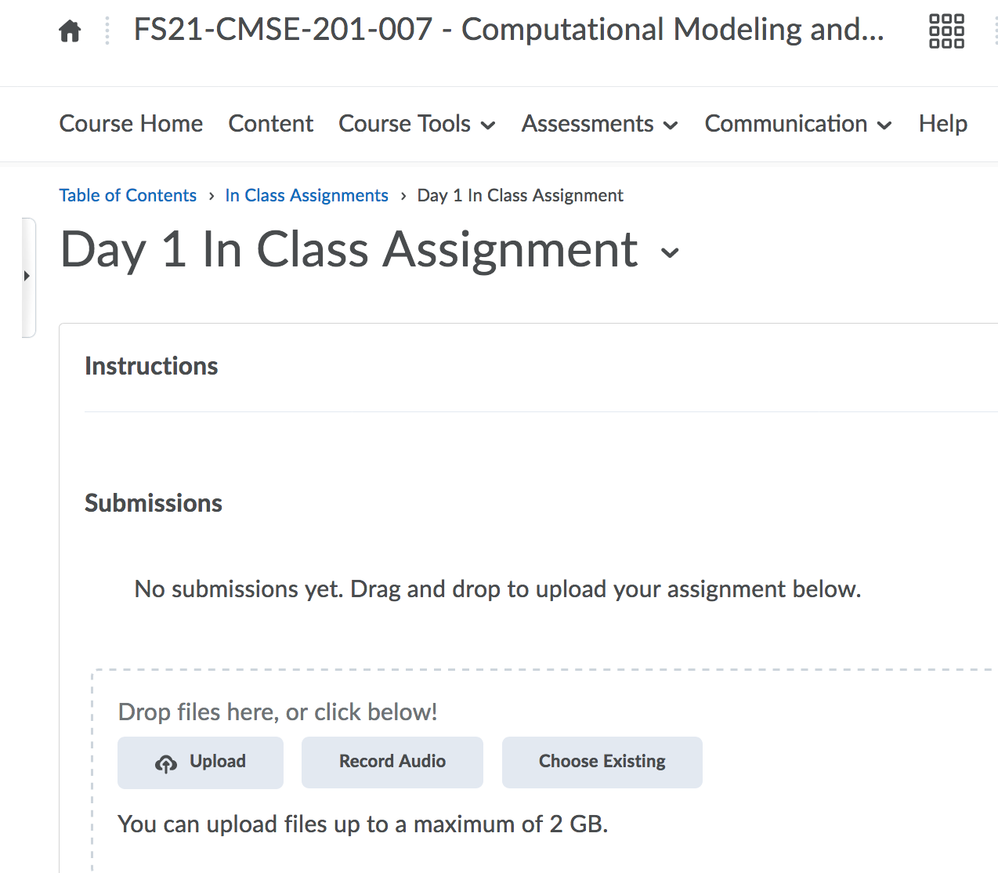
Submitting
Navigate to the Appropriate Assignment on D2L (“Day 1 In Class Assignment” here)
Click ”Upload”

Slide 7
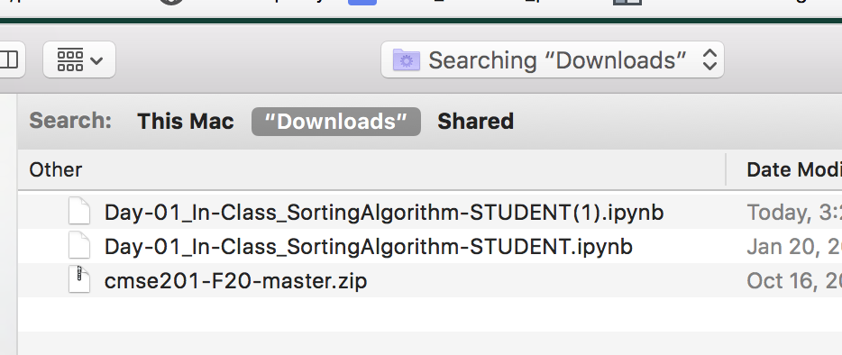
Submitting
Navigate to the Appropriate Assignment on D2L (“Day 1 In Class Assignment” here)
Click ”Upload”
Find the Assignment on your computer
  Using Search or by navigating to the folder you saved it in
Select the file
NOTE: Make sure this is the file you have filled out!

Slide 8
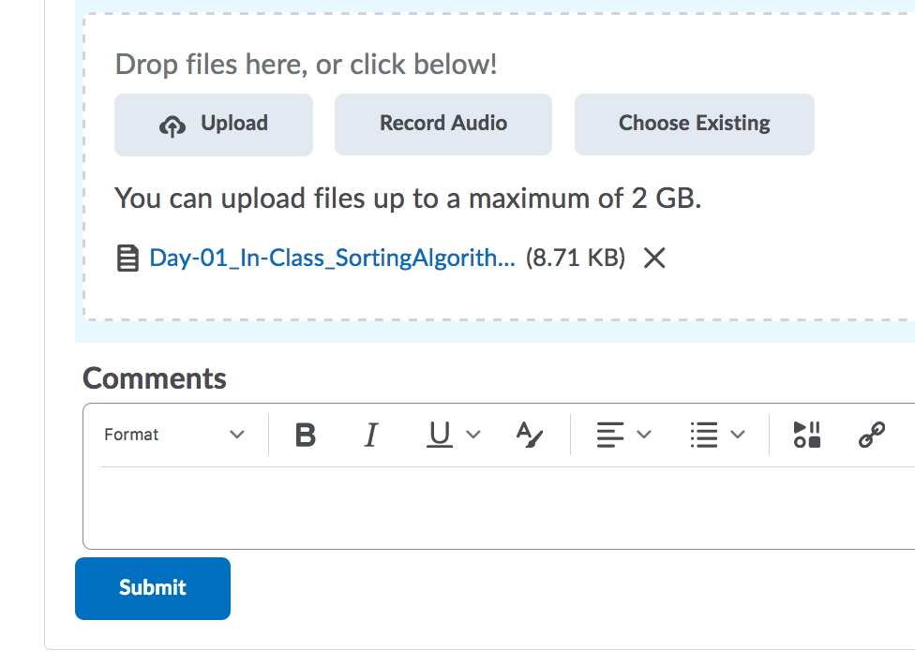
Submitting
Click the “Submit” button
Congratulations, you’re done!
Make sure to ask for help if you aren’t sure that you did it correctly!

