Slide 1
MINA SWAP
MINA L2 AMM DEX

Slide 2
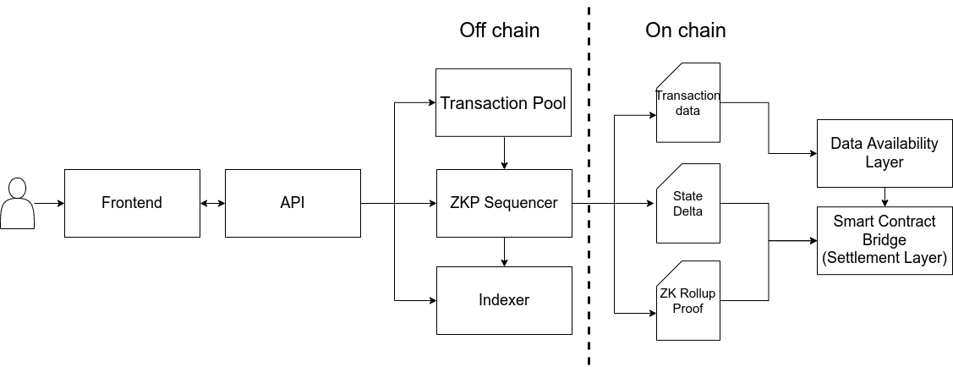
ARCHITECTURE

Slide 3
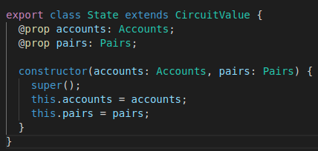
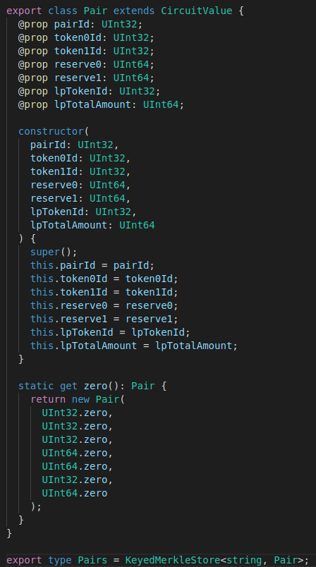
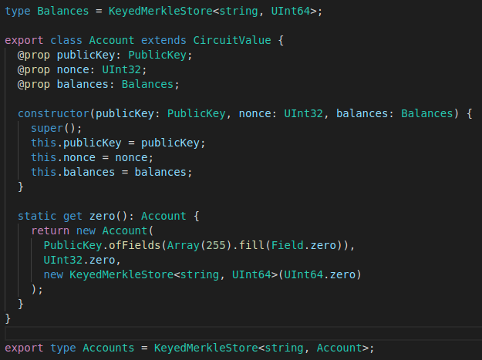
DATA MODEL

Slide 4
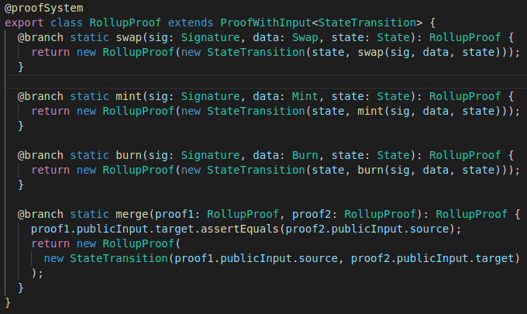
PROOF SYSTEM

Slide 5
DEMO...
Actions:
1) Get tokens from faucet
2) Provide liquidity for pair and mint LP token
3) Make a swap against pair
4) Burn LP token

Slide 6
FUTURE WORK
UInt comparison operators not working. Implement new logic once supported.
Implement proof generation once snarkyjs backend supports it
Implement simple persistence layer for sequencer state
Develop on-chain components
Develop front-end
Explore DA problem

